Slide 1
Changing Land, Enduring People
2nd Grade
Social Sciences Lesson
Oregon Tribes and the Dawes Act
Notes:
Utilize the PowerPoint slides during the lesson. Explain to students that today, they will learn about an important law called the Dawes Act and how it changed life for Oregon tribes.

Slide 2
Essential Questions
How did tribal lands change over time?
What is an allotment?
What is the Dawes Act, and how did it change the way Oregon Tribes lived on their land?
Notes:
Read and discuss. Give time for students to answer, question and wonder.

Slide 3
Learning Outcomes
Success Criteria
I understand that the basic purpose and impact of the Dawes Act on Oregon tribes.
I understand the notion of treaties and how they took away tribes’ land
I understand how tribes maintained cultural connections to land despite these changes.
I can explain in simple terms what the Dawes Act was and how it changed tribal lands.
I can explain how acts of the federal government took away tribes’ land.
I can identify ways Oregon tribes adapted to changes while maintaining their culture
Notes:
Review the learning outcomes and success criteria with students so they understand what the intended learning is and what it looks like when they’ve achieved it.

Slide 4
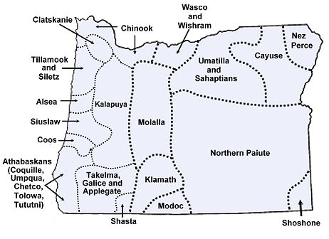
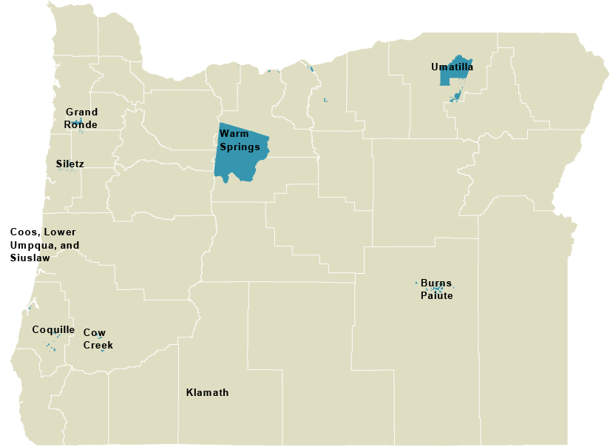
Early Map of Oregon Tribal Lands
Current Map of Oregon Tribal Lands
Map from: https://www.native-languages.org/maps.htm
Map source: https://www.nwcphp.org/docs/tribes-toolkit/tribal/oregon.html
Notes:
Show two maps. The first map is of Tribal lands prior to treaties with the U.S. government. The second map is of tribal lands as reservation currently.
Ask students:
“What do you notice about these two maps? What is different?”

Slide 5
Key Words and Ideas (1)
Treaty: A handshake and a piece of paper.
Reservation: A large area of land with natural features.
Allotment: Same land shape with small boxes and rows of plants.
Communal: A plankhouse.

Slide 6


Key Words and Ideas (2)
Treaty: An agreement between sovereign nations.

Slide 7








Key Words and Ideas (3)
Reservation: Land set aside for tribal communities by federal treaties.

Slide 8
Key Words and Ideas (4)
Allotment: A small plot of land.

Slide 9
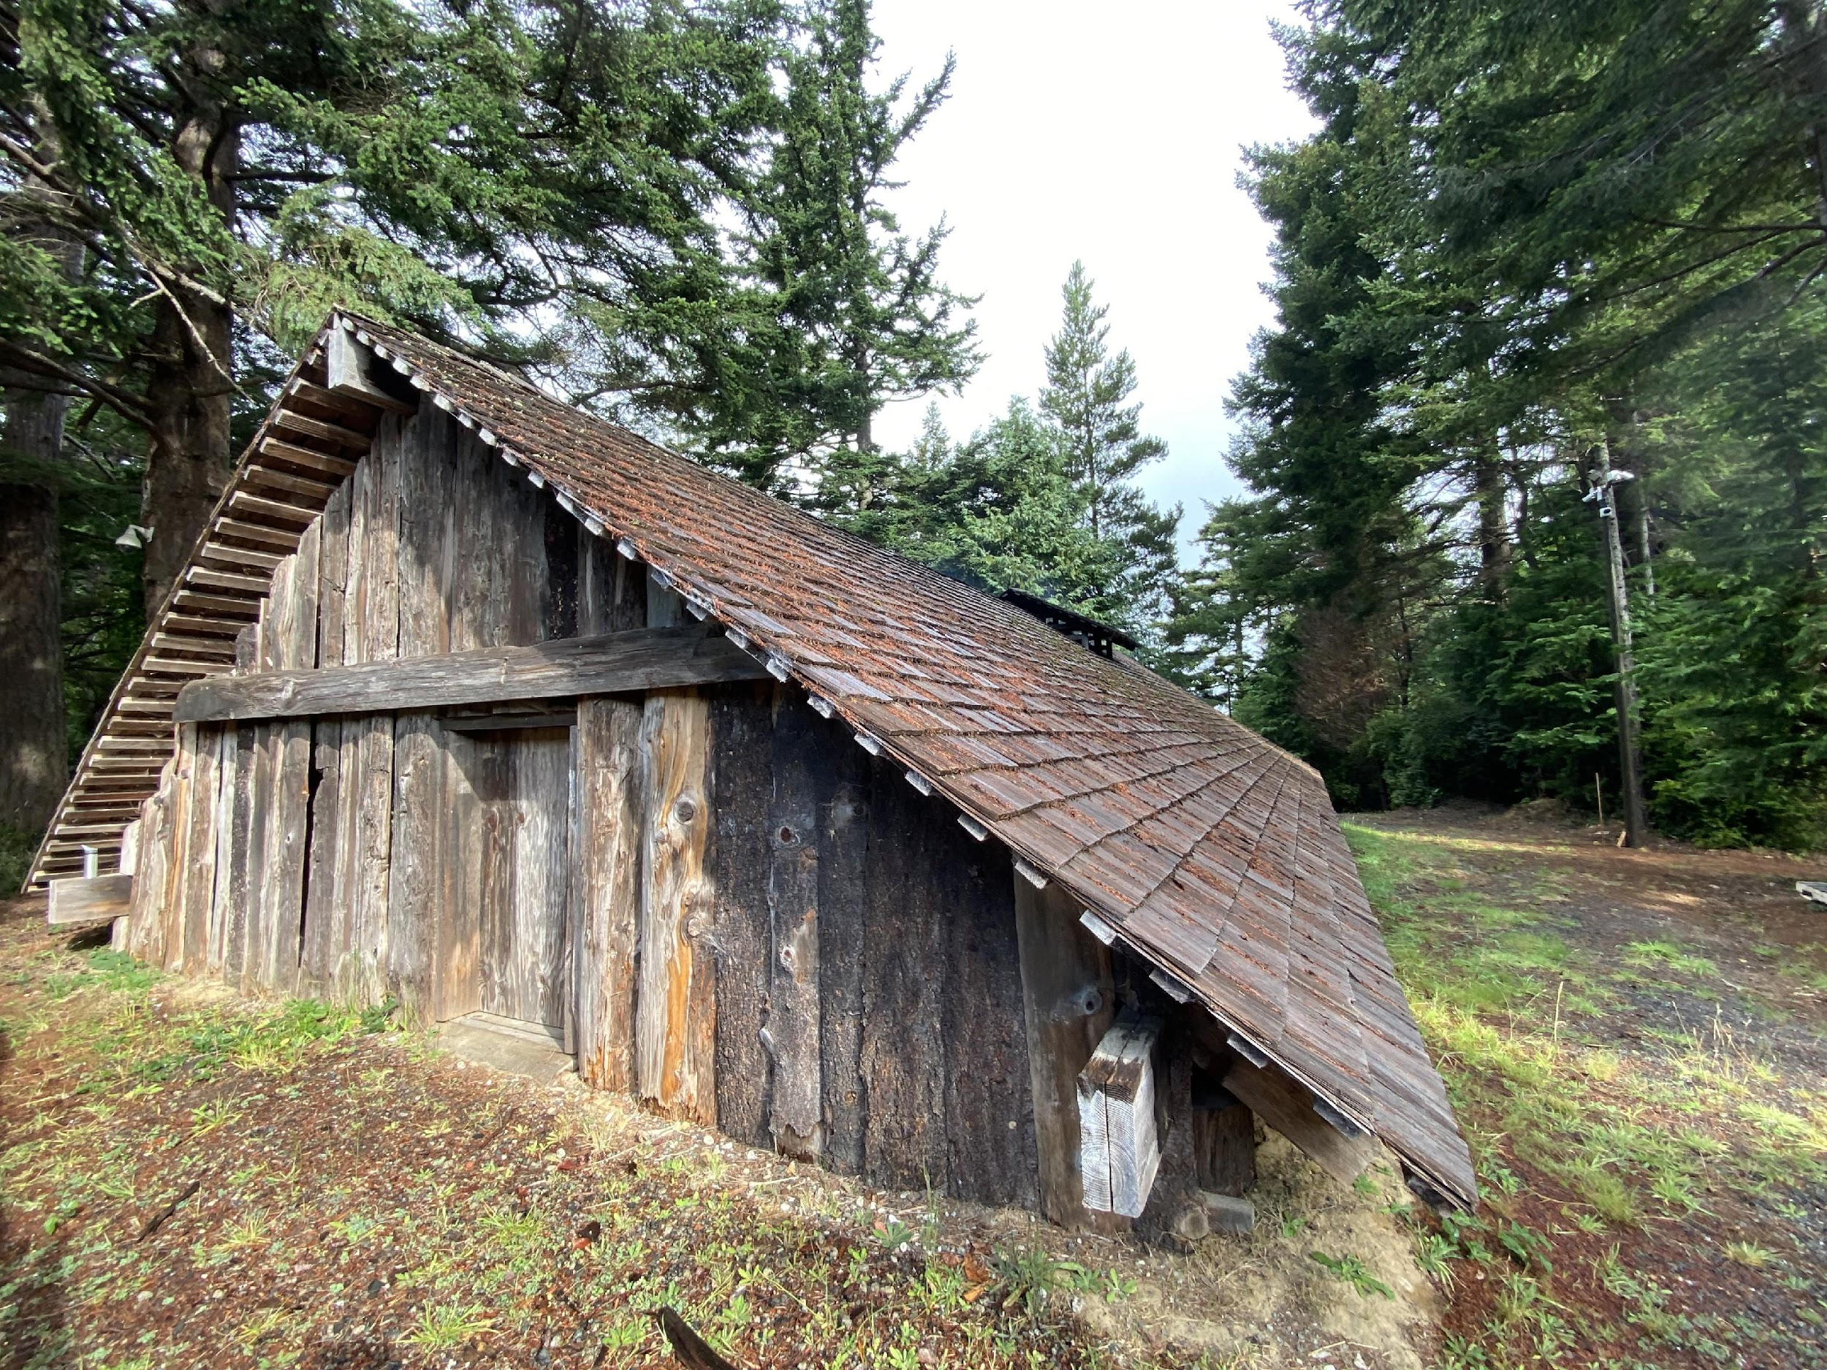
Key Words and Ideas (5)
Communal: Shared by a community.
Source: Confederated Tribes of Coos, Lower Umpqua, and Siuslaw Indians
Notes:
This is a ceremonial plankhouse used by an entire community. This photo is of a plankhouse on the Confederated Tribes of Coos, Lower Umpqua, and Siuslaw Indian Reservation.

Slide 10
The Dawes Act
In 1887, the U.S. government passed a law that changed how Native American tribes lived on their land.
Before this law, tribes owned and used their land together as a community.
The Dawes Act divided reservation lands into small plots, called allotments. Each Native American family was promised an allotment, but not all families received one, and some were unusable.
The government also sold many of the allotments, often the best ones, to European settlers.
This was one way the land that the Oregon Tribes had lived on and cared for since time immemorial was taken from them.
Notes:
Explain to students that the federal government made and then broke treaties with Tribes in Oregon, which is how much of their land was taken from them. One way that treaties were broken was through laws. One of those laws is known as the Dawes Act. We’re now going to read a little bit about what the Dawes Act was and how it affected Oregon Tribes.
Read the text aloud.

Slide 11
Drawing Activity
Resources to draw on Tribal land:
A plankhouse: A house large enough for eight whole families to live in. This might be between 50–70 people.
A stream or river to fish in.
An area with small bushes and grasses where roots, like camus, would grow.
Mountains or hills where deer and elk would be hunted.
Notes:
Give students a large piece of paper that represents the tribal lands. You can use the worksheet at the end of this document.
Have them draw the resources and living spaces tribes used on the lands- have them include:
A plankhouse- a house large enough for 8 whole families to live in or 50-70 people
A stream to fish in
An area with small bushes and grasses where roots would grow like camus
Mountains or hills where deer and elk would be hunted

Slide 12
Tribal Land Activity
Notes:
Give students a large piece of paper that represents the tribal lands. You can use the worksheet at the end of this document.
Have them draw the resources and living spaces tribes used on the lands- have them include:
A plankhouse- a house large enough for 8 whole families to live in or 50-70 people
A stream to fish in
An area with small bushes and grasses where roots would grow like camus
Mountains or hills where deer and elk would be hunted

Slide 13
Allotments
Pick one section and circle it. Pretend that is your allotment.
Write down at least one thing you could still do if you were only allowed to use that section.
Write at least two things you would not be able to do anymore.
“In the allotment, we could _____________________, but we could not _____________________ or _______________________.”
Notes:
Have students fold their paper into eight sections to represent the land being divided.
Have students cross out two sections to represent the allotments sold to non-tribal members.
Tell the students: "Pick one section, and circle it. Pretend that is your allotment. Write down at least one thing you could still do, if you were only allowed to use that section. Write at least two things you would not be able to do any more.
"Tell me what you lost access to that was outside the section you circled."
Here is a sentence stem to support students’ explanations: "In the allotment, we could _____, but we could not _____."
Make a list on the board.
Then ask students to tell the class what did you lose access to, what was outside the allotment you circled?
Add to the list on the board.

Slide 14
Questions About Your Allotment
What do you notice about our lists?
How do you think it affected the Oregon Tribes to lose those land parcels that were sold off?
Notes:
Ask the students, “What do you notice about our lists?”
Ask the students, “How do you think it affected the Tribe to lose those land parcels that were sold off?”

Slide 15
Discussion
Who can remind us of what the Dawes Act was?
Can someone else tell us how the Dawes Act changed tribal lands?
Notes:
Step 1:
Review with the class what the Dawes Act was and how it changed tribal lands.
Ask the class, “Who can remind us of what the Dawes Act was?”
Ask the class, “Can someone else tell us how the Dawes Act changed tribal lands?
Step 2:
Discuss with the class some of the specifics of what the federal government did through the Dawes Act. Use the explanation text that the class reviewed earlier in the lesson for the main ideas.
Step 3:
Discuss with the class what they were still able to do with the allotment they circled. Make the connection to what Oregon Tribes are still able to do to maintain their identify and culture even with such smaller amounts of land.

Slide 16


Self-assessment
Success Criteria | Not Yet | Yes
Can I explain in simple terms what the Dawes Act was and how it changed tribal lands?
Can I explain how acts of the federal government took away tribes’ land?
Can I identify ways Oregon tribes adapted to changes while maintaining their culture?
Notes:
Ask students to self-assess based on the success criteria. They can pick their level of learning (not yet or yes) and share with a peer, including why they made that choice, or you can print out the self-assessment and ask students to fill it out and turn it in.

Slide 17
Thank you!

