Slide 1
Exploring Oregon Plankhouses
2nd Grade
Mathematics Lesson
Lifeways: How a group of people live, work and play together.
Notes:
Students will explore shapes and size while learning about Oregon Tribes and how plankhouses are part of their lifeways. This lesson supports 2nd grade math standards in geometry and measurement.

Slide 2
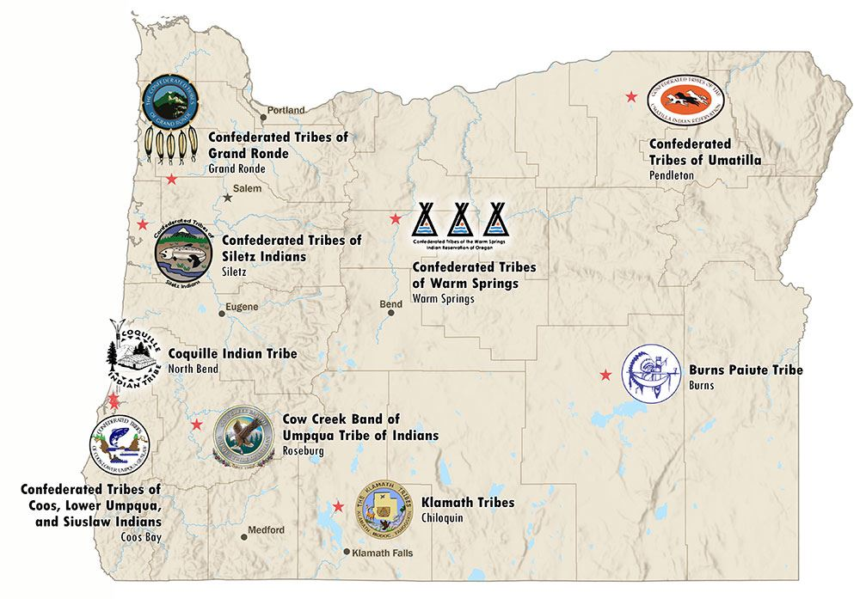
Nine Federally Recognized Tribes in Oregon
Which Tribe is closest to you?
Notes:
Show students the map of Oregon with the nine federally recognized Tribes. Assist students to find the one closest to them. Let students know that they will be learning more about the traditional homes of these Tribes, looking at examples of houses from the Confederated Tribes of Coos, Lower Umpqua and Siuslaw Indians (CTCLUSI). Show students where the CTCLUSI are on the map.

Slide 3
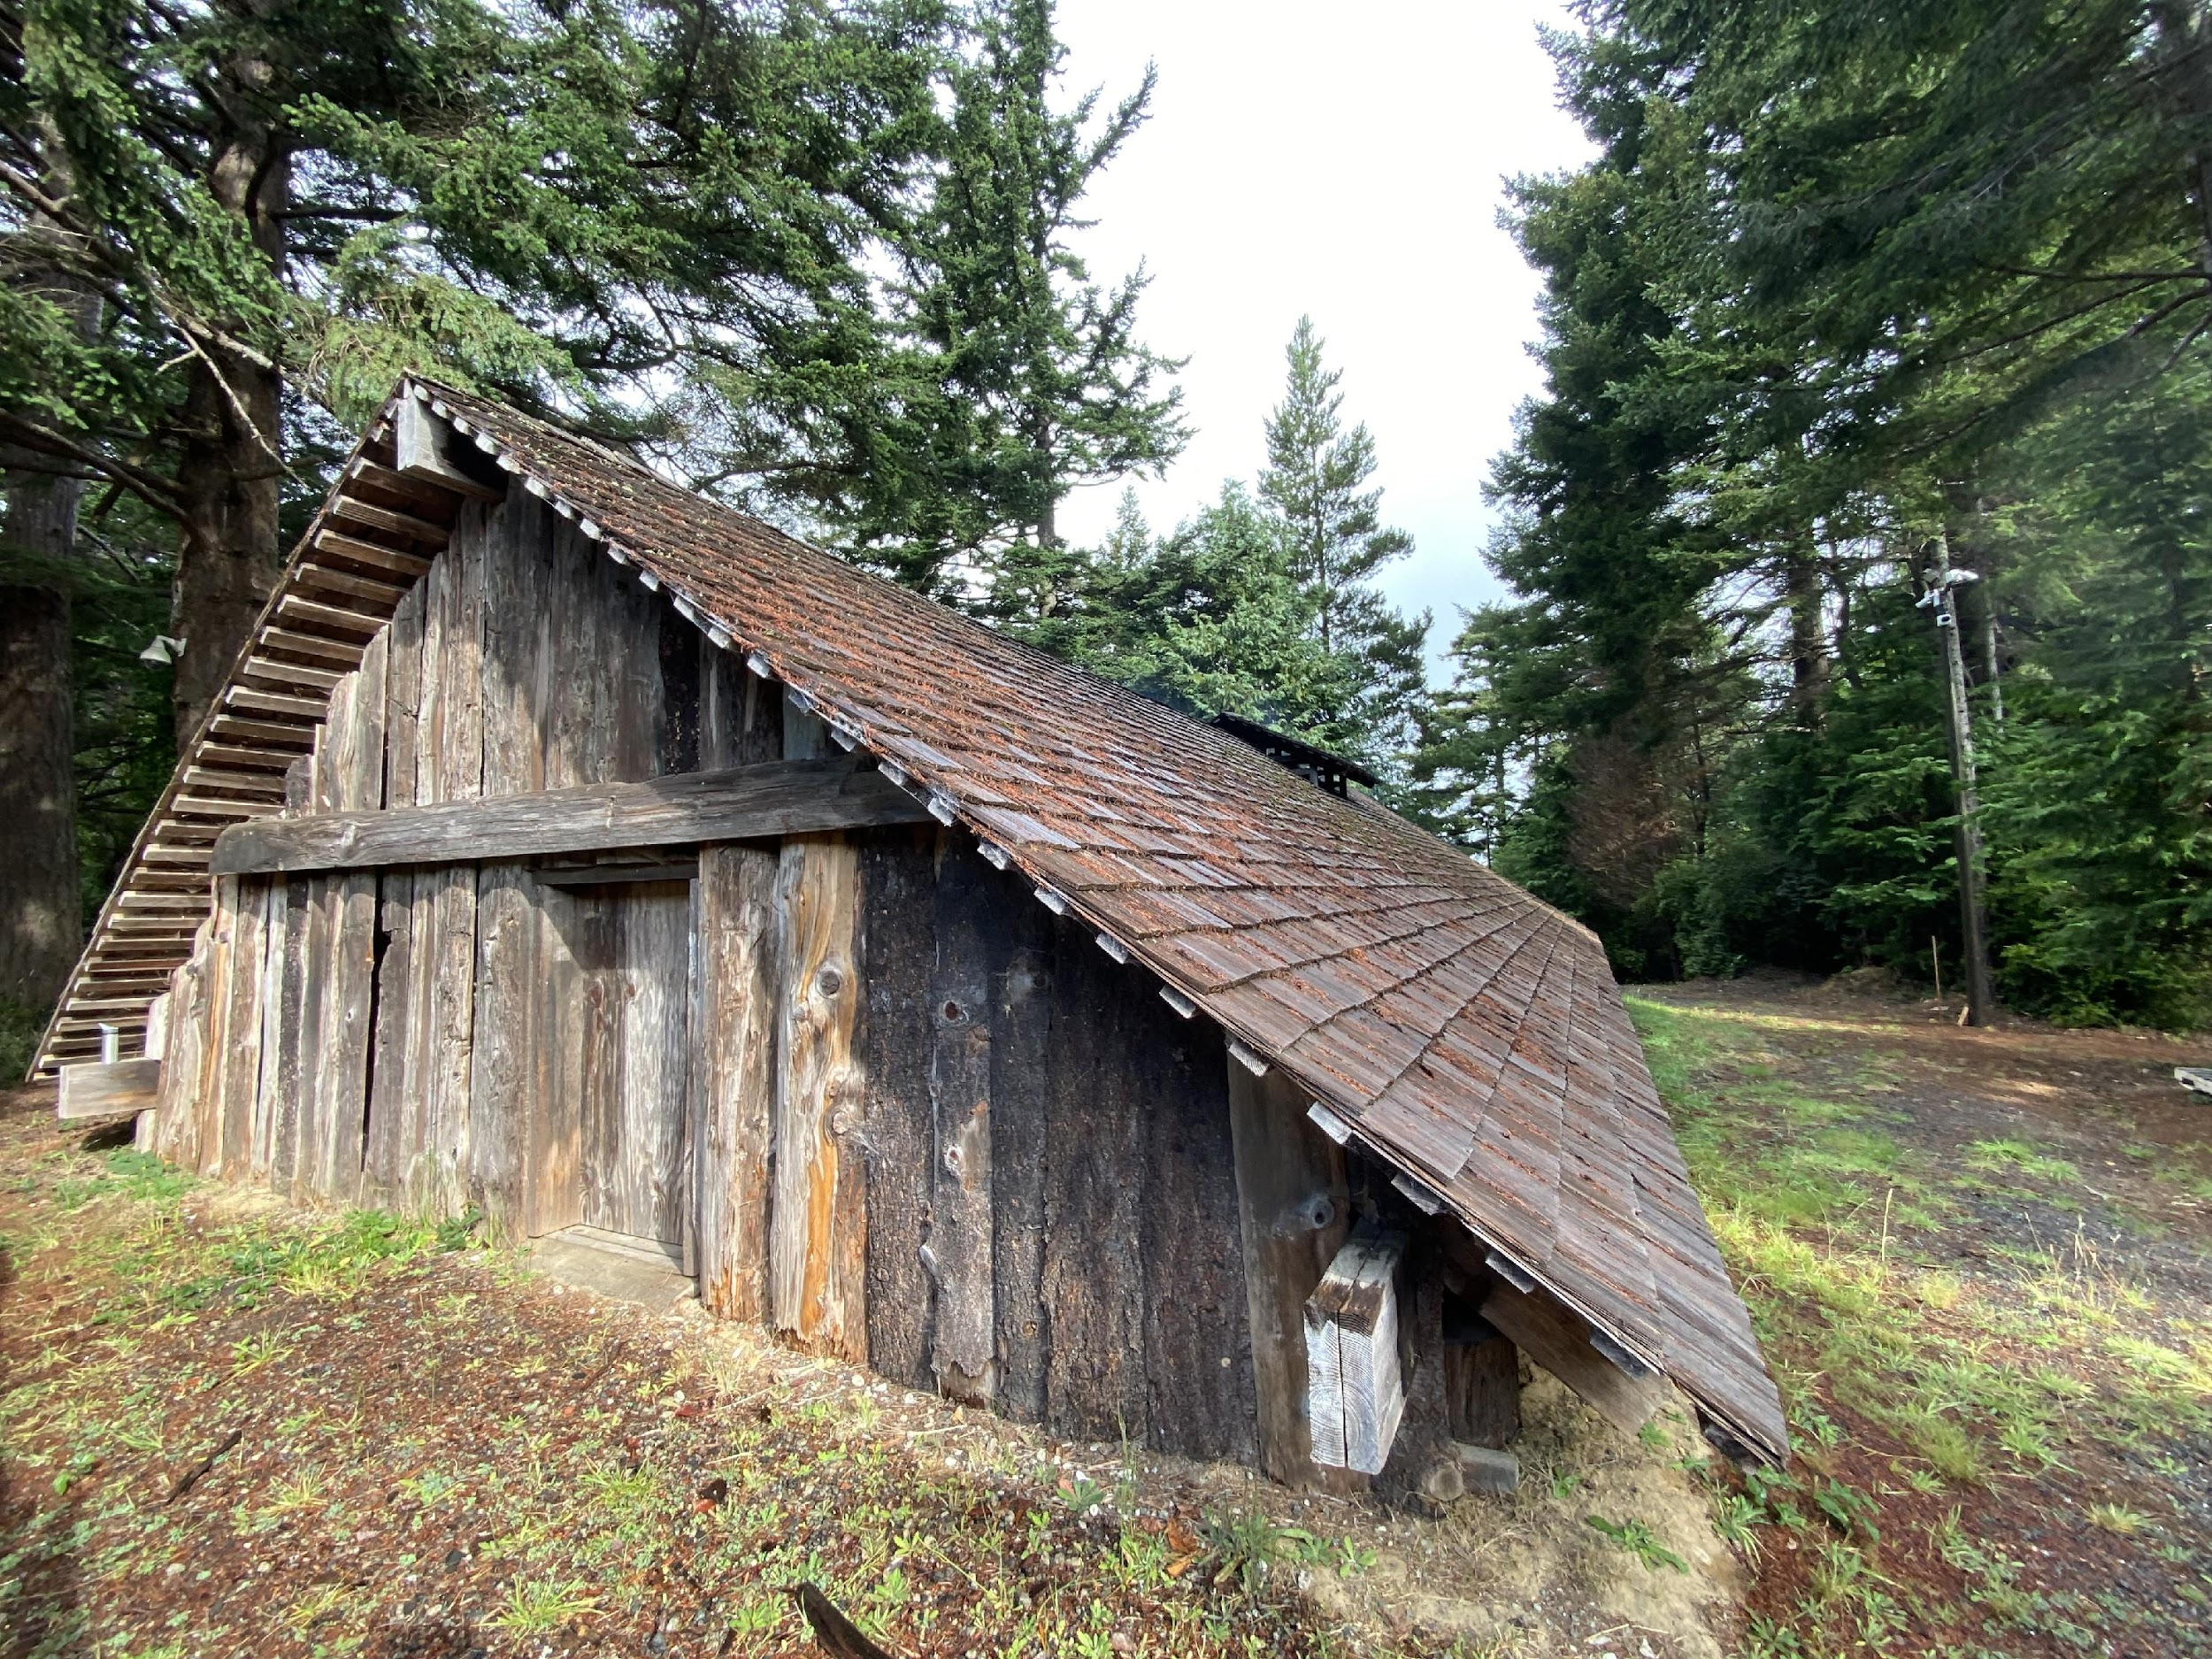
Plankhouse 1 of the Confederated Tribes of Coos, Lower Umpqua and Siuslaw Indians​
IImage from CTCLUSI, Photographer Morgan Gaines
Notes:
Communicate to students that:
Plankhouses are traditional, large, rectangular structures built by Native American Tribes in Oregon. Cedar was used to build plankhouses because it is naturally resistant to rot and insects.

Slide 4
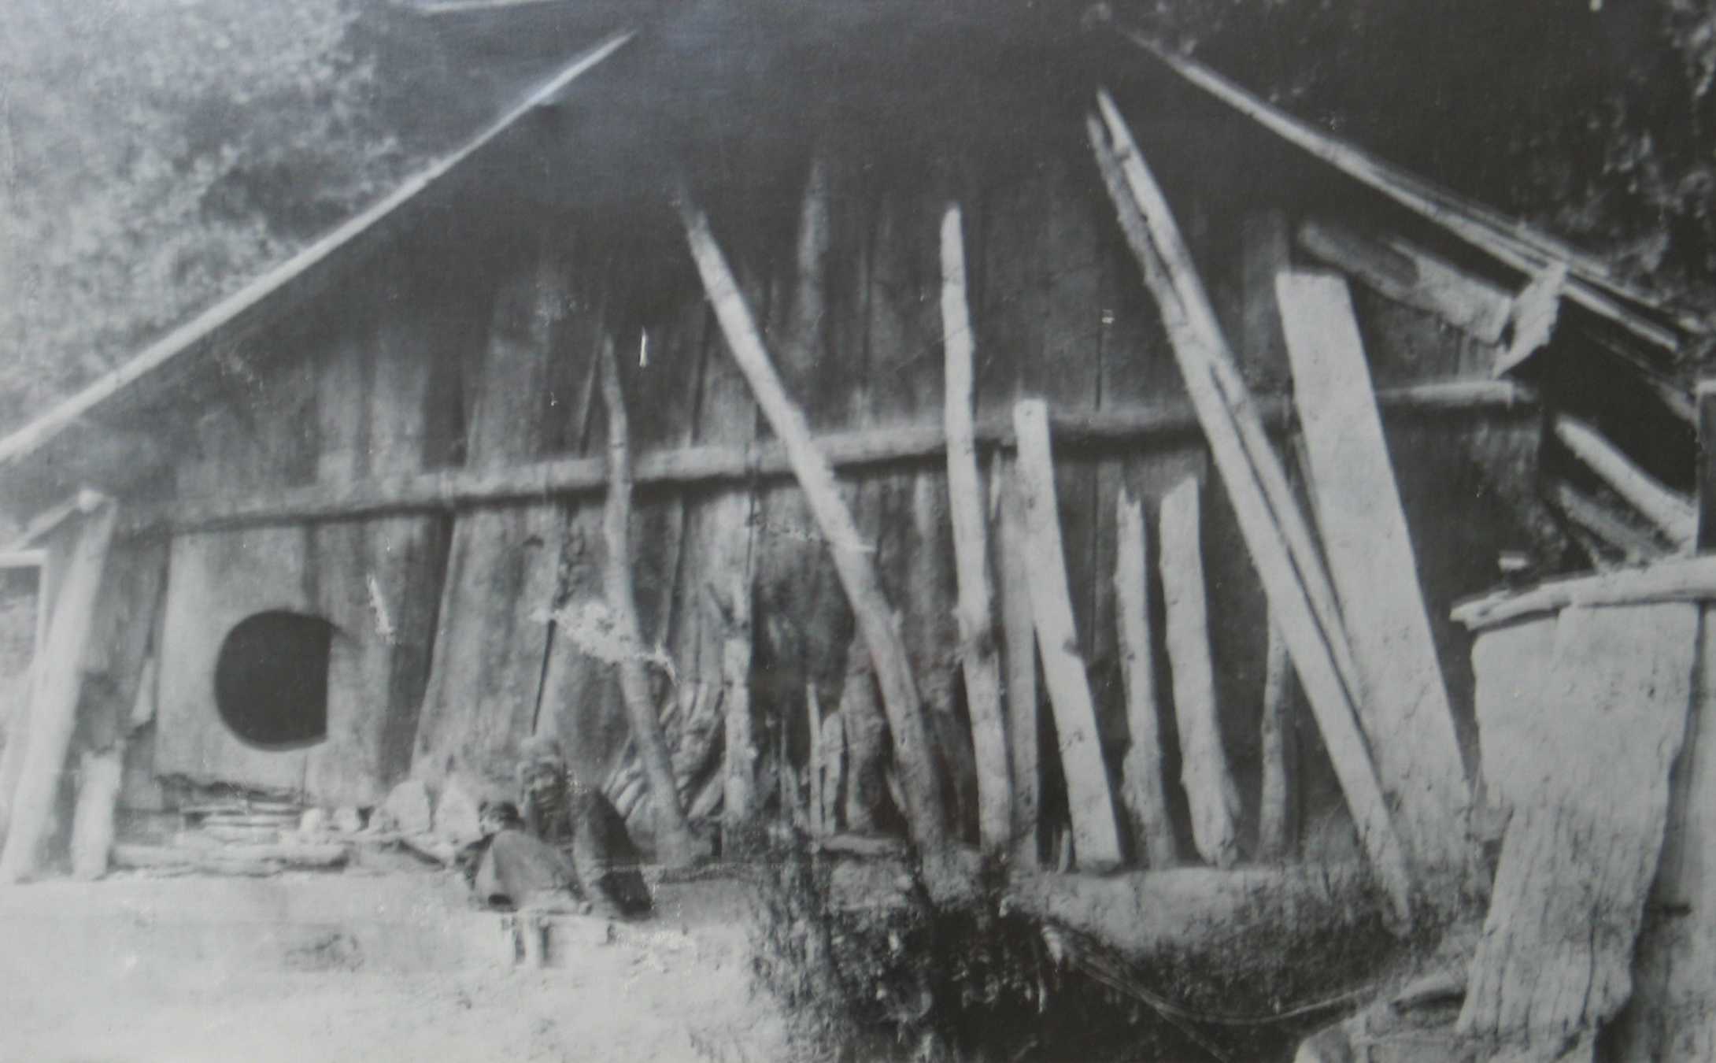
Plankhouse 2 of the Confederated Tribes of Coos, Lower Umpqua and Siuslaw Indians​
Image from Confederated Tribes of Coos, Lower Umpqua & Siuslaw Indians (CTCLUSI)”
Notes:
Communicate to students that:
Plankhouses were designed to house many generations, with one or more extended families living in them in the past. Some plankhouses could house up to 100 people from several families!
Plankhouses were anywhere from 30 to 400 feet long and commonly from 15 to 30 feet wide. Some were as wide as 55 feet (Explain this size relative to how many classrooms the house would be.). Plankhouses were built with removable roof planks that could be adjusted for smoke ventilation.

Slide 5
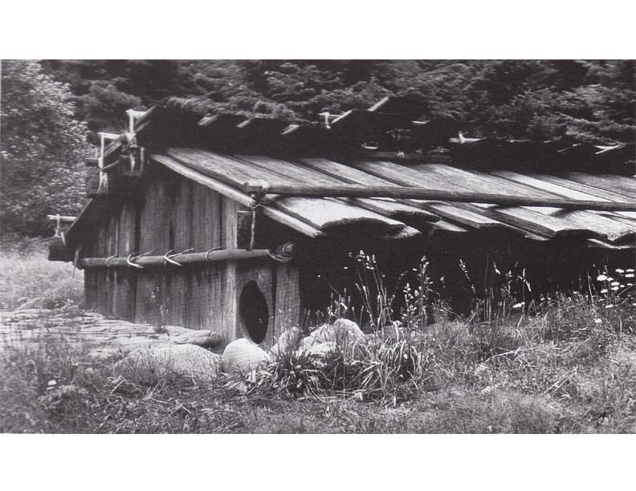
Plankhouse 3 of the Confederated Tribes of Coos, Lower Umpqua and Siuslaw Indians​
Image from Confederated Tribes of Coos, Lower Umpqua & Siuslaw Indians (CTCLUSI)”
Notes:
Communicate to students that:
Ceremonies and meetings were also held in plankhouses. They were important in supporting healthy communities, families, and cultures. Today, Tribes have rebuilt plankhouses. In fact the Confederated Tribes of Grand Ronde have rebuilt plankhouses as cultural centers.

Slide 6
gele!
pronounced “Ga-la (a like ‘cat’)”
“thank you” in Sha’yuushtɬ’a uɬ quuiich,
language of the Siuslaw & Lower Umpqua Tribe

