Slide 1
TAPP Family Advocate Monthly Meeting
Saturday Dec 21
March 13, 2025 - 12:30-2:30PM
✅ Welcome! Please say hello to your colleagues in the Zoom. Rename yourself to your Name, school district initials, Tribal Partner(s), and pronouns.
✅ Materials Needed - Writing utensils, notebook, ambo (water), snacks, reading glasses, any other materials to help you feel comfortable.

Slide 2
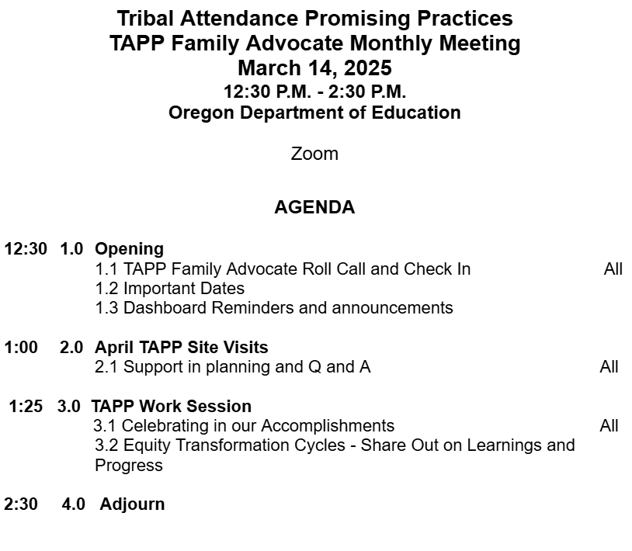

TAPP March Monthly Meeting Agenda

Slide 3
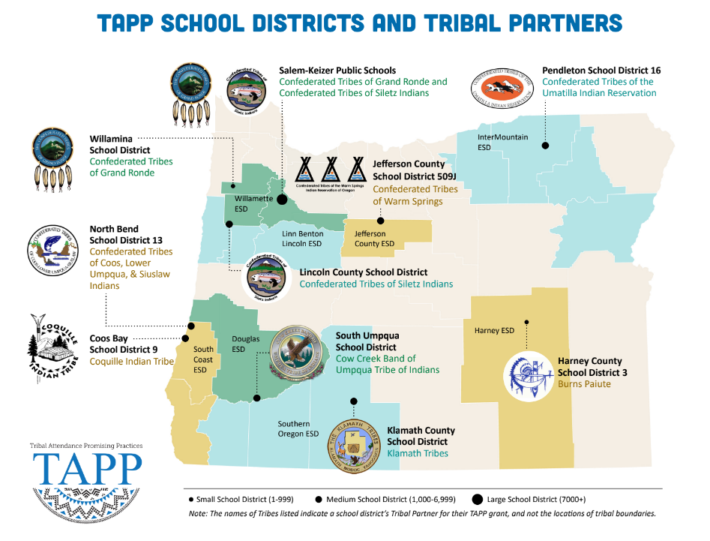
⭐ Indicates TAPP Expansion Position
Mona Smith
Stacey Jacobs
Ray Fox ⭐
Rebecca Arredondo
Mike Solem ⭐
Atcitty Begay
[TBD] ⭐
[TBD] ⭐
RuthEllen Melton
Crystal Hinds
Bre Landrum
Vacancy
Scott Smyth
Janelle Emard
Jodie Woodman ⭐

Slide 4

TAPP Family Advocate Check-In
Roll Call.
It is March and tonight is a Full Moon (Worm Moon) and a full lunar eclipse (Blood Moon).
Tell us about a memory you have about a Full moon, or, do you do anything to honor full moons as they happen?
Start of Penumbral: Thu, Mar 13, 2025 at 8:57 pm PDT
Start of Totality: Thu, Mar 13, 2025 at 11:26 pm PDT
End of Totality: Fri, Mar 14, 2025 at 12:31 am PDT

Slide 5
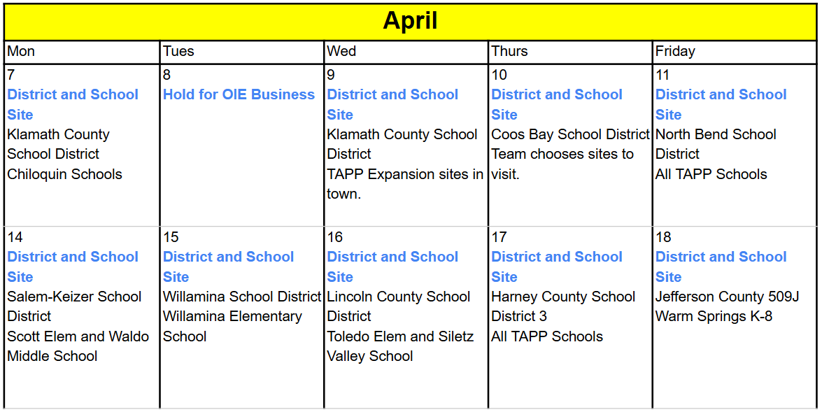
Important Dates
March 19, 9-11AM - TAPP Quarterly Webinar #3
March 21 - Final Report Template sent to Districts
April 7 - April 18 - TAPP Spring Site Visits
May 8-9 - May TAPP Symposium
May 15 - June 13 - Final Reports are accepted and reviewed (May 1st is last day used for attendance data).

Slide 6
Dashboards, Dashboards, Dashboards
TAPP Data Dashboards
These need updated to reflect Quarter 2 and Trimester 2 efforts and progress.
Attendance Tracker - Should be completed by the Project Director or their District-level proxy at the END of a QUARTER or a TRIMESTER for every school served directly by a TAPP Family Advocate.
Strategy Tracking Log - Should be completed by the TAPP Family Advocate at least monthly, but twice a month is highly recommended; add as many rows as you need.
Data Justice Log - Should be completed at the END of a QUARTER or a TRIMESTER in collaboration with the Project Director, TAPP Family Advocate, and Tribal Partner(s)

Slide 7

Street Data Podcast
You can listen to the author Shane Safir of Street Data with her co-host Alcine Mumby in their podcast, “Street Data Pod”.
https://streetdata.podbean.com/

Slide 8

OIEA March Youth Conference
Monday, March 24, 2025, 10AM-5PM
NAYA Youth and Family Center in Portland
Registration Link:
https://forms.gle/4cw4ir7S6dkxjxBV9
For More Information:
https://nayapdx.org/event/oiea-youth-conference/

Slide 9
Latest Update from ODE Communications
The Oregon Department of Education is actively monitoring changes at the federal level for any impact that they have on Oregon. We’ve launched a new page on the ODE website to clearly communicate with anyone else seeking a better understanding of changes at the federal level.
You will find our guiding statement, any actions that have immediate impact on our work, the latest updates to districts and a quick look at Oregon programs that receive federal funding.
ODE is committed to making sure students have the tools and resources to thrive, to continue our vision for serving each and every scholar receiving education in Oregon. Please contact ode.communications@ode.oregon.gov with any questions.

Slide 10
April TAPP Site Visits
General Overview
Notes:
12:50AM -

Slide 11
Menu of Options - Updated for Spring
Menu of Options – Share it with your TAPP Site team.
Follow the directions to build your full-day agenda for the TAPP Site Visit.
The visit will be comprised of –
A TAPP Site Team meeting (a slide deck template is provided this year based on your feedback 😊)
Group Educator Empathy Interviews
A Project Director Interview
Classroom Observations
Tribal and Site Specific Options (these options are provided to you based on feedback from advocates and tribes)
Please start planning early. April is also state-testing season, so please be aware of this when working with building leaders to schedule observations.

Slide 12
TAPP Work Session
Celebrating in our Accomplishments
Notes:
12:50AM -

Slide 13
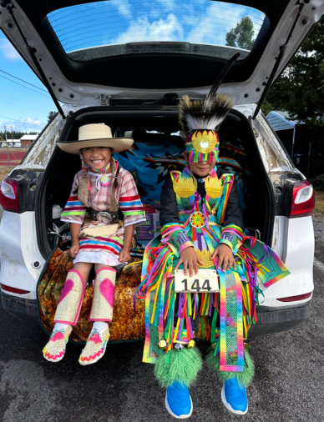
Celebrating in our Accomplishments
Three words to describe this school year…
This year my best day as an advocate was when…
The best conversation I had with a teacher was…
Something I learned about the local tribe I didn’t know before is…
The biggest growth we have made in our TAPP efforts has been…
One hard-fought accomplishment from this year I am most proud of is…

Slide 14
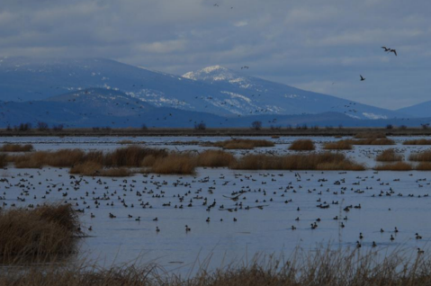
Celebrating our Equity Transformation Cycles
Readable Documents
Chiloquin Elementary School - KCSD
Willamina Elementary School- WSD
Willamina Middle and High School - WSD
Washington Elementary School - PSD
Sunridge Middle School - PSD
Lincoln County School District
Harney County School District 3
North Bend School District
The following ETCs are past due -
Coos Bay
Jefferson County 509J
Salem-Keizer
Book Time to Meet with Stacy if needed, finalize your cycles using this link - Book time with STACY PARRISH * ODE
Padlet - Once finished planning, email Stacy. She will then transfer it over to the document template which can then be finalized and shared with your TAPP Site Team.
A picture of Upper Klamath Lake, an important ecosystem for the endemic species of fish known by the Klamath Tribes as the c’waam.

Slide 15

Embracing Vulnerability - Sharing Out on our Equity Transformation Cycles
By investing in human conversation around the purpose and nature of the work, we accomplish a few crucial things:
Focus: The ability to know where we are going as a community and reinforce it consistently through our messages. (Less is more: focus is everything)
Holism: A tenet of Indigenous epistemology, holism helps us account for the whole of the system and the individual learner - the emotional, spiritual, physical, intellectual, and cultural dimensions - rather than fragment people into parts.
Well-Being: An experience of holism as integration of mind, body, spirit, and identity.
Hearing from each of you, share out the ways in which you have conveyed the purpose and nature of the Equity Transformation Cycle to others.
Share out some initial “wins” on beginning your cycles.

Slide 16
2024-2025 TAPP Districts’ Dashboard
Key Resources and Documents
2024-2025 TAPP Districts’ Dashboard
Dashboard Orientation Video - 11 minutes
TAPP Shared Folder
TAPP Program Promising and Best Practices – This document underwent a comprehensive revision this summer. It is important to revisit this document individually and as a team. There are four key sections to the document –
SECTION I. General TAPP Grant Execution - Lessons Learned
SECTION II. Setting the TAPP Family Advocate Up for Success NEW Advocate? START HERE!
SECTION III. Foundational Supports for AI/AN Students that Lead to Positive Conditions for Learning (Includes a self-assessment to utilize with school teams!)
SECTION IV. Culturally Responsive Tiered Attendance Systems (also includes a self-assessment to utilize with school teams!)

Slide 17
Text Parrish anytime at 971-208-0270
Or - send me an email. Call if you must.
There is no such thing as, “I know you are busy”. I am here for you.

