Slide 1
TAPP Quarterly Webinar #3
March 19, 2025 9-11AM
✅ Welcome! Please rename yourself by clicking on the three dots by your name and typing your preferred name, school district or initials of Tribe, role, and pronouns.
Refill your water, grab some snacks, paper, and writing utensil.

Slide 2
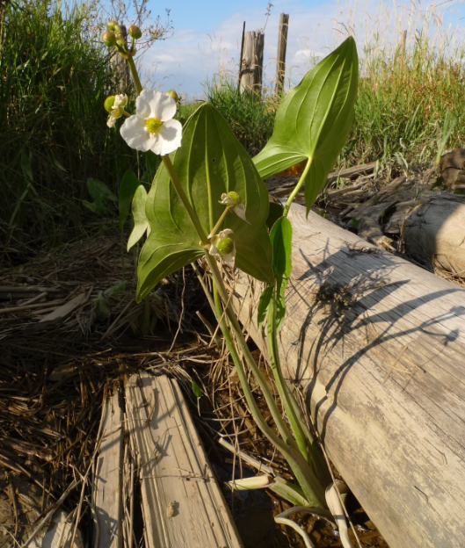
Welcoming the Tribal Partners
🔊 If you are a Tribal Partner, please unmute and further introduce yourself and the role you have with TAPP efforts in the local school district.
Picture of wapato or “duck potato” or arrowroot; image is from a grade 5 Science lesson from CTGR

Slide 3
Checking In
Reflect silently for one minute.
Spring is a powerful time for all of us. The days start becoming longer, and even if the Lands we are on are still covered in snow, sunny days remind us that the thaw is near.
What are your favorite Springtime activities? Tell us about it.
🔊 Unmute (preferred) or drop your response into the Chat.

Slide 4
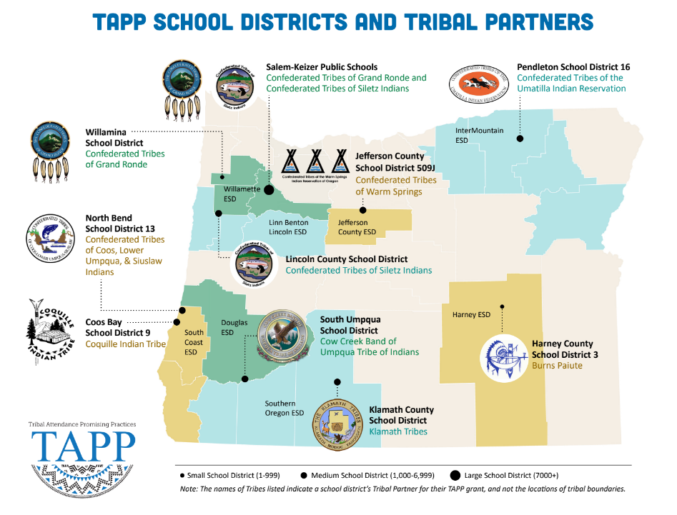
⭐ Indicates TAPP Expansion Position
Mona Smith
Stacey Jacobs
Ray Fox ⭐
Rebecca Arredondo
Mike Solem ⭐
Atcitty Begay
[TBD] ⭐
[TBD] ⭐
RuthEllen Melton
Crystal Hinds
Bre Landrum
Vacancy
Scott Smyth
Janelle Emard
Jodie Woodman ⭐

Slide 5

TAPP Quarterly Webinar Agenda
20 min - Checking In as a Community and Important Reminders
45 min - What Have the TAPP Family Advocates Been Up To? (Whole Group Shareouts + Breakout Rooms)
40 min - Analyzing our Second Quarter/Trimester Attendance (Breakout Rooms and Whole Group Reflections)
20 min - Q and A for the Upcoming TAPP Spring Site Visits

Slide 6
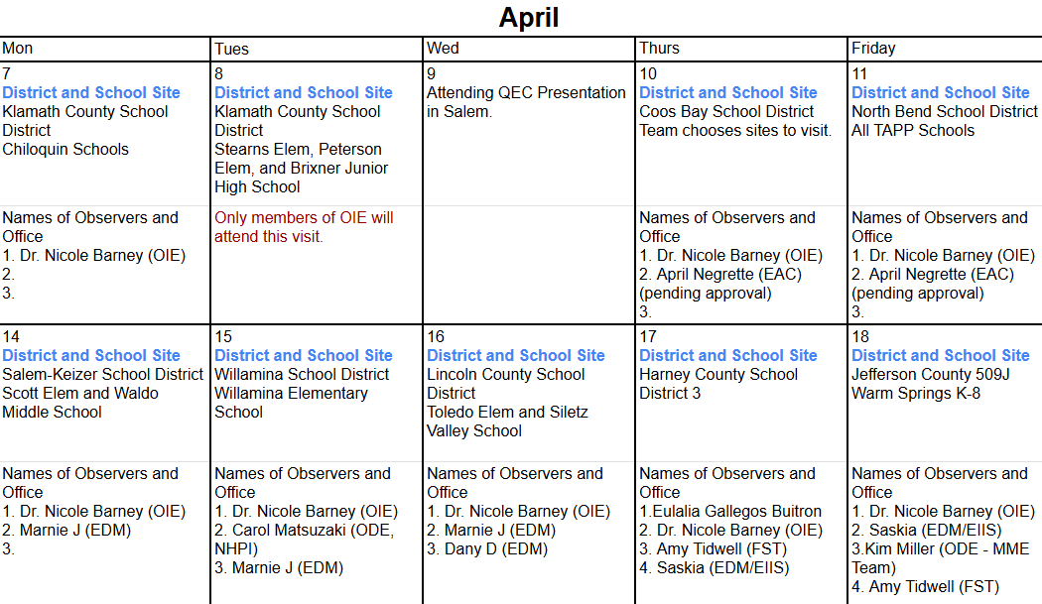
Important Reminders-
April 7 to April 18 TAPP Spring Site Visits

Slide 7
Important Reminders
May TAPP Symposium
When - May 8-9
Who Attends - The Entire TAPP Site Team!
What - 1.5 Day Professional Development, 25-27 Planning, and Celebrations
Day 1 - Shane Safir, author of Street Data: A Next Generation Model for Equity, Pedagogy, and School Transformation (upcoming book - Pedagogies of Voice: Street Data and the Path to Student Agency (Corwin, May 2025) and Leona Prince, Assistant Superintendent, Indigenous Education for the Ministry of Education and Child Care, British Columbia, and author “A Dance through the Seasons” and “Be a Good Ancestor”
Day 2 - Planning for 25-27 and celebrations
Location - Clackamas Community College in Oregon City, OR
Start time will be 8AM on Thursday - Breakfast and Lunch provided
End time will be 1:00PM on Thursday - Breakfast Only provided

Slide 8
Important Reminders
Final Reports Due for the 2023-2025 Biennium
May 15 - June 13 - Final Reports are accepted and reviewed
(May 1st is last day used for attendance data in your data analysis; similar format to the Interim Report).
Template should be sent next week.

Slide 9
Equity Transformation Cycles
What Have the TAPP Family Advocates Been Up To?

Slide 10
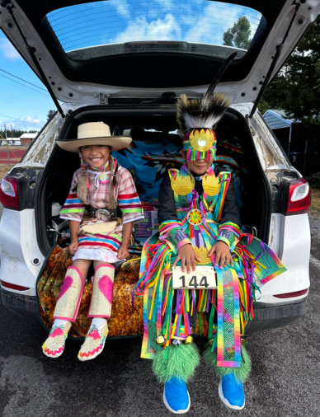
When we met last week, the TAPP Family Advocates shared out on….
Celebrating in our Accomplishments
Three words to describe this school year…
This year my best day as an advocate was when…
The best conversation I had with a teacher was…
Something I learned about the local tribe I didn’t know before is…
The biggest growth we have made in our TAPP efforts has been…
One hard-fought accomplishment from this year I am most proud of is…

Slide 11
Systemic Change - What is it?
Sustainable, long-lasting changes at a systemwide level - district, school, department, classroom - that alter the status quo, including outcomes and people’s experiences in and with the system.
Systemic change requires shifts in the structures of a system and how it operates. This includes changes in the system’s values, policies, resources, practices, relationships, and power structures.

Slide 12
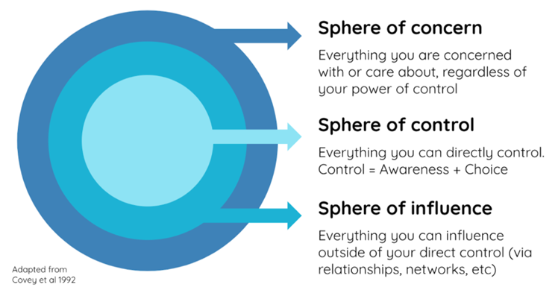
Key Learning #1 - Finding our Agency
Definition -
Agency refers to the capacity of educators to act purposefully and constructively, to make choices, and to take actions that shape their professional growth and/or learning experiences.
Foundational Questions -
What is within our sphere of control as advocates, to positively impact AI/AN+ success through our TAPP efforts? AND
What is within our sphere of influence to positively impact systemic change by elevating issues to our Project Director or Tribal Partner?

Slide 13
Reflection and Share Out for Project Directors and Tribal Partners….
Talk about the relationship with the advocate(s) and the issues brought to you this year where they needed your expertise, guidance, or authority?

Slide 14
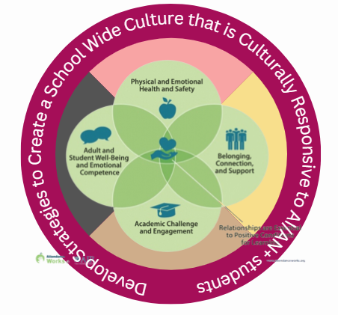
Key Learning #2 - An Indigenized Framework
Foundational Questions -
What does it mean to create school learning environments that are culturally responsive to all students and to American Indian and Alaska Native Students? AND
If we have high levels of chronic absenteeism, it means the four foundational conditions must be addressed FIRST. What is our data saying about our foundational conditions?
Physical and Emotional Health and Safety
Belonging, Connection, and Support
Academic Challenge and Engagement
Adult and Student Well-Being and Emotional Competence

Slide 15
Reflection and Share Out for Any Member of the TAPP Site Team….
Talk about any of the foundational conditions that were identified this school year which needed tended to in order to create a more culturally responsive learning environment for Native students?
Physical and Emotional Health and Safety
Belonging, Connection, and Support
Academic Challenge and Engagement
Adult and Student Well-Being and Emotional Competence

Slide 16
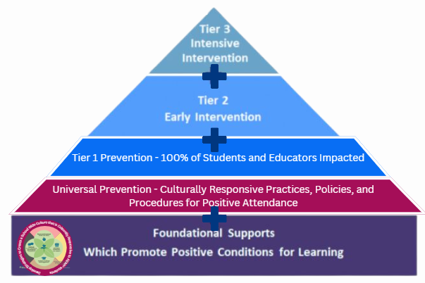
Key Learning #3 - A Tiered Approach
Foundational Question -
What does it mean to co-create a culturally responsive tiered response system for attendance with a tribal partner and a school district?

Slide 17
Reflection and Share Out for anyone on the TAPP Site Team…
What was the self-assessment process like for you as a TAPP Site Team? What did you learn from it? What areas of change or improvement were you able to make this school year?
Culturally Responsive Tiered Attendance Systems - Self Assessment

Slide 18
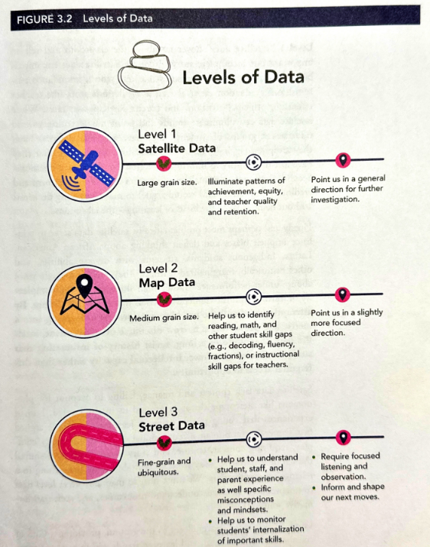

Key Learning #4 - A Data Driven Pedagogy
Definition -
In a data-driven pedagogy context, "street data" refers to qualitative and experiential data gathered from students, families, and staff, focusing on their lived experiences and perspectives to inform TAPP and school improvement efforts, particularly those related to equity and engagement.
Foundational Question -
What does it mean to create school learning environments that are culturally responsive to all students and to American Indian and Alaska Native Students?

Slide 19
Reflection and Share Out for the TAPP Family Advocate…
Share with the Zoom how engaging in study around the book Street Data and its principles has impacted or refined your approach to TAPP as an advocate.

Slide 20
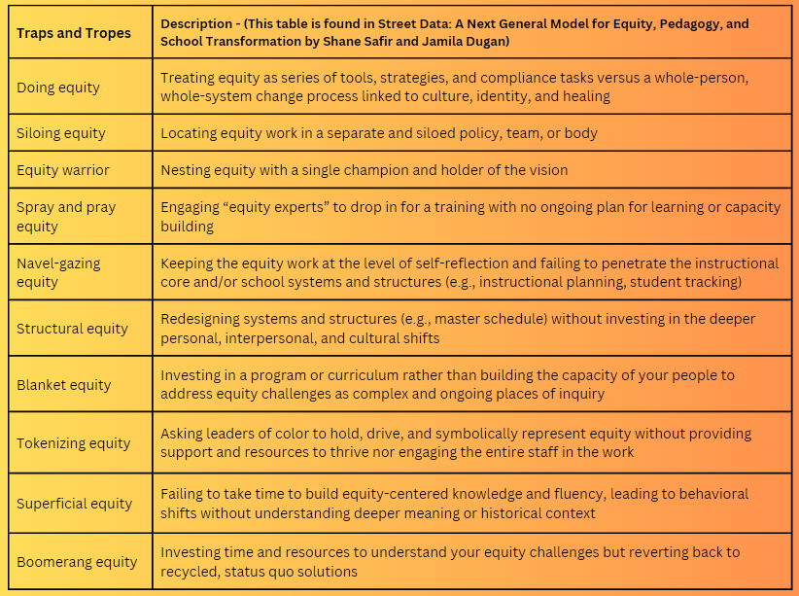
-Which traps and tropes sound or feel familiar to you?
-Where do you see a trap or trope playing out in your school or organizational context?
-What traps or tropes might students and families identify in your context? Are they the same or different from the ones you identified? Why might that be?

Slide 21
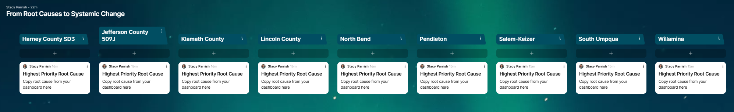

Application of their Learning - Equity Transformation Cycles
Chiloquin Elementary School - KCSD
Willamina Elementary School- WSD
Willamina Middle and High School - WSD
Washington Elementary School - PSD
Sunridge Middle School - PSD
Lincoln County School District
Harney County School District 3
North Bend School District
Padlet Link

Slide 22
Analyzing our Second Quarter or Trimester of Attendance
Team and Whole Group Reflections
2024-2025 TAPP Districts’ Dashboard

Slide 23
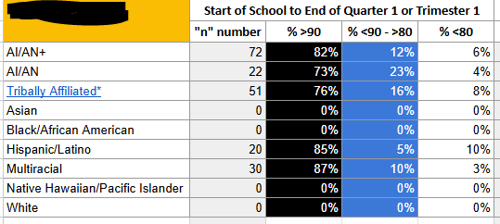
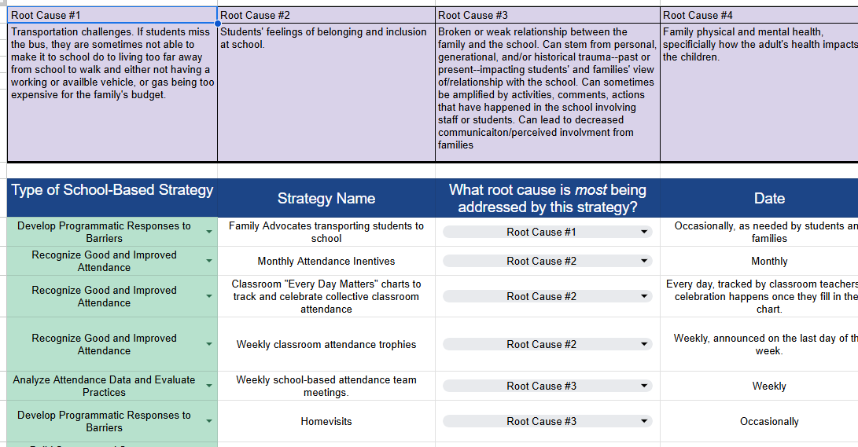
Pre-Work for Breakout Rooms
Four Minutes - Silent Analysis
Go to your school district’s TAPP Dashboard.
Toggle to the Attendance Tracker tab.
Review Quarter or Trimester 2 attendance for each school supported by an advocate.
  What % of students are at each level?
  Are you seeing gains from first quarter?
  Are there differences between different groups?
Review the Strategy Tracking Log.

Slide 24
Breakout Rooms - Data Driven Dialogue
What is our data telling us about the strength of our foundational conditions?
What is our data telling us about the effectiveness of our Attendance Tiered Response Systems?

Slide 25
Q and A for the Upcoming TAPP Spring Site Visits
Menu of Options and Q & A
Notes:
The past two years our TAPP Site Teams have been focused on re-establishing and fine-tuning their TAPP Practices especially as we began climbing up and out of the most impactful years of the COVID pandemic. Implementing the TAPP Dashboard in the 2022-2023 school year allowed us to not only ensure we are using data driven practices to ensure our TAPP strategies were achieving the impact as intended, but the Data Justice logs provided a safeguard of sorts to make sure our data analyses were culturally responsive and asked all TAPP Sites to sit with what your respective efforts, challenges, and strengths are made visible to your districts and tribes.

Slide 26
Menu of Options - Updated for Spring
Menu of Options – Share it with your TAPP Site team.
Follow the directions to build your full-day agenda for the TAPP Site Visit.
The visit will be comprised of –
  A TAPP Site Team meeting (a slide deck template is provided this year based on your feedback 😊)
  Group Educator Empathy Interviews
  A Project Director Interview
  Classroom Observations
  Tribal and Site Specific Options (these options are provided to you based on feedback from advocates and tribes)
Please start planning early. April is also state-testing season, so please be aware of this when working with building leaders to schedule observations.

Slide 27
Text Parrish anytime at 971-208-0270
Or - send me an email. Call if you must.
There is no such thing as, “I know you are busy”. I am here for you.

