Slide 1
Traditional Ecological Knowledge
3rd grade
Science Lesson
Oregon Tribes use traditional ecological knowledge to sustainably harvest native plants since time immemorial.
Notes:
Note to teachers: This lesson focuses on the Essential Understanding, Since Time Immemorial, which refers to the deep, ancestral connection that Oregon’s tribal nations’ have to their lands, cultures, and traditions. Students will learn about Tribes’ traditional ecological knowledge (TEK) and how this type of knowledge enables them and others to engage in sustainable harvests and ecosystems.

Slide 2
Essential Questions
What is traditional ecological knowledge (TEK), and how was it developed since time immemorial?
What can TEK teach us about taking care of local plants and ecosystems?
Notes:
Read and discuss what these might mean.

Slide 3
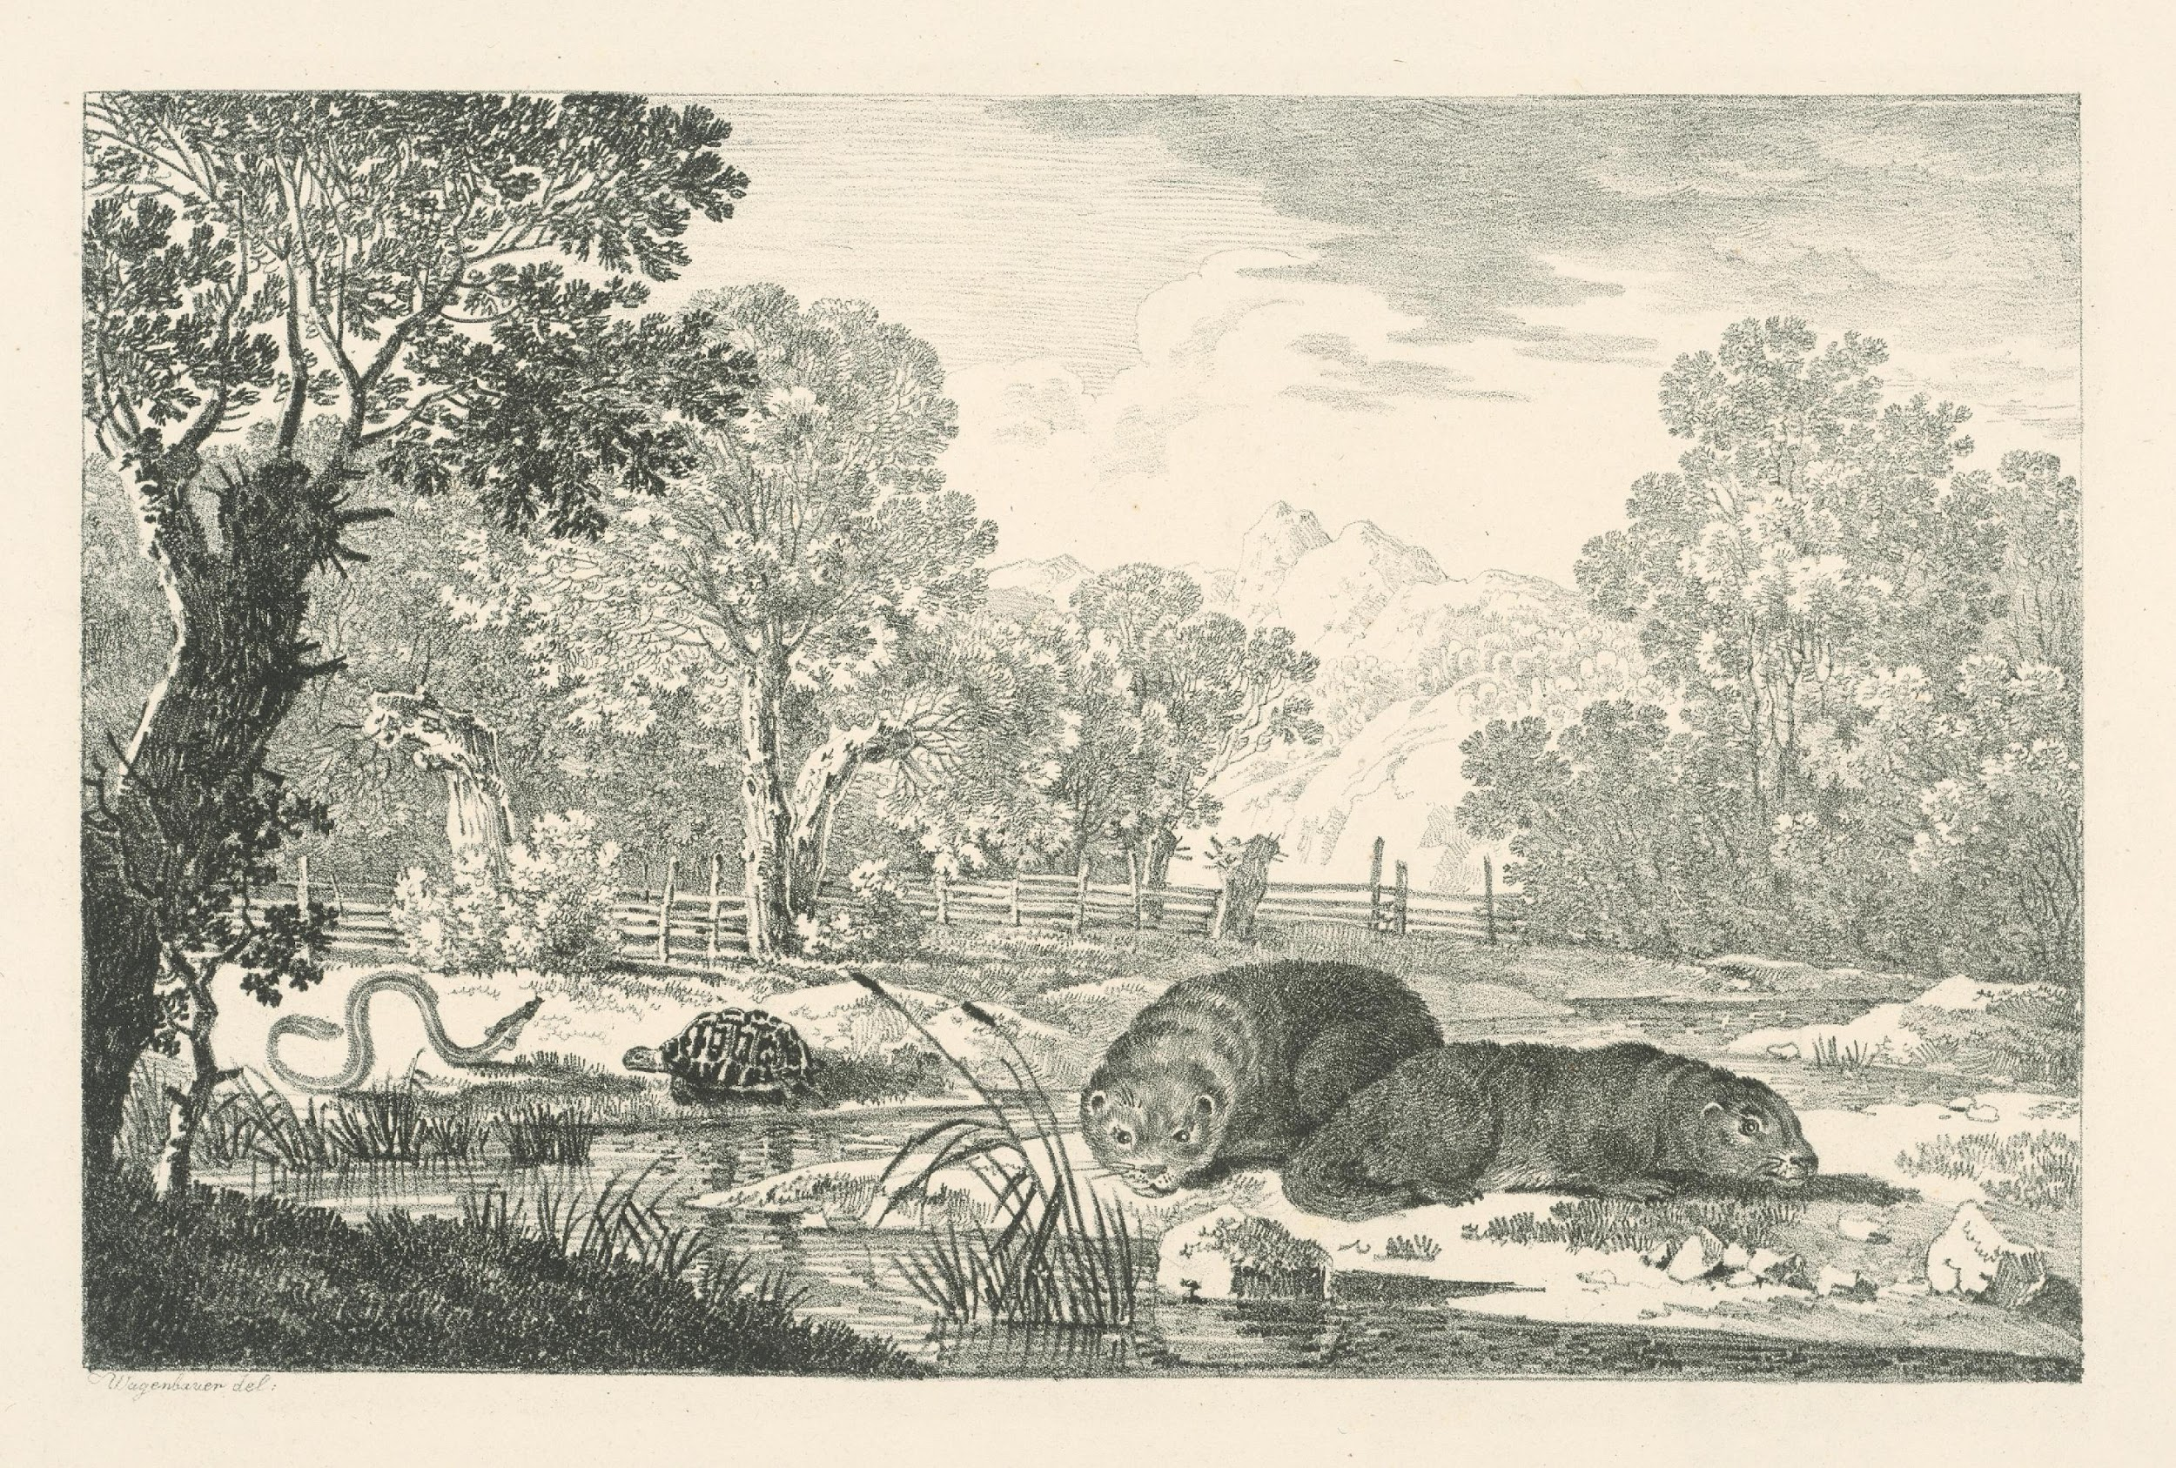
Group Talk
What are some things you know about plants and animals?
How did you learn about them?
Credit: rawpixel.com
Notes:
Begin by asking students, “What are some things you have learned about plants and animals? How did you learn about them?”
List their ideas on the whiteboard.
Say, “Today we’re going to be learning about ways Native Tribes in Oregon learn about plants and animals. Some of those ways will be the same ways you learn, and others will be different. We’ll also explore how Tribes use their knowledge of plants and animals to support their environments.”
Image dedicated to the public domain: https://creativecommons.org/publicdomain/zero/1.0/

Slide 4
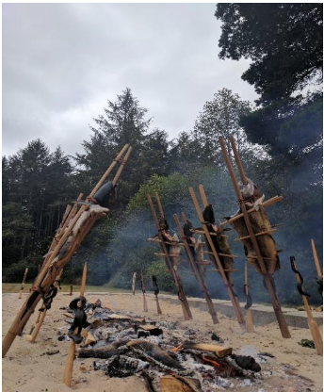
Traditional Ecological Knowledge (2)
Native people have learned about nature by living close to the land for a very long time.
This knowledge is passed down from elders to children through stories, songs and doing things together.
It connects people to their ancestors, traditions and lands.
Photo courtesy of The Confederated Tribes of Coos, Lower Umpqua and Siuslaw Indians.​
​
Notes:
Say, “Native American Tribes in Oregon learn about the living things around them through what’s called Traditional Ecological Knowledge, which is what Native people have learned about nature by living close to the land for a very long time. This knowledge is passed down from elders to children through stories, songs, and doing things together.
Image from the Essential Understandings document. Photo courtesy of The Confederated Tribes of Coos, Lower Umpqua and Siuslaw Indians.

Slide 5
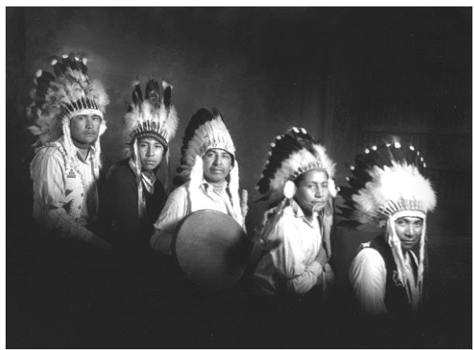
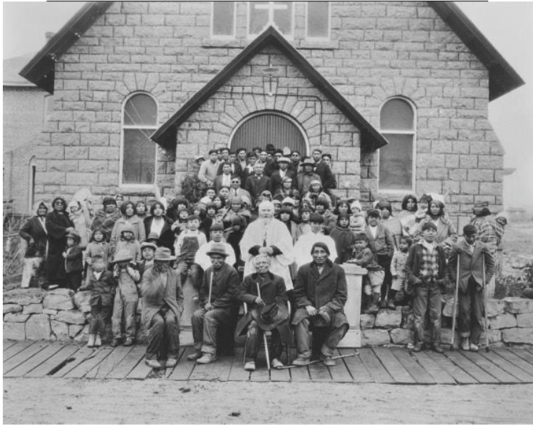
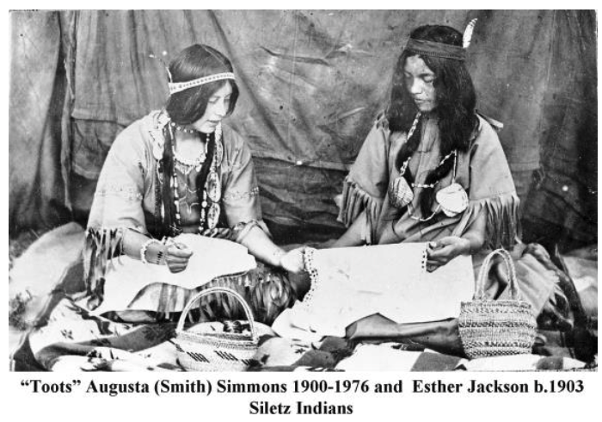
Time Immemorial means a very long time in the past beyond memory or record of history.
“From the coast to the interior valleys to the plateau and to the great basin, tribal peoples maintain continuous and balanced relationships including land and water.”
The Essential Understandings
Photo courtesy of The Burns Paiute Tribe
Photo courtesy of The Burns Paiute Tribe
Photo courtesy of The Confederated Tribes of Siletz Indians
Notes:
Discuss the meaning of time immemorial. Emphasize that tribal nations were created in this place and have existed here since the beginning of time, developing deep knowledge of the land, plants and animals throughout countless generations.
Ask students to do a quick turn and talk.
Say, “In your own words, explain to a friend what time immemorial means.”
Say, “Today we’ll also explore how Tribes’ traditional ecological knowledge developed since time immemorial enables them and others to engage in sustainable harvests and ecosystems.

Slide 6
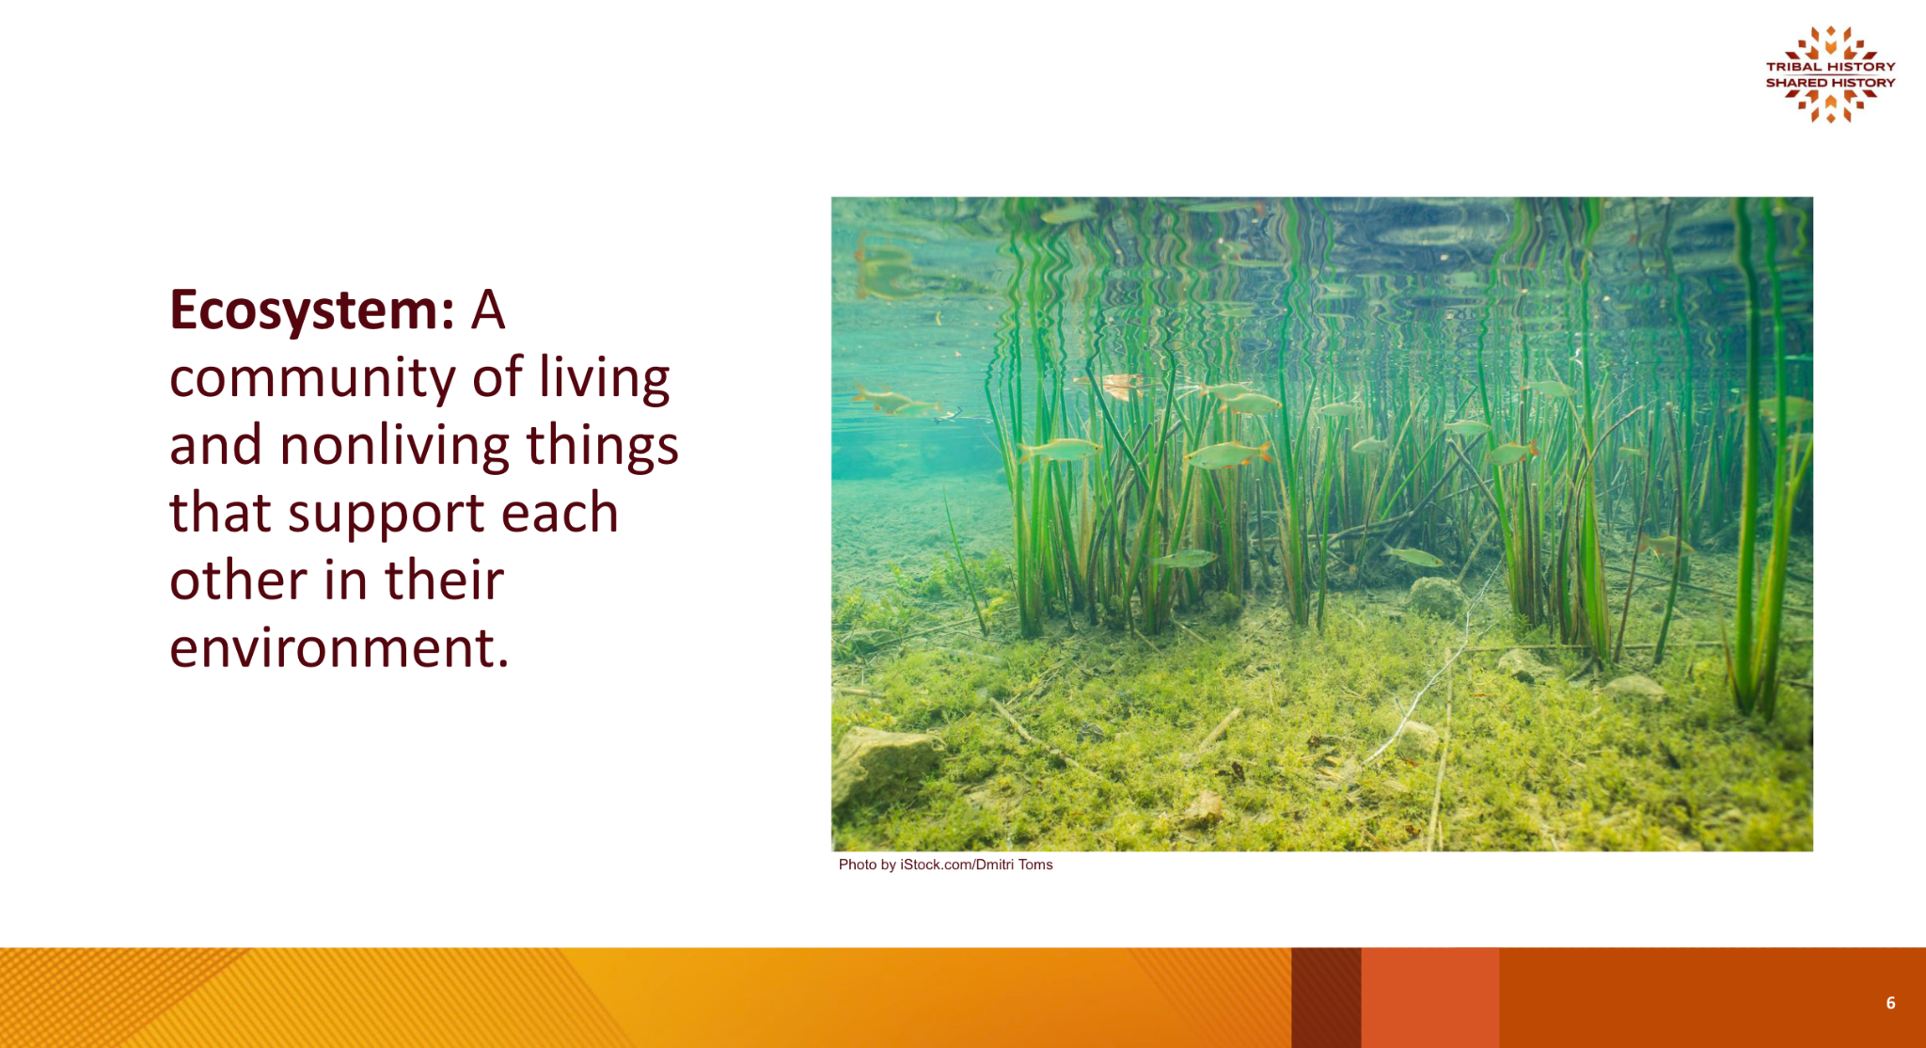
Ecosystem: A community of living and nonliving things that support each other in their environment.
Photo by iStock.com/Dmitri Toms
Notes:
Say, “An ecosystem is a community of living and nonliving things that support each other in their environment. Can you think of some ways that the plants and animals in this picture of a pond support one another?”
Ask students to turn and talk, and then ask for a few volunteers to share with the whole group.
Image credit: iStock.com/Dmitri Toms

Slide 7
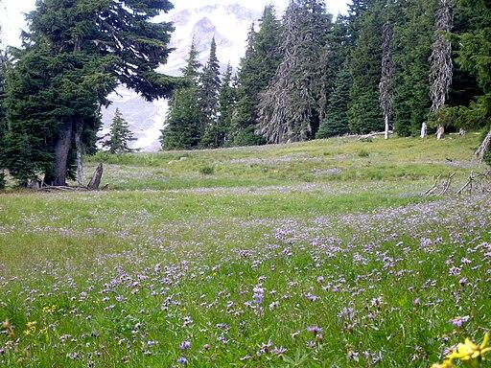
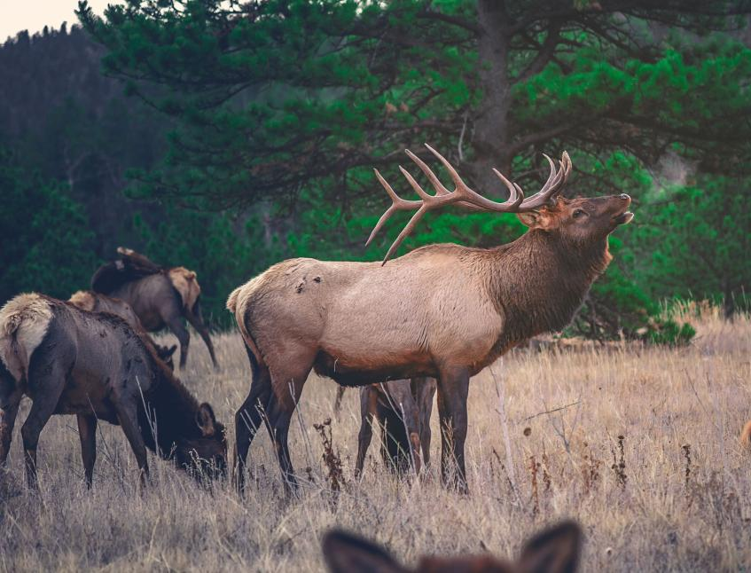
Meadows and Forests
EncMstr, CC BY-SA 3.0 <https://creativecommons.org/licenses/by-sa/3.0>, via Wikimedia Commons
Photo by Unsplash from Freerange Stock
Notes:
Say, “Now think about the ecosystem of a meadow or forest that has plants and animals. How do you think they support one another?”
Ask for a few volunteers to share with the whole group.

Slide 8
Learning Expectations
Learning Outcomes
I understand what traditional ecological knowledge (TEK) is.
I understand how Oregon Tribes use TEK to sustainably harvest native plants.
Success Criteria
I can describe an example of traditional harvesting practices.
I can explain how tribal ecological knowledge helps maintain healthy ecosystems.
Notes:
Review the Learning Objectives and Success Criteria with students so they understand what the intended learning is and what it looks like when they’ve achieved it.

Slide 9
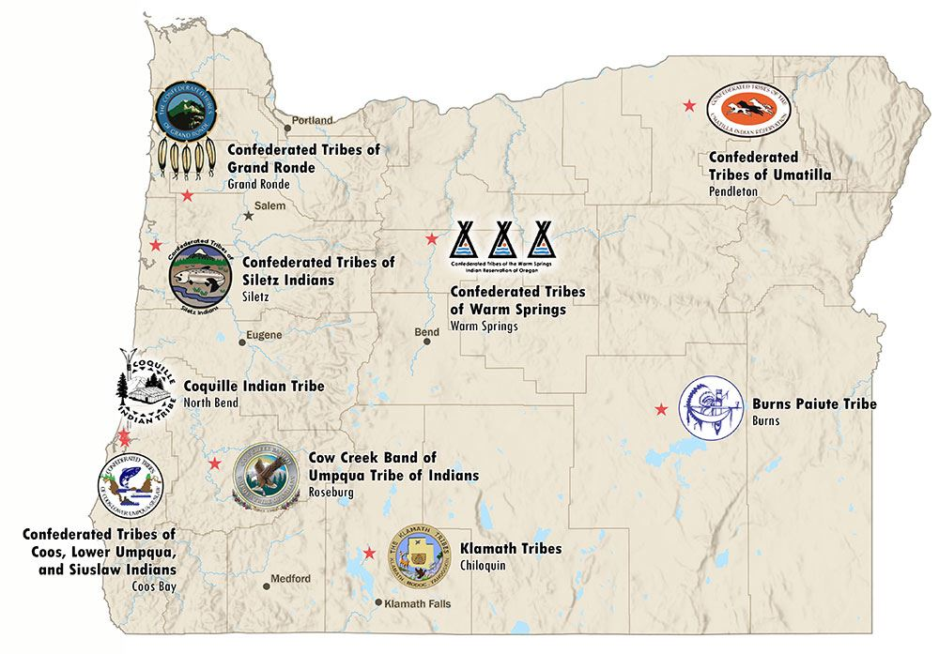
Nine Federally Recognized Tribes in Oregon
Can you find the Tribe closest to you?
Notes:
Say, “Today we’re going to be learning about the traditional ecological knowledge of Oregon Tribes. Though each Tribe has a lot in common, each Tribe developed their traditional ecological knowledge in relation to the specific area where they live. Can you find the Tribe closest to you? Take a minute to think about what the land is like there and what you might also know about it.”

Slide 10
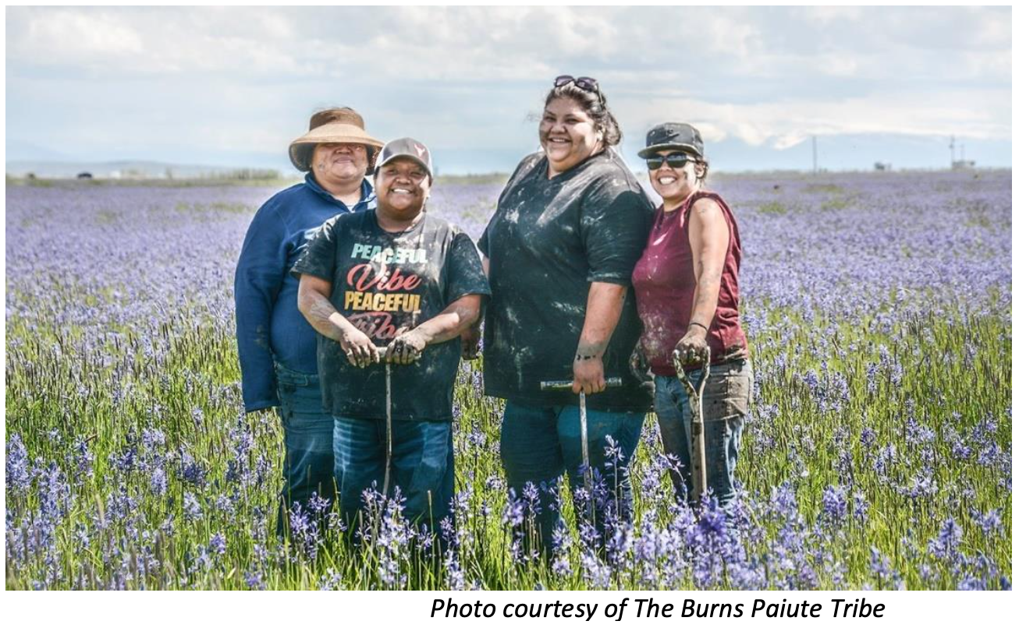
Harvesting Camas
Notes:
Explain that as part of their TEK, many Oregon Tribes have been harvesting native plants such as acorns, huckleberries, and camas for a long, long time. Camas is a plant with a blue flower and a nutritious root that can be eaten when cooked and was an important food source for many Oregon Tribes. Note: There is also a camas with a white flower that is deadly called Death Camas. This is different from the camas harvested by Native Tribes in Oregon.
Photo from the Essential Understandings document.

Slide 11
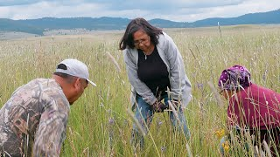
Rooted in Culture: Oregon’s Wild Camas
Notes:
Show the video of the Confederate Tribe of Warm Spring Elders harvesting camas: Rooted in Culture: Oregon's Wild Camas
Ask students to think about the traditional ecological knowledge described in the video.
After viewing, ask students to turn and talk with a partner about what they learned from the video. Ask a few students to share out after with the whole group.

Slide 12
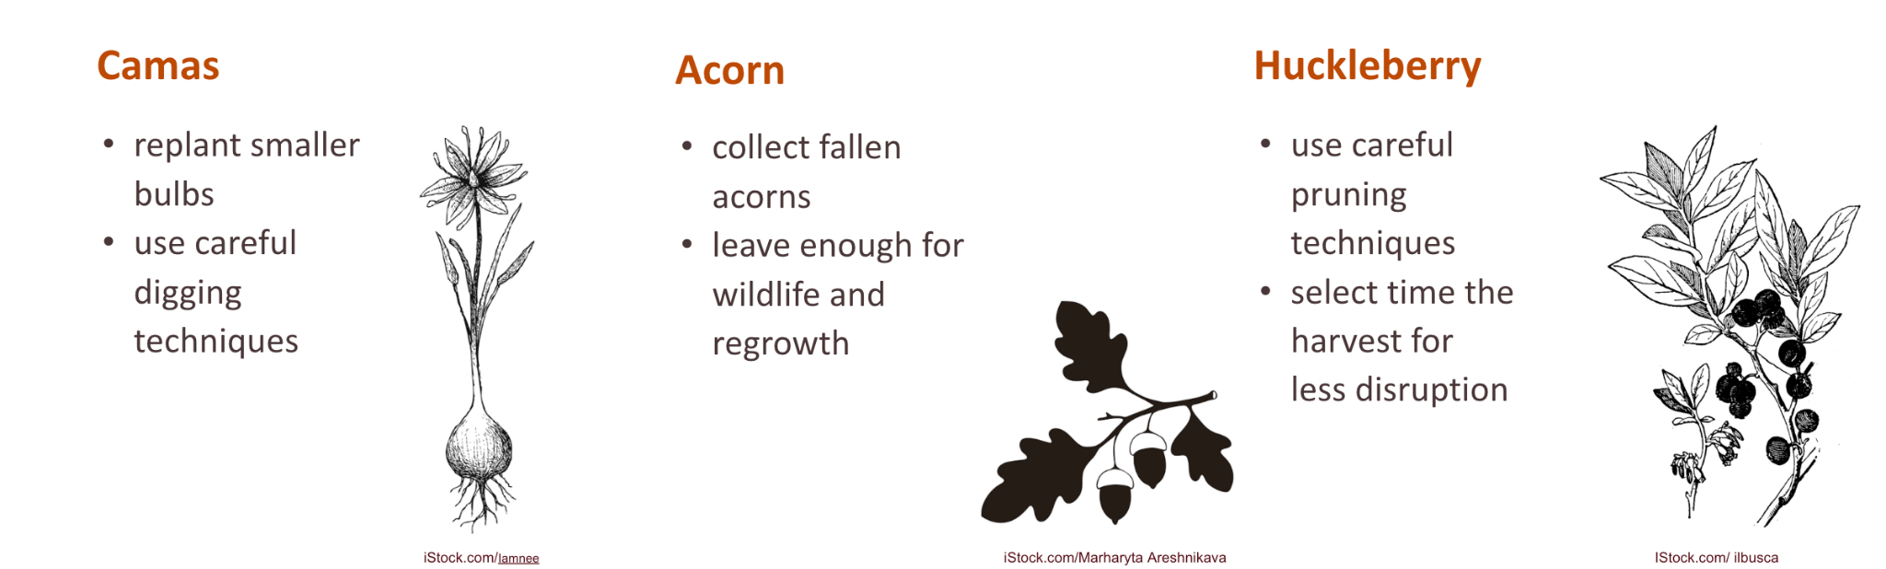
Sustainable Harvest with TEK
Means gathering food in a way that ensures the land and plants will still be healthy in the future
Camas
Acorn
Huckleberry
replant smaller bulbs
use careful digging techniques
collect fallen acorns
leave enough for wildlife and regrowth
use careful pruning techniques
select time the harvest for less disruption
iStock.com/Iamnee
iStock.com/Marharyta Areshnikava
IStock.com/ ilbusca
Notes:
Share about the traditional harvesting practices of Oregon Tribes that lead to sustainable ecosystems.
Camas harvesting (replanting smaller bulbs, careful digging techniques)
Acorn gathering (collecting fallen acorns, leaving enough for wildlife and regrowth)
Huckleberry harvesting (careful pruning techniques, timing of harvest)
Have students discuss in small groups:
Why might the practices be considered sustainable harvesting?
Print cards with the information from the slide about harvesting acorns, camas and huckleberry for each small group and create flashcards with them.
Have students show each other the pictures in turn and ask what they remember about the sustainable harvesting technique for each plant.
After, discuss as a class: How could these types of sustainable harvesting practices help solve the environmental problems we face today?
Images: iStock: camas: Iamnee, acorn: Marharyta Areshnikava, huckleberry: ilbusca

Slide 13
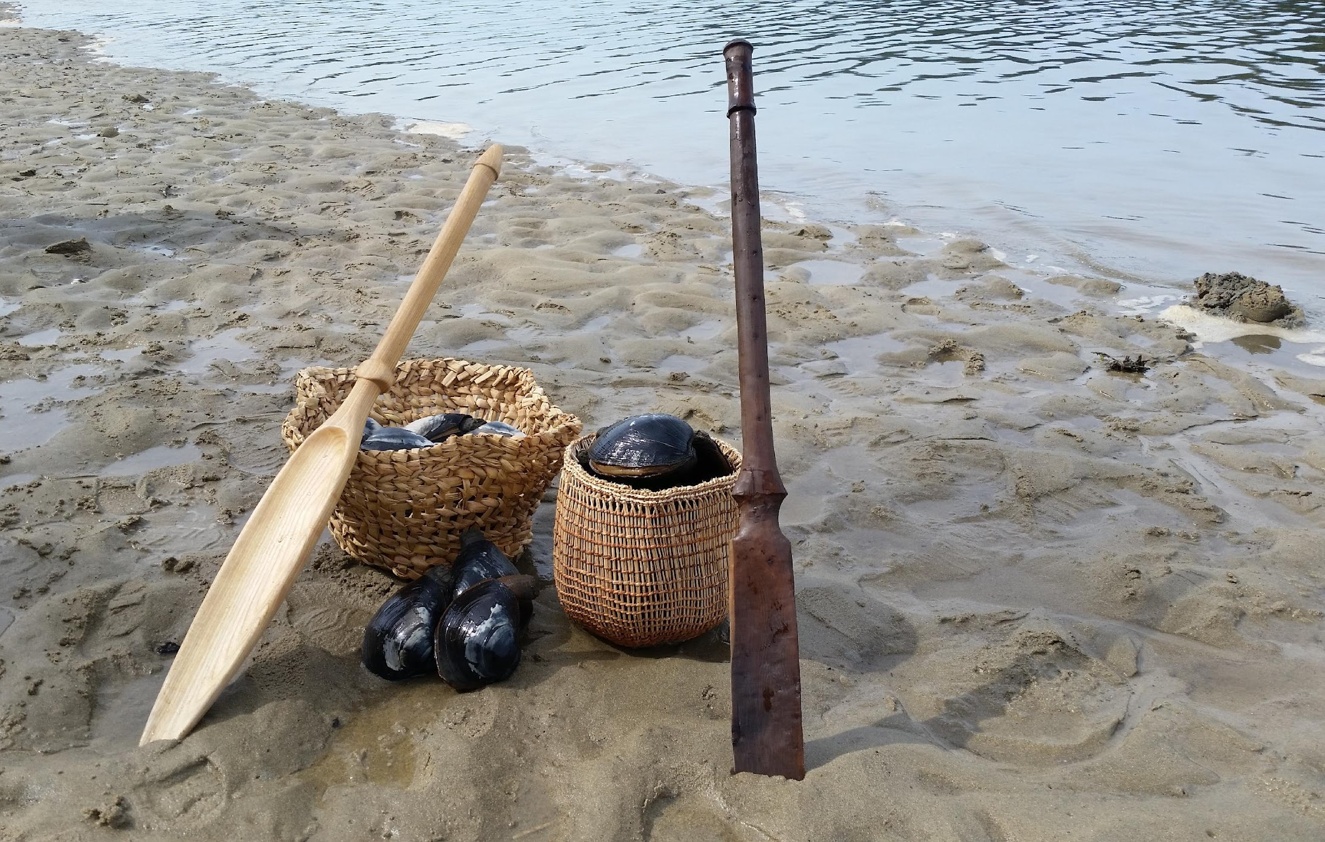
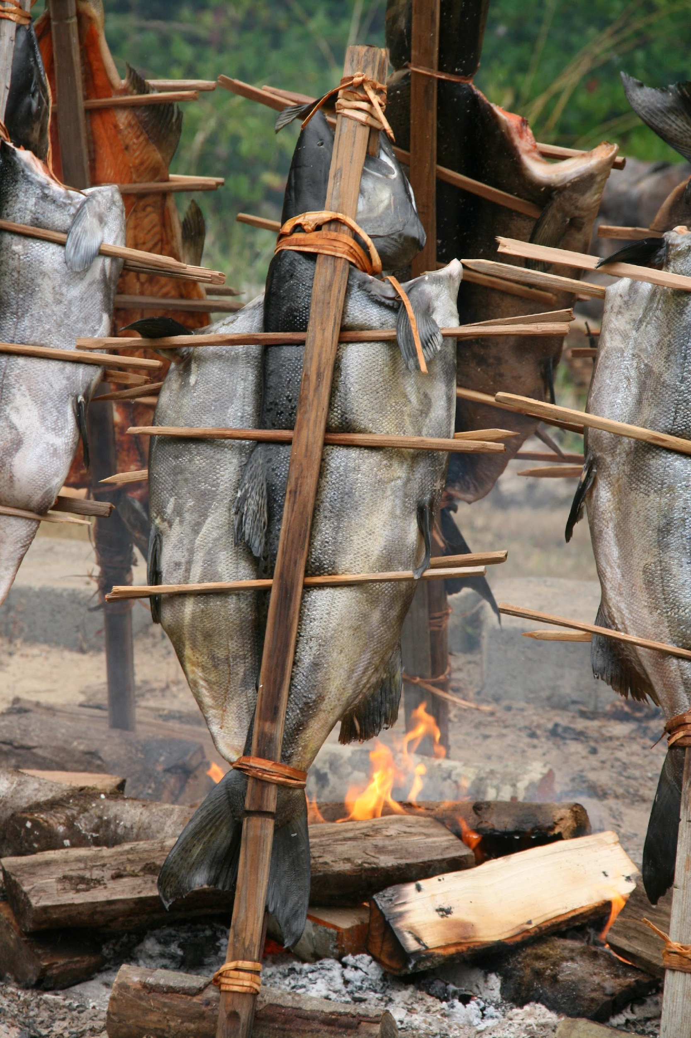
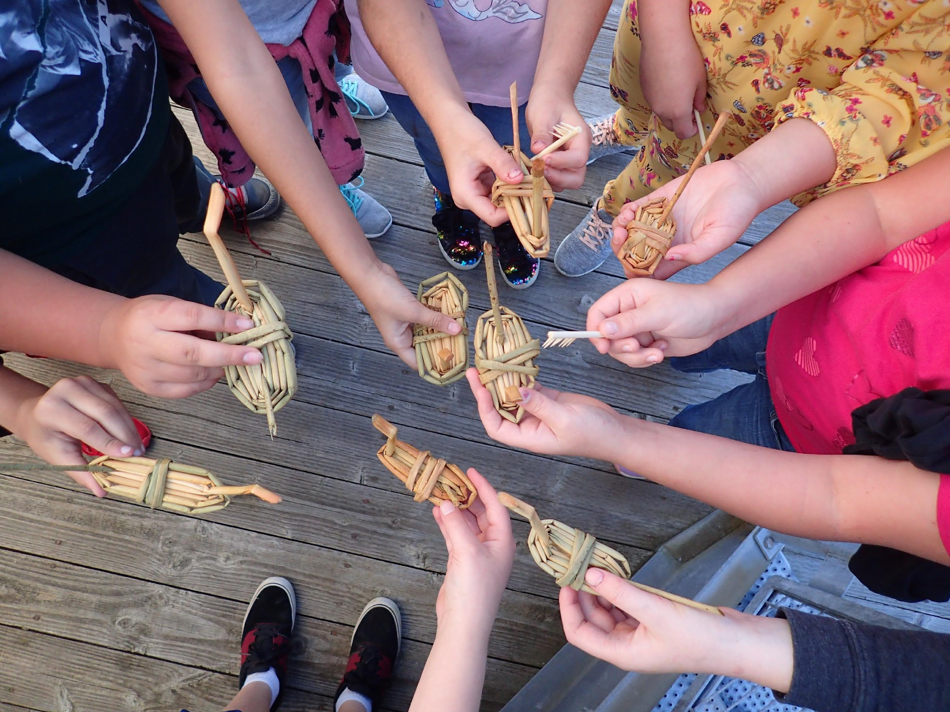
How can this knowledge impact the future?
Image from CTCLUSI, Photographer John Schaefer
Image from CTCLUSI, Photographer Morgan Gaines
Image from CTCLUSI, Photographer Morgan Gaines
Notes:
Communicate to students that to be able to protect and use their lands, Oregon Tribes have also sought to reclaim their traditional lands and practices. For example, the Confederated Tribes of Coos, Lower Umpqua and Siuslaw use their land to engage in clamming, fishing salmon, and gathering natural materials for toys.

Slide 14
Closing
One thing I learned about traditional ecological knowledge is _______________.
This knowledge is important because____________________.
Notes:
Ask students to complete a quick write: "One thing I learned about traditional ecological knowledge is..." and "This knowledge is important because..."
Remind students that Oregon Tribes continue to practice and share this knowledge today. TEK is a crucial aspect of Indigenous cultures and can offer valuable insights for understanding and managing ecosystems.
Emphasize that this knowledge continues to be valuable for solving environmental challenges in our modern world.

Slide 15


Self-assessment
# | Success Criteria | Sort of | Yes
1 | Can I explain what "since time immemorial" means for Oregon Tribes? | . | .
2 | Can I describe an example of traditional harvesting practices? | . | .
3 | Can I explain how tribal ecological knowledge helps maintain healthy ecosystems? | . | .
Notes:
Ask students to self-assess based on the Success Criteria. They can pick their level of learning (not yet, sort of, or yes) and share with a peer, or you can print out the self-assessment and ask students to fill it out and turn it in.
Success Criteria
I can explain what "since time immemorial" means for Oregon Tribes.
I can describe an example of traditional harvesting practices.
I can explain how tribal ecological knowledge helps maintain healthy ecosystems.

Slide 16
Thank you!

