Slide 1
The Mathematics of Basket Weaving
3rd Grade
Science Lesson
Lifeways are how a group of people live, and preserve their cultural traditions.
Notes:
Explain that today they will learn about basket weaving, a part of the lifeways of many Native peoples in Oregon and how basket weavers use mathematics to weave their baskets.
Explain that lifeways are how a group of people live and preserve their cultural traditions. It is a big idea that includes many activities important to Native peoples in Oregon. Basket weaving is one of them. For many years, Native peoples in Oregon had to hide their lifeways, but they were resilient, which means they kept on weaving baskets and with as many lifeways as possible, even when it was very hard.
Ask students to turn and talk and explain lifeways in their own words.

Slide 2
Essential Questions
How do Native Americans in Oregon use geometry in basket weaving?
Why is it important to continue traditional Native handicraft practices in Oregon?
Notes:
Read and discuss what these might mean.

Slide 3
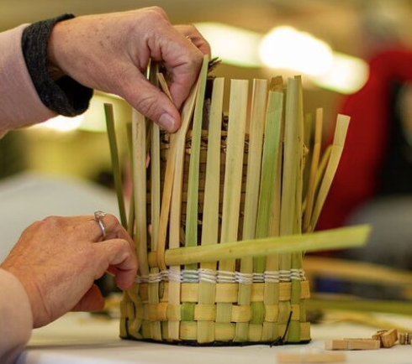
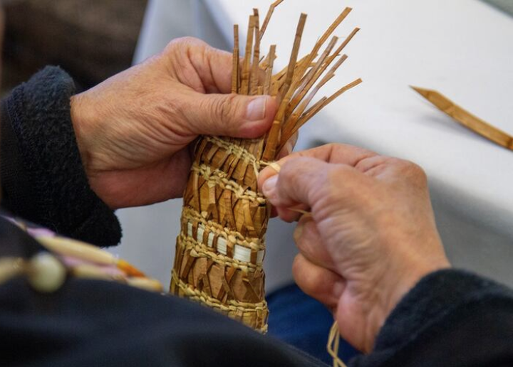
Basket Weaving
Interlacing materials to create a pattern or object
Jarrette Werk Underscore News / Report for America
Jarrette Werk Underscore News / Report for America​
Notes:
Introduce Basket Weaving
Provide the simple definition: interlacing materials to create a pattern or object.
Ask students to describe the images and how they show “interlacing materials.”
List their ideas on the board.

Slide 4
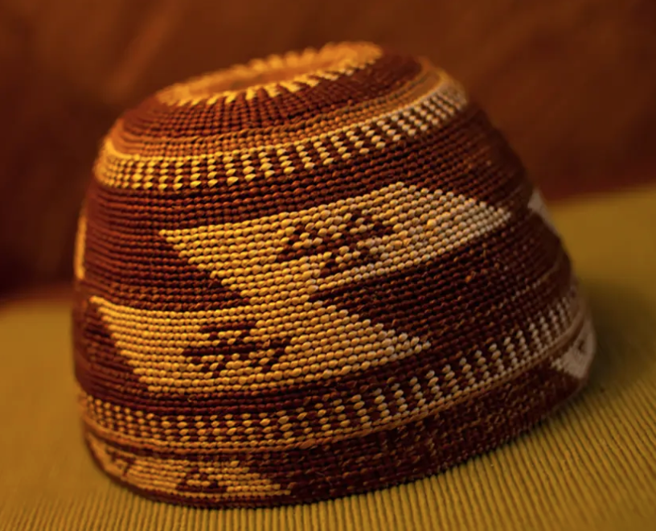
Purposes of Native Baskets in Oregon
Now and In the Past
Ornamental and ceremonial purposes
Carrying everyday items
Supporting fishing, harvesting, and other activities
Basket made by "Bud" Lane / Photo from the First Peoples Fund
Notes:
Discuss the various purposes of baskets.
Image from the The Art of Ceremony: Regalia of Native Oregon September 28, 2008 – January 18, 2009, Hallie Ford Museum of Art, Willamette University Teachers Guide
Image of Xee-tr’at (Woman’s cap) 1998 Alfred “Bud” Lane III Hazel sticks, spruce roots, bear grass, maidenhair fern, porcupine quill dyed with Oregon grape root 3.5” x 6.5” Collection of the artist

Slide 5
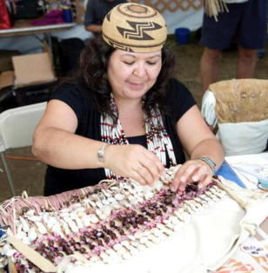
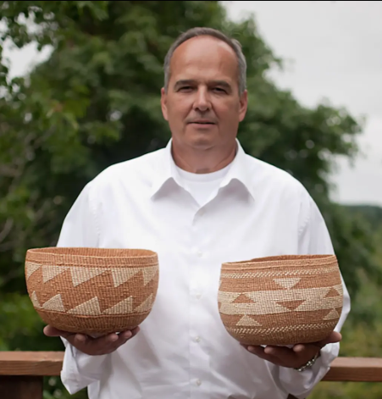
Oregon Contemporary Artists: Basket Weavers
Sonya Moody-Jurado / Photo from First People Fund website
Alfred “Bud” Lane, III / Photo from First People Fund website
Notes:
Communicate that contemporary artists across Oregon Tribes, like Bud Lane and Sonya Moody-Jurado of the Confederated Tribes of Siletz Indians, maintain these traditions of basket weaving.
Explain how their work shows how mathematical understanding is embedded in cultural practices and has been passed down through generations.

Slide 6
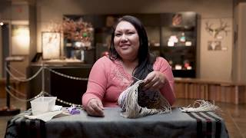
Kelli Palmer, The Confederated Tribe of Warm Springs, Master Basket Weaver
Video from Travel Oregon: Central Oregon Makers, River Canyon Country
Notes:
Share with students that next they’ll watch a video of Kelli Palmer, a master basket weaver and member of the Confederated Tribe of Warm Springs, who talks about learning to make baskets and the connection it provides to her family.
Afterward, ask students, “Is there something like this that you have learned from an older person in your life?”
Have students turn and talk. Then ask a few students to share with the whole class.
Video: Basket Weaver Draws from Native Culture: https://youtu.be/lqJBXHA630A?feature=shared
Video from Travel Oregon: Central Oregon Makers, River Canyon Country

Slide 7
Learning Outcomes
Success Criteria
I understand that basket weaving uses geometric patterns.
I understand how to apply multiplication to determine the area of repeating patterns.
I understand that Native Oregon crafts reflect lifeways and cultural traditions.
I can name one way math is used in Oregon’s Native basket weaving.
I can apply multiplication to determine the area of repeating patterns in basket weaving designs.
I can explain why basket weaving is an important tradition for Oregon Tribes.
Notes:
Review the learning goals and success criteria with students so they understand what the intended learning is and what it looks like when they’ve achieved it.

Slide 8
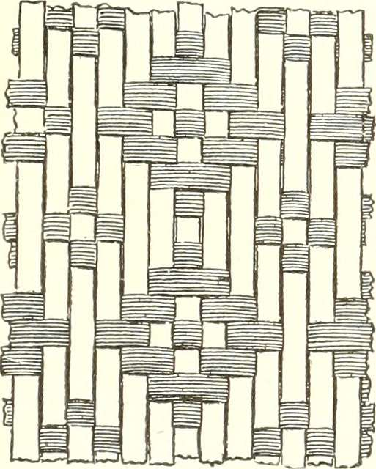
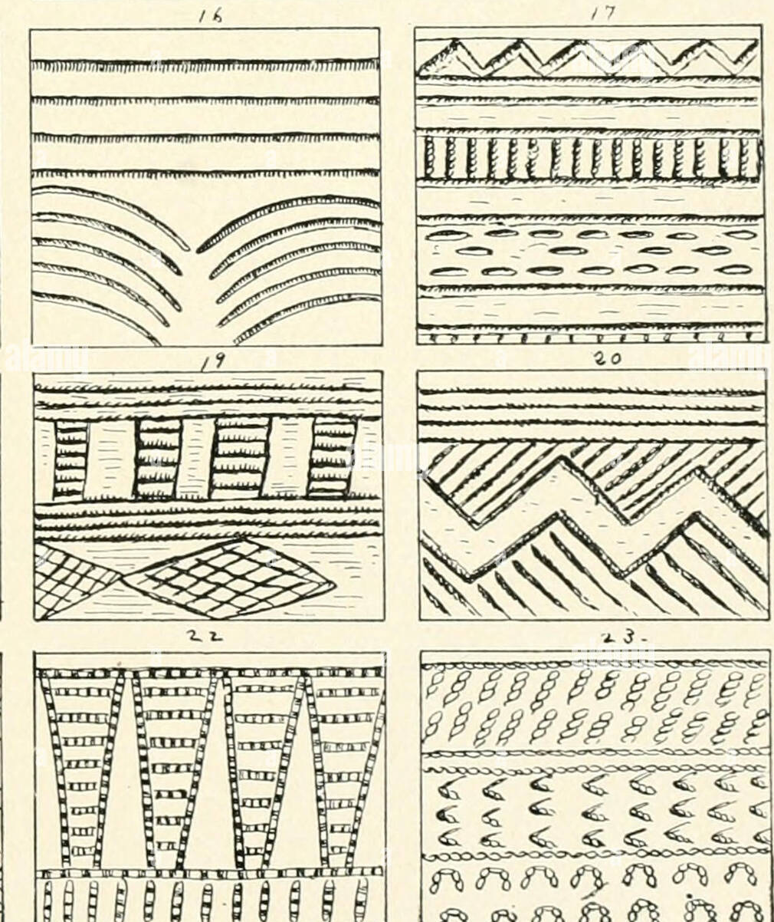
Key Words
Resilience
Pattern
Symmetry
Geometric
Array
Area
Weaving
Notes:
Touch base on the key vocabulary words:
Pattern - a repeating design or sequence
Symmetry - balance in a design where one half mirrors the other
Array - an arrangement of objects in rows and columns
Area - the amount of space inside a two-dimensional shape
Weaving - interlacing materials to create a pattern or object
Geometric - relating to shapes, sizes and properties of figures
Lifeway- all the activities, ceremonies, crafts and governance of tribal peoples in Oregon.
Resilience- the ability to stay strong or bounce back when things get tough
Images Left to right
https://itoldya420.getarchive.net/amp/media/annual-report-of-the-board-of-regents-of-the-smithsonian-institution-1902-18248707508-e2f8fb

Slide 9
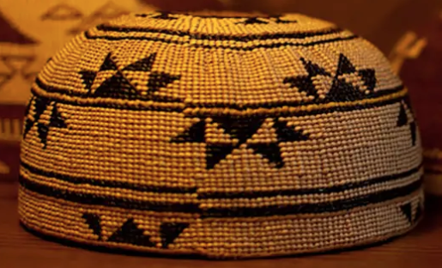
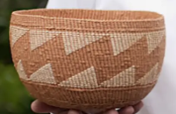
Geometric Shapes and Patterns
Basket made by “Bud” Lane / Photo from First People Fund website
Basket made by “Bud” Lane / Photo from First People Fund website
Notes:
Ask students to point out repeating geometric shapes and patterns.
Project an image for the class to see, and have students turn and talk about patterns they see and count the shapes in their pattern.

Slide 10
From the Basket Weavers
What patterns and shapes do you notice in the baskets we saw?
Turn and talk to a partner about the patterns they observe.
Notes:
Ask students: "What patterns and shapes do you notice in the baskets we saw?"
Have students turn and talk to a partner about the patterns they observe.

Slide 11

Repeating Geometric Shapes and Patterns
Notes:
After students reported what they saw (repeating shapes and patterns), you may show this slide to confirm their understanding.
Ask them how many shapes they counted.
Ask students to share out in the whole group, writing down a list of their noticings.

Slide 12

Pattern Exploration
Grid paper
Colored pencils
Notes:
Provide students with grid paper and colored pencils.
Model how to create a simple basket pattern on grid paper based on the students’ noticings from the day before.

Slide 13
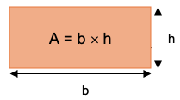
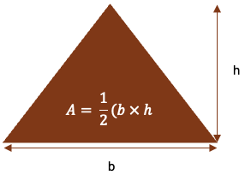
Area Formulas
Notes:
If students are finding the area of the shapes, you may show this slide for students to work with.
Demonstrate how to identify the area of the repeating pattern unit using multiplication
Have students create their own basket-inspired pattern on grid paper.
Ask students to create a repeating pattern.
Identify shapes in their pattern
Calculate the area of their repeating pattern unit
Wrap-Up:
Pair-share: Students explain their designs and calculations to a partner.

Slide 14
Reflections and Class Discussion
Why is basket weaving an important tradition for Oregon Tribes?
How is math used in Oregon’s Native basket weaving?
Without math, what might your pattern look like? Would you be able to weave a basket without a geometric pattern?
Notes:
Why is basket weaving an important tradition for Oregon Tribes?
How is math used in Oregon’s Native basket weaving?
Without math, what might your pattern look like? Would you be able to weave a basket without a geometric pattern?

Slide 15


Self-assessment
# | Can I… ? | Sort of | Yes
1 | describe why basket weaving an important tradition for Oregon Tribes?
2 | name one way math is used in Oregon’s Native basket weaving?
3 | apply multiplication to determine the area of repeating patterns in basket weaving designs?
Notes:
Ask students to self-assess based on the success criteria. They can pick their level of learning (not yet, sort of, or yes) and share with a peer, or you can print out the self-assessment and ask students to fill it out and turn it in.
Success Criteria
I can explain what "since time immemorial" means for Oregon Tribes.
I can describe an example of traditional harvesting practices.
I can explain how tribal ecological knowledge helps maintain healthy ecosystems.

Slide 16
Thank you!

