Slide 1
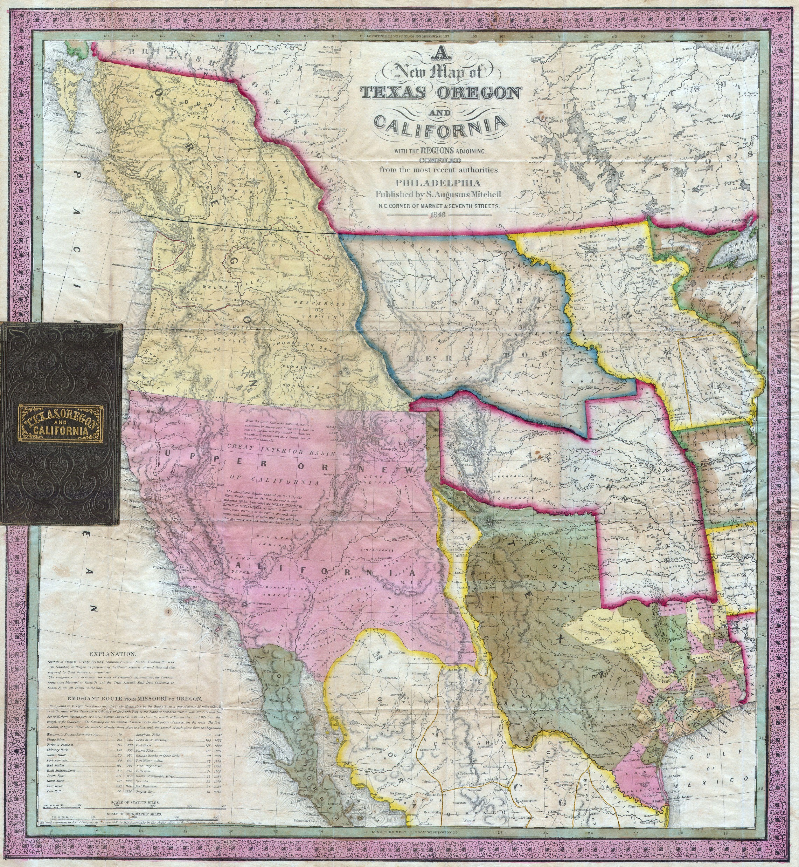
This map is from 1846. Later the same year, the United States and Great Britain decided to split the land known as the Oregon Territory at the line between modern-day Canada and Washington state. The outline of modern-day Oregon has been added in black on top of the original map to make it easier to find, but the state did not take this shape until it attained statehood in 1859.

Slide 2
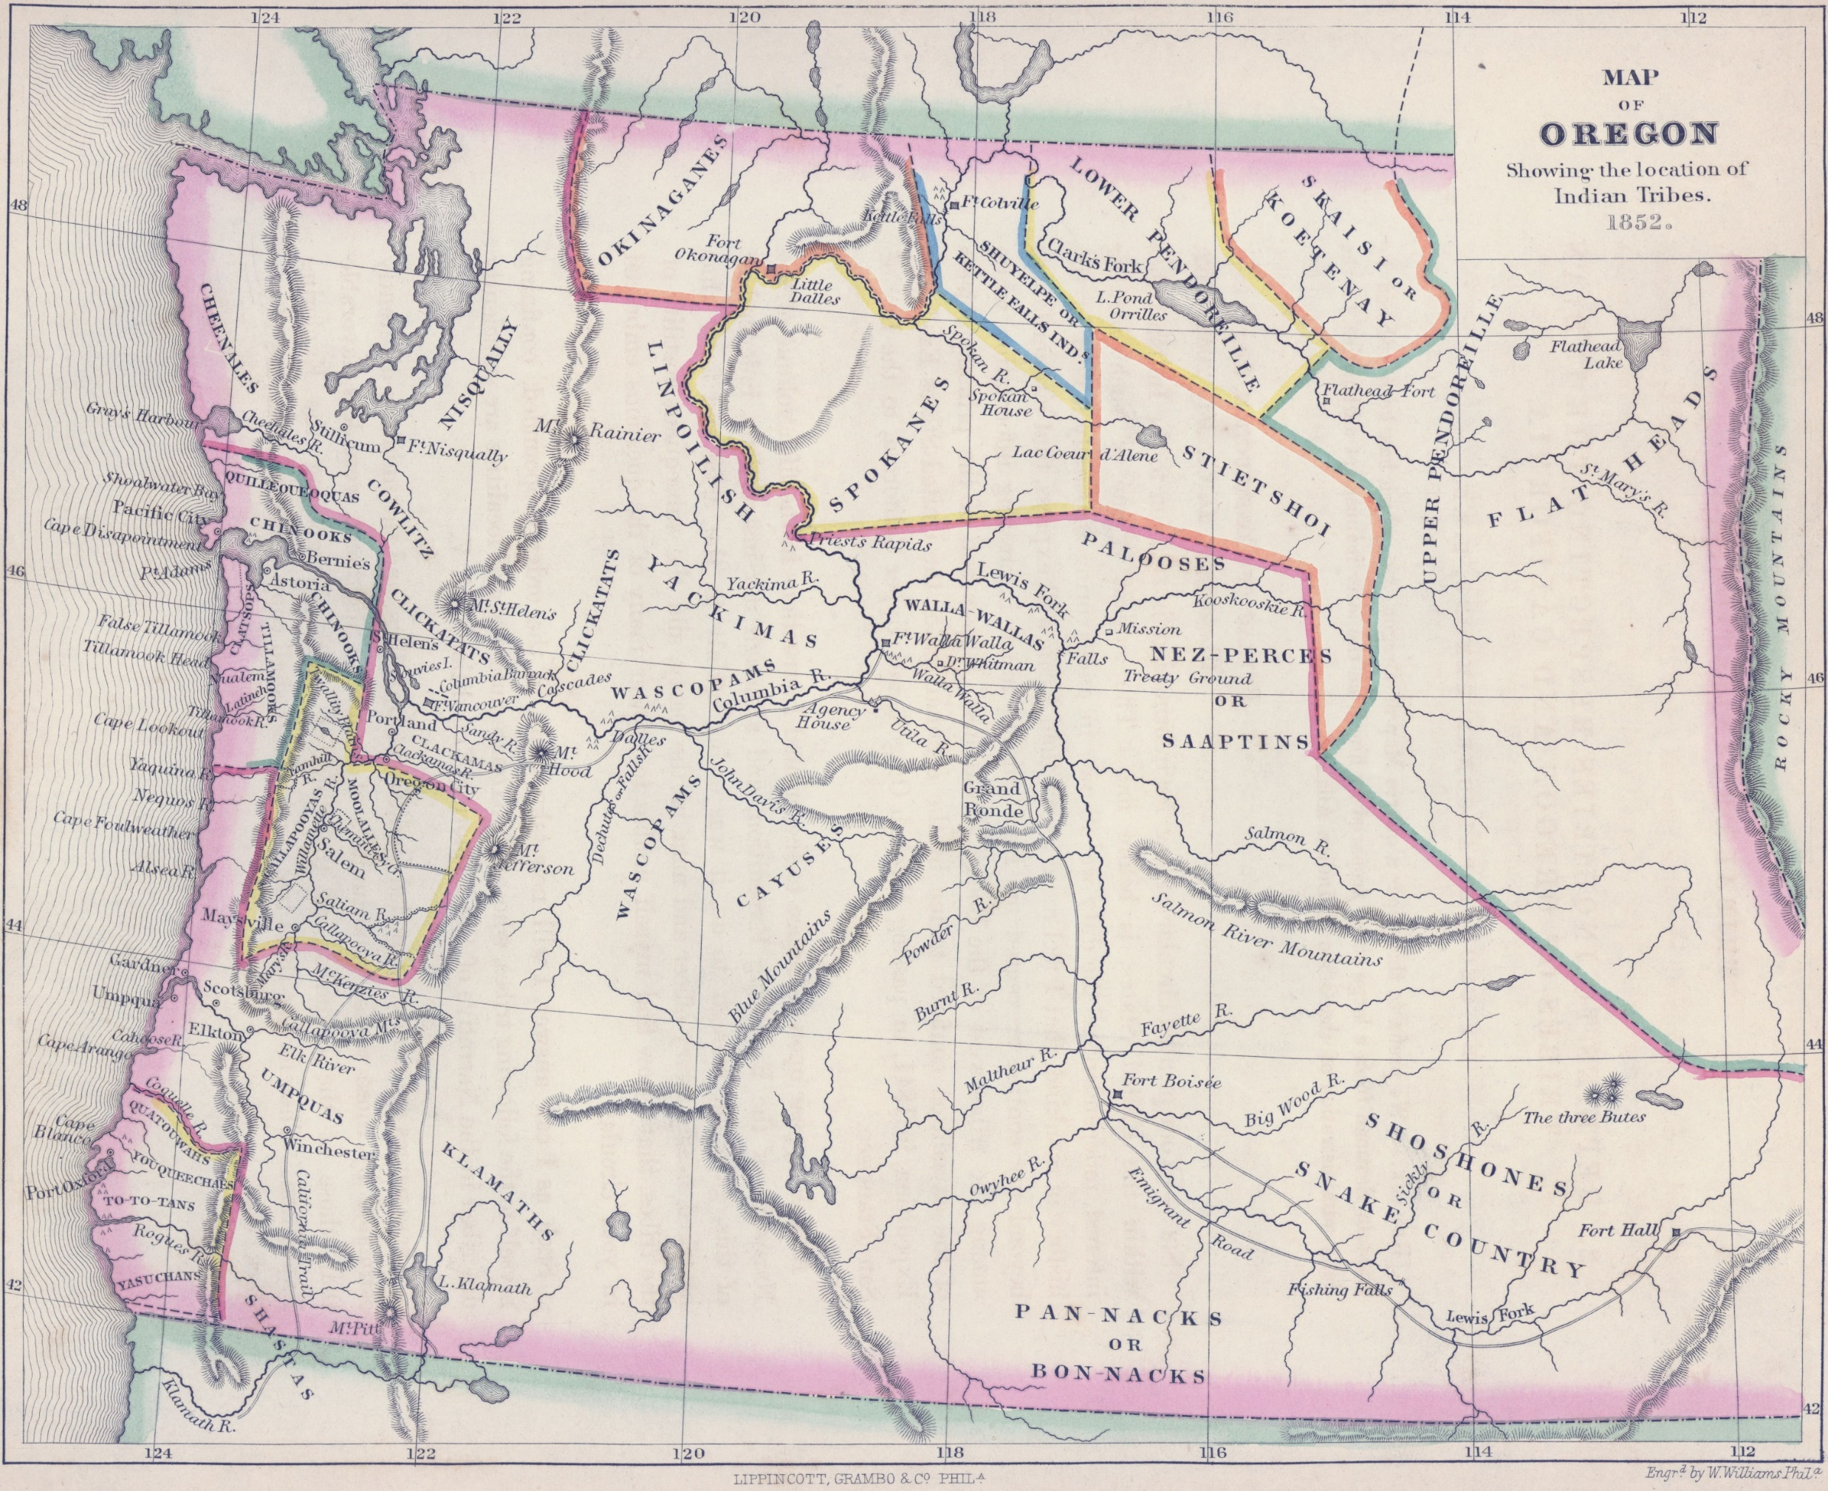
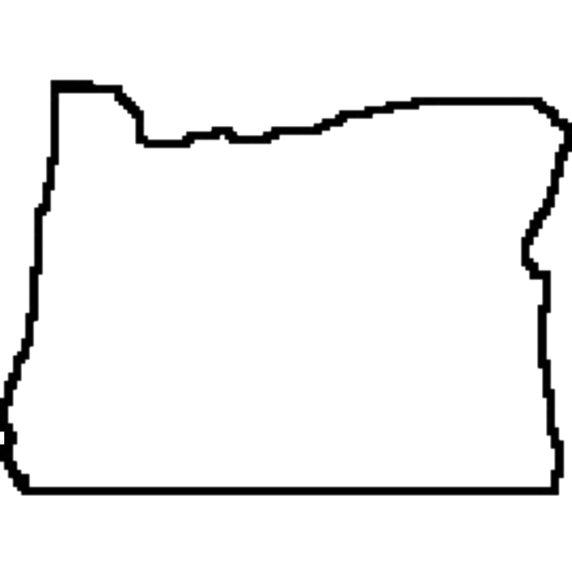
This map is from 1852 before any treaties were made with American Indian tribes in the area that is now known as Oregon. The outline of modern-day Oregon has been added in black on top of the original map to make it easier to find, but the state did not take this shape until it attained statehood in 1859.

