Slide 1
TAPP Family Advocate Monthly Space
Saturday Dec 21
September 3, 2025 - 12:30-2:30PM
✅ Welcome! Please say hello to your colleagues in the chat.
✅ Rename yourself to your Name, school district initials, Tribal Partner(s), and pronouns.
✅ Materials Needed - Writing materials, water, snacks, etc.

Slide 2
This monthly meeting is a sacred space for TAPP Family Advocates to –
Be in community with other educators doing the same work
Prevent isolation and burnout
Grow our individual and collective capacities to lead systemic change
This space needs everyone to participate fully, be on camera to the greatest extent possible, and push yourself and one another to grow and lead in a good way. 💙

Slide 3
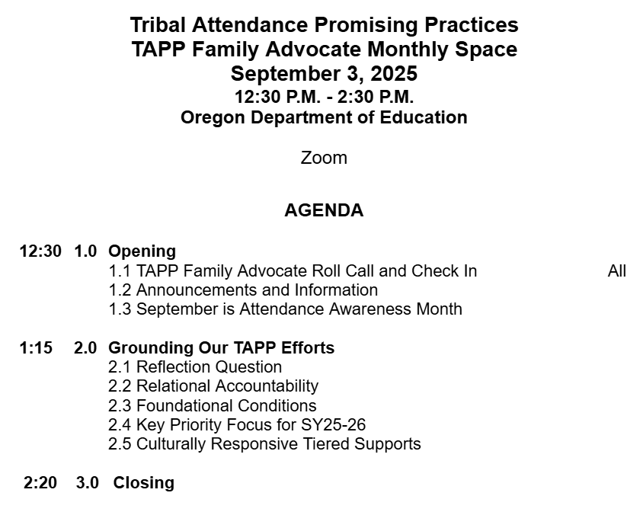

TAPP September Monthly Meeting Arc

Slide 4
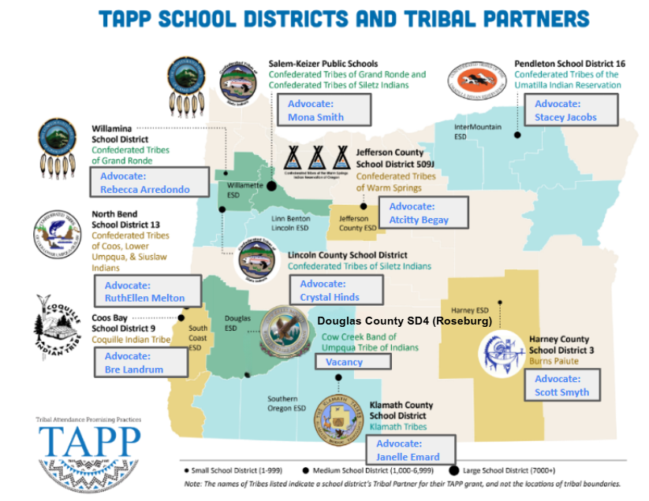
Advocates:
Rebecca Arredondo and Mike Solem

Slide 5
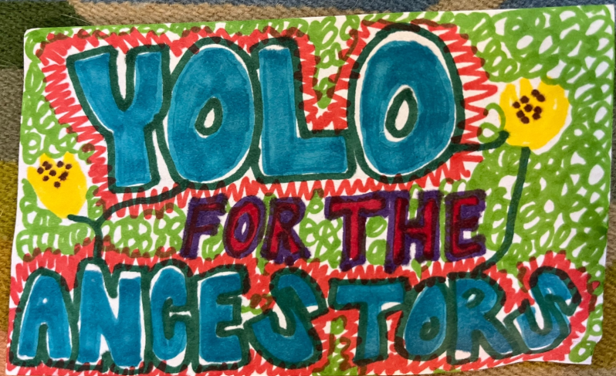
TAPP Family Advocate Check-In
Roll Call.
What activities or events did you engage in this summer that made you feel alive and appreciative of the air you have in your lungs.

Slide 6
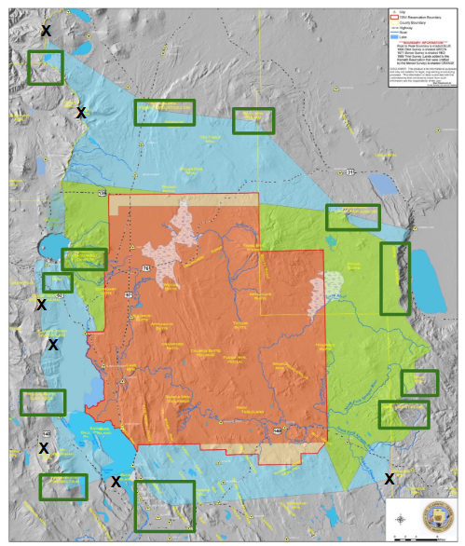
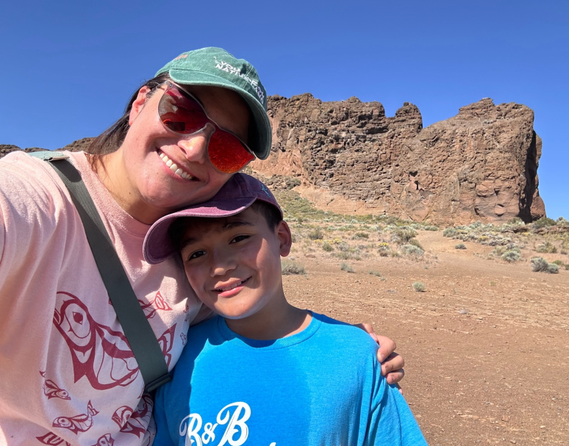
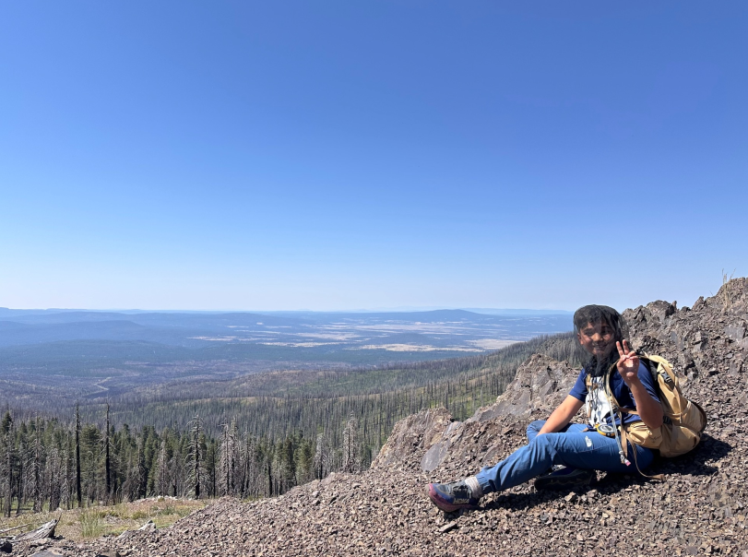
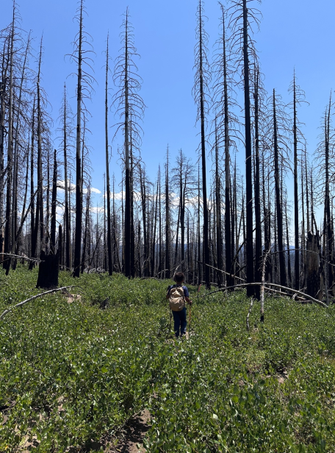
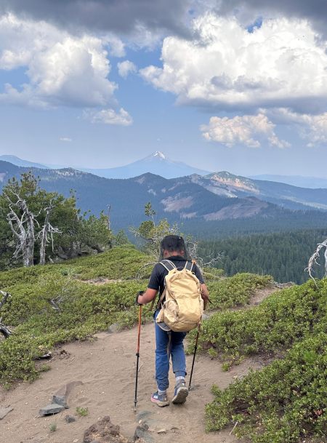
FORT ROCK
GEARHART MT.
ASPEN BUTTE

Slide 7
Announcements and Information
Initial Plan templates - due September 30, 2025
See my Start of Biennium Launch email on 8/27
Fall Learning Visits
Achievement Data Insight - Regular Attender Data File + Special AI/AN+ and Tribal Affiliation Regular Attender Data File sent to Project Directors and District Superintendents EOD yesterday (unsuppressed data = 100% of students in a focal group, even if there is <10.) The usual Regular Attender Data from other ODE subgroups has already been sent.
NIEA - ARE YOU GOING?

Slide 8
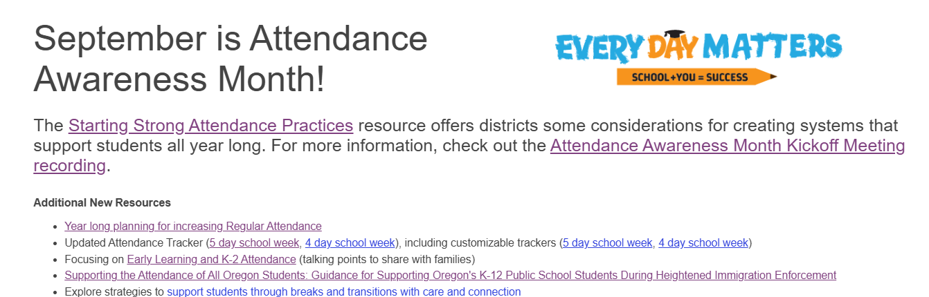
✅
Activity: Explore the Starting Strong Attendance Practices resource. Identify a practice from either “Setting the Stage” or the “Strong Communication Practices” that was a good reminder for you as you launch the first 30 days of school at your respective TAPP school sites.

Slide 9
Grounding our TAPP Efforts
It is not about looking “outward” for the answers; it is about turning in.

Slide 10
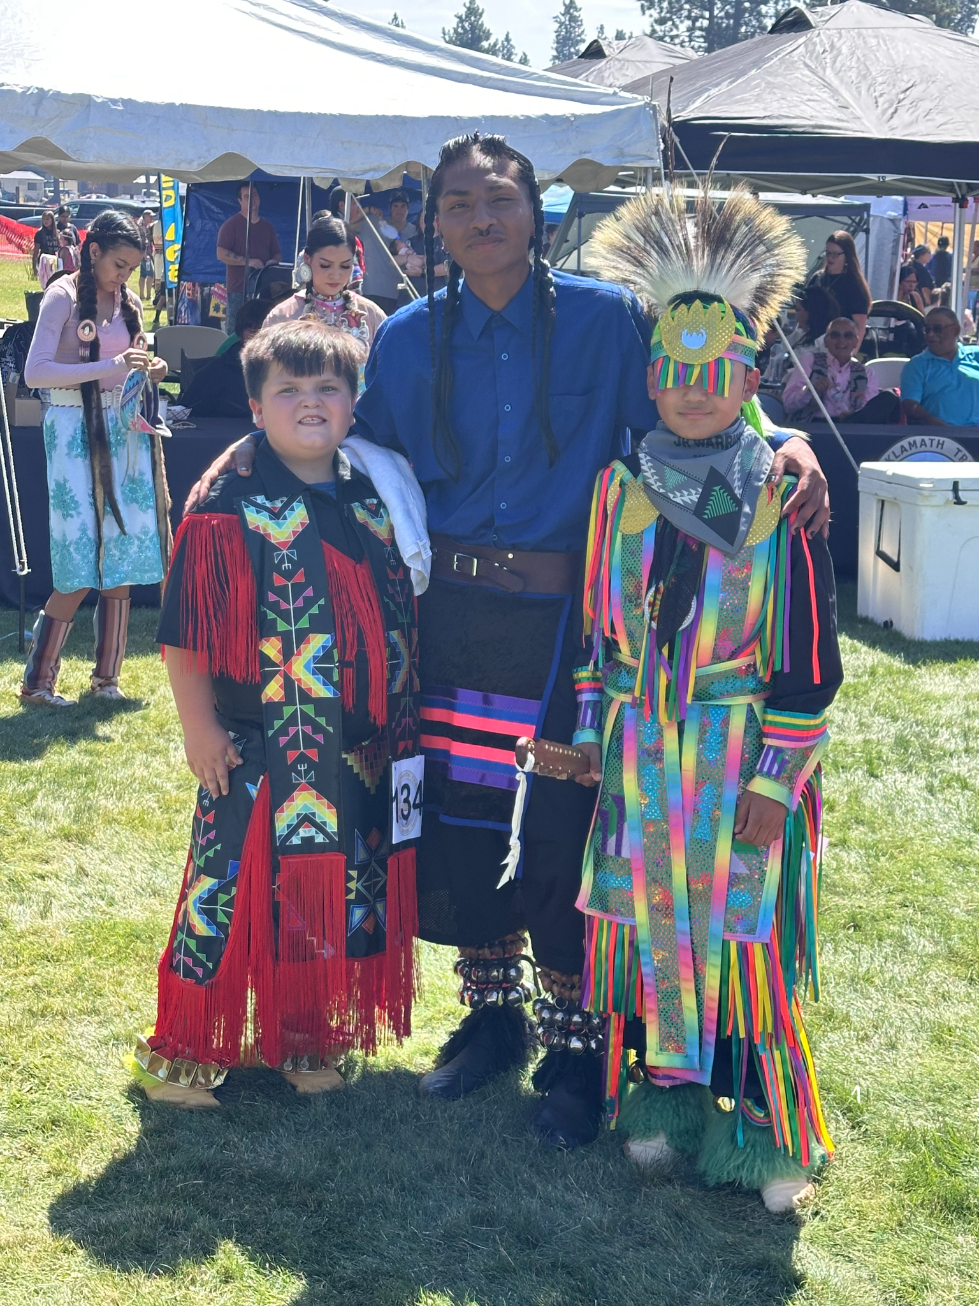
Reflection Question
The school year has begun. A new season of this work is upon us.
What is at the forefront of your mind?
What were the wealths of knowledge you learned last year that have impacted your first steps into the 2025-2026 school year?
Lastly, what might have you lost track of already that you know you need to re-prioritize with the site team immediately?
Write silently for 5 minutes. Spend time with each question. Then, we will share out as a whole group.

Slide 11

Shawn Wilson, author of Research is Ceremony, on relational accountability –
Interpreted quote -
The shared aspect of Indigenous [ways of being] and [knowing] is relationality — all things are related and therefore relevant. The shared aspect of an Indigenous value system and [how knowledge is taught] is accountability — to your relations.

Slide 12
Shawn Wilson, in Research is Ceremony, on our responsibility to future generations -
“When you accept relational accountability, every action you take becomes a ceremony — because you are mindful of its impact on all your relations, including those yet to come.”

Slide 13
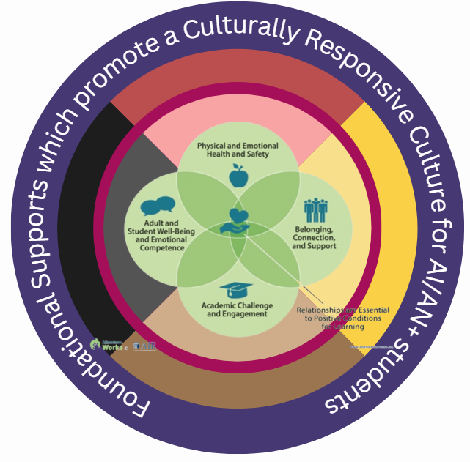
Foundational Conditions
These four foundational supports from Attendance Works must be in place to create positive conditions for any student to learn.
Physical and Emotional Health and Safety
Belonging Connection and Support
Academic Challenge and Engagement
Adult and Student Well-Being and Emotional Competence
When high levels of chronic absenteeism are present, it can indicate a deteorization of these foundational supports.
Reflection: In what ways does the learning about the foundational conditions relate to the previous two teachings on relational accountability?

Slide 14
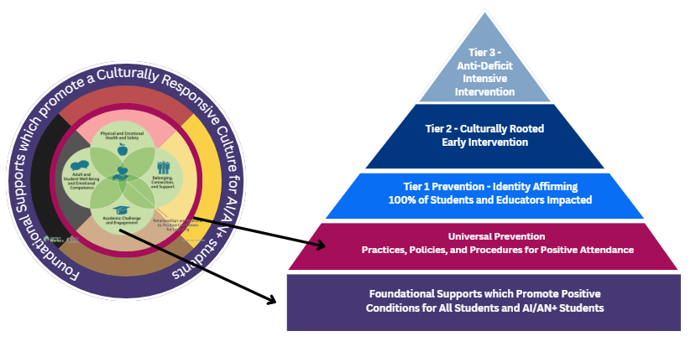
The fuchsia circle reminds us that we must tend to both the foundational supports and our practices, policies, and procedures or we risk perpetuating harm.

Slide 15

A key focus this school year will be to ensure we are developing and monitoring the effectiveness of our tiered supports in addressing the root causes of chronic absenteeism of AI/AN+ youth.
TAPP | Student Group | Student Count | Greater than 90% | 90%- 80% | 80% or less
Non TAPP | AIAN+ | 34681 | 58.4 | 24.8 | 16.8
TAPP | AIAN+ | 2377 | 54.4 | 27.7 | 17.8
Non TAPP | Total | 506263 | 66.8 | 21.7 | 11.5
TAPP | Total | 13592 | 56.3 | 25.8 | 18.0

Slide 16
ESSENTIAL QUESTION -
Is a Proposed Intervention Culturally Responsive?
Scholars such as Hammond (Culturally Responsive Teaching and the Brain) and Khalifa (Culturally Responsive School Leadership) argue that MTSS often fails to account for systemic racism unless it explicitly integrates:
Identity-affirming Tier 1 practices (e.g., relational trust, Native language, and land-based curriculum).
Culturally-rooted Tier 2 supports (e.g., family advocates, mentoring with elders).
Anti-deficit Tier 3 approaches that avoid pathologizing Native youth and instead address systemic barriers.

Slide 17
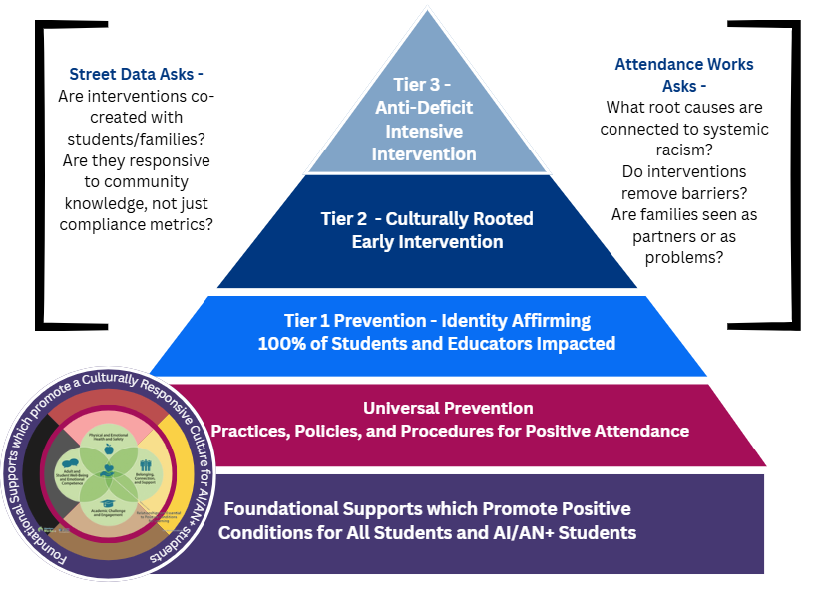
Notes:
Our tiered supports are created –
in response to student needs (Street Data)
in real-time and from knowledge learned from one another
are about affirming the truths of one another, and
growing toward futures of healing and thriving for our Native youth.

Slide 18
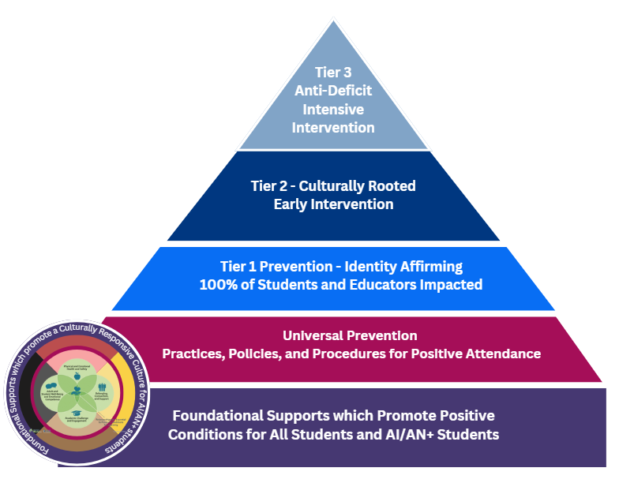
Snapshot of our Tiered Supports for Attendance
Let’s capture a snapshot of the Tiered Supports for Attendance currently in place at our most impacted school.
Go to this link in Canva.
Scroll until you find the page with the name of your school district.
Begin your silent work time.

Slide 19
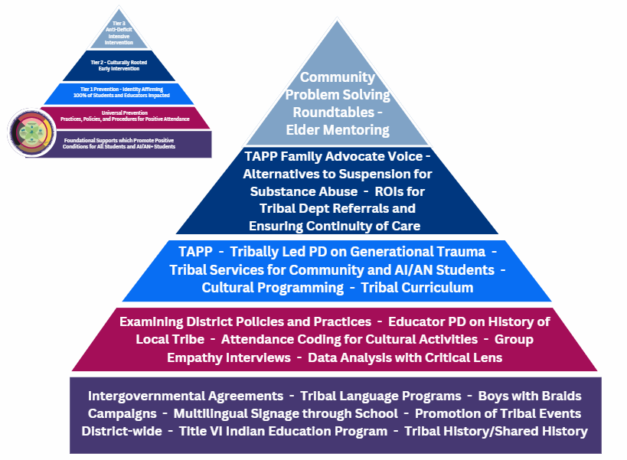

Slide 20
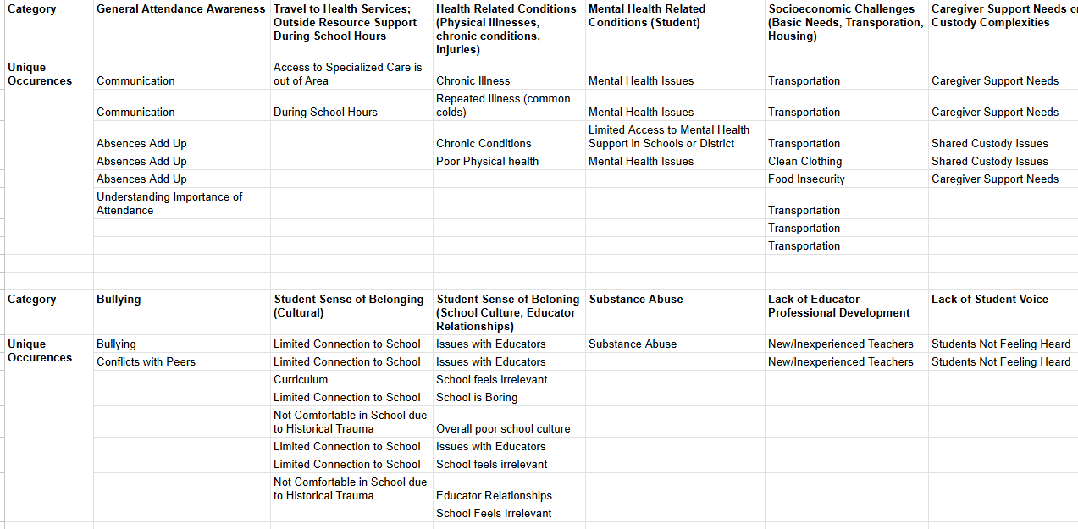
Snapshot of Root Causes from TAPP Final Reports
Next Month - We will workshop the build out of a tiered support for one of these areas.

Slide 21
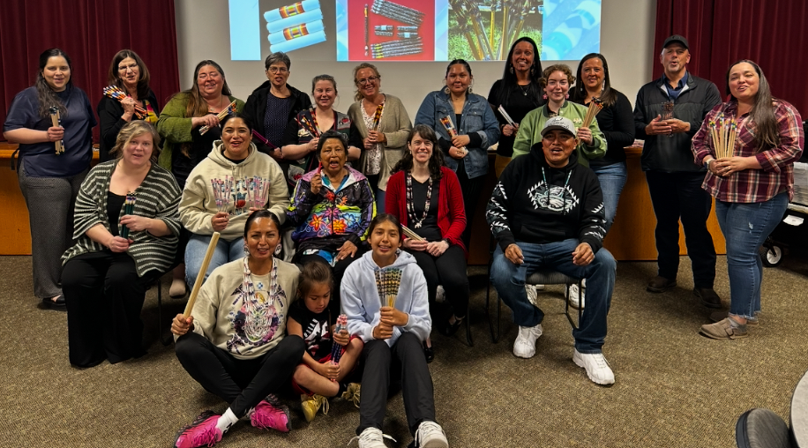
My Love Poem to You
“Ten districts, nine of them neighboring one of Oregon’s nine federally recognized tribes, receive a Tribal Attendance Promising Practices grant. These are not just “any” districts; together they serve 41% of the state’s American Indian/Alaska Native (AI/AN) students and do so in some of the most historically and politically complicated border-town contexts in the Pacific Northwest. Oregon, the so-called “end of the trail,” carries the layered weight of broken treaties, land theft, termination, and boarding school trauma—and yet, these districts, alongside their tribal partners, are showing what it takes to shift entire ecosystems for Native students. This work is not about checking boxes on attendance—it is about indigenizing public education systems and refusing to let colonial structures keep defining what school should mean for our youth. TAPP is about affirming truths, reconciling complex histories, and growing toward futures of healing and thriving for our Native youth.”
Share out on a mantra that will remind you of the power and gift of relational accountability you bring to this work.

Slide 22
Text Parrish anytime at 971-208-0270
Or - send me an email. Call if you must.
There is no such thing as, “I know you are busy”. I am here for you.

