Slide 1
TAPP Family Advocate Monthly Meeting
September 12, 2024 - 12:30-2:30PM
✅ Welcome! Please rename yourself by clicking on the three dots by your name and typing your preferred name, school district initials, and pronouns in the chat.
Materials Needed - Writing utensils, notebook, ambo (water), snacks, any other materials to help you feel comfortable

Slide 2
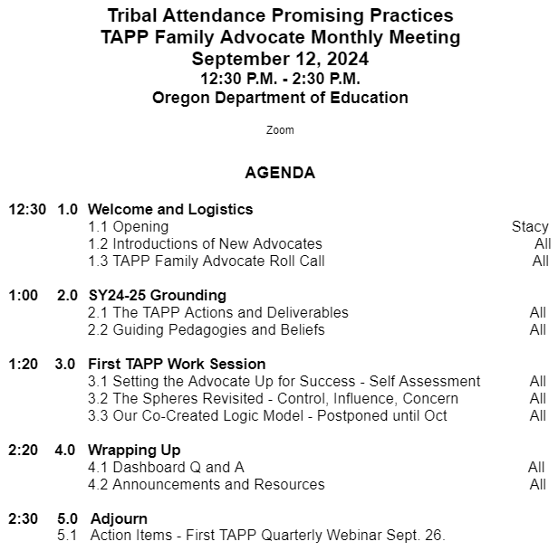

TAPP September Monthly Meeting Agenda

Slide 3

Welcoming our Newest TAPP Family Advocates
Crystal Hinds - Lincoln County School District - Toledo Elementary School and Siletz Valley Schools
RuthEllen Melton - North Bend School District - North Bay Elementary and Hillcrest Elementary School
Mona Smith - She is back, baby! - Salem-Keizer Public Schools - Scott Elementary School, Four Corners Elementary School, Waldo Middle School, and McKay High School

Slide 4
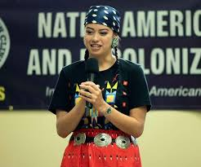
TAPP Family Advocate New School Year Check-In
Roll Call.
When called on, share your …
Name
Tribal Partner(s)
District and Grade Levels you directly serve as an advocate
Years in the position
Come to me if you want help with…

Slide 5
SY24-25 Grounding

Slide 6
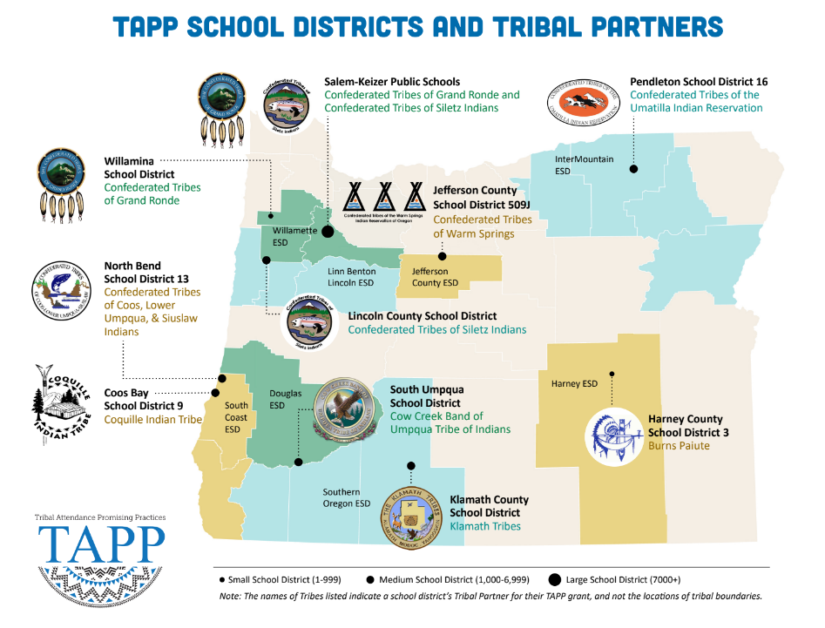
Mona Smith
Stacey Jacobs
[TBD]
Rebecca Arredondo
[TBD]
Atcitty Begay
[TBD]
[TBD]
RuthEllen Melton
Crystal Hinds
Bre Landrum
Vacancy
Scott Smyth
Janelle Emard
[TBD]
Notes:
Speak about the TAPP Expansion –
State AI/AN Total
State AI/AN+ total
Cost for 2025-2027 Biennium
2023-2024 Enrollment
5,638
38,556
Current % of Students Served by TAPP
41%
17%
—
Potential Served with Top Three Sites
49%%
27%
$595,151.76
Potential Served with 5% Expansion
58%
46%
$1,983,839.20
Potential Served with 9% Expansion
67%
62%
$3,570,910.56

Slide 7
The purpose of a district receiving a TAPP grant is to address the root causes of chronic absenteeism in American Indian and Alaska Native students. It is intentionally not to “improve or increase AI/AN attendance” for many reasons.
What might some of those reasons be?

Slide 8

“Improvement feels like we are tinkering around the edges of systemic realities that trace back to slavery, restrictive immigration laws, Native American genocide and dispossession, and centuries of exclusionary policy. We don’t need improvement. We need an approach that fundamentally and radically transforms the experiences of children and families at the margins.”
from Safir, Shane and Jamila Dugan. Street Data: A Next-Generation Model for Equity,
Pedagogy, and School Transformation. FIRST EDITION. Page 75
Notes:
Script: Read quote. Then, stamp that TAPP does that and even has the opportunity to do that because of the TAPP Family Advocate.

Slide 9
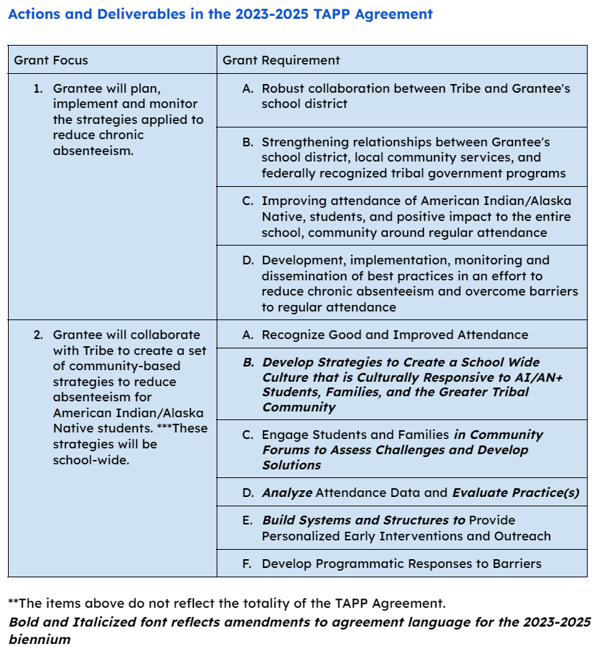
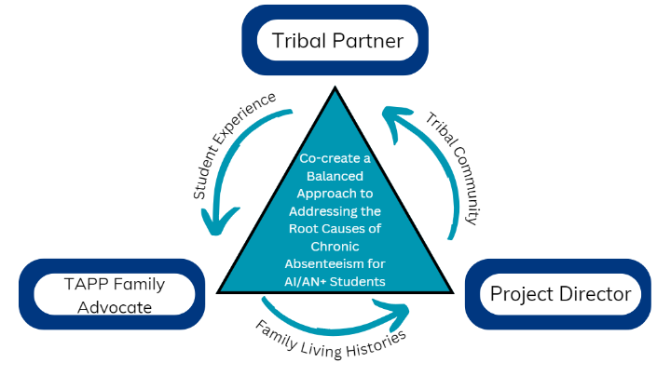

Slide 10
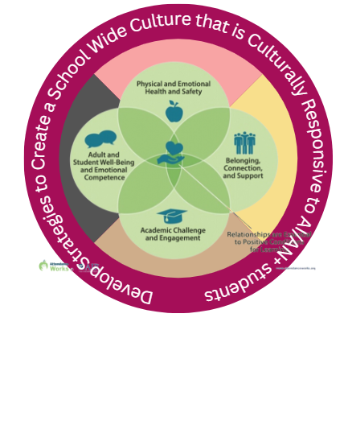

✔
✔
✔
✔
✔

Slide 11
TAPP Work Session
TAPP Best Practices - Launching Strong

Slide 12
During Our First Work Session Together…
First, we are going to engage in a Self-Assessment to determine to what extent you feel set up for success as an advocate as the school year has begun.
Then, we are going to revisit the spheres of control, influence, and concern from last year.
We will end with reflecting on areas of our Self-Assessment with the greatest need for improvement and which of those areas are within our control and which ones need our influence.
Notes:
The Spring TAPP Site Visits from last school year revealed two key areas of improvement for all TAPP sites.
Many TAPP Family Advocates are working in isolation, most in buildings without a structured attendance team or a tiered support team (or, they are not invited to join these teams). This limits their ability to build systems and structures to provide proactive interventions to students and to elevate barriers impacting AI/AN+ students to individuals with positional power and authority in the schools to address them.
Second, while TAPP Family Advocates are working diligently to support students and their families in attending school regularly, they are doing it in environments where the Tier 1 structures in a school require immediate (at times) and ongoing attention – a responsibility of building and district leaders. TAPP Family Advocates are in a unique position to “see” both the strengths of a school community and the gaps and deficits which greatly impact our Native youth. I challenge all of our Project Directors to listen-in to the experiences of our TAPP Family Advocates, because their knowledge and stories have the power to strengthen every system, structure, and educator in the buildings they serve – and beyond!

Slide 13
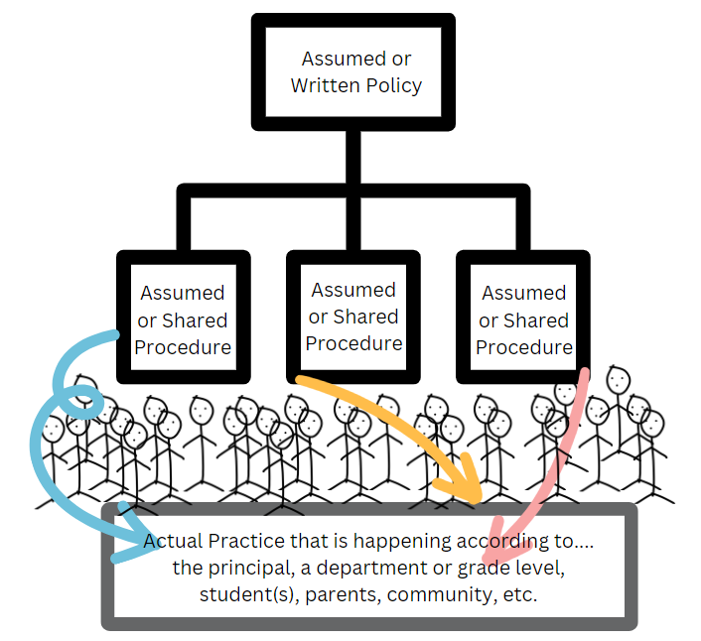
Individual Reflection -
Setting You Up for Success
Take the Self-Assessment
Advanced Reflection -
Consider your Self-Assessment from May/June.
To what extent have you launched this school year focused on the areas of improvement you previously identified?

Slide 14
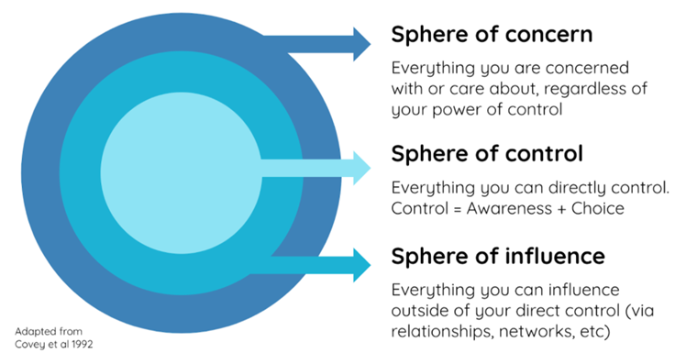
The Spheres Revisited
Sphere of Concern
This includes individuals in other departments or teams, systems we cannot affect, the weather, and politics as some examples.
Sphere of Control
The Sphere of Control is the smallest of the three and contains everything that we can have a direct impact upon.The Sphere of Control contains only what we think, what we say, and what we do.
Sphere of Influence
It contains all that we are able to affect but not directly control, including the actions of some people and systems you operate with. It is about using your position of authority to inspire passion and drive in others to achieve shared objectives and goals.

Slide 15
Our Respective TAPP Family Advocate Spheres
What is in this sphere for you right now related to the responsibilities of your position?

Slide 16
Our Respective TAPP Family Advocate Spheres
What is in this sphere for you that is critical you can influence in regards to the TAPP efforts?

Slide 17
Our Respective TAPP Family Advocate Spheres
What is in this sphere for you that is critical you can influence in regards to the TAPP efforts?
Notes:
Deficit thinking article - https://quod.lib.umich.edu/c/currents/17387731.0001.110/--what-is-deficit-thinking-an-analysis-of-conceptualizations?rgn=main;view=fulltext

Slide 18
The Self-Assessment and the Spheres
Reflection and Share Out -
Consider the areas you marked as “Urgent Gap” and “Don’t Know”. Share with the group which ones are within your control and which ones rely more greatly on your sphere of influence.

Slide 19
Developing our Advocate Logic Model
When we….
Names the Inputs (what the advocate invests in the TAPP program - funds, staff, time, partners, advocacy, allyship, etc, and…
Activities (what the program does for students, educators, schools, families, districts, etc) we ensure as advocates]
Then we will be able to…
Names the Outputs (direct results of advocate and program activities)
So that we…
Names the Outcomes (the lasting benefits realized in Native youth and our Districts serving them)
These should be initial, intermediate, and long-term, but they should also be ambitious.
Notes:
This is for us…to keep us grounded when everything get hard.

Slide 20
SY24-25 Launch - Dashboard Support -
Q and A

Slide 21
2024-2025 TAPP Districts’ Dashboard
Key Resources and Documents
2024-2025 TAPP Districts’ Dashboard
Dashboard Orientation Video - 11 minutes
TAPP Shared Folder
TAPP Program Promising and Best Practices – This document underwent a comprehensive revision this summer. It is important to revisit this document individually and as a team. There are four key sections to the document –
SECTION I. General TAPP Grant Execution - Lessons Learned
SECTION II. Setting the TAPP Family Advocate Up for Success NEW Advocate? START HERE!
SECTION III. Foundational Supports for AI/AN Students that Lead to Positive Conditions for Learning (Includes a self-assessment to utilize with school teams!)
SECTION IV. Culturally Responsive Tiered Attendance Systems (also includes a self-assessment to utilize with school teams!)

Slide 22



Announcements and Resources
September is Attendance Awareness Month for the State of Oregon
Check out ODE’s updated Every Day Matters page
From Beliefs to Action: Designing Culturally Responsive Systems - Recordings from the Webinar Series
Session 2: Foundations of Culturally Responsive & Sustaining Education
Session 3: Solving Disproportionality & Culturally Responsive Data Literacy
Session 4: From Awareness to Action: Equity Detours and the Equity Literacy Framework
SIGN UP FOR https://www.healthynativeyouth.org/

Slide 23
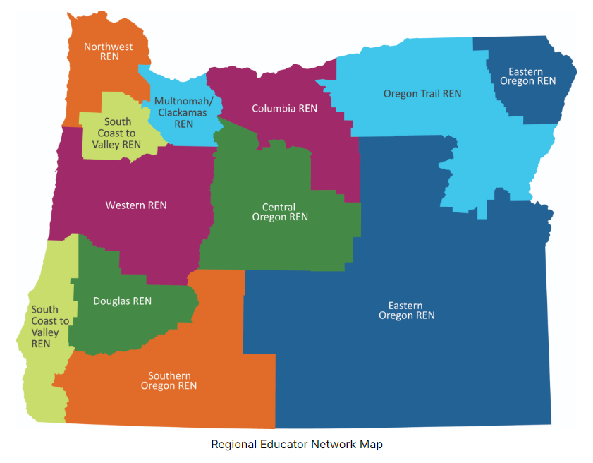
Regional Educator Networks
Use the links below to find updates, contact information, and news on each of the ten RENs:
Central Oregon REN (Crook, Deschutes, & Jefferson counties)
Columbia REN (Gilliam, Hood River, Sherman, Wasco, & Wheeler counties)
Douglas REN (Douglas County)
Eastern Oregon REN (Grant, Harney, Lake, Malheur, & Wallowa counties)
Multnomah-Clackamas REN (Multnomah & Clackamas counties)
Northwest REN (Clatsop, Columbia, Tillamook, & Washington counties)
Oregon Trail REN (Baker, Morrow, Umatilla, & Union counties)
South Coast to Valley REN (Coos, Curry, Marion, Polk, & Yamhill counties)
Southern Oregon REN (Jackson, Josephine, & Klamath counties)
Western REN (Benton, Lane, Lincoln, & Linn counties)

Slide 24



Share with your amazing Educators - https://outdoorlearning.com/workshops/

Slide 25

Registration is $140 or $70 for any Native educator - https://outdoorlearning.com/event/season-1-foundations-of-knowledge-usa/

Slide 26
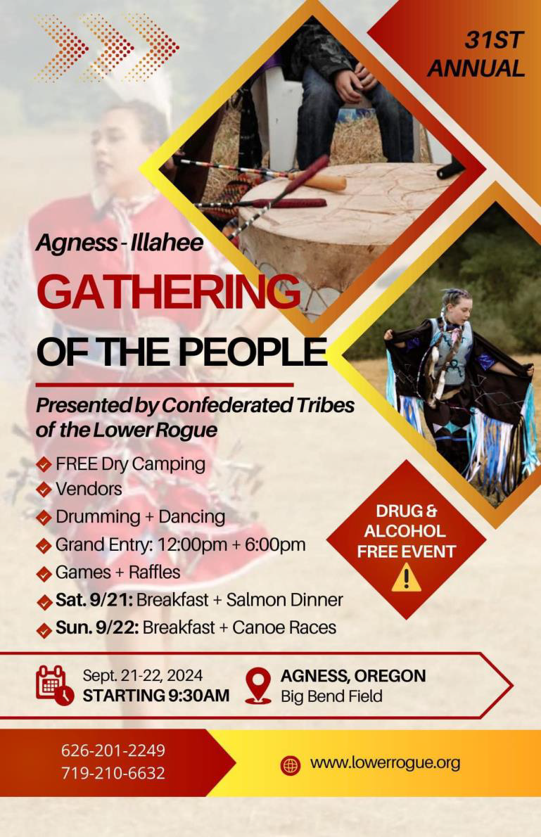


Slide 27


Slide 28
Text Parrish anytime at 971-208-0270
Or - send me an email. Call if you must.
There is no such thing as, “I know you are busy”. I am here for you.

