Slide 1


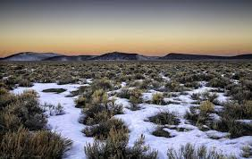


Oregon Title VI Community of Practice
Wednesday, December 18, 11AM-12PM
Rename your Zoom Name to your –
first and last name
name of district ,ESD, or Tribe, and
official role for Title VI - Project Coordinator, Authorized Official Representative, student liaison, etc.
pronouns

Slide 2

Introductions and Role
Oregon Office of Indian Education Title VI Lead -
Stacy Parrish, Education Program Specialist II, Proud Member of the Klamath Tribes (Yahooskin Paiute)
Everyone - Greet one another in your tribal language or in the language of the local tribe(s).
Then, Drop into the chat one of your favorite Winter activities you are looking forward to doing in the next couple of weeks OR what traditions do you engage in during this time?
Notes:
ALL

Slide 3
Reminder - A Challenge to You All –
Find ways to use your tribal language or the language of the local tribe in everyday conversation as much as you can.
Many of our ancestors only know the old language and using it – no matter our pronunciation or fluency – keeps them strong and able to hear us when we speak.

Slide 4
Today’s Agenda -
Community Building, Updates, and the Formula Grant Timeline
Integrated Guidance - Throwing Your Blanket Over a Chair; Save Your Spot at the Table for Integrated Guidance
The Elusive Native Student Count - AI/AN, AI/AN+, Tribally Affiliated, and More
Community of Practice Shared Folder - Update it Regularly and Contact List

Slide 5

Title VI Intro and Check In with Three Awardees
We heard from Coquille SD, Klamath County SD, David-Douglas, Willamette ESD, North Bend SD, and Lincoln County, Reynolds SD, Beaverton, and Coquille SD so far this year.
Let’s get to know three of you better…
If your district, consortium, or tribe has not already shared out, unmute and tell us your…
Name
Tribes you “Meaningfully Collaborate with” for Title VI
Your role with Title VI
Years in the role
Come to me if you want help with…

Slide 6
Quick Updates from the EASIE Website
Have a list of technical questions?
EASIE Title VI Office Hours with the US Department of Education -
These new technical assistance sessions, which are intended to allow prospective and current grantees to receive direct support from their assigned OIE Program Officer via breakout sessions during the event.
Register for all sessions in the series or select specific sessions to attend by completing the WebEx Registration Form.
First Application Window
EASIE PART 1 Opens February 3, 2025. It closes March 8 at 11:59ET.
Part I of the application consists of selecting the applicant type, entering the Indian and All student count and application cycle.
EASIE Part 1 Paper Document
EASIE Part 1 FAQs
EASIE ED 506 Form Webinar SY 2021-22
UPDATED: EASIE Part I Webinar FY 2024-25

Slide 7
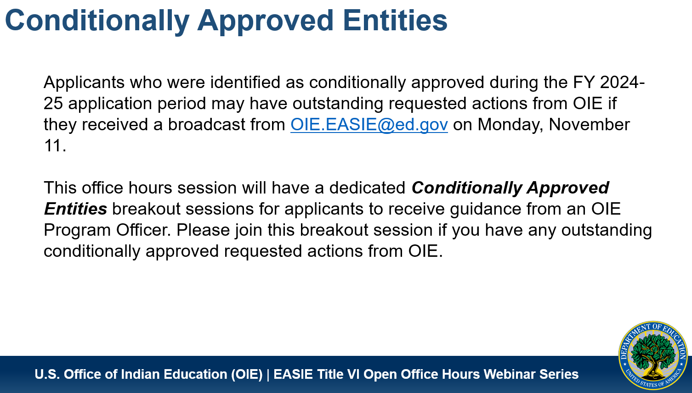
Quick Updates from the EASIE Website
PSC Phone Number Change -
The Partner Support Center phone number has changed. It is now - (866) 731-4711
EASIE Title VI Open Office Hours November 2024 –

Slide 8
Next Month – Looking Ahead
At the January 15, 2025 meeting, we will be talking about Phase 2 of ODE’s compliance to Section 7429 of the Title VI Indian Education legislation.
§7429. State educational agency review
Before submitting an application to the Secretary under section 7424 of this title, a local educational agency shall submit the application to the State educational agency, which may comment on such application. If the State educational agency comments on the application, the agency shall comment on all applications submitted by local educational agencies in the State and shall provide those comments to the respective local educational agencies, with an opportunity to respond.
Spring 2024 - Phase 1
Every LEA and LEA-C must provide a copy of their certified EASIE Part 2 application to the SEA.
Spring 2025 - Phase 2
Option 1- Submit application and seek comments prior to submission with opportunity to respond
Option 2 - Submit application without seeking comments prior to submission; comments are provided after the submission. LEAs and LEA-Cs may respond, but knowingly after-the-fact.

Slide 9
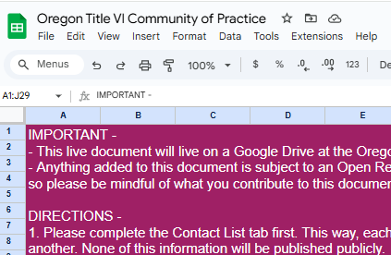
ODE Title VI Community of Practice Spreadsheet
ODE Title VI Community of Practice Spreadsheet
Peer Request –
In column B of the Contact List tab, please add in the name of your Title VI Indian Education program and drop in a screenshot of your logo if you have one.
Some programs are looking for inspiration for rebranding and revamping purposes!

Slide 10
General Formula Grant Timeline
To Do List -
✅ Save Your Spot - Integrated Guidance
✅ 506 Form collection process
✅ Indian Parent Committee Planning
-EASIE APR for FY 23-24 opened Sept. 9
-Indian Parent Committee Start of Year Outreach
-District and School-Wide Registration Norming - 506
-Native American Heritage Month
-Winter Solstice, Dec 21
-EASIE PART I Closes March 8
-Tribal Consultation window for Integrated Guidance Opens
-Public Hearing must be held before Part II closes
-EASIE PART II Submission Deadline May 9
SEPTEMBER
NOVEMBER/DECEMBER
MARCH
MAY
OCTOBER
JANUARY/FEBRUARY
APRIL
-EASIE APR for FY 23-24 closed October 11
-Indigenous Peoples Day, Monday Oct 14
-EASIE Part 1 Opens February 3rd
-EASIE PART II Application Available April 7
-Tribal Consultation closes April 30th for Integrated Guidance
This is a general visual of the Title VI school year timeline. All LEAs and LEA-Cs should adhere to all published DOE timelines to plan their efforts.

Slide 11
Integrated Guidance
Throw your Blanket Over a Chair; Save your Spot at the Table

Slide 12

Leveraging Title VI Efforts to Impact District Improvement
Integrated Guidance Window Opens March 1 and Closes April 30
“This guidance now integrates nine programs or initiatives. Bringing these programs together operationally creates significant opportunities to improve outcomes and learning conditions for students and educators. (7)
The headline is that students, communities, educators, school leaders, and postsecondary, business, and industry partners have the opportunity and responsibility to plan and integrate these programs and funding streams in a way that improves the well-being, health, climate, quality of instruction, and outcomes for each and every student in Oregon with dedicated attention to focal student groups. (8)”

Slide 13
Funding Amounts for Integrated Guidance
High School Success - $267M
Student Investment Account - $1.1B
Early Indicator and Intervention Systems - $3.8M
Early Literacy Success Grants - $90M
Career & Technical Education - $3.5M
Federal School Improvement - $22M

Slide 14
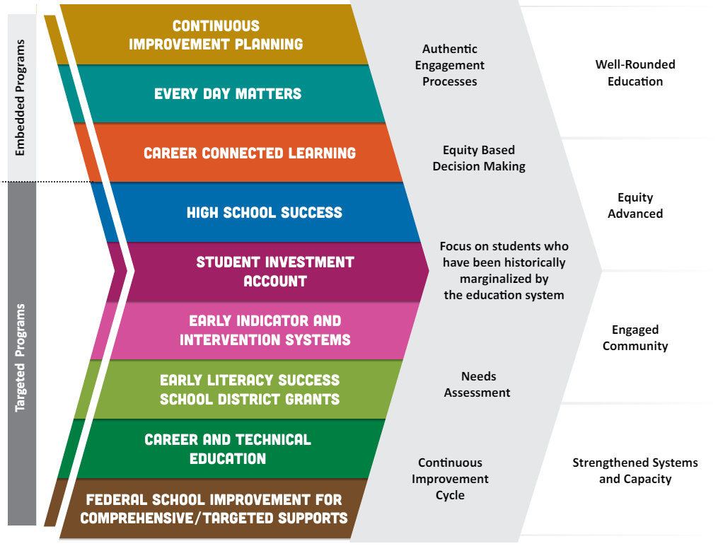
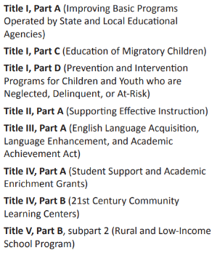
Title VI
Comprehensive Indian Education Program and Proposed Objectives
SEA-Administered Federal Title Programs:
Notes:
SAY -
Starting with the top – As recipients of a Title VI Indian Education formula grant, you now have received funds or the consortia has received funds on your behalf to create a comprehensive Indian Education program, which not only has three program requirements called out in the statute
1. to meet the unique educational and culturally related academic needs of Indian students, so that such students can meet the challenging State academic standards;
2. to ensure that Indian students gain knowledge and understanding of Native communities, languages, tribal histories, traditions, and cultures; and
3. to ensure that teachers, principals, other school leaders, and other staff who serve Indian students have the ability to provide culturally appropriate and effective instruction and supports to such students.
but you ALL have also identified proposed objectives being focused on throughout the cycle of the grant based on the specific needs of your AI/AN population. These objectives are those BIG GOALS you are striving toward in the administration of the grant; those are the BIG GOALS to which you backwards plan your comprehensive program.
However, everything your district does to methodically co-create with the community your district’s continuous improvement plan via the Integrated Guidance application - seen on the left here - also has significant impacts on your Title VI Indian Education program. It goes back to one of those three key messages above, in that AI/AN student success is not assured by merely having a Title VI program, it is done by design through thinking through where AI/AN students are represented throughout the planning process for your Integrated Plan in all of these embedded and targeted programs.
By now, all of your districts have submitted their budget narratives on how they are utilizing their SEA-Administered Federal Title funds to which many of our Native students also benefit.
1) how they are determining which schools are getting IA funds, why, and what type of program the school(s) will run.
2) data from any needs assessments done for the school(s) and district wide.
3) Their academic / SEL / behavioral goals for the school(s) and district and how they're going to support educators and students in achieving those goals.

Slide 15
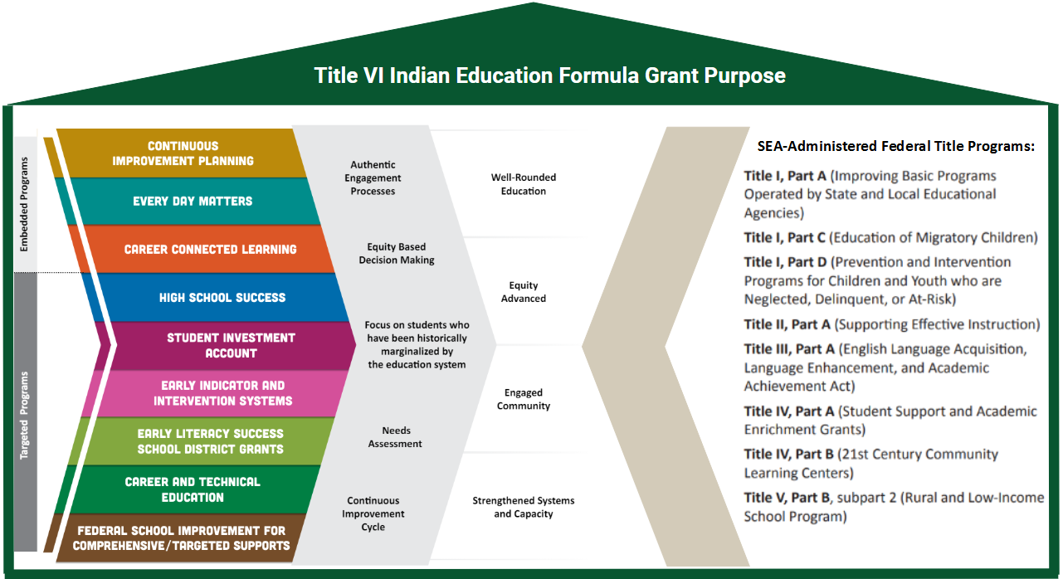
It is all connected. We are all connected.
Title VI Indian Education, SEC. 7421, PURPOSE
It is the purpose of this subpart to support the efforts of local educational agencies, Indian tribes and organizations, and other entities in developing elementary school and secondary school programs for Indian students that are designed to−
meet the unique cultural, language, and educational needs of such students; and
ensure that all students meet the challenging State academic standards.
Title VI Part A Indian Education Legislation

Slide 16
It is all connected. We are all connected.
Title VI Indian Education, SEC.7424, Assurances
(c) Assurances
Each application submitted under subsection (a) shall include assurances that—
(1) the local educational agency will use funds received under this subpart only to supplement the funds that, in the absence of the Federal funds made available under this subpart, such agency would make available for services described in this subsection, and not to supplant such funds;
(2) the local educational agency will prepare and submit to the Secretary such reports, in such form and containing such information, as the Secretary may require to—
(A) carry out the functions of the Secretary under this subpart;
(B) determine the extent to which activities carried out with funds provided to the local educational agency under this subpart are effective in improving the educational achievement of Indian students served by such agency, and meet program objectives and outcomes for activities under this subpart; and
(C) determine the extent to which such activities by the local educational agency address the unique cultural, language, and educational needs of Indian students;
(3) the program for which assistance is sought—
(A) is based on a comprehensive local assessment and prioritization of the unique educational and culturally related academic needs of the Indian students for whom the local educational agency is providing an education;
(B) will use the best available talents and resources, including individuals from the Indian community; and
(C) was developed by such agency in open consultation with parents of Indian children and teachers, representatives of Indian tribes on Indian lands located within 50 miles of any school that the agency will serve if such tribes have any children in such school, Indian organizations, and, if appropriate, Indian students from secondary schools, including through public hearings held by such agency to provide to the individuals described in this subparagraph a full opportunity to understand the program and to offer recommendations regarding the program;
…will use funds received under this subpart only to supplement the funds…not to supplant these funds
…effective in improving the educational achievement of Indian students served by such agency…
…is based on a comprehensive local assessment and prioritization of the unique educational and culturally related academic needs of the Indian students for whom the local educational agency is providing an education…

Slide 17
Ensuring the Voices of Tribes, Students, and Families are Heard
Awardees $40K or More
All LEA and LEA-C Title VI Awardees
As a state requirement, all affected school districts (those receiving $40K or more for their award, including those districts who are part of a consortium receiving $40K or more) must engage in Tribal Consultation with all local tribes prior to submitting their Integrated Guidance Plan.
Any district who receives a Title VI Indian Education Formula grant or any district who is a part of a consortium who receives the grant, should consider engaging in the Needs Assessment process with
the Indian Parent Committee
and/or with tribal students served by Title VI Indian Education
in order to listen intently with this high priority focal group in the district.

Slide 18
Ensuring the Voices of Tribes, Students, and Families are Heard
Reflection -
In what ways does your school district include Title VI families and students intentionally in their Integrated Guidance planning? OR
What are ways you can advocate for Title VI families and students to be intentionally included in creating this plan given your District’s context and your leadership style?
What additional training will your families and students need to prepare for these conversations to help inform a district’s Integrated Guidance application? (Resource: Appendix G and Appendix H, pages 122-136)

Slide 19
The Elusive Native Student Count
AI/AN, AI/AN+, Tribally Affiliated, and More

Slide 20

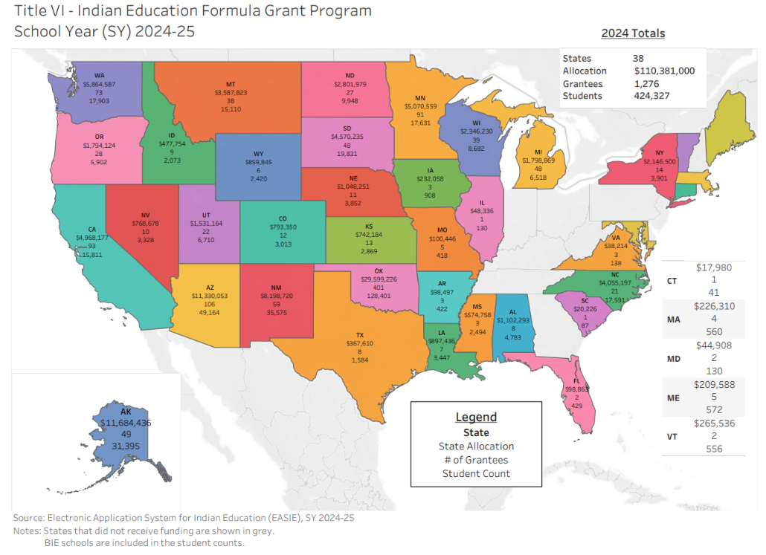
State of Oregon Student Data
6,150 AI/AN Students
Family or Guardian only selects AI/AN
40,943 AI/AN+ Diaspora
This number reflects all students identifying as AI/AN, plus one or more other races, and/or AI/AN and Latino/Hispanic ethnicity
5,902 Title VI Students
28 Awardees
1 Bureau of Indian Affairs program (Chemawa)
2 Tribal Programs - CTUIR and CTWS
3 Consortium Programs (Columbia Gorge ESD, Southern Oregon ESD, and Willamette ESD)
45 School Districts served by a Program
https://easie.communities.ed.gov/#program/additional-resources

Slide 21

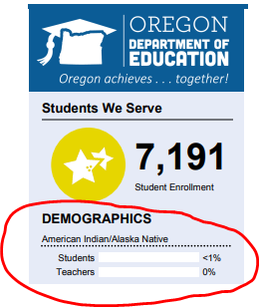
AI/AN
Federal Definition
A student identifies as American Indian/Alaska Native ONLY, and are non-Hispanic
Example:
This is the only data published in state accountability reports.
AI/AN+
State Subgroup
A student identifies as American Indian/Alaska Native and/or one or more other Races and/or Hispanic
Examples of How AI/AN Students are Hidden in the Data -
AI/AN and Black/African American = Multiracial by Federal reporting standards
AI/AN and Hispanic =
Hispanic by Federal reporting standards
This demographic data is only published in the statewide annual report card; it is not connected to any accountability data.
Tribally Affiliated (ODE’s Guidance)
New State Data Collection Requirement in SY24-25
A student identifies as being affiliated with a tribe through their own, their parent's or their grandparents enrollment in a federally recognized tribe.
May 2024 Memo
A family does not provide any documentation to verify their enrollment or descendancy. It is entirely self-reported.
506 Indian Student Eligibility Certification Form
US Department of Education Requirement
The official record of the eligibility determination for each individual student included in the student count for the Title VI Indian Education Formula Grant Program.
506 Form

Slide 22
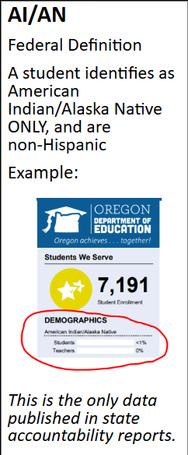
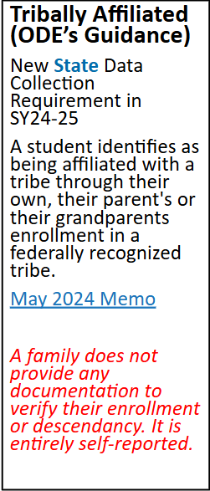

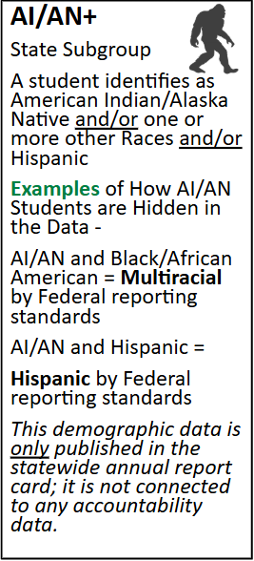
506 Indian Student Eligibility Certification Form
US Department of Education Requirement
The official record of the eligibility determination for each individual student included in the student count for the Title VI Indian Education Formula Grant Program.
506 Form
SUBMITTED DURING
Who are our eligible students?
ODE Help Guide for 506 Counts
EASIE PART 1 WINDOW

Slide 23
Community of Practice Shared Drive
Please bookmark the link to the folder dropped in the Chat. We will not be posting it here, because these slides are shared publicly.
Notes:
https://drive.google.com/drive/folders/13H1gX2FzA_edl5cKmGq0MyAiD30yhcGO?usp=drive_link

Slide 24
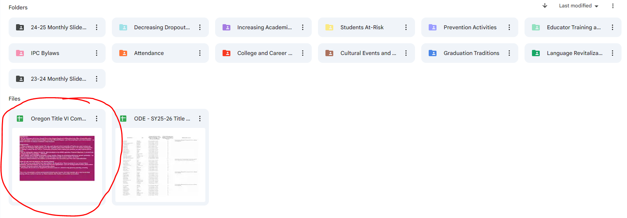
Step 1 - Open the circled document. Read the directions.
Step 2 - Fill out the Contact List first. This list is not public, but for internal use.
Step 3 - Contribute to the CoP tab as much or little as you like!

Slide 25
Contact Stacy Anytime
Stacy Parrish, Education Program Specialist II
Email - stacy.parrish@ode.oregon.gov
Book an Office Hours -
Book time with STACY PARRISH * ODE
Text/Call - 971-208-0270
I am available for things like…
Indian Parent Committee Training
“Advocating Up” Help
Data Analysis Work / Data Systems
ESD Consortium Support
Tribal Consultation and Improving Tribal Relations Help/Coaching

