Slide 1
EII - Tribal Consultation Annual Training
Presented by Stacy Parrish, Indian Education Specialist
Member of the Klamath Tribes (Yahooskin Paiute)
A copy of this slidedeck will be provided at the conclusion of this presentation.

Slide 2

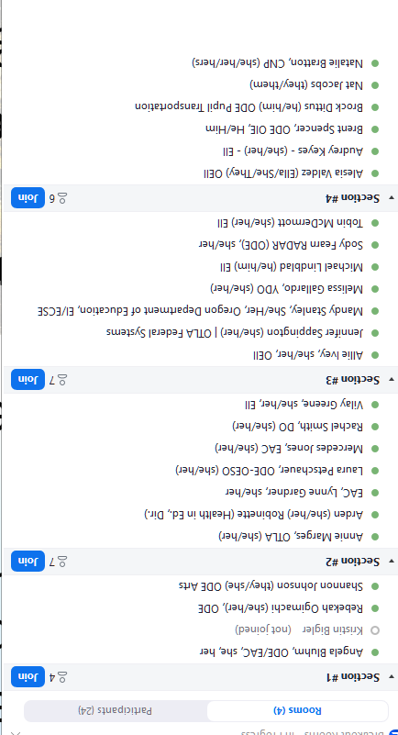
Learning Arc for Our Time
This session will –
Share out a refresher on Tribal Consultation between LEAs, LEA-Cs, and tribes
Provide information on when Tribal Consultation intersects with the work of EII
Highlight key sections of the Tribal Consultation Toolkit 2.1 most related to your work
As you engage in this training, determine your role in EII regarding Tribal Consultation – direct or indirect. Every ODE staff member has a role in supporting consultation.
Notes:
Resource: ODE Tribal Consultation Website - https://www.oregon.gov/ode/students-and-family/equity/NativeAmericanEducation/Pages/Tribal-Consultation.aspx

Slide 3
Key Terms to Track
LEA - Local Education Agency (i.e. School District)
LEA-C - Local Education Agency Consortium
In Oregon, this refers to an Education Service District who is the lead for a Title VI Indian Education consortium formula grant application. Any school district with at least 10 tribally affiliated students may join the consortium.
Southern Oregon ESD, Columbia Gorge ESD, and Willamette ESD are all LEA-C’s in Oregon for SY24-25.
Affected LEAs and LEA-C
A term from the US Department of Education which identifies -
LEAs or LEA-Cs that receive >$40K for their Title VI Indian Education formula grant, including school districts who are members of a consortium that receives >$40K for their formula grant, or
Districts with an AI/AN+ population of 50% or more are also considered

Slide 4
Refresher
Tribal Consultation Between LEAs, LEA-Cs, and Federally Recognized Tribes

Slide 5


Two Types of Consultation
“Little c” Consultation
Colloquially, this refers to Tribal Consultation efforts between LEAs and LEA-Cs and one or more federally recognized tribes. In our state’s context, this includes:
the the nine federally recognized tribes of Oregon, and
the Confederated Tribes and Bands of the Yakama Nation in Washington and the Tolowa Dee-Ni’ Nation in California.
LEAs and LEA-C’s determine who they consult with by identifying all tribes with a tribal reservation boundary, Indian Lands, ceded, unceded, and aboriginal lands located within 50 miles of the LEA or LEA-C.
“Big C” Consultation
Colloquially, this refers to Tribal Consultation efforts between the nine federally recognized tribes of Oregon and another state agency. It occurs when an action impacts tribal interests.
An “action” can include, but is not limited to the following ODE actions related to ODE programs:
a. Regulations or rules
b. Legislative proposals
c. Policies, guidance documents, directives, initiatives, or other policy statements.
Resource: Heart and Spirit of Tribal Consultation video

Slide 6
ODE Tribal Consultation History
2017 - The Tribal Consultation federal requirement under ESEA began during FY 2017 aligned to Title VI formula grant funding for the 2017-2018 school year.
2018 - ODE Launches Tribal Consultation Toolkit 1.0. This was guidance in effect until Fall of 2023.
November 1, 2023 - ODE Launched the Revised Tribal Consultation Toolkit 2.0
Symbolically coincided with Native American Heritage Month
OIE created a new Tribal Consultation website
Internal and External Trainings Commenced
Open Office Hours and Dept trainings by request
Title VI Awardees, Tribal Education Directors, and led presentations at COSA and OSBA
June 2024 - ODE Launched an Updated Tribal Consultation Toolkit 2.1 (to include Integrated Guidance)
December 2024 - On Demand Tribal Consultation Modules launched in Canvas via PDNetworks; a GovDelivery was sent to LEA and ESD Superintendents and Charter School Leaders

Slide 7
What are the Requirements?
Consultation requirements under section 8538 of the ESEA, as amended by ESSA, require affected local education agencies (LEAs) to consult with Indian tribes, or those tribal organizations approved by the tribes located in the area served by the LEA, prior to submitting a plan or application for covered programs. This requirement is designed “to ensure timely and meaningful consultation on issues affecting American Indian and Alaska Native students.”
Affected LEA Criteria:
Title VI Indian Education Formula Grant was >$40K in previous fiscal year, including LEA-Cs and LEAs who are members of a consortium who received >$40K | Has 50% or more of its student enrollment made up of AI/AN+*
Required Plans or Applications:
Title VI Part A Formula Grant (Completed Annually in Spring) | Application for SEA-Administered Covered Programs (Annually, Due Oct. 1) *Any grant disbursed with Federal funding also requires Tribal Consultation. | SEA Application Integrated Guidance (Spring, every odd year) A state requirement
Impacts LEAs and LEA-C’s | Impacts LEAs and LEA-C’s | Impacts LEAs ONLY
US Department of Education | Oregon Department of Education | Oregon Department of Education

Slide 8
SY25-26 Affected School Districts*
Title VI Awardee Name | Title VI 24/25 Allocation
Ashland - SOESD | Based on LEA-C - $81,309.00
Beaverton SD | $41,950.00
Central Point 6 - SOESD | Based on LEA-C - $81,309.00
Eagle Point School District 9 - SOESD | Based on LEA-C - $81,309.00
Eugene School District-4J | $230,424.00
Grants Pass 7 School District - SOESD | Based on LEA-C - $81,309.00
Hillsboro SD | $41,039.00
Klamath County School District | $125,632.00
Klamath Falls City Schools | $51,368.00
Lincoln County School DIstrict | $122,697.00
Medford 549C School District - SOESD | Based on LEA-C - $81,309.00
Multnomah School District No. 1 | $143,538.00
Phoenix-Talent 4 School District - SOESD | Based on LEA-C - $81,309.00
Rogue River 35 School District - SOESD | Based on LEA-C - $81,309.00
Salem Keizer Public Schools | $191,090.00
Springfield School District | $49,020.00
Three Rivers/Josephine County - SOESD | Based on LEA-C - $81,309.00
Willamina School District 30 J | $69,567.00
Important -
LEAs required to engage in Tribal Consultation for SY25-26 will differ from those who were required to engage for SY24-25. This is because it is based on an awardee’s Title VI award amount for the previous fiscal year.
*Affected Consortiums are not included in this list, because they do not completed an Integrated Guidance application.

Slide 9
Unpacking the Term “Indian Tribes”
Consultation requirements under section 8538 of the ESEA, as amended by ESSA, require affected local education agencies (LEAs) to consult with Indian tribes, or those tribal organizations approved by the tribes located in the area served by the LEA, prior to submitting a plan or application for covered programs. This requirement is designed “to ensure timely and meaningful consultation on issues affecting American Indian and Alaska Native students.”
Definition -
Is a federally recognized tribe that has a tribal reservation boundary, Indian Lands, ceded, unceded, and aboriginal lands within 50 miles of the LEA or LEA-C. Consultation does not include state recognized tribes; Oregon has no state recognized tribes.
Important Note -
An affected LEA should conduct Tribal Consultations with each tribe that has a tribal reservation boundary, Indian Lands, ceded, unceded, and/or aboriginal lands within 50 miles of each LEA, LEA-C, and LEAs who are members of an affected consortium.

Slide 10
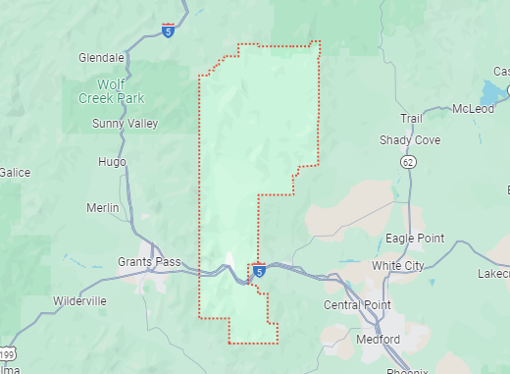
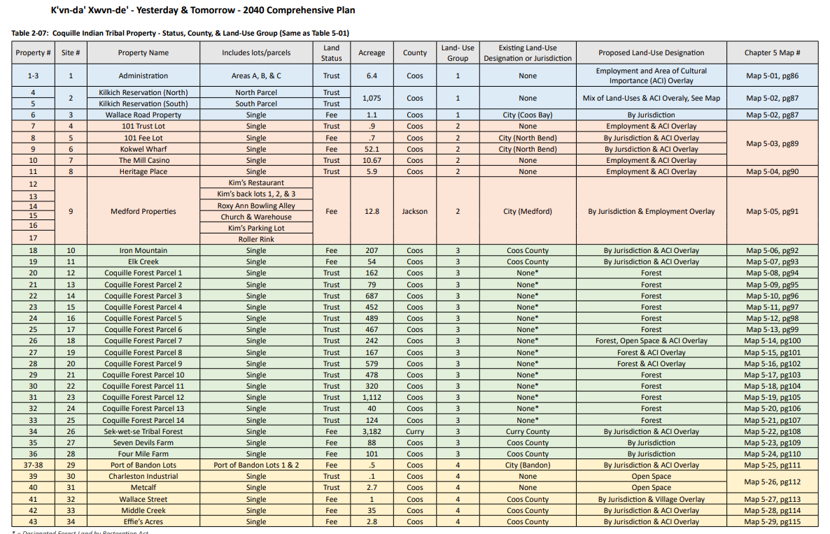
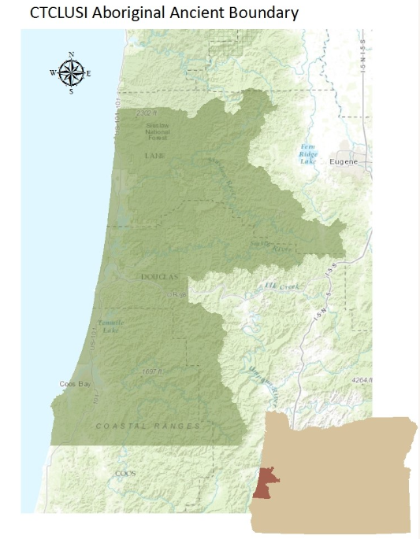
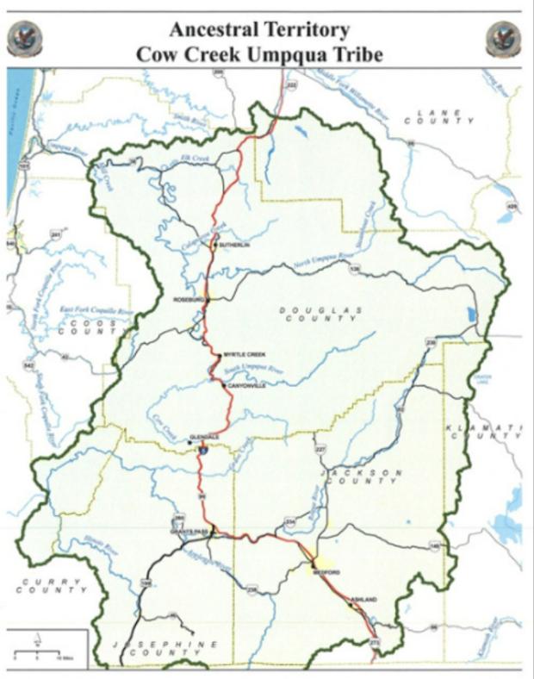
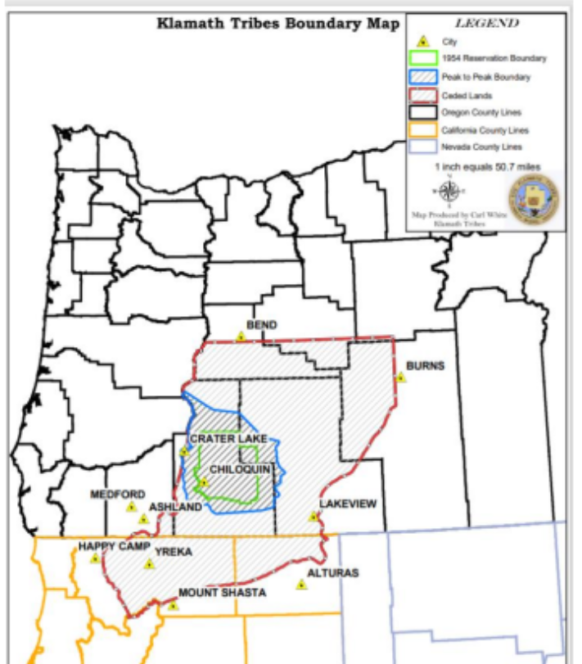
Example: Rogue River SD - member of the Southern Oregon ESD Consortium District
Screenshot of Coquille Indian Tribe land holdings
Confederated Tribes of Coos, Lower Umpqua and Siuslaw Indians map
Cow Creek Band of Umpqua Tribe of Indians
Klamath Tribes

Slide 11
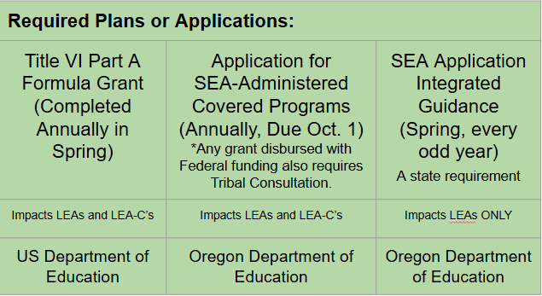
Who Leads Consultation Efforts in an LEA?
For Every Plan- District Superintendent or other District Leadership
Key Support Staff: Title VI Coordinator or Federal Title Staff
Key Support Staff: Federal Title Staff
Key Support Staff: Numerous

Slide 12

Checking In
Share out a refresher on Tribal Consultation between LEAs, LEA-Cs, and tribes
✔ What is the requirement
✔ Who must engage in tribal consultation
✔ What plan and applications are impacted
✔ Who leads consultation in an LEA
Provide information on when Tribal Consultation intersects with the work of EII
Highlight key sections of Tribal Consultation Toolkit 2.1 most related to your work
Notes:
Resource: ODE Tribal Consultation Website - https://www.oregon.gov/ode/students-and-family/equity/NativeAmericanEducation/Pages/Tribal-Consultation.aspx

Slide 13
Tribal Consultation and the Work of EII
Integrated Guidance: Aligning for Student Success

Slide 14
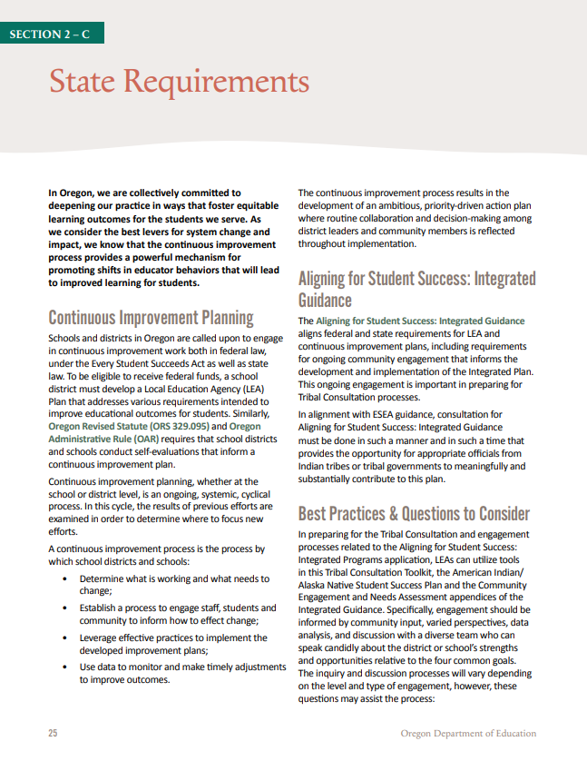
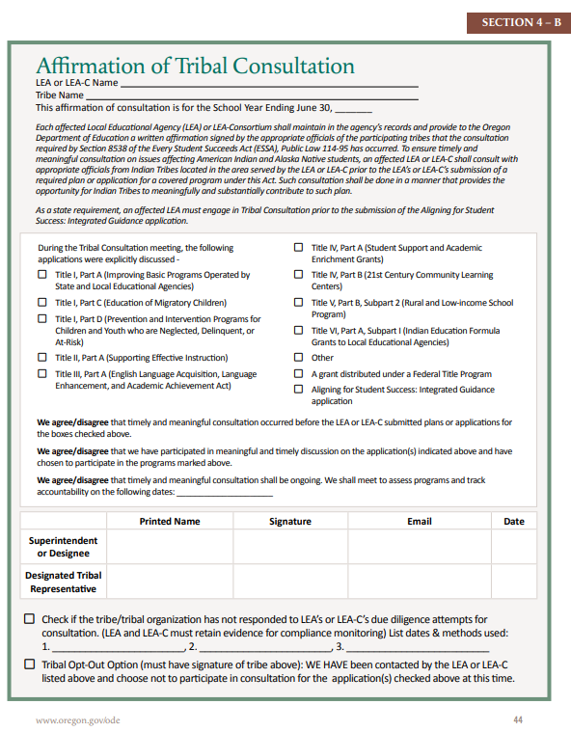
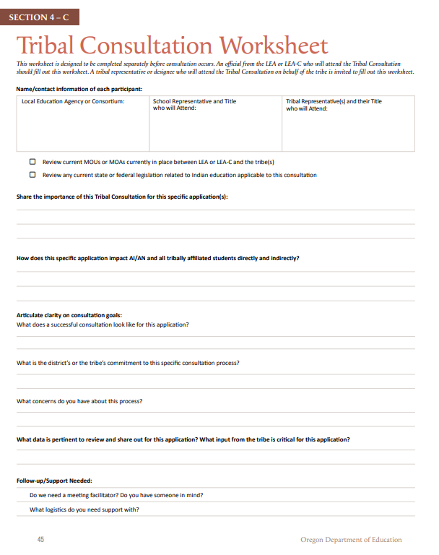
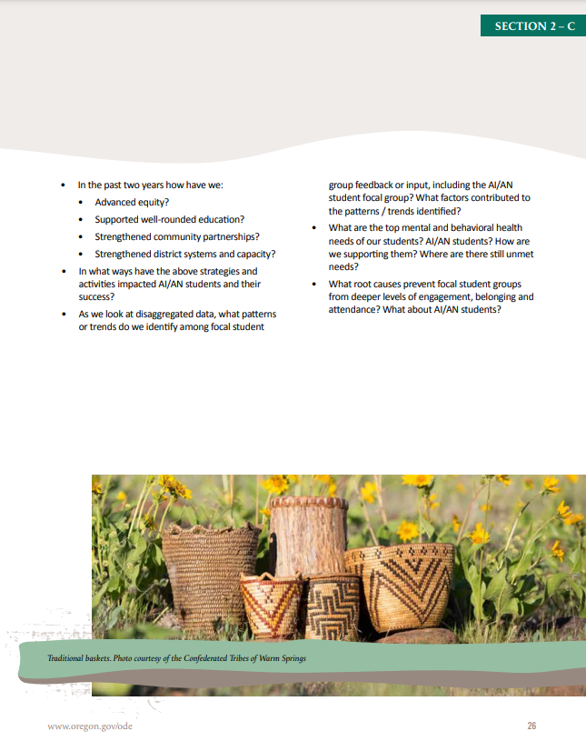
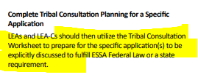
Example of Consultation in Practice - EII
Upcoming Window - Integrated Guidance - March 1, 2025 to April 30, 2025
Upcoming - EII will be tracking all affected LEAs to make sure EACH entity is submitting the required documents for all local tribes in their area under the 50 mile rule. Only after the documents have been verified can an LEA have an approved application and receive their full funding.
SEA Application Integrated Guidance (Spring, every odd year) A state requirement
Impacts LEAs ONLY
Oregon Department of Education
Affirmation of Tribal Consultation p. 44
Tribal Consultation Worksheet p. 45

Slide 15
EII Responsibilities - Overview
Designated Staff from EII will -
Utilize the SY25-26 Template to track Affirmations of Tribal Consultation and the Tribal Consultation Worksheets in Smartsheet (highly recommended). Affirmations of TC can be submitted to reflect -
Completed Tribal Consultation
A Tribe Opted Out (p. 43, FAQ #12)
A Tribe was unresponsive to LEA communication
Use the provided Internal Guide for Supporting Tribal Consultation Efforts as a Lead Department for -
Communication to LEAs Before, During, and After the window
Reviewing Affirmations of Tribal Consultation
Upcoming - EII will be tracking all affected LEAs to make sure EACH entity is submitting the required documents for all local tribes in their area under the 50 mile rule. Only after the documents have been verified can an LEA have an approved application and receive their full funding.
Affirmation of Tribal Consultation p. 44
Tribal Consultation Worksheet p. 45

Slide 16
How are LEAs and LEA-Cs Supported with Consultation for Integrated Guidance?

Slide 17
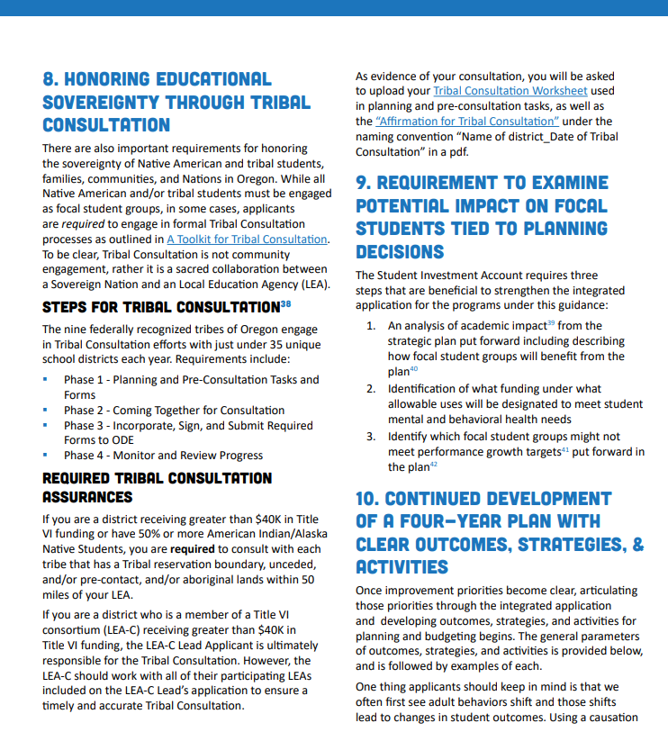

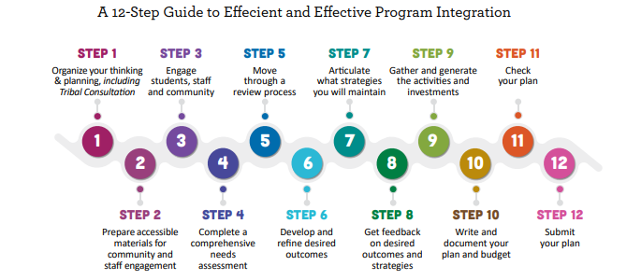
How are LEAs and LEA-Cs Supported with Consultation for Integrated Guidance?
Integrated Guidance Update p. 14
Integrated Guidance Update p. 29

Slide 18
How are Tribes Supported with Consultation for Integrated Guidance?
Previous -
June Tribal training on toolkit 2.1 updates
Upcoming -
December 16 from 3-4PM
Training for Tribal Education Directors and Tribal Representatives led by EII
Ongoing -
Quarterly Government-to-Government Education Cluster

Slide 19

How are LEAs and LEA-Cs Supported in Consultation?
Toolkit Version 2.1
History of Native Education
Federal Requirements for Tribal Consultation
State Requirements
The Four Phases of Tribal Consultation
Required Documents to verify Tribal Consultation occurred successfully
Office of Indian Education Trainings
July District Leaders training
Technical Assistance/ Regular Office Hours
NEW!!! On-Demand Tribal Consultation Modules
In partnership with Southern Oregon ESD, anyone can take up to five tribal consultation modules through PDNetworks.

Slide 20
ODE - Your Role in This Work
The Historical Significance of Tribal Consultation
The Bigger Picture
In exchange for their Land, the Federal government promised tribes they would ensure Native American students received a high quality education in perpetuity - forever.
An LEA or LEA-C receiving Federal funds for the education of Indian children are a part of this trust treaty responsibility of ensuring Native students receive that high quality education. Consultation with Sovereign Nations helps to ensure that.
Allyship - “To Be in Relations”
This isn’t an ODE Office of Indian Education “thing” - it is a federal requirement.
Consistent Messaging on the Requirements for Tribal Consultation from all ODE Departments
Include information it in 100% of general information regarding the Integrated Guidance application
EII applicable websites
Training Slide decks
GovDelivery Blasts
Always link to our Tribal Consultation webpage instead of linking it to the Toolkit

Slide 21
ODE - Your Role in This Work
Shared Understanding
While the toolkit and the requirements might convey this is largely technical, this work is relational and complex.
Understand the impact of deferring to OIE first on general requirements; please take the lead!
Be an ally to OIE, Sovereign Nations, and Native students – address microaggressions when they arise - such as:
LEAs continuing to mispronounce or not learn the names of the local tribes
Allowing debates on whether consultation “matters”
Denying the importance of consultation because “only 1% of our District is AI/AN”
Making generalities or reinforcing stereotypes on Native students or tribal communities
As an Organization with an Equity Stance - Expanding Your Learning is a Requirement
Read books – use search engines to find quality book lists on the topic of Native American history
Read everything you can on tribal websites
Watch documentaries and informational videos produced by reputable sources and the tribes themselves.
Instead of saying, “I never learned that in school,” say “I was taught a one-sided account of US History which erased and also misrepresented the impacts of settler colonialism on Native American tribes and the people who have been here since time immemorial. Because of that, I am unlearning and relearning the accurate history of what happened by __________ and _________. I am also keeping up with the contemporary issues tribes face by _______.

Slide 22


Tribal Consultation Website
Visit our Website for -
Current and upcoming Tribal Consultation windows
Link to Register for the Tribal Consultation modules
The Updated Tribal Consultation Toolkit 2.1
List of Affected LEAs and LEA-Cs
Detailed Title VI Awardee Spreadsheet
Updated PDFs required for Tribal Consultation -
Affirmation of Tribal Consultation
Tribal Consultation Worksheet
Alignment Rubric (for Covered Programs)
Links to past trainings

Slide 23
Review Key Updates in Version 2.1 and FAQs
Version 2.1 and all Supporting Documents Replaces all Previous Versions of the Toolkit.

Slide 24
Key Updates in Version 2.1
Version 2.1 is live on our Tribal Consultation webpage.
Subtitle changed from “Support” to “Honor”
Consortium language has been incorporated throughout the entire toolkit
LINK to version 2.1

Slide 25
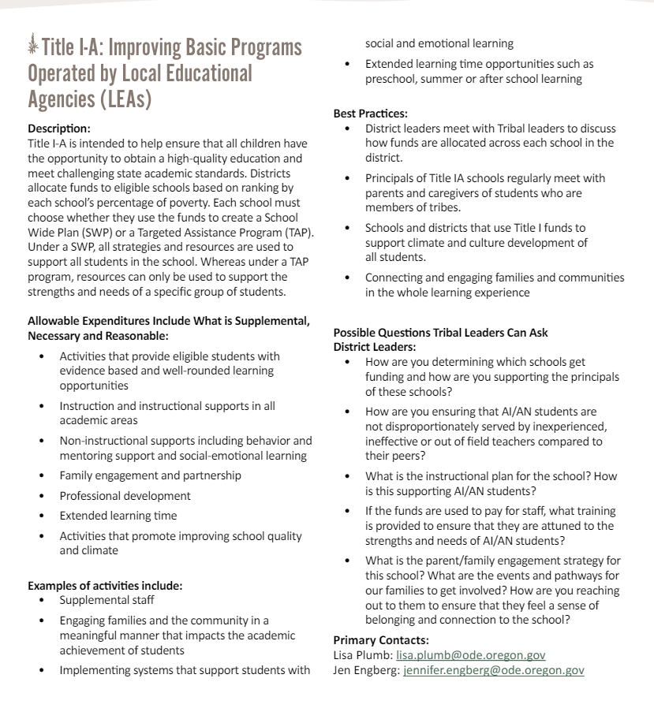
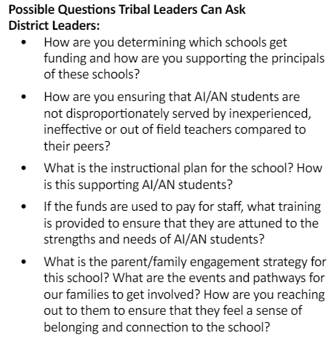
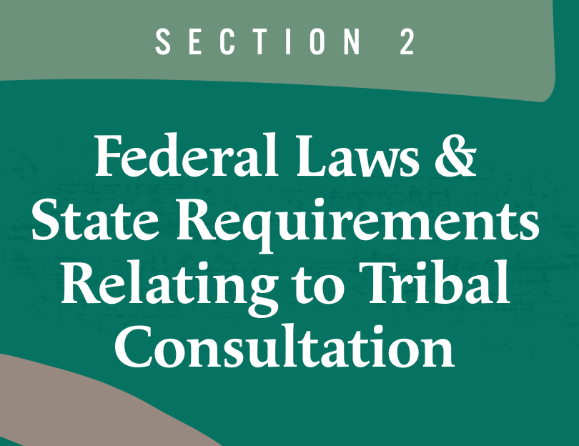
“Possible Questions” have been added throughout pgs. 15-24

Slide 26
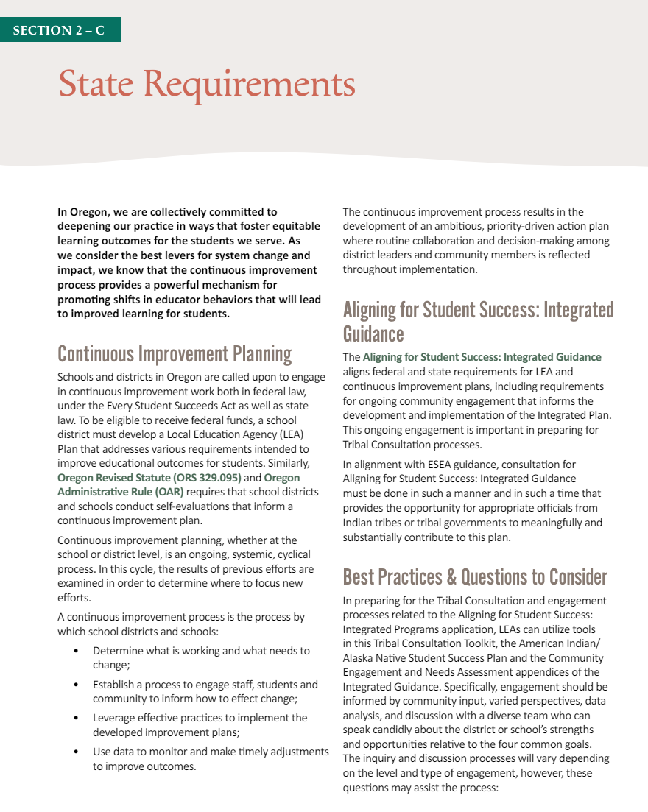
NEW Section - pgs 25-26
Calls out the Integrated Guidance requirement in a dedicated section vs. an obscure text
Draws attention to the law - purpose and scope of Integrated Guidance
Names the AI/AN Student Success Plan specifically, and how LEAs are attending to the needs of Native students
Reiterates the importance of Community Engagement with the AI/AN focal group - students, families, and communities

Slide 27
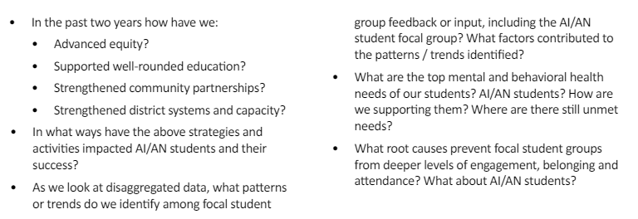

Provides Questions to Support Tribes

Slide 28
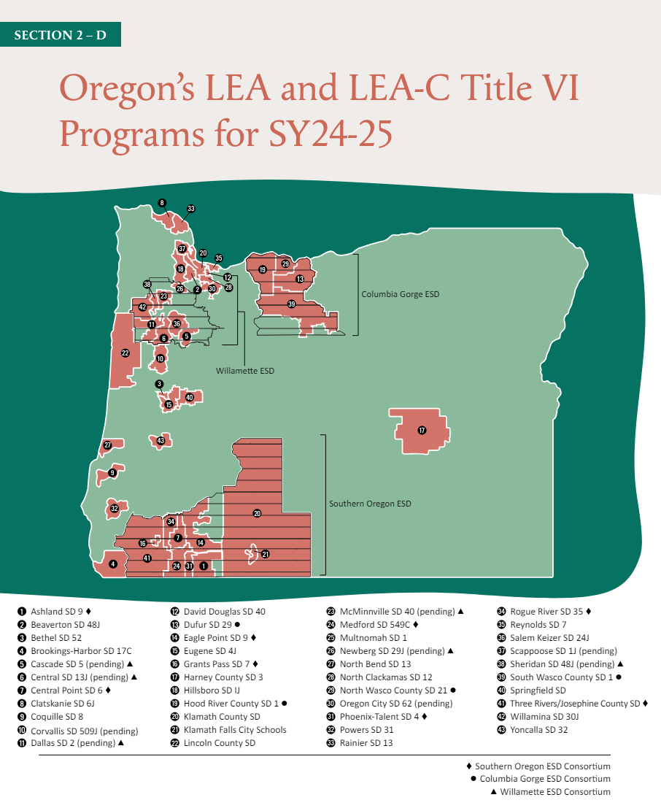
Updated Map for Title VI Programs – page 27
Many applications were still in “pending” status at the time of publication.
Since then the following have approved applications for SY24-25 –
Corvallis SD
Scappoose
Willamette ESD
Cascade SD
Central SD
Dallas SD
McMinnville SD
Newberg SD
Sheridan SD

Slide 29
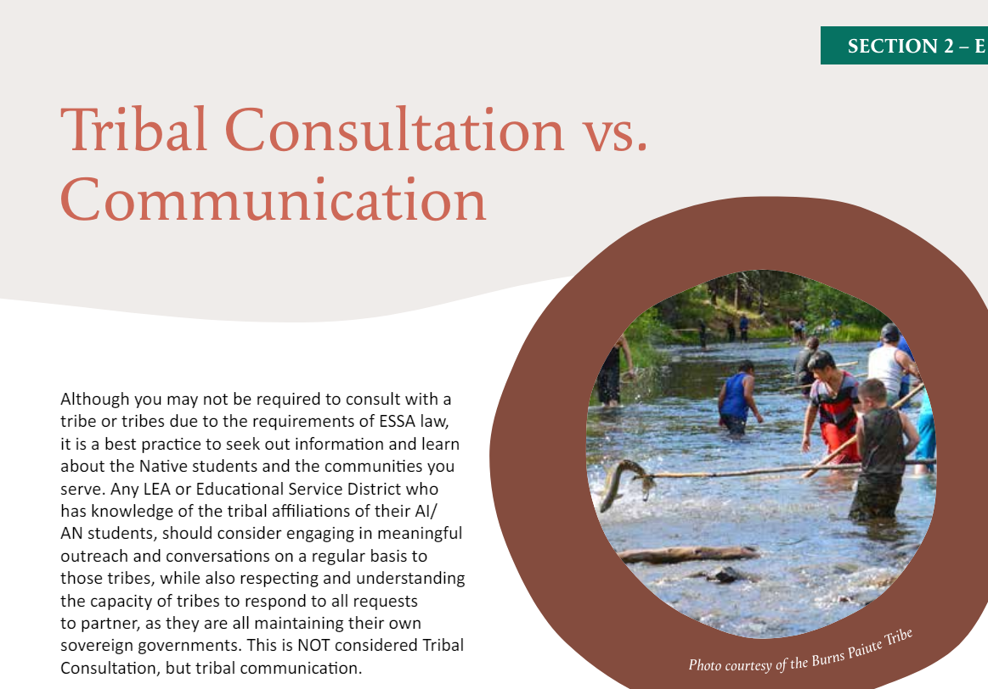
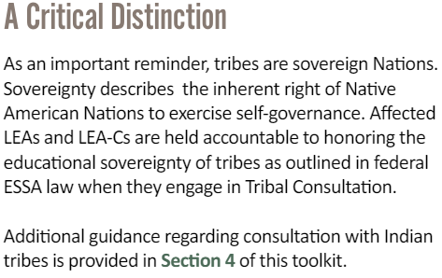
Updated Section - p. 28

Slide 30
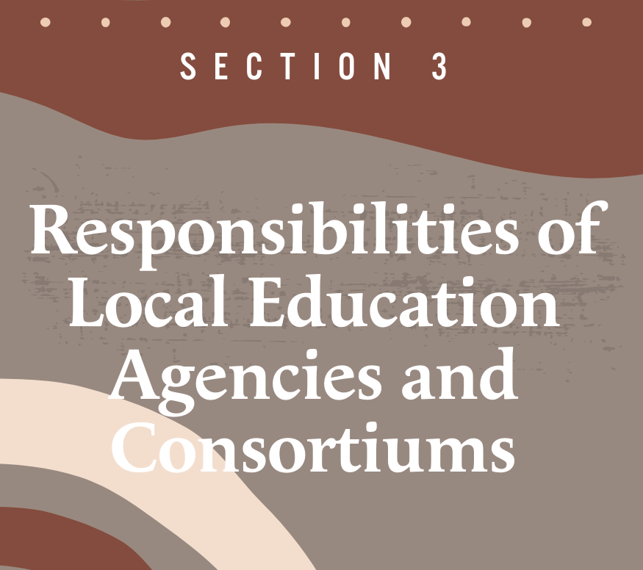



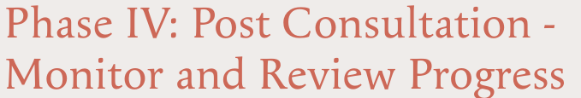
Most Powerful Update
Phases I-IV Have ALL Been Amended
Pre-Consultation Changes - See 31-32 of the Toolkit
👀 See pages 30-36

Slide 31
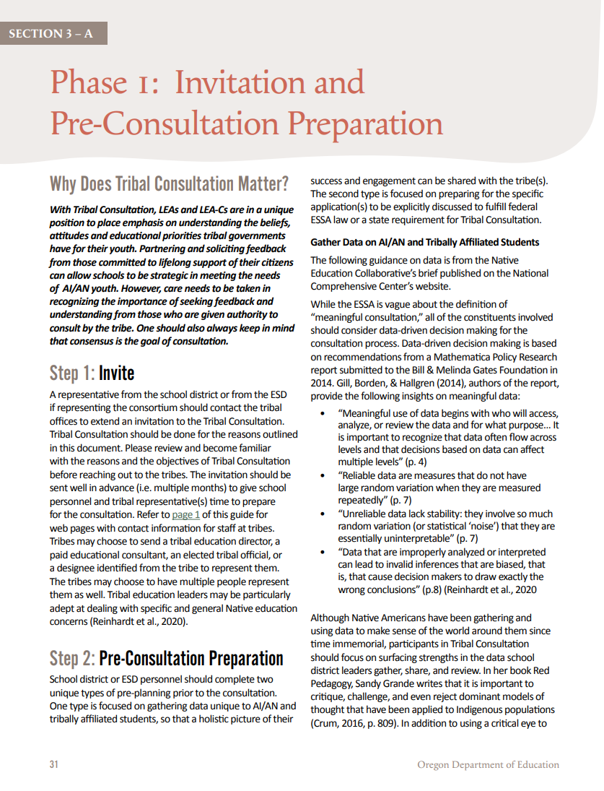
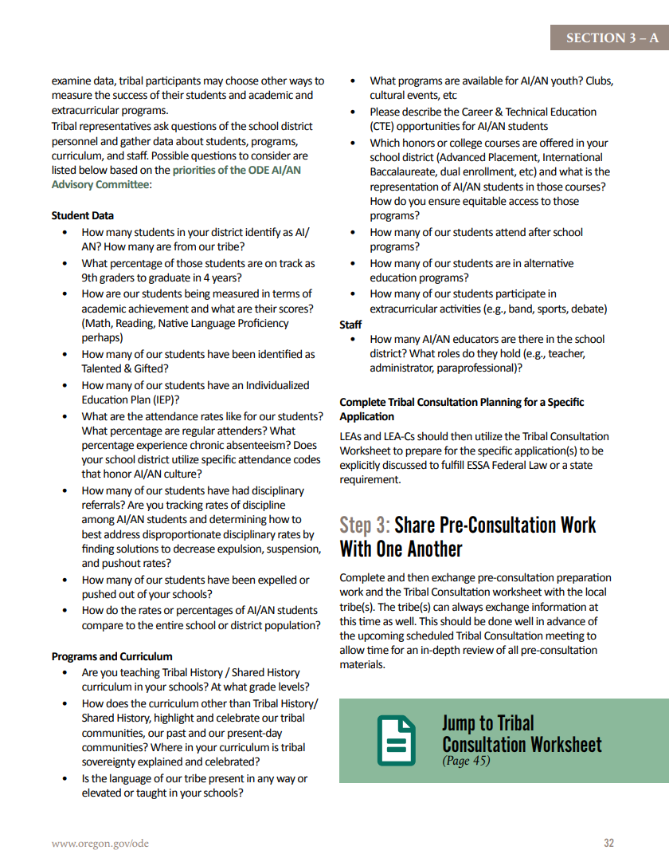
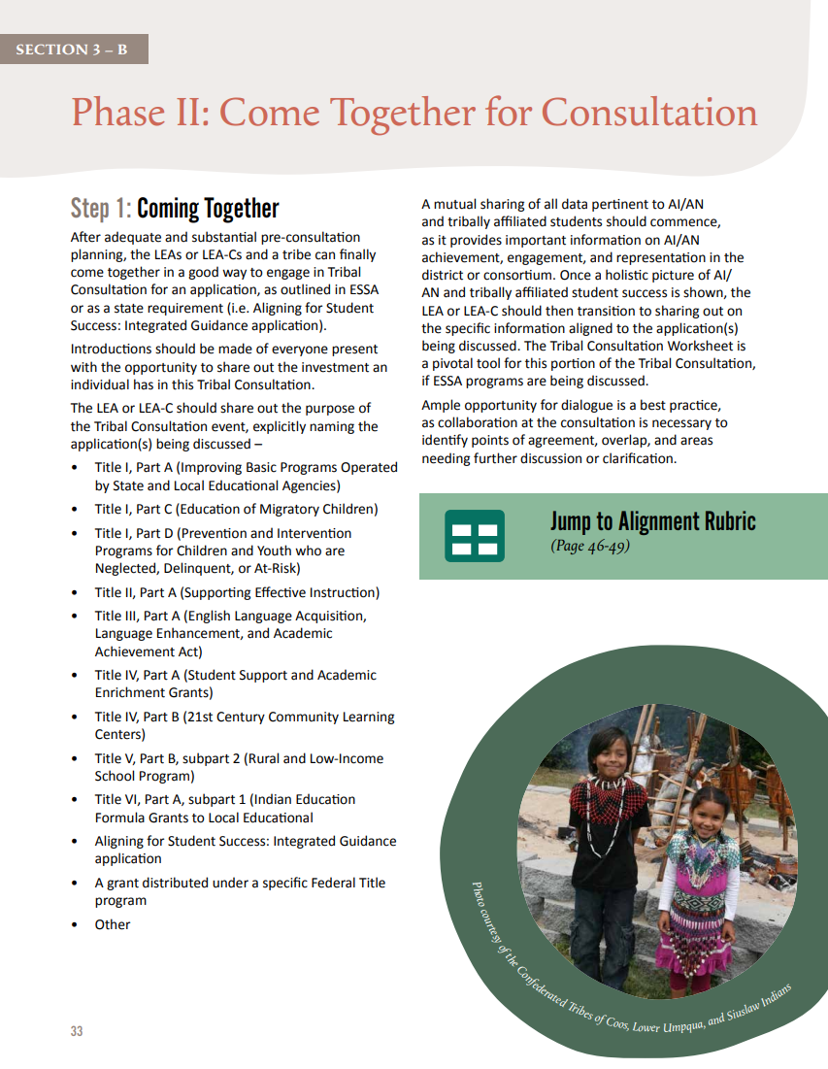
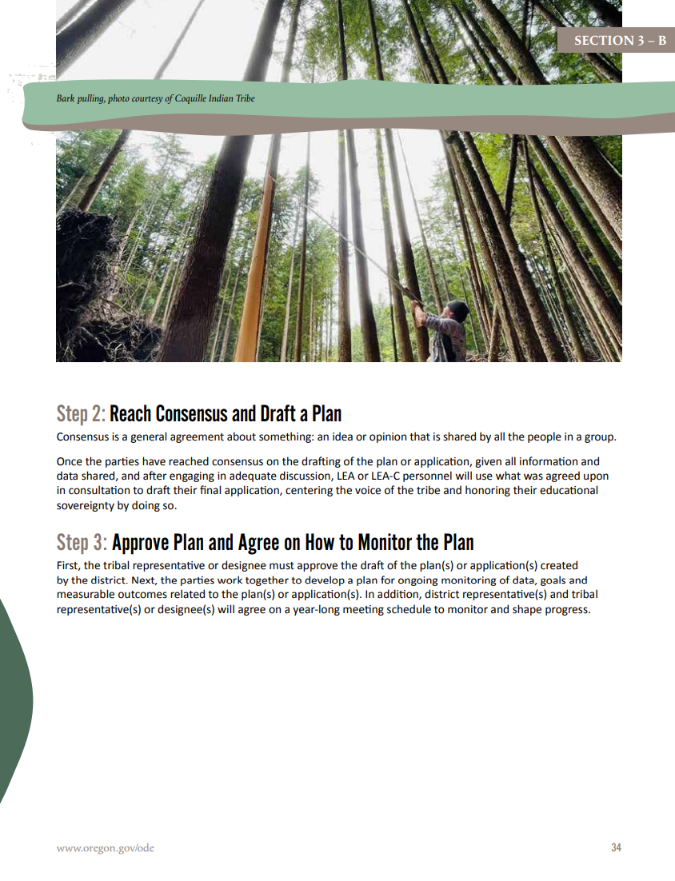
Most Powerful Update
Phases I-IV Have ALL Been Amended
👀 See pages 30-36

Slide 32
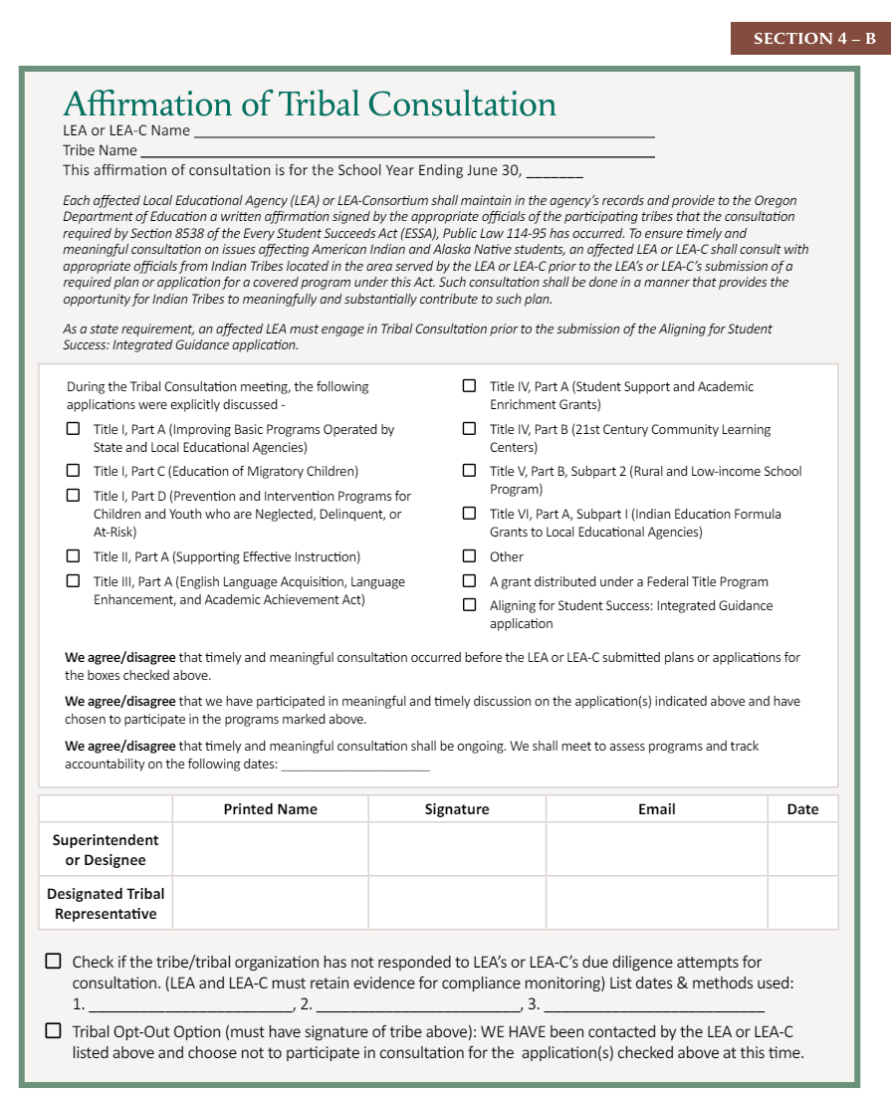
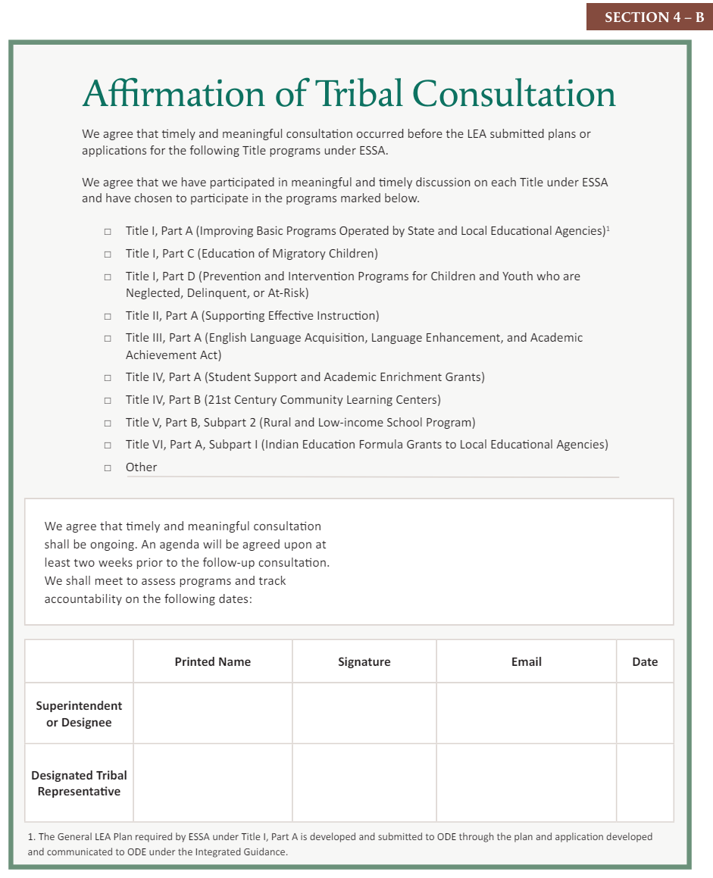
OLD
NEW

Slide 33
KEY EDITS - page 44
Consortium Language
Federal and State requirement language
New Checkboxes for grants and Integrated Guidance
“We agree/disagree” statements
New Checkboxes for a lack of response from a tribe and to acknowledge a tribe opted-out

Slide 34
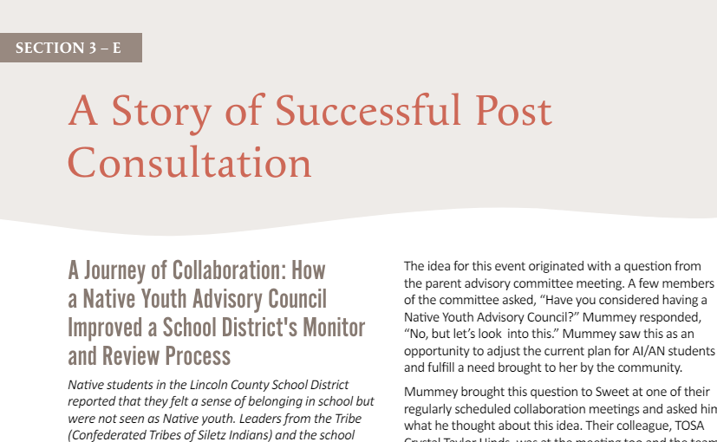
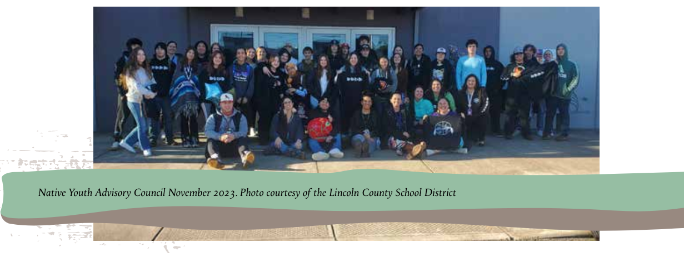
NEW Section - pgs 37-38
Shares a beautiful story of Phase IV of Tribal Consultation - “Monitor and Review” - between the Lincoln County SD and the Confederated Tribes of Siletz Indians

Slide 35
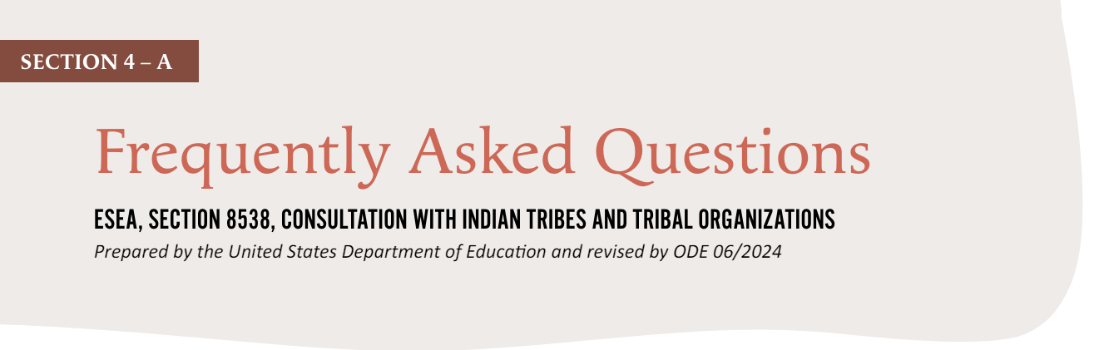
Updated FAQs - pgs 41-43
Biggest Additions -
#3 - Who is responsible for Tribal Consultation if an LEA is a member of a consortium (LEA-C) who is the recipient of an Indian Education formula grant under Title VI?
#4 - What is the definition of a "Local Tribe"?
#11 - If an LEA or LEA-C has multiple tribes in the geographic area it serves, or if there is one tribe and multiple LEAs, must there be separate consultations with each tribe or LEA?
#12 - Are tribes “required” to engage in Tribal Consultation with an LEA or LEA-C?
#13 - What if a tribe engages in a meeting with an LEA or LEA-C and believes that it was not done in a meaningful or timely manner and thus, will not sign off that Tribal Consultation occurred?

