Slide 1

Title VI Indian Education Community of Practice
Indigenous Family Special Education Guides
February 19, 2026

Slide 2

Happy Black History Month
The book, “Stronger Than” by Nikki Grimes and Stacy Wells (Choctaw), illustrated by E.B. Lewis, was just released in January. This book follows Dante, a Black Choctaw boy who finds strength in the example and history of his ancestors who survived both the Trail of Tears and the Tulsa Race Massacre. This picture book introduces these topics to young readers in an accessible way and includes historical references and a glossary.

Slide 3

A big WELCOME to Special Educators joining us in the space today.
💛💙💚🧡💜🩵🤎
THANK YOU for all you do to support our students.
Notes:
Say: This space is about strengthening how we work together — across Title VI, special education, and tribal communities — so families don’t have to navigate these systems alone.

Slide 4

Building Virtual Relations
First –
Zoom Names:
Please rename yourselves to your first and last name
School District, ESD, or Tribe Initials
Professional Role
Pronouns
Then –
Building Relations
Drop in the Chat how your role intersects with supporting or ensuring the success of American Indian and Alaska Native students’ with IEPs or 504 plans.

Slide 5
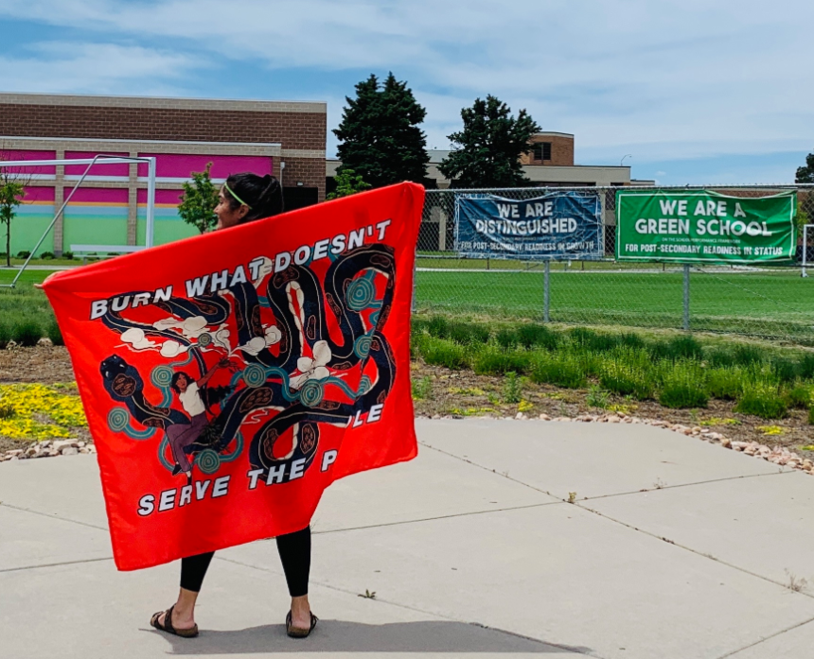
Presenter Introduction
Stacy Parrish, Indian Education Specialist
Office of Indian Education
Proud member of the Klamath Tribes (Yahooskin)
I help support -
this Title VI Indian Education monthly Community of Practice
the Tribal Attendance Promising Practices grant
Tribal Consultation between affected LEAs and ESDs and the nine federally recognized tribes
Substance Use Disorder and Prevention work
the Indigenous Family Special Education Guides

Slide 6

Learning Arc of our Time
Learn about the intended purpose of the Indigenous Family Special Education Guides
Preview the resources, familiarizing yourselves with the content
Review the “Implementation Considerations for School Districts and ESDs” to see how these guides can be utilized in your district or ESD
Complete a brief survey to share feedback, questions, and requests for support for our team
Notes:
These guides exist so families are not guests in systems that serve their children

Slide 7
Why These Guides Exist
Indigenous families have always advocated for their children.
Yet too often, Special Education systems are:
Complex
Legalistic
Culturally disconnected
Built without Indigenous voices
These guides exist to restore access, dignity, and shared power.

Slide 8
Remember…
For many Indigenous families, special education is not just a technical process.
It intersects with histories of removal, misidentification, silencing, and exclusion.
So when families ask question, hesitate, or push back, that is often advocacy shaped by experience – not resistance.

Slide 9

Native Student
Representation
5,951 Federal AI/AN Students (1.2%)
Family or Guardian only selects AI/AN
40,853 AI/AN+ Students (7.5%)
Students identifying as AI/AN and one or more other races, and/or and Hispanic/Latino
7,770 Self-Disclosed Tribally Affiliated Students from Federally Recognized Tribes*
263 Unique Federal Tribal Affiliations
5,902 Title VI Indian Education Student Count
*This data is incomplete and preliminary. It comprises a new data collection required by ODE in SY24-25.

Slide 10
Data Snapshot
American Indian or Alaska Native students with disabilities are more likely to drop out than all students with disabilities and less likely to be inside regular class less than 40% of the day than all students with disabilities.
U.S. Department of Education, Office of Special Education and Rehabilitative Services. (2021, August 13). OSEP Fast Facts looks at race and ethnicity of children with disabilities served under IDEA. Individuals with Disabilities Education Act (IDEA). https://sites.ed.gov/idea/osep-fast-facts-looks-at-race-and-ethnicity-of-children-with-disabilities-served-under-idea
20% of AI/AN Students receive Special Education Services, this is in comparison to 15.4% statewide.
10.3% of AI/AN Students received a Modified Diploma in SY24-25.
Notes:
Say: These numbers don’t reflect deficits in our students.
They reflect stress points in our systems.

Slide 11




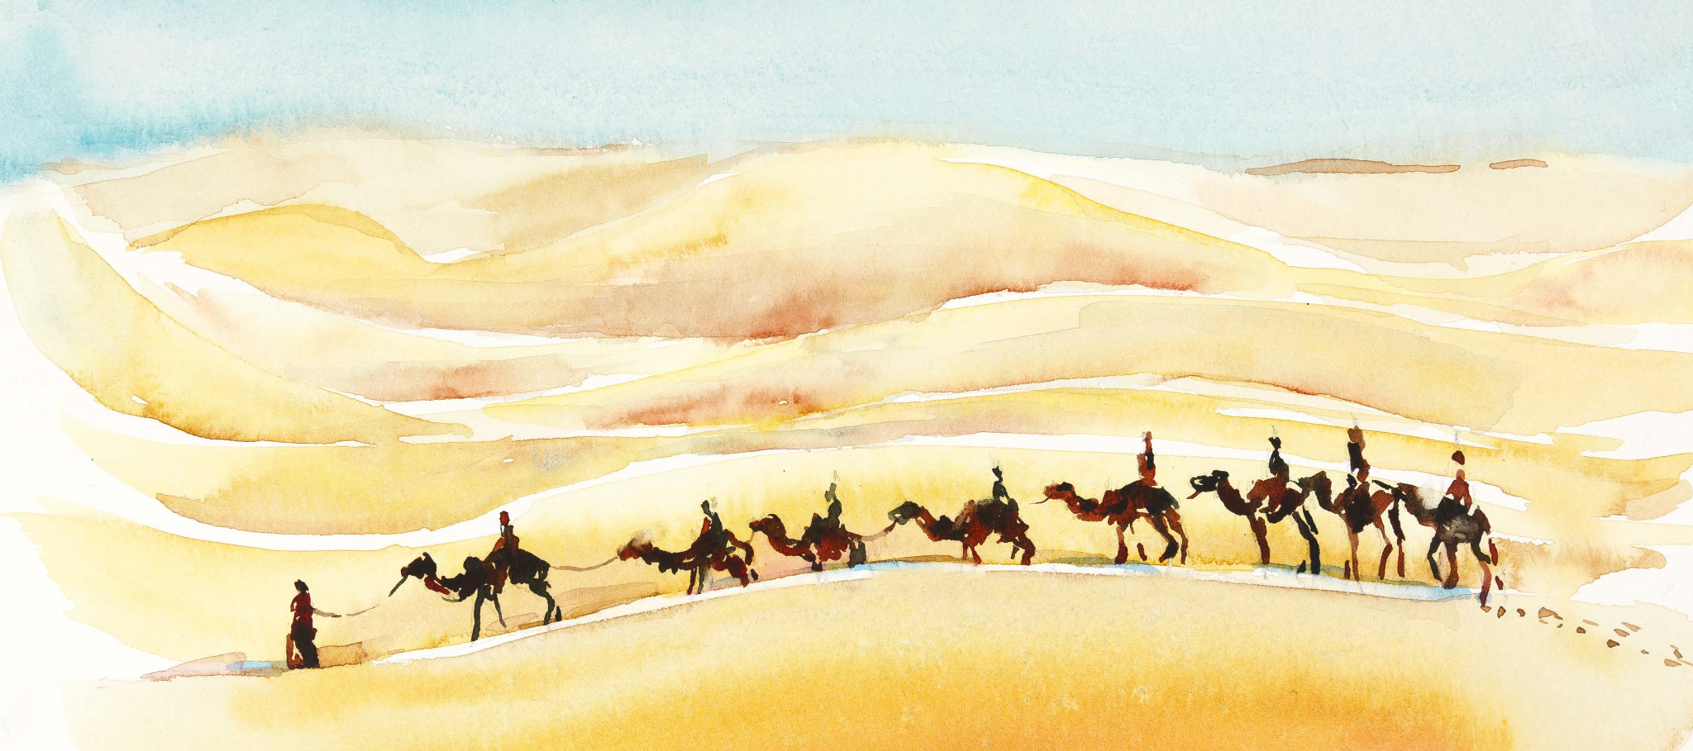
Goals in our 2025-2030 AI/AN Student Success Plan
Champion Tribal Languages
Address Inequity in Native Student Data
Pursue Native Excellence
Cultivate Holistic Systems of Support
Source: https://www.oregon.gov/ode/students-and-family/equity/NativeAmericanEducation/Documents/SB13%20Curriculum/FINAL%20AIAN%20Student%20Success%20Plan%202025%20-%202030.pdf
Center Culturally Responsive Approaches

Slide 12

Address Inequity in Native Student Data
OBJECTIVE 2B: Address Disparate Identification of Native Students in Special Education
▪ Ensure accurate identification of Native students in special education by providing additional guidance to school districts and ESDs on the analysis of data to identify disproportionalities beyond federal requirements, by promoting culturally responsive assessments and tools, and advocating for the use of informational resources to empower Native families with their rights and responsibilities in Special Education.
Notes:
Say: These guides were created because many Indigenous families enter special education spaces already carrying historical harm, mistrust, and real power imbalances.
Not because they don’t care. Not because they aren’t engaged.
But because the system was never designed with them in mind.

Slide 13
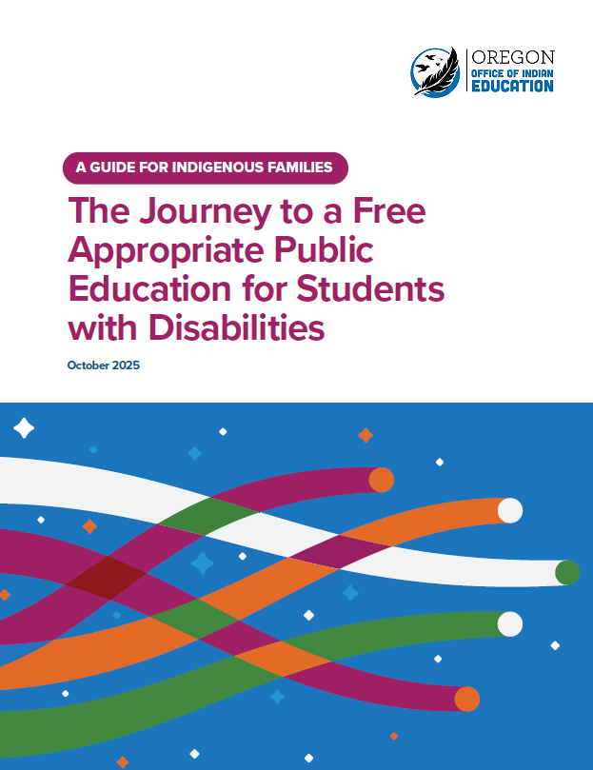
The Guides -
Comprehensive Guide: “The Journey to Ensure a Free and Appropriate Public Education for Students with Disabilities: A Guide for Indigenous Families” (pictured left)
Mini Guide 1 - “Getting Started with Special Education - Navigating the Special Education Referral Process”
Mini Guide 2 - “Parent/Caregiver Rights in Special Education”
Mini Guide 3 - “Individualized Education Programs (IEPs)”
Mini Guide 4 - “Discipline for Students in Special Education”
Mini Guide 5 - “Choosing an IEP or a 504 Plan”
Infographic Quick Summaries -
“Centering Indigenous Ways of Knowing in Special Education”
“IEP At-a-Glance”
“Parents Rights in Special Education: At-a-Glance”
Source: https://www.oregon.gov/ode/students-and-family/equity/NativeAmericanEducation/Documents/SB13%20Curriculum/Indigenous_SPED_Guide_2025_508c_.pdf
Notes:
Say:
These guides are one way we turn the Student Success Plan from a document into lived practice.
These guides are not just informational.
They are relational tools.
They are designed to help families walk into meetings informed, confident, and respected.
Comprehensive Guide Content - “This covers seven areas – Parent Involvement, Does my Child Have a Disability?, the Special Education Referral Process, Developing an IEP, Transition Services: Planning for Life After High School, Discipline and Student Protection and IEP vs. 504 Plans. It also contains rich appendices.”

Slide 14
Statewide Rollout of the Guides
Communication
February
Universal - GovDelivery to District and ESD Superintendents, Tribal Partners, SPED Directors
March - April
Targeted - Title VI grantees + TAPP; post-Discipline data published
Strategic - High AI/AN or tribal students
New Website
OIE Special Education website
Addition to ODE SPED sites (coming soon!)
Implementation Considerations for Districts and ESDs
Intentional Trainings
March
March 3 - General Information Session for Tribal Partners
March 4 - General Information Session for Districts and ESDs
Spring
Partner with 1-2 TAPP Districts for Phase 3 & 4 support for local communities
Partner with 1-2 Title VI Indian Ed grantees for Phase 3 & 4 support (ESD’s emphasized)

Slide 15
Our Intended Purpose –
District Level Impact
Districts select a phased implementation approach based on their context.
These guides will increase awareness that Indigenous families need different and additional support in navigating Special Education.
Districts and their respective schools will have an additional, culturally responsive resource to utilize with their staff and families.
Intentional opportunities to empower families with information which can help elevate their voices.
Notes:
Say: Before you read bullets:
“Our goal is not compliance. Our goal is partnership.”
Then:
“When families understand the system, they can advocate within it — and help transform it.”

Slide 16
Our Intended Purpose –
Student and Family Impact
Families see the guides as a “good first/next step” their district is taking to value their lived experience(s) with Special Education.
These culturally responsive resources increase Native visibility in a district and school
Improved communication and partnership between families and Special Education providers
Intentional opportunities to empower families with information which can help elevate their voices.

Slide 17
In the Padlet –
As you reflect, explicitly name:
SYSTEMS - Policies, timelines, funding, eligibility
PRACTICES - Meetings, communication, discipline, referrals
RELATIONSHIPS - Trust, advocacy, cultural safety
which influence a student with disabilities’ success in the public education system.
One idea per post. Add at least three.
Notes:
https://padlet.com/stacyparrish/indigenous-family-special-education-guides-imkut7wpzdth487s
Before launching:
“We’re doing this reflection because equity work starts with noticing — noticing where systems unintentionally create barriers.”
After:
“What we’re seeing here are not individual issues. These are patterns.”

Slide 18
Whole Group Discussion -
Please unmute or drop in the chat.
Consider your Native students supported by Special Education.
Which system or practice feels most urgent to address or change in your context?
Who currently holds power in that space?
Where could families be better positioned as partners in Special Education?

Slide 19

Diving into the Comprehensive
Guide and Mini Guide(s) of Your Choice
Read the Introduction: A Message for Indigenous Families and Chapter 1 in The Journey to Ensure a Free and Appropriate Public Education for Students with Disabilities - A Guide for Indigenous Families”
Next, review the Table of Contents to take a deeper dive into any additional section of interest to you.
Select a Mini Guide of a topic of high-interest to your Native families.
Resource: OIE Special Education Guides webpage
As you review, notice:
A section you’d use immediately
A mindset shift the guide(s) encouraged
A barrier you anticipate in using it
A support you’ll need.
Notes:
Say: Before sending them off:
“As you read, imagine sitting next to a parent who is entering their first IEP meeting. Ask yourself: Would this help them feel prepared and respected?”

Slide 20
Whole Group Share Out
Reactions, comments, or…
A section you’d use immediately
A mindset shift the guide(s) encouraged
A barrier you anticipate in using it
A support you’ll need
Notes:
Say:
After:
“Your feedback helps us make this a living resource.”

Slide 21
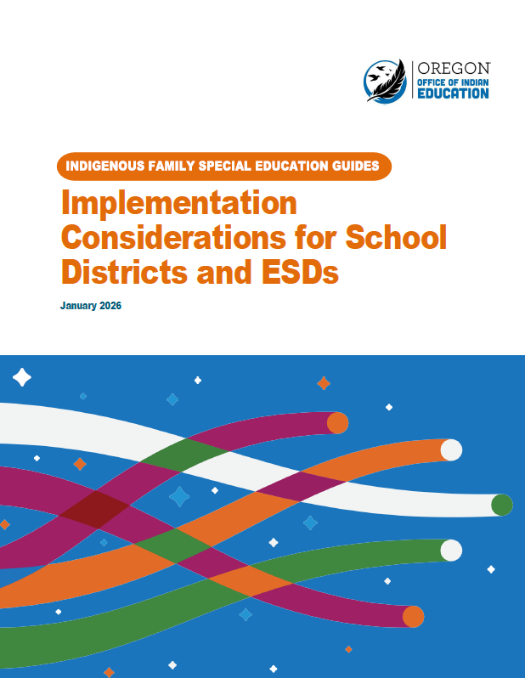
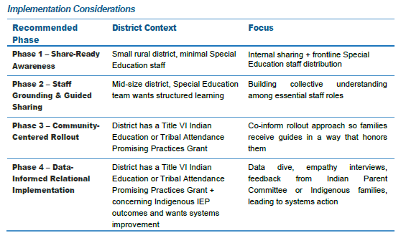
Prompt: Based on your District’s perceived context, skim through that phase in the “Implementations Considerations for School Districts and ESDs guide”
Source: https://www.oregon.gov/ode/students-and-family/equity/NativeAmericanEducation/Documents/SB13%20Curriculum/Implementation_Districts_ESDs_Indigenous_SPED_Guide_.pdf
Notes:
Say: “Implementation isn’t about distribution.
It’s about relationship.”

Slide 22
Whole Group Discussion Invitation
For these guides to shift from information to shared power, consider:
🟢 What must change in relationships?
🟡 What must change in systems?
🔵 What must change in mindsets?
so these guides become tools for advocacy – not just handouts.
Notes:
Say:
Before the big question:
“This question invites us to think beyond ‘Did we share it?’ to ‘Did it shift power?’”

Slide 23
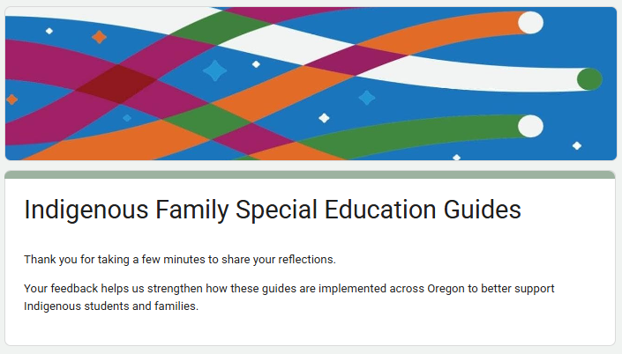
Please Take this Brief Survey
Link - https://forms.gle/1ubh4DYaQgpVX7Mk9
Your feedback will help us better meet your needs, as well as advocate for additional resources our office needs to implement these guides in a good way.

