Slide 1
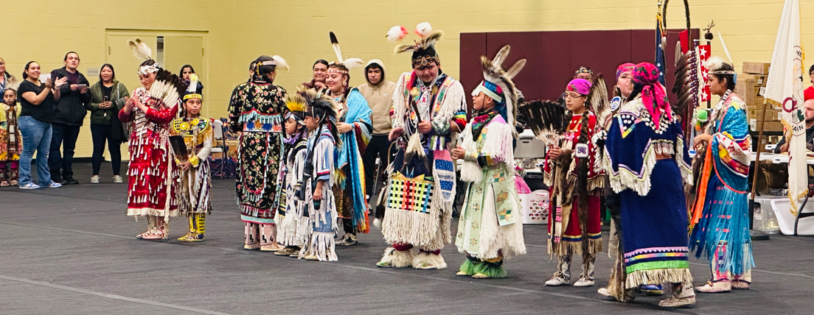
TAPP Family Advocate Monthly Space
February 5, 2026 - 12:30-2:00PM
✅ Pisa tabino! In Zoom, rename yourself to Name, school district initials, Tribal Partner(s), and pronouns.
✅ Materials Needed - Writing materials, water, snacks, etc.

Slide 2
This monthly meeting is a sacred space for TAPP Family Advocates to –
Be in community with other educators doing the same work
Prevent isolation and burnout
Grow our individual and collective capacities to lead systemic change
This space needs everyone to participate fully, be on camera to the greatest extent possible, and push yourself and one another to grow and lead in a good way. 💙

Slide 3
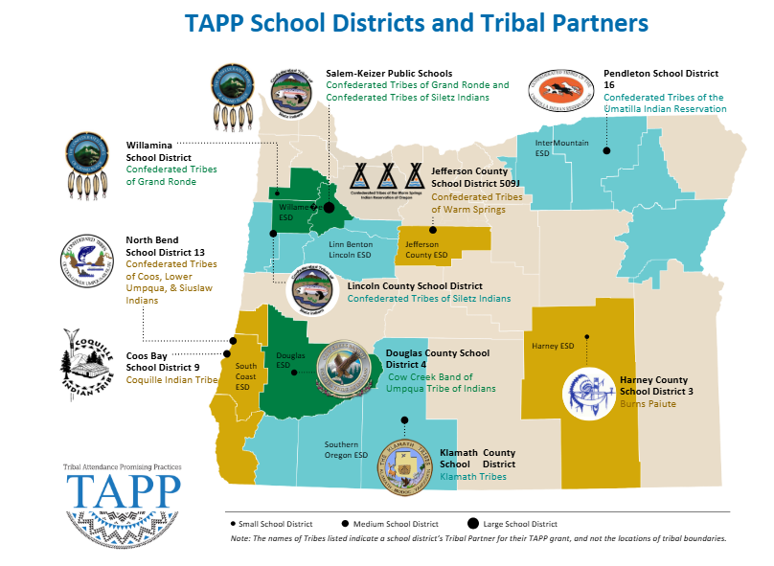
Advocate: Mona Smith
Advocate: Stacey Jacobs
and Crystal Kirkie
Advocate: Rebecca Arredondo and Expansion TBD
Advocates: Attcity Begay and Lana Leonard
Advocate: RuthEllen Melton
Advocate: Crystal Taylor Hinds
Advocate: Bre Landrum
Advocate: Taher Christensen
Advocate: Scott Smyth
Advocate: Janelle Emard and Marcus Paschal

Slide 4

TAPP February Monthly Meeting Arc
12:30-12:50
TAPP Family Advocate Check In
12:50-12:55
Complete Contact Info in Dashboard
1:00-1:30
Special Guest - Eulalia Gallegos Buitron from EDM for HB 3199 + SB315
1:30-2:15
💗🩷💙“Need Dating” on TAPP Topics💙🩷💗

Slide 5
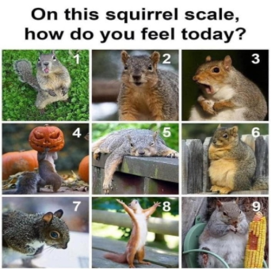
TAPP Family Advocate Check-In
Roll Call.
Select a squirrel that best captures how you feel today and tell us why.
💙 Shout out to Alanna Russell the Substance Use Prevention and Intervention Coordinator for this check-in idea.

Slide 6
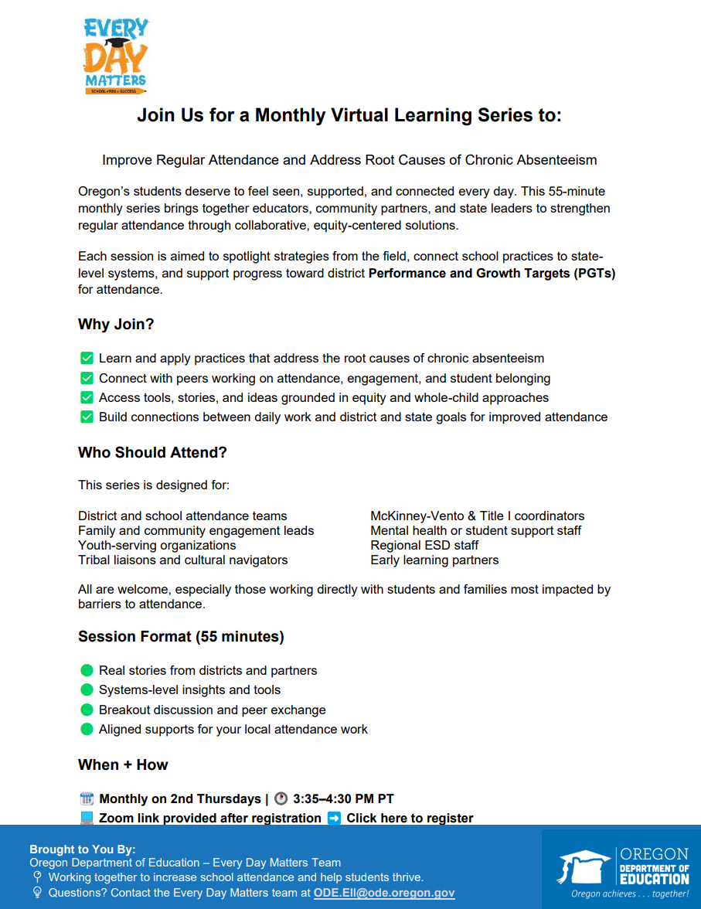
Professional Development Opportunity
Attendance Skill Building
Grab your Attendance people and get to the monthly Every Day Matters Learning Series!
Website - https://www.oregon.gov/ode/students-and-family/attendance/Documents/Attendance%20Learning%20Series.pdf

Slide 7

Professional Development Opportunity
Being in Good Relations
Grab your coffee and login to the Healthy Native Youth Community of Practice
Website - https://www.healthynativeyouth.org/community-of-practice/

Slide 8
HB3199 & SB315
Overview and Opportunity for Insight from the Advocates
Hosted by Eulalia Gallegos Buitron

Slide 9
TAPP “Need” Dating
Purpose: To succinctly share our best tips, insight, and knowledge with peers on common TAPP dilemmas

Slide 10
“Need” Dating Norms
Share out succinctly.
Be explicit and concrete. We need the details.
Context is everything. Consider -
Leadership style (turnover? new? Supportive? Transformative? Status quo?)
Resources (funding - district investments, grants, tribal support, technology)
Capacity (support staff, dedicated departments, collaborative teaming)

Slide 11
TOPIC #1
Relationship Building Structures
“I feel badly pulling students from class to meet with them, because I don’t want them to miss out on their learning.
What are creative ways you have worked to build 1:1 relationships with students without pulling them from class?”

Slide 12
TOPIC #2
AI/AN+ Data
“This is important data for our TAPP work, but how is it pulled in your districts?”
Please share first if you have built a ready-made report in your SIS.
Share next if you have to pull it in other ways.

Slide 13
What Need Dating Topics do you want to explore?
Add as many topics as you want to the Padlet – One post per topic - until time is called.
Refresh the page.
Then, take 1 minute to “like” a Post. The most “likes” = our next topic
https://padlet.com/stacyparrish/tapp-need-dating-ff0vxjxesa5jrju7

Slide 14
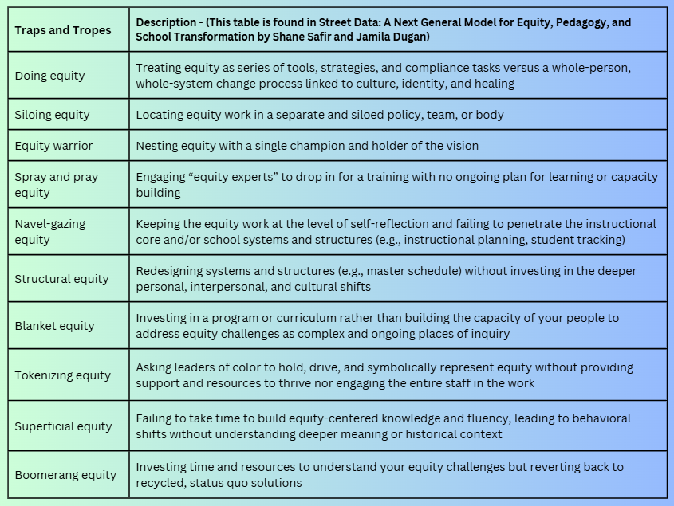
“A trap is a mechanism or device designed to catch and retain. It offers a quick entry but does not allow exit. A trope is a recurring theme we've seen happen before, a cliché of sorts. Over our years as educators, we have found ourselves, and have watched others, unintentionally fall victim to the very circumstances we are trying to change—stepping into unsuspected traps and replaying oppressive tropes.” (Dugan, 2021)
Notes:
“We are going to take a another trip down memory lane and kick it old school today and revisit the concept about equity traps and tropes from the book Street Data because it is connected to this concept and the work of systemic change.
Where are one of these living in the district or a school’s practices today? Tell us about it.

