Slide 1
TAPP Quarterly Learning Series #3
February 19, 2026 12PM-2PM
✅ Click on the three dots by your name in the Zoom to rename yourself to your preferred name, school district or tribe initials, role, and pronouns.
📓✍ Materials - Notebook/Journal, writing utensil, drinks, snacks, and your lived experience (i.e. your personal “street data”).

Slide 2
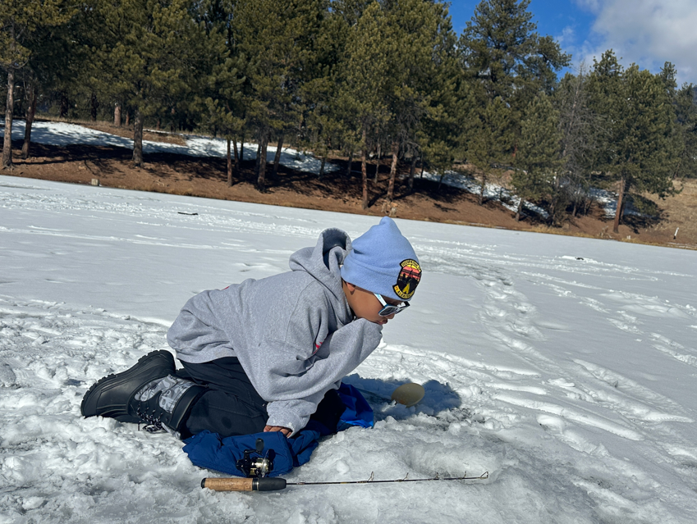
Meet Your Host
Stacy Parrish, Klamath Tribes (Yahooskin)
Education Program Specialist II in the Office of Indian Education
Everyone – Please take time to further introduce yourself in the chat!
Name
Role
School District or Tribe
Pronouns
Picture of Blue Parrish, 11YO, his first time ice fishing. Hosted by our local Indian Education program. Got skunk’ed.

Slide 3
Unmute or Drop in the Chat and Tell Us….
Humor is Medicine -
Since we last met, what’s something that made you laugh out loud? Tell us about it. 🤣

Slide 4
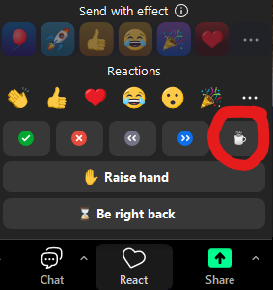
Ways to Engage Today
📷 Camera – We’d love to see your face if you’re comfortable
🎤 Voice – Unmute and jump into the conversation
💬 Chat – Share responses, thoughts, links, or questions
Reactions - Use the button to interact with the content or the
conversation in real-time.
Need to take a break? - Click the “coffee icon” from the Reactions button OR just drop a note in the chat that lets us know you have stepped away.
✨ All forms of participation are valued and appreciated. ✨

Slide 5
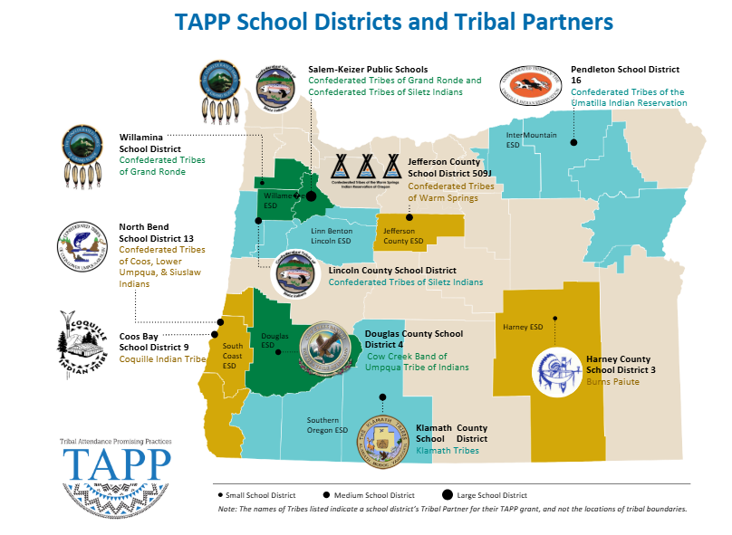

Slide 6
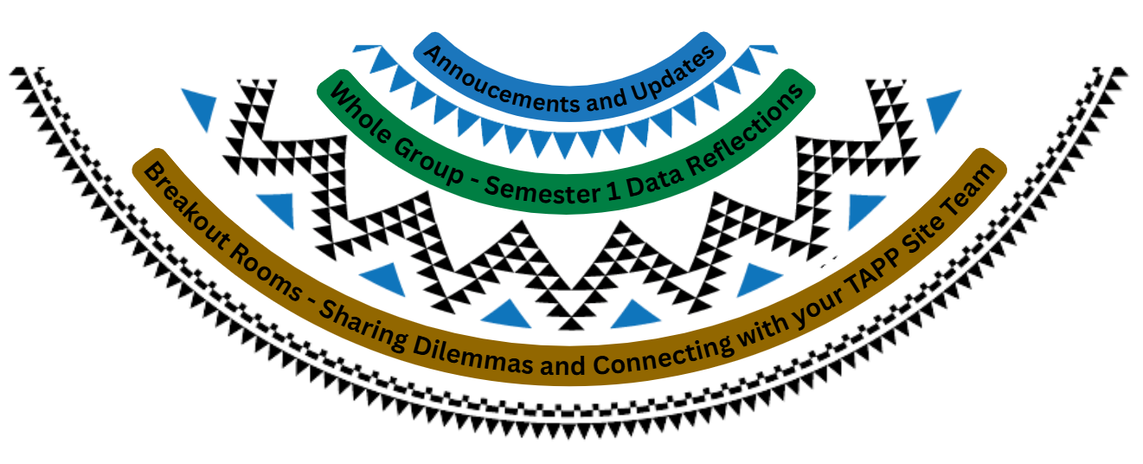
Things in our TAPP Basket Today –
🙾Anticipate reflection time, whole group discussion, and breakout rooms with your teams.🙿

Slide 7

Announcements and Updates

Slide 8
Announcements
TAPP Agreements and Funding Updates
To date, all TAPP Agreements are signed and EGMS notices have been sent.
The SIF was deleted from the e-approval system, likely due to the high turnover at ODE within key positions.
Just received approval again from ODE leadership to make all grant funds available.
ETA is 1-2 weeks at this point.

Slide 9
Announcements
📣Attention TAPP Project Directors and Tribal Partners
Please take the TAPP Survey Monkey regarding HB3218 by February 28, known as the “TAPP Expansion Study”. See the email sent February 4.
This survey is one critical component of our holistic TAPP Expansion study and will help us identify -
Opportunities to expand the program, including increases in funding to enable the program to serve more students at existing program locations, and
Increases in funding to facilitate the establishment of additional program locations throughout this state.
It should be completed by Tribal Partners and TAPP District Leaders only.
Tribal Partners are defined as the Tribal Education Director and/or any other official tribal representative designated to have an opinion on such matters as TAPP Expansion.
TAPP District Leaders are defined as Superintendents, TAPP Project Directors, and/or their official designees.

Slide 10
Announcements - TAPP Visits - April 13 - 24
Format Shifts this School Year
Pre-planning meeting with TAPP Site Team, school leadership, and teacher-leaders (if applicable)
Site will identify their focus for the visit based on their needs and/or an area of growth from the TAPP Frameworks. Examples -
  Classroom Observations w/teacher leaders with a more intentional debrief
  Observing a team meeting (TAPP meeting, site data, MTSS or attendance meeting, etc) and providing coaching and feedback
Engaging school leadership, teacher-leaders, students, families, etc, in a half-day workshop around a problem of practice or topic of interest to the TAPP Site
*Evening Activity - This Spring there is an opportunity for me to support a District’s Implementation phase of the new Indigenous Family Special Education Guides or other tribally-specific support to share the guides with families and the community

Slide 11

Announcements - TAPP Learning Visits
Tentative Host Site
Warm Springs K-8, Jefferson County 509J
Cultural Integration into Every Day School-Wide Culture
Tribal Language programs incorporated throughout the school day
Early Literacy Practices
Increasing the number of Native Educators through relationality and district investments
Tentative Host Site
Washington Elementary, Pendleton
Cultural Integration into Every Day School-Wide Culture
Tribal Language programs incorporated throughout the day
Reading Intervention Program
School-wide rigorous classroom instruction

Slide 12
Announcements - TAPP Site Visits
April
13 Can be in the Klamath Homelands | 14 Can be in the CCBUTI area and the coast | 15 Can be in the CCBUTI area and the coast | 16 Can be in the Willamette Valley | 17 In-Person AI/AN Advisory Committee in Salem
20 Can be in the Willamette Valley | 21 Can start heading to central and eastern Oregon | 22 Evening - ODE Community Conversations with Burns Paiute Tribe | 23 Can be in eastern Oregon or the CTUIR homelands | 24 Can be in eastern Oregon or the CTUIR homelands

Slide 13
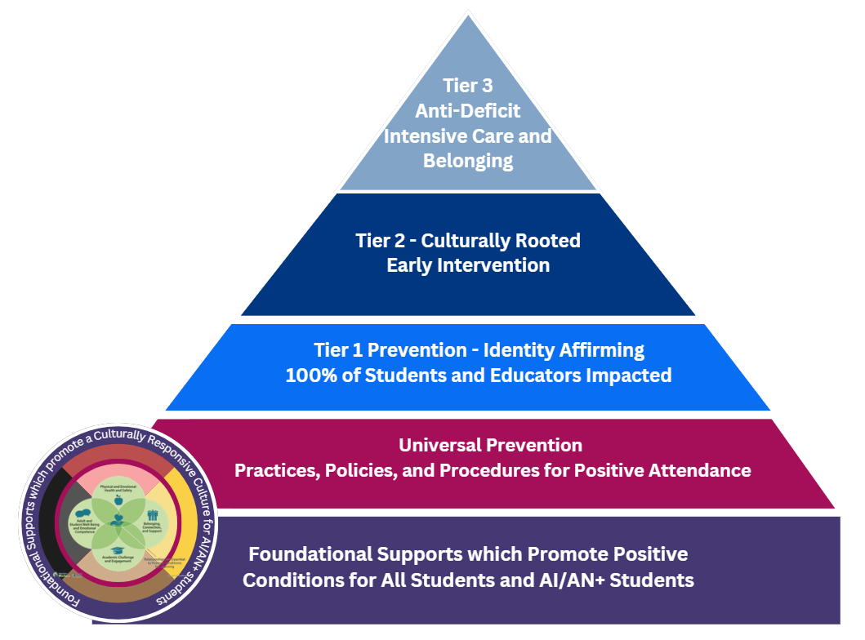
Exciting Updates
Important Dates to Track
📅 March 3, 11AM-12PM - Information Session for Tribal Partners, register here on Zoom.
📅 March 4, 11AM-12PM -
Information Session for Districts and ESDs, register here on Zoom.
🙌 Indigenous Family Special Education Guides Published
The Office of Indian Education is excited to share the Indigenous Family Special Education Comprehensive Guide, the full Mini-Guide Series, and the District and ESD Implementation Guide are now complete and ready to share with tribal partners, districts, ESDs, and most importantly – our Native families.
This has been a significant lift for the Office of Indian Education, representing years of work to ensure Indigenous families have clear, culturally grounded, and legally accurate information about their students’ special education rights and services. These resources are the first of their kind in our State and reflect OIE’s collective effort to bring visibility, understanding, and advocacy support to Native families navigating complex systems.
Check out the new website - Oregon Department of Education : Special Education Comprehensive Guides : American Indian/Alaska Native Education : State of Oregon

Slide 14
Exciting Updates - Bringing NIEA’s 2.5 Day Prevention Core Competencies Training to Indian Country
🙌 Interagency and Interdepartmental Partnership
The Office of Indian Education, in partnership with ODE’s School Wellness, Inclusion, Safety and Health Unit, and OHA are bringing culturally grounded, evidence-informed substance use prevention training to school districts and ESDs serving Indian Country through regional offerings.
Why Training Is the Right Lever
While statutory change is a longer-term effort, district and school-level decision-making can shift immediately when educators and support staff have shared, culturally responsive prevention competencies. Oregon law explicitly allows districts to employ prevention and intervention-based strategies that are proportional, trauma-informed, and developmentally appropriate. The gap is not authority—it is capacity and coherence.
The Prevention Core Competencies training, delivered in partnership with the National Indian Education Association, provides that missing bridge. It equips educators, tribal programs, and prevention practitioners with:
Foundational prevention knowledge aligned to evidence-informed practice,
Skills across assessment, planning, implementation, and evaluation,
Culturally grounded strategies that honor Tribal context, relational accountability, and community wellness.
This training supports consistent interpretation of discipline law, strengthens Tier 2 and Tier 3 supports, and aligns directly with existing ODE substance use prevention guidance—without adding new mandates. Preview the content here - NIEA Core Competencies Companion Guide

Slide 15
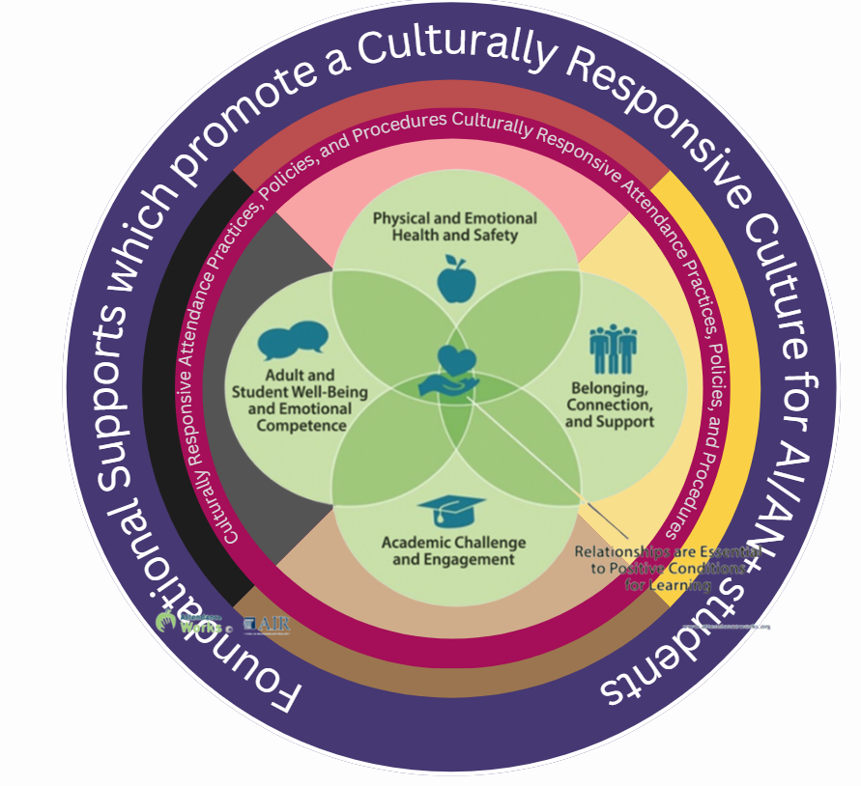
Exciting Updates - English 10 with AP Seminar for All
🙌 Looking for Interested TAPP Sites for SY27-28
I am looking for TAPP school districts interested in bringing English 10 with Advanced Placement (AP) Seminar for all to high schools located in tribal communities.
The components for an Indigenized approach -
Interested educators would join a cohort to learn from one another
Educators and students would come together for a summer session to build relationships and prepare for their first AP course, using trauma-informed practices
We would partner with Miranda Snider in Bernalillo, New Mexico, who has experienced significant success bringing this to Navajo Nation.
We would look to recruit “Native Aunties” in regions implementing the program to offer support – social-emotional and academic – to students engaged in the program.

Slide 16

Data Reflection: Semester 1 Check In

Slide 17

Calling Students into Our Space
Think of one Native student from this school year whose experience continues to inspire you to improve education systems.
Write the student’s name somewhere where you can see it throughout our time together today.
Slide borrowed from a colleague Andrea Lockard from the Office of RADAR

Slide 18
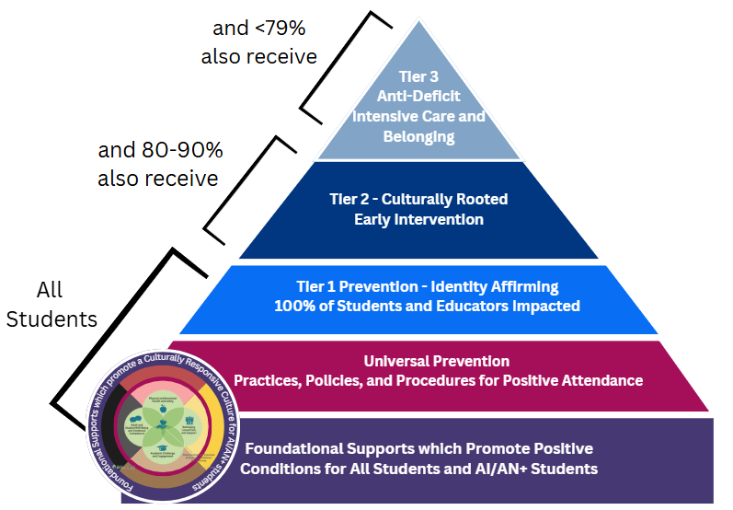
Our Anchor:
Analyzing Data in an Indigenous Way
Root causes live in stories, patterns, relationships, and conditions — not in children.
Street Data teaches us to look close-up, at student experiences.
Pedagogies of Voice teach us to listen deeply to students, to make space for truth and truth-telling.
And Indigenous ways of knowing teach us that data is not numbers — it is story, memory, land, and responsibility.

Slide 19
Whole Group - All TAPP District Compilation
Patterns are not student problems - they are system signals.
Take 5 minutes to review the tab titled, “Semester 1 Attendance Snapshot” in the 2025-2026 TAPP Dashboard.
Please take notes on the following prompts and be ready to share out –
What are you noticing?
What concerns you?
What gives you hope?

Slide 20
Deeper Patterns
Tier 2 root causes lean relational. Tier 3 leans structural and survival-based.
When students move from 80–89% to Tier 3 levels:
Health becomes chronic.
Instability becomes acute.
Socioeconomic pressures increase.
Trauma compounds.
Belonging erodes.
This is not a motivation problem. This is:
Health equity Housing equity Relational trust Systems design
and Historical trauma intersecting with poverty
Notes:
Then ask:
What are we treating as Tier 2 that is actually Tier 3 complexity?
Where are we responding behaviorally to what is actually structural?
What would a belonging-centered Tier 2 system look like?

Slide 21
Breakout Rooms: Dilemmas of Practice
Each room will need a
Timekeeper – keeps flow moving
Note-taker – captures themes
Share-back person – synthesizes, not reports everything
Optional Role - “Relationship Keeper” — watches tone and supports inclusion
Dilemma Protocol
How does this show up in our community?
How do our systems currently respond?
What are we already trying through TAPP and school efforts? [This is a different question than the one above.]
What barriers do we still face within our control?
What support do we need from tribal partners? | What support do we need from the school district (if you are a tribal partner)?
Breakout Room Options:
Health (Physical & Mental – Student and Family)
Belonging, Connection & Relationships
Family Instability, Crisis & Trauma
Socioeconomic & Housing Instability
Disengagement, Motivation & Academic Struggles
Transportation Barriers
School Systems & Institutional Practices

Slide 22
Decompress in TAPP Districts
Return to your TAPP District + Tribal Partner Breakout Room
Take turns sharing out – what are you sitting with after today’s conversations? What do you want to make sure the TAPP Site Team is tracking?
Notes:
“Let’s bring our voices together. Please share boldly — your insight may be exactly what another district needs to hear.”

Slide 23

Drop a final word in the chat:
“What are you taking with you?

