Slide 1

First Grade Tribal Government
Treaty and Flag Lesson Set
Click on the audio recording to hear and repeat the
Kiksht word for ‘IŁsandi: Flag’
Source: CTWS, Kiksht Flag Lesson, June 8th 2011
Language Program & Consultants:
Gladys Thompson, Madeline Mcinturff, Warren “Rudy” Clements, Joann Smith & Alice Harmon.

Slide 2

The outline of the reservation represents the boundaries of the Confederated Tribes of Warm Springs Indian Reservation boundaries.
Click on the audio recordings to hear and repeat the Kiksht words for ‘IgmqiqwŁimat: line, border’
and
‘IgmqiqwŁit ilxax: Our reservation border’

Slide 3
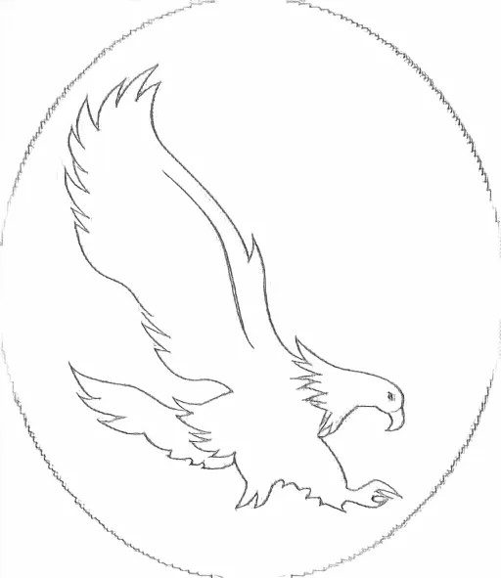
The pair of eagles represents our reservation’s freedom for our people, wildlife and courage for all people as long as the mountains stand.
Click on the audio recording to hear and repeat the Kiksht word for ‘Ich’inun: Bald Eagle’

Slide 4

The 3 teepees represent our old Indian way of life, rejoicing, singing, dancing and happy Indian celebrations.
Click on the audio recording to hear and repeat the Kiksht word for ‘Itc’uxwili: Tipis/Teepees’

Slide 5
The round lone Warshield represents the Sacred Circle of Life, the Gift of Life and the Rebirth of Life.

Slide 6
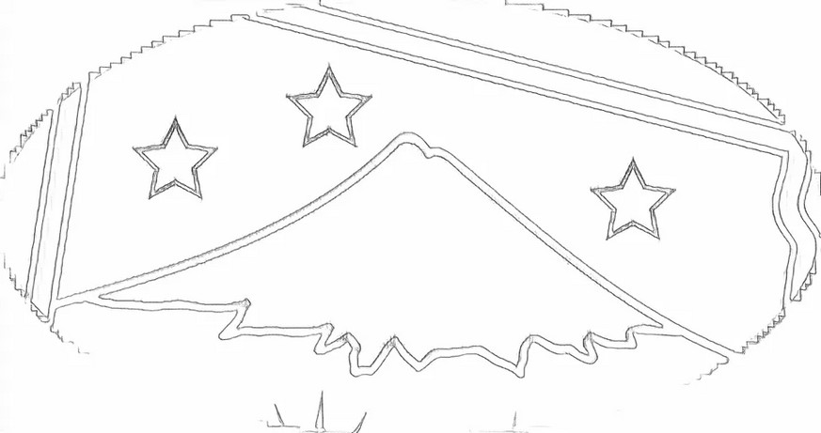
The mountain represents Mt. Jefferson and signifies our beautiful Mother Earth and Indian Land.
Click on the audio recording to hear and repeat the Kiksht word for ‘Akakan: Mountain’

Slide 7
The three stars above Mt. Jefferson represents the people of the Confederated Tribes of Warm Springs; The Warm Springs, The Wasq’u and Paiute Tribes.
Click on the audio recording to hear and repeat the Kiksht word for ‘Itq’xanaba: Stars’

Slide 8
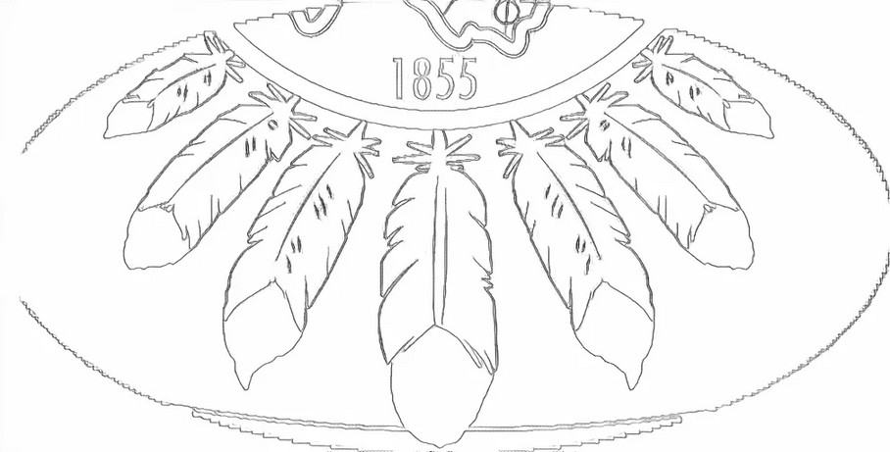
The seven eagle feathers represent Tribal religion, praising the Great Spirit, praying for peace and forgiveness and the cleansing of our souls.
Click on the audio recording to hear and repeat the Kiksht word for ‘Itpiq: Feather (Eagle)’

Slide 9
The number 1855 represents the year of our treaty with the United States government and our sovereign powers reserved through this treaty.
Click on the audio recording to hear and repeat the Kiksht word for ‘WiŁx: Year’

Slide 10
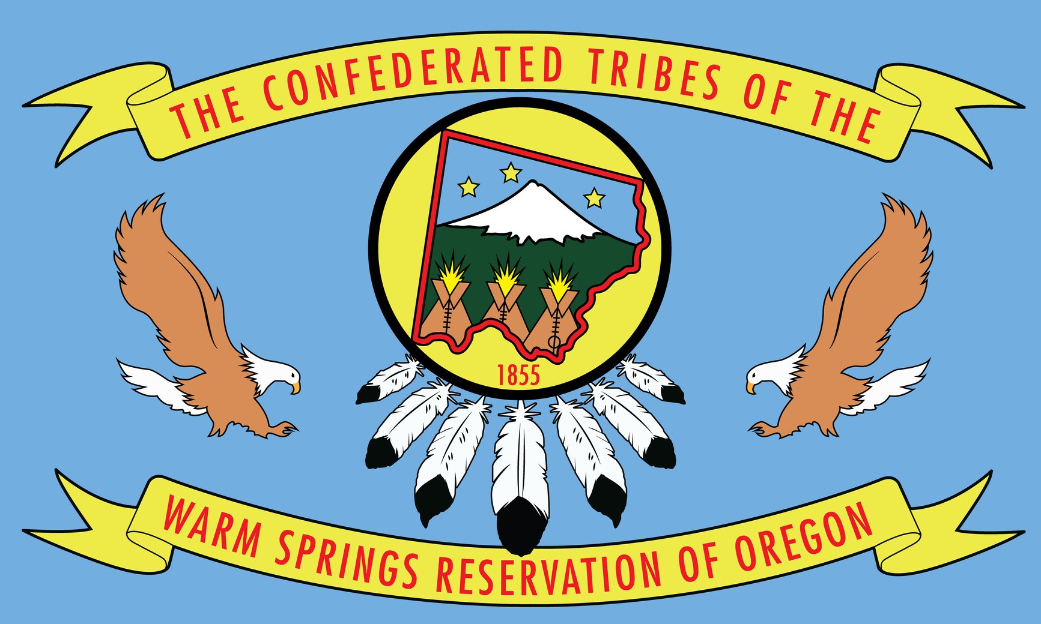
The color blue represents the land of the Great Spirit without whom, our people’s way of life, the fish, roots, birds and other animals cannot survive.
Click on the audio recording to hear and repeat the Kiksht word for ‘IŁla’luba: Ribbon’
Click on the audio recording to hear and repeat the Kiksht word for ‘Daptchäx: Blue/Blueish’

Slide 11

The color green represents our Warm Springs Reservation “for as long as the grass should grow”.
Click on the audio recording to hear and repeat the Kiksht word for ‘Daptcäx: Green’
Click on the audio recording to hear and repeat the Kiksht word for ‘Datgúp: White’
Click on the audio recording to hear and repeat the Kiksht word for ‘Idagashumit: Yellow’
Click on the audio recording to hear and repeat the Kiksht word for ‘Dałbäl: Red’

