Slide 1


GRADE 3 Honoring Siletz Women

Slide 2
Impact
Impact
Definition | Example | Non-example
Impact means the effect or influence that something has on a person, group, or thing. | I have an impact on the earth when I recycle. | Wearing a certain color shirt has no impact on other people.

Slide 3
Impact
Accomplishment
Definition | Example | Non-example
An accomplishment can be anything that you have worked hard for and succeeded in, like learning a new skill, finishing a difficult task, or making progress toward a goal. | Learning to ride a bike. Completing a puzzle or a difficult homework assignment. | Brushing your teeth. Eating breakfast.

Slide 4
Impact
Contribution
Definition | Example | Non-example
A contribution is something that you give or do to help someone or make something better. | Helping to clean up a park or beach with a group of volunteers. | Being unkind. Littering.

Slide 5
Impact
Equality
Definition | Example | Non-example
Equality is about ensuring that every individual has equal status, rights, and opportunities. | An example of equality is when two people receive the same pay for doing the same job. | A non-example of equality would be if only boys could play sports and girls couldn't participate.

Slide 6






Impact
Fishbowl Discussion
Get in groups
Switch groups
Listen and learn
Keep discussion going
Take turns
Wrap up

Slide 7
What is a biography?
Notes:
A biography is a story about someone’s life. It’s a book about a real person and it can help us learn about what they did and how they made a difference in the world. Biographies can teach us about famous people like presidents, inventors, or athletes. They can also be about everyday people who have done something amazing and made important contributions to their country, Tribe, family, or community. By reading a biography, we can get inspired and learn about all the interesting things that people can do!
Let’s learn about the important features of a biography.

Slide 8
Why read biographies?
We read biographies to:
Learn about important people in history
See how people overcome challenges and obstacles
Inspire and motivate us to pursue our own goals and dreams

Slide 9
How to read a biography
Steps for reading a biography:
Preview by looking at the title, pictures, headings, and subheadings
Read the introduction to learn about the person's life and accomplishments
Read the main text and take notes on important events and details
Reflect on what you learned and discuss with others

Slide 10
Biographical Text Features
Biographies have specific text features:
Headings and subheadings
Photographs and illustrations
Captions and labels
Maps and timelines

Slide 11
What is a confederated Tribe?
Notes:
The Confederated Tribes of Siletz Indians is a confederated Tribe. A confederated Tribe is a group of different Native American Tribes that were often forced by the federal government to come together on a single reservation. Today, confederated Tribes have one Tribal government but are made up of people from many different Tribes and bands. Lots of different Tribes in Oregon are confederated Tribes—like the Confederated Tribes of Warm Springs and the Confederated Tribes of Siletz Indians.

Slide 12
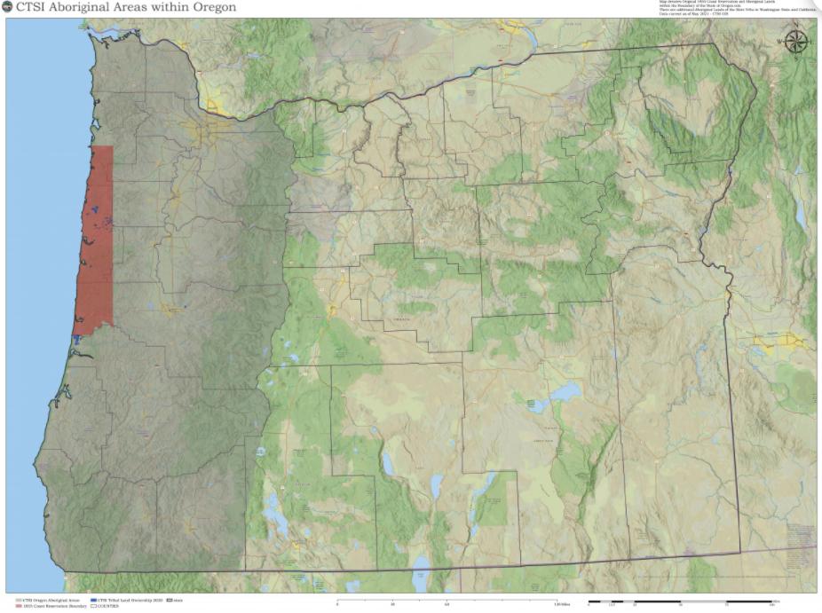
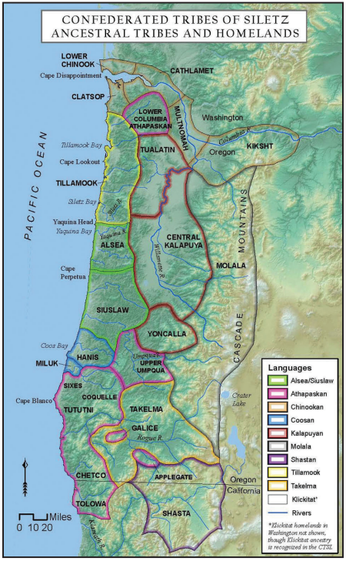
The Confederated Tribes of Siletz
Images source: CTSI
Notes:
The ancestors of the Siletz people came from different Tribes that lived in western Oregon and parts of northern California and southwest Washington. Each of these Tribes has their own special ways of living and doing things, but they also share many things in common, like building houses out of planks, fishing for salmon to eat, and visiting and trading with each other.
In the 1850s, the U.S. government forced these Tribes to leave their homes and live together on the Coast (Siletz) Reservation. Times were hard—people had to leave their homes and everything they knew. There often wasn’t enough to eat. But people survived and kept together and today members of those many different Tribes are all part of the Confederated Tribes of Siletz Indians.
Keep this in mind as we read these biographies. All the women that we are going to read about today are Siletz Tribal members. Their families were removed from many different places across western Oregon to the Coast (Siletz) Reservation.

Slide 13
Honoring Siletz Women: Biography Stations
Step 1. Today, we will be learning about some amazing women from the Confederated Tribes of Siletz Indians by reading their biographies.
Step 1: Today, we will be learning about some amazing women from the Confederated Tribes of Siletz Indians by reading their biographies.
Step 2. You will work in small groups of 3‒4 to read the biographies and complete activity packets.
Step 3. There will be several stations set up around the room, and each station will have a number, 1‒2 biography packets, a set of highlighters, and colored pens or pencils.
Step 4. You will have 20 minutes at each station to read the biography and complete the packet of activities. When time is up, you will rotate to the next station.
Step 5. Remember to work together and help each other. If you finish early, you can read other biographies or work on the activities from previous stations.
Step 6. At the end of the activity, we will have a whole class reflection where you can share what you learned and what stood out to you about these impactful women.
Notes:
Today, you’ll be working in small groups to read biographies about some important women from the Confederated Tribes of Siletz Indians. You can choose to read the biographies by yourself, or you can select a group member to be the reader and read aloud to the rest of the group. Then, you’ll work together to answer the questions in your packet. Remember to help each other and work together as a team!

Slide 14
Biography Poster
Step 1. Choose a Siletz woman you learned about during the station activity.
Write their name in big letters at the top of the poster.
Step 2. Use colorful markers, crayons, or colored pencils to decorate the poster with pictures and information about the person. Make it look beautiful and creative!
Step 3. Find or draw pictures or symbols that represent the person you are writing about.
Step 4. Write short descriptions or captions about the person's accomplishments and contributions.
Explain how their life impacted the Siletz people and the world.
1
2
3
4
Notes:
Using the information that you gathered during the station activities, you will create a biography poster on one of the impactful women from the Siletz Tribe. Your poster should highlight the person’s contributions and accomplishments and provide insights into their life experiences. Remember to use the information you learned from your reading and to write in your own words!
Step 1. Choose a Siletz woman you learned about in class and write their name in big letters at the top of the poster.
Step 2. Use colorful markers, crayons, or colored pencils to decorate the poster with pictures and information about the person that you read about. Make it look beautiful and creative!
Step 3. Find photos or pictures of the person you are writing about or draw a picture of the person.
Step 4. Write short descriptions or captions that talk about the woman’s accomplishments and contributions. Explain how their life impacted the Siletz people and the world.

Slide 15
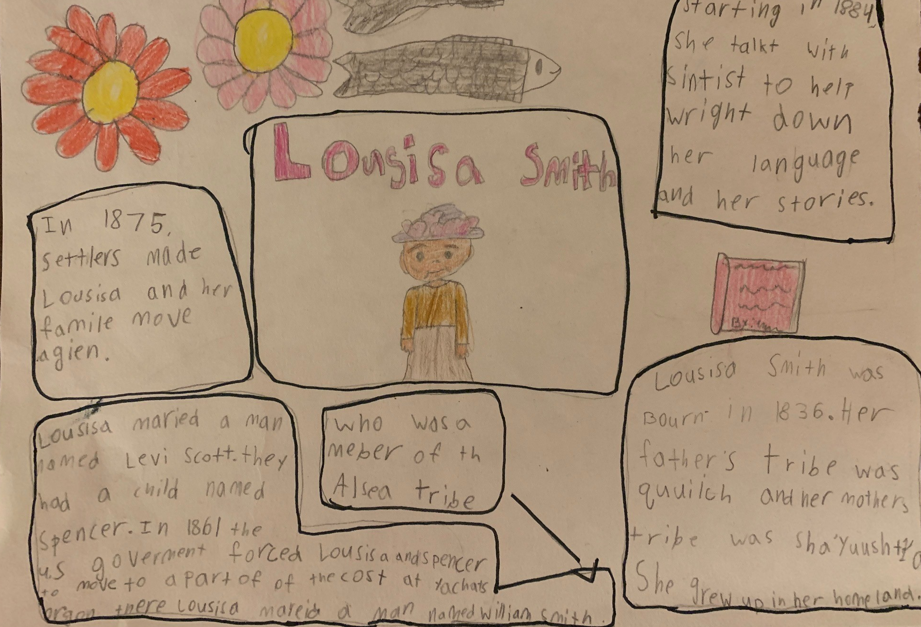
Example

