Slide 1
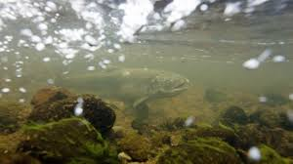
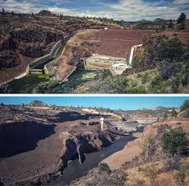
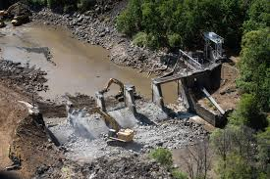
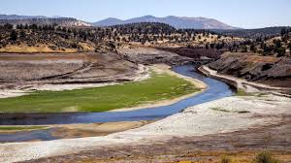
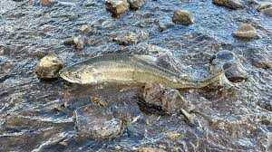
Oregon Title VI Community of Practice
Wednesday, January 15, 11AM-12PM
Rename your Zoom Name to your –
first and last name
name of district ,ESD, or Tribe, and
official role for Title VI - Project Coordinator, Authorized Official Representative, student liaison, etc.
pronouns

Slide 2

Introductions and Role
Oregon Office of Indian Education Title VI Lead -
Stacy Parrish, Education Program Specialist II, Proud Member of the Klamath Tribes (Yahooskin Paiute)
Everyone - Greet one another in your tribal language or in the language of the local tribe(s).
Then, drop into the chat the last river you visited. Which one was it and what still stays with you from that day?
Notes:
ALL

Slide 3
Reminder - A Challenge to All of Us –
Find ways to use your tribal language or the language of the local tribe in everyday conversation as much as you can.
Many of our ancestors only know the old language and using it – no matter our pronunciation or fluency – keeps them strong and able to hear us when we speak.

Slide 4
Today’s Agenda -
Community Building, Updates, and the Formula Grant Timeline
Steps to Ensure Compliance to Section 6119 of the Title VI Indian Education legislation
Sharing Best Practices with One Another - Preparing for EASIE Part 1 (Indian Student Count)
Community of Practice Shared Folder - Update it and the Contact List Regularly

Slide 5

Title VI Intro and Check In with Three Awardees
We heard from Coquille SD, Klamath County SD, David-Douglas, Willamette ESD, North Bend SD, and Lincoln County, Reynolds SD, Beaverton, Coquille SD, and _______ so far this year. (I totally forgot who shared out in December)
Let’s get to know one of you better…
If your district, consortium, or tribe has not already shared out, unmute and tell us your…
Name
Tribes you “Meaningfully Collaborate with” for Title VI
Your role with Title VI
Years in the role
Come to me if you want help with…

Slide 6
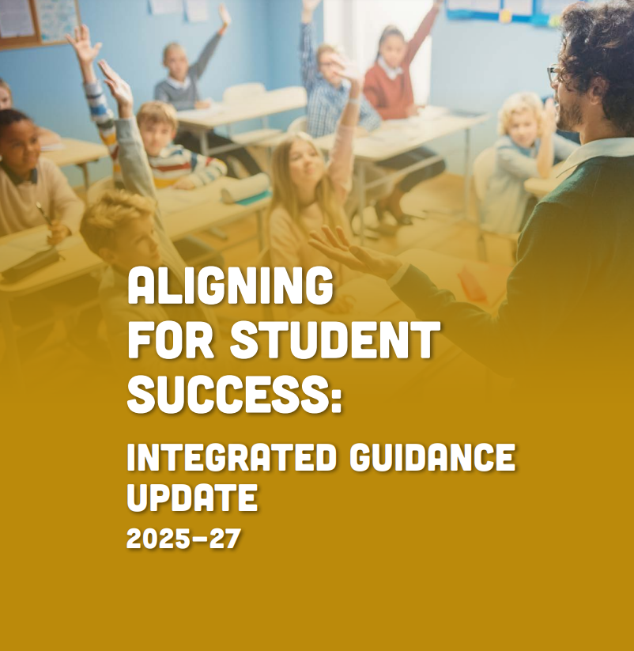
December Meeting Recap
In December we talked about Integrated Guidance and why it is so critical to elevate the voices of our students and families to inform the Integrated Guidance application.
Share with the group the steps you have taken since we last met to ensure your Title VI students and families help provide input and feedback to inform your district’s Integrated Guidance application.

Slide 7
Quick Updates from the EASIE Website
Have a list of technical questions?
EASIE Title VI Office Hours with the US Department of Education -
These new technical assistance sessions, which are intended to allow prospective and current grantees to receive direct support from their assigned OIE Program Officer via breakout sessions during the event.
Register for all sessions in the series or select specific sessions to attend by completing the WebEx Registration Form.
Important Note on Dates
Currently the EASIE Announcements page has dates listed for both the EASIE Part I and Part 11 windows; however, the application referenced for these dates is still for FY24-25. Please keep checking it (and your emails) for any updated application windows!

Slide 8
General Formula Grant Timeline
To Do List -
✅ Save Your Spot - Integrated Guidance
✅ 506 Form collection process
✅ Indian Parent Committee Planning
-EASIE APR for FY 23-24 opened Sept. 9
-Indian Parent Committee Start of Year Outreach
-District and School-Wide Registration Norming - 506
-Native American Heritage Month
-Winter Solstice, Dec 21
-EASIE PART I Closes March 7
-Tribal Consultation window for Integrated Guidance Opens
-Public Hearing must be held before Part II closes
-EASIE PART II Submission Deadline May 9
SEPTEMBER
NOVEMBER/DECEMBER
MARCH
MAY
OCTOBER
JANUARY/FEBRUARY
APRIL
-EASIE APR for FY 23-24 closed October 11
-Indigenous Peoples Day, Monday Oct 14
-EASIE Part 1 Opens February 3rd
-EASIE PART II Application Available April 7
-Tribal Consultation closes April 30th for Integrated Guidance
This is a general visual of the Title VI school year timeline. All LEAs and LEA-Cs should adhere to all published DOE timelines to plan their efforts.

Slide 9
Section 6119 Compliance
Initial Training for Awardees

Slide 10
Section 6119- Making Sense of Limited Guidance
As a state educational agency, our scope of supporting Title VI Indian Education efforts is outlined in Sec. 6119 of the Title VI Indian Education legislation (p. 320) –
SEC. 6119. [20 U.S.C. 7429] STATE EDUCATIONAL AGENCY REVIEW.
Before submitting an application to the Secretary under section 6114, a local educational agency shall submit the application to the State educational agency, which may comment on such application. If the State educational agency comments on the application, the agency shall comment on all applications submitted by local educational agencies in the State and shall provide those comments to the respective local educational agencies, with an opportunity to respond.
This expectation is also in the EASIE Part II FAQ document on page 29 –
11.4 Is there anything I need to do after my entity has certified my application? Yes, there are several remaining steps:
Before Part II closes, download and save your application in PDF form. You should also save a signed copy of the program assurances which are available as a link from the certification screen.
If you are an LEA, send a copy of your application to your SEA. Section 6119 of the ESEA requires that all LEA applicants send a copy of their Title VI Indian Education Formula Grant application to their SEA. If you do not have a specific contact, mail it to the SEA (or the State superintendent) at the general address.

Slide 11
Priorities for ODE in Spring 2025
Goal - ODE hopes to achieve full compliance to Section 6119 - ODE will collect 100% of EASIE Part 2 applications from LEAs and LEA-Cs and will comment on 100% of them.
High Level Summary
Timeline - Last year we began phase 1 of getting into compliance with 6119. To date, 66% of non-tribal awardees are in compliance. (Here is the previous training about it from April 2024.)
Who is Impacted by this? This only applies to EASIE Part 2. This requirement does not apply to tribes (see Section 6119).
While working to achieve compliance, provide LEAs and LEA-Cs the option of when they knowingly will receive comments on their applications and opportunity to respond to them (see next slides).
How are applications submitted? Via email to stacy.parrish@ode.oregon.gov
How will districts leaders be notified about this? A GovDelivery (official communication to district and ESD superintendents) will be sent to Superintendents by the first week of March which will detail this information.

Slide 12
Priorities for ODE in SY24-25 - Continued
Important Details
An SEA’s comments on a Title VI Indian Education Formula Grant application have no impact on the Department of Education’s approval of an application.
The EASIE Part 2 application has limited sections with written/original content. For SY24-25, while the entire application will be reviewed, we will have a heightened focus on the following -
Indian Parent Committee Approval Form
Section 2 Part 2. Description of Comprehensive Program for American Indian/Alaska Native Students
Section 2 Part 3. Coordination of Services Professional Development

Slide 13
Option 1 Overview
Option 1
LEAs and LEA-Cs make the determination to submit copies to the agency during the submission window. ODE will provide comments on the applications, allowing an LEA or LEA-C an opportunity to respond to comments prior to the close of the EASIE Part 2 application window.
Window for Applications to Be Submitted to ODE for Review - April 7-14
Window for Applications to Receive Comments by ODE and Returned to LEA - April 15-21
LEAs and LEA-Cs may respond to comments. This is not required - April 22 - May 9
Deadline for Applications to be Received by US Department of Education - May 9, 2025
A copy of the final EASIE Part 2 application will still need to be provided to ODE prior to closure of EASIE Part 2, May 9, 2025, via emailed PDF.
Why Choose this Option?
The LEA or LEA-C’s EASIE Part 2 application will be completed early in the EASIE Part 2 window, which includes obtaining full approval by the Indian Parent Committee and Meaningful Collaboration.
The LEA or LEA-C would like comments on their application.
The LEA or LEA-C would like to review comments and respond (which is NOT required) to them.

Slide 14
Option 2 Overview
Option 2
LEAs and LEA-Cs make the determination to not send copies of their application during the specified review window in April. ODE will still make comments on the application to be in compliance with Section 6119, but it will be after the EASIE Part 2 submission window closes on May 9, 2025.
A copy of the final EASIE Part 2 application will be need to be provided to ODE prior to closure of EASIE Part 2, May 9, 2025 via emailed PDF.
Window for Applications to Receive Comments by ODE and Returned to LEA if Option 2 is selected - May 13-21, 2025
Why Choose this Option?
The LEA or LEA-C’s EASIE Part 2 application will not be completed early in the EASIE Part 2 window and/or Meaningful Collaboration and Indian Parent Committee Approval has not taken place.
The LEA or LEA-C would like comments on their application, but not prior to their submission of their application to the US Department of Education.
The LEA or LEA-C would like to review comments and have an opportunity to respond (which is NOT required), albeit, after the EASIE Part 2 application window has closed.

Slide 15
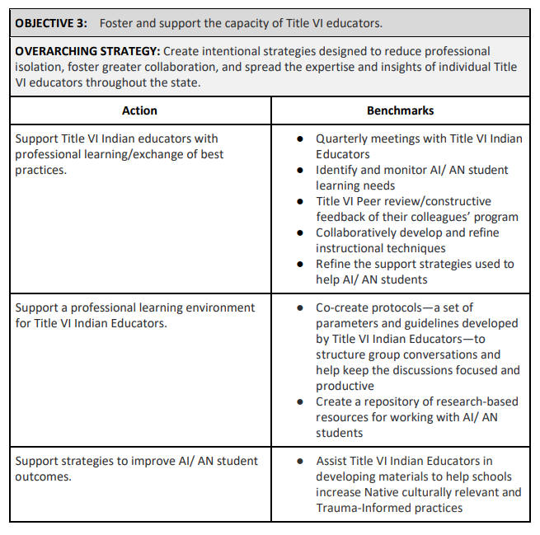
The Bigger “Why” - Looking Ahead
As codified into law in the American Indian and Alaska Native Student Success Plan, the Office of Indian Education has an obligation to our AI/AN Advisory Community and to the Government to Government Education Cluster, to uplift Objective 3 of our AI/AN SSP. This requires us as an SEA to have comprehensive knowledge and synthesis of all Title VI formula grant applications submitted by LEAs and LEA-Cs in order to uplift our AI/AN SSP Plan Goals –
The current AI/AN SSP can be found here - American Indian and Alaska Native Student Success Plan (AI/AN SSP)

Slide 16
Sharing Best Practices
Preparing for EASIE Part 1

Slide 17

EASIE Part 1 Application Window - Feb 3 to March 7
Important Links from EASIE Communities Site -
Part I of the application consists of selecting the applicant type, entering the Indian and All student count and application cycle.
EASIE Part 1 Paper Document
EASIE Part 1 FAQs
EASIE ED 506 Form Webinar SY 2021-22
UPDATED: EASIE Part I Webinar FY 2024-25
Your go-to for Technical Assistance is either
the Partner Support Center at 866-731-4711, or
Greg Hindsley, US Department of Education OIE Formula Team for Oregon at 202-453-5795 or gregory.hindsley@ed.gov

Slide 18
Sharing Our Best Practices
Take 3 minutes of work time. Type into the chat some of your BEST PRACTICES for -
🦅 Ensuring an accurate and higher Indian Student Count.
🦅 Maintaining secure records in the event of an audit or staff turnover
🦅 Raising awareness of the 506 form – internally with staff or externally with families
🦅 How your districts utilizes electronic versions of the 506 form
🦅 How your IPC has gotten involved to help recruit more families
We will then ask some of you to expand more upon your reflection to learn from you after the chat is full of your wisdom!

Slide 19

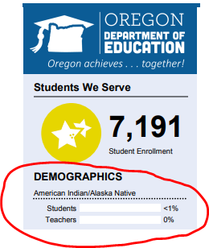
AI/AN
Federal Definition
A student identifies as American Indian/Alaska Native ONLY, and are non-Hispanic
Example:
This is the only data published in state accountability reports.
AI/AN+
State Subgroup
A student identifies as American Indian/Alaska Native and/or one or more other Races and/or Hispanic
Examples of How AI/AN Students are Hidden in the Data -
AI/AN and Black/African American = Multiracial by Federal reporting standards
AI/AN and Hispanic =
Hispanic by Federal reporting standards
This demographic data is only published in the statewide annual report card; it is not connected to any accountability data.
Tribally Affiliated (ODE’s Guidance)
New State Data Collection Requirement in SY24-25
A student identifies as being affiliated with a federally recognized tribe through their own, their parent's or their grandparents enrollment in a federally recognized tribe.
May 2024 Memo
A family does not provide any documentation to verify their enrollment or descendancy. It is entirely self-reported.
*Only federally recognized tribes are included at this time.
506 Indian Student Eligibility Certification Form
US Department of Education Requirement
The official record of the eligibility determination for each individual student included in the student count for the Title VI Indian Education Formula Grant Program.
506 Form

Slide 20
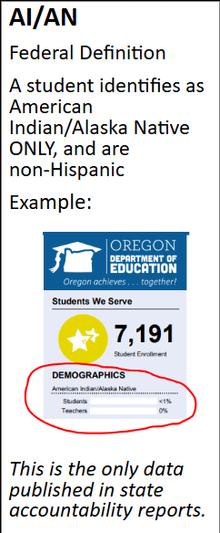
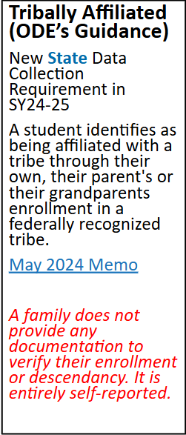

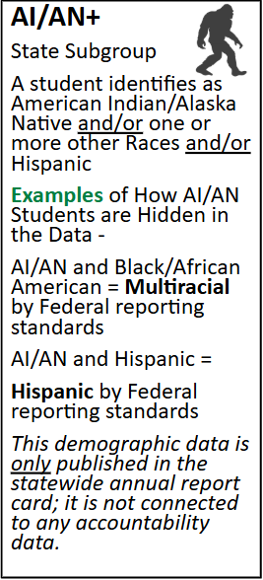
506 Indian Student Eligibility Certification Form
US Department of Education Requirement
The official record of the eligibility determination for each individual student included in the student count for the Title VI Indian Education Formula Grant Program.
506 Form
SUBMITTED DURING
Who are our eligible students?
ODE Help Guide for 506 Counts
EASIE PART 1 WINDOW

Slide 21
Community of Practice Shared Drive
Please bookmark the link to the folder dropped in the Chat. We will not be posting it here, because these slides are shared publicly.
Notes:
https://drive.google.com/drive/folders/13H1gX2FzA_edl5cKmGq0MyAiD30yhcGO?usp=drive_link

Slide 22
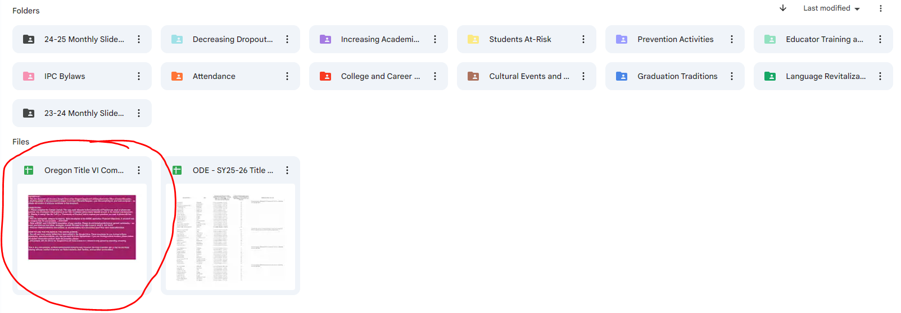
Step 1 - Open the circled document. Read the directions.
Step 2 - Fill out the Contact List first. This list is not public, but for internal use.
Step 3 - Contribute to the CoP tab as much or little as you like!

Slide 23
Contact Stacy Anytime
Stacy Parrish, Education Program Specialist II
Email - stacy.parrish@ode.oregon.gov
Book an Office Hours -
Book time with STACY PARRISH * ODE
Text/Call - 971-208-0270
I am available for things like…
Indian Parent Committee Training
“Advocating Up” Help
Data Analysis Work / Data Systems
ESD Consortium Support
Tribal Consultation and Improving Tribal Relations Help/Coaching

