Slide 1
Exploring Movement in Nature
3rd Grade
Science Lesson
Time Immemorial is a very long time ago, before anyone remembers.
Notes:
Note to teachers: This lesson focuses on the Essential Understandings, Lifeways and Since Time Immemorial, which refers to the deep, ancestral connection that Oregon’s tribal nations have to their lands, cultures and traditions.

Slide 2
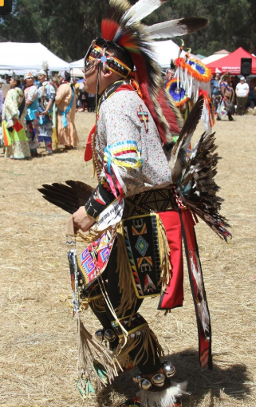
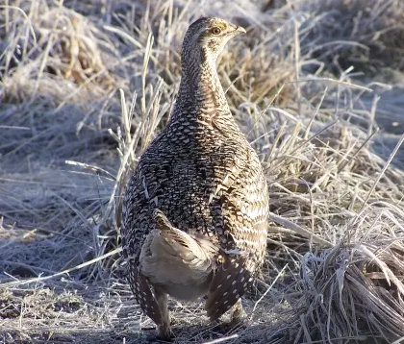
Learning From Animals
Traditional Native American dances help pass down knowledge from one generation to the next, showing how people, animals and the land are all connected.
Sharp-Tailed Grouse aka Prairie Chickens
Used to live in the grasslands and foothills of Cascade Mountains in Oregon
Chicken Dancer at
Stanford Powwow
Notes:
Step 1:
Activate students’ prior knowledge. Ask if students have ever heard a story about animals living in nature. Explain that this is one way people record what they see so they can remember it and share it with others later. Let students know that today they will learn how some people use dance to communicate what they've learned about animals from observing them.
Step 2:
Introduce students to the idea that animals’ behavior helps them live well in their environments and that people can observe these behaviors to learn how to also live well in those places. Share that animals move their bodies in different ways to help them live well in places like the mountains or the ocean. When people learn about the way animals adjust, they can sometimes learn useful tricks.
Explain that Native American Tribes honor nature by creating dances that replicate the movements and behaviors of animals in nature. These dances help pass down knowledge from one generation to the next, showing how people, animals, and the land are all connected.
Pic 1, Photo by Mike Hansen via Oregon Department of Fish and Wildlife (https://myodfw.com/wildlife-viewing/species/sharp-tailed-grouse#:~:text=Columbian%20sharp%2Dtailed%20grouse%2C%20commonly,the%20state%20by%20the%201970s.)
Pic 2 from FineARt on freepik.com (Stanford Powwow)

Slide 3
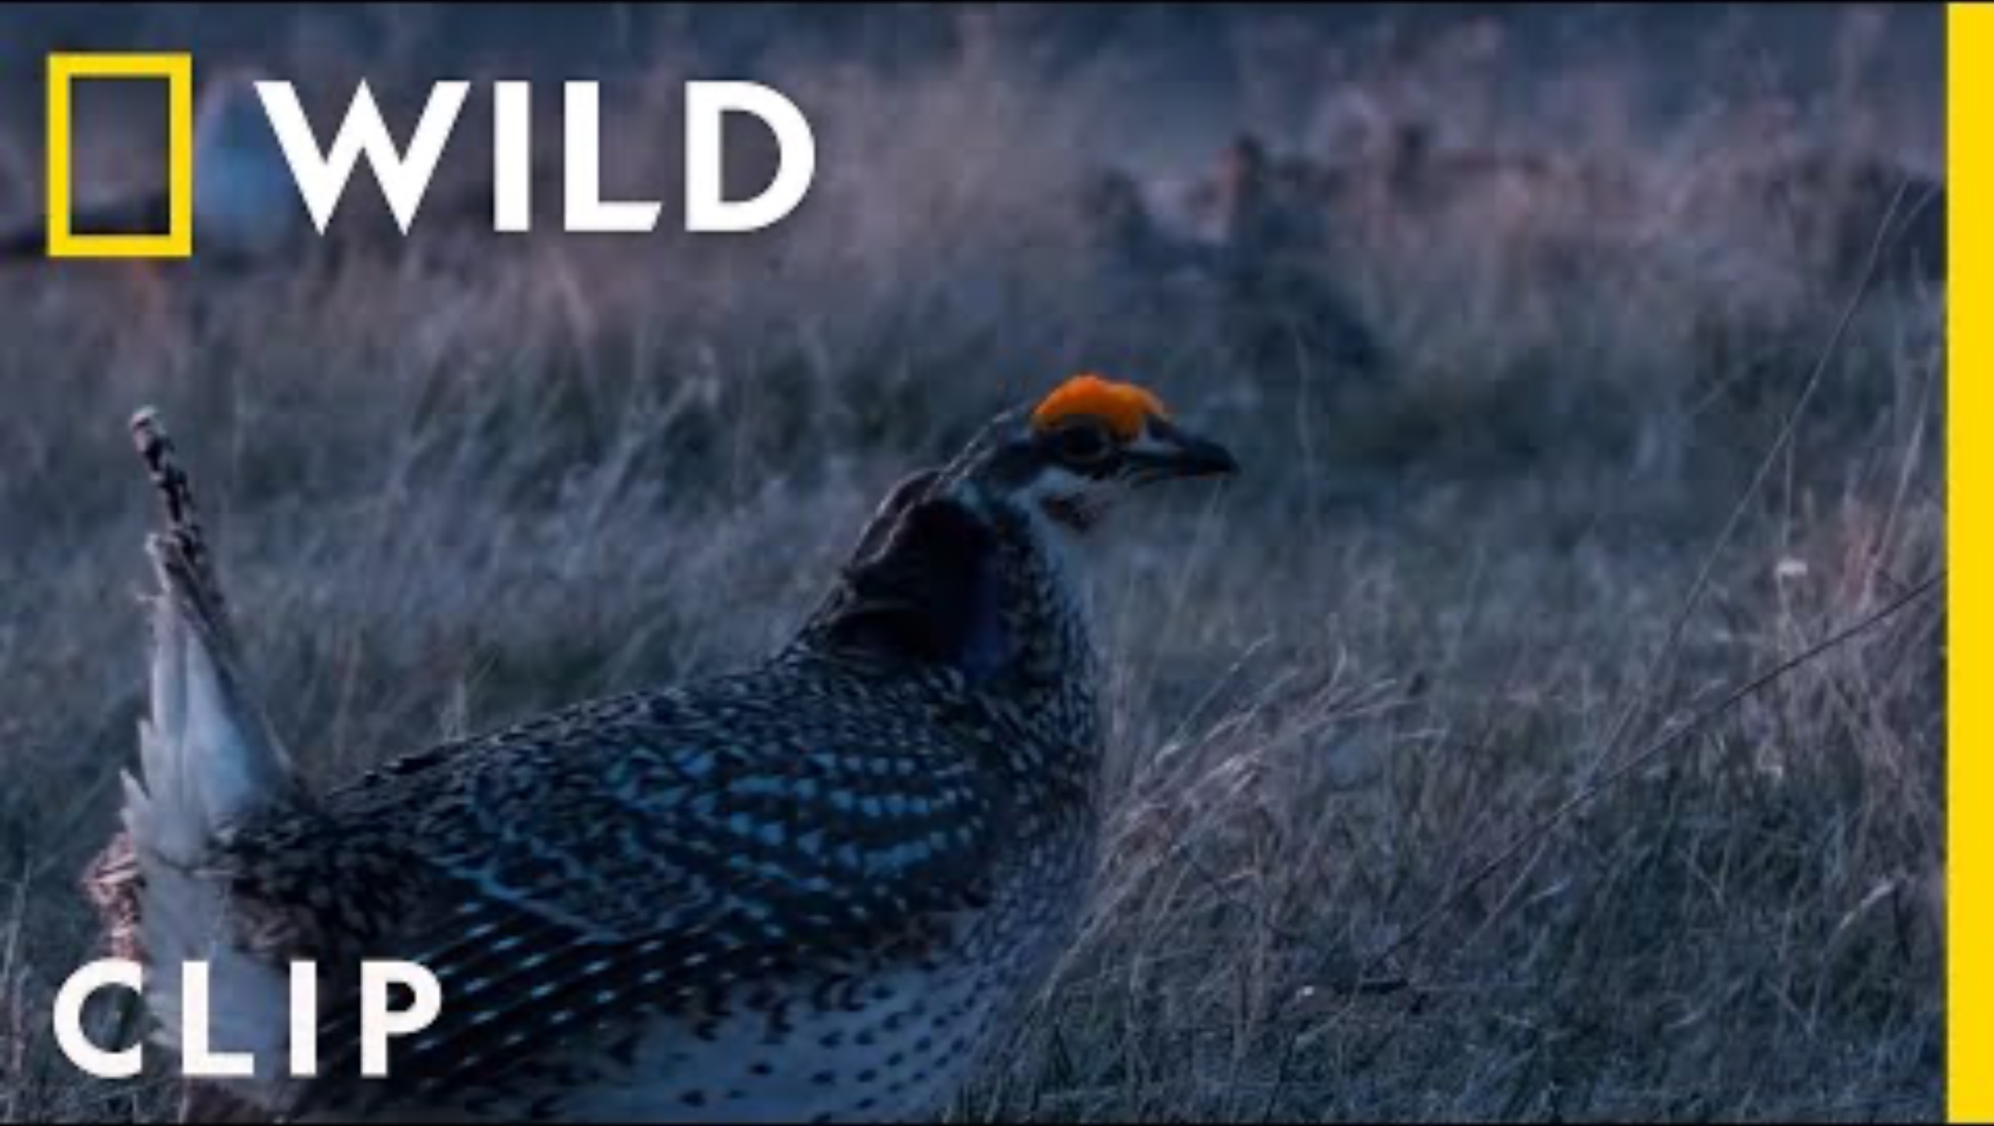
Sharp-tailed Grouse aka Prairie Chickens
Notes:
Next, help students explore this idea by watching real-life animal behavior.
Provide students with the opportunity to observe and respond to real-life animal behavior. Ask students to stand up and prepare to move their bodies. Show them a video of a male sage grouse courting, puffing out his chest and fanning his feathers. These birds live in the sagebrush of Oregon. Ask students to copy the bird's movements.
Video: Sharp-tailed grouse have a dance battle in the Badlands: https://www.youtube.com/watch?v=vUicA4gRC24
When the video ends, ask students, "What did you notice about how the birds moved their bodies? Do you think it will be easier for you to remember how the sage grouse moves now that you have moved like one?”

Slide 4
Essential Question
How do Oregon Tribes share what they know about animals?
Notes:
Share the essential question with students and ask if they have any ideas about how to answer it. This is intended to spark curiosity and get students thinking about a bigger picture.

Slide 5
Learning Outcomes
Success Criteria
I understand that animals change based on their environments.
I understand that Native American Tribes have lived in Oregon since time immemorial, and they learn from animals to live better.
I understand that people can learn from animals by observing them.
I can explain why Oregon Tribes show animal movements in their dances.
I can copy animal movements that I observe.
I can describe one animal movement I observe.
Notes:
Review the learning outcomes and success criteria with students so they understand what the intended learning is and what it looks like when they’ve achieved it.

Slide 6
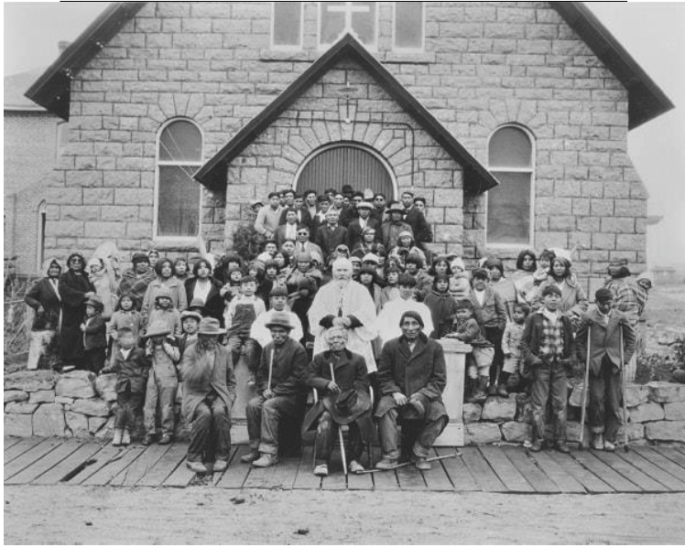
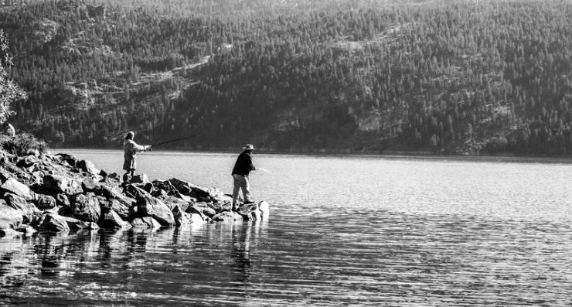
Time Immemorial Means Since the Beginning
“From the coast to the interior valleys to the plateau and to the great basin, tribal peoples maintain continuous and balanced relationships including land and water.”
The Essential Understandings,
page 4
Photo courtesy of The Burns Paiute Tribe
Notes:
Discuss the meaning of "time immemorial.“ Emphasize that tribal nations were created in this place and have existed here since the beginning of time, developing deep knowledge of the land, plants, and animals throughout countless generations.
Explain that they know a lot about the plants and animals that live here because they pay attention to nature and the world around them.
Say: “Some tribes use dance to tell stories and teach children how animals and nature work together.”
Photo by EyeEm on freepik.com

Slide 7
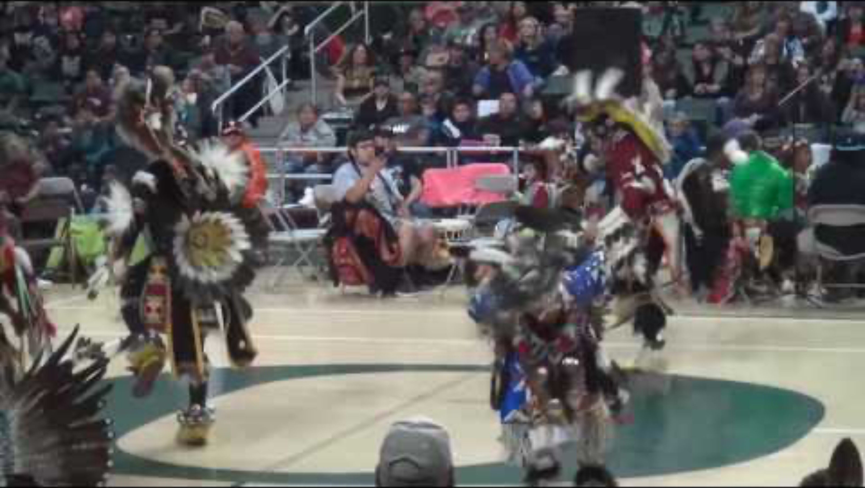
Traditional Chicken Dance
University of Oregon Powwow Chicken Dance
Notes:
Provide context for the activity. Explain that Native American Tribes create dances that imitate the movements and behaviors of animals in nature. These dances help pass down knowledge about animals that can be helpful to others.
Give students an opportunity to see dance as a way to show what they have learned about animals. Explain that some Native American dances, like the Chicken Dance, are inspired by birds that live in Oregon, such as the grouse. Share that the chicken dance is a traditional men's dance often seen at powwows. A powwow is a gathering where people come together to dance, sing, and celebrate their cultures. The chicken dance was inspired by the prairie chicken's movements, such as puffing out its chest and shaking its feathers to attract attention. Dancers copy the bird's movements in the wild. This dance honors the bird and teaches us about its behavior and place in nature.
Watch a short video clip of the dance at a powwow. University of Oregon Powwow Chicken Dance (1:00–3:11)
Additional video option: FCNU Powwow Chicken Dance (1:30–3:44)

Slide 8
What movements did you see?
Now draw what you saw!
Were they steps, hops or shakes?
Were they fast, slow or sharp?
Were they funny, cute or exciting?
Notes:
Students reflect and share. Ask students to share the types of movement they saw, such as small hops, quick steps and shoulder shakes. Record their answers in a table you create on chart paper or on the whiteboard. There is an example table at the end of this lesson plan.
Ask students to share something they noticed about each movement, e.g., was it fast, slow, big, small, sharp, soft? Add this information to the table.
Ask students to think about the effects of the different movements, e.g., were they silly, cute, fun, exciting, scary? Add this information to the table.
Ask students why they think the dancers and the sage grouse might move in those ways. Explain to students that these movements are a way that the grouse tries to get attention from other grouse. Native people in Oregon have tried to learn from the sage grouse.
Let students know that observing and thinking about these movements helps us understand animals and one another. Explain that putting this type of information into a table is another way to show and share ideas with one another. (See the worksheet handout)
Ask students to pick one of the movements and do a drawing of it. If they can, they can also label it, copying the words about the movement from the shared table.
Have students turn and talk with a peer to share about the movement in their drawing.

Slide 9


Self-assessment
Success Criteria | Not Yet | Yes
I can explain why Oregon Tribes show animal movements in their dances?
I can copy animal movements that I observe?
I can describe one animal movement I observe?
Notes:
Ask students to self-assess based on the success criteria. They can pick their level of learning (not yet, sort of, or yes) and share with a peer, or you can print out the self-assessment and ask students to fill it out and turn it in.

Slide 10
Thank you!

