Slide 1
All About Ancestors
3rd grade
Science Lesson
Tradition is a way of doing things that is passed down from long ago.
Notes:
Note to teachers: In this lesson, students will explore the concept of ancestors and understand that Native American ancestors lived in Oregon since time immemorial. Over time, their cultural traditions, customs, and ways of life have adapted. Students will also engage in an activity identifying their own ancestors. This also reinforces the idea that Native American cultures in Oregon are living and evolving today.

Slide 2
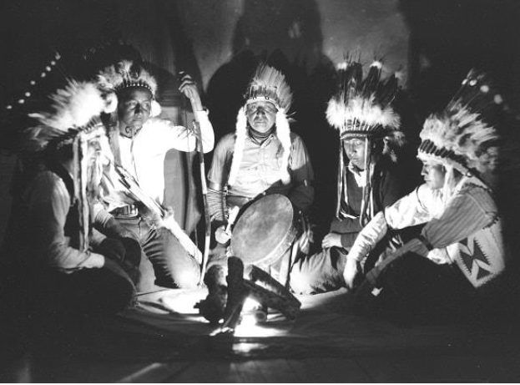
Essential Question
What is an ancestor and why are they important for Oregon Tribes?
Photo courtesy of The Burns Paiute Tribe​
Notes:
Read and discuss what this might mean. Give students an opportunity to answer, question and wonder.
Photo courtesy of The Burns Paiute Tribe

Slide 3
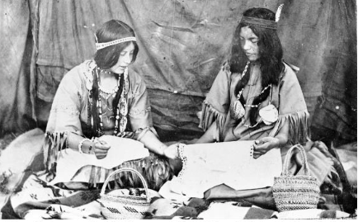
Group Talk
Do you know what an ancestor is?
Photo courtesy of The Confederated Tribes of Siletz Indians
Notes:
Ask students What do you think of when you hear the word “ancestors”?
Tell them to turn and talk to their elbow partner about the word “ancestors”.
Ask a few students to share their thoughts with the whole group.
Provide clarification as needed.
Say: "An ancestor is a person in our family who lived a long, long time ago, like your great-grandparents or even people from even further back in time. Everyone has ancestors“.
Say: “For many Native Americans, animals and plants are also relatives and ancestors.”
Say: “Ancestors can also be living creatures from a long time ago. We don’t always know them, but they are a part of our history and help shape who we are today.”
Let students share any thoughts or experiences they have about ancestors.
Photo courtesy of The Confederated Tribes of Siletz Indians

Slide 4
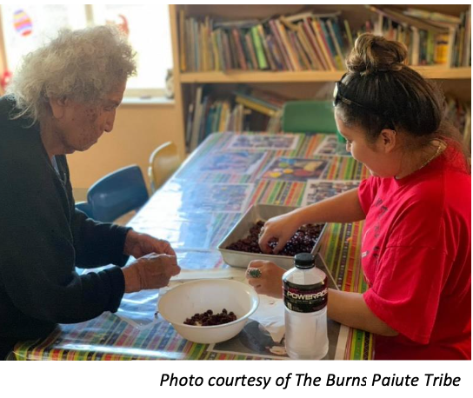
Ancestors
People in our family who lived a long, long time ago.
Like your grandparents and great-grandparents.
Photo courtesy of The Burns Paiute Tribe​
Notes:
Say: "An ancestor is a person in our family who lived a long, long time ago, like your great-grandparents or even people from even further back in time! Everyone has ancestors"
Say: “For many Native Americans, animals and plants are also relatives and ancestors.”
Say: “Ancestors can also be living creatures from a long time ago. We don’t always know them, but they are a part of our history and help shape who we are today.”
Why do you think people talk about their ancestors?"
"What can we learn from talking about, and thinking about our ancestors?
Photo courtesy of The Burns Paiute Tribe

Slide 5
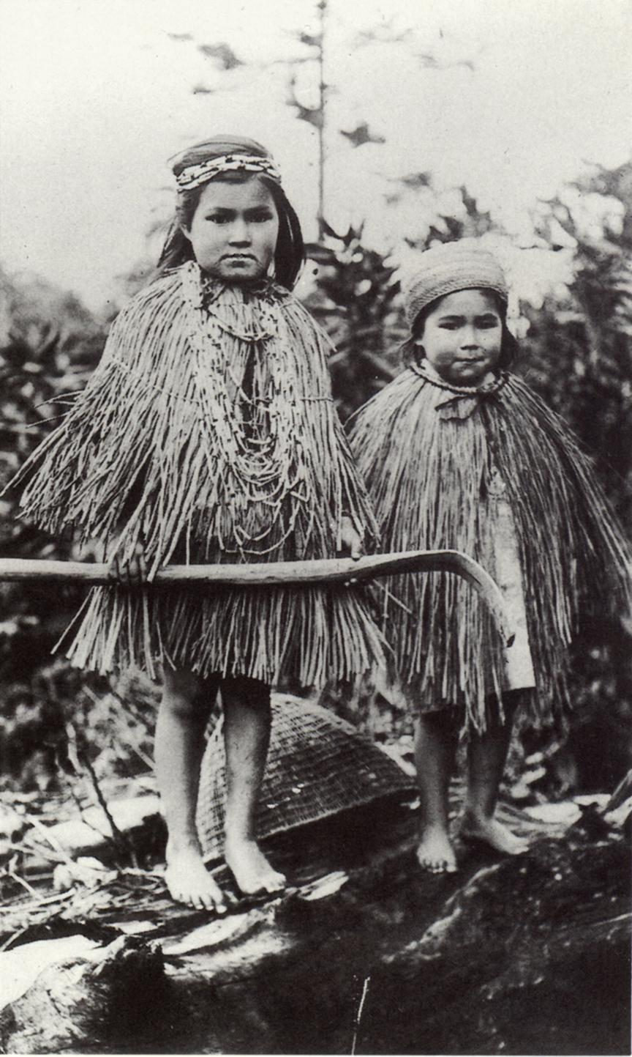
Native American ancestors in Oregon have lived here since time immemorial—since a very long time ago.
Image from CTCLUSI, Photographer Morgan Gaine.s
Notes:
Say, “Some ancestors came to this country from other countries, while others, like Native American ancestors in Oregon, have lived here since time immemorial, meaning they have been here a very, very long time. Some ways of life are the same as back then, while others have changed over time.”
Image from CTCLUSI, Photographer Morgan Gaines.

Slide 6
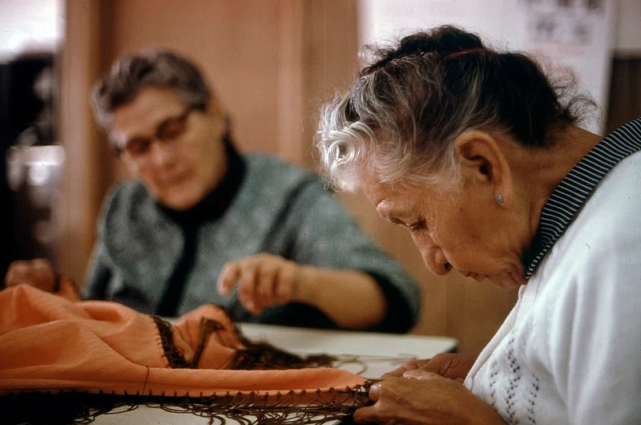
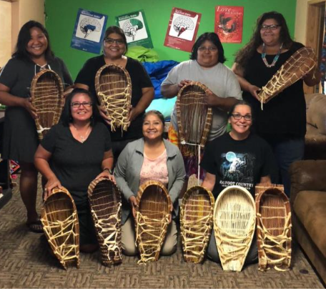
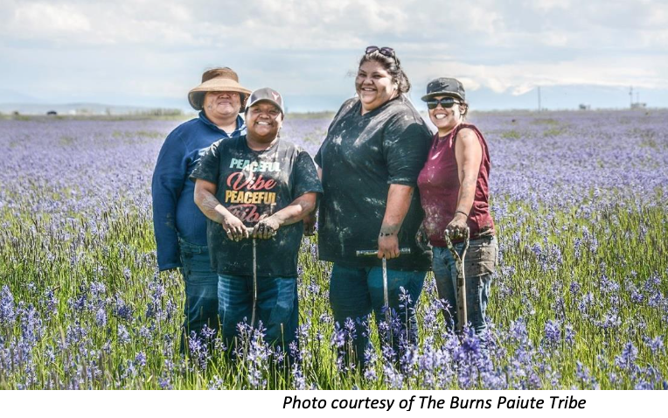
Traditions
Photographer: Duncan, Patricia D., Original public domain image​
Photo courtesy of The Burns Paiute Tribe
Photo courtesy of The Burns Paiute Tribe
Notes:
Say,
“Ancestors teach us about our family traditions and how to keep them going. A tradition is a special way our family does something or a story we tell.
Oregon Tribes have many traditions that their ancestors have taught through time immemorial.
There are crafts like making baby carriers we see in the first picture.
Histories and stories, like we see being told in the middle picture.
And there are ways of farming the land, like we see in the last picture.”
Ask, “Do you have any family traditions, like weekly dinners, celebrating birthdays or holidays, or times for storytelling?”
Have students share with a friend before the whole group.
Photo 2: Photographer: Duncan, Patricia D., Original public domain image
Photos 1 and 3 courtesy of The Burns Paiute Tribe

Slide 7
Learning Expectations
Learning Outcomes
I understand that ancestors are family members from long ago.
I understand that Native American ancestors lived in Oregon since time immemorial.
I understand that Native American ancestors in Oregon passed down cultures and traditions that are still thriving today.
Success Criteria
I can explain what an ancestor is.
I can share about one tradition I know.
I can describe why coyote is an ancestor.
I can identify ancestors in my own family.
Notes:
Review the Learning Outcomes and Success Criteria with students so they understand what the intended learning is and what it looks like when they’ve achieved it.

Slide 8
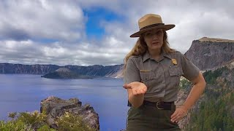
Storytime: Coyote and Crater Lake
Notes:
Story Time: Coyote and Crater Lake
Explain that Native American stories are important ways to understand how the world was made and how nature came to be. Stories can also share a little about ancestors. Say, “Today, you will watch a video of a traditional story of how Crater Lake was formed. It is a story that was shared down through ancestors. The story is called Coyote in Love with a Star. It is a story told by the Klamath Tribe and other Tribes in Oregon.”
Ask students to pair-share what they learned about ancestors in the video. Invite a few students to share with the whole group.
Virtual Junior Ranger Activity Video- https://youtu.be/fH4AkVyHHP4 (5:44 mins). Play video from 1:46 - 4:34 min
The story is compiled and shared in the book Coyote was Going There by Gerald Ramsey.

Slide 9
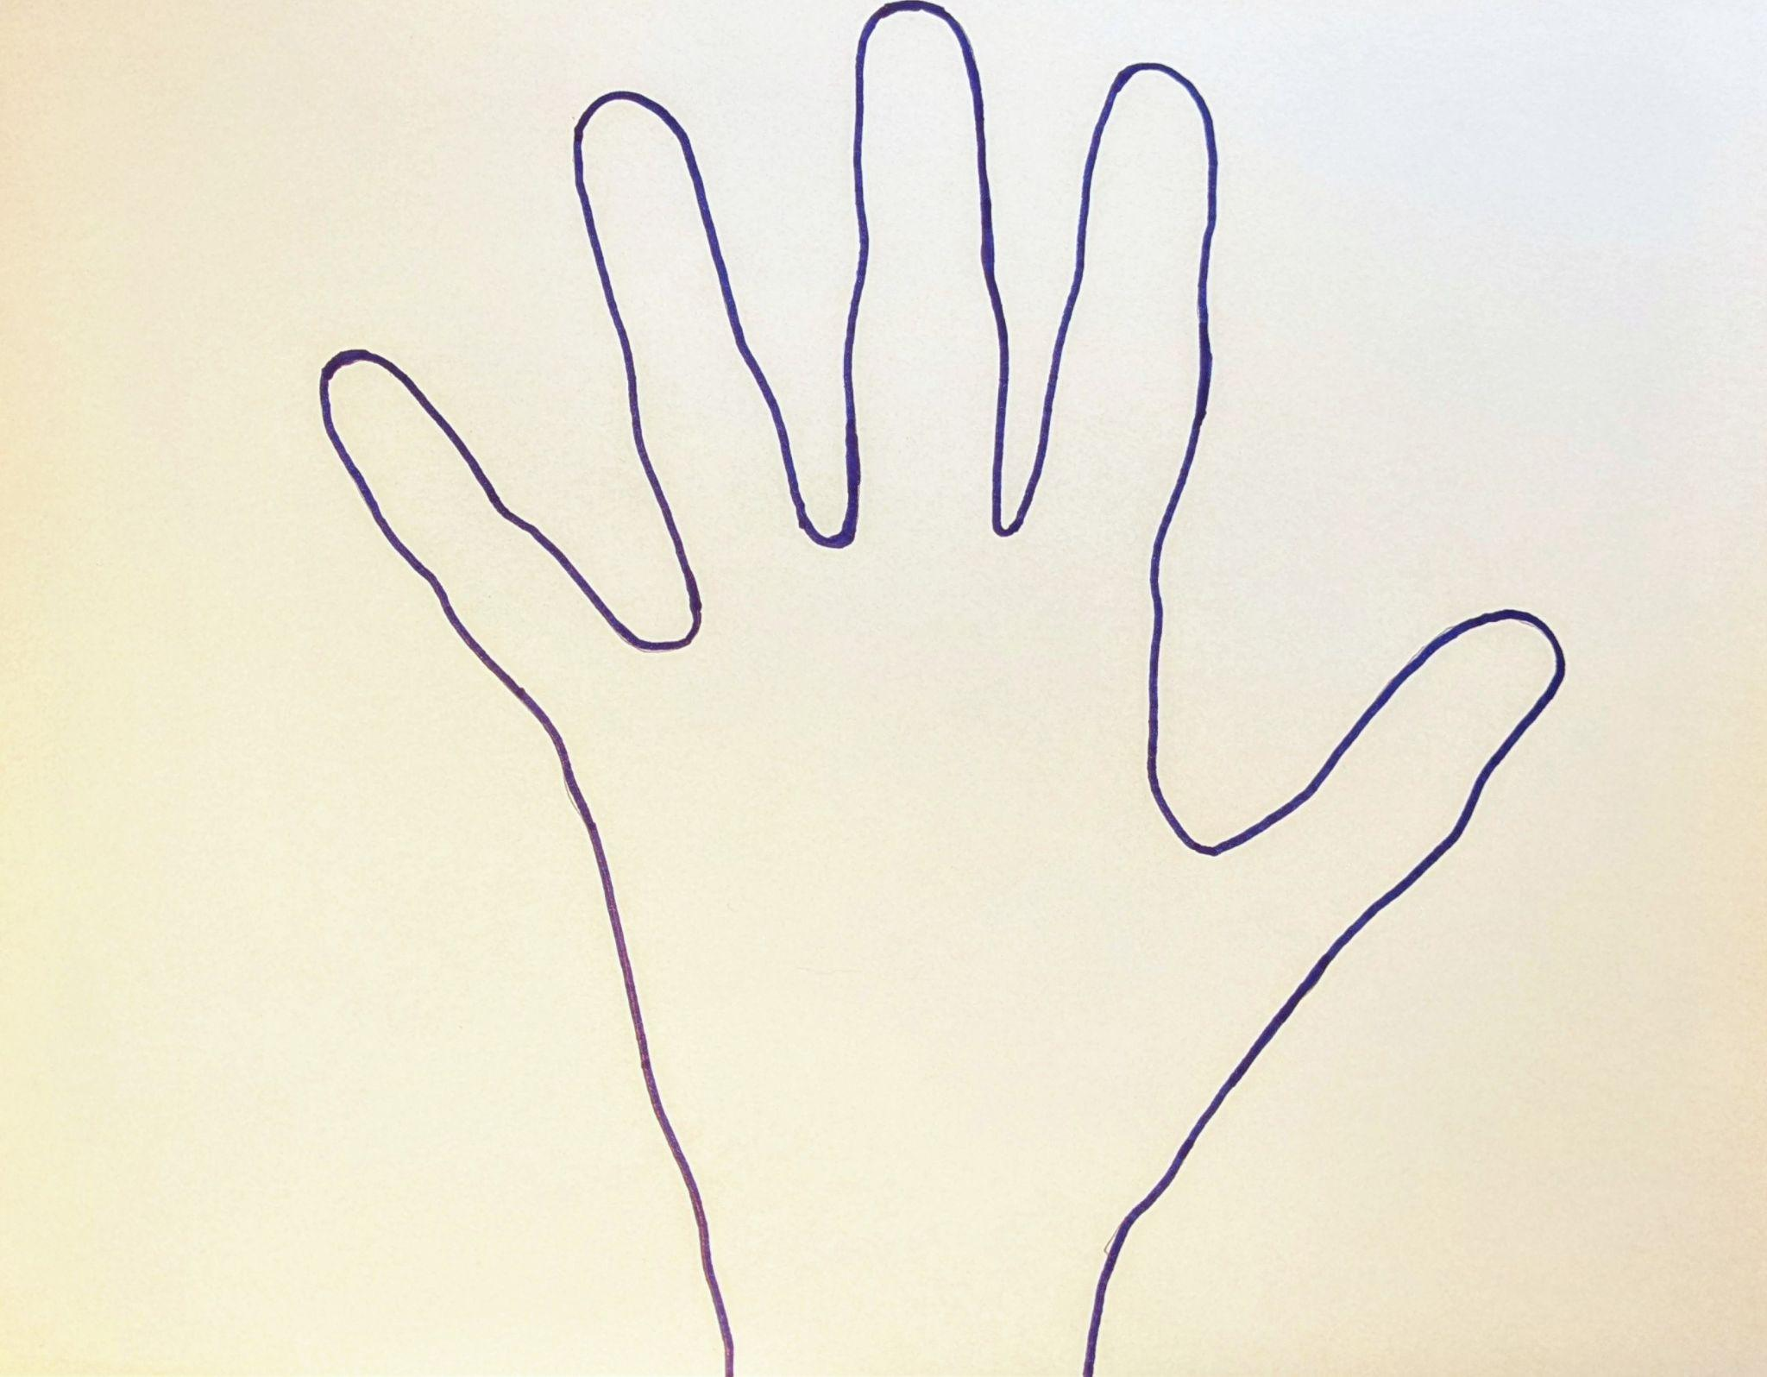
My Ancestors
Notes:
Activity
Project a tracing of your hand on the whiteboard or project this slide on a whiteboard and add to it. Model for students how to add names and pictures from your own or another family.
Ask students to either trace their own hand and write their name on the palm of the hand or use the handout with a hand already drawn for them. Then have them draw pictures or names of their human ancestors on their fingers.
You can ask them to include their non-human relatives and ancestors (dogs, cats, fish) and have them add them to their ancestors.
Share the idea that ancestors lived long ago but are still important to us today.
--------------------------------------------------------------
Handprint Circle of Care Activity Instructions
Have each student trace their hand on a piece of paper.
In the palm, they write or draw themselves (e.g., "Me!" with a self-portrait or name).
In each finger, they write or draw someone important to them—this could be a parent, friend, grandparent, teacher, pet, or anyone they feel close to. You can ask them to include their non-human relatives and ancestors (dogs, cats, fish) and have them add it to their ancestors.
They can decorate it with stickers, drawings, or color it in.
If students need additional support, project a tracing of your hand on the whiteboard or project the slide on a whiteboard. Model for students how to add names and pictures from your own or another family. There is also a handout with a traced hand on it that students can use if they are not able to do the drawing themselves.

Slide 10
Closing
"One thing I learned about Native American ancestors is _________."
"A story my family passed down to me is ____________________."
Notes:
Wrap-up and Reflection (3 minutes)
Recap key concepts:
Say, “Today, we learned that ancestors are family members from long ago who passed down traditions. Native American ancestors in Oregon lived here for thousands of years, and their cultures are still alive today. And their stories and ancestors can still be seen in the Oregon landscapes today, like Crater Lake.
Ask reflection questions
"What is something new you learned today about Native American ancestors?"
"What are some traditions or stories your family has passed down to you?"
Students can share their answer with a peer and then with the whole group.

Slide 11


Self-assessment
# | Success Criteria | Not yet | Yes
1 | Can I explain what an ancestor is? | . | .
2 | Can I share about one tradition I know? | . | .
3 | Can I describe why coyote is an ancestor? | . | .
4 | Can I identify ancestors in my own family? | . | .
Notes:
Revisit the Success Criteria.
Ask students to complete the self-assessment, either verbally to a peer or by completing the self-assessment form, indicating their learning relative to the Success Criteria.
Success Criteria
I can explain what an ancestor is.
I can share one tradition I know.
I can describe why Coyote is considered an ancestor.
I can identify ancestors in my own family.

Slide 12
luuwii!
pronounced “loo – wee”
“thank you” in Hanis,
language of the Coos Tribe

