Slide 1
Learning From Ceremonies
Kindergarten
English Language Arts
Identity is about understanding yourself and what makes you, you.
Notes:
Opening Step 1:
Gather the students in a circle.
Ask students to think about special days celebrated by their families and communities. Ask students to share examples of these special days. Explain that celebrations and ceremonies are a big part of Tribes’ identities. Identities are the ways that we think about ourselves and our communities.
Say, “There are many Native American Tribes across Oregon that have ceremonies to celebrate special times and special animals like the C’waam. At these ceremonies, sometimes young kids learn from older people, from elders, about nature and traditional ways of living.
Say, “Today, we will learn about the Klamath Tribes’ C’waam Ceremony. Other Oregon Tribes have similar ceremonies.

Slide 2
Essential Question
How do ceremonies help grow your identity?
Notes:
Opening Step 2:
Review the Essential Question with students. Give them an opportunity to answer, question and wonder.
How do ceremonies grow people’s identity?

Slide 3
Learning Outcomes
Success Criteria
I understand Oregon Tribes have ceremonies as part of their identities.
I understand why the C’waam is important to Oregon Tribes and celebrated in ceremonies.
I understand that ceremonies help people understand more about themselves.
I can explain what a ceremony is.
I can describe one way that the C’waam Ceremony is important for the Klamath Tribes.
I can draw and explain one thing that happened in the C’waam Ceremony.
Notes:
Opening Step 3:
Review the learning goals and success criteria with students so they understand what the intended learning is and what it looks like when they have achieved it.

Slide 4
Key Words and Ideas
Identity: Who you are + your family
+ the things you do
+ the people you spend time with
C’waam (tch-wom): A fish with a sucker that is important to Tribes in Oregon.
Ceremony: An event for an important time.
Notes:
Main Activity 1 Step 1:
Review the key words and ideas with students. Spend time focusing on identity.
Write identity on the board
Offer an example:
On the weekend, I like to ... (read, ride my bike, bake, etc.)
I am a (reader), that is part of my identity!
Main Activity 1 Step 2:
Ask a few students to say what they like to do with their friends or family or on the weekends.
They might say: “I like to run!”
Respond: “You are a runner, that is part of your identity.”
Ask the class: “Raise your hand if you like to run!”

Slide 5
Group Talk: Celebrations
What are some special celebrations or gatherings you enjoy?
How does it make you feel to attend these celebrations?
What do you like about the celebrations?
Notes:
Main Activity 1 Step 3:
Discuss what a Celebration is - offer an example and then ask students to talk about celebrations they do with their family, ask how it feels to attend these celebrations, and what they like about the celebrations.
Then give an example of a celebration you participate in (holiday, birthday, or something with your family).
Example:
I celebrate spring by (participating in Passover, Easter, the equinox, taking time to notice the spring growth on plants, etc.).
This is a way I celebrate spring, and that is part of my identity.
It makes me feel…
I like ______part of the celebration
Ask the students:
Can anyone share a celebration they do with their family or other people?
How does it feel?
What do you like?
Explain that when groups of people have special celebrations with activities, these can be called Ceremonies.
Ask the students: Has anyone heard that term?
So, a celebration can be any party, but a ceremony has a very special meaning and activities.
Introduce the idea of a ceremony as a special celebration with activities. Let students know that ceremonies are important traditions for Oregon Tribes and that today they will look at an example of a ceremony by the Klamath Tribe.

Slide 6
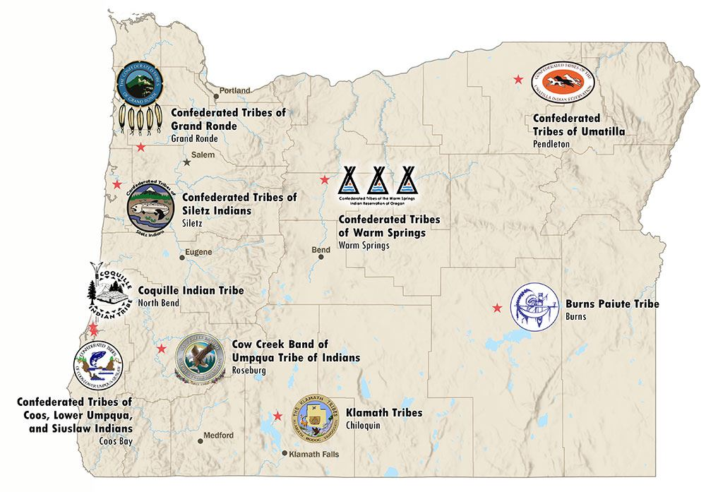

Nine Federally Recognized Tribes in Oregon
Can you find this picture on the map?
Notes:
Main Activity 1 Step 4:
Ask students if they can locate the picture of the Klamath Tribe symbol on the map. Explain that it is a symbol for the Klamath Tribes and indicates their location in Oregon on the map. The Klamath Tribes are a group of Native Americans who have lived in Oregon since time immemorial, since before anyone can remember.
Say, “Today we are going to learn about ceremonies, which are a special celebration with activities. Ceremonies are important for Oregon Tribes. Today, we will learn about a ceremony by the Klamath Tribe as an example. The Klamath Tribes, just like other Oregon Tribes, have done these ceremonies for longer than anyone can remember! As long as the rivers have existed! The Klamath Tribes (point to their land on the map) have a ceremony for a special fish every year in March called the C’waam Ceremony. Other Oregon Tribes have similar ceremonies.”
(C’Waam is pronounced T’Uaam)

Slide 7
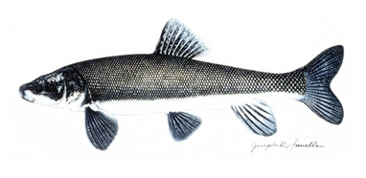
Listen and Repeat
The Klamath Tribes are Native Americans who live in Oregon.
Every March, they go to the river dance, drum and pray to their Creator so the C’waam fish will swim up the river.
C’waam fish
Notes:
Main Activity 2 Step 1:
Listen and Repeat: On slide 7, read each line and have students repeat after you:
The Klamath Tribes are Native Americans who live in Oregon. Every March, they go to the river, dance, drum and pray to their Creator so the C’waam fish will swim up the river.
Note: image from the 3rd grade Klamanth Tribes' C’waam lesson https://www.oregon.gov/ode/students-and-family/equity/NativeAmericanEducation/Documents/SB13%20Curriculum/3rd%20Grade%20Curriculum%20(Whole%20Package).pdf

Slide 8
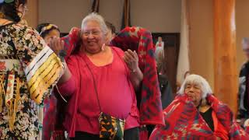
C’waam (sucker fish) Ceremony
Notes:
Main Activity 2 Step 2:
Show students this video, The Klamath Tribes' C’waam Ceremony: https://youtu.be/PlcoCz6-1CQ
Start video at 3:03 and go to the end.
Explain that this video shows part of a ceremony to honor the C’waam that is public. Part of the ceremony is private to the Klamath Tribes’ members.
Ask students to see if they can notice at least two things from the video, such as what people are doing, what the ceremony sounds like, where it takes place, what people are wearing, and how people are feeling.

Slide 9
Turn and Talk
Tell your neighbor one thing you saw in the video.
Raise your hand to share something you saw in the video.
Notes:
Main Activity 2 Step 3:
Ask them to share one thing they saw in the video.
Write the things on the board. Draw quick pictures to accompany their words.
Connect this to the idea of identity:
Explain to students that this ceremony, like many ceremonies, is very important to the Klamath Tribes because it connects the people to the natural world, in particular to the C’waam who will soon travel up the river.
Ceremonies can help to teach people about what it is important. In this example, the c’waam fish is very important to the lives of the Klamath tribal members.

Slide 10
Draw one thing you saw in the video
Notes:
Main Activity 2 Step 4:
· Have students choose one thing to draw from the Ceremony and (if appropriate) write the name of the thing
· Have students turn to a partner as say one then they learned about the C’waam ceremony

Slide 11
Closing
Turn and Talk
Tribes in Oregon, like the Klamath, have many important ceremonies, which support their identity.
Turn to your partner and tell them:
One thing about your drawing
Why the C’waam Ceremony is important
Notes:
Closing Step 1:
Turn and Talk:
Say, “Tribes in Oregon, like the Klamath, have many important Ceremonies, which support their identity.”
Have students turn to a partner and tell them:
· One thing about your drawing
· Why the C’waam Ceremony is important

Slide 12


Self-assessment
# | Success Criteria Can I… | Sort of | Yes
1 | give an example of a ceremony?
2 | say why the C’aam Ceremony is important?
3 | draw one thing from the C’aam Ceremony?
Notes:
Closing Step 2:
Ask students to self-assess based on the Success Criteria. This can also be done collectively by the whole group. They can pick their level of learning (sort of or yes) and share with a peer, or you can print out the self-assessment and ask students to fill it out and turn it in.

Slide 13
Thank You.

