Slide 1
The Importance of First Foods
Kindergarten
English Language Arts
Lifeways are how a group of people live, work and play together.

Slide 2
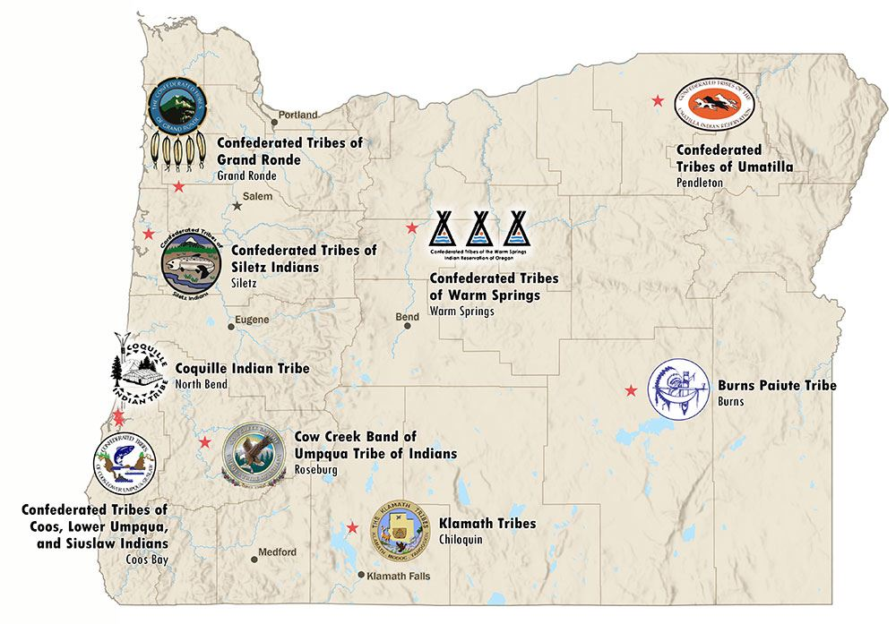
Which Tribe lives near you?
Notes:
Step 1:
Gather students in a circle.
Show students a simple map of Oregon Tell students that all the Tribes have important foods and we are going to learn about them. Point out the Tribe closest to students on the map. Explain that they all have important foods and they may be familiar with some of them. Let students know that they are going to learn about them.

Slide 3
Essential Question
How do first foods help Oregon Tribes stay strong?
Notes:
Step 2:
Review the Essential Questions with students. Give them an opportunity to answer, question and wonder.
· How do first foods help Oregon Tribes stay strong?

Slide 4
Learning Outcomes
Success Criteria
I understand what first foods are and why they are important.
I know why first foods are important to Oregon Tribes.
I know what Tribes are doing today to protect first foods.
I can explain what first food are.
I can say why first foods are important to Oregon Tribes.
I can describe what one food does for one's body.
Notes:
Step 3:
Review the learning outcomes and success criteria with students so they understand what the intended learning is and what it looks like when they have achieved it.

Slide 5
Key Words and Ideas
First foods are foods important to Native American Tribes.
Healthy means good for our bodies and minds.
The Confederated Tribes of the Umatilla Indian Reservation are a Native Nation in Oregon.
Lifeways are ways that people live their lives.
Notes:
Step 4:
Review the key words and ideas with students.

Slide 6
First Foods Are the Heartbeat of Our Community
As old as time
Earth is our food provider
Each season and each first food has a thank you ceremony
The Tribe protects the land and first foods
First foods keep people strong and healthy
The Confederated Tribes of the Umatilla Reservation
Notes:
Explain to students that for the Confederated Tribes of the Umatilla Indian Reservation and other tribes in Oregon first food are the heartbeat of the community.
Teachers read:
· Tribes lik the Cayuse, Umatilla, and Walla Walla tribes have lived in the same area for a very, very long time - longer than anyone can remember!
· The tribes believe the earth gives them all the food they need. Before they eat any new foods each season, they say "thank you" with special celebrations. The Cayuse, Umatilla, and Walla Walla Tribes still have a Root Feast today!
· The tribal governments works hard to protect these special foods.
· They want to make sure there will always be clean water, healthy salmon, plenty of deer, growing roots, and sweet berries for their people.
· These first foods help keep the people strong and healthy
Text adapted from the Cayuse-Umatilla-Walla Walla Confederated Tribes of the Umatilla Indian Reservation website on First Foods and Life Cycles- The heartbeat of our community https://ctuir.org/about/first-foods/

Slide 7
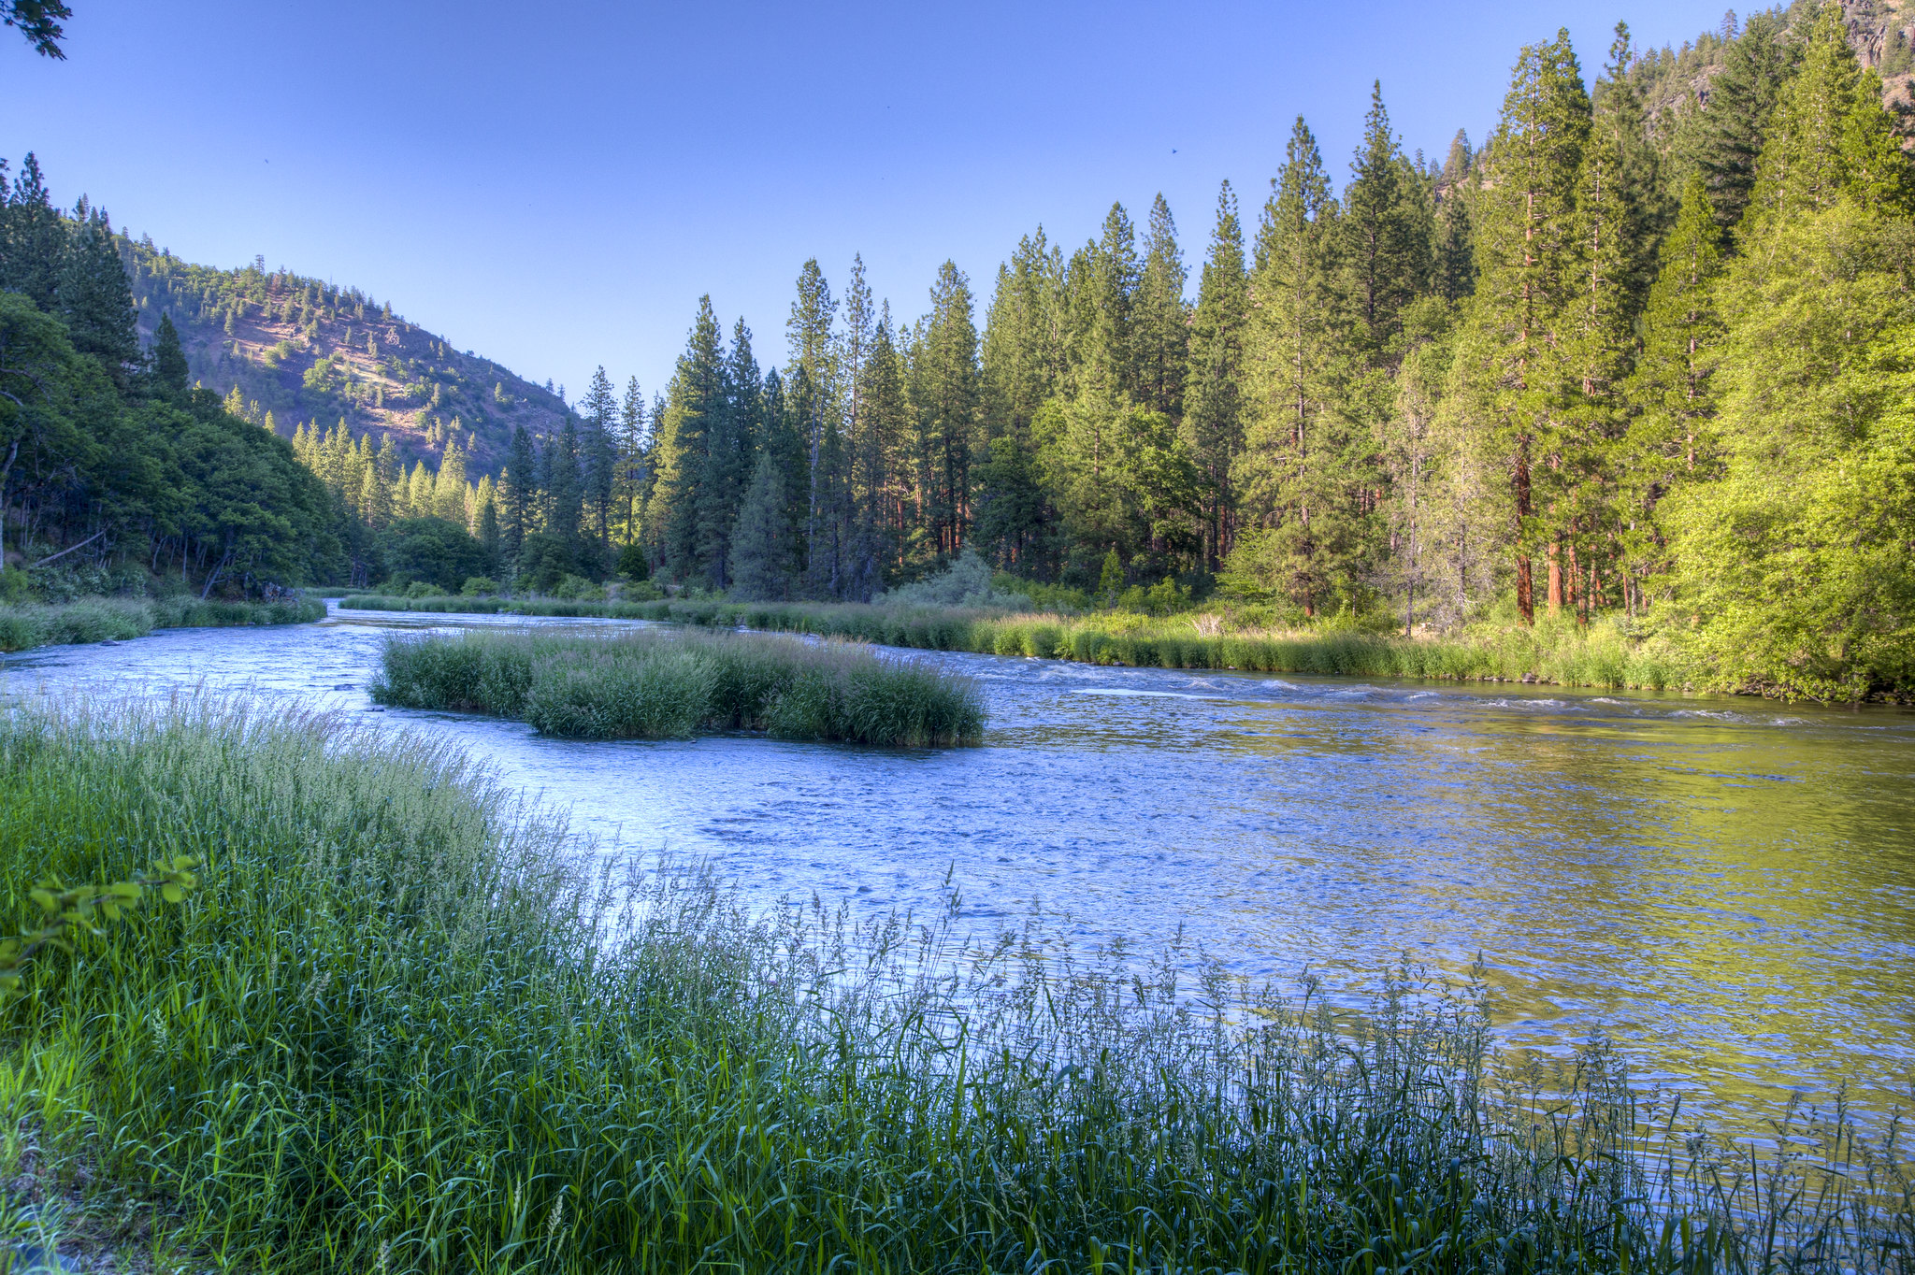
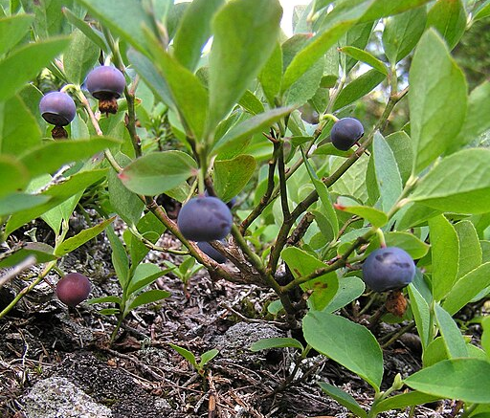
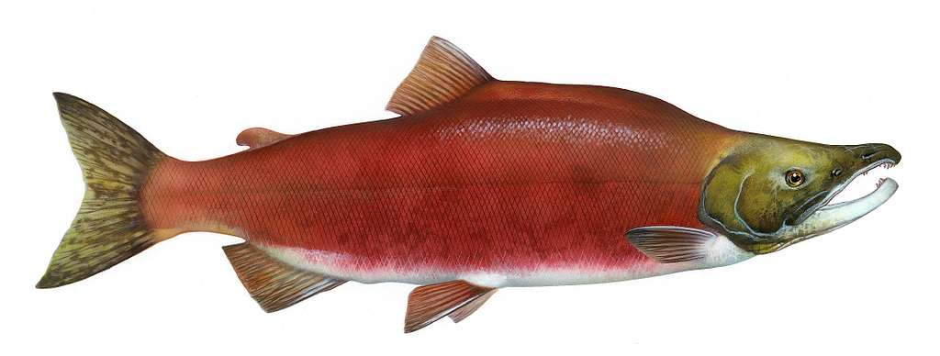
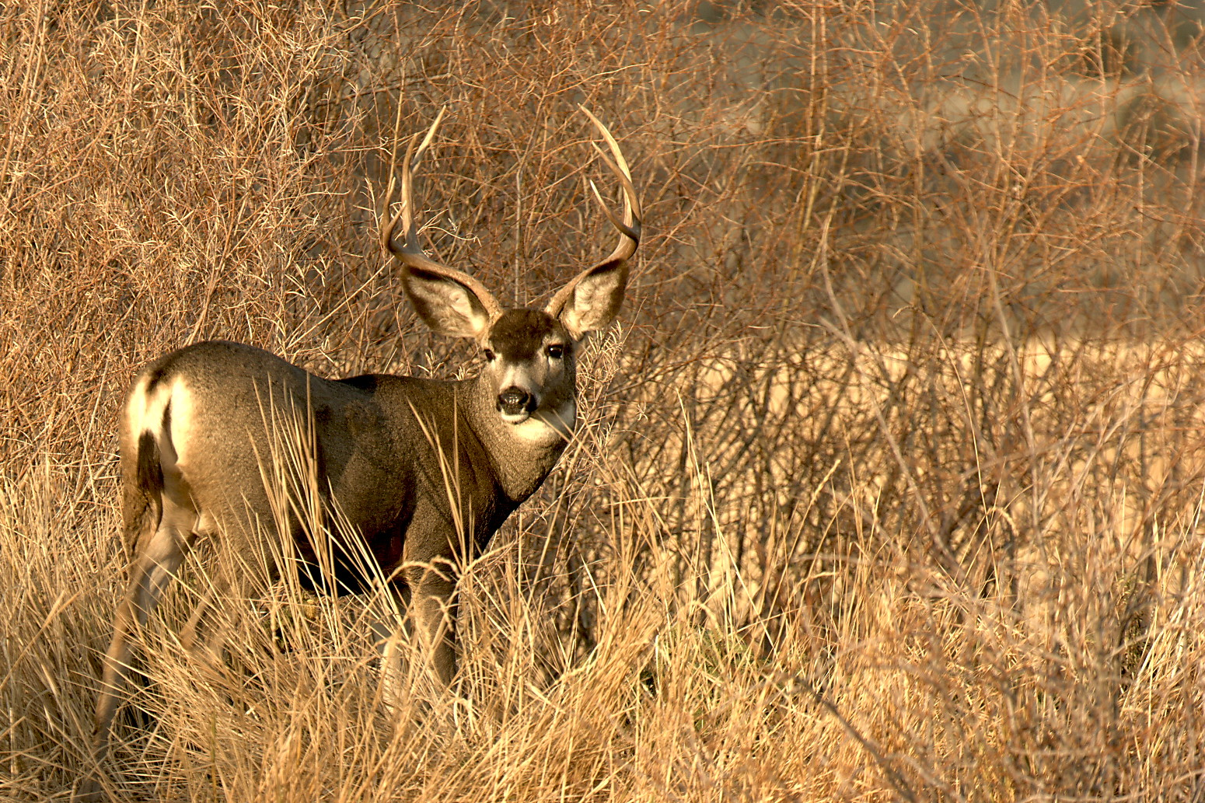
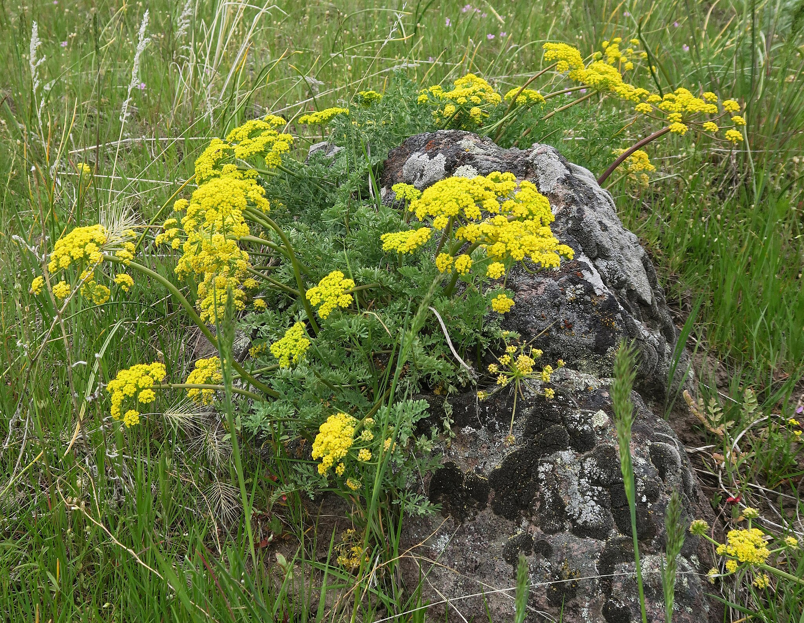
What plants and animals do you see that might be first foods?
PICRYL.com
Photo by Bob Wick, BLM.
Laurel F, CC BY-SA 2.0 , via Wikimedia Commons
Photo by Barabara Wheeler
Adamschneider, CC BY-SA 4.0 , via Wikimedia Commons
Notes:
Step 1:
Share with the students that Oregon Tribes like the Cayuse, Umatilla, and Walla Walla tribes have lived in the same area for a very, very long time - longer than anyone can remember! These Tribes follow a special food circle. The most important foods are:
· Water (which is in the center of the circle)
· Salmon (fish from the rivers)
· Deer and elk (animals from the forest)
· Roots like cous (plants that grow in the ground)
· Berries like huckleberries (sweet fruits that grow on bushes)
When explaining this
Step 2:
Explain to students that long ago, the Native American families would move from place to place to find these foods:
· In spring, they went to big rivers to catch salmon
· Then they went to the hills to dig for roots
· In summer, they went to the mountains to pick berries and hunt deer
· In fall, they went back to the rivers for more salmon
· In winter, they stayed in warm camps and ate the foods they saved
The tribal government works hard to protect these special foods. They want to make sure there will always be clean water, healthy salmon, plenty of deer, growing roots, and sweet berries for their people.
These first foods help keep the people strong and healthy.
Step 3:
Group Talk: Ask students if they can identify different foods in the pictures.
· What plants and animals do you see that might be first foods?
· Have you ever tried any of these foods made from these plants and animals?
· Share with your neighbor one thing that you have learned about First Foods.
Image attributes
Klamath river: https://creativecommons.org/licenses/by/2.0/
Salmon: https://creativecommons.org/publicdomain/mark/1.0/
Deer: https://creativecommons.org/licenses/by/2.0/
Cous: https://commons.wikimedia.org/wiki/File:Lomatium_donnellii.jpg

Slide 8
Salmon
Fished in Spring
Lives in Oceans and Rivers
Protein for muscles
Omegas for brain
PICRYL.com
Notes:
First Foods Circle Activity
At the end of the lesson packet, you will find the First Foods Handout for students and First foods cycle- both color and grayscale options. You will need to cut out each item to create a simple "First Foods Circle" in the classroom making posters from the attached cards- or print out the cards and distribute one to each student.
Spend time on each of the four foods, either looking at the poster or at their individual cards.
At each poster/for each food, students can talk about:
o What the food is (Salmon)
o Where it grows and when it was eaten (Rivers, spring and fall)
o How it helps bodies grow (e.g., helps people have strong muscles)
After visiting each station ask:
o Which food would you like to eat?
o Tell the students to draw a picture of the food, show where it grows, and what it does for the body.

Slide 9
Huckleberry
Gathered in the late summer
Grow in the mountains
Dried to save for winter
Antioxidants for a strong heart
Fiber for healthy digestion
Laurel F, CC BY-SA 2.0 , via Wikimedia Commons

Slide 10
Cous or Biscuitroot
A flower with a root that is good to eat
Gathered in the early summer
Grows in hillsides and fields
Supports strong lungs
Rich in vitamins and minerals
Adamschneider, CC BY-SA 4.0 , via Wikimedia Commons

Slide 11
Deer
Hunted in the Mountains
Hunted in the late summer and fall
Dried to save for winter
Protein for strong muscles
Phosphorus for strong bones
Photo by Barabara Wheeler
Notes:
When students finish with the first foods circle activity, ask them to draw one of the foods and the place where it grows.
Image information: Mule deer buck at Malheur National Wildlife Refuge in Oregon, Barbara Wheeler, Public Domain, https://www.fws.gov/media/mule-deer-buck-malheur-national-wildlife-refuge-oregon

Slide 12
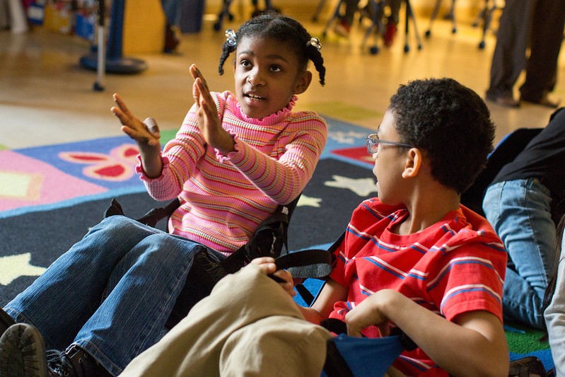
Turn and Talk
Photo by Allison Shelley/The Verbatim Agency for EDUimages​
Notes:
Step 1: Reflection and Discussion
Review key points: "Today we learned about the Oregon Tribes' special foods called first foods."
Directions to students:
· Tell your neighbor two things:
o Why first foods are important to Tribes like the Confederated Tribes of the Umatilla Indian Reservation.
o How the food helps one's body
Afterwards, ask a few students to share with the whole group.
Image source: images.all4ed.org/
PHOTO CREDIT: Photo by Allison Shelley/The Verbatim Agency for EDUimages

Slide 13


Self-assessment
# | Did I… ? | Not Yet | Yes
1 | give an example of what a first food is?
2 | say why first foods are important?
3 | describe what the food does for my body?
Notes:
Step 2: Self-Assessment
Ask students to self-assess based on the success criteria. They can pick their level of learning (not yet, sort of, or yes) and share with a peer.

Slide 14
luuwii!
pronounced “loo - wee”
“Thank you” ​ In Hanis, language of the Coos Tribe

