Slide 1

Geography and Mapping Traditional Lands

Slide 2
Essential Understanding:
Since Time Immemorial
Oral traditions of tribes maintain teachings that indigenous people were created here and have existed here since time immemorial. From the coast to the interior valleys to the plateau and to the great basin, tribal peoples maintain continuous and balanced relationships including land and water. The Western Hemisphere is Native American Country; therefore, the Pacific Northwest is Native American Country.
Notes:
Source: ODE Essential Understandings for Indian Education

Slide 3
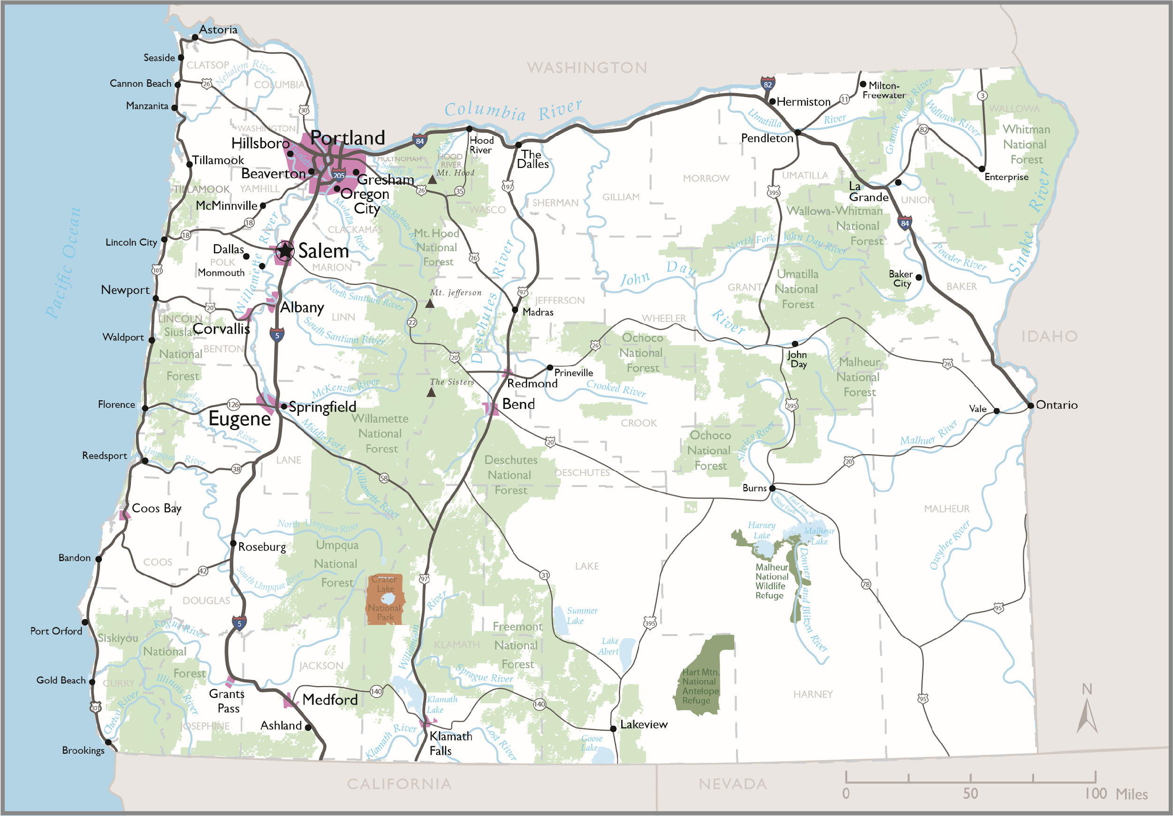
General Reference Map of Oregon
Notes:
Source: Center for Geography Education in Oregon, Portland State University. The Student Atlas of Oregon. Used with permission.

Slide 4
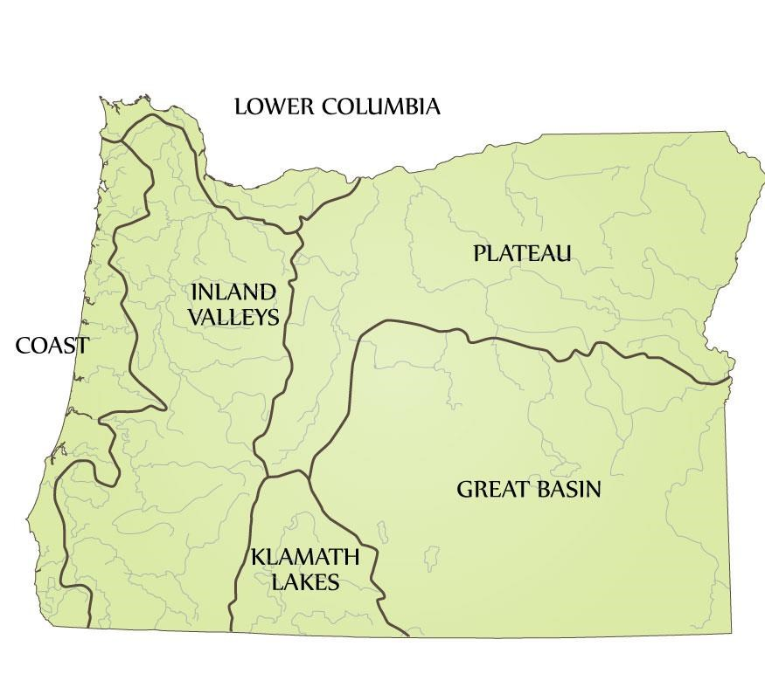
Pre-Contact Indigenous Cultural Regions of Oregon
Notes:
Source: Center for Geography Education in Oregon, Portland State University. The Student Atlas of Oregon. Used with permission.

Slide 5
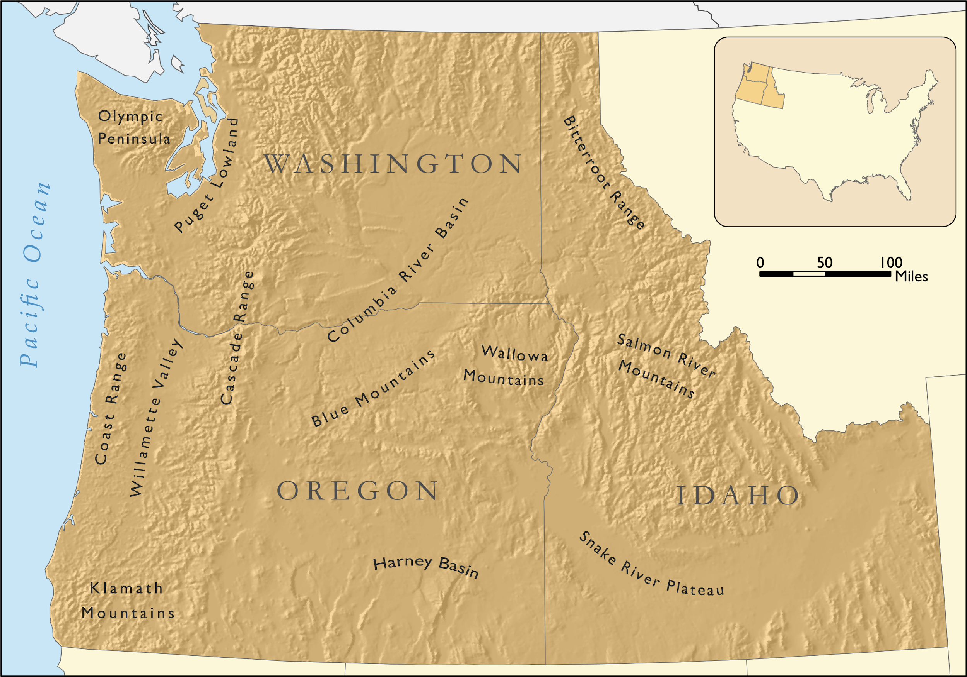
Physical Regions of the
Pacific Northwest
Notes:
Source: Center for Geography Education in Oregon, Portland State University. The Student Atlas of Oregon. Used with permission.

Slide 6
Oregon Topography
Elevation Range
(
feet
8,000 -
11,235
7
,000 -
8,000
6
,000 -
7,000
5
,000 -
6,000
4
,000 -
5,000
3
,000 -
4,000
2
,000 -
3,000
1
,000 -
2,000
0
-
1,000
Topography is the shape and features of land surfaces.
Notes:
Source: Center for Geography Education in Oregon, Portland State University. The Student Atlas of Oregon. Used with permission.

Slide 7
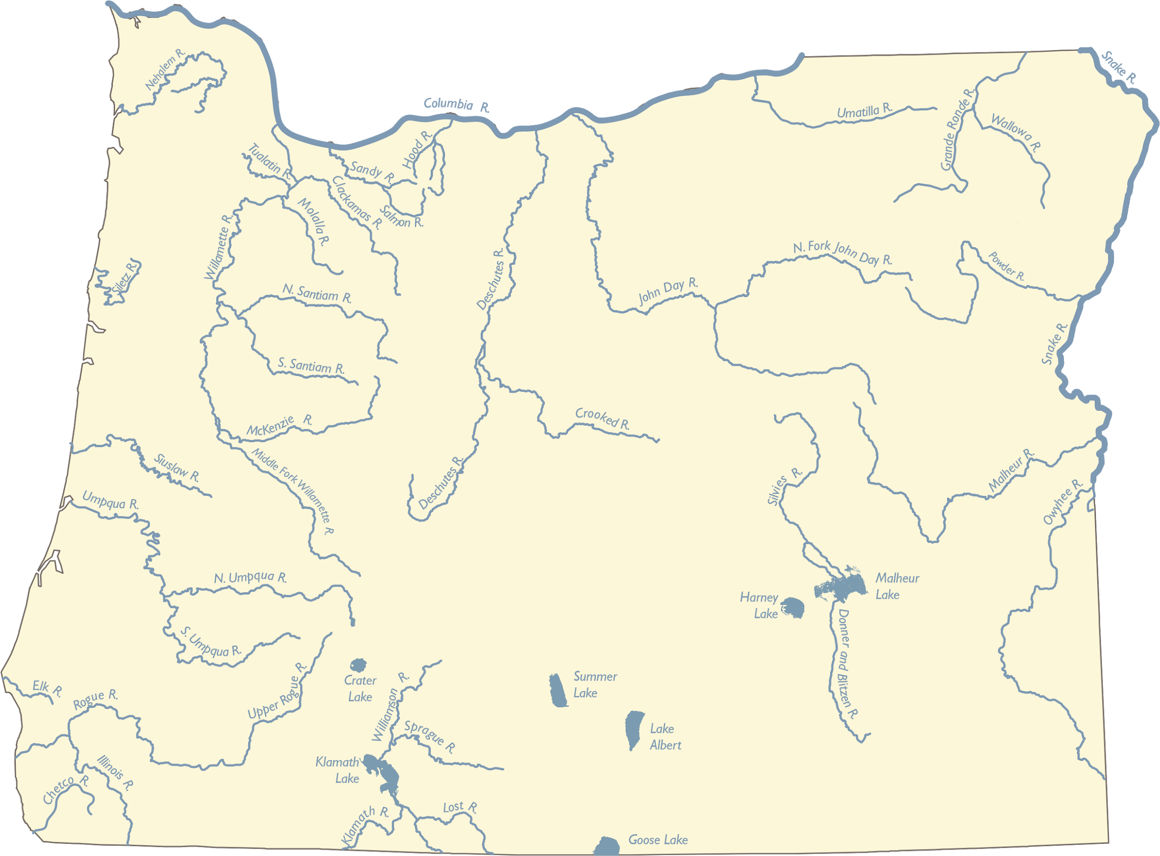
Oregon Rivers and Lakes
Notes:
Source: Center for Geography Education in Oregon, Portland State University. The Student Atlas of Oregon. Used with permission.

Slide 8
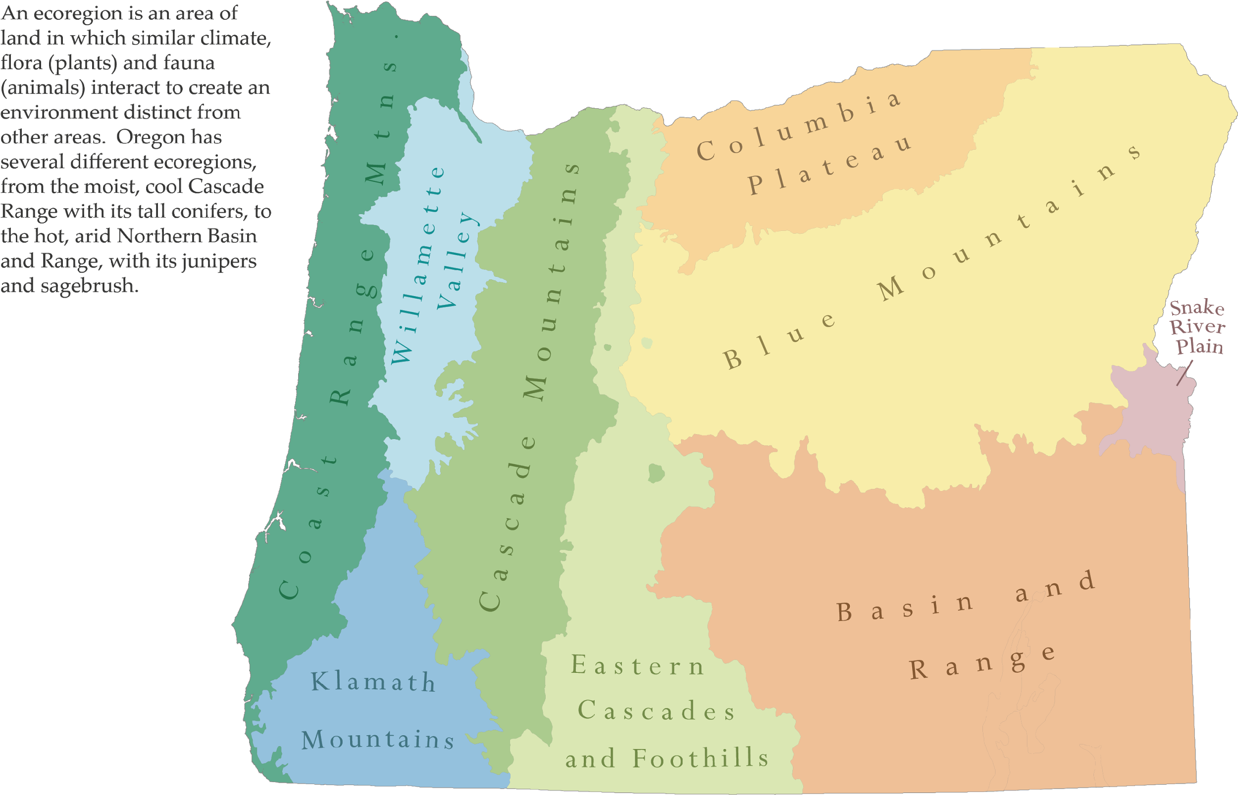
Oregon Ecoregions
Notes:
Source: Center for Geography Education in Oregon, Portland State University. The Student Atlas of Oregon. Used with permission.

Slide 9
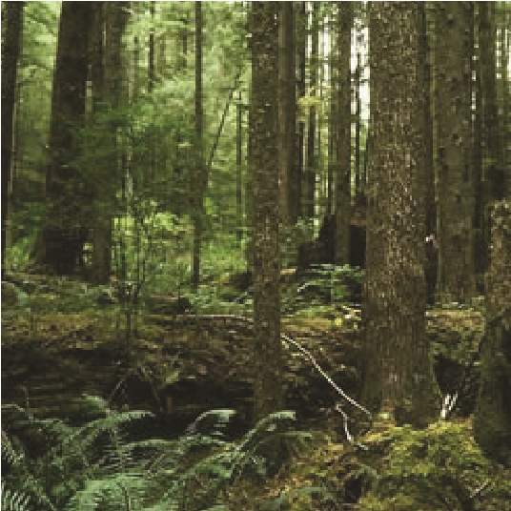
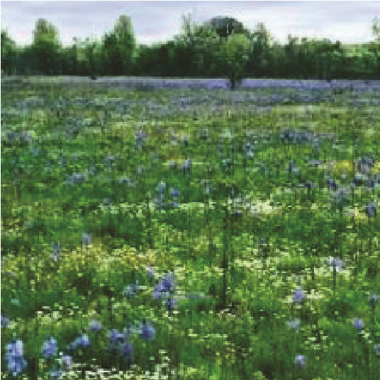
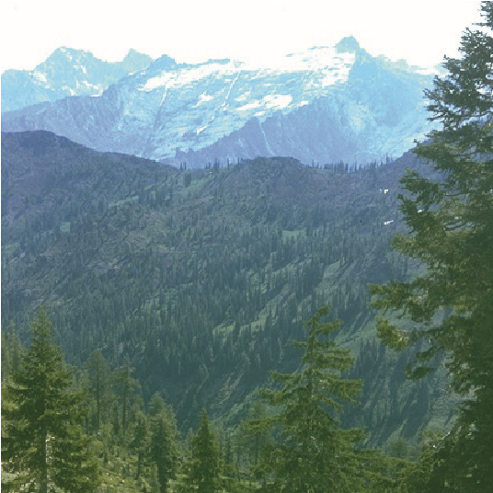
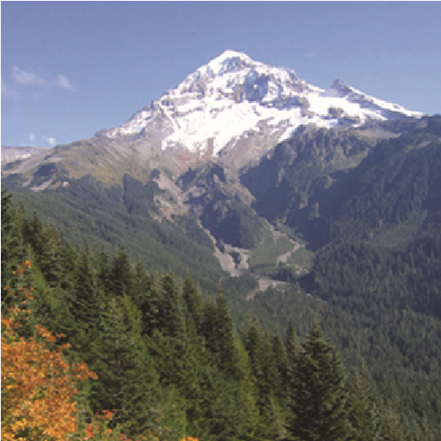
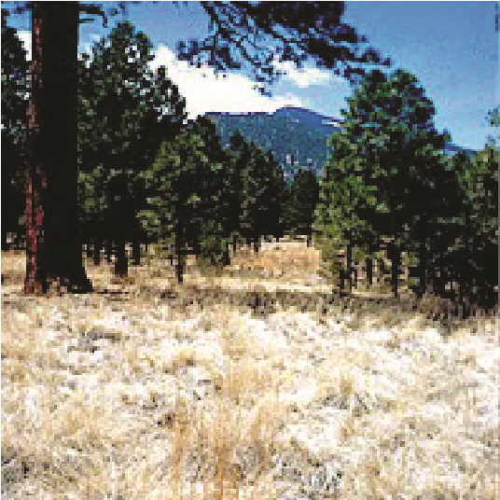
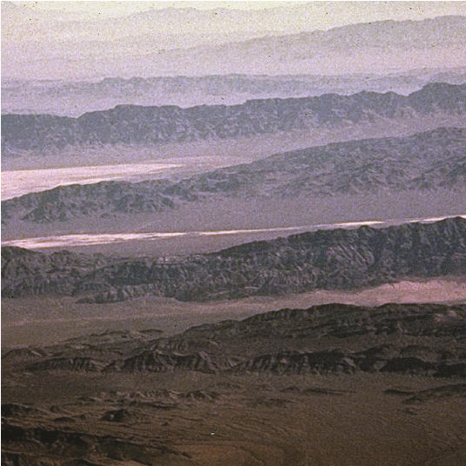
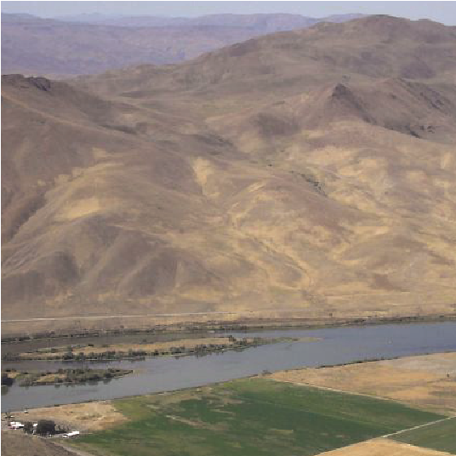
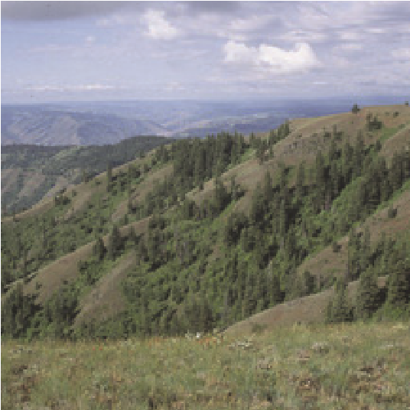
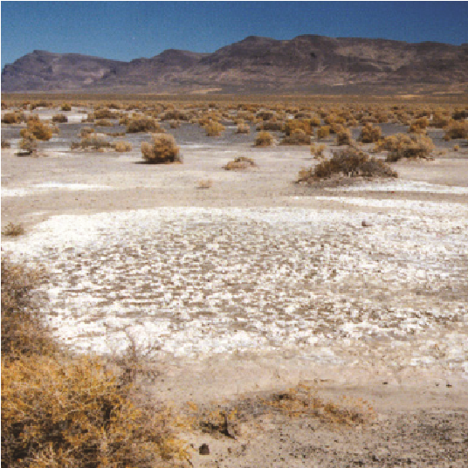
Oregon Ecoregions in Pictures
1
2
3
1
Coast Range
Willamette Valley
Klamath Mountains
2
9
4
8
7
6
4
5
6
3
5
Cascade Mountains
Eastern Cascades and Foothills
Basin and Range
7
8
9
Snake River Plain
Blue Mountains
Columbia Plateau
Notes:
Source: Center for Geography Education in Oregon, Portland State University. The Student Atlas of Oregon. Used with permission.

Slide 10
Oregon Vegetation Zones
Western Hemlock Zone – Varied groups of
plants occur depending on precipitation and
elevation.
Willamette Forest-Prairie Zone – Various
forest, woodland, open savanna and prairie
type groups of plants.
Alpine Zone – These relatively small areas
are found only at the highest elevations and
consist of small plants and low-lying shrubs.
Mixed Conifer and Broadleaf Forest Zone –
This zone’s plant groups have a mix of
Oregon and Californian species.
Cascade Subalpine Forest Zone – Open
meadow and forests form patterns
according to elevation and snowpack.
Grand Fir and Douglas Fir Zone – The
plant groups in this zone require only a
moderate amount of water.
Ponderosa Pine Zone – Drier than the fir
zones, these plant groups consist of
Ponderosas with woody shrub or
grassland.
Grasslands Zone – These areas
have grassland plant groups with
almost no trees or shrubs.
Western Juniper Zone – These
open woodlands have Juniper
Vegetation zones are areas with similar groups of plants.
trees with desert shrubs or
sagebrush plant groups.
Big Sagebrush Zone – This large
zone is dominated by sagebrush,
with some other shrubs and
grasses .
Notes:
Source: Center for Geography Education in Oregon, Portland State University. The Student Atlas of Oregon. Used with permission.

Slide 11
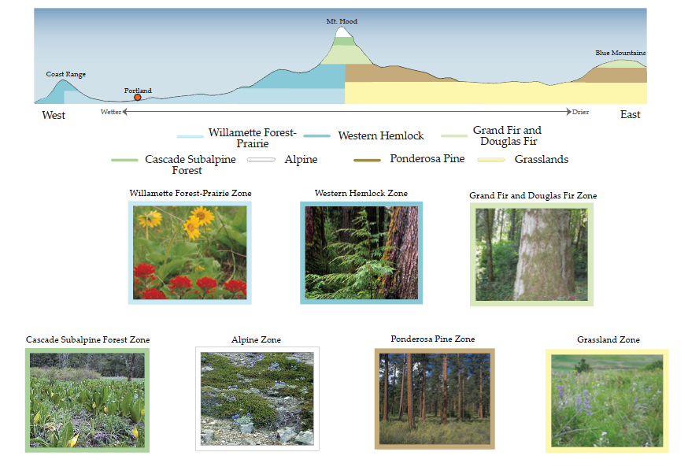
Oregon Vegetation Zones:
Elevation Cross-Section
Notes:
Source: Center for Geography Education in Oregon, Portland State University. The Student Atlas of Oregon. Used with permission.

Slide 12
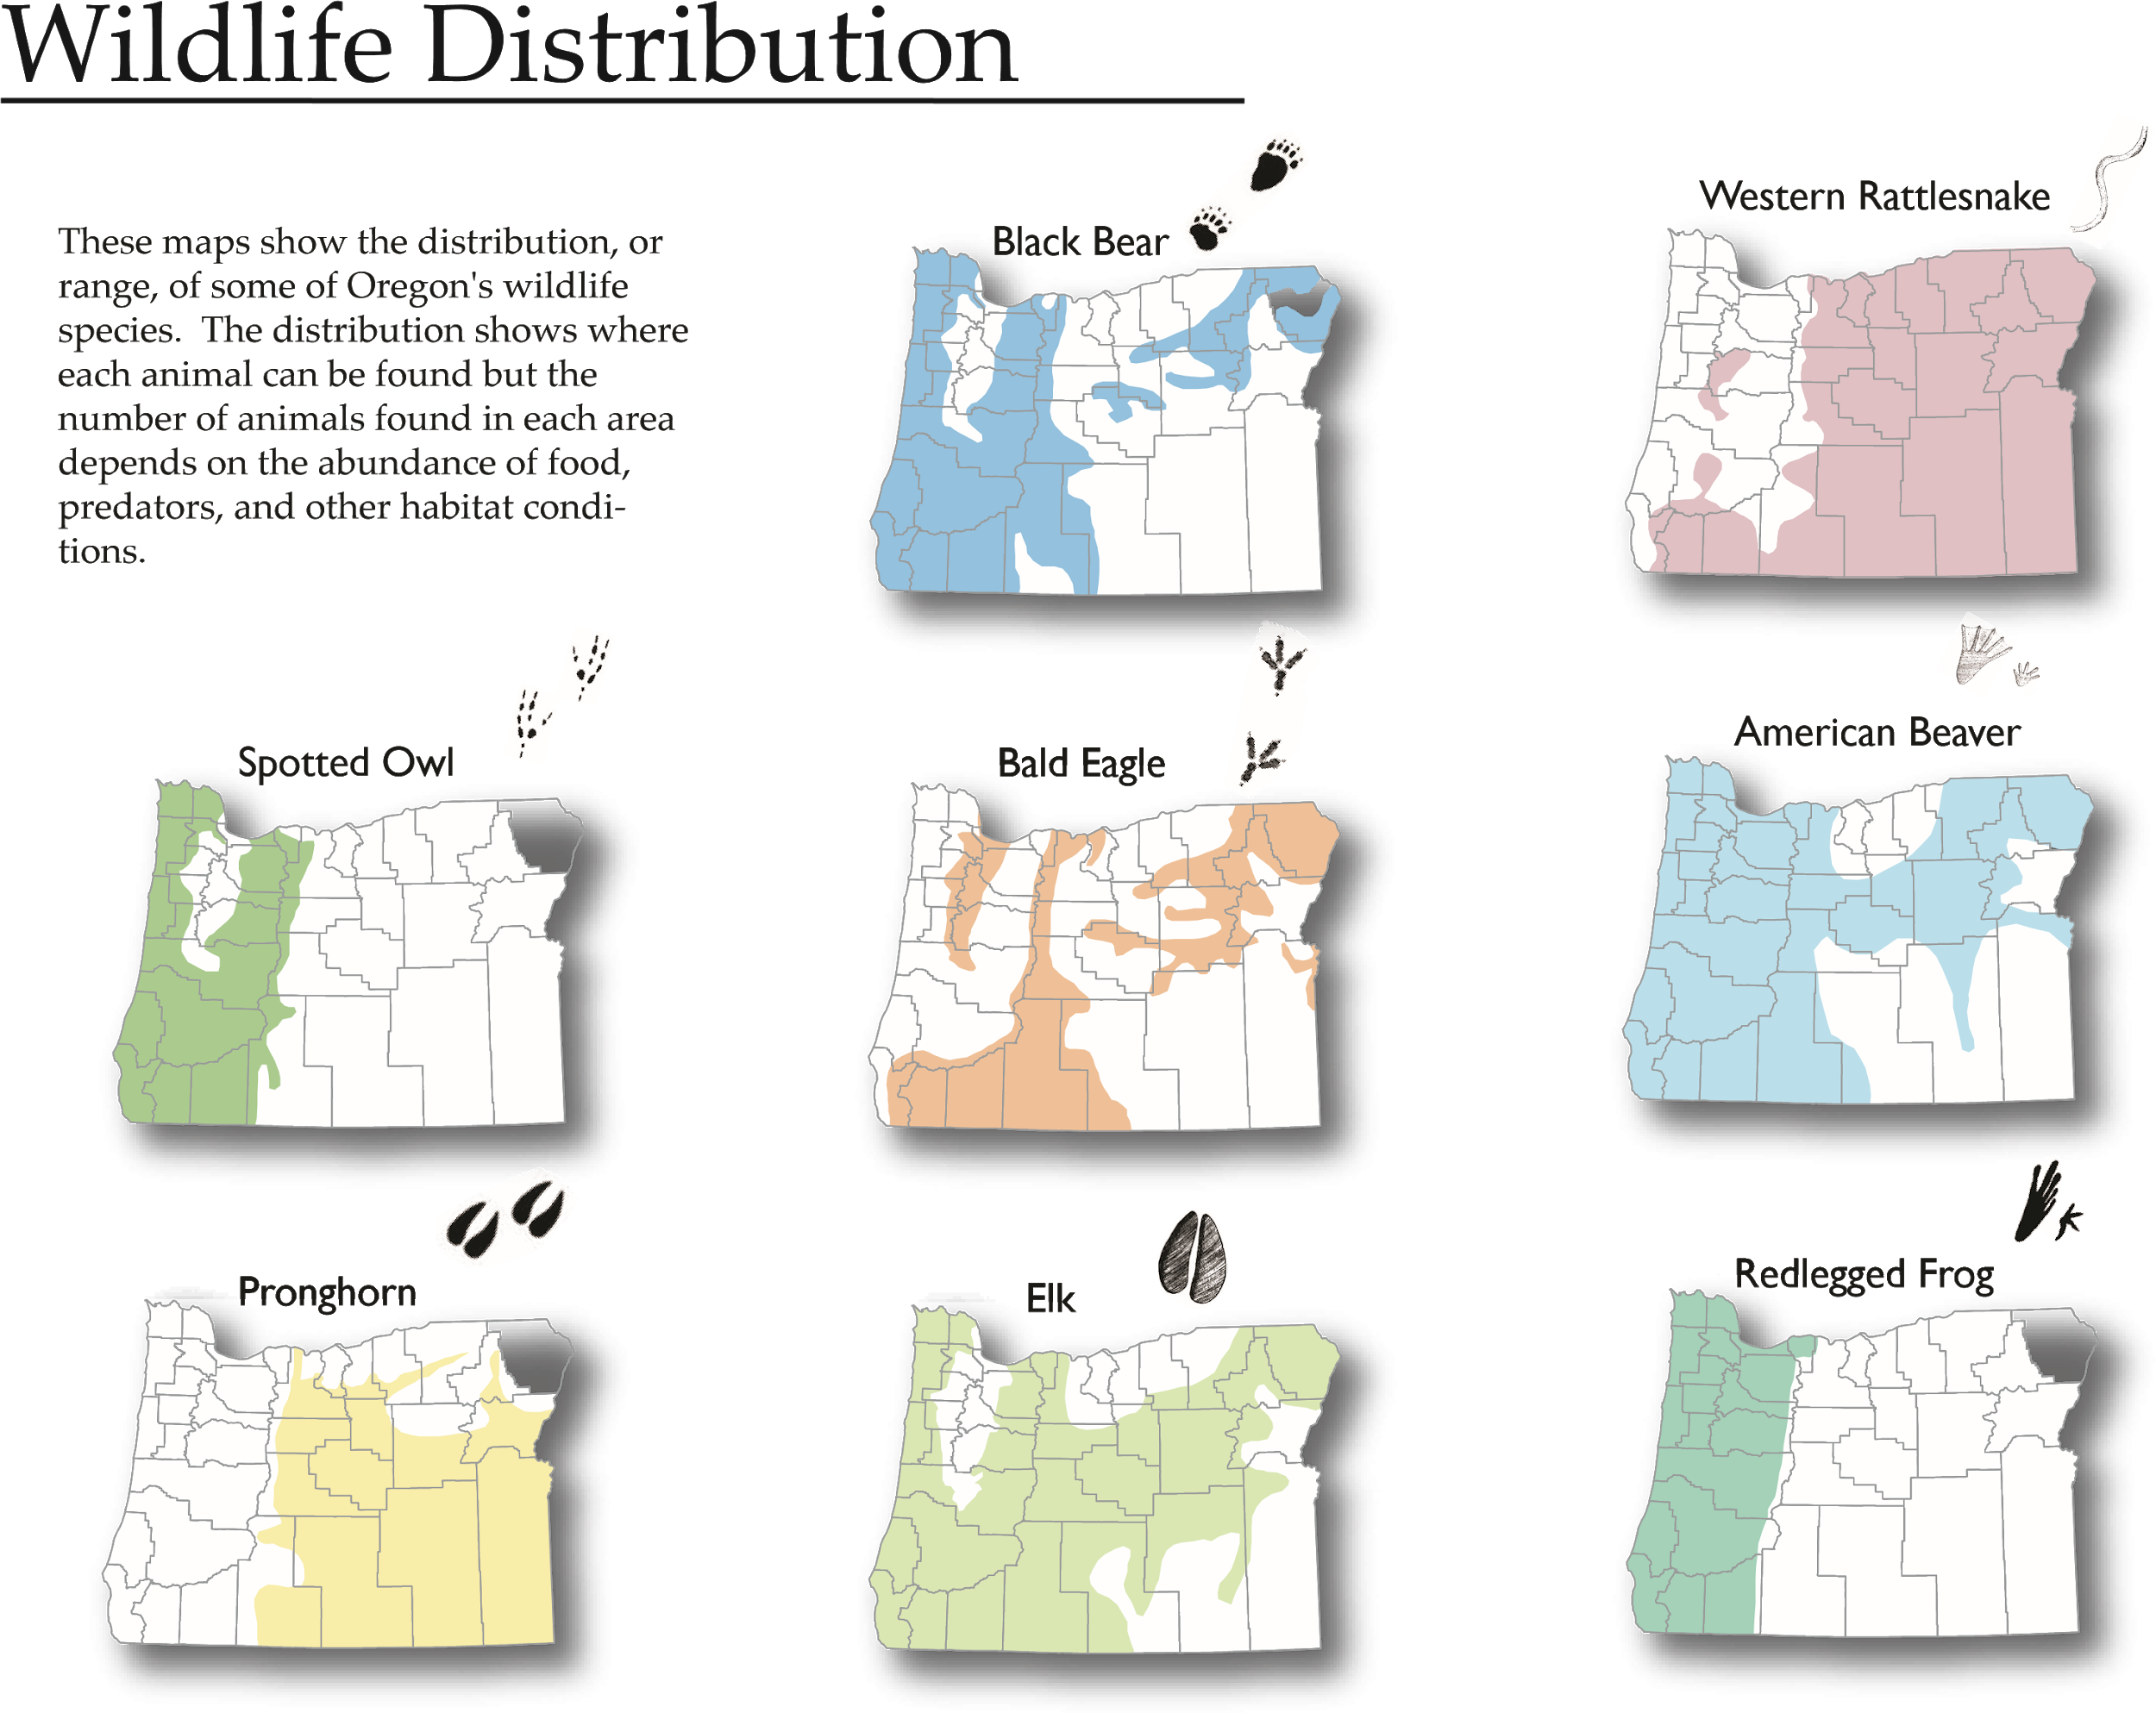
Oregon Wildlife Distribution
Notes:
Source: Center for Geography Education in Oregon, Portland State University. The Student Atlas of Oregon. Used with permission.

Slide 13
Oregon Native Americans:
1780 Population
1780:
Umatilla
Estimated Number of People
Grand
per 100 Square Miles
Ronde
Warm
100 - 350
Siletz
Springs
50
-
99
20
-
49
Coos,
Lower Umpqua,
and Siuslaw
Burns Paiute
0
-
19
Coquille
Today:
Cow Creek
Native American Reservations
Klamath
Reservations with land
too small to display
Notes:
Source: Center for Geography Education in Oregon, Portland State University. The Student Atlas of Oregon. Used with permission.

Slide 14
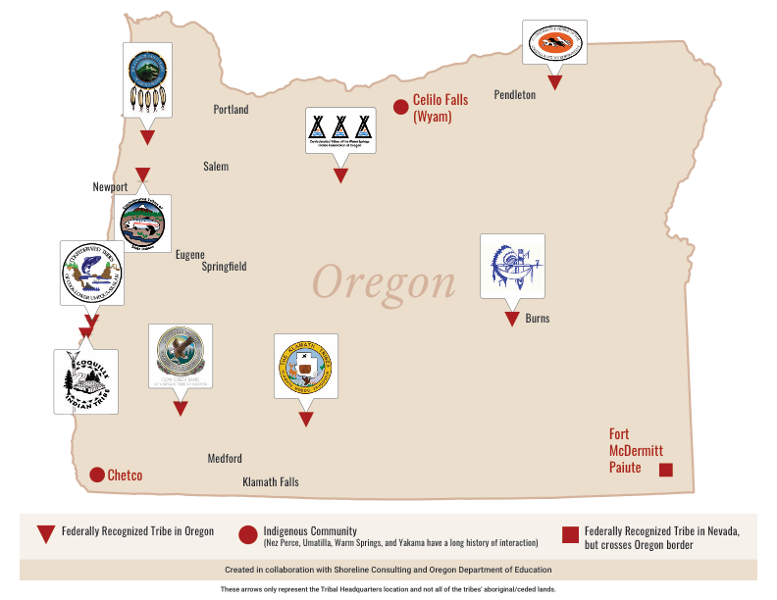
Oregon Tribes Today

