Slide 1
Oregon Title VI Community of Practice
Wednesday, March 19, 2025, 11AM-12PM
Rename your Zoom Name to your –
first and last name
name of district ,ESD, or Tribe, and
official role for Title VI - Project Coordinator, Authorized Official Representative, student liaison, etc.
pronouns

Slide 2

Everyone - Greet one another in your tribal language or in the language of the local tribe(s).
Then, drop into the chat your plans for Spring Break (staying local? getting your car stuck on an old logging road? sleeping for five days? traveling? binge-watching shows?)

Slide 3
Today’s Agenda -
ODE Updates, EASIE Updates, the Formula Grant Timeline, & Graduation and Dropout/Pushout Data
Look familiar? We ran out of time last meeting, so will be going back to the previous slidedeck.
LEAs and LEA-C - Option 1 or Option 2 for Section 6119 Compliance
Upcoming EASIE Part 2 Window - Intentional Pre-Planning Work
Community of Practice Shared Folder - Update it and the Contact List Regularly

Slide 4
Resources Shared by ODE
✅ Sign up for ODE GovDelivery communications HERE.
✅ The Oregon Department of Education is actively monitoring changes at the federal level for any impact that they have on Oregon. We’ve launched a new page on the ODE website to clearly communicate with anyone else seeking a better understanding of changes at the federal level.
You will find our guiding statement, any actions that have immediate impact on our work, the latest updates to districts and a quick look at Oregon programs that receive federal funding.
ODE is committed to making sure students have the tools and resources to thrive, to continue our vision for serving each and every scholar receiving education in Oregon. Please contact ode.communications@ode.oregon.gov with any questions.

Slide 5
Quick Updates from the EASIE Website
Important Links from EASIE Communities Site -
Part 2 of the application provides applicants their initial allocation based on the Indian student count total submitted under Part I. Part II also enables applicants to select the objectives, corresponding activities/services, and data sources for measuring progress towards the objectives and build a realistic program budget.
Indian Parent Committee Approval Form
Public Hearing
Meaningful Collaboration
EASIE Part II Paper Form
EASIE Part II Frequently Asked Questions
EASIE Part II Applicant Checklist
What Year Are We in Our Application?
Navigate to the US Department of Education Office of Indian Education website.
Scroll down until you see the document titled, “FY 2024 OIE Formula (Title VI A) Awards with ISC, Award Amounts, and NCES IDs (updated 10/2/24)”.
Sort the spreadsheet to filter only “Oregon” awardees. Find your LEA, LEA-C, or tribe.
Review the information.

Slide 6
General Formula Grant Timeline
To Do List -
✅ Make sure the Public Hearing is scheduled, as well as Meaningful Collaboration
✅ Deep dive into data in preparation for EASIE Part II
✅Public Hearing and ✅Meaningful Collaboration must be held before Part II closes
-ALL LEAs and LEA-Cs send final EASIE Part II app and IPC Approval form emailed to ODE
-EASIE PART II Submission Deadline to US Department of Ed May 9
-OPTION 2 LEAs and LEA-Cs receive comments back May 13-21
-EASIE PART I Closes March 7
-Integrated Guidance Opens March 1
- NEW March 31 EASIE PART II Application Available
-EASIE APR for FY 23-24 opened Sept. 9
-Indian Parent Committee Start of Year Outreach
-District and School-Wide Registration Norming - 506
-Native American Heritage Month
-Winter Solstice, Dec 21
SEPTEMBER
NOVEMBER/DECEMBER
MARCH
MAY
OCTOBER
JANUARY/FEBRUARY
APRIL
-EASIE APR for FY 23-24 closed October 11
-Indigenous Peoples Day, Monday Oct 14
-EASIE Part 1 Opens February 3rd
-OPTION 1, April 7-14, LEAs and LEA-Cs, Applications submitted to ODE for Comments
-Applications returned with Comments, April 15-22 (NEW DATE - was the 21st)
-April 30 Integrated Guidance Window Closes
This is a general visual of the Title VI school year timeline. All LEAs and LEA-Cs should adhere to all published DOE timelines to plan their efforts.

Slide 7
Graduation and Dropout/Pushout Data is Now Public
Definitions -
A graduate - Student who earned an Oregon Regular Diploma, participated in a Post Graduate Scholars program, or received an Oregon Modified Diploma.
Dropout/Pushout - A student who withdrew from school and did not graduate or transfer to another school that leads to graduation is included in this dropout/pushout data.
Where to Access It
ODE’s Cohort Graduation site
Dropout/Pushout Rates in Oregon’s Schools site
Suppressed and Unsuppressed Data
State suppression rules for all data published publicly. Rules for a data set can be found in a “Notes” tab.
You will need to seek permission from District leadership to review the unsuppressed data (i.e. “all data, regardless of cohort size”), as it is a FERPA violation for this data to be published or available to the public.

Slide 8
Four Year Graduation Cohort Highlights
In the statewide news release from ODE Class of 2024 Overcame Historic Obstacles to Graduate at Second-Highest Rate in Oregon, celebrations were shared on the statewide graduation rate for the class of 2024 at 81.8%. Those graduates began high school during remote learning of the pandemic, ending their 9th grade year with only 73.6% of them On-Track.
🥳 American Indian and Alaska Native students had a four year cohort graduation rate of 70.1%, reflecting a 1.9% increase from the previous graduating class. This is quite an achievement, as 57.6% of AI/AN students were On-Track after their 9th grade year, demonstrating their resilience to overcome the challenges of the pandemic.
🥳 Six districts receiving the Tribal Attendance Promising Practices grant had an average rate of 72%, surpassing the state AI/AN average. Four of those same TAPP districts’ AI/AN graduation rate exceeded the statewide overall average. North Bend, Pendleton, Jefferson County, and Willamina
The average graduation rate for districts receiving the benefits of a Title VI program was 62.5%, reflecting a significant gap even from the state AI/AN average.
However, we cannot lose sight of the fact that 183 AI/AN students failed to graduate last year, with only 35 of those Native young people continuing their enrollment to a 5th year of schooling.

Slide 9
Dropout/Pushout Data
Definition: Dropout/Pushout - A student who withdrew from school and did not graduate or transfer to another school that leads to graduation is included in this dropout/pushout data.
Statewide the Dropout/Pushout rate is 3.6%; however, the AI/AN rate is 7.8% – the highest out of all student groups.
The Dropout/Pushout rate for AI/AN students in alternative schools is 17.5% for AI/AN students; while AI/AN rate for students in fully virtual programs is 19%.
Last school year alone, 173 American Indian and Alaska Native dropped out or were pushed out of school.

Slide 10
Critical Lens of Analysis
Our Native students are overrepresented in Alternative and Online schools. When analyzing data, look at how AI/AN students did at the local high school(s) and then the alternative or local online schools.
  Ask: What do you notice? What do you see?
Regardless of cohort size, losing any of our AI/AN students has negative implications on tribal sovereignty. What will you say when someone says, “Well, the data looks bad, because there were only five Native students represented in that data.”

Slide 11
Section 6119 Compliance
Before April 4 -
Please email me at stacy.parrish@ode.oregon.gov if your LEA or LEA-C will be selecting Option 1 or Option 2.
This is non-binding and is only being used for internal planning purposes.
Once your response is received, I will indicate which option you have selected in ODE’s Title VI Awardees Form posted on our website.
SEC. 6119. [20 U.S.C. 7429] STATE EDUCATIONAL AGENCY REVIEW.
Before submitting an application to the Secretary under section 6114, a local educational agency shall submit the application to the State educational agency, which may comment on such application. If the State educational agency comments on the application, the agency shall comment on all applications submitted by local educational agencies in the State and shall provide those comments to the respective local educational agencies, with an opportunity to respond.

Slide 12
Option 1 Overview - Comments Before April 22
Option 1
LEAs and LEA-Cs make the determination to submit copies to the agency during the submission window. ODE will provide comments on the applications, allowing an LEA or LEA-C an opportunity to respond to comments prior to the close of the EASIE Part 2 application window.
Window for Applications to Be Submitted to ODE for Review - April 7-14
Window for Applications to Receive Comments by ODE and Returned to LEA - April 15-22
LEAs and LEA-Cs may respond to comments. This is not required - April 22 - May 9
Deadline for Applications to be Received by US Department of Education - May 9, 2025
A copy of the final EASIE Part 2 application will still need to be provided to ODE prior to closure of EASIE Part 2, May 9, 2025, via emailed PDF.
Why Choose this Option?
The LEA or LEA-C’s EASIE Part 2 application will be completed early in the EASIE Part 2 window, which includes obtaining full approval by the Indian Parent Committee and Meaningful Collaboration.
The LEA or LEA-C would like comments on their application.
The LEA or LEA-C would like to review comments and respond (which is NOT required) to them.

Slide 13
Option 1 Directions and Next Steps
Directions -
Complete your EASIE Part II application, but do not submit it to US Department of Education.
Email a PDF of your completed EASIE Part II Application and your Indian Parent Committee Attestation Form to stacy.parrish@ode.oregon.gov between April 7-14.
Next Steps -
ODE will provide comments on your application and will send you those comments on or before April 22.
LEAs and LEA-Cs may respond to these comments between April 22 - May 9, but that is not required.
Submit your completed application to the US Department of Education on or before May 9, 2025.
Email a copy of the final EASIE Part 2 application to Stacy upon submission of your application to the US Department of Education.

Slide 14
Option 2 Overview - Comments after May 9
Option 2
LEAs and LEA-Cs make the determination to not send copies of their application during the specified review window in April. ODE will still make comments on the application to be in compliance with Section 6119, but it will be after the EASIE Part 2 submission window closes on May 9, 2025.
A copy of the final EASIE Part 2 application will be need to be provided to ODE prior to closure of EASIE Part 2, May 9, 2025 via emailed PDF.
Window for Applications to Receive Comments by ODE and Returned to LEA if Option 2 is selected - May 13-21, 2025
Why Choose this Option?
The LEA or LEA-C’s EASIE Part 2 application will not be completed early in the EASIE Part 2 window and/or Meaningful Collaboration and Indian Parent Committee Approval has not taken place.
The LEA or LEA-C would like comments on their application, but not prior to their submission of their application to the US Department of Education.
The LEA or LEA-C would like to review comments and have an opportunity to respond (which is NOT required), albeit, after the EASIE Part 2 application window has closed.

Slide 15
Option 2 Overview - Directions and Next Steps
Directions
Complete your EASIE Part II application and submit it to US Department of Education.
Email a PDF of your completed EASIE Part II Application and your Indian Parent Committee Attestation Form to stacy.parrish@ode.oregon.gov after the window closes on May 9.
Next Steps -
ODE will provide comments on your application and will send you those comments on or before May 21.
LEAs and LEA-Cs may respond to these comments, but that is not required.

Slide 16
Pre-planning for EASIE Part 2
The Application and then Greater Planning

Slide 17
EASIE Part 2 Application Window - March 31 to May 9
Year 4 of 4 of the Multi-Year Application
Bethel School District
Coquille School District #8
David Douglas School District
Harney County SD #3
Lincoln County School DIstrict
North Bend School District #13
Powers School District #31 aka Coos County 31
Rainier School District #13
Salem Keizer Public Schools
Willamina School District 30 J
Single Year Applications
Beaverton School District
Clatskanie School District
Corvallis School District
Klamath Falls City Schools
Multnomah School District No. 1
North Clackamas School District
North Wasco County SD 21
Scappoose School District
Southern Oregon Education Service District

Slide 18
Backwards Plan from the Legislation (YES!)
Backwards Plan from the dreams tribes [and you] have for their youth. (EVEN BETTER!)
EASIE Part 2 Application
The application itself is quite slim. There are two places for a district to write original content (2000 character limit description of a comprehensive program and a professional development table), with most of the application comprised of drop down menus.
More Importantly….
Supplement, not supplant: What does it look like in your district, outside of Title VI efforts, to -
Meet the unique cultural, language, and educational needs of such students; and
Ensure that all students meet the challenging State academic standards.
Title VI Part A Indian Education Legislation

Slide 19
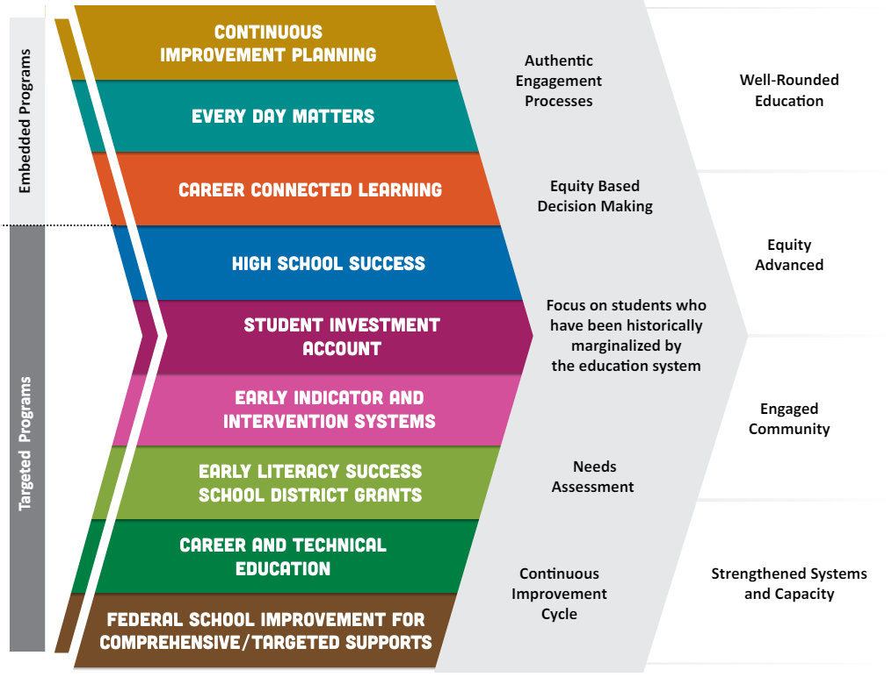
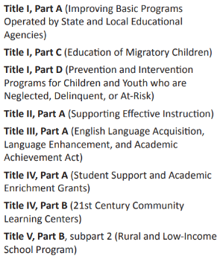
Title VI
Comprehensive Indian Education Program and Proposed Objectives
SEA-Administered Federal Title Programs:

Slide 20

How Can We Approach EASIE Part II Planning Beyond the Status Quo?
Call everyone to the table.
District leaders
Other district staff
Educators
Students
Families
Tribal Community
(You get it.)
Dig into data to get a holistic picture of Native student success. Use protocols. Use norms.
(The average person seems inherently terrified of spreadsheets and most educators are not well-equipped to analyze data.)
Backwards plan from legislation as a baseline.

Slide 21
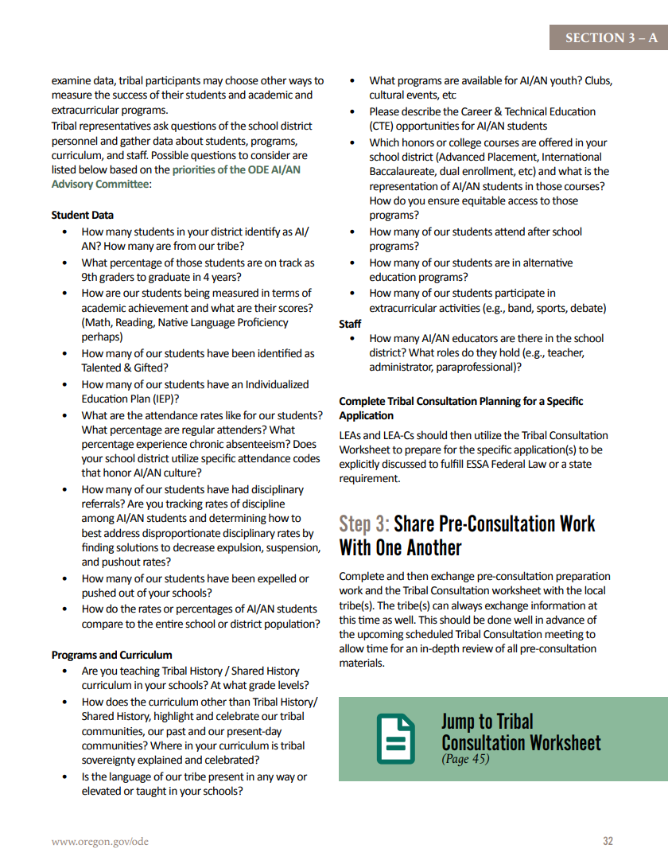

Borrowed from the Toolkit….
✅ Dig into data to get a holistic picture of Native student success.
Key questions to understand a comprehensive picture of Native success -
Student Data
• How many students in your district identify as AI/ AN? How many are from our tribe?
• What percentage of those students are on track as 9th graders to graduate in 4 years?
• How are our students being measured in terms of academic achievement and what are their scores? (Math, Reading, Native Language Proficiency perhaps)
• How many of our students have been identified as Talented & Gifted?
• How many of our students have an Individualized Education Plan (IEP)?
Tribal Consultation Toolkit 2.1; State Requirement p. 31

Slide 22
Borrowed from the Toolkit….
Tribal Consultation Toolkit 2.1; State Requirement p. 26
Continued - Key questions to understand a comprehensive picture of Native success
• What are the attendance rates like for our students? What percentage are regular attenders? What percentage experience chronic absenteeism? Does your school district utilize specific attendance codes that honor AI/AN culture?
• How many of our students have had disciplinary referrals? Are you tracking rates of discipline among AI/AN students and determining how to best address disproportionate disciplinary rates by finding solutions to decrease expulsion, suspension, and pushout rates?
• How many of our students have been expelled or pushed out of your schools?
• How do the rates or percentages of AI/AN students compare to the entire school or district population?
Programs and Curriculum
• Are you teaching Tribal History / Shared History curriculum in your schools? At what grade levels?
• How does the curriculum other than Tribal History/ Shared History, highlight and celebrate our tribal communities, our past and our present-day communities? Where in your curriculum is tribal sovereignty explained and celebrated?

Slide 23
Borrowed from the Toolkit….
Tribal Consultation Toolkit 2.1; State Requirement p. 26
Continued - Key questions to understand a comprehensive picture of Native success
• Is the language of our tribe present in any way or elevated or taught in your schools?
• What programs are available for AI/AN youth? Clubs, cultural events, etc
• Please describe the Career & Technical Education (CTE) opportunities for AI/AN students
• Which honors or college courses are offered in your school district (Advanced Placement, International Baccalaureate, dual enrollment, etc) and what is the representation of AI/AN students in those courses? How do you ensure equitable access to those programs?
How many of our students attend after school programs?
• How many of our students are in alternative education programs?
• How many of our students participate in extracurricular activities (e.g., band, sports, debate) Staff
• How many AI/AN educators are there in the school district? What roles do they hold (e.g., teacher, administrator, paraprofessional)?

Slide 24
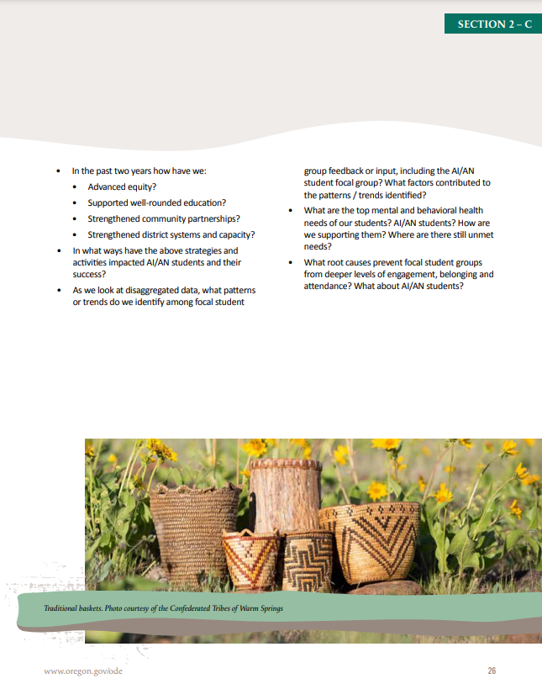
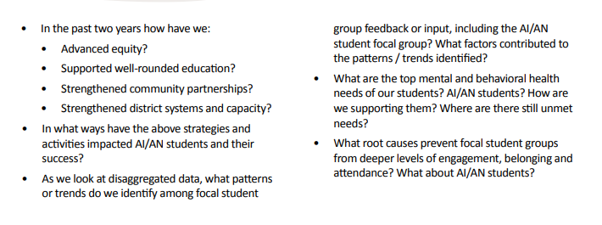
Borrowed from the Toolkit….
Key questions to ask about the Integrated Guidance application -
Tribal Consultation Toolkit 2.1; State Requirement p. 26

Slide 25
Contact Stacy Anytime
Stacy Parrish, Education Program Specialist II
Email - stacy.parrish@ode.oregon.gov
Book an Office Hours -
Book time with STACY PARRISH * ODE
Text/Call - 971-208-0270
I am available for things like…
Indian Parent Committee Training
“Advocating Up” Help
Data Analysis Work / Data Systems
ESD Consortium Support
Tribal Consultation and Improving Tribal Relations Help/Coaching

Slide 26
Section 6119 Compliance
The slides below are from a previous CoP. They are included here for your reference.
Initial Training for Awardees

Slide 27
Section 6119- Making Sense of Limited Guidance
As a state educational agency, our scope of supporting Title VI Indian Education efforts is outlined in Sec. 6119 of the Title VI Indian Education legislation (p. 320) –
SEC. 6119. [20 U.S.C. 7429] STATE EDUCATIONAL AGENCY REVIEW.
Before submitting an application to the Secretary under section 6114, a local educational agency shall submit the application to the State educational agency, which may comment on such application. If the State educational agency comments on the application, the agency shall comment on all applications submitted by local educational agencies in the State and shall provide those comments to the respective local educational agencies, with an opportunity to respond.
This expectation is also in the EASIE Part II FAQ document on page 29 –
11.4 Is there anything I need to do after my entity has certified my application? Yes, there are several remaining steps:
Before Part II closes, download and save your application in PDF form. You should also save a signed copy of the program assurances which are available as a link from the certification screen.
If you are an LEA, send a copy of your application to your SEA. Section 6119 of the ESEA requires that all LEA applicants send a copy of their Title VI Indian Education Formula Grant application to their SEA. If you do not have a specific contact, mail it to the SEA (or the State superintendent) at the general address.

Slide 28
Priorities for ODE in Spring 2025
Goal - ODE hopes to achieve full compliance to Section 6119 - ODE will collect 100% of EASIE Part 2 applications from LEAs and LEA-Cs and will comment on 100% of them.
High Level Summary
Timeline - Last year we began phase 1 of getting into compliance with 6119. To date, 66% of non-tribal awardees are in compliance. (Here is the previous training about it from April 2024.)
Who is Impacted by this? This only applies to EASIE Part 2. This requirement does not apply to tribes (see Section 6119).
While working to achieve compliance, provide LEAs and LEA-Cs the option of when they knowingly will receive comments on their applications and opportunity to respond to them (see next slides).
How are applications submitted? Via email to stacy.parrish@ode.oregon.gov
How will districts leaders be notified about this? A GovDelivery (official communication to district and ESD superintendents) will be sent to Superintendents by the first week of March which will detail this information.

Slide 29
Priorities for ODE in SY24-25 - Continued
Important Details
An SEA’s comments on a Title VI Indian Education Formula Grant application have no impact on the Department of Education’s approval of an application.
The EASIE Part 2 application has limited sections with written/original content. For SY24-25, while the entire application will be reviewed, we will have a heightened focus on the following -
  Indian Parent Committee Approval Form
  Section 2 Part 2. Description of Comprehensive Program for American Indian/Alaska Native Students
  Section 2 Part 3. Coordination of Services Professional Development

Slide 30
Option 1 Overview - Comments Before May 9
Option 1
LEAs and LEA-Cs make the determination to submit copies to the agency during the submission window. ODE will provide comments on the applications, allowing an LEA or LEA-C an opportunity to respond to comments prior to the close of the EASIE Part 2 application window.
Window for Applications to Be Submitted to ODE for Review - April 7-14
Window for Applications to Receive Comments by ODE and Returned to LEA - April 15-21
LEAs and LEA-Cs may respond to comments. This is not required - April 22 - May 9
Deadline for Applications to be Received by US Department of Education - May 9, 2025
A copy of the final EASIE Part 2 application will still need to be provided to ODE prior to closure of EASIE Part 2, May 9, 2025, via emailed PDF.
Why Choose this Option?
The LEA or LEA-C’s EASIE Part 2 application will be completed early in the EASIE Part 2 window, which includes obtaining full approval by the Indian Parent Committee and Meaningful Collaboration.
The LEA or LEA-C would like comments on their application.
The LEA or LEA-C would like to review comments and respond (which is NOT required) to them.

Slide 31
Option 2 Overview - Comments after May 9
Option 2
LEAs and LEA-Cs make the determination to not send copies of their application during the specified review window in April. ODE will still make comments on the application to be in compliance with Section 6119, but it will be after the EASIE Part 2 submission window closes on May 9, 2025.
A copy of the final EASIE Part 2 application will be need to be provided to ODE prior to closure of EASIE Part 2, May 9, 2025 via emailed PDF.
Window for Applications to Receive Comments by ODE and Returned to LEA if Option 2 is selected - May 13-21, 2025
Why Choose this Option?
The LEA or LEA-C’s EASIE Part 2 application will not be completed early in the EASIE Part 2 window and/or Meaningful Collaboration and Indian Parent Committee Approval has not taken place.
The LEA or LEA-C would like comments on their application, but not prior to their submission of their application to the US Department of Education.
The LEA or LEA-C would like to review comments and have an opportunity to respond (which is NOT required), albeit, after the EASIE Part 2 application window has closed.

Slide 32
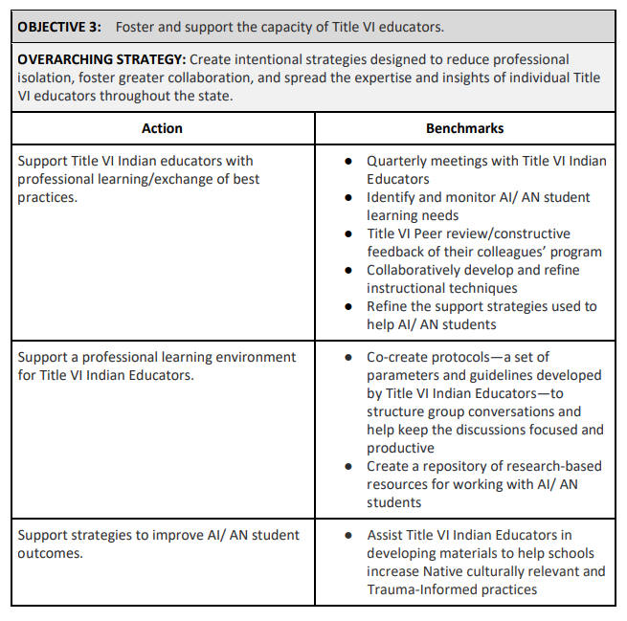
The Bigger “Why” - Looking Ahead
As codified into law in the American Indian and Alaska Native Student Success Plan, the Office of Indian Education has an obligation to our AI/AN Advisory Community and to the Government to Government Education Cluster, to uplift Objective 3 of our AI/AN SSP. This requires us as an SEA to have comprehensive knowledge and synthesis of all Title VI formula grant applications submitted by LEAs and LEA-Cs in order to uplift our AI/AN SSP Plan Goals –
The current AI/AN SSP can be found here - American Indian and Alaska Native Student Success Plan (AI/AN SSP)

Slide 33
Community of Practice Shared Drive
Please bookmark the link to the folder dropped in the Chat. We will not be posting it here, because these slides are shared publicly.
Notes:
https://drive.google.com/drive/folders/13H1gX2FzA_edl5cKmGq0MyAiD30yhcGO?usp=drive_link

Slide 34
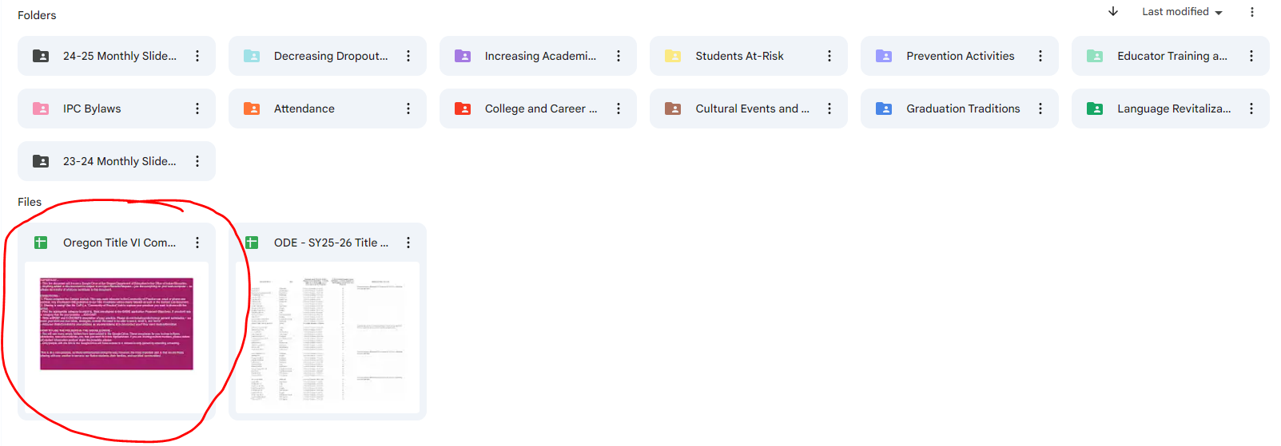
Step 1 - Open the circled document. Read the directions.
Step 2 - Fill out the Contact List first. This list is not public, but for internal use.
Step 3 - Contribute to the CoP tab as much or little as you like!

