Slide 1

ODE Grade 10, Science Seasonal Rounds and Ecosystems

Slide 2
Historical Context
Historical Context
https://www.opb.org/television/programs/oregon-experience/article/broken-treaties-oregon-native-americans/
Notes:
Show video 8:00-12:00 4 minutes

Slide 3
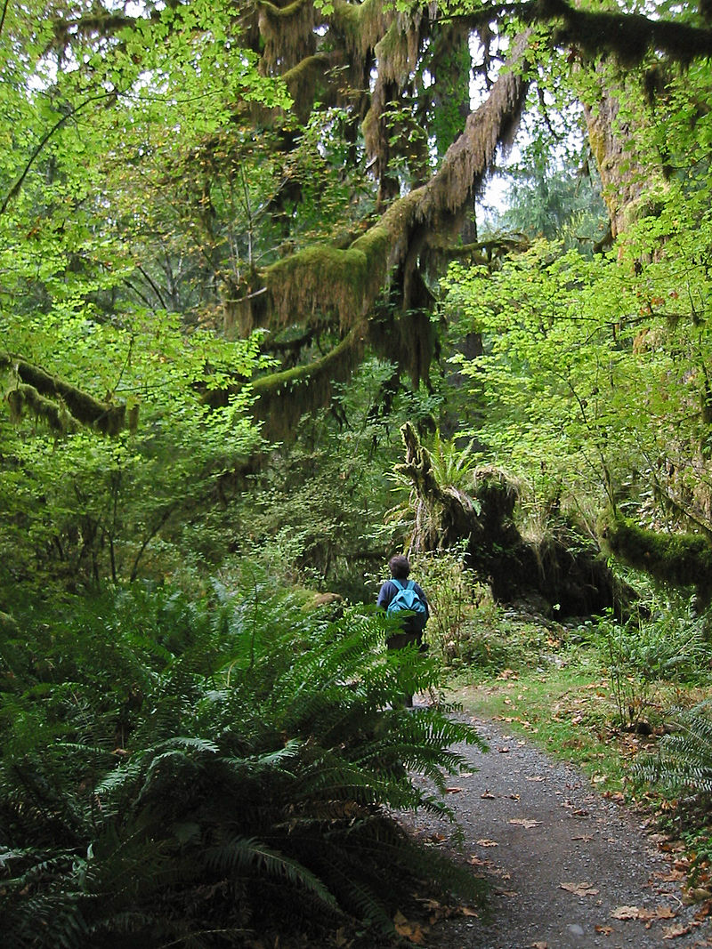
What Is an Ecosystem?
What Is an Ecosystem?
By Wsiegmund - Self-published work by Wsiegmund, CC BY 2.5, https://commons.wikimedia.org/w/index.php?curid=336095
Notes:
An ecosystem is a community of living organisms in conjunction with the nonliving components of their environment, interacting as a system. These biotic and abiotic components are linked together through nutrient cycles and energy flows. Energy enters the system through photosynthesis and is incorporated into plant tissue. By feeding on plants and on one another, animals play an important role in the movement of matter and energy through the system. They also influence the quantity of plant and microbial biomass present. By breaking down dead organic matter, decomposers release carbon back to the atmosphere and facilitate nutrient cycling by converting nutrients stored in dead biomass back to a form that can be readily used by plants and other microbes. Ecosystems are controlled by external and internal factors. External factors such as climate, parent material which forms the soil, and topography control the overall structure of an ecosystem but are not themselves influenced by the ecosystem. Unlike external factors, internal factors are controlled, for example, decomposition, root competition, shading, disturbance, succession, and the types of species present.
Ecosystems are dynamic entities—they are subject to periodic disturbances and are in the process of recovering from some past disturbance. Ecosystems in similar environments that are located in different parts of the world can end up doing things very differently simply because they have different pools of species present. Internal factors not only control ecosystem processes but are also controlled by them and are often subject to feedback loops.
Resource inputs are generally controlled by external processes like climate and parent material. Resource availability within the ecosystem is controlled by internal factors like decomposition, root competition or shading. Although humans operate within ecosystems, their cumulative effects are large enough to influence external factors like climate. Biodiversity affects ecosystem functioning, as do the processes of disturbance and succession. Ecosystems provide a variety of goods and services upon which people depend.

Slide 4
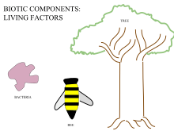
Biotic Components
Biotic Components
By IBBIOLOGYHL, CC BY-SA 4.0, https://commons.wikimedia.org/wiki/File:Biotic_Components_Living_Factors.svg
Notes:
Biotic components, or biotic factors, are any living component that affects another organism or shapes the ecosystem. This includes both animals that consume other organisms within their ecosystem and the organism that is consumed. Biotic factors also include human influence, pathogens, and disease outbreaks. Each biotic factor needs the proper amount of energy and nutrition to function day to day.

Slide 5
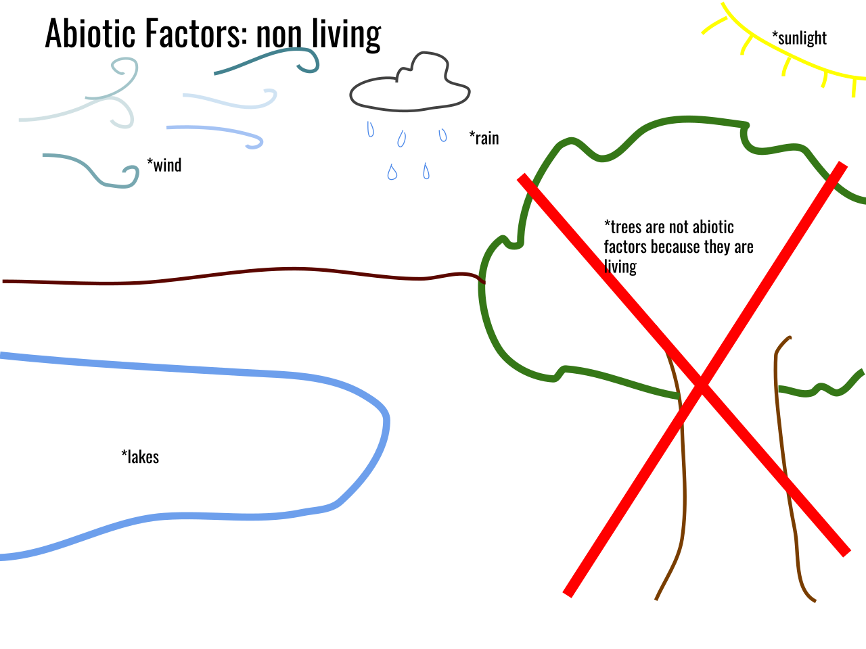
Abiotic Components
Abiotic Components
By Meghina, CC BY-SA 4.0, https://commons.wikimedia.org/w/index.php?curid=69447760
Notes:
In biology and ecology, abiotic components or abiotic factors are non-living chemical and physical parts of the environment that affect living organisms and the functioning of ecosystems. Abiotic factors and the phenomena associated with them underpin all biology.
Abiotic components include physical conditions and non-living resources that affect living organisms in terms of growth, maintenance, and reproduction. Resources are distinguished as substances or objects in the environment required by one organism and consumed or otherwise made unavailable for use by other organisms. These are different settings on earth that are abiotic factors, which mean they are not living organisms, that contribute to the earth in many different ways. Component degradation of a substance occurs by chemical or physical processes, e.g. hydrolysis. All non-living components of an ecosystem, such as atmospheric conditions and water resources, are called abiotic components.

Slide 6
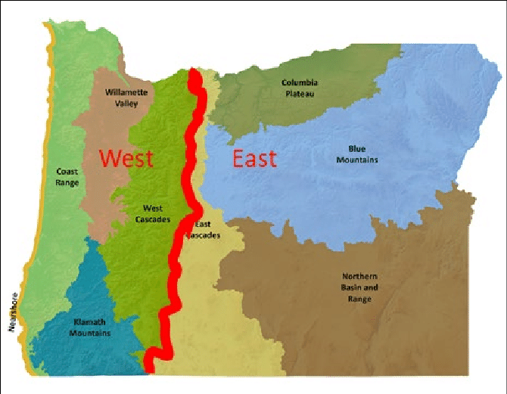
What Is an Ecoregion?
What Is an Ecoregion?
https://www.researchgate.net/figure/EPA-Level-III-Ecoregions-in-Oregon-Modified-from-original-image-Oregon-Department-of_fig6_329001387
Notes:
http://people.oregonstate.edu/~muirp/FuelsReductionSWOregon/ToolsResources/EcoregionsOregonLevelIVEPA.pdf

Slide 7
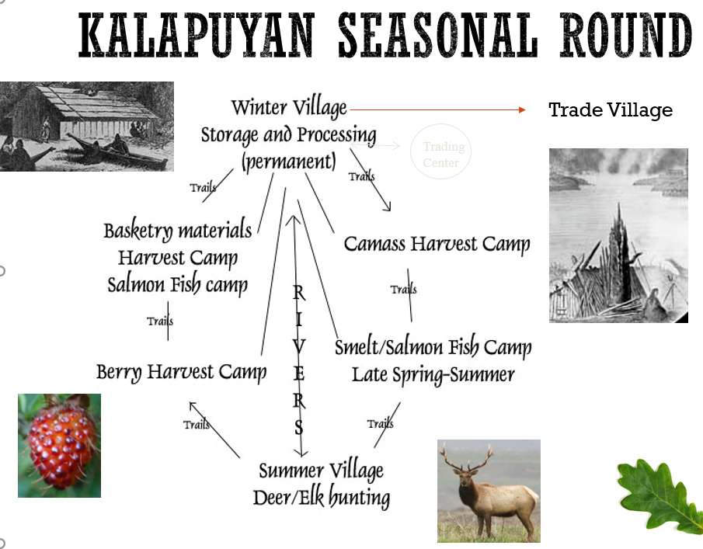
Seasonal Rounds
Seasonal Rounds
https://ndnhistoryresearch.com/2016/11/08/kalapuyans-seasonal-lifeways-tek-anthropolocene
Notes:
A seasonal round is a pattern of movement from one resource-gathering area to another in a cycle that is followed every year. In the spring, summer, and fall, Oregon’s people moved to a variety of resource areas. During the winter they gathered in winter villages. The abundance of resources also determined how often people moved. In areas that had a greater abundance of variety, people could stay in one location for longer than in areas where resources were scarcer (Campbell, Menzies, & Peacock, 2003).
All Tribes in Oregon practiced the seasonal round. This involved an annual system of whole villages and families moving where resources were ready for harvest, hunting, or fishing. Many resources, processed in the field, would be returned to winter villages for storage. The Kalapuyan seasonal round is pictured above. How does the idea of a seasonal round fit within a particular ecoregion?

Slide 8
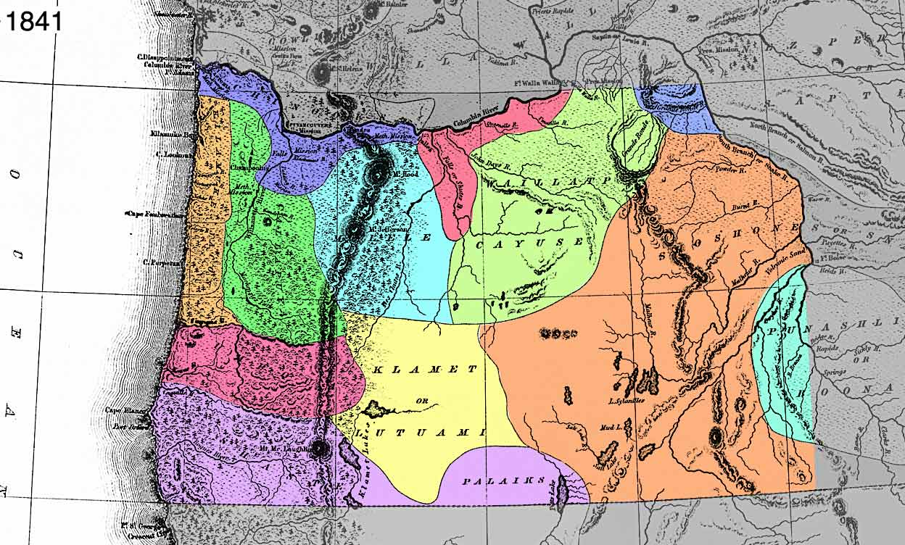
Ancestral Homelands and Ecoregions
Ancestral Homelands and Ecoregions

Slide 9
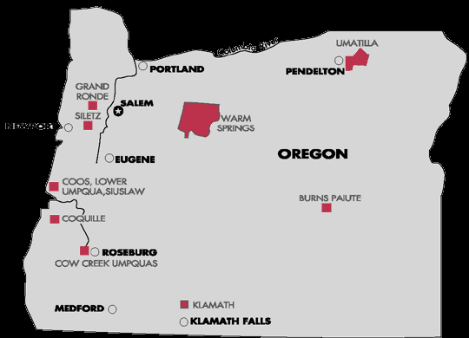
Impacts of Forced Relocation to Reservations on Seasonal Rounds
Impacts of Forced Relocation to Reservations on Seasonal Rounds

