Slide 1
OREGON DEPARTMENT OF EDUCATION | GRADE 8, HEALTH Native Stereotypes, Cultural Bias, and Cultural Appropriation

Slide 2
Stereotypes
Notes:
https://www.c-span.org/video/?313037-1/native-americans-common-stereotypes

Slide 3
More Examples of Cultural Appropriation
Notes:
https://www.nationalgeographic.com/culture/2018/10/indigenous-peoples-day-cultural-appropriation/#/native-americans-appropriation-worldview-misrepresentation-object-11.jpg
https://www.youtube.com/watch?v=sjNDRPQoXB0

Slide 4
Yet More Examples of Cultural Appropriation
Notes:
https://www.nationalgeographic.com/culture/2018/10/indigenous-peoples-day-cultural-appropriation/#/native-americans-appropriation-worldview-misrepresentation-object-11.jpg
https://www.youtube.com/watch?v=sjNDRPQoXB0

Slide 5
Appropriation Images 1

Slide 6
Appropriation images 2

Slide 7
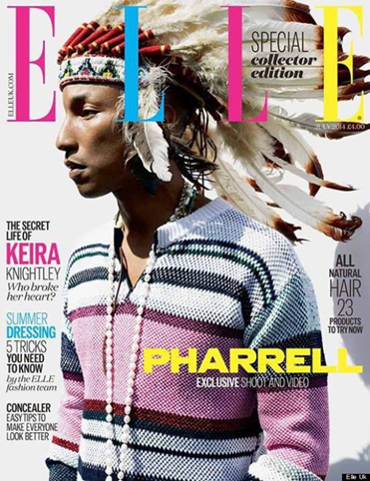
Appropriation Images 3

