Slide 1
Oregon Title VI Community of Practice
Wednesday, October 16, 11AM-12PM
In the chat, please share
your first and last name
name of district ,ESD, or Tribe, and
official Title VI Role - Project Coordinator, Authorized Official Representative, student liaison, etc.

Slide 2

Introductions and Role
Peer Community of Practice Leaders -
Gillian Murr - Portland Public Schools
Shelby Maerz - Salem-Keizer Public Schools
[Small District CoP Leader Wanted]
[Consortium CoP Leader Wanted]
Oregon Office of Indian Education Title VI Lead -
Stacy Parrish, Education Program Specialist II, Proud Member of the Klamath Tribes (Yahooskin Paiute)
Notes:
ALL

Slide 3
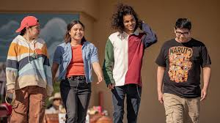
Title VI Intro and Check In with Three Awardees
Let’s get to know three of you better…
When called on, share your …
Name
Tribes you “Meaningfully Collaborate with” for Title VI
Your role with Title VI
Years in the role
Come to me if you want help with…
In September we heard from Coquille SD, Klamath County SD, and David-Douglas.

Slide 4
Quick Updates
The US Department of Education Office of Indian Education released the public-facing list of FY24-25 Awardees for Title VI Indian Education. Visit the website below to learn more about your award.
ODE uses this information for our own public-facing list, which is more comprehensive. It can be found on our Title VI website and on our Tribal Consultation website. View it here.
In Case you Missed It!
NEW EASIE New OIE Formula Project Director Webinar and Authorized Official Representative (AOR) Webinar from Aug. 14, 2024

Slide 5
Today’s Agenda -
Teamwork Makes the Dreamwork - Sharing out on our Native American Heritage month Approaches, Events, Activities, and Traditions
Indian Parent Committees - Learning from Columbia Gorge Consortium
Indian Parent Committee Bylaws - Examples and Discussion
Community of Practice Shared Folder - Spreadsheet Fun and Contact List

Slide 6
Teamwork Makes the Dreamwork
Sharing out on our Native American Heritage Month Approaches, Events, Activities, and Traditions

Slide 7
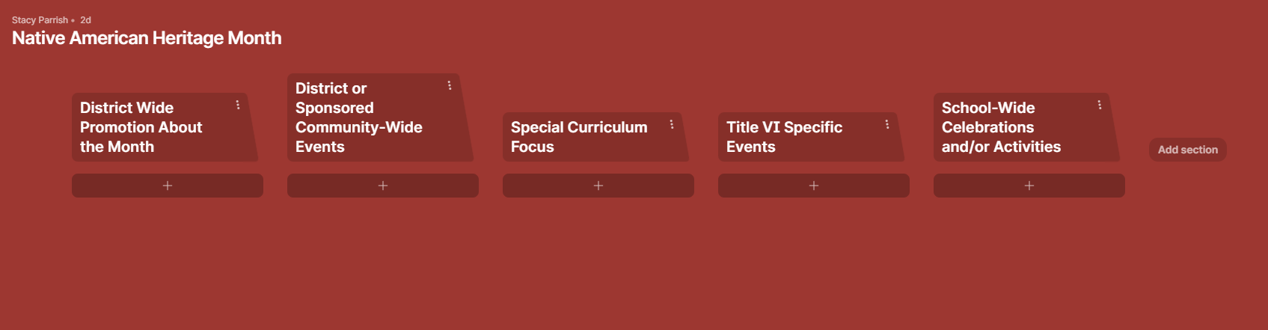
Contribute to this Padlet —
Open the Padlet and click on the + to add how your district is planning for Native American Heritage Month. Please take four minutes to add to it.

Slide 8
General Formula Grant Timeline
To Do List -
✅ 506 Form collection process
✅ Indian Parent Committee Planning
✅ Identify your 31 day count window
-EASIE APR for FY 23-24 opened Sept. 9
-Indian Parent Committee Start of Year Outreach
-District and School-Wide Registration Norming - 506
Native American Heritage Month
-EASIE PART I Closes, 2nd week of month
-Tribal Consultation window for Integrated Guidance Opens
-Public Hearing must be held before Part II closes
-EASIE PART II Submission Deadline, Second week of Month Approx.
SEPTEMBER
NOVEMBER/DECEMBER
MARCH
MAY
OCTOBER
JANUARY/FEBRUARY
APRIL
-EASIE APR for FY 23-24 closed October 11
-Indigenous Peoples Day, Monday Oct 14
-EASIE Part 1 Opens, 2nd week of February Approx.
-EASIE PART II Application Available, 1st week of Month
-Tribal Consultation closes April 30th for Integrated Guidance
This is a general visual of the Title VI school year timeline. All LEAs and LEA-Cs should adhere to all published DOE timelines to plan their efforts.

Slide 9
Indian Parent Committee
Its Role and Importance

Slide 10

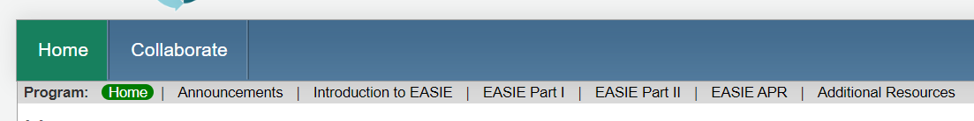
INDIAN PARENT COMMITTEE
EASIE COMMUNITIES 360 Support
EASIE 360 Communities 360 website
Indian Parent Committee Specific Resources | UPDATED IPCA Form - Indian Parent Committee Approval Form Indian Parent Committee - Title VI Application Process and Addressing Concerns Webinar FY 2024-25 This link includes the webinar slide decks and video recordings from the Indian Parent Committee - Title VI Application Process and Addressing Concerns Webinar FY 2024-25 session. UPDATED Part II Frequently Asked Questions ❗❗❗ See pages 8 to 11 on the role and responsibility of the IPC and pages 30-32 on the Indian Parent Committee Approval Form NEW OIE EASIE Title VI Bylaws Template

Slide 11
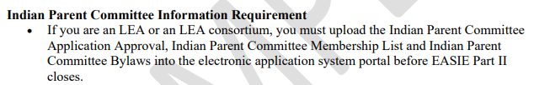
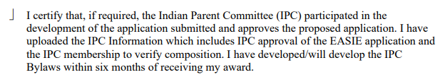
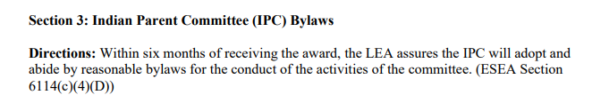
EASIE COMMUNITIES 360 Support
From the EASIE Part II Paper Application –

Slide 12

Columbia Gorge Title VI Consortium
Azariah Ozias
Columbia Gorge LEA-C, Title VI Home-School Liaison
Contact Information: aozias@cgesd.k12.or.us
Venus Allison
CGESD Indian Parent Committee Chair
Russell Spino
CGESD Indian Parent Committee Vice Chair
The Columbia Gorge Consortium supports
North Wasco
South Wasco
Hood River
Dufur
🦅 First, further introduce yourself to the group, including your role on the Indian Parent Committee.
🦅 Share out what interested you in joining the Indian Parent Committee, as well as what drew you to the role you play on it?
🦅 Describe what the Indian Parent Committee looks like for Columbia Gorge ESD and the responsibilities it has?
🦅 In what ways has the Indian Parent Committee been able to push the ESD and the school districts in how they support Native youth?
Notes:
Share out approximately 3-4 minutes per question

Slide 13
Indian Committee Bylaws
Examples and Discussion

Slide 14
INDIAN PARENT COMMITTEE BYLAWS
EASIE COMMUNITIES 360 SUPPORT
EASIE 360 Communities 360 website
Bylaws Specific Resources | NEW OIE EASIE Title VI Bylaws Template

Slide 15


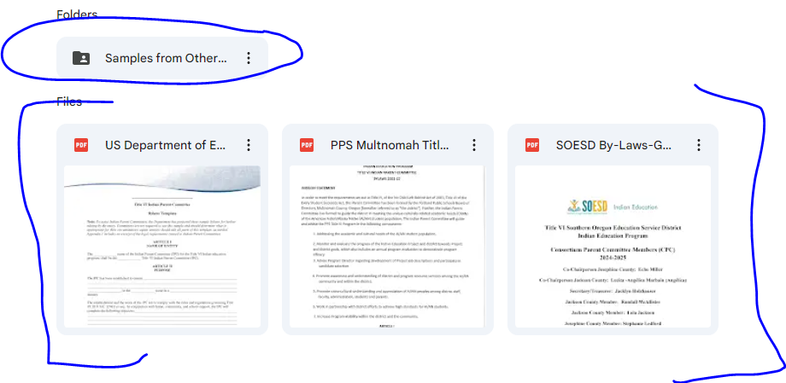
Oregon’s OIE Support
Tip
Bylaws creation should begin with both –
Empowering all community members to share their voice on their experience in the school system, including how Title VI Indian Education can positively impact the educational experience of their child(ren), and
a separate training where community members can learn about the Title VI legislation, including the roles and responsibilities of the IPC

Slide 16
Community of Practice Shared Drive
Please bookmark the link to the folder dropped in the Chat. We will not be posting it here, because these slides are shared publicly.

Slide 17
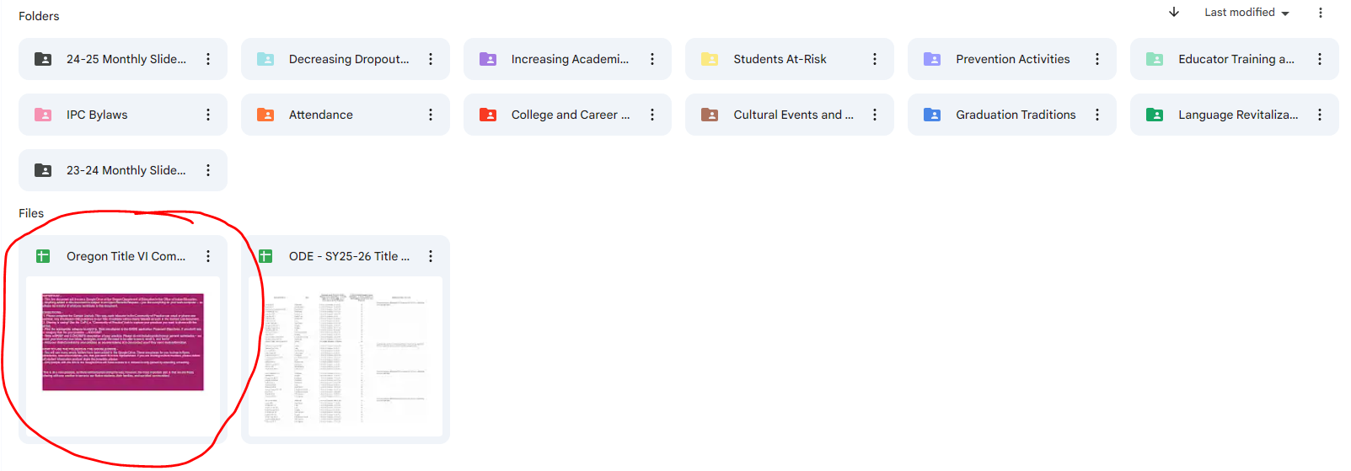
Step 1 - Open the circled document. Read the directions.
Step 2 - Fill out the Contact List first. This list is not public, but for internal use.
Step 3 - Contribute to the CoP tab as much or little as you like!

Slide 18
Contact Stacy Anytime
Stacy Parrish, Education Program Specialist II
Email - stacy.parrish@ode.oregon.gov
Book an Office Hours -
Book time with STACY PARRISH * ODE
Text/Call - 971-208-0270
I am available for things like…
Indian Parent Committee Training
“Advocating Up” Help
Data Analysis Work / Data Systems
ESD Consortium Support
Tribal Consultation and Improving Tribal Relations Help/Coaching

