Slide 1

Oregon Poet Laureate 2016-2018 Elizabeth Woody

Slide 2
Oregon Poet Laureate
Serves as a state ambassador of poetry
Appointed by the governor of Oregon
Travels the state to share the power of reading and writing poetry

Slide 3
Elizabeth Woody
Elizabeth Woody is a poet and educator of Navajo, Wasco, and Yakama descent. She is an enrolled tribal member of the Confederated Tribes of Warm Springs.
Woody’s subject matter includes the histories of her ancestors, the rich Pacific Northwest landscape, and the experience of being a tribal member, an American, and a woman in contemporary society.
Woody is the winner of the American Book Award.
In 2017, she was named the eighth poet laureate of Oregon.
She is the first person of American Indian heritage to be named poet laureate of Oregon.

Slide 4
Elizabeth Woody’s Books of Poetry
Luminaries of the Humble, (Sun Tracks, Vol 30), University of Arizona Press
Seven Hands Seven Hearts, Eighth Mountain Press
Hand into Stone: Poems, Contact II Publications

Slide 5
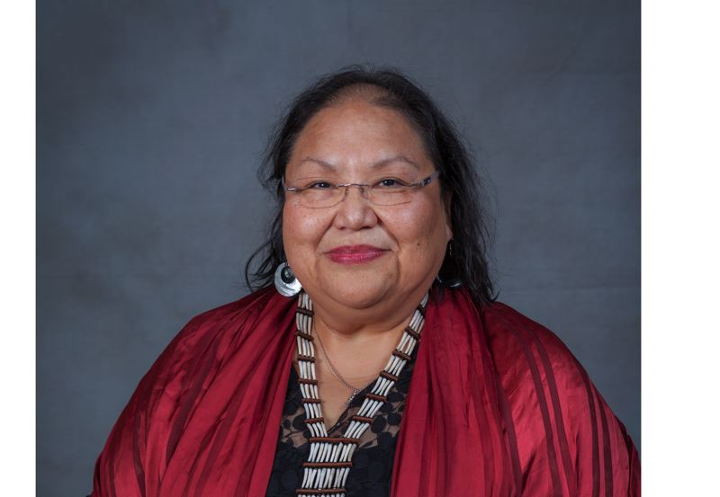
Elizabeth Woody: Transcending Chaos Through Art PLAY VIDEO
Notes:
https://www.opb.org/television/programs/artbeat/segment/oregon-poet-laureate-elizabeth-woody-warm-springs-poetry/

Slide 6
A theme in poetry is…
The central thought or underlying meaning of the poem
NOT the same as the subject or topic of the poem
A statement the poem makes about the topic

Slide 7
TPCASTT Poetry Analysis
T- Title
P- Paraphrase
C- Connotation
A- Attitude
S- Shift
T- Title Revisited
T- Theme

Slide 8
Title
Before you read the poem, consider the title and its possible meaning.
Questions:
What ideas does the title evoke?
What images does the title suggest?
Can you make any predictions about the poem?

Slide 9
Paraphrase
Put the poem in your own words. Begin by highlighting or underlining words, phrases, and images that stand out for you. Write your paraphrase next to the poem.
Questions:
What is the surface meaning of the poem?
What is the topic/subject of the poem?

Slide 10
Connotation
Consider what you highlighted/underlined. Think about the “under surface” meanings of these words or phrases.
Questions:
What could these words or images tell you?
What could the author be saying?

Slide 11
Attitude
The attitude of the poem can be thought of as the perspective or tone of the poem. Reflect on who is the speaker of the poem and the feelings projected through word choice and figurative language.
Questions:
What is the speaker’s attitude? What is the tone of the poem?
What is the author’s attitude/tone? Does it differ from that of the speaker?

Slide 12
Shift
Shift refers to changes or progression from one idea to another in the poem. Look for changes in time, tone, or speaker. This should always be noted as it will affect meaning.
Questions:
Are there changes in key words (but, yet, however, although)?
Are there dramatic changes in punctuation such as dashes, periods, or colons?
Are there changes in the level of diction (for example, from more formal to more informal)?

Slide 13
Title – Again!
Return to the title of the poem. Take a few minutes to reflect on its meaning.
Questions:
Did the interpretation change?
What does the title tell us about the poem?

Slide 14
Theme
A theme in poetry is the central thought or underlying meaning of the poem. Look at the other parts of TPCASTT. The theme is communicated through use of connotation, attitude/tone, and the progression of ideas.
Questions:
What is the poem saying?
What message or idea is the author trying to get across?

Slide 15
Celilo Falls (Wy-am)
For thousands of years, Celilo Falls (Wy-am) was one of history’s great market places
Northwest tribes fished for the salmon that struggled to make their way upstream
There were permanent villages between the falls and where the city of The Dalles now stands
As many as 5,000 people would gather to trade, feast, and participate in games and religious ceremonies
In 1957, the opening of the Dalles Dam formed a lake that flooded Celilo Falls
Notes:
https://www.critfc.org/salmon-culture/tribal-salmon-culture/celilo-falls/

Slide 16
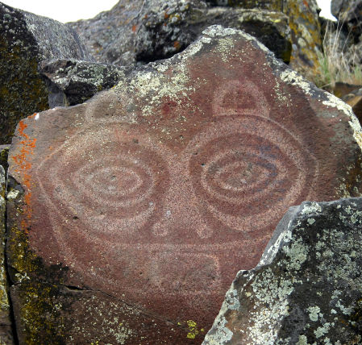
She-Who-Watches, the Names Are Prayer For David Sohappy, April 25, 1925 – May 7, 1991
Woody dedicated this poem to David Sohappy, a Yakama religious leader who led the fight to restore fishing rights to American Indian tribes along the Columbia River
The speaker of this poem is a petroglyph (a rock carving) on the Columbia River
Woody explains that, “She was originally a woman chief, the last, before Coyote changed her into rock to watch over her people and the male chiefs who followed her” (notes to poems in Seven Hands Seven Hearts 123)

Slide 17
Elizabeth Woody: Transcending Chaos Through Art

