Slide 1
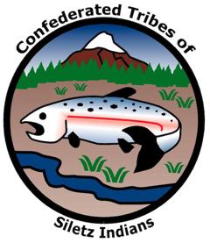

GRADE 12 Place and Remembrance

Slide 2
The Power of Place Names
Spend five minutes discussing the following questions with a classmate:
How do place names reflect a society's values, beliefs, history, and identity? Can you think of any examples?
What names in our area and state come from Native languages or reference Native people?
What complications and opportunities can arise when choosing to rename a place?

Slide 3
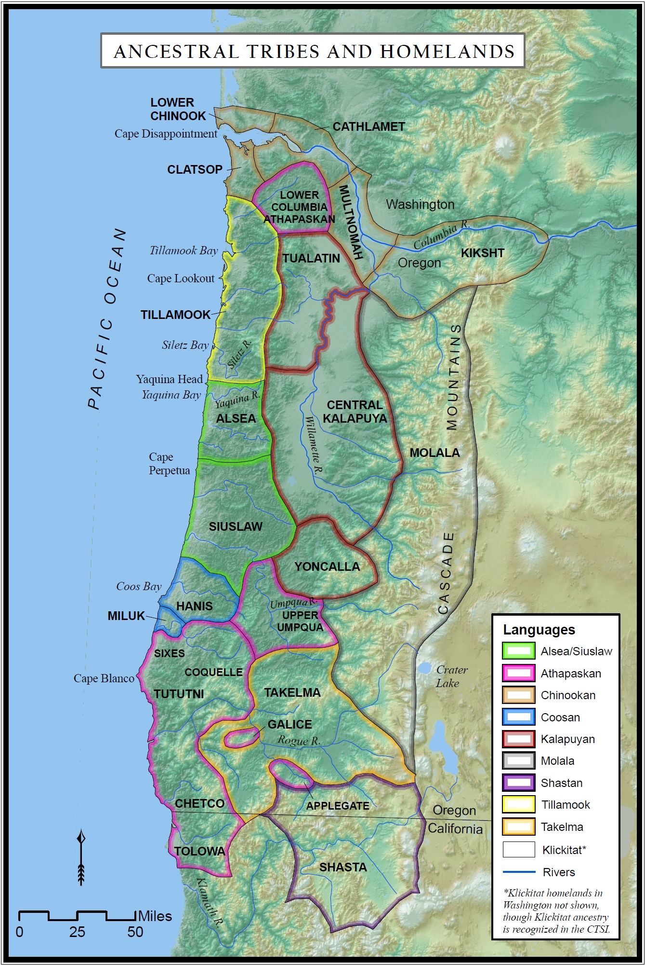
Confederated Tribe
A single Tribal government that is composed of multiple ancestral Tribes and bands. The Siletz are a Tribe confederated from many different people groups that lived in what is now western Oregon, as well as parts of northern California and southwest Washington.
A map of the ancestral Tribes and homelands of the Confederated Tribes of Siletz Indians (CTSI) can be seen on the right.
Images source: CTSI website.

Slide 4




Linguistic and Cultural Diversity
Western Oregon was very linguistically diverse
The area is home to 10 unrelated Indigenous language families
*Linguistic = Related to languages.
Images source: CTSI website.
Notes:
Say:
Before the forced removal of the many individual Tribes and bands that today make up the Confederated Tribes of Siletz Indians, western Oregon was very linguistically diverse, home to 10 unrelated language families. What does “linguistic” mean? (Pause.) Linguistic means related to language. Some of these languages were as different from each other as English is from Korean. Take a minute to think about this linguistic diversity across Native cultures in this region. Imagine the diverse tapestry of languages, dialects, and cultures in this region. (Pause and model or walk students through a few deep breaths here.) At the time, many places or landmarks were named for significant events, resources, or descriptions of the landscape in the very specific Native language of a given area.

Slide 5
Connected Peoples
The people of western Oregon had interconnected and complex relationships.
These relationships were created through trade networks that fostered:
Trade
Marriages
Celebrations
Other complex relationships
Images source: CTSI website.
Notes:
Say:
Despite speaking different languages, the people of western Oregon had very interconnected and complex relationships. Trade networks facilitated many types of cultural exchange, including intermarriage, celebrations, and shared traditions. In many cases, these relationships went back thousands of years and involved Tribes spread across hundreds of miles. These relationships created shared experiences and kinship between the various Tribes and bands living in the area.

Slide 6
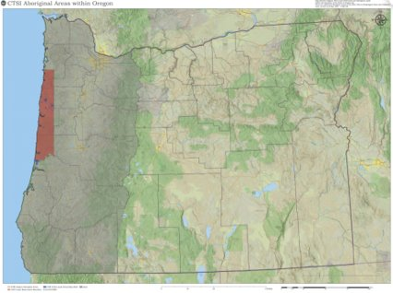
Removal
Removal led to conflicts and adjustments as different groups were brought together on the reservation.
Chinook Jargon (also known as chinuk wawa) emerged as a new language, reflecting a mix of the linguistic diversity found on the reservation.
Images source: CTSI
Notes:
Say:
Beginning in the mid-1850s, the U.S. government forcibly removed dozens of these Tribes from their ancestral homelands with the intent of concentrating them on the 1.1 million acre Coast (Siletz) Reservation, an area that originally encompassed close to a third of the Oregon coastline. Reality was messier. Some people slated to be removed to the Coast (Siletz) Reservation ended up on what would later become the Grand Ronde Reservation, while still other families managed to remain in their ancestral homelands, becoming the ancestors of other Confederations and tribal groups.
Those forced to the Coast (Siletz) Reservation soon saw the federal government abandon its promise to secure a “permanent home” for them. Instead, the government bowed to the demands of settlers and business interests and reduced the size of the reservation. Within 20 years of its establishment in 1855, the government had reduced the Coast (Siletz) Reservation by more than 80 percent—first in 1865, through an illegal presidential executive order that opened a 200,000-acre tract of land centered on Yaquina Bay, and then by an act of Congress in 1875 that removed an additional 700,000 acres, or two-thirds of the original reservation. On this slide, we can see the difference in the original size of the land set aside for the Tribes that were forcibly removed (shown in gray) and the area to which they were ultimately moved (shown in red).
The many individual Tribes and bands forced onto the Coast (Siletz) Reservation mostly supported each other and remained peaceful. However, the trauma of removal also led to some conflicts and adjustments as different groups were brought together on the reservation. Take a moment to imagine all these culturally and linguistically diverse groups being forced to relocate and live together in a new place. What difficulties or challenges do you think might have arisen from this forced relocation and mixing of different peoples? (Pause for responses.) The shift also required innovation by the people of the newly formed community. One such innovation was that a new language, chinuk wawa (also known as Chinook Jargon) came into use.

Slide 7
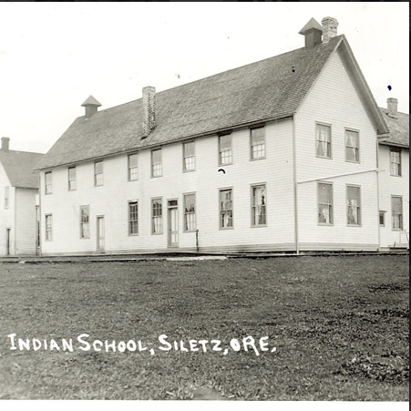
Removal and Language
The federal government discouraged and outlawed the use of Indigenous languages and cultural practices.
Boarding schools were established to assimilate Native children into the mainstream culture by cutting them off from their community, traditions, and languages.
Many languages of the Siletz people have few or no speakers.
Images source: CTSI https://www.ctsi.nsn.us/historical-photo-gallery/
Notes:
Say:
At the time, the federal government discouraged and even outlawed the use of Indigenous languages and cultural practices through a variety of programs, most notably boarding schools. Boarding schools were established to force Indigenous people to assimilate into the mainstream and to cut Native children off from their cultural traditions and ancestral languages. Because of these assimilationist efforts, many languages of the Siletz people have few or no speakers today. Take a moment and imagine what it might be like to be one of the last speakers of a language.

Slide 8
Quote about Siletz Languages
“Our Language is as old as time itself. For countless generations, our people lived out their lives speaking our words. In all that time, our words were never written. They were carried in the hearts and minds of our ancestors. They were learned by each generation and in turn taught to the next. For all of our history up to the 1850s our people prospered, by obeying the Laws of the Creator and living in balance with the land. With the arrival of the Europeans a tragedy began to unfold for our People, which in many ways extends to this day.”
– CTSI website

Slide 9
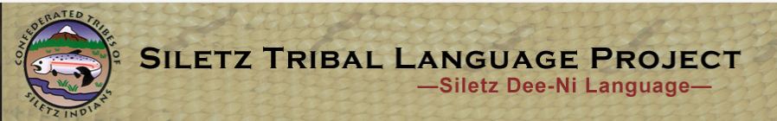
Siletz Languages Today
The Confederated Tribes of Siletz Indians works today to remember and revitalize its ancestral languages. The Siletz Tribal Language Project offers community classes in Nuu-wee-ya’ (Athabaksan) as well as supports classes at the local high school.
Siletz families maintain connection to the named places, with their own names for towns and rivers.
Images source: Siletz Tribal Language Project
Notes:
Say:
Despite this history of forced assimilation, the Tribes of Siletz have worked hard to document, preserve, and revitalize many of their ancestral languages. Today, the Siletz Tribal Language Project offers community classes in Nuu-wee-ya’ (Athabaksan) and supports classes at the local high school. In addition, Siletz families maintain their connection to their languages and the landscape by using their own names for towns, rivers, and other geographical features.

Slide 10
Place Names
Read through the handout, “Selected English Place Names with Indigenous Origins in Western Oregon ” with the peers at your table.
Choose a graphic organizer option and fill in connections between place names that stood out to you in the reading.
You will have 35 minutes to complete tasks 1 and 2.
Notes:
Say:
Even though the modern Siletz Reservation may be far away from these places, many families at Siletz still remember their ancestral homelands and have worked across the generations to remain connected to all the areas shown on this map. Because of the systematic ways that the federal government discouraged Indigenous people from passing down their languages, traditions, and history, there are some place names whose origins have conflicting stories. Some of these languages don’t have a modern alphabet or writing system and were only written down by non-Native ethnographers and linguists. Many of the names have simplified spelling in order to make them easier to pronounce for English speakers. One thing to keep in mind as you read is that many of the place names drawn from the Native languages of the Siletz are closely tied to traditional stories or describe specific geographical features. Unlike many place names in English, they are rarely named after a person or a deed.

Slide 11
Place Name Changes
Step 1. Divide up the readings among your group.
Step 2. Read your article(s) independently, highlighting or jotting down things that stand out to you in the reading.
Step 3. If you finish before your peers, read another article or look at the handout “Selected English Place Names with Indigenous Origins in Western Oregon” and draw connections between that handout and your reading.
Step 4. As the members of your group finish, share key points from the article that you read as a group.
Note: This activity will be followed by a whole-group discussion about these articles and topics.

Slide 12
Reflection Question
Revisit the following question at your table. Use examples from today’s lesson and from your own context, drawing connections where possible.
How does the naming of places reflect a society’s values, beliefs, history, and identity?

