Slide 1

DEPARTAMENTO DE EDUCACIÓN DE OREGON | GRADO 8, SALUD
Estereotipos nativos, prejuicios culturales y apropiación cultural

Slide 2
Estereotipos
Notes:
https://www.c-span.org/video/?313037-1/native-americans-common-stereotypes

Slide 3
Más ejemplos de apropiación cultural
Notes:
https://www.nationalgeographic.com/culture/2018/10/indigenous-peoples-day-cultural-appropriation/#/native-americans-appropriation-worldview-misrepresentation-object-11.jpg
https://www.youtube.com/watch?v=sjNDRPQoXB0

Slide 4
Más ejemplos de apropiación cultural
Notes:
https://www.nationalgeographic.com/culture/2018/10/indigenous-peoples-day-cultural-appropriation/#/native-americans-appropriation-worldview-misrepresentation-object-11.jpg
https://www.youtube.com/watch?v=sjNDRPQoXB0

Slide 5
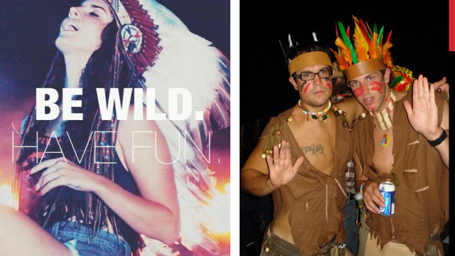
Appropriation Images 1

Slide 6
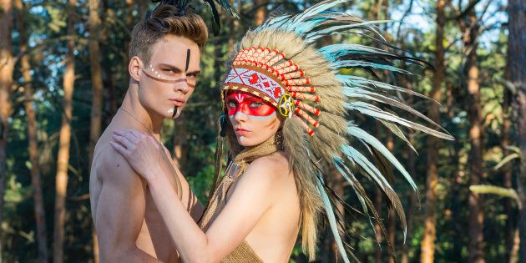
Appropriation images 2

Slide 7
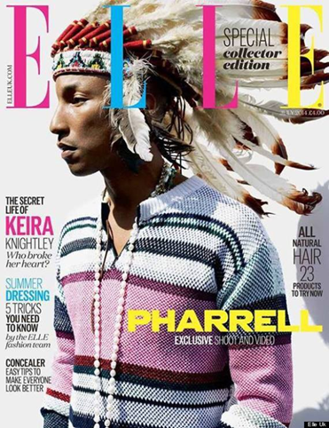
Appropriation Images 3

