Slide 1
TAPP Quarterly Learning Series #1
September 18, 2025 12PM-2PM
✅ Click on the three dots by your name in the Zoom to rename yourself to your preferred name, school district or tribe initials, role, and pronouns.
📓✍ Materials - Notebook/Journal, writing utensil, drinks, snacks, and your lived experience (i.e. your Street Data).

Slide 2
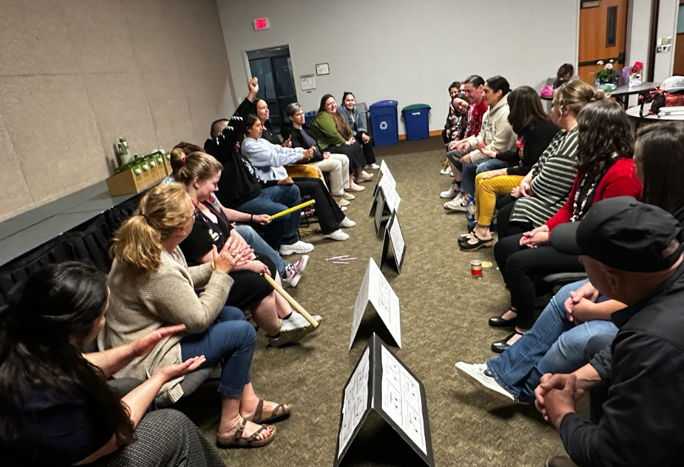
Opening Reflection
As everyone is transitioning to the space, take three minutes to reflect on a time this summer where you were in community or “in relations” with other people.
What was going on and talk about the impact it had on your spirit.
Drop it in the chat or at the end of time, please unmute and share it with the group.
Picture of the first Annual TAPP Stick Game held at Clackamas Community College during the May TAPP Symposium in 2025

Slide 3
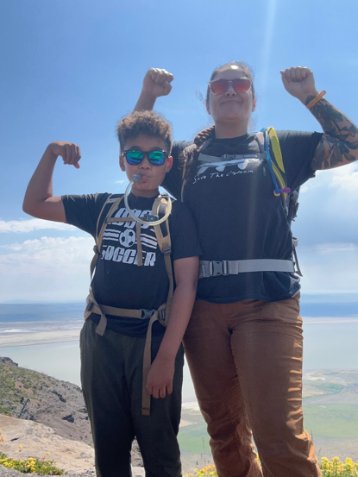
Meet Your Host
Stacy Parrish, Klamath Tribes (Yahooskin)
Education Program Specialist II in the Office of Indian Education
Within OIE I help support -
The TAPP grant
Title VI Community of Practice
Tribal Consultation between Tribes and School Districts and ESDs
Special Education
Other Duties as Assigned
Everyone – Please take time to further introduce yourself in the chat!
Picture of Stacy and Blue Parrish at the end of the Winter Rim trail, overlooking Summer Lake; eastern boundary of the Klamath Tribes Peak to Peak Reservation of 1864; Summer 2025

Slide 4
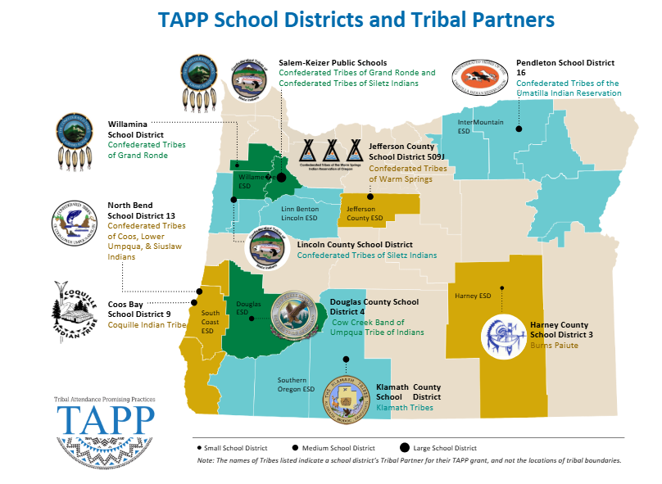
Notes:
Ask Douglas County SD 4 to further introduce themselves in the Chat.
Give shouts out on the data of some TAPP districts.

Slide 5
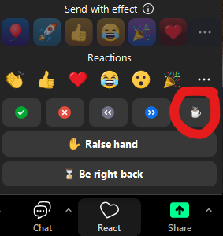
Ways to Engage Today
📷 Camera – We’d love to see your face if you’re comfortable
🎤 Voice – Unmute and jump into the conversation
💬 Chat – Share responses, thoughts, links, or reactions
Reactions - Use the button to interact with the content or the
conversation in real-time.
Need to take a break? - Click the “coffee icon” from the Reactions button OR just drop a note in the chat that lets us know you have stepped away.
✨ All forms of participation are valued and appreciated. ✨
Notes:
I can’t think of any place in the country where educators, educational leaders, and tribes are convening, let alone on a regular basis.

Slide 6
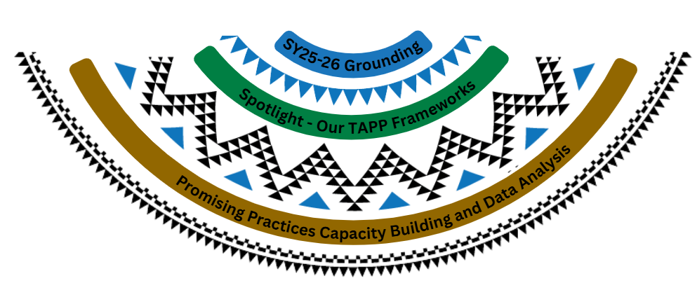
Things in our TAPP Basket Today –
🙾Anticipate reflection time, whole group discussion, and breakout rooms with your teams.🙿
Notes:
Speak to the purpose of the grounding – new year, most importantly new biennium.
Spotlight – Dig in and engage in sensemaking of our TAPP Frameworks, not only how they can be used as tools to assist you in this work, but provide a common language as to what it means to ensure our schools are culturally responsive to AI/AN students, but our supports are as well.
Promising practices – In breakout rooms, continue having or start having discussions around the work ahead.

Slide 7
SY 25-26 Grounding
For the New School Year and Beyond
Notes:
Script - As we gather for this first quarterly learning series, I want to invite us into deep reflection about what it means to do this work together. Each of us comes into this space with a role—whether as a district leader, a family advocate, or a tribal partner. Just look at everyone who is here in the chat. Each role carries its own responsibilities and perspectives. I’d like to ask two connected questions that speak to our different positionalities.

Slide 8
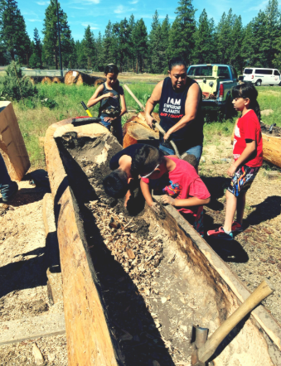
Reflection then Discussion
Reflecting silently, please write for four minutes on the following prompt depending on your role –
For District Leaders/Staff and TAPP Family Advocates -
When we talk about ‘root causes’ of absenteeism for Native students, we are not just talking about attendance barriers. We are talking about histories, policies, and lived realities of the local context that stretch across generations. From your perspective, what are the deeper truths schools and the district must be willing to name in order to transform these systems?
For Tribal Partners –
The TAPP grant is not just a school initiative; it is a commitment to honoring tribal sovereignty and voice. Tribal partners, what do you most want schools to hold at the center of their work this year with Native students and families?
At the end of four minutes, we will share out in a whole-group discussion.
Picture of youth with a tribal staff member making a dugout canoe.
Notes:
If needed, for tribal partners – The TAPP grant is not just a school initiative; it is a commitment to honoring tribal sovereignty and voice. Tribal partners, what do you most want schools to hold at the center of their work this year with Native students and families?”
Consider adding in one more slide which name “all the things” a district might say, but elevate that hear, listen, feel from Leona Prince.

Slide 9
Building from Last Year
Across the ten TAPP districts, a powerful set of common themes emerged from the end of biennium reflections:
Family Advocate Leadership: Advocates are not auxiliary — they are catalysts for relational accountability, family reconnection (both to school and to their culture), and systems change in both the schools they serve and in their school districts.
Root-Cause-Oriented Practices: Districts embraced frameworks that named trauma, poverty, racism, and systemic neglect as causes of chronic absenteeism — not student or family failure. This reflects a powerful shift in our TAPP School Districts to critically examine and identify systemic shifts needed in our organizations to serve Native students, their families, and tribal communities in more culturally sustaining ways.
Healing-Centered Engagement: Shifting away from punitive approaches of addressing attendance and towards healing-centered engagement through cultural activities, home visits, and being mindful of each interaction with students and families as opportunities to restore trust with our schools, with educators, and even the relationships families have with the public school system.
Elevating Tribal Voice: Fostering tribal partnership efforts and building space for Tribal partners to shape district strategies and policies. From unique attendance codes to honor when Native students are engaging in cultural events and activities during the school day, to the creation or revision of robust Memorandums of Understanding between the tribe and school district, or in the implementation of both Tribal History/Shared History lesson plans AND the curriculum of the local tribe(s), TAPP school districts are identifying these as foundational practices that must be in place given the proximity to a Sovereign Nation.
Place-Based Cultural Curriculum: Expansion of Native language instruction, cultural events, and curriculum shaped by tribes has increased significantly this biennium in our ten TAPP school districts.
Notes:
As I read through these, determine to what extent this theme is evident in your own local context. Start considering what might be needed to get to this place captured here.
Please take a moment to unmute and uplift one of these areas that you would like to celebrate as an area of strength in your TAPP site from last school year. Tell us the category and then something specific about your school site.

Slide 10
Call to Action
Using TAPP to facilitate deepening tribal partnerships beyond compliance across all TAPP districts
Strengthening data use to monitor impact of our efforts
Investing in professional learning centered on Indigenous frameworks, and
Ensuring sustainable funding for Advocate roles
This work must continue — led by community, grounded in healing, and in good relationship with the sovereign Tribal Nations of Oregon.

Slide 11
Spotlight - Our TAPP Frameworks
Call to Action: Investing in professional learning centered on Indigenous frameworks

Slide 12
Street Data
Everyday Interactions, Lived Experiences of Students, Families, and Educators
Satellite Data
Regular Attender Rates; State Achievement Scores
Being Named TAPP District
Tribal Sovereignty
Dreams and Goals for the Future of the Tribe, Tribal Land, and Membership
Local Context
Housing
Healthcare
Transportation
Food or Food Deserts
Economic Outlook
Having a TAPP Tribal Partner
Native Educational Literature
Representation, Trauma Informed, Place-Based, Land-Based, Indigenizing and Decolonizing, Diverse Staff
Education Literature
Best Practices
Cultural Responsiveness
PBIS, OR TSEL, AVID, Building Relationships, Restorative Justice, Curriculum
TAPP Agreement Actions and Deliverables
Notes:
Eight Districts have had this grant for 9 years.
As a TAPP District, you have had to navigate all of this –
The saying surfaced last year during the TAPP Symposium – We wish TAPP was just about Attendance. The next iteration of that is “We wish it was just as easy about knowing about all of these things”.
Instead it is about having a lens – of being able to interpret what is happening around us; a skill of readying so we know what to do when something comes up with a student, their family, in a school culture of a particular school; it is a discipline of understanding the role we play in this work.

Slide 13
As a TAPP Site Team – Our responsibility is to engage in sensemaking with all we see, all we hear, all we are being taught, and all we feel – in our spirit and in our gut – about this work.
Sensemaking (in Safir’s work) is the collaborative process by which educators and leaders gather, listen to, and engage deeply with people’s lived experiences (students, families, teachers), especially qualitative and experiential data (“street data”); reflect on those insights (not just what is measured, but what is felt, what is hidden, what is culturally specific); uncover patterns, tensions, and context; and use that understanding to shift beliefs, structures, practices, and policies toward more equitable, responsive, and culturally grounded education.
Notes:
Script - Re-read this quote: What words or what is a phrase that jumps out to you and why.
What does it make you (YOU) specifically think about?

Slide 14

TAPP Frameworks
Our TAPP Tiered Response Pyramid
Adapted from Attendance Works
Pulling in teachings from Street Data
Uplifting Lessons Learned from Tribal Partners
Foundational Supports Framework
Adapted from Attendance Works
Applies an Indigenous Lens to a National Model
Our focus as we start the year will be on the development of culturally responsive tiered systems to support attendance. It is our biggest area of improvement.
Notes:
One tool we have to help with sensemaking is our TAPP Frameworks.

Slide 15
Drop in the Chat –
Question 1 - On a scale of 1 to 5 with 5 being the highest level of knowledge on the subject, what is your level of understanding about the function “Tiered Support Systems” play in student success (i.e. academic, engagement, sense of belonging, etc) in a school setting.
Question 2 - On a scale of 1 to 5 with 5 being the highest level of knowledge on the subject, what is your level of understanding about how to create a school that is culturally responsive for all students and especially American Indian and Alaska Native students.
Let’s hop out in our team breakout rooms. Say good afternoon. Share the number you gave for each question and why (Question 1 - Tiered Support Systems; Question 2 - Culturally Responsive schools. Then, share what you hope to learn about these frameworks today.

Slide 16

As we dive into these frameworks…
...remember –
This might be new work to some or the first time tiered supports are talked about in this way (opportunities for “unlearning”)
We come from different positionalities
The focus is on strengthening our systems TOGETHER
Notes:
Remember -
These Frameworks are just something to Anchor us so that we don't get swept Downstream from all of the tool kits, frameworks, initiative, legislation, trends, Changes in Federal policy, changes in school boards, changes in school leaders. the list could go on and on. at the end of the day these Frameworks are to give us a common guide as to what a culturally responsive School culture is for American Indian and Alaska native plus students and what culturally responsive supports are. They are to show us the components of both, not to tell us what to do. It is about HOW to build them and WHY and not about what – stuff, things, the latest initiative, or trends to do.

Slide 17
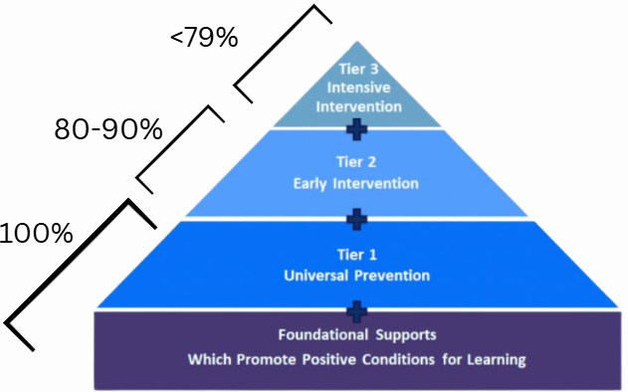
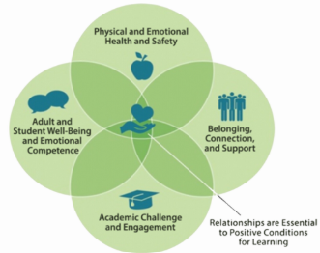

Attendance Works –
Tiered Response System
Organizes support: It helps schools systematically respond to student attendance challenges by laying out levels (tiers) of support.
Consistency: It gives districts and educators a common framework, so that access to supports are not left to chance or handled differently in every classroom.
Notes:
Purpose of a Tiered Support System - Shout it out;
With predictability – by design, not by change – 100% of the students in the school receive
My son’s school district has a policy called, “No Wrong Door”.

Slide 18
Answer this question in the chat —
A tiered response system is NOTHING without ____________________.
Notes:
By now, your TAPP Family Advocate should know all of their Tier 3 students. They should have a growing collection of Street Data as to why some students have missed more than 2 days of school already.

Slide 19
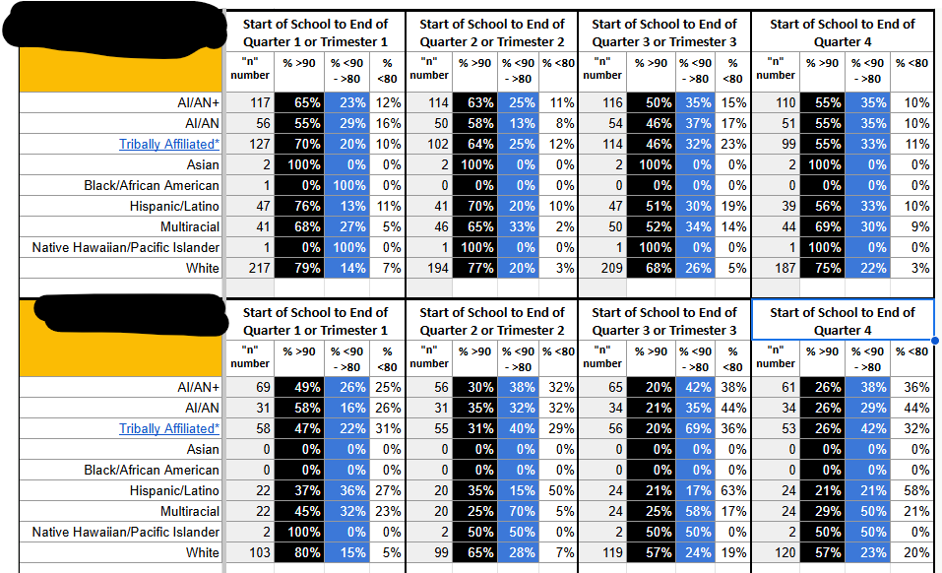
TAPP Attendance Tracker - Evaluates Our Efforts
What is our data saying about the types of Tiered Supports students, families, and educators need? Are our efforts effective? What additional supports are needed?
Notes:
This data is really about progress monitoring – a time to stop, at the end of a grading or marking period – to really reflect on to what extent our TAPP efforts are positively impacting Attendance of ALL students, and especially Native students.
What you're looking at here is an actual tap School two of them from last school year their names have been marked out. all top schools keep track of the number of students in each racial or ethnic category and then at the end of each quarter or trimester they go in to indicate what percentage of students in that particular student group are attending school more than 90% of the time those are regular attenders. they also track what percentage of students are attending 80 to 90% of the time and then what students are are attending less than 80% of the time. The Assumption here is that students falling in one of these three tiered bands are receiving support based on their need and aligned to the level of intensity that those needs are really calling for. we're going to revisit this again in a few more slides

Slide 20
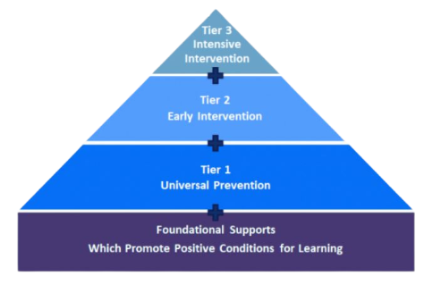
Attendance Works –
Tiered Response System
Notes:
A Tiered Response System not only pushes us to be consistent (predictable) and organized, but it helps us stay disciplined to the importance of the conditions that create a positive school culture.
AW identifies these four conditions —
AW teaches us that high chronic absenteeism indicates a deterioration of these four foundational conditions.

Slide 21
Answer this question —-
In a school, creating a positive foundation for Physical and Emotional Health and Safety looks like _____________________.
Notes:
By now, your TAPP Family Advocate should know all of their Tier 3 students. They should have a growing collection of Street Data as to why some students have missed more than 2 days of school already.

Slide 22
Answer this question —-
In a school, creating a positive foundation for Belonging, Connection, and Support looks like _____________________.
Notes:
By now, your TAPP Family Advocate should know all of their Tier 3 students. They should have a growing collection of Street Data as to why some students have missed more than 2 days of school already.

Slide 23
Answer this question —-
In a school, creating a positive foundation for Adult and Student Well Being and Emotional Competence looks like _____________________.
Notes:
By now, your TAPP Family Advocate should know all of their Tier 3 students. They should have a growing collection of Street Data as to why some students have missed more than 2 days of school already.

Slide 24
Answer this question —-
In a school, creating a positive foundation for Academic Challenge and Engagement looks like _____________________.
Notes:
By now, your TAPP Family Advocate should know all of their Tier 3 students. They should have a growing collection of Street Data as to why some students have missed more than 2 days of school already.

Slide 25

Fundamental Understanding
High rates of chronic absenteeism mean that one or more of the foundational conditions has deteriorated.
TAPP programs have to work collaboratively to tend to this foundation or equity issues will erupt, causing some students/groups to be disproportionately in Tiers 2/3 because of systemic bias or barriers.

Slide 26
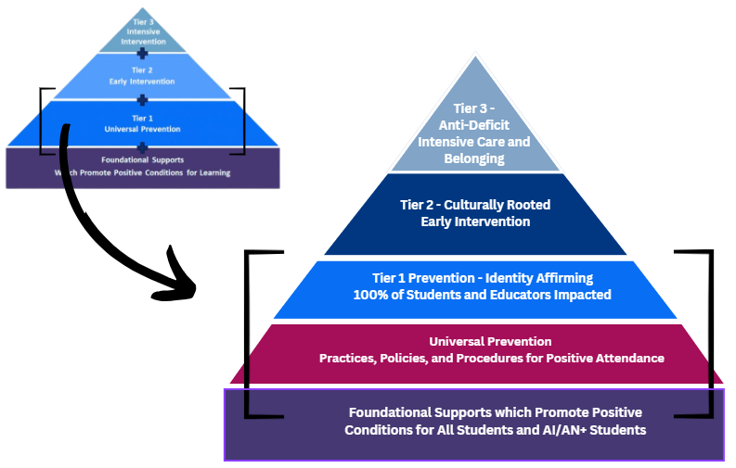
Based on Action-Research and Case Studies from TAPP –
Culturally Sustaining Tiered Response System
Shift #1 -
Breaking AW’s “Tier 1 Universal Prevention” into two parts.
Notes:
On the left here is the pyramid from attendance works. I've highlighted their category called Tier 1 universal prevention.
By the sheer nature of being tapp Grant recipients, we have to have a very keen understanding about how our Practices, Policies, and Procedures related to Attendance impact our students.
This includes both the written practices, policies, and procedures AND ALSO the ones not written, but they are institutionalized in our respective school cultures – which are more often than not defined by
People, personalities, and power
With the TAPP pyramid we have learned that it is really hard to tend to these foundational supports which are promoting positive conditions for all students and Native students to learn and still putting them at the mercy of broken outdated or punitive attendance systems. so that is why in our tap pyramid we've included it as its own unique section.

Slide 27
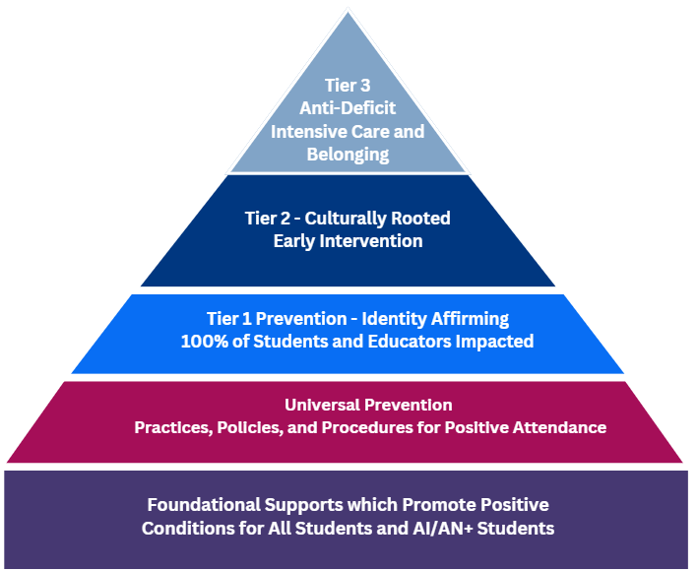
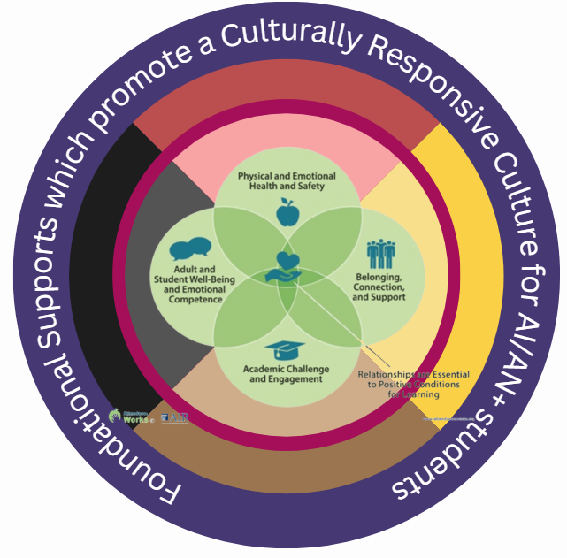
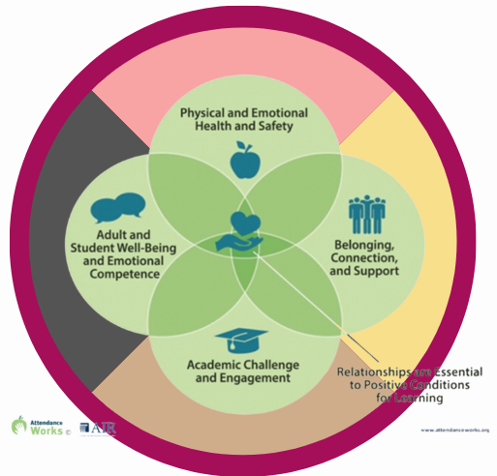
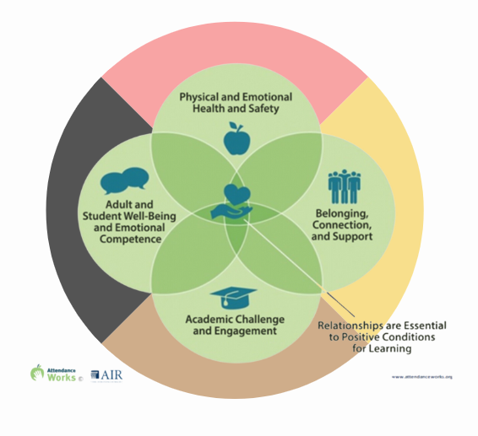
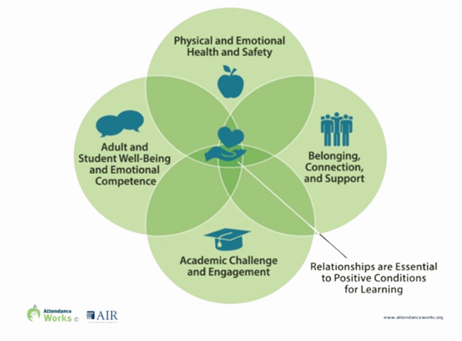
Based on Action-Research and Case Studies from TAPP –
Culturally Sustaining Tiered Response System
Notes:
And because of how TAPP districts have approached their work related to their attendance policy and their TAPP efforts, it has evolved how we see the attendance works Foundational SUpports.
This is our TAPP take on the AW supports –

Slide 28
Answer this question —-
In a TAPP school, creating a positive foundation for Physical and Emotional Health and Safety for AI/AN+ looks like _____________________.
Notes:
By now, your TAPP Family Advocate should know all of their Tier 3 students. They should have a growing collection of Street Data as to why some students have missed more than 2 days of school already.

Slide 29
Answer this question —-
In a school, creating a positive foundation for Belonging, Connection, and Support for AI/AN+ looks like _____________________.
Notes:
By now, your TAPP Family Advocate should know all of their Tier 3 students. They should have a growing collection of Street Data as to why some students have missed more than 2 days of school already.

Slide 30
Answer this question —-
In a school, creating a positive foundation for Adult and Student Well Being and Emotional Competence for AI/AN+ looks like _____________________.
Notes:
By now, your TAPP Family Advocate should know all of their Tier 3 students. They should have a growing collection of Street Data as to why some students have missed more than 2 days of school already.

Slide 31
Answer this question —-
In a school, creating a positive foundation for Academic Challenge and Engagement for AI/AN+ looks like _____________________.
Notes:
By now, your TAPP Family Advocate should know all of their Tier 3 students. They should have a growing collection of Street Data as to why some students have missed more than 2 days of school already.

Slide 32
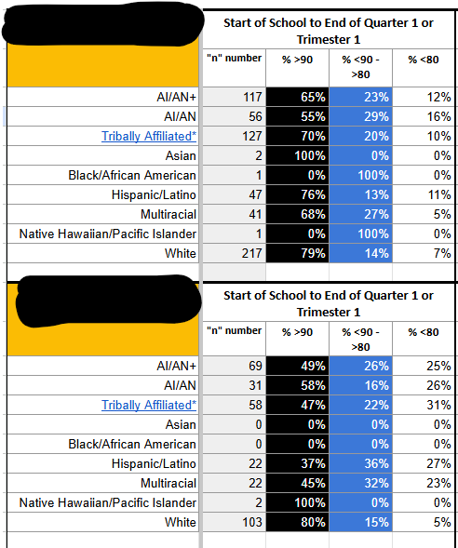
SCHOOL A
Let’s Practice –
Look at this attendance data (≥90%, 70–89%, <70%). Which tier of support are most students who are chronically absent experiencing? How does that differ across both schools? Are their differences between different student groups? What questions might you want to ask about the Foundational Supports?
This is actual data from one of our TAPP sites. Please be kind in your reflections.
SCHOOL B
Notes:
Consider positionality – A TAPP Family advocate is really the on-site specialist for examining

Slide 33
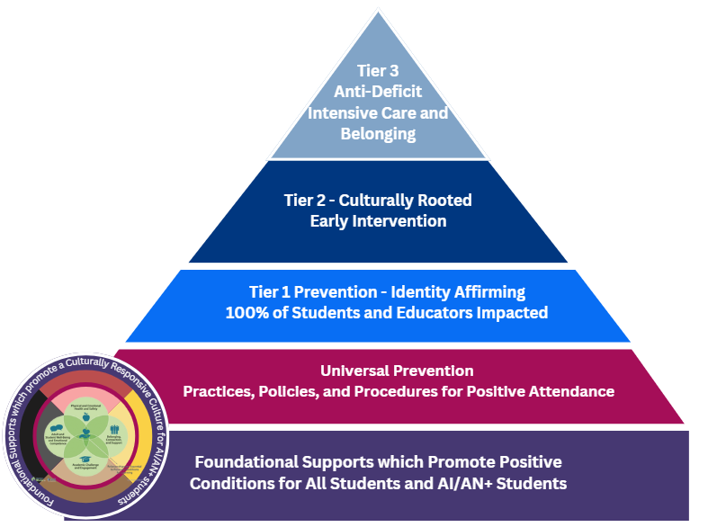
Based on Action-Research and Case Studies from TAPP –
Culturally Sustaining Tiered Response System
Shift #2 -
Uplifting lessons learned from Tribal Partners to ensure tiered supports reflect Indigenous values.
Notes:
“Our TAPP Pyramid sets the standard for how we define culturally rooted, anti-deficit attendance supports. Today, we ask: Are we living this standard in practice, and how do we know?”

Slide 34
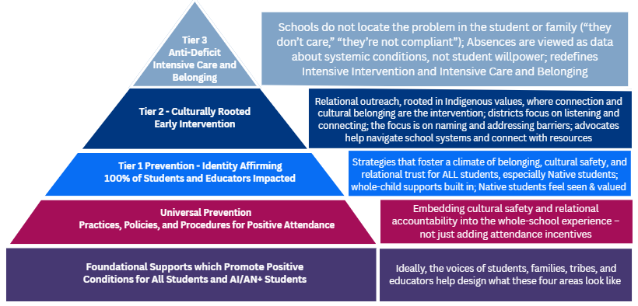
Based on Action-Research and Case Studies from TAPP –
Culturally Sustaining Tiered Response System

Slide 35
Local Context is EVERYTHING.
Your TAPP Site Team has to define what these terms mean and what these supports can look like for their local and tribal context –
Identify Affirming (found in Tier 1)
Culturally Rooted (found in Tier 2)
Anti-Deficit / Intensive Care and Belonging (found in Tier 3)
Remember –
Interventions that work in one community may not map onto values, norms, or culture of another
TAPP schools can differ GREATLY from one site to another: Assuming every school or student will respond similarly to the same approaches is futile.

Slide 36

Breakout Rooms
In your TAPP Site Teams engage in dialogue.
Step 1 – Take turns sharing what these terms mean to each team member.
Identify Affirming (found in Tier 1)
Culturally Rooted (found in Tier 2)
Anti-Deficit / Intensive Care and Belonging (found in Tier 3)
Step 2 – Identify where your EXISTING SUPPORTS might fit into each category.
Step 3 – Identify where there is gaps in tiered supports and potential next steps.
CAUTION - This work is not “all on the tribe”. There should be a balance of district and school specific efforts and support and resources from the tribe.

Slide 37
Promising Practices Capacity Building
Call to Action: Strengthening data use to monitor impact of our efforts

Slide 38

Breakout Room - Work Time
Silently and in writing –
Step 1 - Go to Canva.
Step 2 - Scroll down until you find a page for one school served by a TAPP Family Advocate.
Step 3 - In the upper left hand corner of this page, you will see the Tiered data from last school year.
Step 4 - Answer these questions –
Which tier of support did most students who were chronically absent experience?
What questions come up while seeing the data?
What questions do you have about the foundational supports?
Look at the draft pyramid. Where are we strongest? Where are we misaligned or underdeveloped?
Notes:
“Our TAPP Pyramid sets the standard for how we define culturally rooted, anti-deficit attendance supports. Today, we ask: Are we living this standard in practice, and how do we know?”

Slide 39

Closing
What is one word or phrase you are sitting with after our time today?
Either unmute or drop it in the chat.

Slide 40
Text Parrish anytime at 971-208-0270
Or - send me an email. Call if you must.
There is no such thing as, “I know you are busy”. I am here for you.

