Slide 1
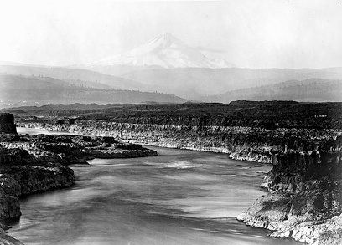

Columbia River Trade
N’chi Wana
Wasq’u and Ichishkin People
Click on the audio recording to hear and
repeat the Ichishkin word for ‘N’chi Wana: The Big River’

Slide 2
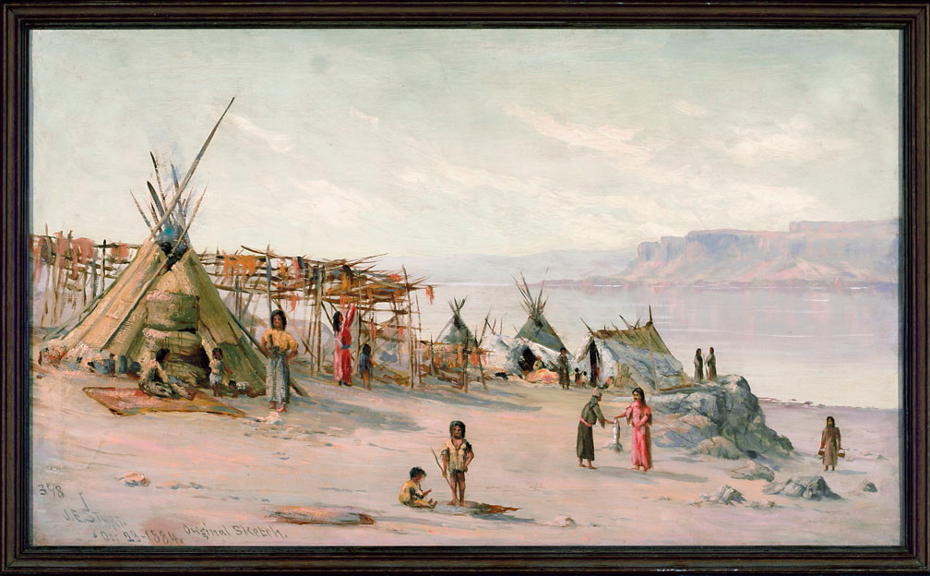
How long do you think people lived there?
Since Time Immemorial.

Slide 3
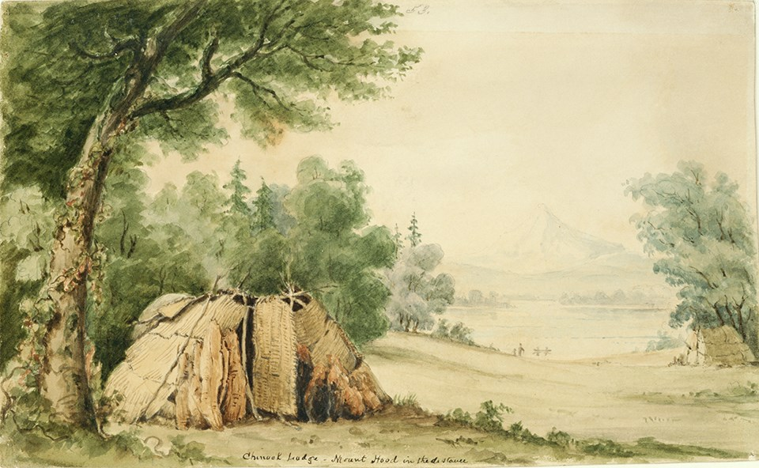
Different bands lived along both sides of N’chi Wana and wherever there was water and food.
Click on the audio recording to hear and
repeat the Ichishkin word for ‘Chuush- Water’
Click on the audio recording to hear and
repeat the Ichishkin word for ‘Tkwátat- Food’

Slide 4
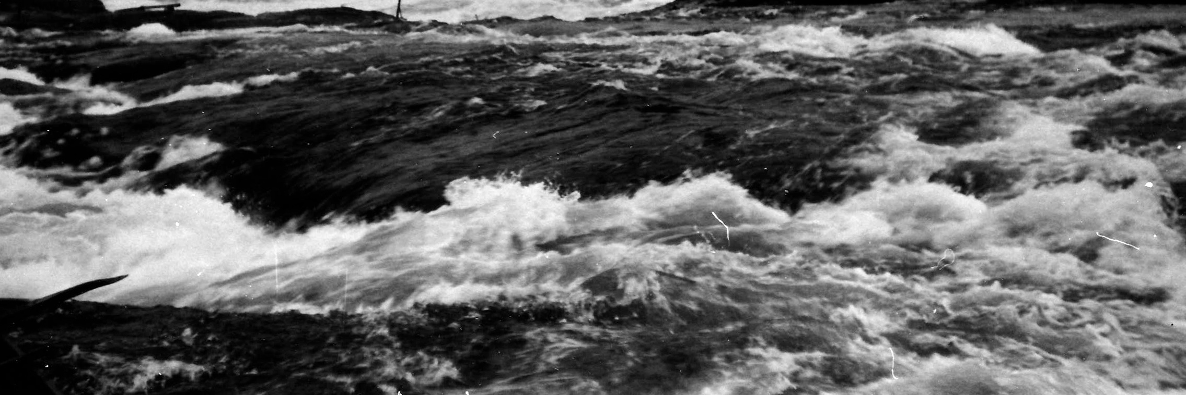
“Wyam”
Echo of Falling Water
This was the name given to Celilo Falls
by many different Tribes.
Click on the audio recording to hear and
repeat the Ichishkin word for ‘Wyam: Echo of falling water’

Slide 5
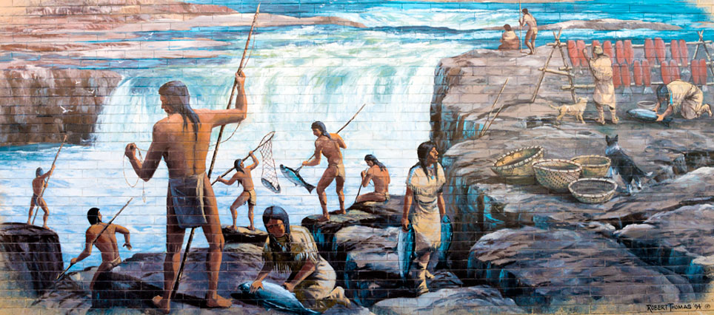
N’chi Wana or Wyam
was the supermarket for many, many people. People would come from hundreds of miles away to trade and meet old and new friends.

Slide 6
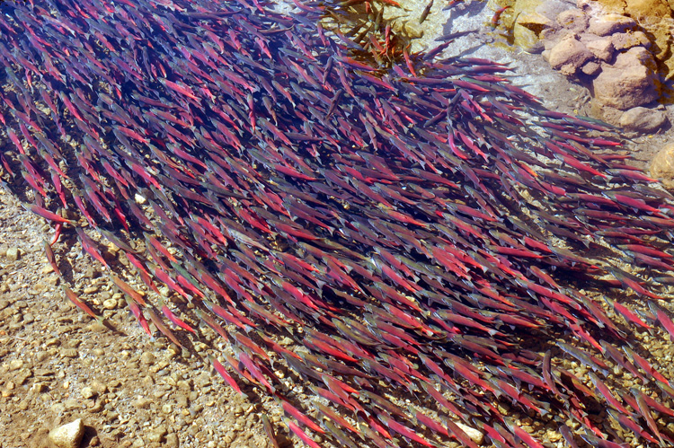
Celilo Falls
and Salmon
Before Celilo Falls was dammed, 15-20 million salmon once journeyed up and down the river.
In 1957, people built a big wall called The Dalles Dam and only around 625,000 fish swam in the river.
But after years of helping the river, things got better! Last year (2024), almost 2 million fish swam in the river
(CRITFC).
Click on the audio recording to hear and
repeat the Ichishkin word for ‘Núsux: Salmon’

Slide 7
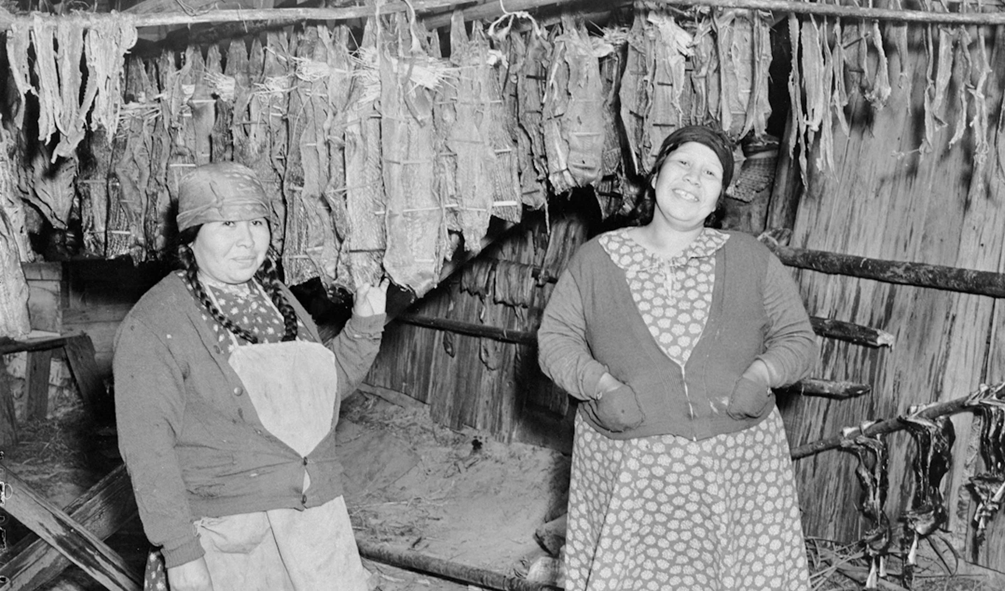
Drying Salmon
Men would catch the salmon and women would dry the salmon from the warm winds that came through Celilo Falls.
Drying made it lighter to carry the
salmon home.

Slide 8
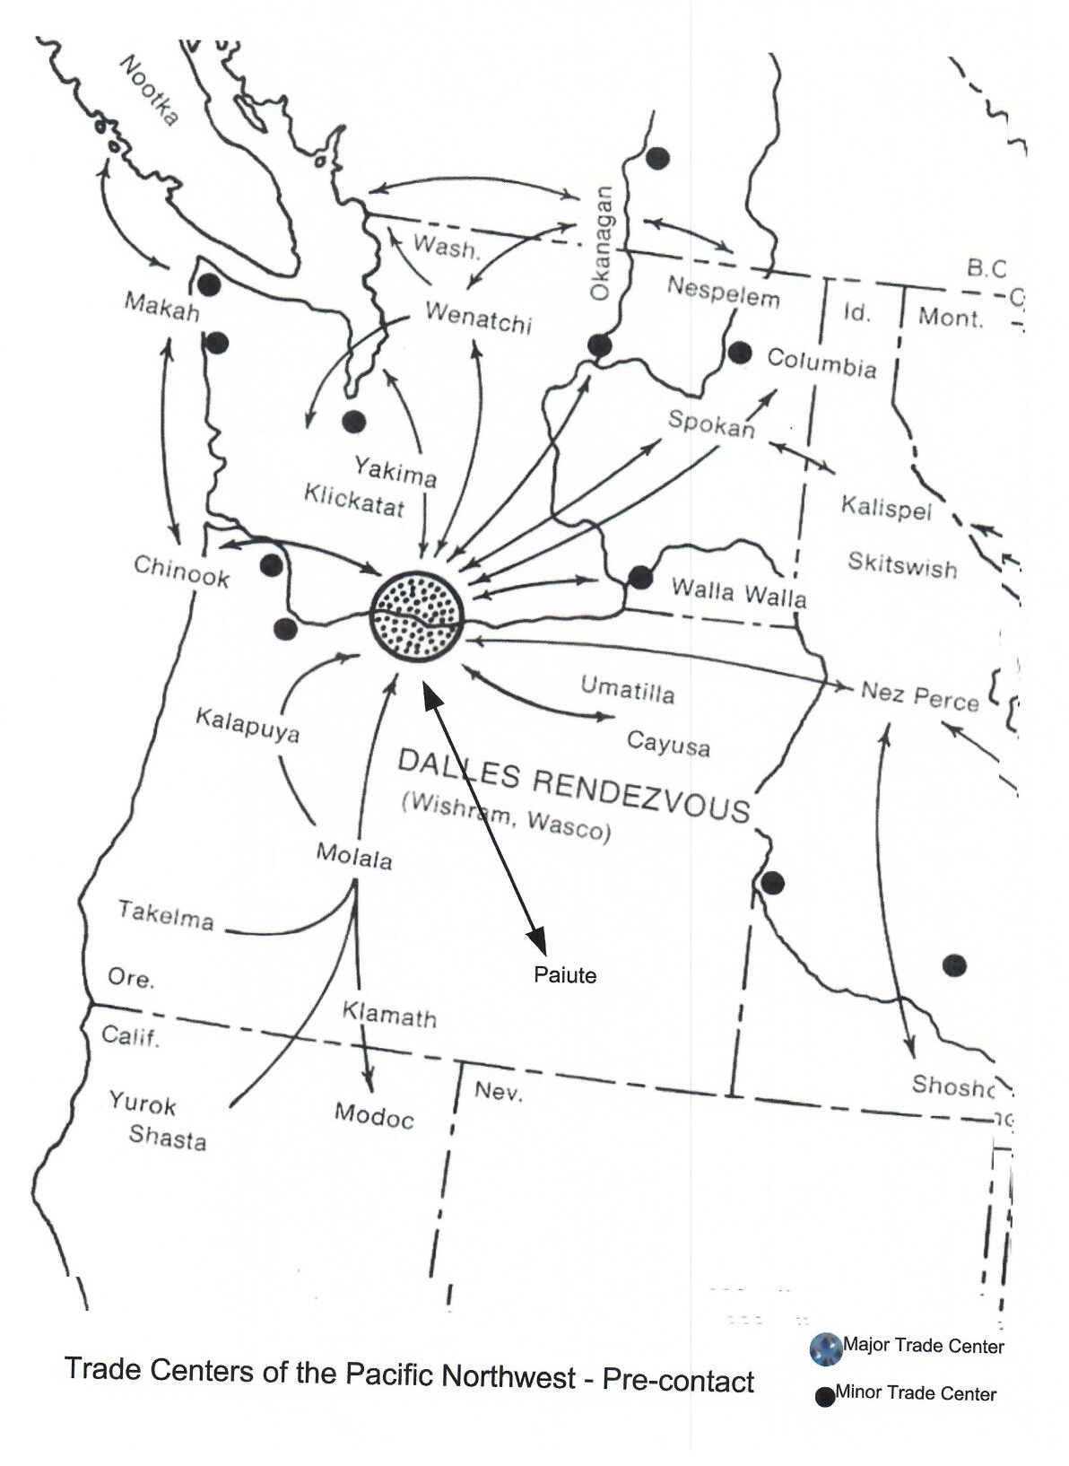
Trade Center
Many Tribes came from everywhere to socialize and trade.

Slide 9
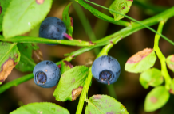
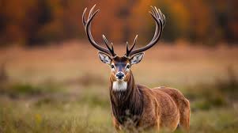
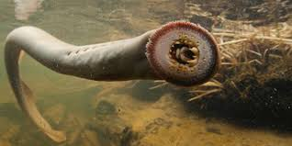
Food people traded included:
Salmon: Núsux
Deer: Yáamash
Eel: Asm
Roots: Xnít
Berries: Tmaanít

Slide 10
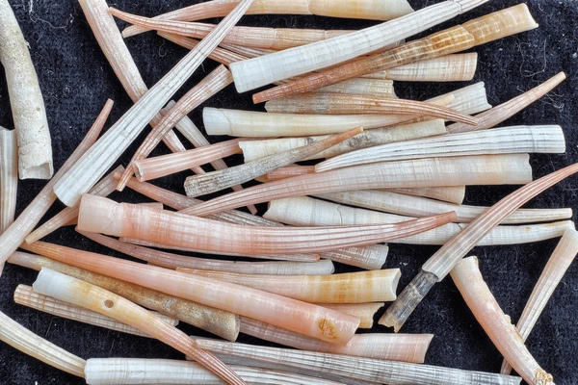
More things people traded:
Furs
Beads
Shells
Dentalium (pictured)
Baskets
Gloves
Horses

Slide 11
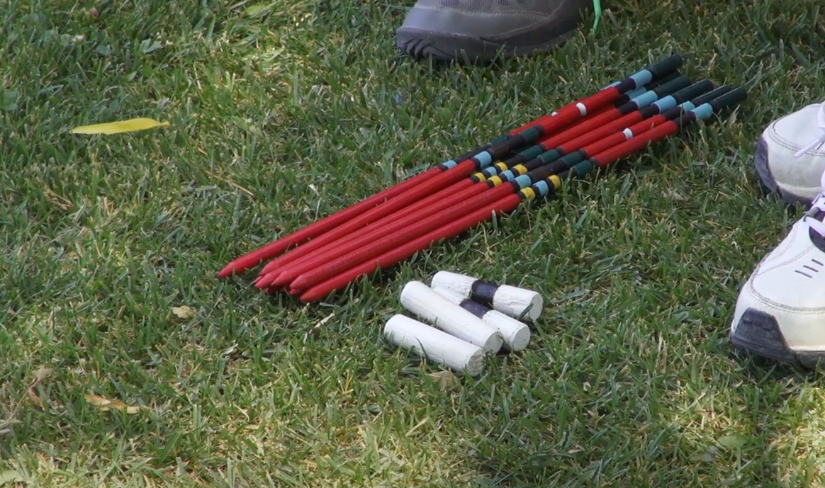
Stick, Hand, or Bone Game
The favorite thing for all the people to do when they gathered along N’chi Wana was to play games. Their favorite was the Stick, Bone, or Hand Game.
“Sticks and Bones, Paiute Hand Games”
https://youtu.be/DwDO59RLyh8

Slide 12
