Slide 1
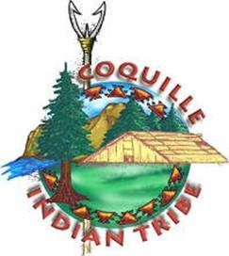
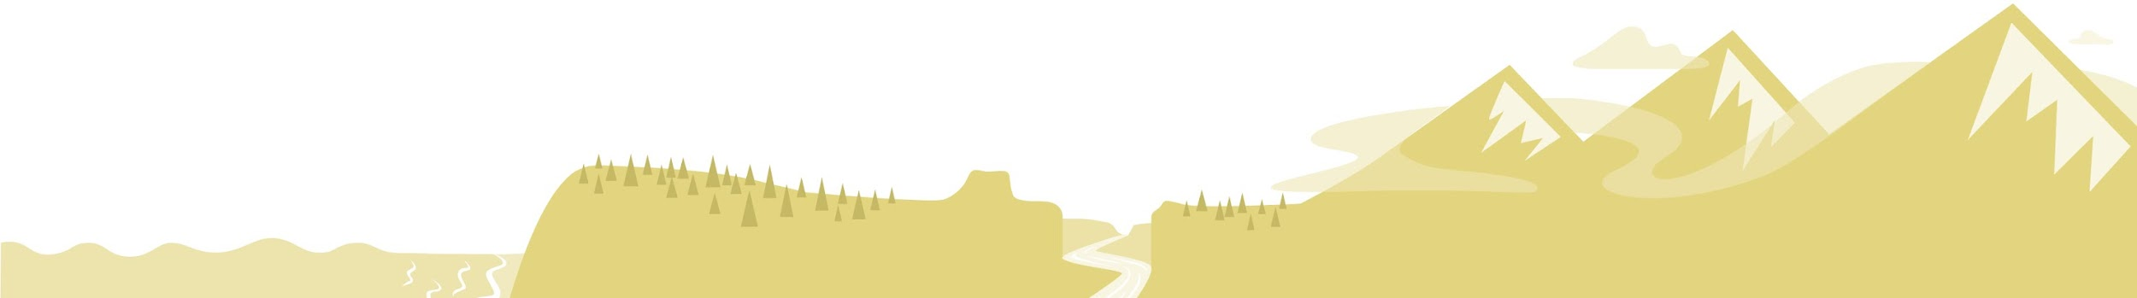
OUR LANDS
Coquille Indian Tribe

Slide 2
Ancestral Territory
The Coquille Tribe's history and culture are inseparable from the forests, meadows, and coast of Southwest Oregon
The Tribe’s ancestral homelands extend from south of Bandon to all reaches of the Coquille River watershed in Coos, Curry, and Douglas counties

Slide 3
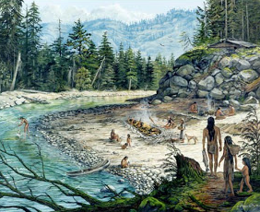
Coastal Landscape
The coastal ecosystem provided abundant resources for the Coquille Tribe
Villages were constructed along the tidewaters and lower reaches of streams and rivers
The Coquille gathered food and materials
from meadows, forests, tidal pools,
estuaries, and the shore

Slide 4
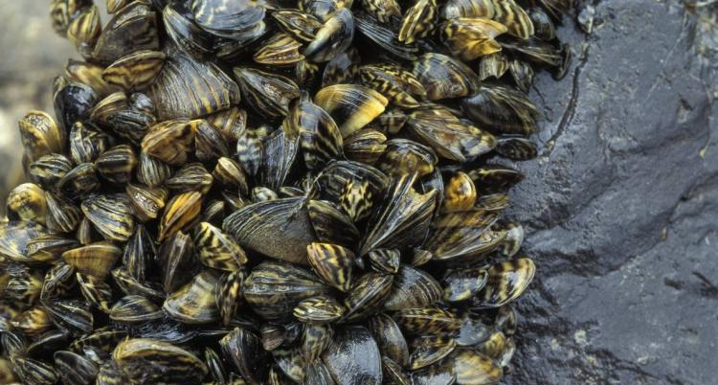
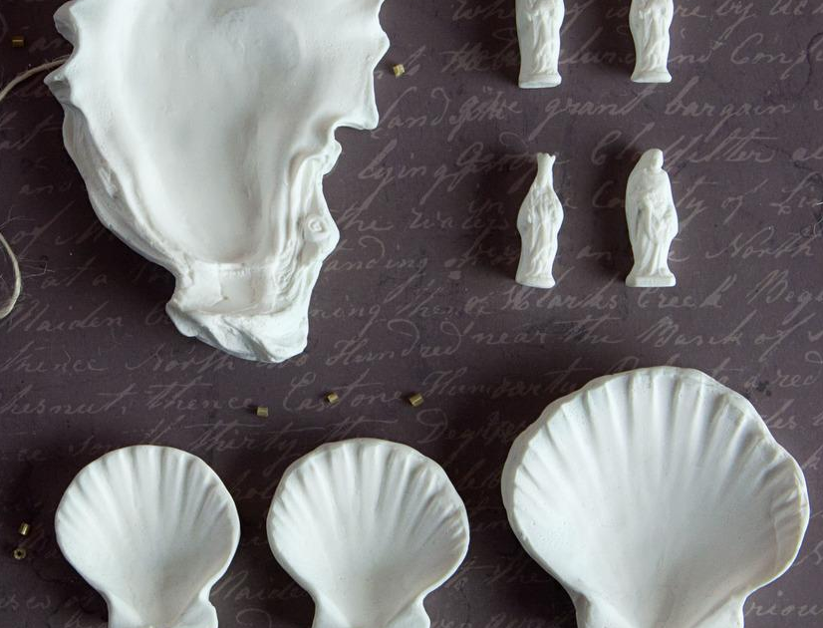
Coastal Resources
Mussels, clams, and other shellfish are important resources for all coastal tribes
Seashells and dentalium shells were used as ornaments on clothing and
were widely traded
Shellfish, urchin, salmon, and lamprey are also important foods

Slide 5
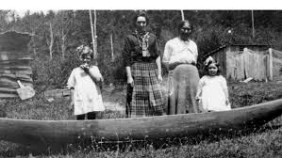
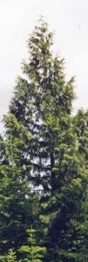
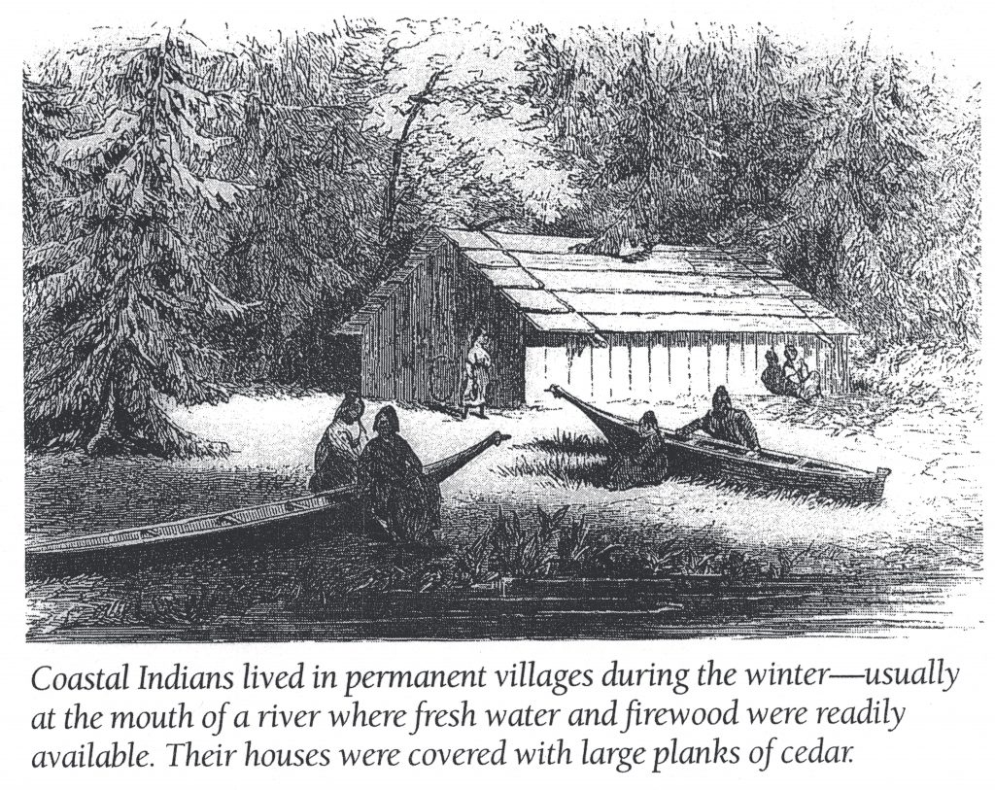
Forest Resources
Red and white cedar were essential to the Coquille Tribe’s traditional way of life
The trunks of these trees could be shaped into canoes or split into timber for houses

Slide 6
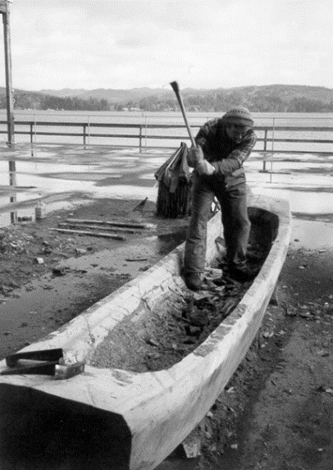
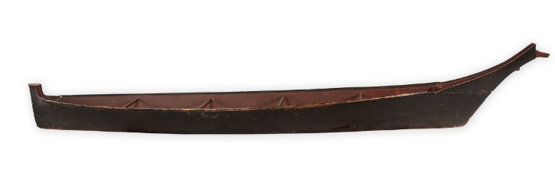
Canoes
Shovelnose canoe
The canoe allowed the Coquille to access the many resources of the coastal ecosystem
Some canoes were made with a shovelnose carved from white cedar
Shovelnose canoes had rounded bottoms to maneuver though river currents
Other canoes were created for the ocean
Ocean-going canoes had high prows to battle rougher waters
Ocean-going canoe

Slide 7
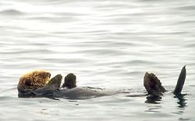
Sea Otter
Native Tribes on the Oregon Coast that spoke Chinuk Wawa, a trade language, knew the sea otter as the Elakha
The sea otter has an important ecological and cultural significance to the Oregon Coast
The sea otter was once present along the entire Pacific Coast, from Alaska to California.
The thick pelt of the sea otter was a prized resource that was used to make clothing for both practical and ceremonial purposes

Slide 8
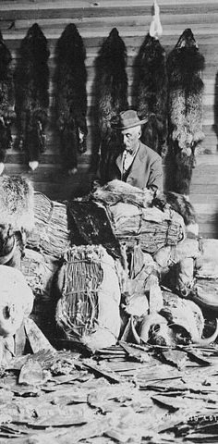
Fur Trade
Fur trapping and trading on the Pacific Coast of Oregon began in 1788, when Captain Robert Gray and the crew of the Lady Washington landed near Yaquina Bay.
Gray and his crew traded with the local Tribes for sea otter pelts, which they brought back with them when they returned home.
The popularity of the fur pelts soon spread throughout many parts of the world, including China, England, Europe, and the eastern United States, and many companies began trading and selling them.

Slide 9
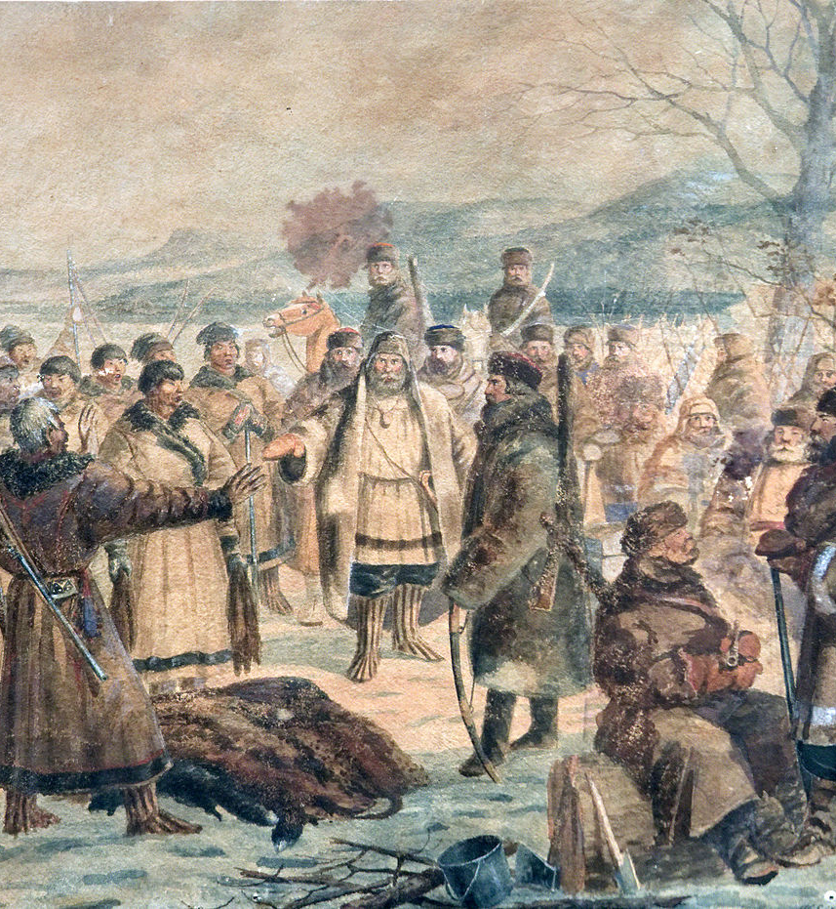
Impact of the fur trade and non-Indian settlement
The fur trade became a major driving force of European and Euroamerican exploration, trade, and settlement in the Northwest region for the next 70 years
This had devastating consequences for the Coastal Tribes and led to the extinction of the Elakha on the Oregon Coast

