Slide 1
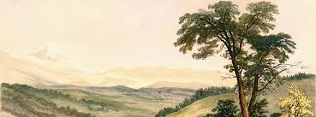
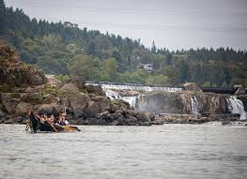
chinuk wawa
Photo courtesy of the Oregon Historical Society
Grade 4 Lesson
Photo courtesy of The Confederated Tribes of Grand Ronde

Slide 2
Language & Culture
Language is a way of understanding the world and how a specific group of people relate to it and to each other.
When learning a new language, you are also learning about the culture (customs and traditions) of a group of people and a place.

Slide 3
Language and Culture Continued
Languages connect tribal people to place and maintain connections to ancestors.
Language remains a direct conduit to important aspects of traditional tribal life.
Each tribe has their own distinct language(s), which includes varied dialects. chinuk wawa is one of many Native languages in Oregon.
It was common for members of tribes to be multilingual, as communication among groups was essential for trade, political and other reasons.

Slide 4
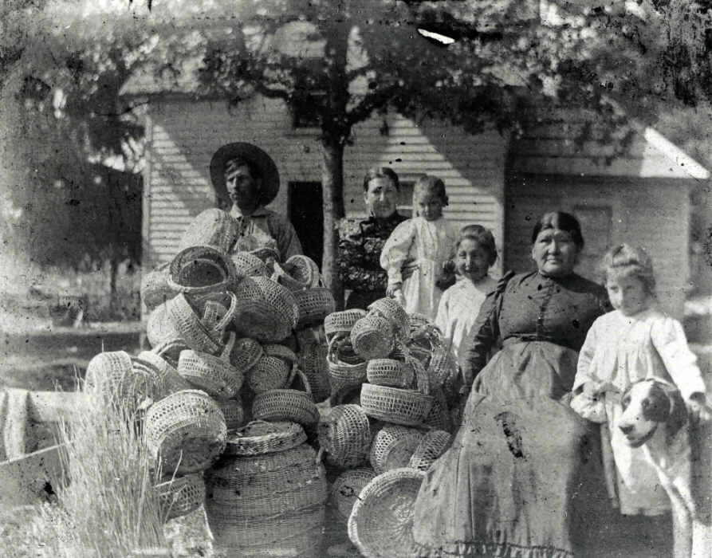
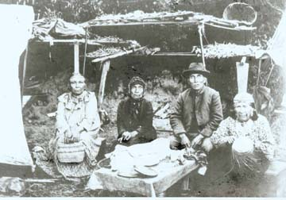
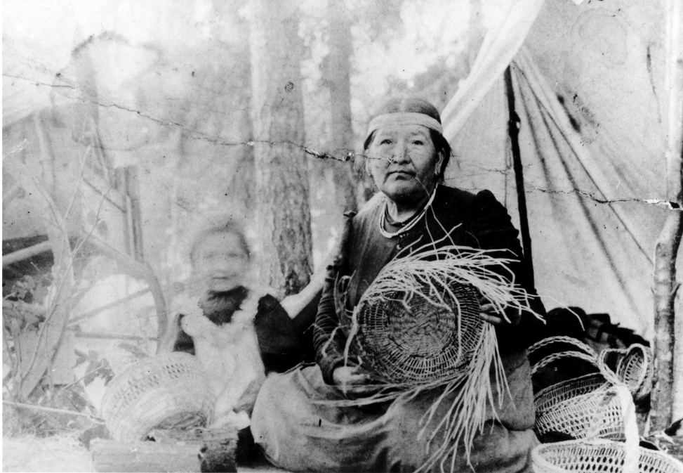
Pictures
Photos courtesy of the Confederated Tribes of Grand Ronde Tribal History curriculum

Slide 5
Vocabulary
chinuk wawa - an intertribal hybrid language indigenous to the Pacific Northwest.
Ancestors – People living before us that we are descended from and have passed down traditions including oral language and stories.
Lingua franca – A language that is adopted as a common language between speakers whose native languages are different.
Dialect – A form of a language spoken by a group of people.
Columbia River – A river that flows through Oregon, Washington, and Canada. It is the largest river in the Pacific Northwest region of North America at 1,243 miles long. The river was home to the Chinookan peoples on the lower river and many other tribes on its upper branches.

Slide 6
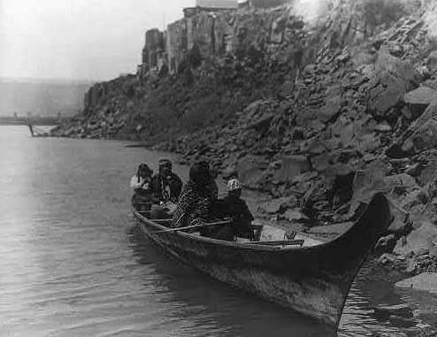
History
chinuk wawa arose as an Indigenous language along the Columbia River.
It served as a regional lingua franca facilitating communication between speakers of different tribal languages as well as between tribal people and speakers of English and Canadian French.
It was utilized to communicate with traders, explorers, and settlers. For a time the language was the most common language between all of the peoples in the region - tribes, settlers, explorers, and fur traders in places like Portland and Seattle.

Slide 7
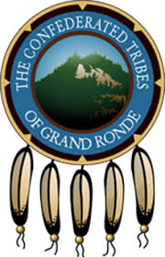
chinuk wawa in Grand Ronde
It was the common language of the Grand Ronde reservation (at the time of establishment) used by the Native people to communicate with each other.
At Grand Ronde it became the first language in the households of most tribal members.
It continues to be a first language and lifeway of many households of CTGR citizens today as they work to restore and preserve oral language traditions for future generations.

Slide 8
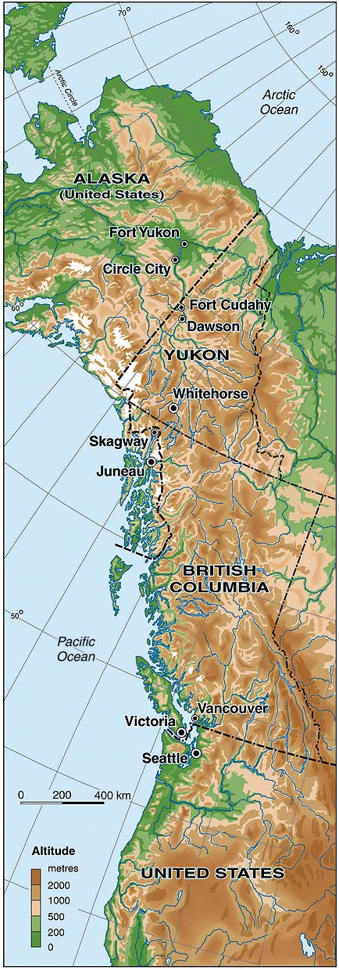
Geographic Spread
chinuk wawa became an important trade language throughout the Pacific Northwest and as far north as Alaska

Slide 9
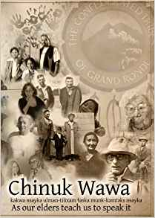
chinuk wawa Today
chinuk wawa survived for generations in families and communities.
This chinuk wawa dictionary is based on records from one such community, the Confederated Tribes of Grand Ronde.
Many chinuk wawa words have been used to name places, geographical features, and so on. For example, Tilikum Crossing, a bridge that opened in 2015 in the Portland metropolitan area, is named after the chinuk wawa word for “people.”

Slide 10
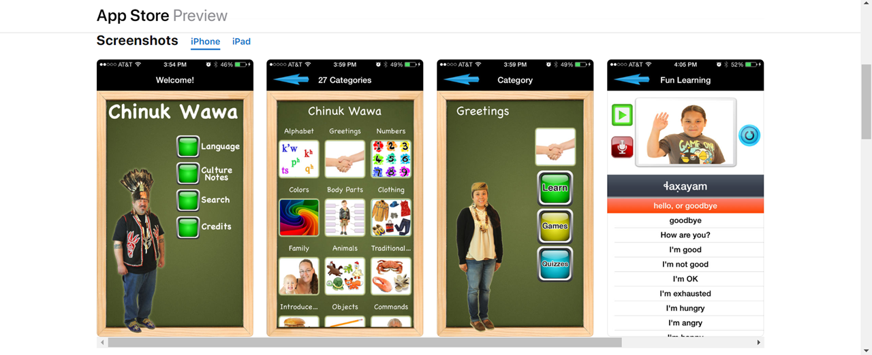
chinuk wawa Language Tool

Slide 11
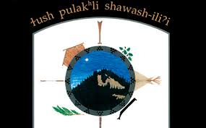
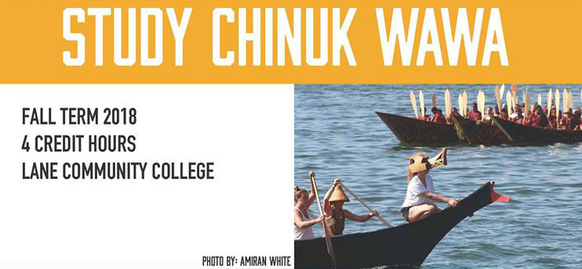
chinuk wawa Language Program
chinuk wawa is taught as a community heritage language in Grand Ronde, Oregon
The chinuk wawa Language Program of the Confederated Tribes of Grand Ronde provides chinuk wawa lessons to students in early childhood through adult levels:
https://www.grandronde.org/services/education/chinuk-wawa-language-program/#:~:text=The%20Confederated%20Tribes%20of%20Grand,in%20the%20Chinuk%20Wawa%20language.

