Slide 1
Restraint & Seclusion
December 2021

Slide 2
About Us
The Oregon Department of Education works in partnership with school districts, education service districts and community partners to foster equity and excellence for every learner;
Together, we serve over 560,907* K-12 students and support 75,807* school employees, including teachers, administrators and classified staff;
We believe every student should have access to a high-quality, well-rounded learning experience; and
We work to ensure every student in Oregon graduates with a plan for their future.
*Data from October 2021

Slide 3
Disclaimer
These materials constitute the Oregon Department of Education’s interpretation of various state laws and are provided to support public education programs’ understanding of their obligations under these laws. The information in these materials is subject to change based on future legal and policy changes. These materials are intended for informational purposes only and do not constitute legal advice.

Slide 4
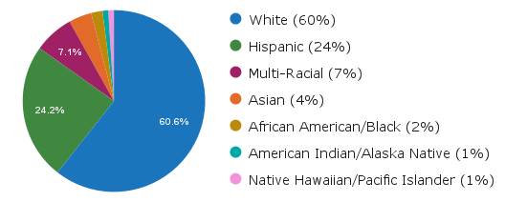
Who We Serve
Student Diversity
560,907 Students
Economically Disadvantaged: 53%
Ever English Learners: 18%
Homeless: 3%
Lesbian/Gay /Bisexual: 12.6%
Mobile Students: 11%
Students with Disabilities: 15%
More than 200 languages spoken
75,807 Educators
Staff of Color
11.4% of Teachers
12.3% of Administrators
16.4% of Counselors
21.1% of Educational Assistants
197 Districts
1,257 Schools
133 Charter Schools
19 Education Service Districts

Slide 5
Equity
Education equity is the equitable implementation of policy, practices, procedures, and legislation that translates into resource allocation, education rigor, and opportunities for historically and currently marginalized youth, students, and families including civil rights protected classes. This means the restructuring and dismantling of systems and institutions that create the dichotomy of beneficiaries and the oppressed and marginalized.

Slide 6
Restraint and Seclusion are Equity Issues
In the 2015–2016 school year, 122,000 students across the country were restrained or secluded.
Student group | Percent total population | Percent subjected to restraint | Percent subjected to seclusion
Students with disabilities | 12% of total enrollment | 71 % | 66 %
African American students | 15% of total enrollment | 27 % | 23 %
Civil Rights Data Collection (2018)

Slide 7
Restraint and Seclusion
Restraint and seclusion are safety responses used as a last resort when risk of harm or injury is high, when lesser interventions are not effective, and when an emergency response may reduce that risk.
Restraint and seclusion are not behavioral or therapeutic interventions.
Restraint or seclusion may not be used for discipline, punishment, retaliation or convenience of personnel, contractors, or volunteers of the public education program.

Slide 8
What is the Definition of Restraint?
“Restraint” means the restriction of a student’s actions or movements by holding the student or using pressure or other means.

Slide 9
Restraint Does Not Include
Holding a student’s hand or arm to escort the student safely and without the use of force from one area to another.
Assisting a student to complete a task if the student does not resist the physical contact.

Slide 10
Restraint Does Not Include
Providing reasonable intervention with the minimal exertion of force necessary if the intervention does not include a restraint prohibited under ORS 339.288 and the intervention is necessary to:
Break up a physical fight.
Interrupt a student’s impulsive behavior that threatens the student’s immediate safety, including running in front of a vehicle or climbing on unsafe structures or objects.
Effectively protect oneself or another from an assault, injury or sexual contact with the minimum physical contact necessary for protection.

Slide 11
How to Report an Incident that is Not Restraint
Intervention in a manner that is not restraint during an incident would fall under the district's “Student Code of Conduct” policy and would be communicated and documented in accordance with the policy, which may include:
Parent phone call
Incident report
Referral
Other appropriate verbal and/or written documentation that is consistent with district policy

Slide 12
Prohibited Restraints
Chemical restraint
Mechanical restraint
Prone restraint
Supine restraint

Slide 13
Prohibited Restraints
Any restraint that involves the intentional placement of the hands, feet, elbow, knee, or any object on a student’s neck, throat, genitals, or other intimate parts.
Any restraint that causes pressure to be placed, or creates a risk of causing pressure to be placed, on the stomach or back by a knee, foot, or elbow bone.
Any action designed for the primary purpose of inflicting pain.

Slide 14
Prohibited Restraints
Any restraint that places, or creates a risk of placing pressure on a student’s neck or throat.
Any restraint that places, or creates a risk of placing pressure on a student’s mouth, unless the restraint is necessary for the purpose of extracting a body part from a bite.
Any restraint that impedes, or creates a risk of impeding breathing.

Slide 15
Any restraint that involves the intentional and nonincidental use of a solid object, including a wall or the floor, to impede a student’s movement is prohibited, unless the restraint is necessary to prevent an imminent life-threatening injury or to gain control of a weapon.
Prohibited Restraints
The use of a solid object, including a piece of furniture, a wall, or the floor, by public education program personnel performing a restraint, is not prohibited if the object is used for the personnel’s own stability or support while performing the restraint and not as a mechanism to apply pressure directly to the student’s body.

Slide 16
What is the Definition of Seclusion?
“Seclusion’” means the involuntary confinement of a student alone in a room from which the student is physically prevented from leaving. Seclusion includes, but is not limited to, the involuntary confinement of a student alone in a room with a closed door, whether the door is locked or unlocked.

Slide 17
Seclusion Does Not Include
Removing a student for a short period of time to provide the student with an opportunity to regain self-control if the student is in a setting from which the student is not physically prevented from leaving.
Leaving a student alone in a room with a closed door for a brief period of time if the student is left alone for a purpose that is unrelated to the student’s behavior.

Slide 18
Seclusion: Examples and Nonexamples
Example
Student is alone and prevented from leaving the room after a “room clear” with the teacher/staff person on the outside of the room.
The student is alone in the classroom and prevented from leaving the designated area with the teacher/staff person outside of the designated area.
Non-Example
The room is “cleared” and a teacher/staff person remains in the room with the student to assist with needs.
The student is not alone and there is a teacher/staff person present with that student in the designated area.

Slide 19
Threshold for intervention
Restraint
The student’s behavior imposes a reasonable risk of imminent and substantial physical or bodily injury to the student or others, and less restrictive interventions would not be effective.
Seclusion
The student’s behavior imposes a reasonable risk of imminent and serious bodily injury to the student or others, and less restrictive interventions would not be effective.

Slide 20
Threshold Definitions
Restraint
Seclusion
“Substantial physical or bodily injury” means any impairment of the physical condition of a person that requires some form of medical treatment.
“Serious bodily injury” means any significant impairment of the physical condition of a person, as determined by qualified medical personnel, whether self-inflicted or inflicted by someone else.

Slide 21
If Restraint or Seclusion is Utilized...
The student’s behavior imposes a reasonable risk.
Less restrictive interventions would not be effective.
Used only for as long as the student’s behavior poses a reasonable risk.
Must be implemented by those who are trained.
Requires continuous monitoring for the duration of the restraint or seclusion.

Slide 22
Time Limits and Rules for Seclusion and Restraint
If restraint or seclusion continues for more than 30 minutes:
Adequate access to bathroom or water breaks must be established after 30 minutes.
Every 15 minutes after the first 30 minutes of the physical restraint or seclusion, an administrator for the public education program must provide written authorization for the continuation, including providing documentation for the reason the physical restraint or seclusion must be continued.
Personnel of the public education program must immediately attempt to verbally or electronically notify a parent or guardian of the student.
Continuous 360 degree monitoring of the situation for the duration.

Slide 23
Functional Behavioral Assessment
Districts must conduct a functional behavioral assessment and develop, review or revise a behavior intervention plan within 45 school days of receiving parental consent to conduct the assessment for every student who has:
• An individualized education program or a 504 Plan; and
• Placed the student, other students or staff at imminent risk of serious bodily injury as a result of the student’s behavior.
If a functional behavioral assessment has been previously completed, the school district must review and/or revise the existing functional behavior assessment.

Slide 24
Functional Behavioral Assessment
When a behavior intervention plan is developed, reviewed or revised, the school district must:
Ensure that the behavior intervention plan is based on a functional behavioral assessment conducted by a qualified person;
Ensure that the behavior intervention plan addresses the student’s needs;
Allow service providers involved in the incident when the student, other students or staff were at imminent risk of serious bodily injury to provide meaningful input into the development, review or revision;
Inform the service providers about portions of the behavior intervention plan that are relevant to them and about any training opportunities for the service providers; and
Ensure that the behavior intervention plan was correctly implemented before revising.

Slide 25
Restraint and Seclusion Reporting Requirements
Verbal or electronic parent/guardian notification of the incident by the end of the school day when the incident occurred.
Written documentation of the incident within 24 hours.
Timely notification of a debriefing meeting to be held and of the parent's or guardian's right to attend.
A debriefing meeting must be held within two school days of the incident and must include all personnel of the public education program who were involved in the incident and any other appropriate personnel.
Written notes must be taken.
A copy of the written notes must be provided to parent or guardian.

Slide 26
Restraint & Seclusion: 5 Incidents in a School Year
If a student is involved in five incidents in a school year involving restraint or seclusion, a team consisting of:
Personnel of the public education program
Parent or guardian of the student
must be formed for the purposes of:
Reviewing and revising the student's behavior plan and
Ensuring the provision of any necessary behavioral supports.

Slide 27
Approval of Restraint and Seclusion Training Programs for School Staff
Teach evidence-based techniques that are shown to be effective in the prevention and safe use of physical restraint or seclusion.
Provide evidence-based skills training related to:
Positive behavior support
Conflict prevention
De-escalation
Crisis response techniques
Provide training consistent with the philosophies, practices and techniques for physical restraint and seclusion that are established by rule or policy of the Department of Human Services.

Slide 28
Prevention Practices
Anticipate
- Time of day
- Time of year
- Keep a short, clear set of rules visible and talk about them.
Deliver - The best version of yourself.
Understand - Ages and stages of students.
Learn - What to ignore and what to pay attention to.
Teach - and model the positive expectations relentlessly.

Slide 29
Annual Report to ODE on Use of Restraint and Seclusion
The total number of incidents involving restraint.
The total number of students placed in restraint.
The total number of incidents involving seclusion.
The total number of students placed in seclusion.
The total number of seclusions in a locked room.
The total number of seclusion rooms available, including a description of the dimensions and design of the rooms.
The total number of incidents that resulted in injuries or death to students or personnel.
The number of students who were placed in restraint or seclusion more than 10 times in a school year and an explanation of what steps have been taken to decrease the use for each student.
The number of incidents involving untrained staff.
The demographic characteristics of students.

Slide 30
District Annual Report on Use of Restraint and Seclusion
Each entity shall make its annual report about restraint and seclusion available to
The public at the entity's main office and the website of the entity.
The school board or governing body overseeing the entity.
If the entity is an education service district, the component school districts of the education service district.
If the entity is a public charter school, the sponsor of the public charter school.
Parents and guardians of students in a public education program shall be advised at least once each school year about how to access the report.

Slide 31
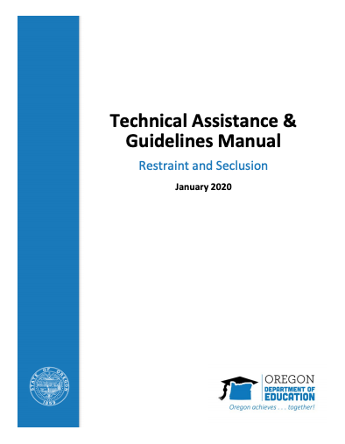
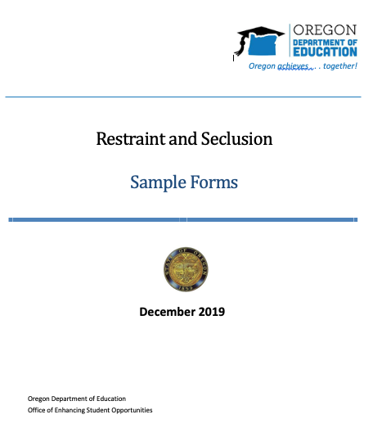
Technical Assistance Manual and ODE Sample Forms
Link- HERE

Slide 32
Oregon Administrative Rules for Restraint & Seclusion
581-021-0550: Definitions - Click here
581-021-0553: Use of Restraint and Seclusion in Public Education Programs - Click here
581-021-0556: Program’s Procedures Regarding Restraint & Seclusion - Click here
581-022-2267: Annual Report on use of Restraint and Seclusion - Click here
581-021-0563: Approval of Restraint and Seclusion Training Programs for School Staff - Click here
581-021-0566: Required Use of Approved Restraint and Seclusion Programs - Click here
581-021-0568: Standards for Seclusion Rooms - Click here
581-021-0569: Use of Seclusion Cells Prohibited - Click here
581-021-0570: Complaint Procedures - Click here
581-015-2181: Functional Behavioral Assessments- Click here

Slide 33
Here to Help
Lisa Bateman
503-947-5655 - lisa.bateman@ode.state.or.us
Follow us on Twitter! @ORDeptEd

