Slide 1
Guidance for Extended School Closure:
Distance Learning for All
Ensuring Care, Connection, and Continuity of Learning

Slide 2
The New Normal
Photo Credit: https://www.shutterstock.com/search/feet+arr
Notes:
COVID-19 has us all feeling like things have been turned upside-down and sideways. We know that you all have a lot going on and it can feel like we are going in many different directions. We are here for you, ready to support you and partner with you. Our community is strong, and we are going to get through this together.

Slide 3
Today’s Goals
Share an overview of the guidance provided by the Oregon Department of Education for the extended school closure: Distance Learning For All.
Provide a clear definition of distance learning and how it might look for our students.
Explain the planning process that we are currently engaged in as a district so that we are ready to launch on the target date of April 13.
Share resources that families and community members can access to learn more.

Slide 4
Timeline
Notes:
How we got here...

Slide 5
What is Distance Learning?
Instruction
Student and instructor are in different locations
Students access appropriate educational materials and receive ongoing interaction with their teacher(s)
Multimedia communication and blended learning strategies (not just digital/online learning)
Asynchronous or synchronous
Districts will enter into distance learning along a continuum. Each district will approach distance learning differently.
Notes:
For the purposes of this guidance, distance learning is defined as instruction in which the student and instructor are in different locations. Students engaging in distance learning have access to appropriate educational materials and receive ongoing interaction with their licensed and/or registered teacher(s). It is important to note that distance learning includes multimedia communication and blended learning strategies, not just digital/online learning. Learning may or may not be separated in time (asynchronous vs. synchronous). School districts will enter into distance learning along a continuum. It is true that each district will approach distance learning differently.

Slide 6
Guiding Principles
Care, Connection and Continuity of Learning
Ensure safety and wellness
Cultivate connection and relationship
Center in equity and efficacy
Innovate
Notes:
Ensure safety and wellness. Students need food, clothing, a safe place to learn and shelter, as well as a sense of care and connection, in order to engage in challenging intellectual work.
Cultivate connection and relationship. Student connections and relationships with trusted adults promote belonging, which is especially important as learning takes place outside of the school setting.
Center in equity and efficacy. Prioritize equity in every decision; build on cultural and linguistic assets to inspire learning and promote student efficacy. Consider how decisions and actions attend to racial equity and social justice (Oregon Educator Equity Lens). Consider the assets of students who experience disability.
Innovate. Iterate through complex change with a spirit of possibility, centering in deep learning, student agency, and culturally sustaining practices.

Slide 7
Guidelines for Distance Learning
Social, Emotional, and Mental Health
Partnering with Parents, Families, and Caregivers
Instructional Time
Equity and Access
Teaching and Learning
Operational and Administrative Logistics:
Attendance
Report Progress
Provide Credit-Earning Options
ODE Tool #1. Overview of Guidelines
Overview of Guidelines for Distance Learning Ensuring Care, Connection, and Continuity of Learning for All Students Guidelines for All Districts Receiving SSF during School Closure
Notes:
The Guiding Principles just mentioned and an overview of the Guidelines for Distance Learning seen here can be found in Tool #1 (share where these tools can be found on your district’s website). We will now provide more details for each of these 6 areas.

Slide 8
SEL, Family Partnerships, and Access
Social, Emotional, and Mental Health
Safety, belonging, and mental health as a foundation
Prioritize care and connection
Apply a trauma-informed lens
Partnering with Parents, Families, and Caregivers
Center equity in all outreach and communication efforts
Honor the home language and culture
Consider student strengths and needs
Equity and Access
Equity and access in all aspects of distance learning
Design instruction using the tenets of Universal Design for Learning (UDL)
Differentiate and use a variety of modes, resources, and strategies
Consider disproportionate impacts

Slide 9
SPED, ELD, and TAG Services
Students who are identified as eligible for Special Education, English Language Development, and Talented & Gifted services will continue to receive them, in accordance with the law.
Specialists and support staff, as available, will be partnering with classroom teachers to ensure that instruction and learning is accessible to every student.
Accommodations, modifications, and extensions will be maintained and/or adjusted based on the individual student’s Distance Learning needs.

Slide 10
Instructional Time
Recommended maximum daily guidelines for Teacher-Led Learning:
Grades K-1: 45 minutes
Grades 2-3: 60 minutes
Grades 4-5: 90 minutes
Grades 6-12: 30 minutes per teacher (3 hours in a day)
Note: Oregon has aligned this recommendation with Kansas and Washington

Slide 11
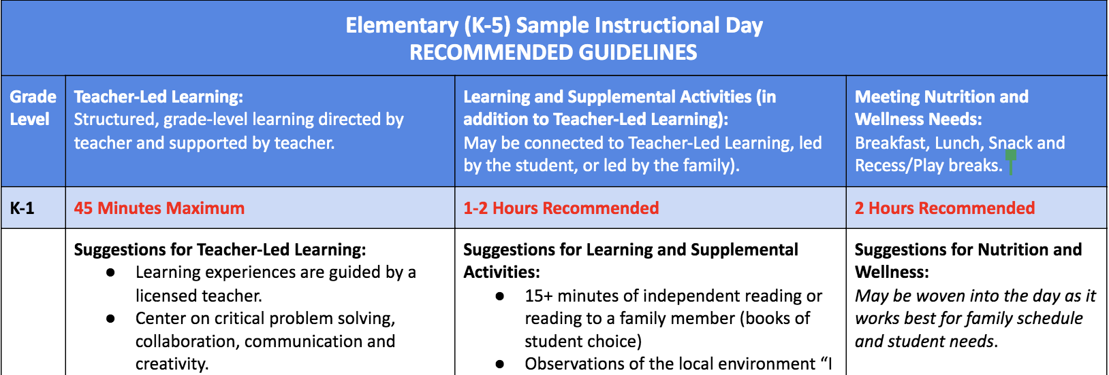
Sample Instructional Day

Slide 12
Teaching & Learning
Learning experiences will:
be guided by a licensed teacher.
ensure access to grade-level content and materials.
focus on the most essential learning.
include teachers monitoring student learning and providing feedback.
provide credit-earning options for seniors to earn a 2020 Diploma.

Slide 13
Attendance, Reporting, and Credit
Attendance: We want to ensure that every student is connecting with a designated school contact on a regular basis. (More information forthcoming.)
Reporting Student Progress: Teachers will monitor and record individual student progress towards learning goals. They will be communicating this to students and their families.
Earning Credit: A range of credit-earning options for high school courses to ensure that students are able to stay on track. More information is available in Section 4 of the DL4A Guidance.
Notes:
Attendance:
Every student has regular contact with school personnel for the purpose of care, connection, and continuity of learning.
Every student has access to a licensed or registered teacher through telephone, writing, electronic, or online means during instruction for progress monitoring.
More information, including reporting information, will be available as ODE develops guidance on attendance, ADMw, and the State School Fund. In the meantime, ensure that every student has a consistent connection to a teacher who tracks their attendance.
Grade and/or Progress Marks:
Monitor, report, and record progress towards learning goals and standards.
Credit-Earning Options for high school students remain the same brick and mortar options. Districts may want to consider the full variety of options to ensure students have clear pathways to earning credits and meeting graduation requirements:
Successful completion of online or distance coursework.
Successful completion of coursework through non-digital resources or equivalent academic assignments.
Passing an exam or work sample(s) (Advanced Placement (AP), International Baccalaureate (IB), General Education Development (GED), locally designed assessment, etc.) or a dual credit course.
Demonstration of proficiency or mastery of required standards.
Successful completion of a portfolio or collection of learning.
Additional guidance on Graduation Pathways for the classes of 2020 and 2021 is forthcoming.

Slide 14
Our District’s Planning Process

Slide 15
Resources for You: Our District Website

Slide 16
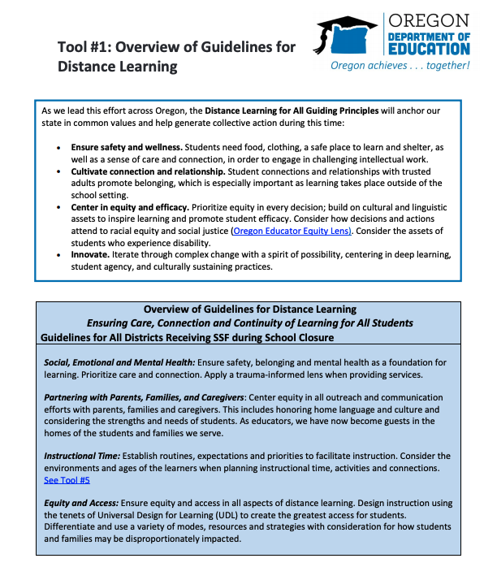
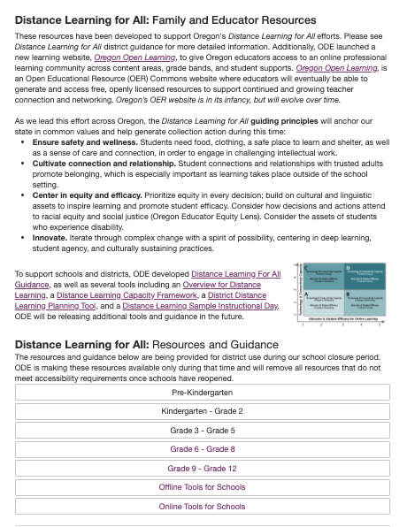
Resources for You: Tools from ODE
Tool #4: Distance Learning for All Family & Educator Resources
Notes:
ODE has provided seven different tools to support districts in understanding the guidance and planning for implementation of Distance Learning for All.
For Tool #4, you may want to go live to the website. The title for Tool #4 is linked to the webpage.

Slide 17
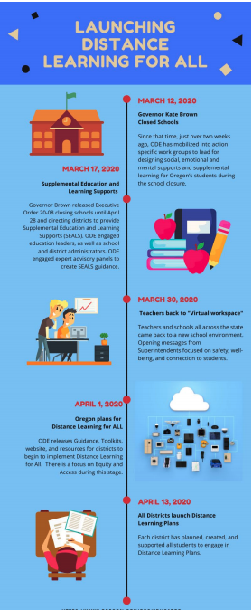
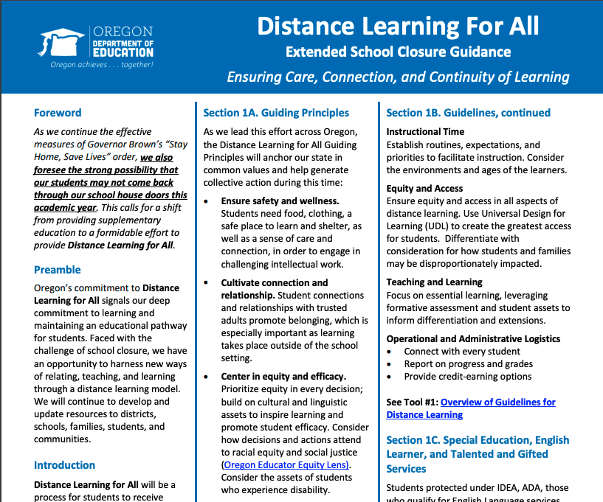
Resources for You: Tools from ODE
#6 Distance Learning Timeline
#7 Summary Document

Slide 18
Other COVID-19 Resources from ODE
Oregon Department of Education : COVID-19 Resources : Health, Safety & Wellness
Notes:
Highlight Mental Health and Social Support and Parents and Families sections.
The webpage is linked at the bottom so you can navigate to the live site.

Slide 19
Our Commitment
Focus on care, connection, and continuity of learning
Provide timely communication
Target and prioritize resources to support our most vulnerable learners
Partner, support, and collaborate
Seek feedback from our stakeholders and embrace a growth mindset
Wordle created from the ODE Distance Learning for All Guidance document.
District Contact Information
Notes:
This image is a wordle created from the Distance for Learning Guidance document. Larger words represent the frequency with which they appear in the document. You can see that learning and partnering with our families are the things that we are centered on. We may be building the plane while we are flying it… nevertheless, we are committed to doing our best for our students and their families.

