Slide 1
Fall Update on COVID-19 in Schools
November 1, 2021

Slide 2

Winter is Coming
Acknowledging Pandemic Fatigue & the Path Forward
Communities are experiencing pandemic fatigue as a result of surging cases.
Many had hoped the pandemic would be over and life back to normal.
Unlike last year, families are likely to travel and gather indoors to see their families and loved ones this year.
The Delta variant is taking a toll on communities and may have unforeseeable consequences this fall and winter.

Slide 3

Our Goal
Safely & reliably hold school in-person, all year
It’s our highest priority to keep kids learning in person every day.
Nearly all children learn better when taught in-person.
Children and families rely on schools to provide a caring and safe environment.
Many need access to a solid breakfast and a warm lunch.
For parents and families, consistency matters, and for many, school is a way to ensure they can go to work and support their family.
Notes:
Our teachers and staff build caring bonds that lead to each child’s growth and learning.
Our children need social interaction.

Slide 4

Our Plan
A statewide effort to keep students learning in-person
Statewide, we are reigniting our efforts to remind, reteach and retrain health and safety protocols because:
Colder conditions will bring activities indoors.
Schools have dedicated funding to invest in their efforts to layer health and safety protocols and maintain successful in-person learning.
Oregon received an unprecedented $1.1 billion in federal monies to help safely reopen schools and sustain school operations.
Notes:
As we transition to colder weather, more students and families will be spending time indoors, where COVID-19 can spread more rapidly.

Slide 5
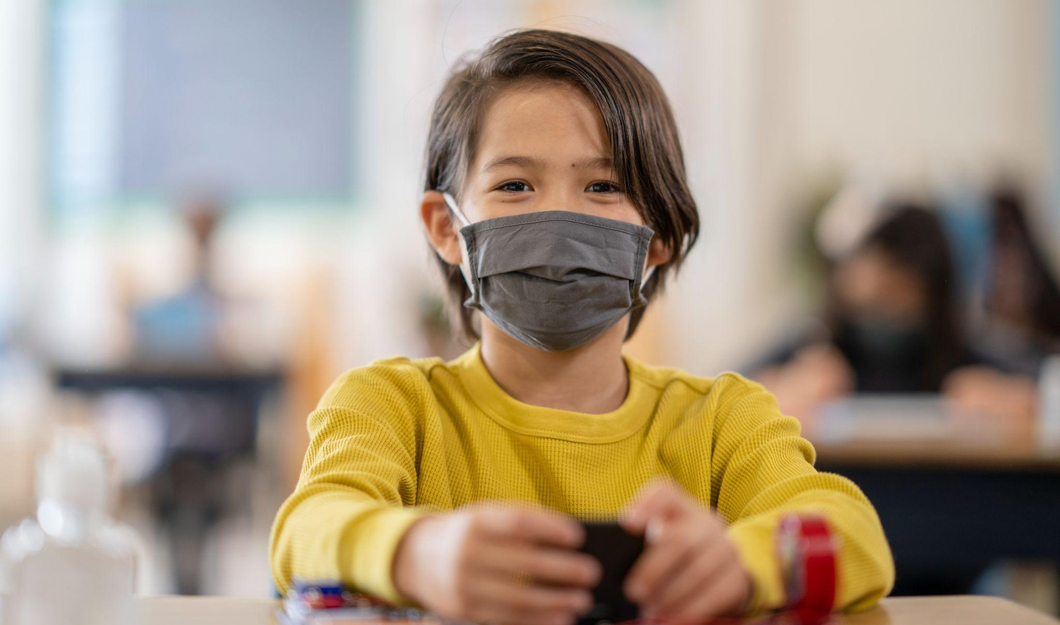
The Opportunity
Strengthen health & safety protocols in all schools
We can take steps now to create and maintain safe environments that keep our students learning in-person. This starts with using routines that everyone in a school can count on:
Markings that support 3 to 6 feet of physical distance.
Using seating charts and cohorts.
Improving air circulation and ventilation.
Providing diagnostic and screening testing for all students and staff.
Notes:
Schools are a controlled setting.
Our students and staff are used to following rules to help everyone get along and keep people safe.

Slide 6
Every Layer Matters

Slide 7
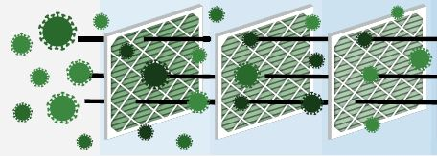
The Key
Layering health & safety protocols
Our best tool to limit the spread of COVID-19 is to follow a multi-layered approach to health & safety protocols:
Get vaccinated when eligible.
Wear a face covering.
Maintain 3-6 feet physical distance.
Cohort students to reduce the number of people who come into contact with each other.
Use seating charts in classrooms and on school buses.

Slide 8
Additional Protocols
Open windows and maximize airflow and circulation with outside air.
Wash hands often.
Clean high-touch surfaces.
Teach parents and families how they can screen for symptoms and have children stay home when sick.
Offer regular COVID-19 testing.
Train and support teachers and school staff.
Review and use the exclusion summary to ensure individuals who are sick stay at home.
Where can we improve?

Slide 9
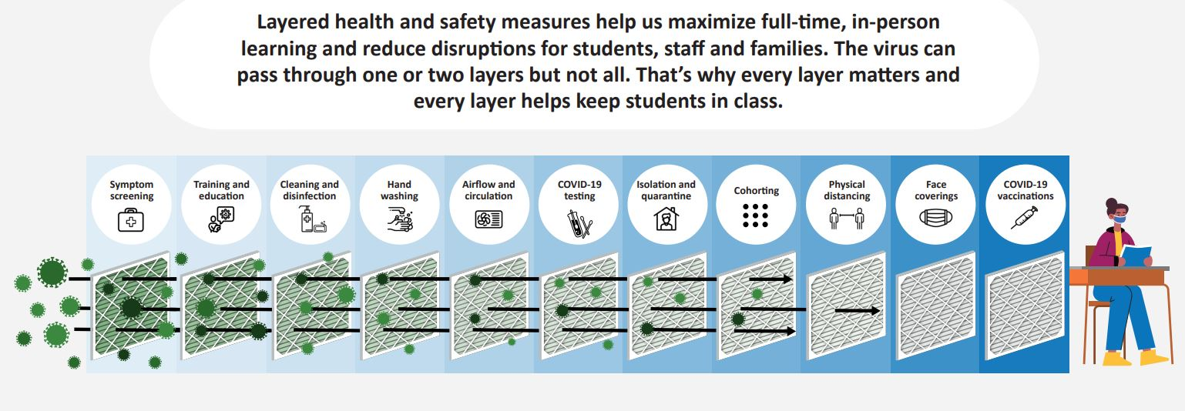
Layering Health & Safety Protocols

Slide 10
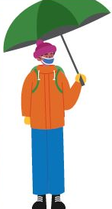
What does it mean to layer up?
When we talk about layering health and safety protocols -- we’re talking about using multiple distinct strategies -- and the best tools we have, to reduce the spread of COVID-19 in our schools.
The layers work together to form layers of protection.
The multi-layered approach allows Oregon’s students to stay in school full-time.

Slide 11
Next: Vaccines for Ages 5-11
Timeline of What We Know:
October 26, 2021 | FDA meets to hear about vaccine safety and efficacy. Made recommendation to authorize use.
November 2, 2021 | CDC vaccine advisory committee panel meets to recommend use.
November 3-4, 2021 (to be determined) | CDC Directors signs off on recommendations
November 4, 2021 (to be determined) | Oregon announces plan for distribution.
November 9, 2021 (expected) | Vaccines available for Oregonians ages 5-11

Slide 12
How We’re Preparing: Vaccines for Ages 5-11
At the State Level
OHA holding calls with Local Public Health Authorities (LPHAs)
Planning for distribution
  doctor’s offices
  pharmacies
  school sites
In our Community
Add information as it becomes available

Slide 13
A Look at the Current Data

Slide 14
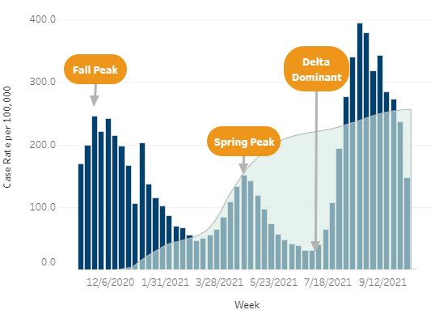
A Look Back
Fall of 2020 - Oregon hit a record number of COVID-19 cases.
Summer 2021 - The Delta Variant surges in Oregon. Hospital capacity compromised and community spread high among unvaccinated populations.
10/27/21 Source: https://public.tableau.com/app/profile/oregon.health.authority.covid.19/viz/OregonCOVID-19CaseandVaccinationStories/Statewide
Notes:
10/27/21 Source: https://public.tableau.com/app/profile/oregon.health.authority.covid.19/viz/OregonCOVID-19CaseandVaccinationStories/Statewide

Slide 15
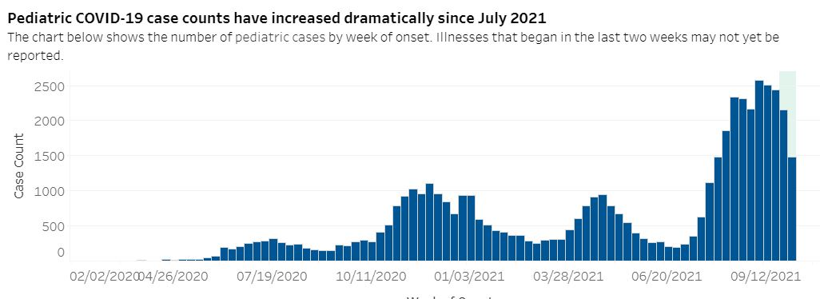
Total COVID-19 Cases for Ages 6-17
10/27/21 Source: https://public.tableau.com/app/profile/oregon.health.authority.covid.19/viz/OregonCOVID-19PediatricReport/Demographics
Notes:
10/27/21 Source: https://public.tableau.com/app/profile/oregon.health.authority.covid.19/viz/OregonCOVID-19PediatricReport/Demographics

Slide 16
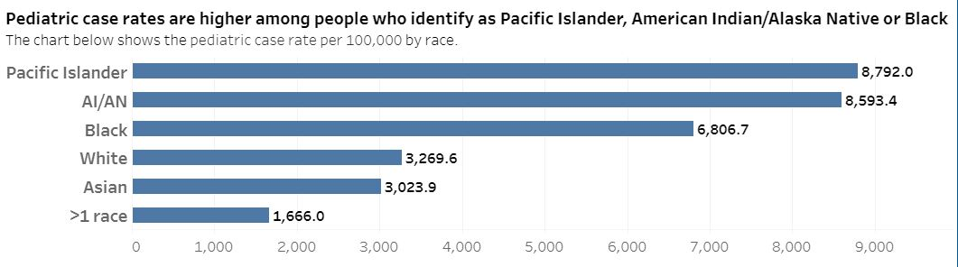
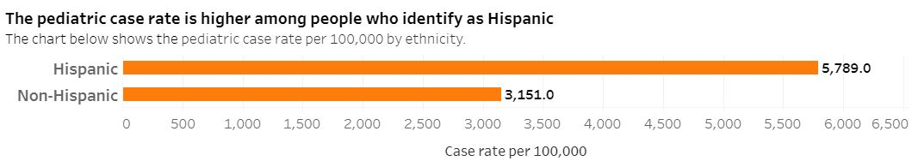
Case Rates for Communities of Color (Ages 6-17)
Notes:
10/27/21 Source: https://public.tableau.com/app/profile/oregon.health.authority.covid.19/viz/OregonCOVID-19PediatricReport/Demographics

Slide 17
Total Pediatric Cases in Our County
Add your data here by using the data dashboard available at www.oregondatadecisions.org

Slide 18
A Call to Action

Slide 19

Join In
5 Steps School Leaders Can Take Now
Take these 5 steps to join the effort to keep our students safe in our schools.
Review your health and safety protocols as a school team and ask what’s working well, and where you can improve.
Retrain teachers and school staff.
Rely on clear protocols to help everyone in school know and follow the protocols.
Re-engage your school community in a conversation about the winter months and keeping our students safe.
Reiterate your priorities and the importance of layering in every communication from email to social media.

Slide 20

5 Steps for Families & Communities
Take these 5 steps to join the effort to keep our students safe in our schools.
Make a plan to vaccinate all eligible household members.
Wear face coverings or masks in public and in carpools.
Limit gatherings with other households for now — including big events for kids, like birthday parties.
Move social activities outdoors.
Make a plan in case your child needs to miss school.

Slide 21
What are we doing to deliver on our promise?
(Add local information here)

