Slide 1

Ready Schools, Safe Learners
Ready Schools, Safe Learners
July 22 Update

Slide 2

RSSL Version Number
July 22, 2020
2.7.2
Major
Minor
Patch
No Major changes to any key design parameters in this
iteration of guidance
There are a number of minor, while still substantial changes. All changes are in the Release Notes at the front of the document
We found a number of corrections and places to clarify or make the guidance more consistent

Slide 3

Dealing with Change
When you can't change the direction of the wind –
adjust your sails

Slide 4
Guiding Principles
Guiding Principles
Ensure safety and wellness
Cultivate connection and relationship
Center Equity
Innovate

Slide 5
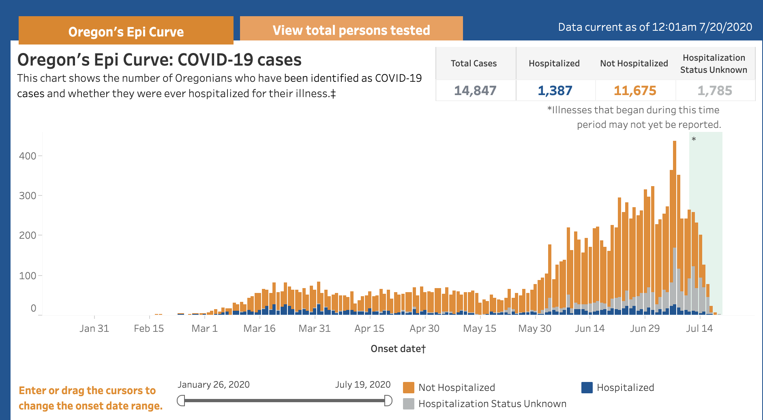
General Updates
General Updates

Slide 6
Bigger Picture
Bigger Picture
Policy Framework | Guidance | Implementation
Ready Schools, Safe Learners returns to decentralized decision-making with clear and evolving health and safety and instructional parameters. | With the authority and responsibility of Governor Brown’s Executive Order 20-29, ODE and OHA provide detailed requirements and recommendations for K-12 schools and related programs. | ODE offers support and coordination at state and regional levels while school, health, and community leaders do the hard work of putting into action their own values and strategies to ensure safety and education for students within the context of the guidance and framework.

Slide 7
Summary of Major Changes
Summary of Major Changes
Clarifying roles and authorities
Cohorting Parameters
Face coverings
Enrollment
Attendance
Instructional Time

Slide 8
Clarifying Roles and Authorities
Clarifying Roles and Authorities
Decisions about when or how schools need to respond to an outbreak of COVID-19 involve collaboration across multiple jurisdictions. If part or an entire school needs to close to in-person instruction and transition from On-Site or Hybrid Instructional models to Distance Learning models as a matter of public health, it is also important that educators, students, families, and the general public have a clear understanding of how decisions are made and who makes those decisions. (pg. 10)

Slide 9
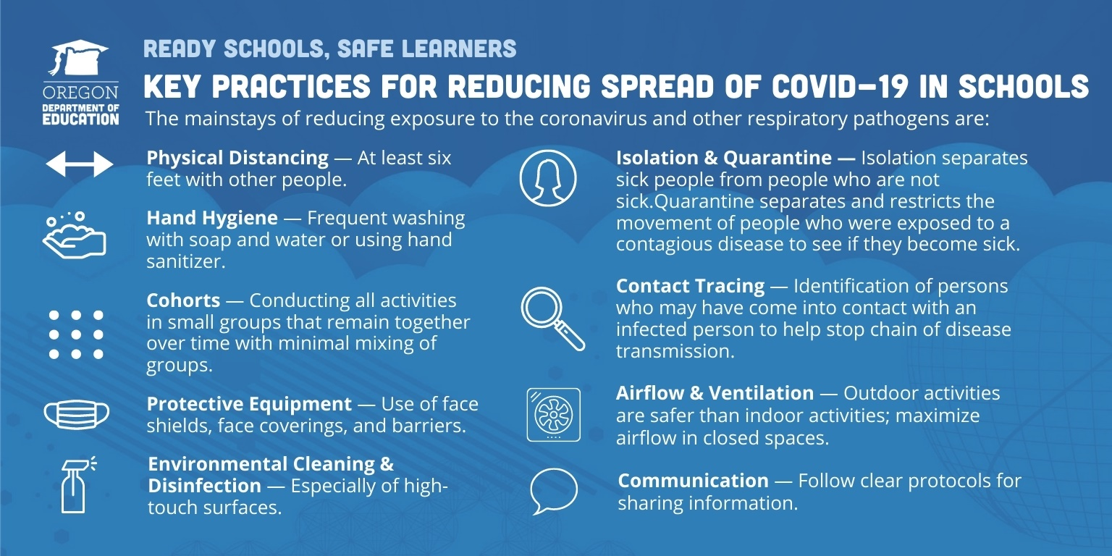
Key Practices
Key Practices

Slide 10
Cohorting Parameters
Cohorting Parameters
Cohorts help manage risks in the potential spread of COVID-19. In particular, the size of the cohort matters for risk management. Student cohorting: (1) limits the number of exposed people when a COVID-19 case is identified in the school, (2) quickly identifies exposed individuals when a COVID-19 case is identified, (3) minimizes school-wide disruptions in student learning. (pg. 23)
Students cannot be part of any single cohort, or part of multiple cohorts that exceed a total of 100 people within the educational week. Schools should plan to limit cohort sizes to allow for efficient contact-tracing and minimal risk for exposure.
A smaller cohort size of 24-36 is recommended for public health and safety.

Slide 11
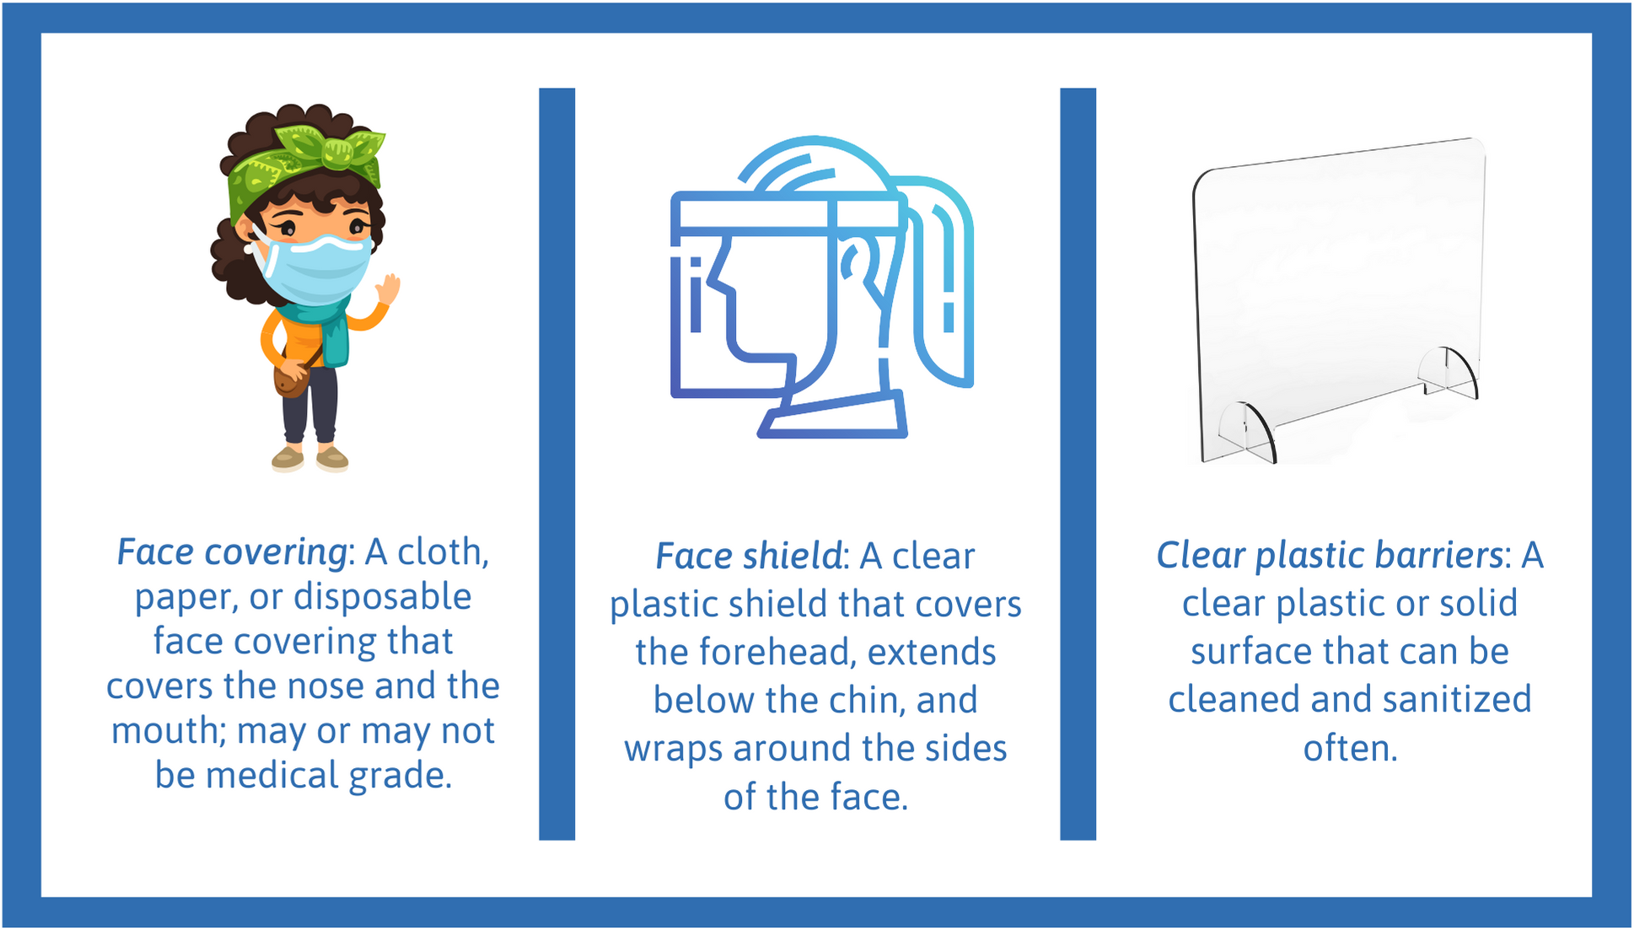
Face Coverings
Face Coverings
Face coverings are now required for all students in grades kindergarten and above along with all staff. Certain accommodations are noted in the guidance . . . (pg. 26)
Students who abstain from wearing a face covering, or students whose families determine the student will not wear a face covering, during On-Site instruction must be provided access to instruction. Comprehensive Distance Learning may be an option, however additional provisions apply to students protected under ADA and IDEA.

Slide 12
Face Coverings and Accommodations
Face Coverings and Accommodations
No disability category universally prescribes whether a student will be able to wear a face covering. However, students eligible for certain disability categories are more likely to have difficulty wearing face coverings. These include: Autism Spectrum Disorder, Other Health Impairment, Emotional Behavior Disability, Orthopedic Impairment. Schools must consider the unique needs that arise from a student’s disability in determining how to appropriately support their access to FAPE.

Slide 13
Enrollment
Enrollment
Enrollment processes support strong school operations and are needed for the financial allocations of the State School Fund. For the 2020-21 school year, ODE plans to suspend the “10-day drop”, pending approval of the State Board of Education, with the expectation that a student will only be unenrolled when a school or district has received notice that they’ve been enrolled in another setting. (pg. 31)

Slide 14
Attendance
Attendance
For On-Site Instructional Models, prior attendance and reporting practices are unchanged and should meet the requirements described in this section and can be informed by the recommendations presented.
For any Hybrid Instructional Model or Comprehensive Distance Learning, ODE is establishing the following definitions and guidance:
Attendance includes both participation in class activities and interaction with a licensed or registered teacher during a school day or interactions with educational assistants and paraprofessionals through teacher designed and facilitated processes.
Interaction can be evidenced by any of the following or reasonable equivalents:
  Participating in a video class;
  Communication from the student to the teacher via chat, text message or email;
  A phone call with the student, or, for younger students, with the parent;
  Posting completed coursework to a learning management system or web-based platform or via email; or
  Turning in completed coursework on a given day.
When there is no evidence of student interaction during a 24-hour period surrounding a scheduled school day as described, students are reported as absent. A day present for attendance may not be claimed for weekends or holidays, per ORS 336.010 and 187.010, or any other day during which a licensed or registered teacher is not available to students.

Slide 15
Instructional Time
Instructional Time
As we work to prioritize student learning in the coming school year, a common approach to instructional time requirements that apply across every instructional model and to every public school district, public charter school, and virtual public charter school are critical. (pg. 47)
For students not attending in-person through the On-Site Instructional Model, at least 50% of instructional time (as defined above) must meet the criteria for teacher-facilitated learning.

Slide 16
Learning Day Overview
Learning Day Overview
Grade Level | Teacher- Facilitated Learning* (Daily/Weekly) Must account for at least 50% of Instructional Time | Applied Learning Must not account for more than 50% of Instructional Time | Nutrition and Wellness (snack, lunch, rest, connect, time management) Does not count for Instructional Time
K-3 | 2 hours, 20 minutes per day 11 hours, 40 minutes per week (Required Minimum) | Daily/weekly No Required Minimum | Daily 2 hours recommended
4-8 | 2 hours, 30 minutes per day 12 hours, 30 minutes per week (Required Minimum) | Daily/weekly No Required Minimum | Daily 2 hours recommended
9-11 | 2 hours, 50 minutes per day 14 hours, 10 minutes per week (Required Minimum) | Daily/weekly No Required Minimum | Daily 2 hours recommended
12** | 2 hours, 45 minutes per day 13 hours, 45 minutes per week (Required Minimum) | Daily/weekly No Required Minimum | Daily 2 hours recommended
*Based on 165 day school year and a 5-day week (50% calculation based on dedicated instructional hours in Division 22; recess, professional development, and parent/teacher conference allowance was subtracted prior to the calculation)
** Twelfth-graders typically follow established daily high school schedules, but end their school year earlier than students in Grade 9-11

Slide 17
Minor Changes
Minor Changes
Clarification on bus driver use of face shields or masks when driving.
New content on Drivers Education programs.
Clarifying guidance on student engagement, attendance, and enrollment across all three instructional models.
New content for K-12 Residential Programs (Boarding Schools).
Clarity on how staff should maintain physical distance, eat, and use staff rooms.
Additional info from OHA on extent of isolation when cohort member tests positive
Prioritize needs of students with Credit Assurance plans
Clarification and preview on future guidance for Hybrid Models.
Integration of feedback from school nurses.
Updated requirements for staying home when staff or students have symptoms and positive test.
Supporting well-rounded education activities while mitigating risk
Updated language on physical distancing to maintain six feet between individuals
Added language about promoting mental health and staff awareness of student social and emotional states
Updates to Assessment, Grading, and Reporting for CDL and Hybrid

Slide 18
Instructional and Extracurricular Activities Requiring Additional Consideration
Instructional and Extracurricular Activities Requiring Additional Consideration
Beyond the general considerations outlined above there are program specific guidelines that will help administrators and educators plan for classes requiring additional considerations. Use the linked guides to develop implementation plans.
Career and Technical Education
Laboratories
Visual and Performing Arts
Physical Education
Driver Education

Slide 19
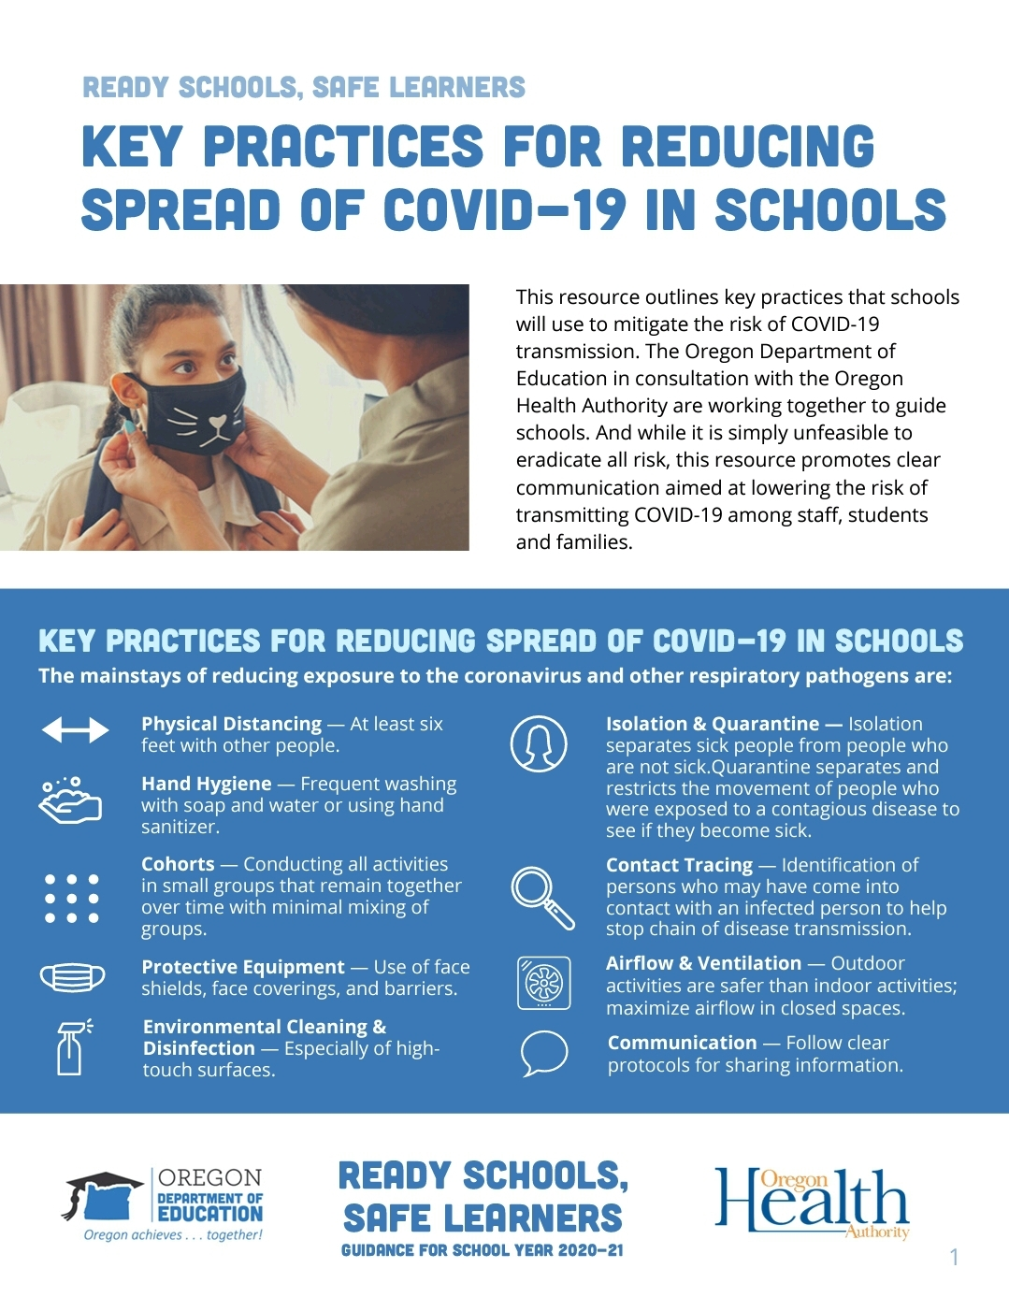
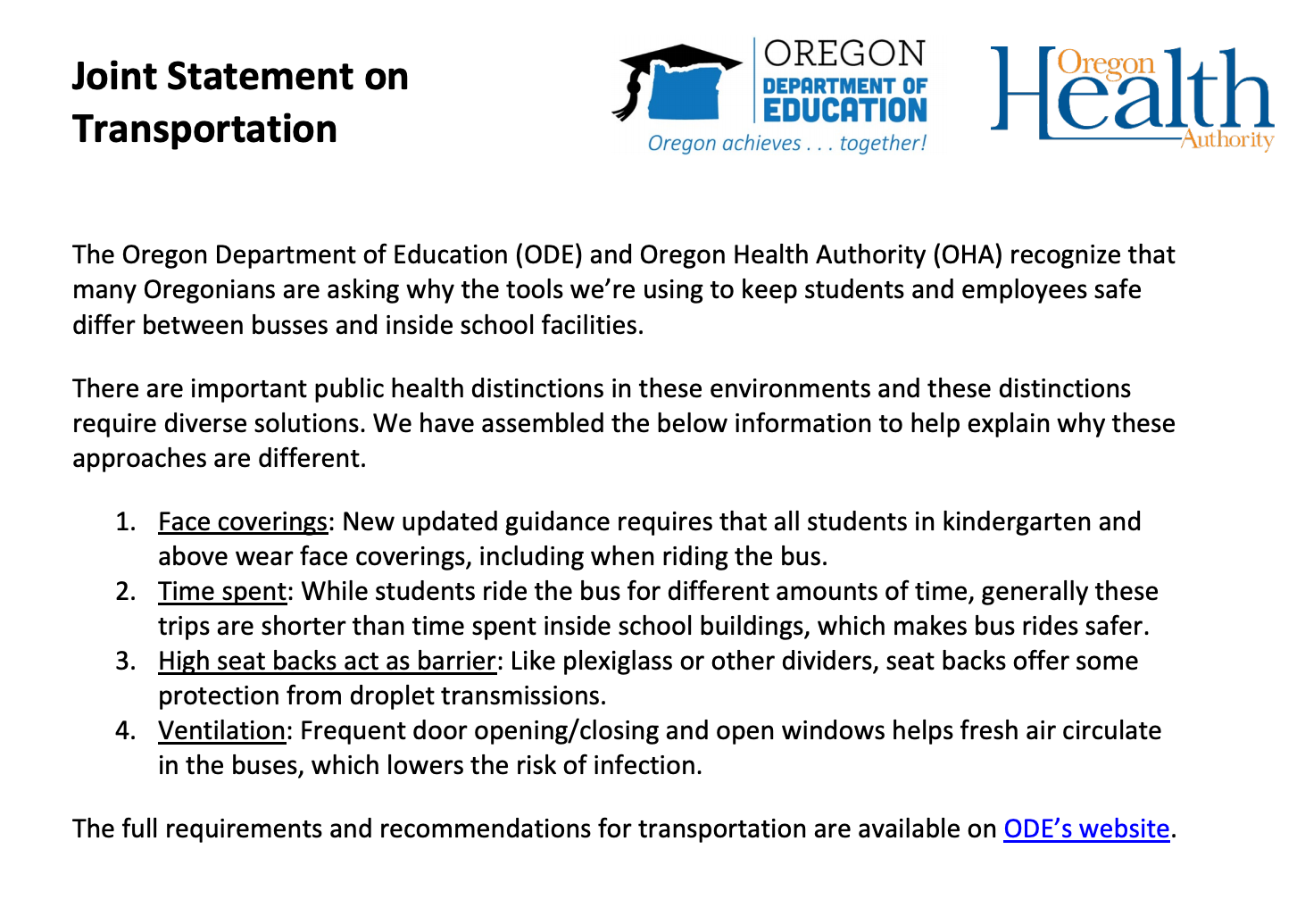
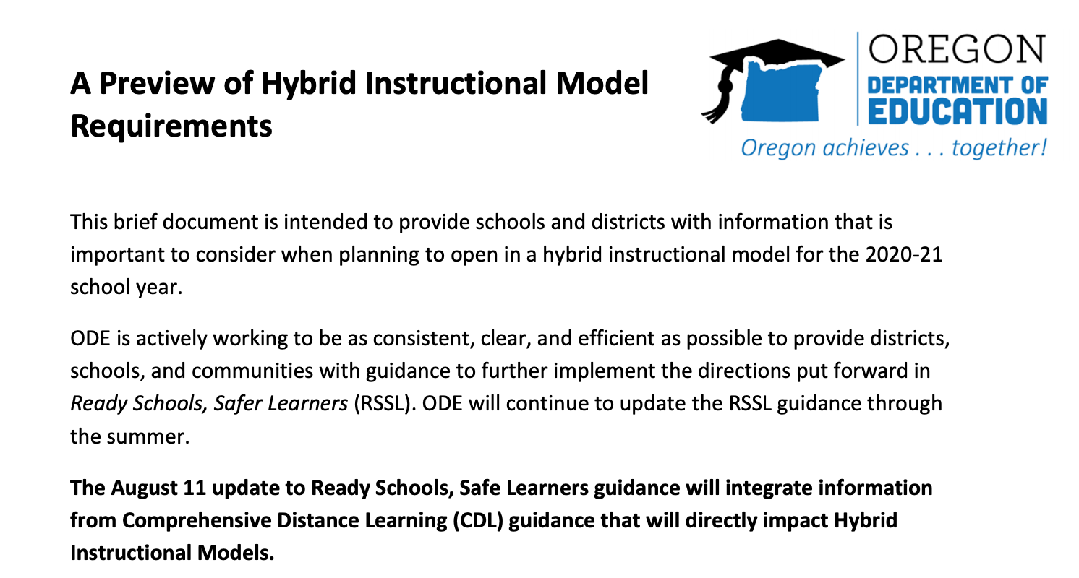
New Support Tools
New Support Tools

Slide 20
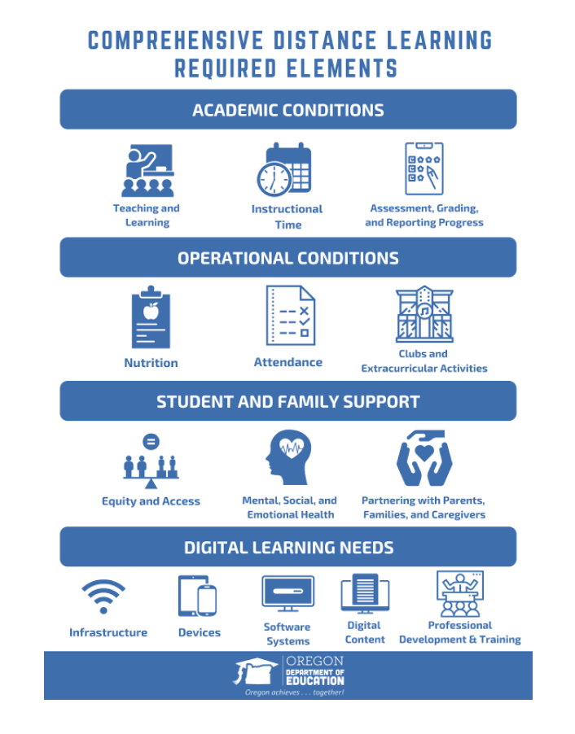
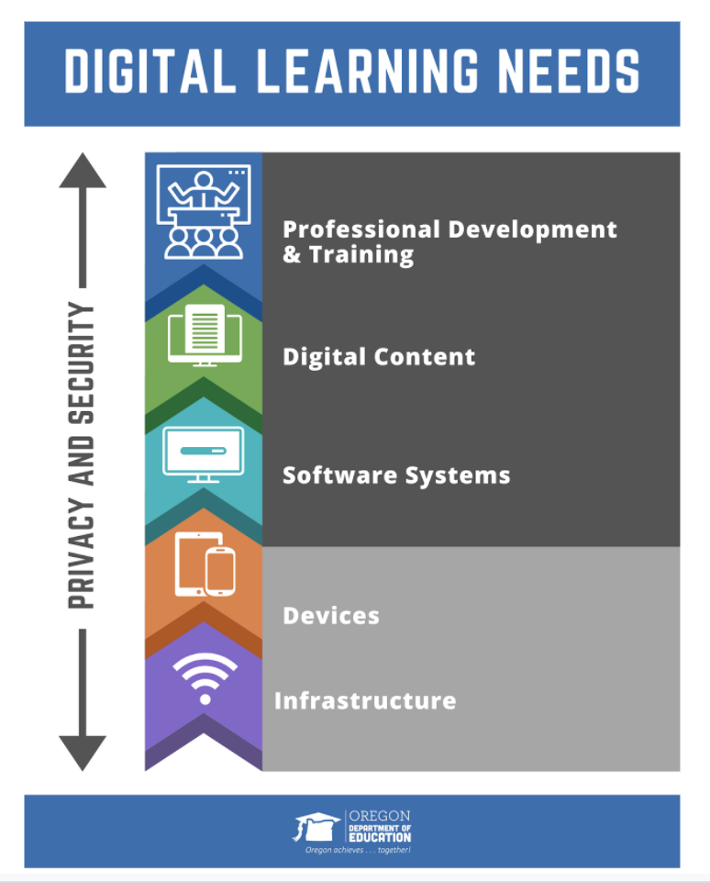
Comprehensive Distance Learning
Comprehensive Distance Learning

Slide 21
Considerations on CDL
Considerations on CDL
Implementation implications for setting an intentional and higher quality standard for distance learning, including resource, infrastructure, and professional learning needs for communities in the state unable to meet those standards if required to move into CDL overtime even if not their initial reopening plan.
Expectations for engagement, attendance, and instructional time.
The majority of each student’s services under ESSA, ADA, or IDEA must be provided synchronously (i.e., with the teacher/service provider and student working together through direct, simultaneous communication). The amount of instruction that is synchronous vs. asynchronous is determined locally by each school and district, but should overwhelmingly lean towards a synchronous nature. This is best when included in inclusive virtual settings using synchronous instruction.
Implications of CDL guidance for Hybrid Instructional Models.

Slide 22
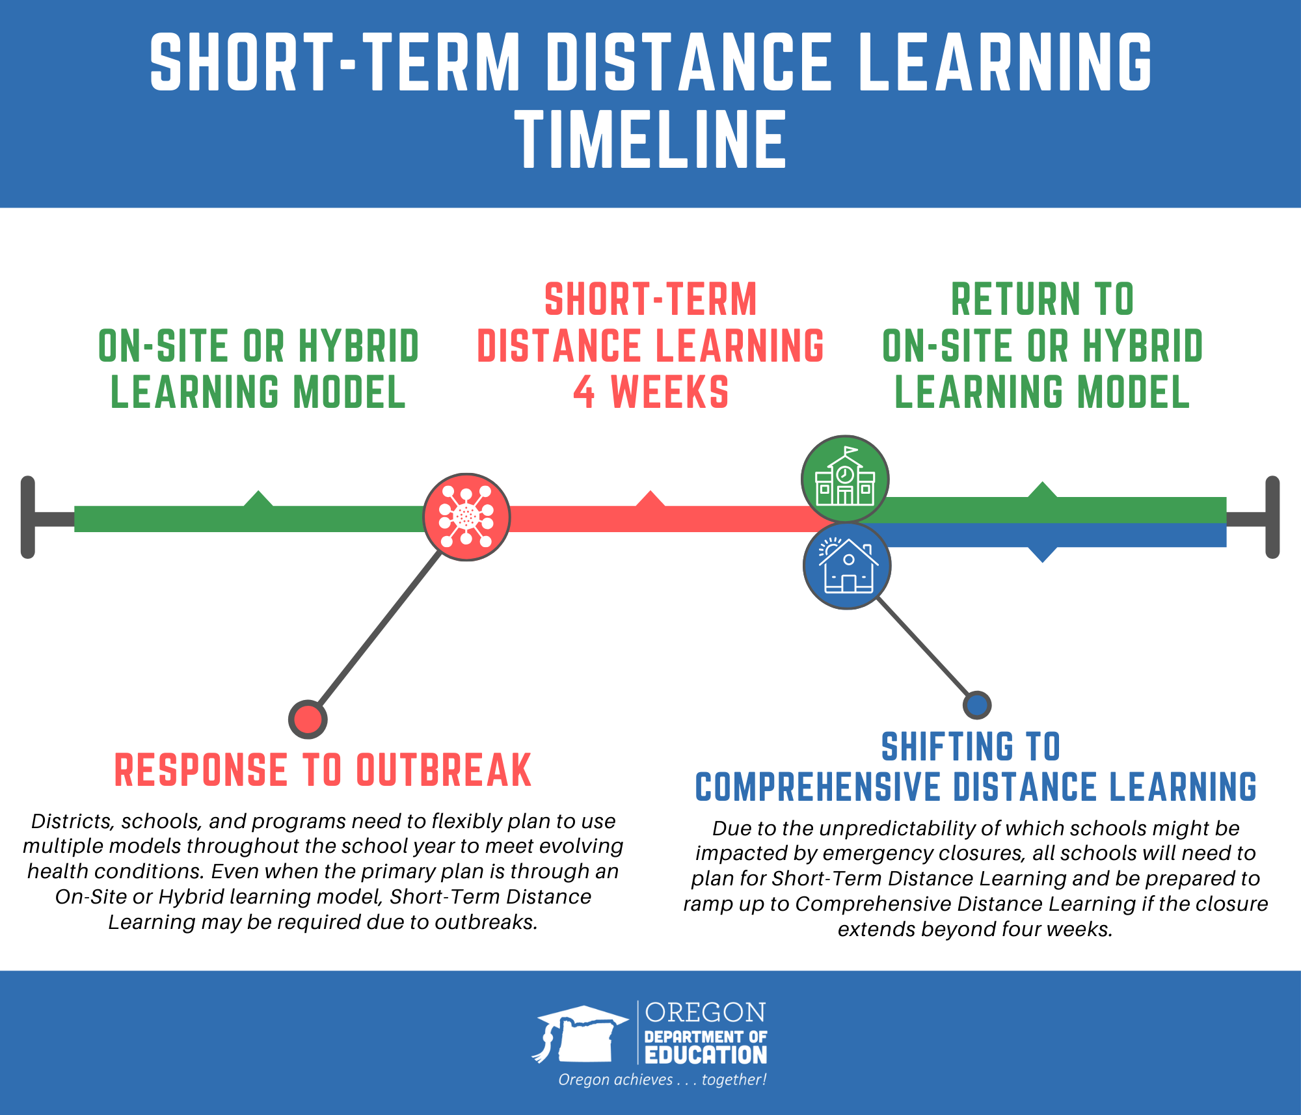
Timeline

Slide 23
Steps of Plan Submission
Steps of Plan Submission
Preparation
Read this Ready Schools, Safe Learners guidance in its entirety.
Consult your Local Public Health Authority and familiarize yourself with the disease management metrics within your health region. Schools with attendance boundaries within more than one county may need to consult multiple local public health authorities.
Assemble appropriate personnel within the school/district, including teachers and any community partners to create a planning team.

Slide 24
Steps of Plan Submission
2
Steps of Plan Submission
Plan Development
Work with the planning team to complete the Operational Blueprint template for your school. This must include a plan for all settings in the school, such as preschool and EI/ECSE classrooms or community transition programs which may be housed in other locations. Private schools are required to complete sections 1-3.
Consult with key partners (see section six, including Tribal Consultation) to complete the Operational Blueprint for Reentry.
Submit the Operational Blueprint for Reentry to your local school board.

Slide 25
Steps of Plan Submission
3
Steps of Plan Submission
Public Health Review
Submit the Operational Blueprint for Reentry to your Local Public Health Authority.
  Public school districts, ESDs, and public charter schools should compile all the school blueprints at the district level. The district should then submit the blueprints to the appropriate LPHA for each school site. School district and ESD boundaries sometimes overlap LPHA (typically county) boundaries. School districts and ESDs may be submitting plans to more than one LPHA based on the location of each school in their district.
  State Sponsored public charter schools should submit directly to the LPHA.
  Private schools that are part of a system of schools (E.g. Catholic schools) should compile all the school blueprints at the system level. The system operator should then submit the blueprints to the appropriate LPHA for each school site. Private school system boundaries sometimes overlap LPHA (typically county) boundaries. Private school systems may be submitting plans to more than one LPHA based on the location of each school in their district.
  Private schools that operate as a single school entity should submit directly to the LPHA.
Your Local Public Health Authority will attest to receiving the blueprint, naming that the LPHA will be reviewing sections 1-3, and that the LPHA stands ready to work together with the school to mitigate impacts from COVID-19.

Slide 26
Steps of Plan Submission
4
Steps of Plan Submission
Final Plan Submission
Post the Operational Blueprint for Reentry on your school and district websites. If there is no school or district website, it can be posted to the ESD website.
Submit links to the final plan(s) for each school to the Oregon Department of Education.

Slide 27

Send your link to ODE
Send your link to ODE

Slide 28


Guidance Development Work in Progress
Governor’s Healthy Schools Reopening Council
Guidance Development Work in Progress
ODE is working on a number of smaller and larger pieces of additional guidance, clarification, and support tools. Some will be released sooner than August 11.
Guidance on Athletics and Activities
Companion guidance for advancing equity and legal obligations under IDEA, ADA, and FAPE
More detailed guidance for Hybrid Instructional Models.
Health and Safety Indicators that can inform or direct what instructional models schools should select
Common Protocols for responding to outbreaks
New content on practicing Safety Drills safely

Slide 29
Guidance Development Work in Progress
2
Governor’s Healthy Schools Reopening Council
Guidance Development Work in Progress
ODE , OHA, and the Governor’s Office are working on a set of COVID-19 impact and healthcare readiness criteria to guide you in your instructional model decision. This should be released in the next few days.
Current COVID-19 Impact:
  Case Rates per 100,000 in population over time
  Test positivity rates
Local readiness for:
  Contact tracing
  Testing
  Hospital capacity/PPE availability

Slide 30


Grace & Patience
Grace & Patience
We are learning together to move powerfully on behalf of children and communities.

Slide 31

Questions
Questions...

