Slide 1
Ready Schools, Safe Learners
Resiliency Framework
for the 2021-22 School Year
July 22, 2021

Slide 2
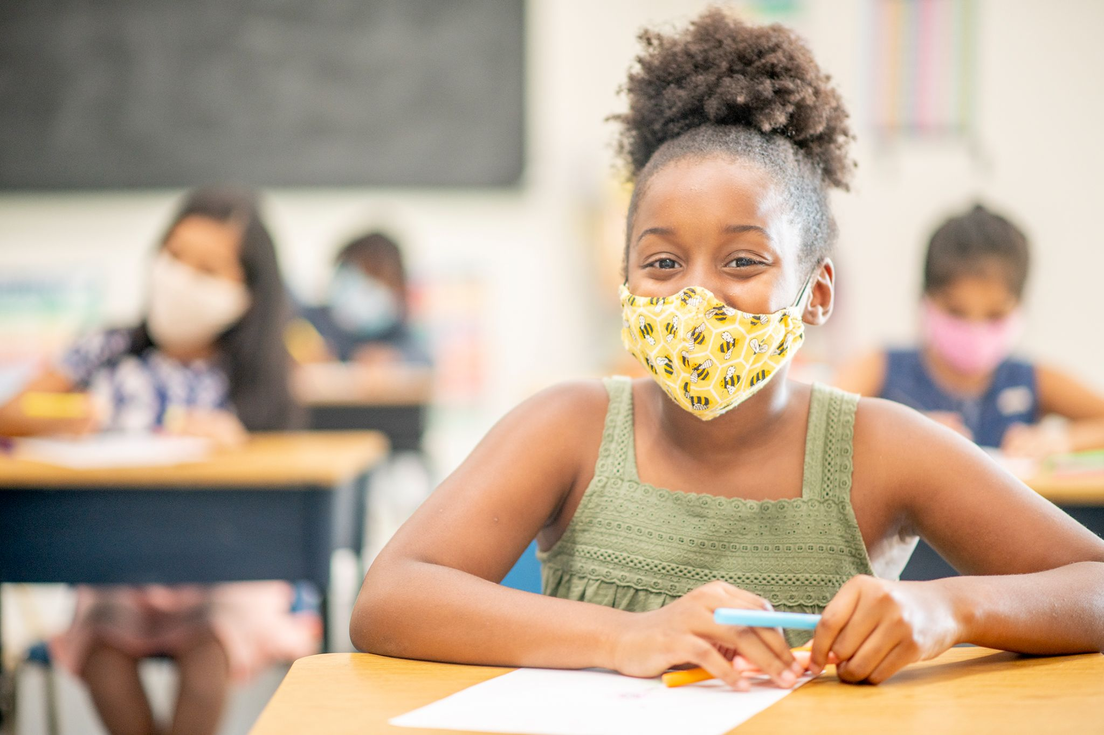
Resiliency Framework
for the 2021-22 School Year
Replaces Ready Schools, Safe Learners version 7.5.2 and applies to the 2021-22 school year.
The framework was jointly developed by the Oregon Department of Education (ODE) and the Oregon Health Authority (OHA) and is informed by U.S. Department of Education and CDC guidance.
Contains advisory guidance, except where compliance is mandated by existing state and federal law.
Requirements are listed with the rule reference for ease of identification.
Prioritizes care, connection and relationship.
Oregon’s K-12 staff and students can reconnect with one another after a year of separation through quality learning experiences and deep interpersonal relationships among families, students and staff.
Centers equity.
Recognizing the disproportionate impact of COVID-19 on Black, American Indian/Alaska Native, Latino/a/x, and Pacific Islander communities; students experiencing disabilities and students living in rural areas.

Slide 3
Resiliency Framework
for the 2021-22 School Year
All schools will operate full-time, in-person instruction every day.
School districts are not required to offer a remote learning option, except during isolation or quarantine.
Returns school health and safety practice decision making to local control to best meet the needs local communities.
As schools plan for the fall 2021 in-person school year, it is important to remember: our communities will be living with the virus until there is widespread immunity.
COVID-19 continues to change with new variants, our knowledge of mitigation efforts grows over time. For these reasons the guidance for responding to COVID-19 also changes.
Right now, the best tools to protect individuals are vaccination for those eligible, face coverings, physical distancing, ventilation and airflow, handwashing, and staying home if ill or exposed to someone with COVID-19.
Opportunity for transmission decreases with each mitigation practice that is implemented.

Slide 4
Safe Return to In-Person Instruction & Continuity of Services Plan
All school districts and public charter schools must submit a Safe Return to In-Person Instruction and Continuity of Services Plan to ODE by end of day August 23, 2021.
Replaces the RSSL Operational Blueprint and meets requirements in OAR 581-022-0105.
This plan meets the requirements of American Rescue Plan Elementary and Secondary School Emergency Relief (ESSER III) State plan.
Aligns with guidance on school operations from the CDC.
Receipt of ARP ESSER funding is dependent on creating and keeping updated a Safe Return to In-Person Instruction and Continuity of Services Plan.
School districts & charter schools should take immediate action to:
Review the directions for meeting these requirements.
Complete the Smartsheet form and upload attachments, including a link to a webpage where your plan is publicly available.
Self-certify and submit signature in the Smartsheet form.

Slide 5
Mental Health Supports

Slide 6
ODE’s Integrated Model of Mental Health
Mental health, which encompasses emotional, social, cognitive and behavioral functioning, is one of the cornerstones of public education, and central to building school cultures and climates where every student, and all who serve them, thrive.
Children and teens do better in school when student and school staff mental health and well-being needs are being met.
ODE’s Model centers health and well-being and consists of four interconnected pillars of practice:
1) trauma informed care,
2) social emotional learning,
3) racial equity, and
4) strengths-based, culturally relevant prevention and intervention programs within a system of care.

Slide 7
ODE’s Integrated Model of Mental Health
Focus on health rather than “fixing what is broken.”
Recognizing the inherent strengths, agency, voice, courage and determination of individuals, families, and communities, and asking what strategies they use to thrive in the face of difficult challenges, and how we can celebrate that resilience.
We strongly discourage the use of school or district wide mental health screenings, particularly where there may be insufficient services and supports to meet mental health service demands.
We recommend assessing each student on an as-needed basis when questions or concerns regarding their well-being have been identified.

Slide 8
Prioritize Student & Staff Health & Well-Being
Devote several days of time and space at the beginning of the school year, and ample opportunities throughout the year for students and staff to connect and build relationships in and out of the classroom.
Provide ample class time at the beginning of the school year, as well as ongoing time, space, and creative opportunities and outlets (art, music, movement/dance, creative writing, clubs and interest groups etc.) for students and staff to make sense of their experiences, and to process personal and professional stresses, emotions, trauma, and grief.
Prioritize linking students and families with culturally responsive mental health services and supports.
Foster peer/student led initiatives on social-emotional well-being and mental health.

Slide 9
Access to Mental Health & Crisis Services
Strengthen communication throughout communities and school networks via newsletters, district website, social media, etc.
Ensure school community members have full information regarding available local services including contact information.
Develop strong relationships, partnerships and contracts (as applicable) with local/county systems of care, coordinated care organizations (CCOs), SBHCs, community-based mental health providers, community health workers and others to ensure access to a comprehensive array of culturally-responsive services for students and families.

Slide 10
Support School Safety & Prevention
Offerings include suicide prevention services, behavioral safety assessments, access to the SafeOregon Tip Line, and positive school culture and climate support that includes programs to prevent bullying, cyberbullying, harassment, and intimidation, and to promote mental health and well-being in school districts statewide.
All of these services and supports align with ODE’s Integrated Model of Mental Health in that they are equity and racial equity-centered, trauma and SEL-informed, and strengths-centered.

Slide 11
COVID-19 Health & Safety

Slide 12
COVID-19 Health & Safety
The Resiliency Framework focuses on advisory health and safety recommendations that provide for flexibility to:
Return to full-time, in-person instruction for all students,
Honor and recognize the uniqueness of communities across Oregon, and
Support schools in health and safety planning to meet community-specific needs and strengths.
As districts plan and implement recommendations included in the Resiliency Framework, they will necessarily need to consider a continuum of risk levels when all recommendations cannot be fully implemented.

Slide 13
Monitoring Local Data
District decisions should consider:
Level of community transmission of COVID-19.
COVID-19 vaccination coverage in the community and among students, teachers, and staff.
Use of a frequent COVID-19 screening testing program for students, teachers, and staff who are not fully vaccinated. Testing provides an important layer of prevention, particularly in areas with substantial to high community transmission levels.
COVID-19 outbreaks or increasing trends in the school or surrounding community.
Ages of children served by K-12 schools and the associated social and behavioral factors that may affect risk of transmission and the feasibility of different prevention strategies.

Slide 14
Requirements in State & Federal Law
Federal Requirement
State Requirement
Use of face coverings on public transit, including school buses (CDC).
Each school district and public charter school must submit an Operational Plan/Safe Return to In-Person Instruction AND Continuity of Services Plan by August 23, 2021.
Maintain a Communicable Disease Management Plan.
Maintain a process to exclude and isolate staff or students who may have been exposed to COVID-19.

Slide 15
COVID-19 Testing in Schools
Diagnostic testing
Test students or staff who develop symptoms at school or are exposed to COVID-19 at school.
This testing program was rolled out in January 2021 and more than 90% of K-12 schools have registered.
For some students, this COVID-19 testing in K-12 schools may represent their only access to a COVID-19 test and the importance of this access cannot be overstated.
This testing may be used to shorten the length of quarantine for exposed individuals who test negative if this is recommended by the local public health authority.
Screening testing
Test students or staff who do not have symptoms of, or exposure to, COVID-19.
Seeks to reach unvaccinated students and staff, but enrollment is open to anyone and vaccination status is not verified.
OHA offers separate screening testing programs for students and staff.
Notes:
https://sharedsystems.dhsoha.state.or.us/DHSForms/Served/le3560.pdf
Staff screening testing is offered through an at-home testing program. Staff participation is confidential. K-12 staff interested in screening may enroll using this form. Student screening testing is offered through partnership with several laboratories across Oregon. Interested schools may learn more here .

Slide 16
Public Health Communication
OHA and ODE strongly advise that school districts, charter schools, and private schools develop plans for communicating health and safety protocols to students, families and communities.
A strong communication plan that includes protocols for communicating potential COVID-19 cases to the school community and other stakeholders is critical.
Provide clarity and supporting materials for communication to community members (in their preferred language) about the specific health and safety protocols in place at the school, and why these might differ from those of nearby schools or be different across school districts.
School and district leaders are encouraged to use the communications toolkit to initiate conversations and communication with staff, students, families, the media and the broader school community.

Slide 17
Training for School Staff
OHA and ODE strongly advise that school districts, charter schools, and private schools develop plans for training all staff in their health and safety protocols and jointly develop lesson plans for instruction to students.
Consider forming a school committee to oversee the implementation of the health and safety protocols that is inclusive of represented and unrepresented staff.
Ensure that all staff have a safe place to bring implementation questions and suggestions forward.

Slide 18
Advisory
Health & Safety Protocols

Slide 19
Face Coverings
In grades kindergarten and up, OHA and ODE strongly advise face coverings for all unvaccinated staff and students when inside buildings.
Per OHA guidance, it is acceptable for both fully vaccinated and unvaccinated people to be outdoors without a face covering.
A face covering is NOT a substitute for physical distancing. Face coverings remain strongly recommended in addition to maintaining at least 3 feet of physical distancing to the extent possible, especially when indoors around people from different households.

Slide 20
Physical Distancing
OHA and ODE strongly advise that schools support and promote physical distancing as described below:
Support physical distancing in all daily activities and instruction, maintaining at least 3 feet between students to the extent possible.
Maintaining physical distancing should not prevent a return to full-time, in-person instruction for all students.
When it is not possible to maintain a physical distance of at least 3 feet, it is especially important to layer multiple other prevention strategies, such as indoor masking.
Consider physical distancing requirements when setting up learning and other spaces, arranging spaces and groups to allow and encourage at least 3 feet of physical distance.
Minimize time standing in lines and take steps to ensure that required distance between students is maintained, including marking spacing on floor, one-way traffic flow in constrained spaces, etc.

Slide 21
COVID-19 Vaccinations
Under Oregon law, youth age 15 years and older may give consent to receive medical treatment, including vaccinations, when provided by a physician, physician assistant, naturopath, nurse practitioner, dentist or optometrist, or other professionals operating under the license of these providers.
Parental or guardian consent is required to vaccinate people 12-14 years old, but the parental or guardian consent requirement does not necessarily mean a parent or guardian must go with the youth to receive the vaccination. Written consent may be obtained in advance.

Slide 22
COVID-19 Vaccinations
CDC guidance states that people who are fully vaccinated and do not have COVID-19 symptoms do not need to quarantine or get tested after an exposure to someone with COVID-19 unless they develop symptoms.
This protects the student’s access to in-person learning, sports and extracurricular activities.
People are considered fully vaccinated 2 weeks after their second dose of the Pfizer-BioNTech or Moderna COVID-19 vaccines, or 2 weeks after the single-dose Johnson & Johnson’s COVID-19 vaccine.

Slide 23
Cohorting
OHA and ODE strongly advise that schools design cohorts for students to the extent possible.
Cohorts help manage risks in the potential spread of COVID-19. In particular, the size of the cohort matters for risk management.
Student cohorting: (1) limits the number of exposed people when a COVID-19 case is identified in the school, (2) quickly identifies exposed individuals when a COVID-19 case is identified, (3) minimizes the number of people who may need to be quarantined as well as school-wide disruptions in student learning.

Slide 24
Quarantine
An exposure is defined as a susceptible individual who has close contact (less than 6 feet) for longer than 15 cumulative minutes in a day with a person who has COVID-19.
If a student or staff member is diagnosed with COVID-19, then the LPHA should be consulted to review the situation.
If a school cannot confirm that 6 feet of distancing was consistently maintained during the school day, or 3 feet of distancing with consistent mask use was maintained during the school day, then each person the confirmed case was in contact with will need to quarantine – this could include all members of a stable cohort.
K-12 Quarantine Exception: Quarantine is not necessary for:
Students who were within 3 or more feet of an person with COVID-19;
Where both students were engaged in consistent and correct use of well-fitting face coverings; and
Other K–12 school prevention strategies were in place in the K–12 school setting.
This exception does not apply to teachers, staff, or other adults in the indoor classroom setting.
See the COVID-19 Exclusion Summary Guide for exclusion and isolation protocols for sick students and staff identified at the time of arrival or during the school day.
Notes:
Schools should follow their usual exclusion guidelines, which should include the primary symptoms of COVID. Diagnostic testing at the school, offered for free through Oregon Health Authority, can be helpful. Isolation and quarantine are LPHA decisions, and schools should work in partnership with their LPHAs to exclude students and staff who have been asked to isolate or quarantine by their LPHA. I’ve added a slide
OAR 333-019-001
(d) "Susceptible":
(A) For a child, means lacking documentation of immunization required under OAR 333-050-0050.
(B) For an employee of a school or child care facility, means lacking evidence of immunity to the disease.
(3) A school administrator shall exclude a susceptible child who attends a school or children's facility if the administrator has reason to suspect that the child has been exposed to measles, mumps, rubella, diphtheria, pertussis, hepatitis A, hepatitis B, or COVID-19, unless the local health officer determines, in accordance with section (6) of this rule, that exclusion is not necessary to protect the public's health.
(4) A school administrator shall exclude a susceptible employee of a school or children’s facility if the administrator has reason to suspect that the employee has been exposed to measles, mumps, rubella, diphtheria, pertussis, hepatitis A, hepatitis B, or COVID-19, unless the local health officer determines, in accordance with section (6) of this rule, that exclusion is not necessary to protect the public’s health.
(5) A school administrator may request that the local health officer determine whether an exclusion under section (3) or (4) of this rule is necessary.

Slide 25
Ventilation & Airflow
ODE and OHA strongly advise schools to ensure effective ventilation and improve the indoor air quality in schools by:
Increasing the amount of fresh outside air that is introduced into the system;
Exhausting air from indoors to the outdoors; and
Cleaning the air that is recirculated indoors with effective filtration methods (e.g., HEPA filters) to remove virus-containing particles from the air.

Slide 26
Handwashing
OHA and ODE strongly advise that schools create protocols and systems to ensure access to soap, water and alcohol-based hand sanitizer with at least 60% alcohol at the key times named below and that schools prioritize handwashing with soap and water after students or staff use the restroom.
All people on campus should be advised and encouraged to frequently wash their hands or use hand sanitizer. Remind students with signage and regular verbal reminders from staff of the critical nature of hand hygiene.

Slide 27
Instruction,
Attendance & Enrollment

Slide 28
Requirements in State Law & Rule
Districts must meet all instructional time requirements in Division 22.
Districts must meet the definition of instructional time, including under the direction or supervision of a licensed or registered teacher, licensed CTE instructor, licensed practitioner, or assigned Educational Assistant.
Districts that use digital content as core curriculum must complete an independent adoption of materials.
Districts must have a plan for administering state assessments to its students.
Districts will use pre-pandemic attendance and reporting practices. For remote instructional models, schools and districts must take daily attendance.

Slide 29
Resources

Slide 30
Resources
Mental Health & Well-Being
ODE’s Integrated Model of Mental Health
The Mental Health Toolkit is designed for district leaders, school administrators, and school-based mental health professionals (i.e. school counselors, school psychologists, school social workers, and school nurses) interested in promoting the health and well-being of school communities while creating a culture of safety, care and belonging.
Mental Health website is designed to assist districts, schools and ESDs in promoting the mental health and well-being of their school communities.
Resources and information on OHA’s School-Based Mental Health Services are an essential component of our education system.
OHA’s Crisis Line and Behavioral Mental Health Resources

Slide 31
Resources
Isolation & Quarantine
Exclusion and isolation protocols for sick students and staff identified at the time of arrival or during the school day. See the COVID-19 Exclusion Summary Guide.
Offer free, on-site COVID-19 testing to students and staff with COVID-19 symptoms or exposure via OHA’s K-12 school testing program.
Adherence to school exclusion processes as laid out in Communicable Disease Guidance for Schools.
Reviewing and using the “Planning for COVID-19 Scenarios in Schools” toolkit.
Cleaning surfaces (e.g. door handles, sink handles, drinking fountains, transport vehicles) following CDC guidance.
Schools and districts must cooperate with any LPHA investigations and requirements to protect the public health. LPHAs follow statewide Investigative Guidelines for COVID-19 and other diseases.
School and district leaders are encouraged to use the communications toolkit to initiate conversations and communication with staff, students, families, the media and the broader school community.

Slide 32
Public Education Campaign
Learn more at
oregon.gov/readyschools

Slide 33
Thank You
ODECOVID19@state.or.us

