Slide 1
Template Slidedeck for School Leaders
Change theme or co-brand with your logo here
[Template Slidedeck for School Leaders]
Updates
January 19, 2021

Slide 2
Communicating with All of Your Community
[About this deck; delete for final presentation]
Communicating with All of Your Community
As the COVID-19 pandemic unfolds, increasing public awareness and understanding about school operations is essential. These slides provide ready access to messaging and updates made to the Ready Schools, Safe Learners guidance on January 19, 2021. You may use and modify these slides to align with your local communications and planning efforts after reviewing the guidance in full and tailoring to the different communities and needs within your whole community.

Slide 3
What’s Included
Please Note: The information in these slides is not intended to be comprehensive. The purpose of these slides is to equip district and school leaders with a resource they can use to share information with teachers, school staff, school boards, students, families and their local community.
What’s Included
Framing and Key messages
A snapshot of updates to the guidance for Oregon’s schools
Brief Explainer on Advisory Health Metrics
Health & Safety Protocols
Vaccine Update
Tools and Resources

Slide 4
important key messages 1
The next several slides contain important key messages to help guide our community’s conversations.

Slide 5
Key Message
Key Message
Every student deserves high-quality instruction and time to learn, grow and thrive.
(across all instructional models)

Slide 6
Every student deserves high-quality instruction
Every student deserves high-quality instruction and time to learn, grow and thrive.
Comprehensive distance learning has been challenging, a source of learning and struggle, and returning to in-person learning, while managing the risks well, is a priority.
Access to high-quality, culturally sustaining practices and services are essential for students to reach their full potential.
Notes:
“You don’t make the timeline. The virus makes the timeline.” – Dr. Anthony Fauci.

Slide 7
Key Message 2
Key Message
Preparation, action, and communication demonstrate that staff and student safety is a top priority.

Slide 8
Staff and student safety
Staff and student safety is a top priority.
Oregon will be living with the virus until there is widespread immunity, which is many, many months off.
We want to ensure the health of our communities and prevent the virus from spreading.
The best tools to protect individuals are physical distancing, face coverings, and hygiene.
This means ensuring young people and our school staff take necessary steps to mitigate risk and protect themselves and their families.
Notes:
https://www.oregon.gov/ode/students-and-family/healthsafety/Documents/Key%20Practices%20for%20Reducing%20Spread%20of%20COVID-19%20in%20Schools.pdf

Slide 9
Staff and student safety 3
Key Message
Success with increasing in-person learning has happened when we take a measured approach and follow the protocols with fidelity.

Slide 10
measured approach
Taking a measured approach to returning to in-person instruction.
Begin on-site instruction for a portion of students, beginning with our youngest learners (K-3).
Create the conditions for staff and students to establish safety routines and cohorts that promote a stable learning environment and safeguard against a transition back to distance learning.
Notes:
https://www.oregon.gov/ode/students-and-family/healthsafety/Documents/Planning%20and%20Responding%20to%20COVID-19%20Scenarios%20in%20Schools.pdf
We know that quarantine and isolation can be disruptive, which is why a measured, thoughtful approach is essential.

Slide 11
Key Message 4
Key Message
We’re in this together.
Being together means each and every person.
Notes:
Consider naming the values of partnership and engagement

Slide 12
We’re in this together.
We’re in this together.
School staff, families and students, are valued and trusted partners in all efforts.
The people who are closest to the education system are the key to unlocking innovative solutions we need to meet the academic needs and strengths of all students and the social-emotional needs of students and staff.

Slide 13
Key Message 5
Key Message
Advancing racial justice means we examine policies and practices through dialogue. Actions that promote education equity benefit everyone.
Notes:
Questions?

Slide 14
Advancing racial justice
Advancing racial justice means we examine policies and practices through dialogue. Actions that promote education equity benefit everyone.
We recognize racial inequities existed before COVID. It is incumbent upon us to identify worsening inequities and create mechanisms to address them.
The COVID-19 pandemic has disproportionately impacted Black, Latino and Native/American Alaska /Native students, staff and families.
In our school / district, we use an equity lens to support our decision-making to ensure all of our students are being served.
Notes:
Examples of what this commitment are: implicit bias training, examining data, dialogue at board meetings, professional learning for certified and classified staff, student advisory council; training for school leaders on how to use the tribal consultation tool.

Slide 15
Snapshot of Key Updates
Snapshot of Key Updates
Ready Schools, Safe Learners
January 19, 2021

Slide 16
Key Update
Key Update
Operating schools in-person is now a local decision.
Opening schools relies on implementing public health and safety protocols/requirements with fidelity and consulting with local public health officials.
[Our district/school] must follow the requirements outlined in RSSL and submit new blueprints when the instructional model changes.

Slide 17
Key Update 2
Key Update
Advisory Metrics expand opportunities to return students to on-site or hybrid instruction.
The county metrics remain and the chart in RSSL serves as the best tool for determining when cases are down enough to return to in-person instruction.
Public and private schools must submit data weekly on how many students they are serving in-person.

Slide 18
Key Update 3
Key Update
Schools should make every effort to promote a stable learning environment for staff and students.
Community case counts (or case rates) should be taken into consideration when determining to open for on-site instruction.
[Our district/school] must actively work to ensure new cases of COVID-19 are not introduced to their schools, causing disruption to the learning environment for students and staff.

Slide 19
Key Update 4
Key Update
All health and safety protocols named in RSSL are required and needed.
[Our district/school] will develop, practice and train our staff and students to use new routines.
This includes diligent entry screening, face coverings, physical distancing, cohorting, frequent handwashing, and all of RSSL sections 1-3.

Slide 20
Key Update 5
Key Update
Every school will have a designated leader to implement, enforce and support health and safety protocols.
[Our district/school] will create a simple process that allows for named and anonymous sharing of concerns;
Establish a process and procedures to train all staff on Section 1-3 of the RSSL guidance (consider virtual training).
Protocol to notify local public health.

Slide 21
Key Update 6
Key Update
Limited In-person Instruction included as part of Comprehensive Distance Learning
Aimed to meet the needs of specific groups of students based on needed educational, relational, social-emotional, curricular, instructional, and/or assessment supports.
Cohorts of 20 students, no more than two cohorts in any given week.
Time on campus: two consecutive hours and cannot be intermittent.
Depending on details, could be considered instructional time
Notes:
Can LIPI constitute instructional time?
The LIPI exception was not designed to serve as instructional time. However, LIPI could be considered instructional time if the activity or activities being completed during LIPI fully meet the definition of instructional time (as established in Division 22 and RSSL section 5). Schools will need to carefully plan for access to full instructional time requirements for each student whether or not they participate in LIPI.
Additional information:
Limited in-person instruction cannot replace the requirements of CDL for any learner.
For students who experience disability, offers of FAPE cannot require students to come on-site during limited in-person instruction to satisfy requirements of SDI or related services. Students must continue to have full provisions of FAPE under CDL.
For students who require language instruction, schools cannot require students to come on-site during limited in-person instruction as the sole means of providing instructional services under Title III.
Schools cannot require students to participate in LIPI.

Slide 22
Advisory Metrics
Advisory Metrics

Slide 23
Advisory Metrics 2
Advisory Metrics
Health Metrics shifted from Required to “Advisory”
As of January 1, 2021, Health Metrics shifted from Required to Advisory per Governor Brown’s directive
Updates based on Harvard Global Health Institute
Ready Schools, Safe Learners will continue to be updated based on:
The continuing impacts of COVID-19 and the state’s evolving mitigation efforts as directed by Governor Brown and the Oregon Health Authority.
Input from educators, students, families, and community partners.
An ongoing review of equity impacts.
Learnings from efforts being rolled out in other states and countries.

Slide 24
Advisory Metrics 3
Advisory Metrics
When students and staff return to on-site instruction in any form, it is required that schools:
Train all staff on Section 1-3 of the RSSL guidance.
Designate a school leader to implement, support and enforce health and safety protocols.
Provide a Comprehensive Distance Learning (CDL) Instructional Model option for students and families that choose to remain off-site.
Work with families to serve all students, even those in high-risk population(s) whether learning is happening through On-Site, Hybrid, or CDL.

Slide 25
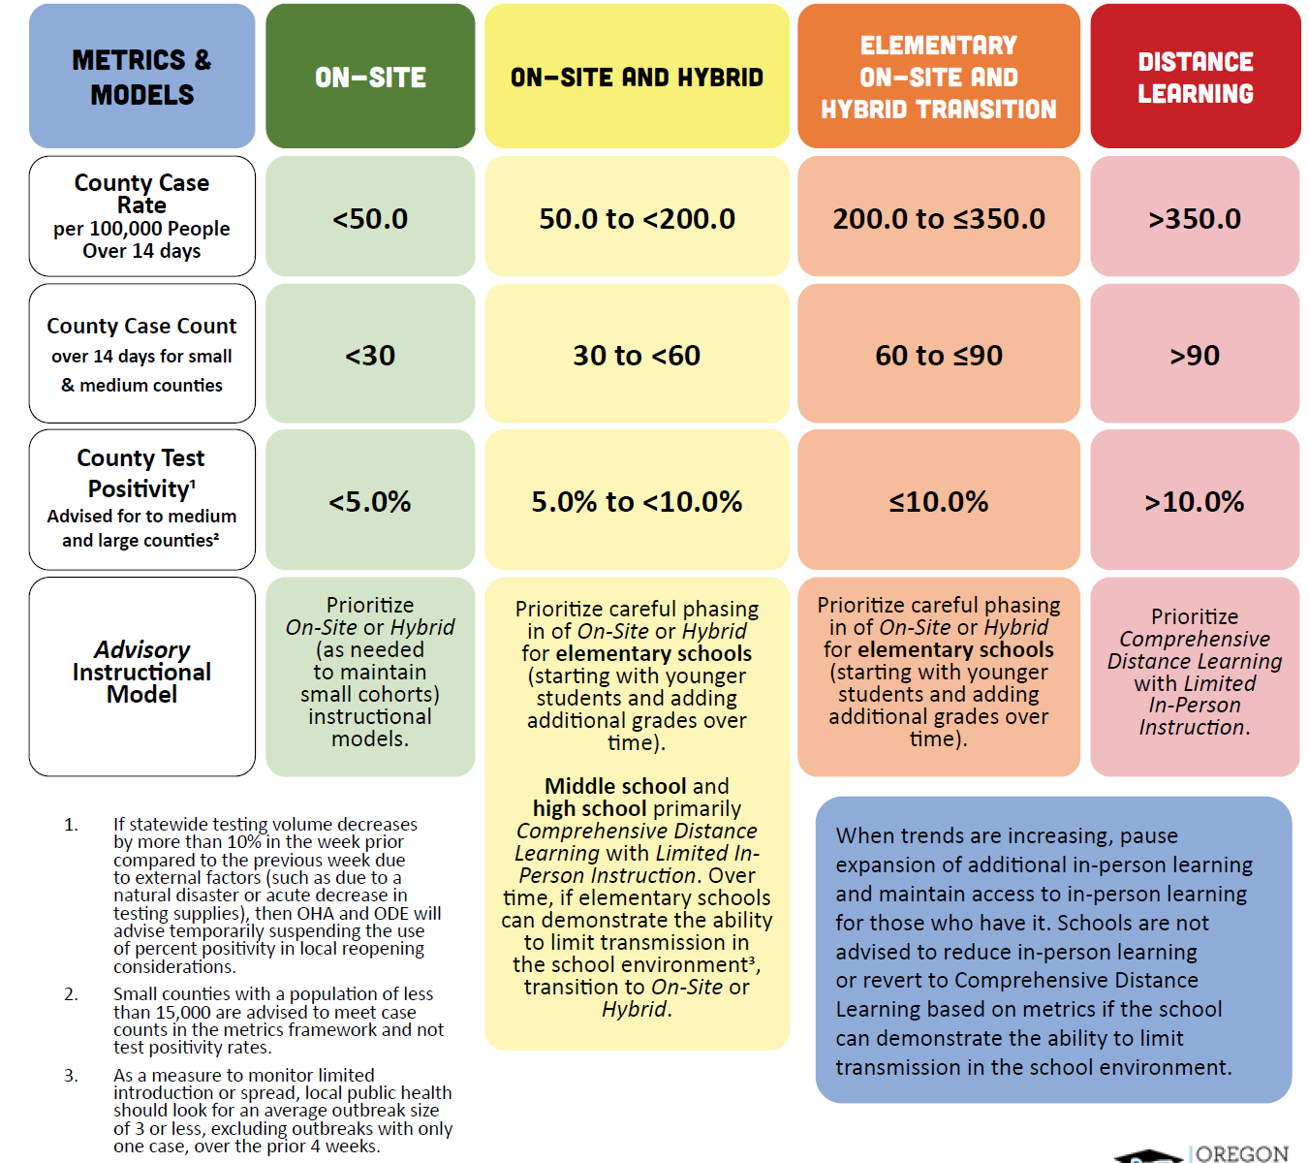
Updated metrics
Updated metrics based on the Harvard Global Health Institute recommendations.

Slide 26
Placeholder: Addressing Testing
[Placeholder: Addressing Testing]
If your school is located in a county that does not meet the advisory metrics; not later than March 1, 2021, the school must offer access to on-site testing for symptomatic students and staff identified on campus as well as those with known exposures to individuals with COVID-19.

Slide 27
Health & Safety Protocols
Health & Safety Protocols

Slide 28
designated leader
Every school will have a designated leader to establish, implement, support and enforce all RSSL health and safety protocols.
Including face coverings and physical distancing requirements, consistent with RSSL guidance and other guidance from OHA.
This role should be known to all staff in the building with consistent ways for licenced and classified staff to access and voice concerns or needs.

Slide 29
Address concerns
Address concerns at all levels.
Create a simple process that allows for named and anonymous sharing of concerns that can be reviewed on a daily and weekly basis by the designated RSSL building point-person.
If a regular committee or group is meeting to support RSSL implementation, it is recommended that one employee member be selected by each local bargaining unit representing employees at the school to participate.
Notes:
Example: Anonymous survey form or suggestion box where at least weekly submissions and resolutions are shared in some format.

Slide 30
Infection Control
Infection Control
What’s Required?
Conduct a risk assessment and review requirements by OSHA
Create a simple process that allows for named and anonymous complaints
Process to train all staff in sections 1-3 of RSSL guidance
Protocols to notify local public health of student or staff cases
Plans for systematic cleaning/disinfecting/sanitizing
Full list of requirements can be found in Section 1a.

Slide 31
Stop COVID at the door
Stop COVID at the door.
Diligently screen all students and staff for symptoms on entry to bus/school/outside learning space every day.
This can be done visually as well as asking students and staff about any new symptoms or close contact with someone with COVID-19. For students, confirmation from a parent/caregiver or guardian can also be appropriate.
Staff members can self-screen and attest to their own health, but regular reminders of the importance of daily screening must be provided to staff.

Slide 32
Exclusion Summary Chart

Slide 33
High-Risk Populations
High-Risk Populations
What’s Required?
Serve students in high-risk populations across all instructional models. According to CDC, high-risk populations include:
age 65 years or older
cancer
COPD (chronic obstructive pulmonary disease)
serious heart conditions
weakened immune system
obesity
Full list of requirements can be found in Section 1b.
type 2 diabetes
chronic kidney disease
sickle cell disease
smoking
pregnancy
other conditions or risk factors identified by OHA, CDC or healthcare provider

Slide 34
Physical Distancing
Physical Distancing
What’s Required?
Establish a minimum of 35 square feet of distance per student and teacher in a classroom.
Minimize time standing in line and take steps to ensure 6 feet of physical distance can be maintained, including marking spaces on the floor, and one way traffic flow in constrained areas.
Full list of requirements can be found in Section 1c.

Slide 35
Cohorting
Cohorting
What’s Required?
Students cannot be a part of any single cohort, or multiple cohorts that exceed 100 people within the educational week.
Schools must have a system for daily logs.
Minimize the number of staff that interact with each cohort to the extent possible.
Elementary staff who interact with multiple cohorts (music, PE, library, paraprofessionals) should have schedules altered to reduce number of cohorts/students they interact with within a week.
Full list of requirements can be found in Section 1d.

Slide 36
Public Health Communication & Training
Public Health Communication & Training
What’s Required?
Offer training to all staff prior to being in-person in any instructional model.
Develop protocols for communicating immediately with staff, families, and the school community when new case(s) of COVID-19 is diagnosed in students or staff members.
Offer periodic training explaining infection control measures.
Full list of requirements can be found in Section 1e.

Slide 37
Training
Training has always been required. And, important as you transition to in-person instruction
Training could be accomplished through all staff webinar, narrated slide decks, online video, using professional learning communities, or mailing handouts with discussion. Training cannot be delivered solely through the sharing or forwarding information electronically or in paper copy form as this is an insufficient method for ensuring fidelity to public health protocols.
Note: Instructional time requirements allow for time to be devoted for professional learning that includes RSSL training.

Slide 38
Entry & Screening
Entry & Screening
What’s Required?
Direct students and staff to stay home if they have COVID-19 symptoms.
Diligently screen all students and staff on entry to bus/school/outside learning space.
This can be done visually as well as questioning students and staff
Follow local public health advice on restricting from school any student or staff known to have been exposed.
Full list of requirements can be found in Section 1f.

Slide 39
Face Coverings
Face Coverings
What’s Required?
Employers are required to provide masks, face coverings or face shields for all staff, contractors, other service providers, visitors and volunteers.
Face coverings or face shields required for all students Kindergarten and up.
Individuals may remove face coverings while working alone in private offices.
Full list of requirements can be found in Section 1h.

Slide 40
Face Coverings 2
Face Coverings are not a choice.
Students who abstain from wearing a face covering, or students whose families determine the student will not wear a face covering for values-based reason should be provided access to CDL. Additional provisions do apply to students protected under ADA and IDEA.
Staff refusal to wear appropriate face coverings should be addressed according to established school or district processes.
OSHA: Employers are required to provide face coverings for all staff, contractors, other service providers, visitors and volunteers.

Slide 41
eating at school
Why is it OK to eat at school?
Young children are not a significant source of spread of COVID-19. This section provides requirements and recommendations to mitigate risk of COVID-19 transmission during mealtime. Staff supervising mealtime should always wear a face covering and maintain at least 6 feet of physical distance while students are eating and wash hands or use an alcohol-based hand sanitizer after mealtime.
Staff should avoid eating with one another in common areas to the greatest extent possible, as this has proven to be a significant source of spread of COVID-19 in workplaces.
Notes:
Consider alternatives so that adults can eat independently, rather than in shared spaces.
Young students often need help opening containers and packages. Take steps to eliminate or reduce the need to help students while they are eating.
Be sure that school meals are fully accessible to students (eg. open packages) before they are provided to them.
Communicate to families that send a meal to school that they need to ensure the meal is packaged in a way that is accessible to their child, so that they may eat independently.

Slide 42
Contact Tracing
Contact Tracing
What’s Required?
LPHAs in Oregon continue to experience high volumes of COVID-19 cases, leading to challenges in completing case investigations and contact tracing.
In order to support LPHAs and reduce the time it takes for an LPHA to respond to an individual and/or to address capacity issues, schools have support from OHA and ODE to use one of three options which need understanding and attention.
The first and primary option is for districts to quarantine entire cohorts whenever there is presumptive or confirmed case following the quarantine guidance outlined in Scenario Planning for COVID-19 in Schools.
For additional information, refer to ODE’s Guidance for Schools Responding to LPHA Capacity Needs Related to Contact Tracing

Slide 43
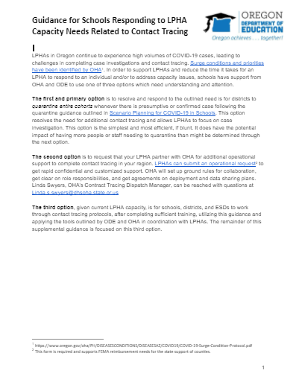
Building contact tracing capacity
Building contact tracing capacity.
Options put safety and risk mitigation first.
LPHAs have priorities under surge conditions.
Aligned to and centered on the guidance in Scenario Planning for COVID-19 in School
Options for training and more...

Slide 44
Transportation
Transportation
What’s Required?
Face coverings for all students, applying the guidance in section 1h to transportation settings. This prevents eating while on the bus.
Take all possible actions to maximize ventilation: Dress warmly, keep vents and windows open to the greatest extent possible.
Full list of requirements can be found in Section 2i

Slide 45
protocols
Share information on this slide about how your district is following health and safety protocols.

Slide 46
Vaccine Update
Vaccine Update
What We Know as of January 19, 2021

Slide 47
Placeholder
[Placeholder to insert regional/local information]

Slide 48
Tools & Resources
Tools & Resources

Slide 49
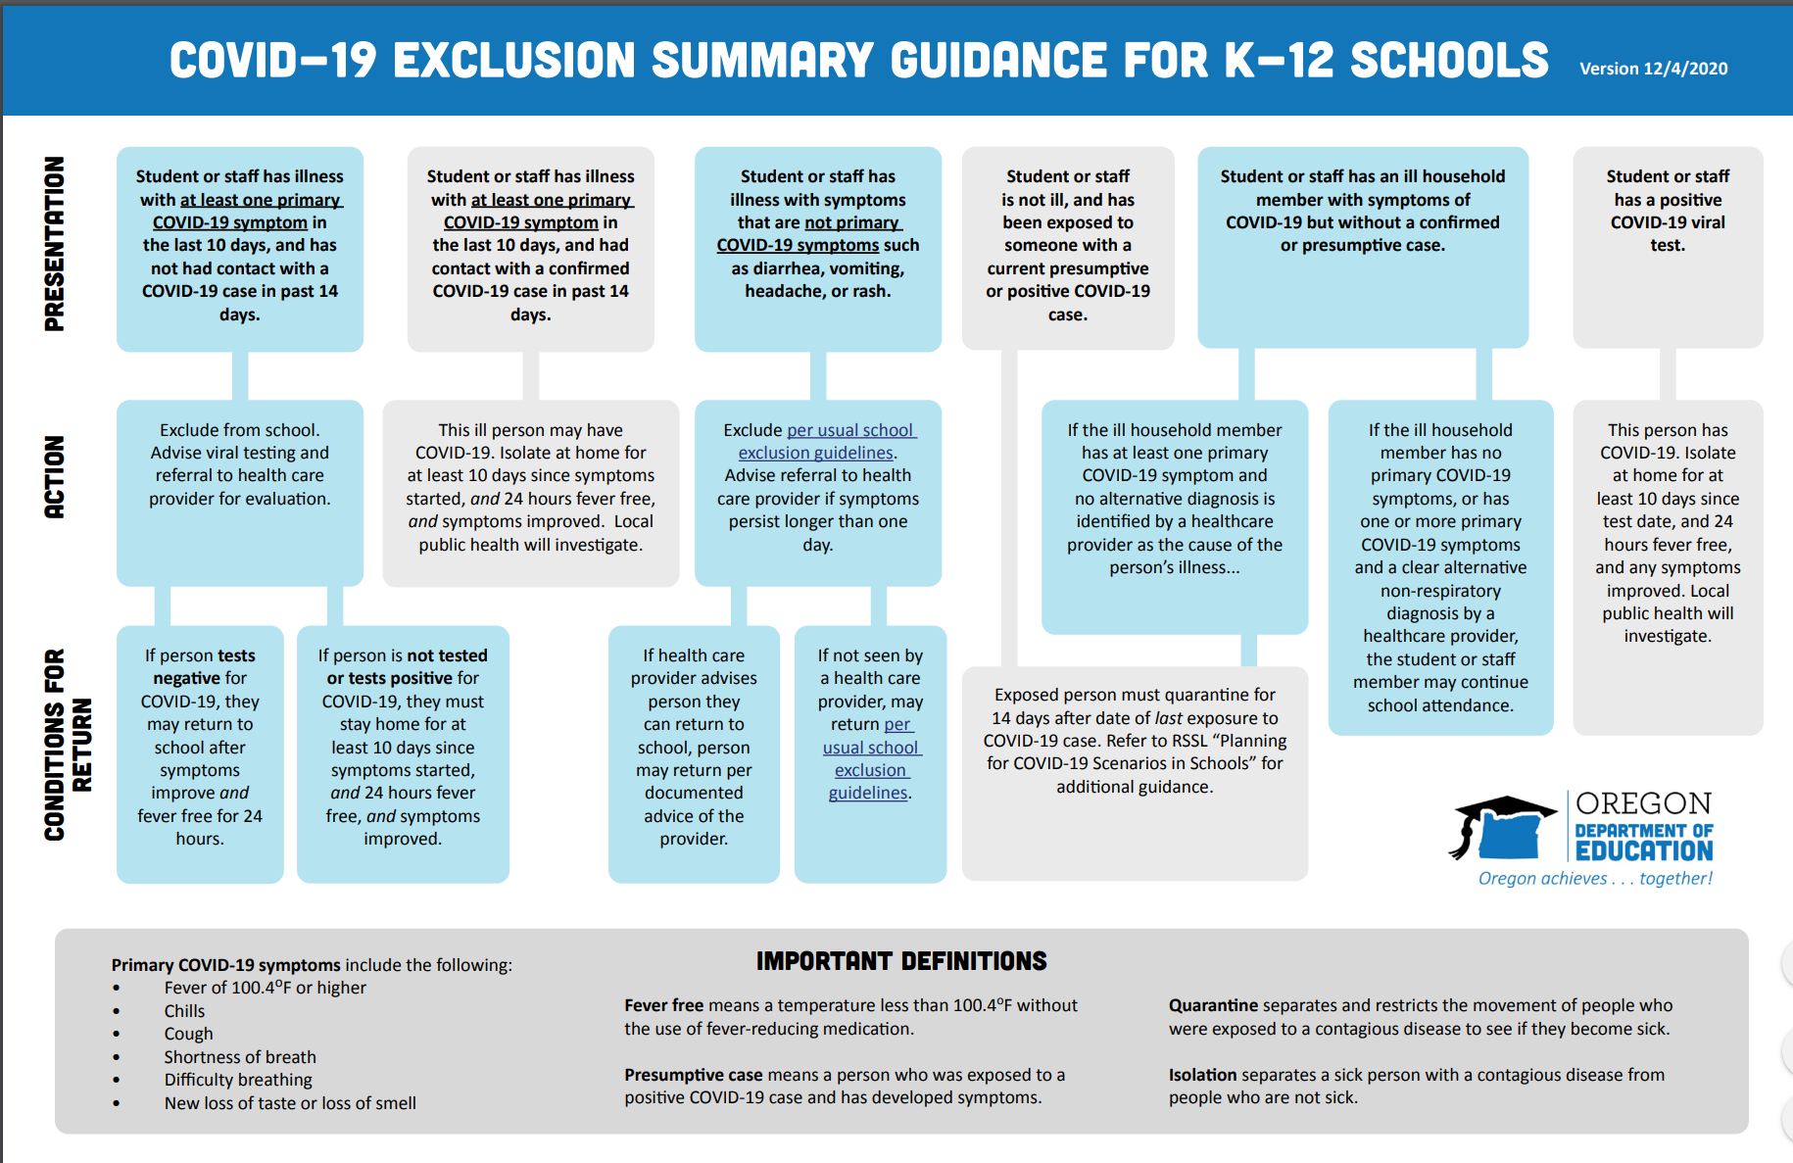
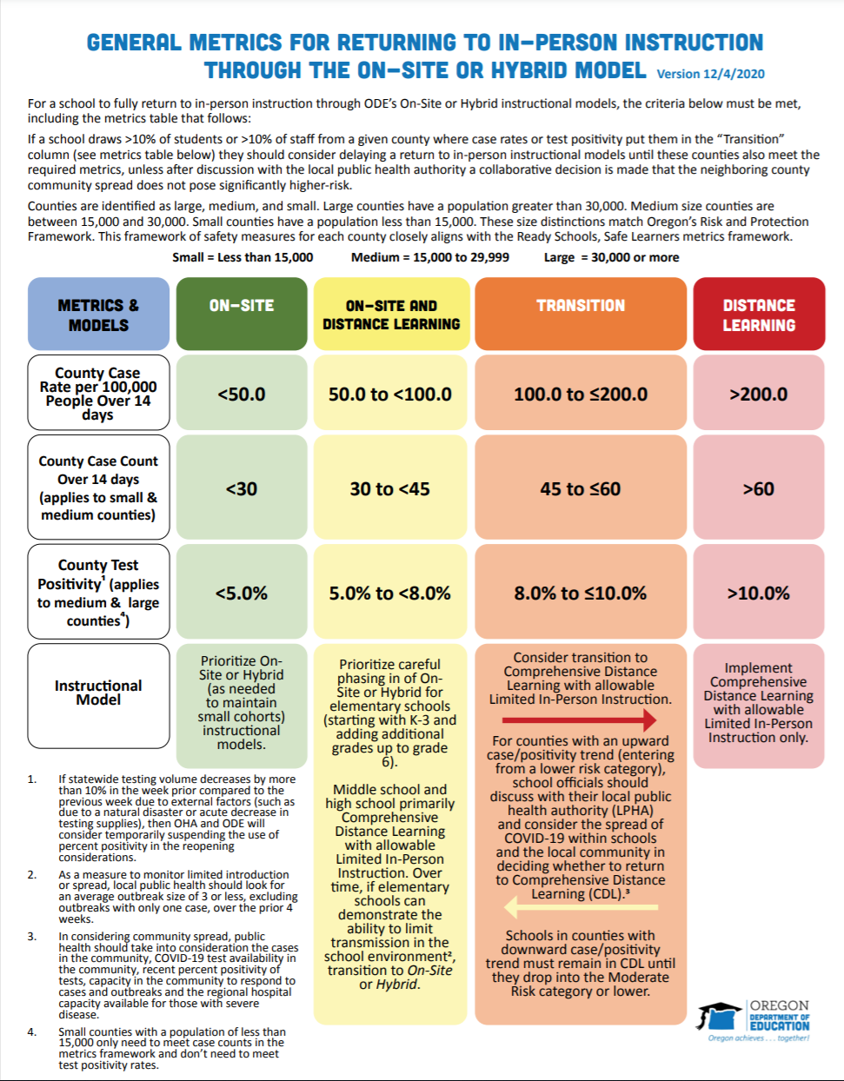
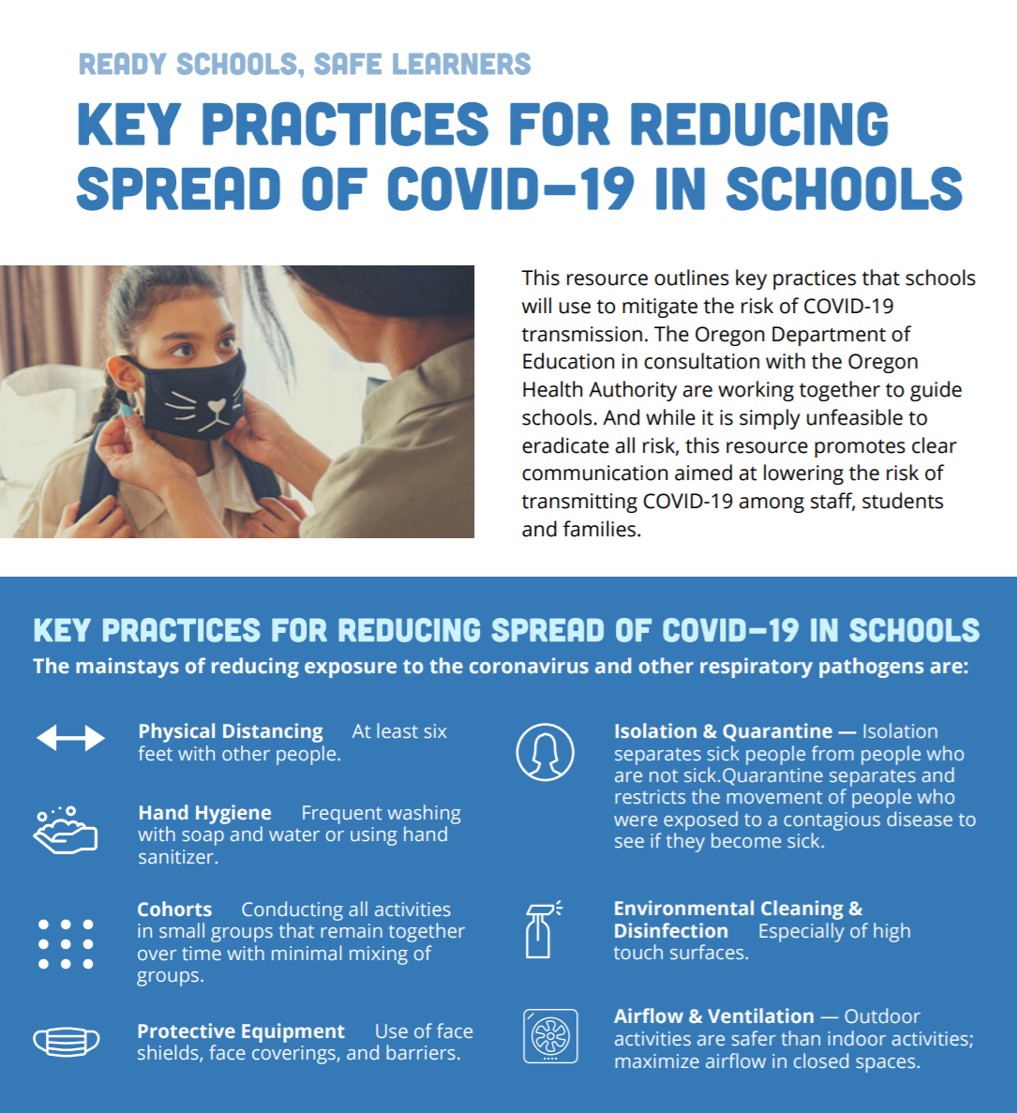
Key Documents
Key Documents

Slide 50
Attendance matters
Attendance matters...
Developed by teachers, TAPP Leaders, and ODE.
Maintaining contact with students is essential.
Throughout Oregon’s experience with the COVID-19 pandemic, teachers and students have had to pivot how they connect with one another.
Attendance allows schools to verify that students learning from home have the tools and supports needed to access instructional materials and focus on students' mental health and wellbeing.

Slide 51
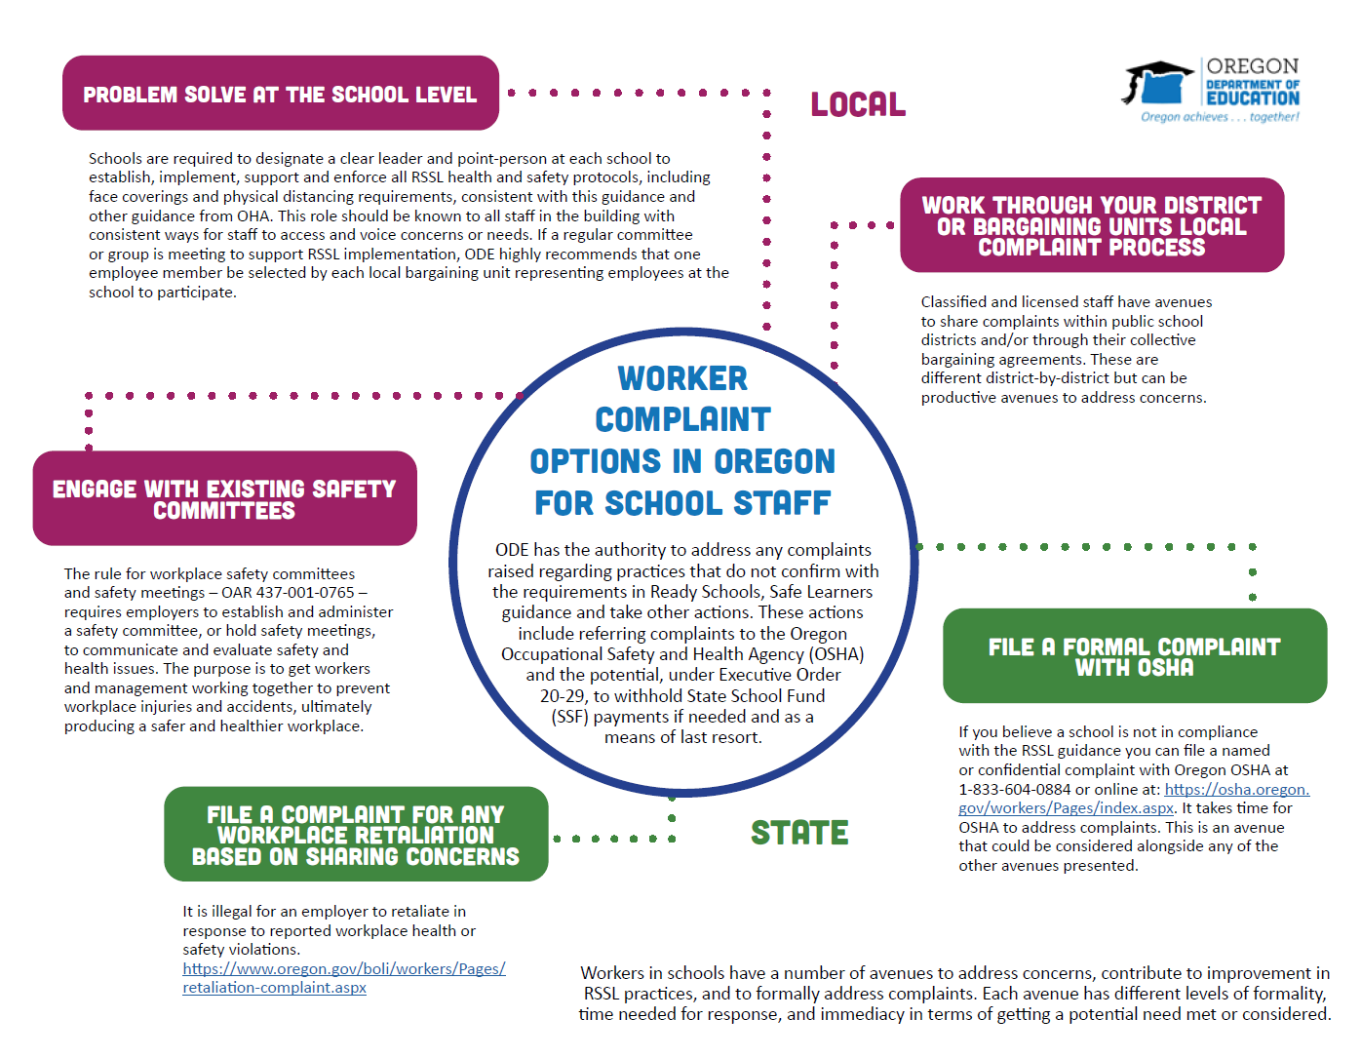
Concerns & Complaints
Concerns & Complaints: Options for Problem Solving

Slide 52
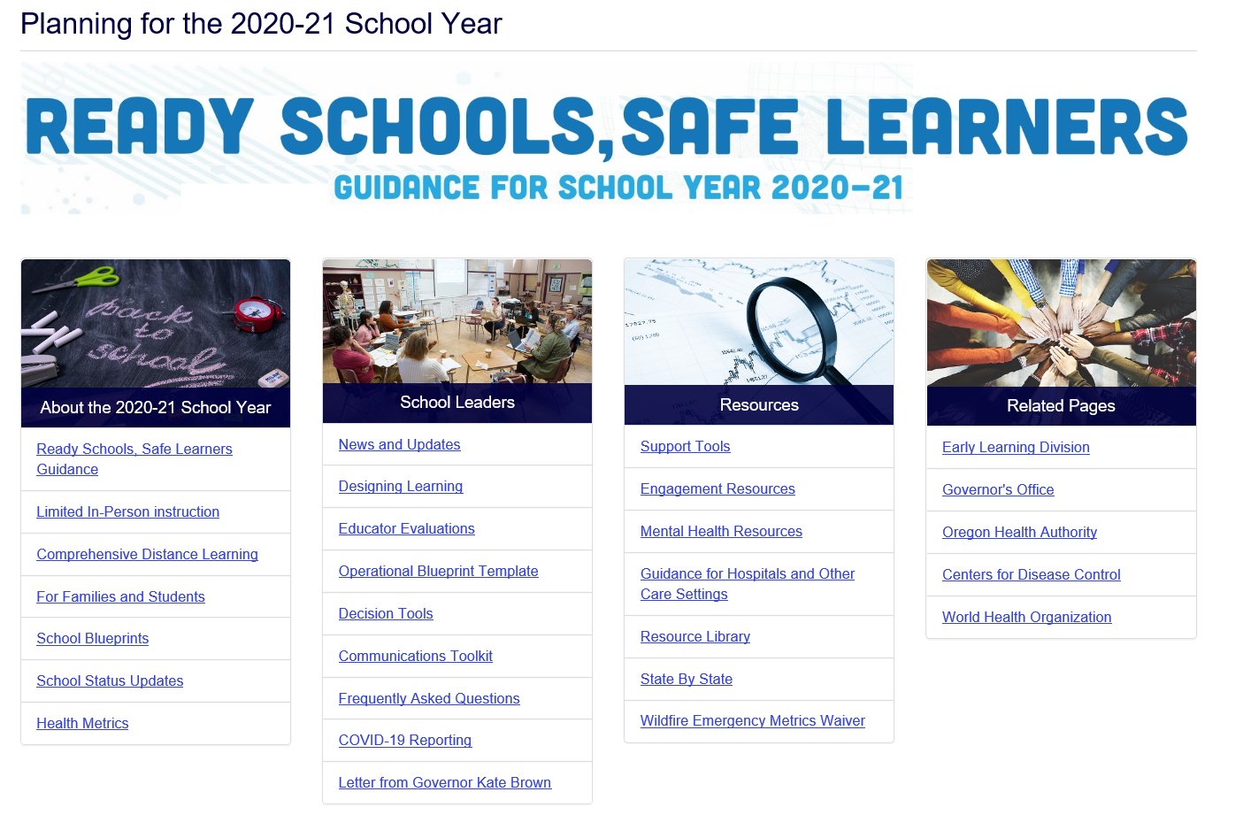
Visit ODE’s Webpage
Visit ODE’s Webpage

Slide 53
Questions
Questions...

