Slide 1
Health & Safety Protocols for Reopening Oregon Schools
A Presentation Slidedeck to Support Training [Placeholder for Educators/Boards/School Leaders/Staff etc]

Slide 2

What’s Included
Preface
Grounding Understanding
Section 1
Planning for On-Site Instruction
Section 2
Preparing the School Environment
Section 3
Key Practices for Reducing Spread of COVID-19 in Schools
Section 4
A Snapshot of a School Day

Slide 3
Objectives
Become familiar with the planning and logistics necessary for returning students and staff to on-site instruction;
Understand many of the key health and safety protocols foundational to preparing the school environment for on-site instruction;
Get a snapshot of the school day -- including how required health and safety protocols are implemented in practice;
Know where to find more information.

Slide 4
Important Note About Slide Format
Under each section, you’ll see information in two columns: “Requirement” and “In Action”
Requirement | In Action
All items listed in this column are required by the Oregon Department of Education and detailed in RSSL. | The items listed in this column are NOT required. Instead, they serve as considerations for how schools might implement the requirement(s) listed.

Slide 5
About These Slides
The information captured in this presentation is not intended to be comprehensive.
The slides serve as a tool to prepare and train teachers and school staff on the required health and safety protocols for operating on-site instruction in Oregon’s schools.
School and district leaders should customize to meet their local needs.

Slide 6
Grounding Our Understanding
A look at the big picture.
Preface

Slide 7
COVID-19 in Our Community
As our school/district makes plans, it is important to remember:
“You don’t make the timeline. The virus makes the timeline.” – Dr. Anthony Fauci.
Our state will be living with the virus until there is widespread immunity, which is many months off.
The best tools to protect individuals are physical distancing, face coverings, and hygiene. When used in combination with entry screening, fresh air, on-site testing and vaccinations, they increase and maximize protection.
Every health restriction lifted increases opportunity for transmission and will increase cases.

Slide 8
Local Decision-Making
Operating schools in-person is now a local decision.
Opening schools relies on implementing public health and safety protocols/requirements with fidelity and consulting with local public health officials.
Advisory Metrics expand opportunities to return students to on-site or hybrid instruction.
The county metrics remain and the chart in “Ready Schools, Safe Learners” serves as the best tool for determining when cases are down enough to return to in-person instruction.
Public and private schools must submit data weekly on how many students they are serving in-person.

Slide 9
Stable Learning Environment
[Our district/school] must actively work to ensure new cases of COVID-19 are not introduced to our schools, causing disruption to the learning environment for students and staff.
[Our district/school] will make every effort to promote a stable learning environment for staff and students.
Community case counts (or case rates) should be taken into consideration when determining whether or not to open for on-site instruction.

Slide 10
160+ Requirements
All of the 160+ health and safety requirements outlined in Ready School Safe Learners (RSSL) are required. Refer to the RSSL webpage for a comprehensive list of related resources.
Implementation requires a deep understanding and collaborative approach with school staff in order to design a safe environment for students, staff, and families.
These slides focus on the what and the how of putting RSSL health and safety requirements into place during the flow of a typical school day.

Slide 11
Planning for On-Site Instruction
Foundational Requirements
Section 1

Slide 12
General Planning
Offer dedicated professional development time to train all staff.
RSSL requirements are extensive and teachers and school staff need time and training to know and understand requirements and worksite operations.
Implementing RSSL is a continuous process.
School and district planning teams should develop mechanisms to monitor:
Efficacy of Protocols
Fidelity of Implementation
Additional Strategies or Protocols

Slide 13
General Planning (cont.)
Teams should consider utilizing existing systems such as safety teams, staff meetings or committees to:
Continuously review safety processes and procedures
Obtain feedback on systems
Address upcoming events (school pictures, holidays, assemblies)
Solve logistical concerns (attendance, technology, cohort groups)
Communicate needs

Slide 14
Planning to Operate On-Site
If your school is operating an On-Site or Hybrid Instructional Model, but is located in a county that DOES NOT MEET the advisory metrics (Section 0b) the school must:
Offer access to on-site testing for symptomatic students and staff identified on campus, as well as those with known exposures to individuals with COVID-19 not later than March 1, 2021. See guidance from the Oregon Health Authority.
Provide a Comprehensive Distance Learning Instructional Model option for students and families that choose to remain off-site. For schools and districts that are required to comply with all sections (0-8) and supplements to this guidance, the remote option must comply with the requirements of the Comprehensive Distance Learning Instructional Model. The school or district may determine the most beneficial way to staff this option, through partnership with other schools or ESDs or with staff who may be at more risk from COVID-19 or through other means.

Slide 15
Update & Submit Operational Blueprint
Requirement:
Assemble a planning team to create a blueprint. The planning team will include one employee member selected by each local bargaining unit representing
employees at the school.
Once the plan has been developed, leadership will:
Submit to the LPHA
Place the blueprint on the school’s website
Submit to ODE https://app.smartsheet.com/b/form/a4dedb5185d94966b1dffc75e4874c8a
In Action:
Each time your instructional model changes, use the blueprint template to update and reflect how your school is operating.
Consult with planning team to update blueprint. and discuss communication to staff, students, and families around changes any time a school alters its instructional model.

Slide 16
Designate a School Leader
Requirement:
Designate a point-person (school leader) at each school to establish, implement, support, and enforce all RSSL health and safety protocols;
This role should be known to all staff in the building with consistent ways for certified and classified staff to access and voice concerns or needs.
In Action:
Post designated school leader’s name and contact information in common areas.
Utilize building or district-wide communication strategies to disseminate blueprint overview and leader’s contact information.

Slide 17
About the Designated School Leader
The school leader (or building point-person) will support team members to:
Fully read RSSL;
Understand both local decision-making and when support from central office is needed;
Download the blueprint and review the requirements of each section;
Reach out to union leadership to get assigned staff planning team members;
Work with school and district leadership to outline timelines for completion of the blueprint, protocols, and when you may start in-person learning;
Make connections with key leaders in the district that will be integral in developing and implementing your school’s plan (e.g. transportation, food service, custodial).

Slide 18
Create a Process for Elevating Concerns
Requirement:
Create a simple process that allows for named and anonymous sharing of concerns that can be reviewed on a daily and weekly basis by the designated RSSL building point-person.
  Example: Anonymous survey form or suggestion box.
In Action:
If a regular committee or group is meeting to support RSSL implementation, it is recommended that one employee member be selected by each local bargaining unit representing employees at the school to participate.
Consider using your OSHA safety concern process for anonymous sharing of COVID concerns.
Designated leader could utilize OSHA safety team to support development of a response to COVID concerns.

Slide 19
Train All School Staff
Requirement:
Train teachers and school staff on health and safety protocols in RSSL (consider virtual training) prior to returning to on-site instruction. Note: The State Board of Education approved the use of instructional time to be devoted for professional learning that includes RSSL training. This training is to occur while staff are not also trying to teach via Comprehensive Distance Learning.
In Action:
Validate people’s emotional responses to COVID-19 while assuring that plans are being made to keep staff, students, and families safe.
Develop a training/support system for staff members to meaningfully engage in dialogue around all of the protocols.
  As you work through each protocol, note adjustments that need to be made based on collaborative conversations regarding their use
For staff that are assigned specific duties within protocols, walk them through the steps, acting out each procedure so that you can mimic the actions of what will happen when students arrive

Slide 20
Update Communicable Disease Plan
Requirement:
All districts and public charter schools must update their written Communicable Disease Management Plan (CDMP).
Conduct a risk assessment.
All district policies related to communicable diseases and student health and wellbeing should be reviewed and updated to assure alignment with new public health requirements.
In Action:
Ensure your CDMP reflects COVID-19 information.
Utilize your safety team to review and adjust the CDMP based on evolving factors.
Post the CDMP and protocols on your website where staff and families can easily locate them.
Regularly remind/train on protocols to increase fidelity of implementation.

Slide 21
Partner with Local Public Health Authority
Requirement:
Protocol to notify the local public health authority (LPHA Directory by County) of any confirmed COVID-19 cases among students or staff.
Process to report to the LPHA any cluster of any illness among staff or students.
Protocol to cooperate with the LPHA recommendations.
Provide all logs and information to the LPHA in a timely manner.
Protocol for screening students and staff for symptoms (see RSSL section 1f).
Protocol to isolate any ill or exposed persons from physical contact with others.
In Action:
Set regular meetings / touch-points with LPHA personnel in order to:
  Exchange information with designated leaders at each district/building and the LPHA designees for case investigation.
  Develop a contact sheet with key LPHA contact and their role (name, schedules and contact information) and distribute to designees.

Slide 22
About the Role of Local Public Health
Local Public Health officials are key partners who can provide support to:
Review and assist with safety protocols
Monitor and offer insight into community case counts and trends
Work directly with district leadership on case investigation of positive, or presumptive positive cases of COVID-19 in schools
Identify, in partnership with the district, close contacts that will be quarantined
Act as a support for COVID-related scenarios in districts

Slide 23
Develop a Communications Plan
Requirement:
Develop protocols for communicating immediately with staff, families, and the school community when a new case(s) of COVID-19 is diagnosed in students or staff members, including a description of how the school or district is responding.
Provide all information in languages and formats accessible to the school community.
In Action:
Take every opportunity to remind your community that every Oregonian can help us return students to in-person instruction.
Develop templates for rapidly sharing information on social media, robo-dialers, and letters home to ensure responsive and timely communications.

Slide 24
Learn More
Operational Blueprint Template
COVID-19 Specific Communicable Disease Plan Template
Problem-Solving Concerns and Complaints
Communications Tools
Planning for COVID-19 Scenarios in Schools
When to Exclude Staff and Students from School
COVID-19 Grants and Funding Resources
Exclusion Summary Guide

Slide 25
School Environment
Preparing the School Campus for On-Site Instruction
Section 2

Slide 26
School Environment
In order to create a school environment where health and safety protocols can be implemented with fidelity, the school setting should be assessed and updated to ensure effective implementation of all health and safety protocols required by the state.

Slide 27
Occupancy
Requirement:
Establish a minimum of 35 square feet per person to determine room capacity
Calculate only usable classroom space
  Subtract cupboards, tables, and non-student desk spaces
Strive to use all of the usable space in the room; work to keep people’s work spaces 6 feet from each other
In Action:
Measure and determine the number of people that can be in each classroom and common space
Consider putting up a sign with the number of people allowed in each space so that people who enter the area understand if there are too many in the room
The number of people in a space will help drive your decision about the model you choose

Slide 28
Seating
Requirement:
Rearrange student desks and other seat spaces so that staff and students’ physical bodies are six feet apart to the maximum extent possible while also maintaining 35 square feet per person
For all grade levels, assign seating so students are in the same seat at all times. This will assist with determining close contacts (for contact-tracing).
In Action:
Remove all unnecessary items from the learning environment. Less items = More people.
Address traditionally high use areas within a classroom (such as turn-in boxes, supply areas, etc.) to prevent congregation of students.
  Individual materials at desk
  Submit papers electronically

Slide 29
Screening Process
Requirement:
Determine what your screening process will include and how staff will be trained on that process. Training should include strategies for being culturally responsive and trauma-informed during screening interactions with students and families.
Determine what process will be followed if a student or staff member exhibits primary symptoms of COVID-19 and needs to be either excluded from entry or moved into isolation until they can be sent home. How will that process be completed without the screener leaving their post at the entry and without causing significant back-up in the line?
Determine how students will have access to either hand sanitizer or soap/water for hand hygiene upon entry
Determine and provide visual signage for foot traffic patterns that will support effective social distancing
In Action:
Reinforce the importance of screening with students and staff; normalize the process and protocols and find ways to encourage and empower personal responsibility, as well as health and safety.
As part of the screening process, staff should be checking and ensuring all who enter the school have appropriate face coverings in place.
Use ODE’s Exclusion Summary Chart

Slide 30
Staff Screening Process
Staff should stay home if: they or anyone in their homes or community living spaces have COVID-19 Symptoms
If a staff member presents with symptoms at work: staff should communicate the symptom(s) to their administrator/designee and go to the isolation room

Slide 31
COVID-19 Primary Symptoms
Temperature of 100.4 F or higher
Chills
Cough
Shortness of breath or difficulty breathing
New loss of taste or smell
Learn More:
Planning for COVID-19 Scenarios in Schools
Notes:
People with COVID-19 can have a wide range of symptoms, ranging from mild symptoms to severe illness. Symptoms may appear 2–14 days after exposure to the virus. The “primary” COVID-19 symptoms require exclusion from school. The “non-primary” COVID-19 symptoms can be seen with many other illnesses, in addition to COVID-19. The non-primary symptoms do not always require exclusion. When feasible, ill students and staff with any primary COVID-19 symptoms should be encouraged to seek viral testing. If a student or staff has non-primary symptoms that persist for more than one day, the parent should consider evaluation by the child’s healthcare provider who can determine if viral testing is advised.
Primary COVID-19 symptoms: • Cough • Temperature of 100.4oF or higher • Chills • Shortness of breath • Difficulty breathing • New loss of taste or smell
Non-primary COVID-19 symptoms: • Fatigue • Muscle or body aches • Headache • Sore throat • Nasal congestion or runny nose • Nausea or vomiting • Diarrhea

Slide 32
Cleaning & Disinfecting
Requirement:
Clean, sanitize, and disinfect frequently touched surfaces (e.g., playground equipment, door handles, sink handles, drinking fountains, transport vehicles) and shared objects (e.g., toys, games, art supplies) between uses, multiple times per day.
Maintain clean and disinfected (CDC guidance) environments, including classrooms, cafeteria settings, restrooms, and playgrounds.
Facilities should be cleaned and disinfected at least once daily to prevent transmission of the virus from surfaces (see CDC’s guidelines on disinfecting public spaces).
In Action:
Include your custodial team in the planning and training of cleaning/disinfecting operations. Train all staff on the requirements.

Slide 33
Physical Distancing in High Traffic Areas
Requirement:
In areas where there will be time spent in lines, take steps to ensure there is 6 feet of distance between students
To avoid congestion, use signage to support physical distancing and proper flow of the building
  Marks on the floor signaling where to stand, one way traffic arrows, separate entrances and exits, etc.
Plan for students who will need training and support to follow these new requirements
In Action:
Make a list of areas where congestion and/or standing in lines occurs, then work through how adjustments will be made
Develop plans for signage - order purchased items early, items are running out quickly
Add training for students on physical distancing to the agenda for acclimating students back to in-person instruction

Slide 34
Contact Tracing
Contact tracing is the methodology used to quickly identify individuals who have been exposed to COVID-19. An exposure is defined as an individual who has close contact (less than 6 feet), for longer than 15 cumulative minutes in a day, with a person who has COVID-19. If a student or staff member is diagnosed with COVID-19, then the LPHA should be consulted to review the situation.
If a school cannot confirm that six-feet distancing was consistently maintained during the school day, all members of a stable cohort group will need to quarantine until the contact tracing process is completed. The clear documentation of the cohort members will allow for the LPHA to rapidly initiate contact tracing.

Slide 35
Contact Tracing
Requirement:
Each school must have a system for daily logs to ensure contract tracing among the cohort (see section 1a).
Each school must adhere to protocol to record/keep daily logs (for contact tracing) for a minimum of four weeks to assist the LPHA as needed.
In Action:
Prepare the logs ahead of time with student information, then just log in/log out.
Determine who will be responsible for logging in the students.
Create a system for submitting the logs so that leaders have access to the information. Calls from the LPHA do not only come in during the workday, and leaders may need access to the information 24/7.
Consider using technology (Excel, Google) to make logging easier (but remember confidentiality rules).
Maintain seating charts, bathroom logs, and cohorting by grades so only specific grades are ever in the hallway/playground/cafeteria/restrooms at the same time.

Slide 36
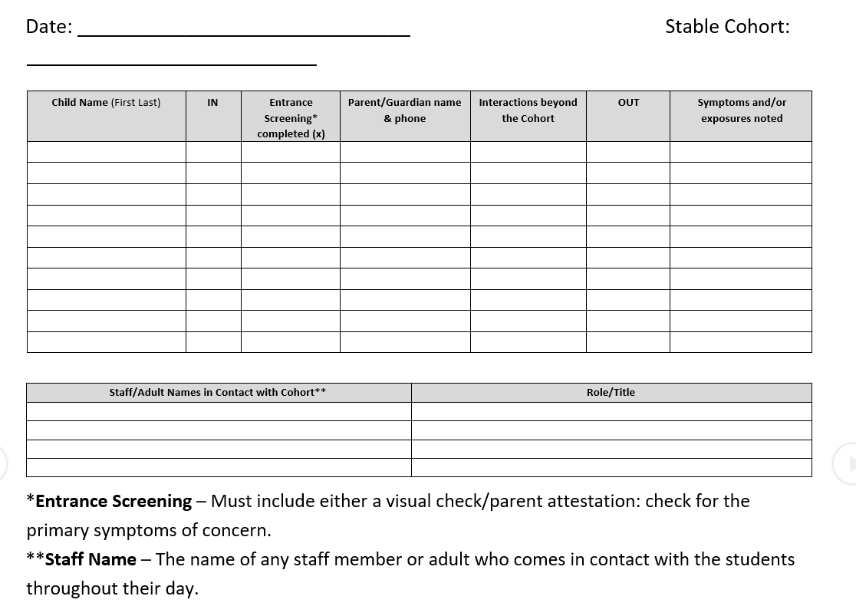
Contact Tracing
Requirement:
Required components of individual, daily student/cohort logs include:
● Child’s name
● Drop off/pick up time
● Parent/guardian name and emergency contact information
● All staff (including itinerant staff, district staff, substitutes, and guest teachers) names and phone numbers who interact with a stable cohort or individual student
Sample logs are available as a part of the Oregon School Nurses Association COVID-19 Toolkit

Slide 37
Learn More
Room Occupancy Signs
Learning Outside
Contact Log Template
Local Public Health and Contact Tracing
Exclusion Summary Guide
CDC’s Toolkit for Schools

Slide 38
Key Practices
Protocols and Practices for Reducing Spread and Minimizing Risk
Section 3

Slide 39
Reducing Spread & Minimizing Risk
It is critical that we all adhere to the key practices for reducing spread of COVID-19 in schools, to ensure that our schools can open with safe protocols and stability:
● Maintain physical distancing
● Use face coverings
● Use personal protective equipment when indicated
● Increase hand hygiene
● Serve students and staff in as small and as stable cohorts as possible
● Be prepared to isolate and quarantine at the first sign of illness or exposure
● Regularly clean and disinfect facilities and the environment
● Maximize airflow and ventilation

Slide 40
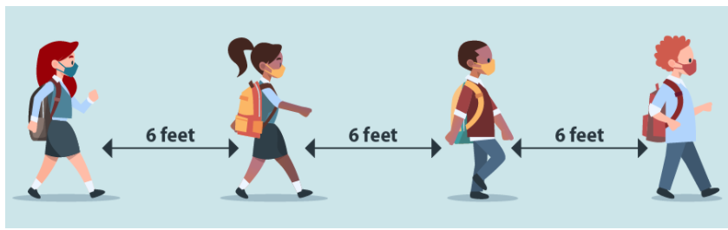
Physical Distancing
Support physical distancing in all daily activities and instruction, maintaining six feet between individuals to the maximum extent possible.

Slide 41
Physical Distancing
Requirements:
Minimize time standing in lines and take steps to ensure that six feet of distance between students is maintained, including marking spacing on floor, one-way traffic flow in constrained spaces, etc.
Schedule modifications to limit the number of students in the building or in the outside learning space (e.g., rotating groups by days or location, staggered schedules to avoid hallway crowding and gathering).
In Action:
Model, teach, and reinforce physical distancing and hygiene practices at the classroom, school, and district level until they become an expected and accepted way of being at school.

Slide 42
Physical Distancing
Requirement:
Establish a minimum of 35 square feet per person when determining room capacity. Calculate only with usable classroom space, understanding that desks and room set-up will require use of all space in the calculation.
Plan for students who will need additional support in learning how to maintain physical distancing requirements. Provide instruction; don’t employ punitive discipline.
Staff must maintain physical distancing during all staff meetings and conferences, or consider remote, web-based meetings
In Action:
Consider utilizing outdoor spaces, common areas, and other buildings in planning. ODE has provided supplemental guidance to support Learning Outside.
In high schools, middle schools, or settings where students require individualized schedules or elective classes, physical distancing between students remains essential, and ways to reduce mixing among cohorts should be considered.
  Reinforce health and safety protocols.
  Daily activities and curriculum should support physical distancing.

Slide 43

Face Coverings
Face coverings are an important mitigation strategy. Leaders need to think through how to train and support students and staff for wearing face coverings properly at all designated times.

Slide 44
Face Coverings
Face coverings are not a choice.
Face coverings are required* for all students in grades kindergarten and up, along with all staff. Certain accommodations for medical needs or disability are noted in the guidance.
Student or family refusal to wear appropriate face coverings for a values-based reason then dictates that educational needs be met through Comprehensive Distance Learning.
Staff refusal to wear appropriate face coverings should be addressed according to established school or district processes.
OSHA: Employers are required to provide face coverings for all staff, contractors, other service providers, visitors and volunteers.
*Full list of requirements can be found in Section 1h of the guidance.

Slide 45
Face Coverings: Students
Requirement:
Face coverings or face shields are required for all students Kindergarten and up.
  Should be worn both indoors and outdoors, including during outdoor recess.
Group “mask breaks” or “full classroom mask breaks” are not allowed.
Students who abstain from wearing a face covering, or students whose families determine the student will not wear a face covering during On-Site instruction must be provided access to instruction. CDL can and should be provided when this decision is values-based. Additional provisions apply to students protected under ADA and IDEA.
In Action:
Provide instruction to students about how to properly wear a face covering
Explain when and where the face coverings are required to be worn
Instruct the students how to ask for a mask break.

Slide 46
Face Coverings: Staff
Requirement:
Employers are required* to provide masks, face coverings or face shields for all staff, contractors, other service providers, visitors and volunteers.
Face masks must be provided for school RNs or other medical personnel when providing direct contact care and monitoring of staff/students displaying symptoms.
Individuals may remove face coverings while working alone in private offices.
*Full list of requirements can be found in Section 1h.
In Action:
Train staff on how to effectively wear a mask and why it is important
Explain where additional masks can be found in the school
Provide information about who to talk to if they are having difficulty wearing a mask and need accommodations

Slide 47
Hand Hygiene
Requirement:
Students must wash hands with soap and water for 20 seconds or use an alcohol-based hand sanitizer with 60-95% alcohol before meals and shall be encouraged to do so after.
After using the restroom students must wash hands with soap and water for 20 seconds. Soap must always be made available to students and staff.
Before and after using playground equipment, students must wash hands with soap and water for 20 seconds or use an alcohol-based hand sanitizer with 60-95% alcohol.
In Action:
Remind students (with signage and regular verbal reminders from staff) of the utmost importance of hand hygiene and respiratory etiquette.
Build in handwashing times throughout the school day.
Teach younger students how to correctly wash their hands.

Slide 48
Cohorts
Cohorting is an essential component in reducing the spread and managing risks associated with the potential spread of COVID-19. Occupancy rates in rooms are one of the primary drivers of cohort sizes.
Student cohorting:
Limits the number of exposed people when a COVID-19 case is identified in the school;
Quickly identifies exposed individuals when a COVID-19 case is identified;
Minimizes school-wide disruptions in student learning.

Slide 49
Cohorts
Requirement:
Schools must plan to limit cohort sizes to allow for efficient contact-tracing and minimal risk for exposure. Cohorts may change week-to-week, but must be stable within the educational week.
Groups shall be no larger than can be accommodated by the space available to provide 35 square feet per person, including staff.
In Action:
Use AM/PM schedules to break up cohorts
Reduce the traditional x-period day into smaller segments (block scheduling or accelerated school terms).
If space permits, utilize technology to break classrooms up into two sections; one that has the teacher and the other with an instructional assistant who has instruction delivered virtually through technology..
Have teachers move from class to class rather than students.
Consider having specialty teachers virtually stream into classrooms rather than pulling individual students from multiple rooms/cohorts for services.

Slide 50
Cohorts
Requirement:
Staff who interact with multiple cohorts (music, PE, library, paraprofessionals who provide supervision at recess, etc.) should have schedules altered to reduce the number of cohorts/students they interact with in a week.
In Action:
Cohort by grade level (staggered time of entry into spaces) with one grade level in the hallway/other spaces at a time.
Consider having specialty teachers and other staff (such as Instructional Assistants, Counselors) virtually stream into classrooms rather than pulling individual students from multiple rooms/cohorts for services.

Slide 51
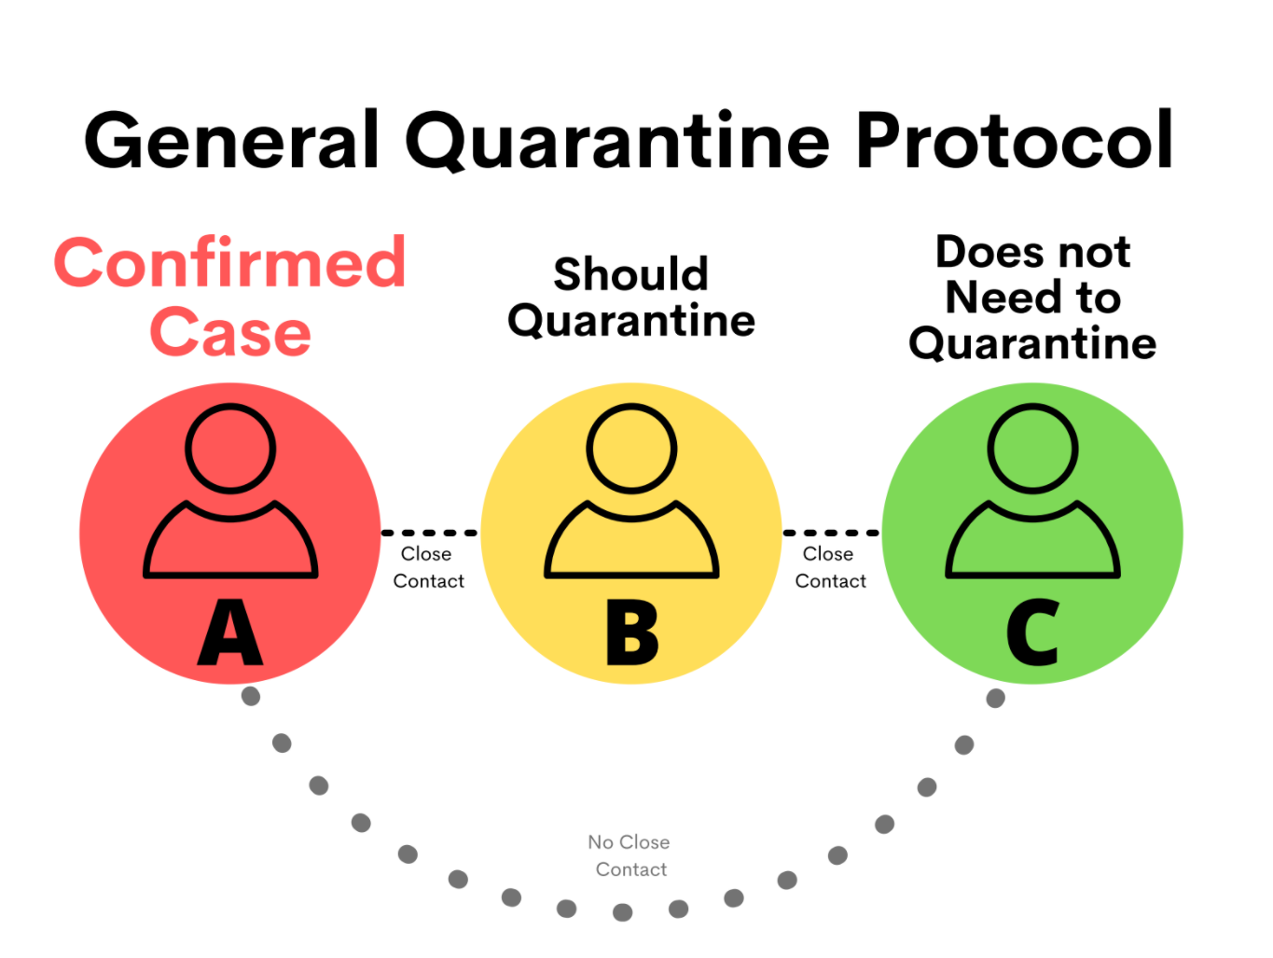
Isolation and Quarantine
Isolation separates sick people with a contagious disease from people who are not sick.
Quarantine separates and restricts the movement of people who were exposed to a contagious disease to see if they become sick.

Slide 52
Isolation and Quarantine
Requirement:
Protocols must be in place for exclusion and isolation for sick students and staff whether identified at the time of bus pick-up, arrival to school, or at any time during the school day.
Protocols for screening students
  Including exclusion and isolation protocols for sick students and staff identified at the time of arrival or during the school day.
In Action:
Ensure the isolation room is ready and available at all times
Train staff who are assigned to the isolation room in the required protocols
Prepare a script for communicating with families, with follow up information readily available
Schools should make information available about community-based health supports and provide this information directly to families in the event a student displays possible COVID-19 symptoms.

Slide 53
Airflow and Ventilation
Requirement:
Schools with HVAC systems must
Evaluate the system to minimize indoor air recirculation (thus maximizing fresh outdoor air) to the extent possible. Schools that do not have mechanical ventilation systems shall, to the extent possible, increase natural ventilation by opening windows and interior doors before students arrive and after students leave, and while students are present.
Ensure all filters are maintained and replaced as necessary to ensure proper functioning of the system.
All intake ports that provide outside air to the HVAC system should be cleaned, maintained, and cleared of any debris that may affect the function and performance of the ventilation system.
In Action:
Utilize your HVAC company to map all systems and determine which filter sizes are available and the MERV ratings which can be utilized.
Develop a spreadsheet to track and monitor the replacement of the filters.
Outline your evaluation plan and replacement pattern in your CDMP

Slide 54
Learn More
Key Practices for Reducing Spread of COVID-19 in Schools
Planning for COVID-19 Scenarios in Schools
Exclusion Summary Chart

Slide 55
Snapshot of a School Day
Arrival to Departure
Section 4

Slide 56

Getting to School
Work with transportation to stagger bus arrival times.
Key Concepts
Consider different start times for different grades to prevent mixing of cohorts and struggles with social distancing.
Have different points of entry for different grade levels.
Determine and mark doors that will be utilized as entry points. Have enough entry points available to prevent lines and to support effective social distancing. Since screening is required upon entry into the building, each available entry needs to be a screening checkpoint.
Utilize signage to remind people to social distance and wear masks.
Remember to have hand sanitizer available for students and staff
Frequently clean common touch points between groups and/or sessions

Slide 57

Arrival
Student arrival will need to be a carefully planned and orchestrated part of the school day in order to ensure health and safety protocols are in place.
Key Concepts
All schools will develop plans and procedures to ensure proper screening before students enter the building.
Each building should evaluate their physical layout, doorways and options for entering the building given physical distancing requirements
Identify available staff to conduct screenings and train them on the protocols
No person exhibiting primary symptoms will be admitted to the campus
  Primary symptoms of concern: cough, fever or chills, shortness of breath, or difficulty breathing
  See isolation protocols for students or staff that present illness upon screening

Slide 58

Screening
Screening is the primary way that we keep ill individuals out of the school environment. Careful planning and training is required for this process to go smoothly. The organization of the screening process will make the difference between a quick and efficient process and one that causes a gridlock, potential exposures, and delays the start of the school day.
Key Concepts
Screen students using trained individuals and a set of developmentally appropriate, standardized questions.
Anyone displaying or reporting the primary symptoms of concern must be isolated (see section 1i) and sent home as soon as possible.
Upon entry to school every day: students should wash with soap and water for 20 seconds or use an alcohol-based hand sanitizer with 60-95% alcohol. This may take place at entry points OR once students arrive to their classrooms.

Slide 59
Screening Staff
Screening is the primary way that we keep ill individuals out of the school environment. Careful planning and training is required for this process to go smoothly. The organization of the screening process will make the difference between a quick and efficient process and one that causes a gridlock, potential exposures, and delays the start of the school day.
Key Concepts
Staff should stay home if: they or anyone in their homes or community living spaces have COVID-19 Symptoms
Staff are responsible for: screening themselves daily upon arrival and during the workday for COVID-19 Primary Symptoms
If the staff member presents with symptoms at work: they should communicate the symptom(s) to their administrator/designee and go to the isolation room.

Slide 60

Visitors and Volunteers
Visitors and volunteers are a critical component to the operations of schools. However, the more people we bring in from the community, the more we increase the likelihood of spreading the disease.
Key Concepts
Volunteers and visitors should be limited, to the greatest extent possible, from all on-site activities.
NOT considered visitors or volunteers:
  Staff members ( itinerant staff, substitute teachers, and other district staff who move between buildings, etc.),
  Contracted service providers (counseling services, maintenance, etc.),
  Partner providers (student teachers, DHS Child Protective Services staff, etc.)
Non-Essential Visitor/Volunteer Examples - Parent Teacher Association (PTA), classroom volunteers, Smart Readers, academic guest speakers, etc.

Slide 61

Attendance
Provide families with clear and concise descriptions of student attendance and participation expectations, as well as family involvement expectations. Take into consideration the home environment, caregiver’s work schedule, and the student’s mental/physical health.
Key Concepts
Grades K-5 (self-contained): Attendance must be taken at least once per day for all students enrolled in school, regardless of the instructional model (On-Site, Hybrid, Comprehensive Distance Learning, online schools).
Grades 6-12 (individual subject): Attendance must be taken at least once for each scheduled class that day for all students enrolled in school, regardless of the instructional model (On-Site, Hybrid, Comprehensive Distance Learning, online schools).
Utilize the attendance tip sheet for ideas on how to effectively take attendance in consideration of all learning models.

Slide 62

Transition Time / Hallways
Limit transitions to the extent possible. Create hallway procedures to promote physical distancing and minimize gatherings.
Key Concepts
Consider implementing directional flow of traffic.
Consider staggered transition times in scheduling.
Consider discontinuing or restricted use of locker systems.
Ensure staff availability to monitor hallways and transition locations.

Slide 63

Student Lunch & Meal Time
Traditionally, mealtime has been done in cafeterias with large groups of people. Under the cohorting and physical distancing rules, mealtimes must be carefully planned to reduce numbers of individuals eating together. Mealtime is especially concerning because students must take off their masks to eat.
Key Concepts
Students must wash their hands/sanitize before meals and are encouraged to do so afterwards
Adequate cleaning measures must be performed
Engage nutrition services in planning conversations
Consider serving meals in classrooms to maintain stable cohorts
Identify the total number of people that can be in the meal service area using physical distancing requirements
Determine the best timing of meal service to students that will maintaining stable cohorts
Notes:
Young children are not a significant source of spread of COVID-1910. This section provides requirements and recommendations to mitigate risk of COVID-19 transmission during mealtime. Staff supervising mealtime should always wear a face covering and maintain at least 6 feet of physical distance while students are eating and wash hands or use an alcohol-based hand sanitizer after mealtime. Staff should avoid eating with one another in common areas to the greatest extent possible, as this has proven to be a significant source of spread of COVID-19 in workplaces.

Slide 64
Staff Break & Lunch Time
Identify break rooms or other areas where staff congregate and prepare the environments similar to classrooms. Since staff must remove their face coverings during eating and drinking it is safest to eat alone.
Key Concepts
Staff are are allowed to eat together as long as physical distancing can be maintained.
Staff should wear a mask at all times unless eating
Cohort requirements are still in place
Occupancy rates must be followed
Staff should refrain from mixing cohorts
Utilize good hygiene and cleaning practices

Slide 65

Recess / Free Time
Unstructured times can be the most dangerous because we may not know with whom and for how long a period of time students spend with each other. As a result, recess and free times that have been traditionally built into the school day now need to be orchestrated in a manner that reduces and tracks contacts, maintains cohorts, all while implementing social distancing.
Key Concepts
Keep school playgrounds closed to the general public until park playground equipment and benches reopen in the community (see Oregon Health Authority’s Specific Guidance for Outdoor Recreation Organizations).
Before and after using playground equipment, students must wash hands with soap and water for 20 seconds or use an alcohol-based hand sanitizer with 60-95% alcohol.
Designate playground and shared equipment solely for the use of one cohort at a time. Outdoor playground structures require normal, routine cleaning and do not require disinfection. Shared equipment (balls, jump ropes, etc.) should be cleaned and disinfected at least daily in accordance with CDC guidance.
Maintain physical distancing requirements, stable cohorts, and square footage requirements.

Slide 66
On-Site Testing
OHA’s Testing Program is designed to test symptomatic and exposed students and staff using the Abbott BinaxNOW tests, through a nasal swab.
Key Concepts
Schools must notify OHA to register.
Schools must identify a school testing administrator.
Student and staff test results must be kept confidential.
Students must have written consent to be tested.

Slide 67

Response to a COVID-19 Case
Understanding outbreak procedures and developing protocols will assist district leaders in quickly responding to exposures and quarantines. Carefully read through the “Response to Outbreak, Section 3” and proactively plan to reduce stress and increase timeliness.
Key Concepts
Review the “Planning for COVID-19 Scenarios in Schools” toolkit.
Coordinate with Local Public Health Authority (LPHA) to establish communication channels related to current transmission level.
Draft letters for COVID positive cases and quarantines of staff and/or students.
Ensure continuous services and implement Comprehensive Distance Learning.
Continue to provide meals for students.
Prepare staff to continue to work from home. Consider bringing necessary work items home over weekends/breaks.

Slide 68
Isolation Room
Isolation separates sick people with a contagious disease from people who are not sick. All buildings need to identify and prepare an isolation room prior to bringing students on campus. In addition, staff should be trained to send sick individuals to this location and the employees who are responsible for monitoring the room should be adequately prepared to follow safety and school procedures.
Key Concepts
Establish protocols for exclusion and isolation of sick students and staff whether identified at the time of bus pick-up, arrival to school, or at any time during the school day.
If two students present COVID-19 symptoms at the same time, they must be isolated at once. If separate rooms are not available, ensure that six feet of distance is maintained. Do not assume they have the same illness.

Slide 69
Staff Common Spaces
Leaders need to address common spaces for staff in order to limit the spread of the disease. Identify break rooms or other areas where staff congregate and prepare the environments similar to classrooms.
Key Concepts
Develop occupancy requirements by establishing a minimum of 35 square feet per person when determining room capacity.
Limit the number of employees gathering in shared spaces. Restrict use of shared spaces such as conference rooms, break rooms, and elevators by limiting occupancy or staggering use, maintaining six feet of distance between adults.
Since staff must remove their face coverings during eating and drinking, limit the number of employees gathering at one time time by staggering lunches, designing break rooms so that staff are a minimum of 6 feet apart.
Notes:
Staff should avoid eating with one another in common areas to the greatest extent possible, as this has proven to be a significant source of spread of COVID-19 in workplaces.

Slide 70

Dismissal
Like arrival, dismissal time will need to be a carefully planned and orchestrated part of the school day in order to ensure safety for all students and staff. The transportation department will be a key partner in supporting safe practices.
Key Concepts
Physical distancing, stable cohorts, square footage, and cleaning requirements must be maintained during arrival and dismissal procedures.
Create schedule(s) and communicate staggered arrival and/or dismissal times.
Assign students or cohorts to an entrance; assign staff member(s) to conduct visual screenings (see section 1f).
Ensure accurate sign-in/sign-out protocols to help facilitate contact tracing by the LPHA. Sign-in procedures are not a replacement for entrance and screening requirements. Students entering school after arrival times must be screened for the primary symptoms of concern.
Eliminate shared pen and paper sign-in/sign-out sheets.
Ensure hand sanitizer is available if signing children in or out on an electronic device.
Ensure alcohol-based hand sanitizer (with 60-95% alcohol) dispensers are easily accessible near all entry doors and other high-traffic areas.
Establish and clearly communicate procedures for keeping caregiver drop-off/pick-up as brief as possible.

Slide 71

After-School Events
Unfortunately, even though students are back in school, the supplemental activities and events we typically provide increase exposure and need to be carefully considered.
Events: To meet requirements for physical distancing, cancel, modify, or postpone field trips, assemblies, athletic events, practices, special performances, school-wide parent meetings, and other large gatherings.
After-School Programs: Plan for offering after-school programs that meet requirements outlined in physical distancing and cohorting.
Community use of school or district facilities: School districts, charter schools and private schools will still need to assure that all OHA and CDC guidelines around physical distancing and other public health protocols and all other federal, state, and local agency requirements, including any additional guidance released by the Oregon Department of Education or the Oregon Health Authority are followed.
For additional guidance on facility use: Governor’s Sector Guidance-Outdoor Recreation and Outdoor Fitness
For additional guidance for sports: Indoor recreation and Outdoor recreation guidance
For additional guidance for Before/After School Childcare: Early Learning Department Health and Safety Guidelines

Slide 72
Share information on this slide about how your district is following health and safety protocols.

Slide 73
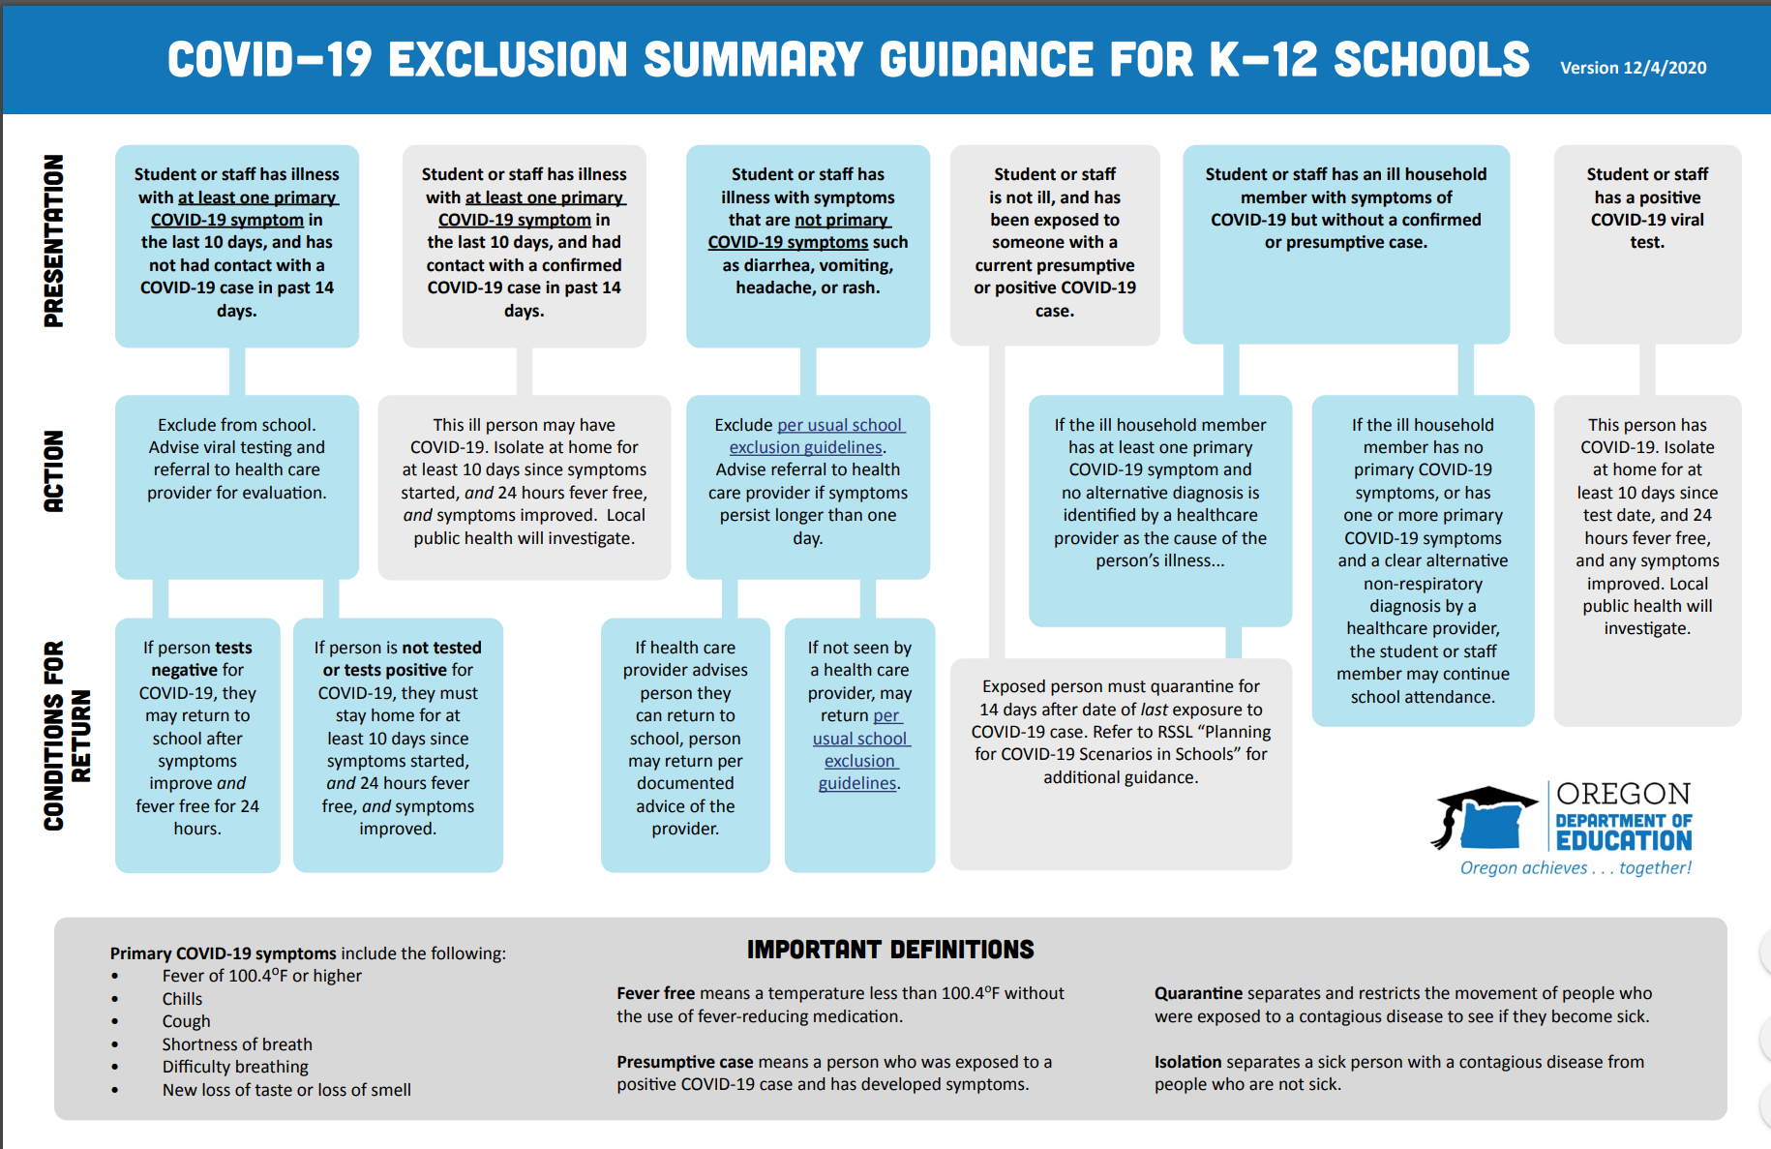
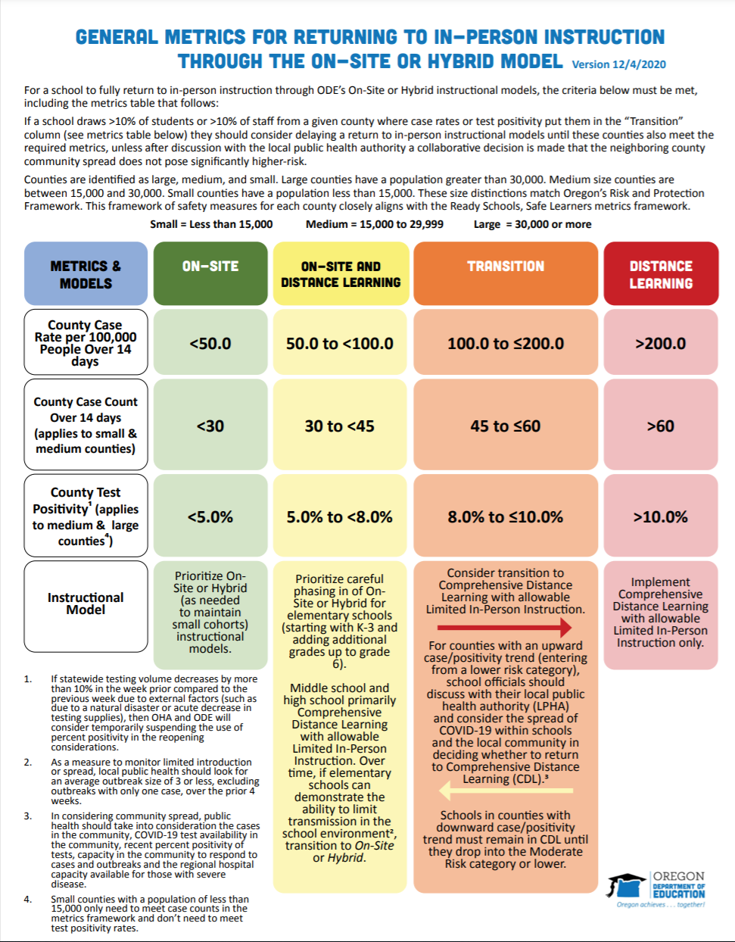


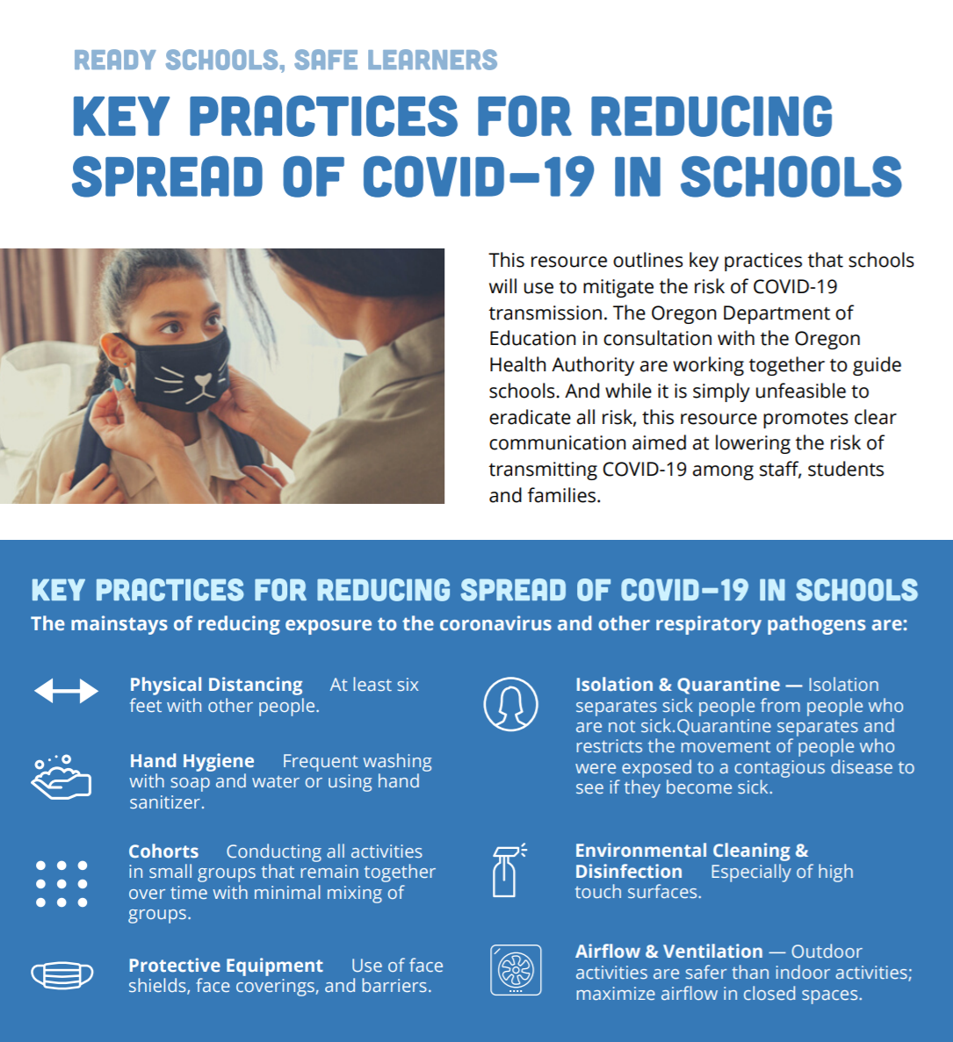
Key Documents

Slide 74
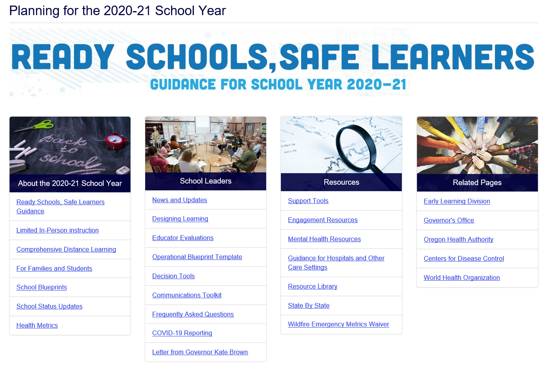
Visit ODE’s Webpage

Slide 75

Questions...

