Slide 1
Ready Schools, Safe learners
School/District Name
Month Date, 2020

Slide 2
Today’s topics
Today’s Topics
Guiding Principles
Local Context
Planning Process
Instructional Model
Operational Blueprint
Review the Plan
Questions
Notes:
Review topics that slides will cover

Slide 3
Grace and Patience
Grace & Patience
We are learning together to move powerfully on behalf of children and communities.
Notes:
Remind folks that the context will continue changing – districts will be receiving updated guidance and that may means plans for school reentry will change prior to and during the school year
We will need to weather those changes together with grace and patience for each other, but also continuing and clear communication

Slide 4
ODE’s Principles
ODE’s Principles
“You don’t make the timeline. The virus makes the timeline.” – Dr. Anthony Fauci
We will be living with the virus until there is immunity, which is many months off.
The primary tools we have are physical distancing and hygiene.
Every restriction we lift increases transmission and will increase cases.
Individual plans should be responsive to local public health and build on the distinct strengths and needs of each district and community.

Slide 5
Our Local Context
Our Local Context
List 3-5 considerations that played into planning process
Notes:
We received guidance from Oregon Department of Education and are submitting our plan based on our local context

Slide 6
Transportation
Transportation
What’s in the Guidance: Key Concepts to Highlight
Include transportation departments (and associated contracted providers, if used) in planning for return to service.
Buses and transit stations are cleaned frequently. Conduct targeted cleanings between routes, with a focus on disinfecting frequently touched surfaces of the bus.
Develop protocol for loading/unloading that includes visual screening for students exhibiting symptoms and logs for contact-tracing.
Consult with parents/guardians of students who may require additional support (e.g., students who experience a disability and require specialized transportation as a related service) to appropriately provide service.
Drivers wear facial shields, or their equivalent.
Inform parents/guardians of practical changes to transportation service (i.e., physical distancing at bus stops and while loading/unloading, potential for increased route time due to additional precautions, sanitizing practices and facial coverings).
Notes:
Ok to delete if not useful

Slide 7
Our Planning Process
Our Planning Process
List out the who and how of the planning process here

Slide 8
10 Critical Steps
10 Critical Steps
Preparation
Read this Ready Schools, Safe Learners guidance in its entirety.
Consult your Local Public Health Authority and familiarize yourself with the disease management metrics within your health region.
Assemble appropriate personnel within the school/district and any community partners to create a planning team.
Plan Development
Work with the planning team to complete the Operational Blueprint template for your school. Private schools are required to complete sections 1-3.
Consult with key partners (see section 6, including Tribal Consultation) to complete the Operational Blueprint for Reentry.
Submit the Operational Blueprint for Reentry to your local school board.
Public Health Review
Submit the Operational Blueprint for Reentry to your Local Public Health Authority.
Your Local Public Health Authority will attest to receiving the blueprint, carefully reviewing sections 1-3, and support your ongoing efforts towards ongoing COVID-19 mitigation efforts.
Final Plan Submission
Post the Operational Blueprint for Reentry on your school and district websites. If there is no school or district website, it can be posted to the ESD website.
Submit final plan for each school to the Oregon Department of Education.

Slide 9
Local Flexibility & Responsibility
Local Flexibility & Responsibility
Critical Step – Plan Development
KEY PRINCIPLES for Reducing Potential Exposures
The mainstays of reducing exposure to the coronavirus and other respiratory pathogens are:
Physical distancing — minimizing close contact (<six feet) with other people.
Hand hygiene — frequent washing with soap and water or using hand sanitizer.
Cohorts — conducting all activities in small groups that remain together over time with minimal mixing of groups.
Protective equipment — use of face shields, face coverings, and barriers.
Environmental cleaning and disinfection — especially of high-touch surfaces.
Isolation of sick people and quarantine of exposed people.
With the above considerations foremost, outdoor activities are safer than indoor activities.

Slide 10
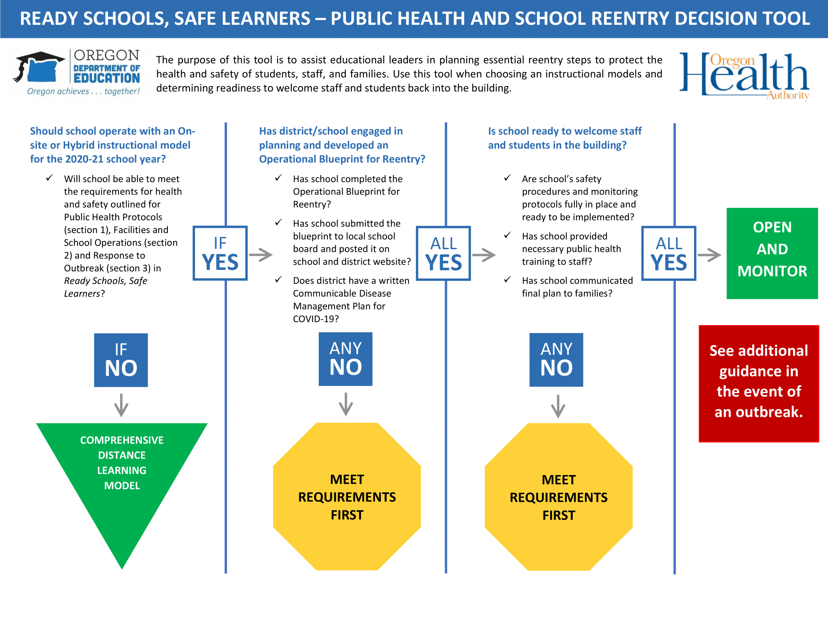
Public health and School Reentry Decision Tool

Slide 11
Face Coverings
Face Coverings
What’s in the Guidance: Key Concepts to Highlight
Notes:
Required
Face coverings or face shields for:
Staff who are regularly within six feet of students and/or staff
This can include staff who support personal care, feeding, or instruction requiring direct physical contact.
Staff who will sustain close contact and interactions with students.
Bus drivers.
Staff preparing and/or serving meals.
Face shields or clear plastic barriers for:
Speech Language Pathologists, Speech Language Pathology Assistants, or other adults providing articulation therapy.
Front office staff.
Face masks for school RNs or other medical personnel when providing direct contact care and monitoring of staff/students displaying symptoms. School nurses should also wear appropriate Personal Protective Equipment (PPE) for their role.
Students who choose not to wear face coverings must be provided access to instruction.
ADA accommodations: If a staff member requires an accommodation for the face covering or face shield requirements, districts and schools should work to limit the staff member’s proximity to students and staff to the extent possible to minimize the possibility of exposure.
Recommended
Face coverings for:
All staff (in accordance with local public health authority and CDC guidelines).
Staff who interact with public (e.g., mail deliveries, varied support personnel).
Staff who interact with multiple stable cohorts.
Students in 6th-12th grade and especially in circumstances when physical distancing cannot be maintained.
If face coverings are worn, they should be washed daily or a new covering worn daily.
Encourage students who wear face coverings to follow recommendations for the CDC Face Coverings.
Children of any age should not wear a face covering:
If they have a medical condition that makes it difficult for them to breathe with a face covering;
If they experience a disability that prevents them from wearing a face covering;
If they are unable to remove the face covering independently; or
While sleeping.

Slide 12
Higher Risk Activities
Higher Risk Activities
What’s in the Guidance: Key Concepts to Highlight
Notes:
We support a well-rounded education
Opportunities to engage students in a well-rounded education often requires hands-on, interactive and physical activities (e.g., laboratory activities, band, choir, theater, career and technical education (CTE), physical education). As such, these activities may put students and staff at a higher risk for COVID-19 spread and may require modifications or specific health and safety protocols to protect staff and students.
Required
For any course, learning experience, or school activity that falls under this category, districts must carefully consider Public Health Protocols (see section 1) and Facilities and School Operations (see section 2). To the extent possible, modifications to the learning experience, course, or physical space should be made.
Follow Instrument Cleaning Guidelines for any music course where instruments are used.
Recommended
Use markings on the floor and/or a student workstation to reinforce physical distance requirements.
Host class or portions of a class outside to increase physical distancing.
Develop safe alternatives or substitutes for live performances, science labs, CTE performance assessments, etc.

Slide 13
Instructional Models for the 2020-21 School year
Instructional Models
Critical Step – Plan Development
Notes:
This slide shows full design

Slide 14
Requirements and recommendations by instructional model

Slide 15
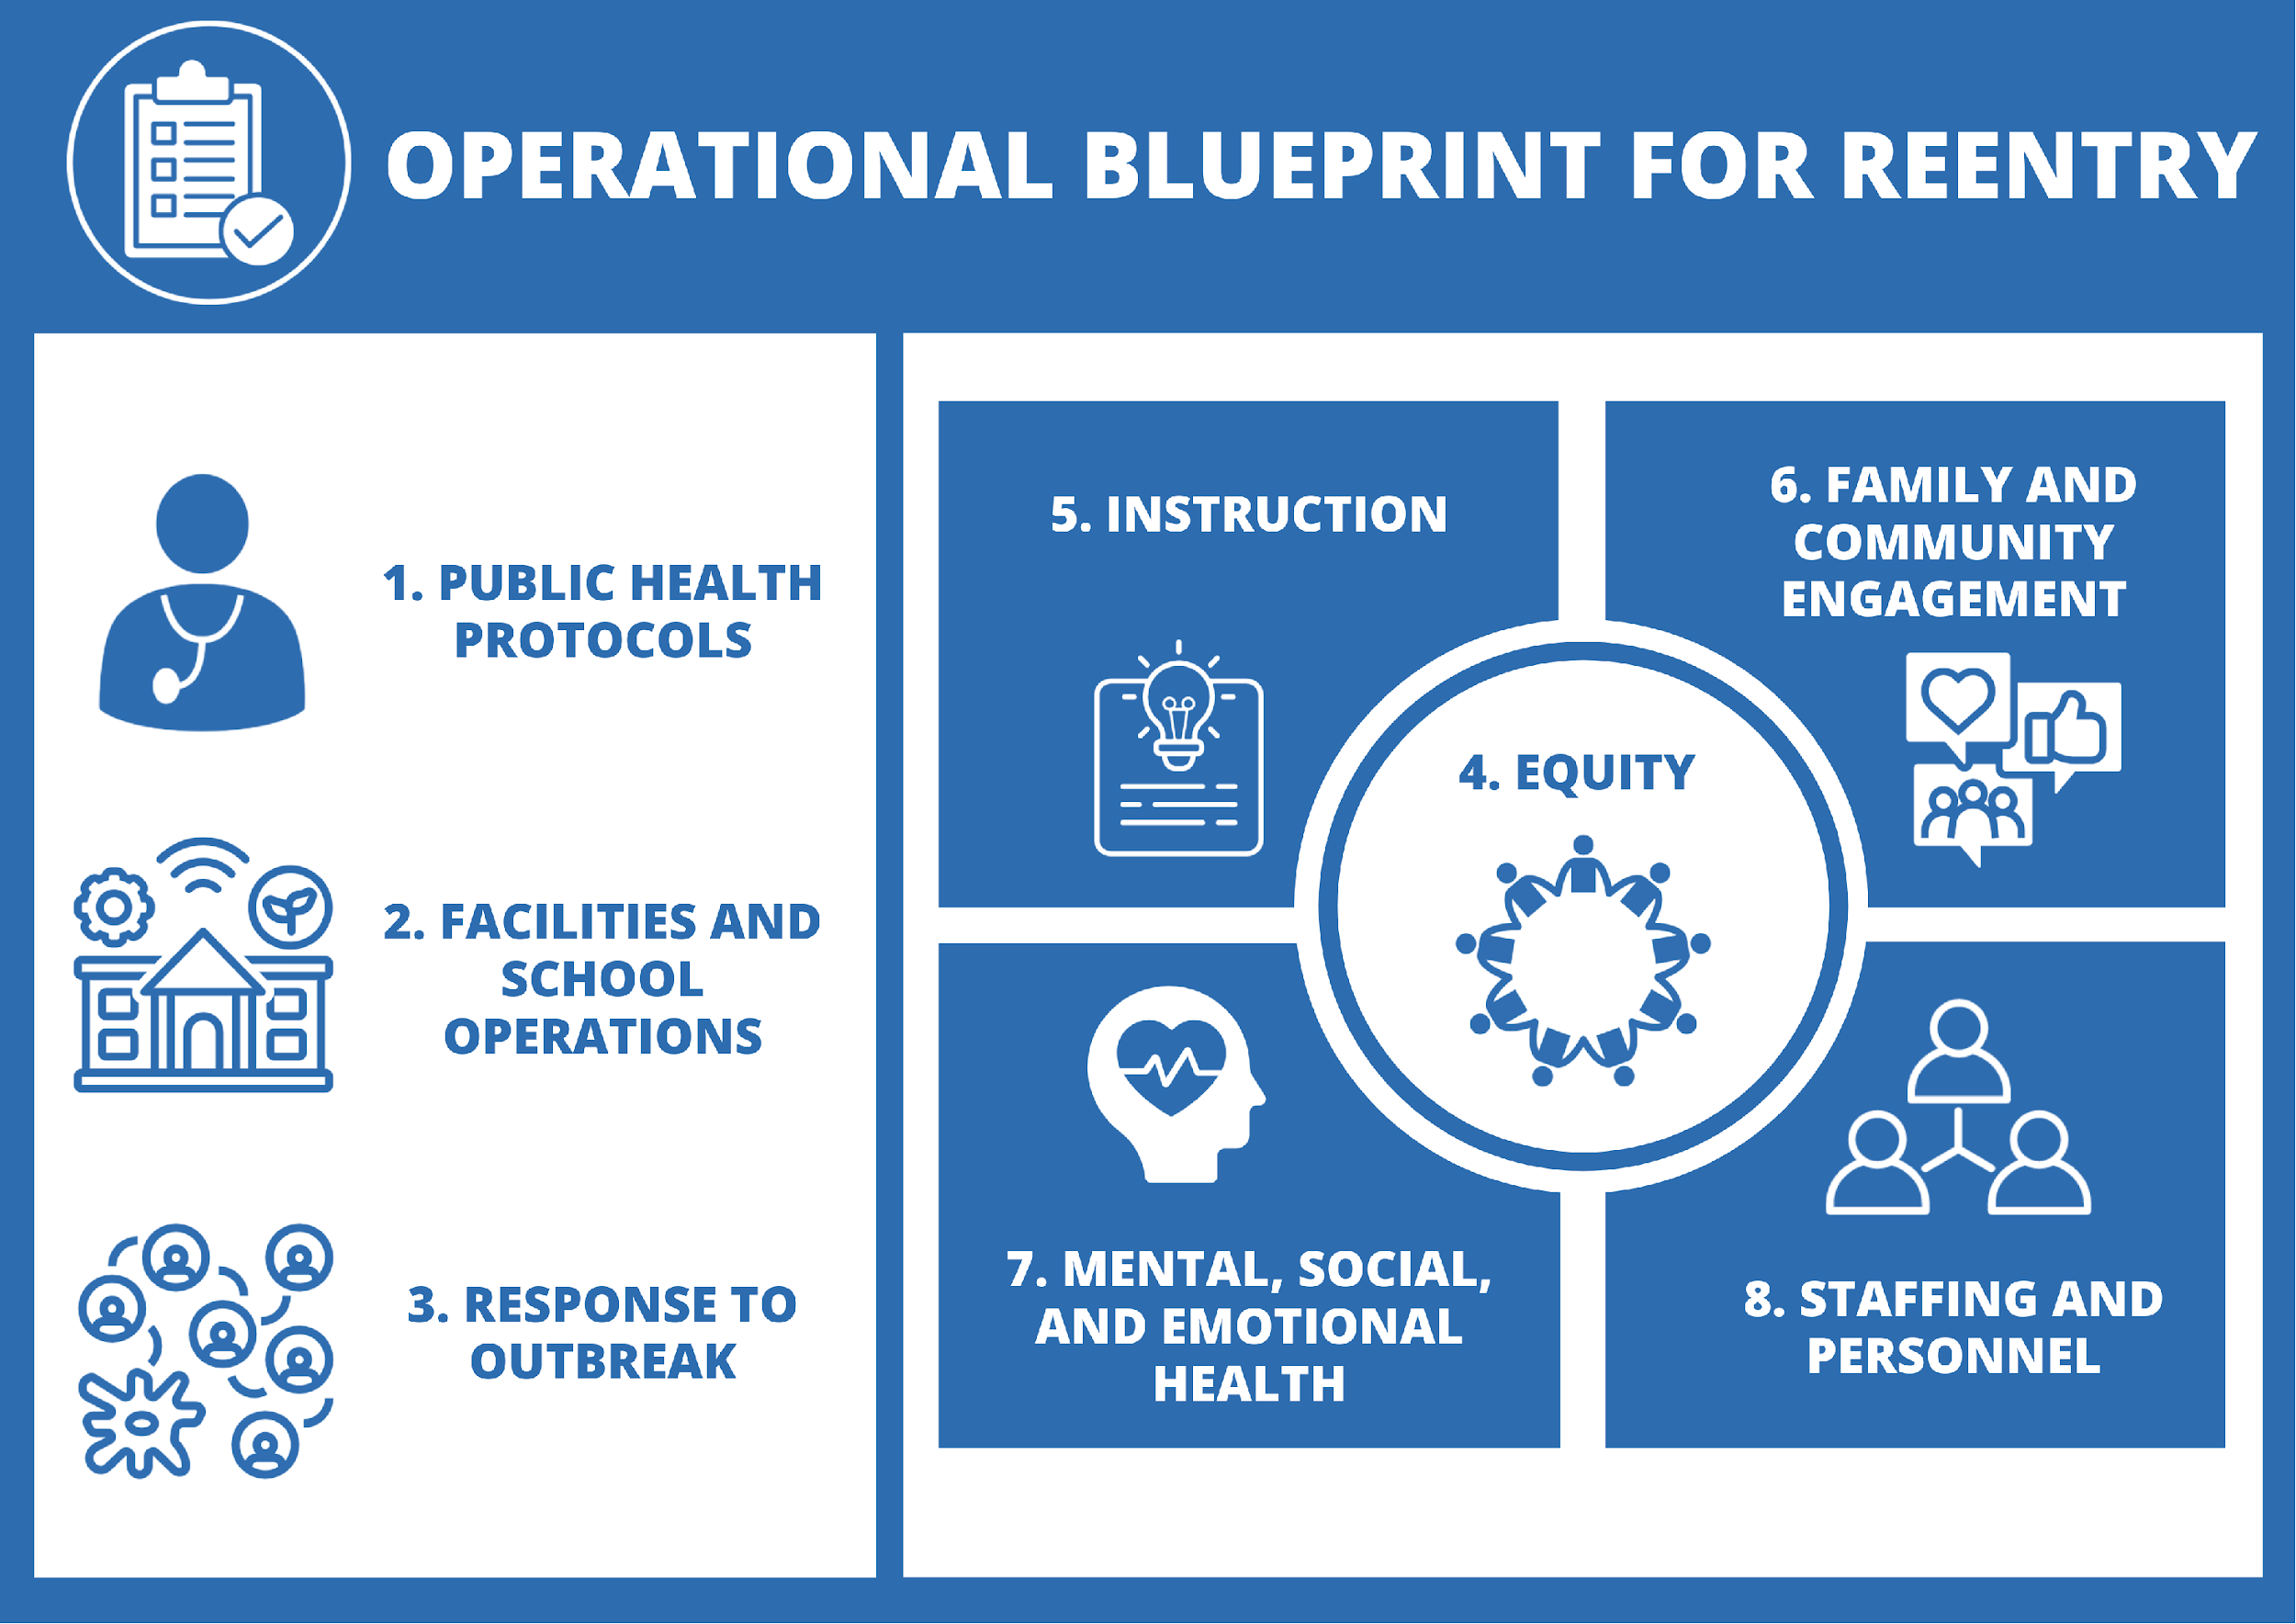
Operational Blueprint 1
Operational Blueprint
Notes:
Review what the operational blueprint is

Slide 16
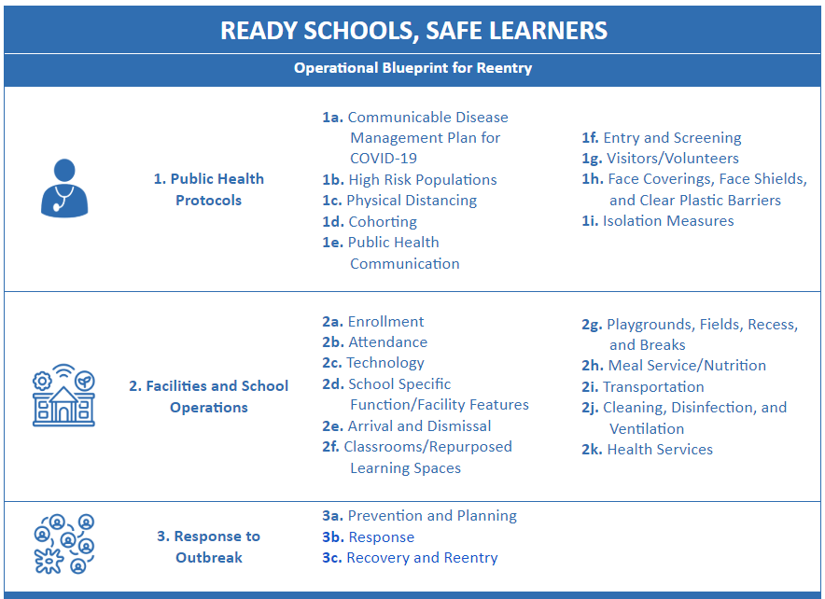
Operational Blueprint 2
Operational Blueprint
Notes:
Review what the plan contains

Slide 17
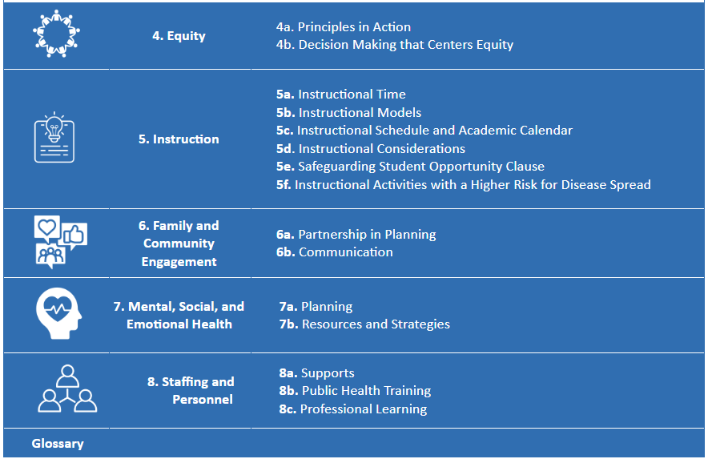
Operational Blueprint 3
Operational Blueprint
Notes:
Continue reviewing what the plan contains

Slide 18
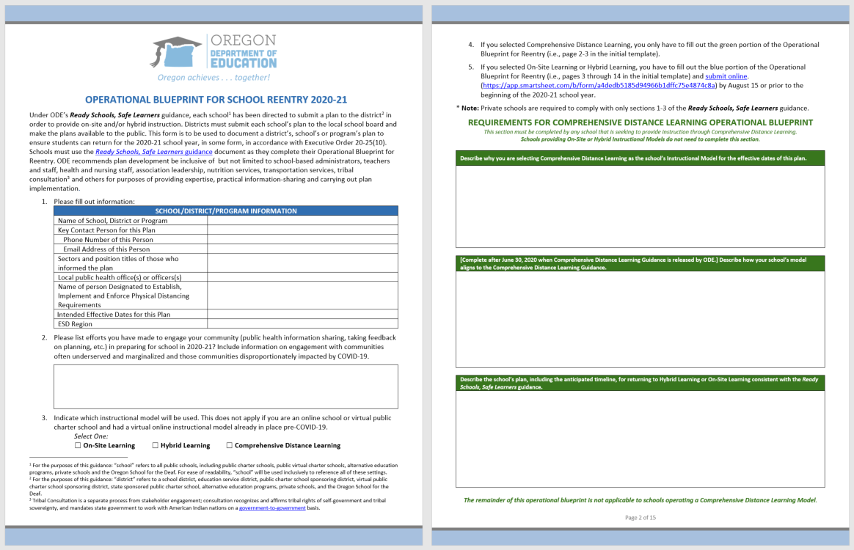
Operational Blueprint 4
Operational Blueprint
Critical Step – Plan Development
Notes:
Operational Blueprint has four sections-
Cover elements:
Who – school, contact, who helped by sector/title, ESD, LPHA,
Which model
Comprehensive distance learning:
Describe why you are selecting Comprehensive Distance Learning as the school’s Instructional Model for the effective dates of this plan.
Describe the steps taken to ensure the school meets the guidance criteria and requirements for Comprehensive Distance Learning, once released by ODE no later than June 30, 2020.
Describe the school’s plan, including the anticipated timeline, for returning to Hybrid Learning or On-Site Learning consistent with the Ready Schools, Safe Learners guidance.

Slide 19
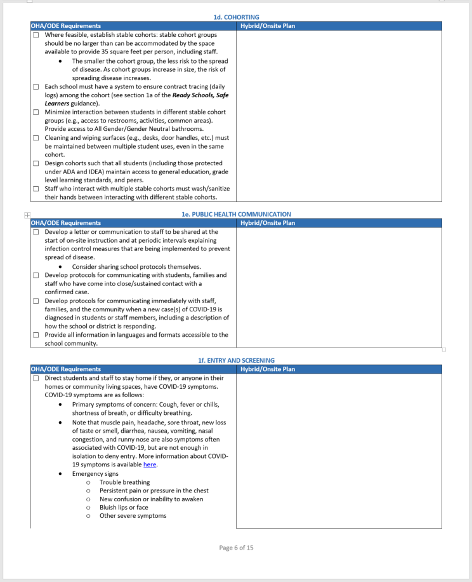
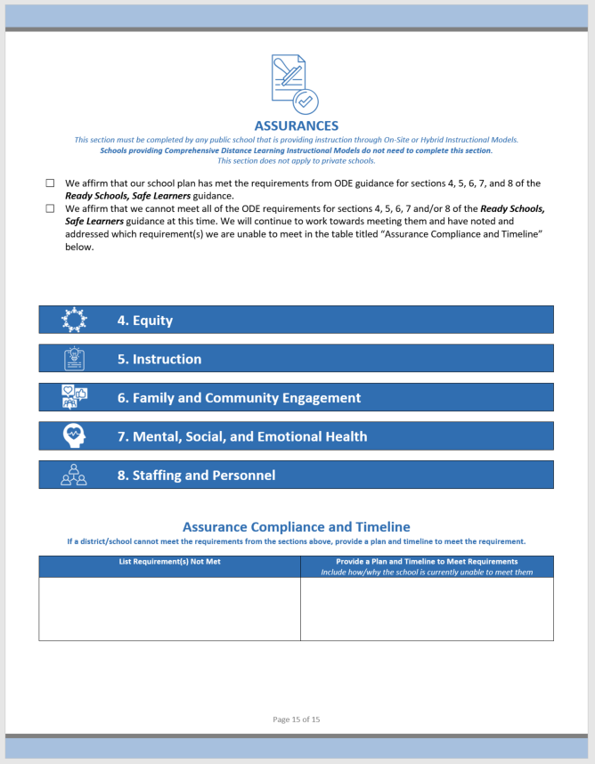
Operational Blueprint 5
Operational Blueprint
Critical Step – Plan Development
Notes:
Operational Blueprint has four sections-
Sections 1-3:
Public Health related implementation
Sections 4-8:
Assurance that you are planning for equity, instruction, engagement, social/emotional/mental health, and staffing and personnel

Slide 20
Operational Blueprint 6
Operational Blueprint
Public Health Protocols
High level list of public health protocols here
Notes:
Continue reviewing what the plan contains

Slide 21
Operational Blueprint7
Operational Blueprint
Facilities & School Operations
High level list
Notes:
Continue reviewing what the plan contains

Slide 22
Operational Blueprint 8
Operational Blueprint
Response to Outbreak
High level list
Notes:
Continue reviewing what the plan contains

Slide 23
Operational Blueprint 9
Operational Blueprint
Equity
High level list
Notes:
Continue reviewing what the plan contains

Slide 24
Operational Blueprint 10
Operational Blueprint
Instruction
High level list
Notes:
Continue reviewing what the plan contains

Slide 25
Operational Blueprint 11
Operational Blueprint
Family & Community Engagement
High level list
Notes:
Continue reviewing what the plan contains

Slide 26
Operational Blueprint 12
Operational Blueprint
Mental, Social, & Emotional Health
High level list
Notes:
Continue reviewing what the plan contains

Slide 27
Operational Blueprint 13
Operational Blueprint
Staffing & Personnel
High level list
Notes:
Continue reviewing what the plan contains

Slide 28
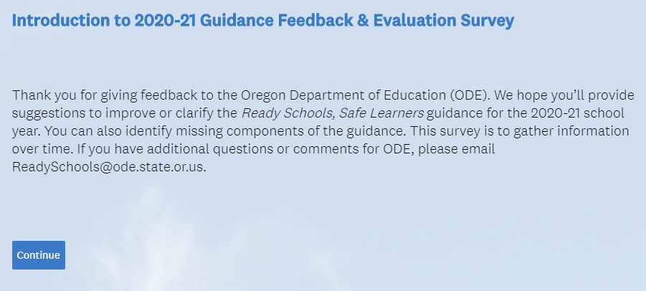
The Next 90 Days…
The Next 90 Days…
Ongoing Efforts
Review Ready Schools, Safe Learners guidance updates
Keep in mind ODE will release new iterations of guidance every three weeks based on changes in science, health, research, and input
[Include your local steps here.]

Slide 29
Conclusion
We can provide ready schools that are safe places for learners, staff, and their families.
Notes:
Build trust and confidence in plan (feel free to change logo)

Slide 30
Questions?
Questions?
Contact Information
Notes:
Questions?

