Slide 1

Ready Schools, Safe Learners
Embargoed Review of Updates
October 29, 2020
Notes:
Fred Rogers: "Often when you think you're at the end of something, you're at the beginning of something else."
We have to be open to constant change and ready to respond to new information. There's nothing about our current situation that allows for sameness and static solutions.

Slide 2

Embargoed Data
This Information is Embargoed
Please Note:
Information that follows is embargoed and should not be shared until the public release at 11:00 am, Friday, October 30, 2020.
Notes:
Notes on sharing embargoed information:
We have a need to vet and engage those impacted - i’m glad we did, it led to key changes and additions of tools.
It is not possible to engage all
Selected based on unique situations, geography and demographics
I was talking with some team members this morning. I noted that my belief is that if we give trust we will get it in response. I think it has worked 99% of the time through this crisis, but that the 1% really hurts.
This time the hurt extended to some of you. This caused anger, confusion and distrust. For that I apologize.
I’m hopeful we can take a collective deep breath and believe, that while the challenges created by some choosing to share embargoed information, there was no ill intent in the process and move forward

Slide 3
Why update metrics?
Improve support systems for children. Returning to in-person instruction is one of Oregon’s highest priorities.
New data is available. ODE & OHA initially created metrics for returning to in-person instruction in early August.
COVID-19 spread can be mitigated in schools. Oregon’s Ready Schools, Safe Learners guidance can help reduce, but not eliminate this risk.
Notes:
Schools are a center of services to students and families
Students receive breakfasts, lunches, and often fresh veggie snacks and even dinner programs in our highest poverty schools
Access to counselors, school psychologists, mental health specialists, and social workers vs. telehealth – because kids don’t; always know to ask.
Access to school nurses and school based health centers
Comparing last September to this September school staff reported 1,500 fewer cases of suspected child abuse. Calls were also about 20% of normal in April and May of last school year.
We are getting reports of mental health strains from students, families, and staff. I don’t have a way of measuring this with any fidelity, but it is real to those expressing it.
It is harder to connect with individual students and build a relationship. Educator – student relationships are key to meeting students needs, whether they are related to physical health, mental health, social-emotional wellness, nutrition, physical needs like shelter and clothing, or educational needs. Relationships
Education appears to be delivered better in-person for most students
Quality learning experiences require deep interpersonal relationships and a learning environment where people feel safe, seen, and valued. Especially in our current context, supporting students and families should begin with connection and relationship.
Relationships build engagement and regular attendance, which are predictive of earning a diploma.
In-person education is an even higher need for our youngest students who are less independent and are still learning basic skills. Learning to read, not yet reading to learn.
There are also worries about screen time and lack of physical activity in distance learning. Although teachers are trying to tackle both of these issues.
It is more difficult to determine how each student is individually responding to instruction. Students may be practicing an incorrect method for longer before a teacher can notice and correct.
It is more difficult to offer small group instruction.
I could go on. Oregon has had virtual/online schools for several years. They are typically schools of choice in districts or they are charter schools. They have not typically performed well on statewide measures (assessments, graduation). There could be many reasons, but the bottom line is it seems that in-person instruction is more effective for most students.
We will continue to improve distance learning. We have just three months of practice in Oregon vs more than 150 years of in-person practice.
News Sources
https://www.npr.org/2020/10/21/925794511/were-the-risks-of-reopening-schools-exaggerated
https://www.nytimes.com/2020/10/19/nyregion/schools-coronavirus.html?name=undefined&region=inline&label=school-reopenings&module=hub_Band&block=&action=click&pgtype=LegacyCollection&impression_id=f0b2a8a0-12f5-11eb-86b1-b973b4ee2810

Slide 4
A Measured, Intentional Approach
In returning to in-person instruction, Governor Brown, ODE, and OHA are focused on:
Ensuring our schools are ready to implement all the public health protocols with fidelity
Providing metrics that allow for in-person instruction at reduced levels of risk
Making clear how Oregonians in every county across the state can take the steps needed to meet these new metrics and allow our kids to return to in-person instruction
Notes:
We cannot eliminate risk, but we can mitigate or reduce it to help keep students, staff, and their families safe while offering in-person instruction.
The CDC and several others have called-out Oregon’s safety guidance as some of the most comprehensive.
We can’t stop the spread of COVID-19 in schools, but we can mitigate it through key practices:
Physical distancing
Face coverings
Hand hygiene
Cohorting
Cleaning and disinfecting
Airflow and ventilation
And, effective screening, and responses to cases with quick access to testing and implementing isolation and quarantining
We have distributed over 5 million disposable face coverings, 100,000 face shields, and are in the midst of distributing 1.2 million cloth face coverings.
We also have new access to testing at much higher levels.

Slide 5
Top Changes
Updated Metrics are effective Friday, October 30, 2020
Advances a new metrics framework with a move to a two week “Look Back” at the metrics data and removal of state positivity rate
Incrementally increases access for in-person instruction beginning at the elementary level
Maintains use of some exceptions, including a hold harmless clause
Extends implementation windows and advises use of an equity decision tool
Limited In-Person Instruction: Changes cohort size from 10 to 20, removes 250 absolute student limit
Notes:
Key changes include:
A clear set of reachable targets for communities to strive for, with a North Star of returning Oregon students to in-person instruction.
Acknowledgement that Oregon’s Ready Schools, Safe Learners guidances strong public health protocols in structured settings like schools, can greatly reduce the risk of transmission of COVID-19.
Additional time for schools to transition between in-person and distance learning models.
Incrementally increased access to in-person instruction at the elementary level.
A two week “look back” at the metrics data rather than one week at a time over a three week period.
Removes state positivity rate in favor of county positivity rates.
Extends implementation windows and advises use of an equity decision tool.
Maintains use of some exceptions.
Detailed explanation of the metrics is available at www.oregon.gov/ode

Slide 6

Two-Week “Look Back” at Data
Su M Tu W Th F Sa
Su M Tu W Th F Sa
1 2 3 4 5 6 7
1 2 3 4 5 6 7
1 2 3 4 5 6 7
8 9 10 11 12 13 14
1 2 3 4 5 6 7
Before: Look at data 1 week at a time over a 3 week period
Now: Single two-week “look back” window to align with CDC
Notes:
This is a two week cumulative number that aligns to CDC guidance. Overall, the rationale for adjusting is to:
Simpler to calculate and understand
Aligns with other school metrics (e.g., Washington state; CDC)
Averaging cases and test positivity over 14 days results smooths out week-to-week variation, which can be an issue especially in counties with smaller populations
Retains ability to look at trends week-by-week because the 14-day numbers would still be released weekly (i.e., two periods overlap)
OHA’s two week “look back” report (next slide) will have both week one and week two listed with a third row that adds the weeks together for you.

Slide 7
Metrics Table
Metrics & Models | On-Site | On-Site and Distance Learning | Transition | Distance Learning
County Case Rate per 100,000 People Over 14 days | <50.0 | 50.0 to <100.0 | 100.0 to ≤200.0 | >200.0
County Case Count Over 14 days (for small counties¹) | <30 | 30 to <45 | 45 to ≤60 | >60
County Test Positivity² | <5.0% | 5.0% to <8.0% | 8.0% to ≤10.0% | >10.0%
Instructional Model | Prioritize On-Site or Hybrid (as needed to maintain small cohorts) instructional models. | Prioritize careful phasing in of On-Site or Hybrid for elementary schools (starting with K-3 and adding additional grades up to grade 6). Middle school and high school primarily Comprehensive Distance Learning with allowable Limited In-Person Instruction. Over time, if elementary schools can demonstrate the ability to limit transmission in the school environment⁵, transition to On-Site or Hybrid. | Consider transition to Comprehensive Distance Learning with allowable Limited In-Person Instruction. For counties with an upward case/positivity trend (entering from a lower risk category), school officials should discuss with their local public health authority (LPHA) and consider the spread of COVID-19 within schools and the local community in deciding whether to return to Comprehensive Distance Learning (CDL). ⁴ Schools in counties with downward case/positivity trend must remain in CDL until they drop into the Moderate Risk category or lower. | Implement Comprehensive Distance Learning with allowable Limited In-Person Instruction only.
Notes:
Metrics Risk Table Footnotes
Counties with <30,000 residents.
If statewide testing volume decreases by more than 10% in the week prior compared to the previous week due to external factors (such as due to a natural disaster or acute decrease in testing supplies), then OHA and ODE will consider temporarily suspending the use of percent positivity in the reopening considerations.
“Local/neighboring” means the areas where the students and staff live (even if outside the school’s typical boundaries), including neighboring larger communities where they typically go for work, shopping, eating, and entertainment.
In considering community spread, public health should take into consideration the cases in the community, COVID-19 test availability in the community, recent percent positivity of tests, capacity in the community to respond to cases and outbreaks and the regional hospital capacity available for those with severe disease.
As a measure to monitor limited introduction or spread, local public health should look for an average outbreak size of 3 or less, excluding outbreaks with only one case, over the prior 4 weeks.

Slide 8
Metrics Table
On-Site | On-Site and Distance Learning | Transition | For counties with upward case/positivity trend (entering from a lower risk category), school officials should discuss with their local public health authority (LPHA) and consider the spread of COVID-19 within schools and the broader community in deciding whether to return to Comprehensive Distance Learning (CDL). ⁴
<50.0 | 50.0 to <100.0 | 100.0 to ≤200.0
<30 | 30 to <45 | 45 to ≤ 60.0
<5.0% | 5.0% to <8.0% | 8.0% to ≤10.0%
Schools in counties with downward case/positivity trend must remain in CDL until they drop into the “On-Site or Distance Learning” category or lower. | Transition | Distance Learning
 | 100.0 to ≤200.0 | >200.0
 | 45 to ≤ 60.0 | >60.0
 | 8.1% to ≤10.0% | >10.1%

Slide 9
General Metrics Overview
General Metrics - for returning to in-person instruction
For schools to fully return to in-person instruction the following must be met:
If >10% of students or >10% staff are from a county where case rates or test positivity puts them in the “Transition” column (on metrics table) they should consider delaying a return to in-person instruction until these counties also meet the required metrics, unless after discussion with the LPHA a collaborative decision is made that the neighboring county does not pose significantly higher-risk.

Slide 10
General Metrics Key Points
General Metrics - for returning to in-person instruction
Operating with the General Metrics - Key Points
Safe Harbor: Schools operating in-person under previous metrics, including exceptions, may initially continue to operate in-person. Apply an equity-based decision-tool Schools have a 14-day window to open from the date the metrics are met. Longer window to transition to Comprehensive Distance Learning (CDL) Updating Operational Blueprints and weekly status updates to reflect current instructional model.
Notes:
New metrics data are released each Monday. Once metrics are met, schools may work within a 14-day (two week) opening window during which they can move toward implementing in-person instruction. This will support district planning, family communication, and a more gradual rather than rushed opening. Example: School Y in a large county learns they have moved from the “Transition” column to the “Onsite and Distance Learning” column with a release of metrics on Monday, November 9. They can plan and open in ways they want by Monday, November 23 – even if the metrics released on Monday, November 16 or November 23 move them back into the “Transition” column.

Slide 11
Schools Currently Operating In-Person
General Metrics - for returning to in-person instruction
Safe Harbor: Any school operating with in-person instruction, including under any prior exceptions, may, initially, continue to operate in-person. Per the Metrics Chart schools:
May continue operating in-person: if the school is located in a county with current metrics in the “On-Site” or “On-Site and Distance Learning” columns.
Should discuss with their local public health authority (LPHA) and consider the spread of COVID-19 within schools and the local community in deciding whether to return to Comprehensive Distance Learning (CDL): if the school is located in a county with current metrics in the “Transition” column of the metrics chart.
Transition to distance learning by January 4, 2021 (unless operating under an exception per Section 0 of the RSSL guidance) if the school is located in a county with metrics in the “Distance Learning” column.
Notes:
Any school operating with in-person instruction in compliance with previous metrics, including under any prior exceptions, released by ODE and OHA may, initially, continue to operate in-person.
If the school is located in a county with current metrics in the “On-Site” or “On-Site and Distance Learning” columns of the metrics chart (above), they may continue operating in-person.
If the school is located in a county with current metrics in the “Transition” column of the metrics chart (above), then school officials should discuss with their local public health authority (LPHA) and consider the spread of COVID-19 within schools and the local community in deciding whether to return to Comprehensive Distance Learning (CDL).
Umatilla & Malheur: Unless operating under an exception in section 0d (below),if the school is located in a county with metrics in the “Distance Learning” column of the metrics chart (above), then the school must transition to distance learning by January 4, 2021.

Slide 12
Two-Week “Look Back” at Data
Su M Tu W Th F Sa
Su M Tu W Th F Sa
1 2 3 4 5 6 7
1 2 3 4 5 6 7
1 2 3 4 5 6 7
8 9 10 11 12 13 14
1 2 3 4 5 6 7
Before: Look at data 1 week at a time over a 3 week period
Now: Single two-week “look back” window to align with CDC

Slide 13
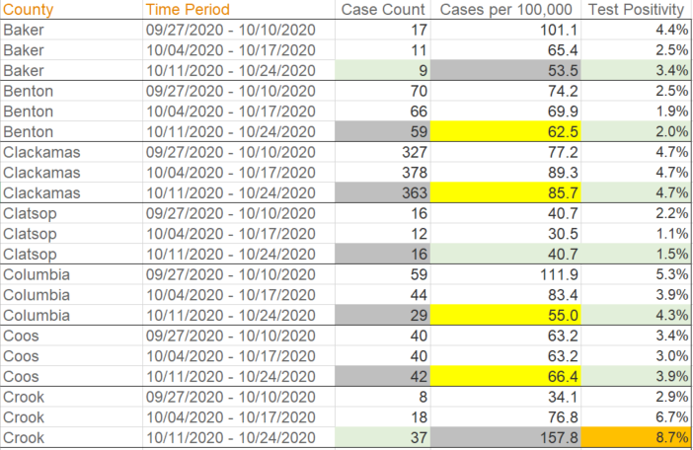
How the Two-Week “Look Back” Works with Data

Slide 14
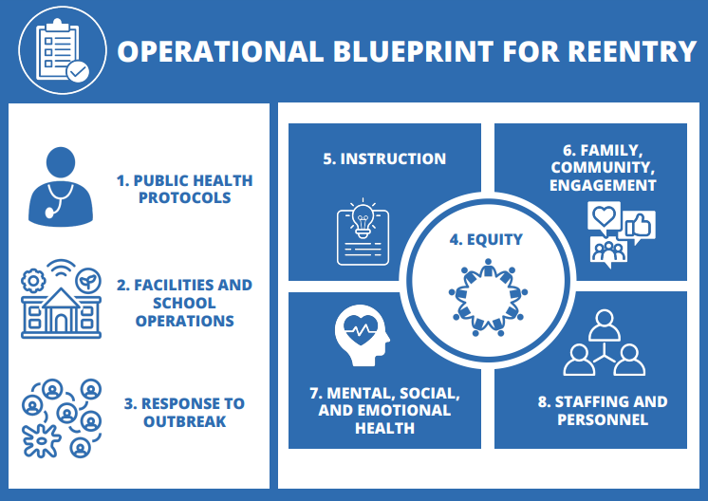
Update Operational Blueprint when / if Instructional Model Changes
Schools do NOT need to submit new blueprints unless they are changing their instructional model.
When and if a schools’ instruction model changes, submit to ODE via Smartsheet Link: https://app.smartsheet.com/b/form/a4dedb5185d94966b1dffc75e4874c8a
Notes:
Schools do NOT need to submit new blueprints unless they are changing their instructional model; BUT if you do change your model you will need to USE the new blueprint.

Slide 15
Changes to the Weekly Status Report
This report is required
The operating status within the general metrics drop down will be aligned with the new metrics table in section 0b of the guidance.
School submitters will select one of 5 options:
•On-Site
•On-Site and Distance Learning
•Transition
•Distance Learning
•Classes not in session/school closed for the week.
Notes:
why:
Helps us update metrics
Our partners at the Oregon Health Authority (OHA) are preparing to implement fairly extensive testing related to the first cases associated with schools. The OHA has lined up resources for this enhanced surveillance. In order to be ready OHA needs to know where to place these resources geographically ahead of a confirmed case in a school. There is still little data worldwide about the spread of COVID-19 in school settings. This enhanced surveillance effort will help us understand how to respond to COVID-19 cases in schools and help us maintain in-person instruction.
The federal government has also committed to provide COVID-19 tests to schools across the county. When Oregon receives these tests, we will work with our public health partners to determine the best way to distribute this resource. Knowing each school’s status will be important.
We continue to seek opportunities for other resources like PPE, cloth face coverings, etc. Again, understanding each school’s current status can help with distributing resources where they are needed.
This information may help with eventual vaccine distribution and dissemination. As we understand, a pediatric vaccine is not likely in the coming months.
State leaders need to understand how schools are operating in different parts of the state and how to replicate successful implementation models.

Slide 16
Changes to the Weekly Status Report
For schools that qualify to operate under one of the exceptions will choose one of the following from the drop down:
•Allowed under previous metrics or prior exceptions (0c.1)
•Exception for Limited In-Person Instruction (0d.1)
•Exception for Small Remote Schools (0d.2)
•Exception for Low Population Density, Large Population Counties (Od.3)

Slide 17
Changes to the Weekly Status Report
For schools operating under the On-Site or Distance Learning model there is a drop down to select which grades are operating On-Site or Hybrid.
There is now only one field to enter the number of student attending (excluding extracurricular activities) on site during the week
There is now only one field to enter the number of cohorts (including transportation) each week.

Slide 18
Changes to the Weekly Status Report
An email will be sent out to all school submitters with full instructions outlining the changes and definitions for all fields.
The weekly update request sent Wednesday Nov 4th will include a link to an updated instructions and definitions document.
The weekly update request sent Wednesday Nov 4th will be the first week to report using the updated guidance.
For this first week, the “No Changes” field will not be available.

Slide 19
Exceptions Overview
Exceptions to the General Metrics
The following exceptions are allowable to schools who meet the criteria outlined:
Limited In-Person Instruction for specific student groups
Small Remote Schools
Low Population Density, Large Population County
Emergency Waiver for In-Person Instruction at Schools Impacted by Wildfires

Slide 20
Exceptions to the General Metrics
Limited In-Person Instruction
Limited In-Person Instruction for specific student groups - allowed statewide as an enhancement of Comprehensive Distance Learning. These conditions should be prioritized:
  Strong screening measures in place
  Fully comply with Sections 1-3 of RSSL guidance
  Fully comply with CDL and LIPI, which includes cohort sizes, times, etc.
  Consider pausing LIPI when county rates climb

Slide 21
Limited In-Person Updates
Limited In-Person Instruction
  20 students at a given time in a cohort
  Staff members (even in multiple roles) cannot interact with more than three cohorts
  Removes 250 student limit
Cohort Defined:
Ready Schools, Safe Learners defines a stable cohort as “a group of students that are consistently in contact with each other or in multiple cohort groups.” One student working with a teacher, by definition, does not constitute a cohort. If teachers are involved in individual 1 to 1 interactions and not cohorts of multiple students, they can still only interact with no more than 60 total students a day.

Slide 22
Exceptions to the General Metrics
Small Remote Schools
2. Small Remote Schools - allowed statewide for public or private schools with enrollments of less than or equal to 75 in total who are located in a county that does not meet the General metrics can consider opening to in-person instruction only when and if their LPHA establishes the following criteria have been met:
  Total enrollment of less than or equal to 75 total
  The school is more than 25 miles by the nearest traveled road from any town or city with a population over 3,000 people
  The school is striving for a COVID-19-free start, and ensure strong screening measures are in place.

Slide 23
Exceptions to the General Metrics
Low Population Density, Large Population County
3. Low Population Density, Large Population County - allowed statewide for
schools under the following conditions:
  Total county COVID-19 case rate in the 14 days is less than 100.0 per 100,000 in population.
  Schools fully comply with Sections 1-3 of RSSL guidance.
  There is not community spread in the school catchment area.
  There is not community spread in the communities that serve as the primary employment and community centers and the school is isolated by a significant distance from communities reporting COVID-19 spread in the previous two weeks.
  Considerations around test availability and capacity in the community to respond to outbreaks.

Slide 24
Exceptions to the General Metrics
Emergency Waiver for In-Person Instruction for Schools Impacted by Wildfires
4. Emergency Waiver for In-Person Instruction for Schools Impacted by
Wildfires - waiver available to provide Emergency In-Person Instruction at schools serving communities impacted by wildfires.

Slide 25
Snapshot of Impacts to of these updates
Not Yet Eligible | Elementary Eligible | K-12 Eligible
Crook | Benton | Baker
Harney | Clackamas | Clatsop
Jackson | Columbia | Curry
Lane | Coos | Giliam
Linn | Deschutes | Grant
Malheur | Douglas | Hood River
Marion | Polk | Jefferson
Morrow | Wallowa | Josephine
Multnomah | Wasco | Klamath
Umatilla |  | Lake
Washington |  | Lincoln
Yamhill |  | Sherman
 |  | Tillamook
 |  | Union
 |  | Wheeler
If New Metrics Were Implemented this Week:
Total Number of Public School Students Newly Eligible for In-Person Instruction Under Updated Metrics: 104,036
Total Number of Public School Students Eligible for In-Person Instruction: 129,942 (with an additional 67,409 over time)
Total Number of Public School Students Initially Ineligible for In-Person Instruction: 451,365
This chart does not include Limited In-Person Instruction (LIPI)
Notes:
Name what this slide communicates and the complexity of how it isn’t fully accurate or quickly changes. Example: Crook Co.
Currently: 29,125 (5%)
Future: 129,942 (22%)
It is not only the metrics holding back:
community
bargaining
supplies
capacity
local C19 impact

Slide 26

Helping counties meet the metrics to return students to school
Considering: Counties that are not on-track to offer in-person instruction be issued a modified Stay Home Order with the aim of reducing spread so that students can return to school in 2021.

Slide 27

RSSL Guidance Updates
RSSL - Version 4.0.0 Updates:
Will go out at 12 p.m. Friday to press and public.
Revisions have also been made to the following guidance documents to ensure alignment with the new metrics (section 0 of RSSL) and face covering requirements (section 1h in RSSL), as well as to reflect other timely additions and updates:
Ensuring Equity and Access
Comprehensive Distance Learning
Planning for COVID-19 Scenarios in Schools
Limited In-Person Instruction

Slide 28
Highlighted RSSL Updates
Contains update “0 Section” with detail on new health metrics.
Updates primary symptoms of concern and an exemptions chart.
Updates face covering guidance requirements to match OHA’s recent changes for all statewide guidance.
Adds a new supplementary resource on FAPE and face coverings.
Clarifies several cleaning/disinfecting requirements.
Updates key definitions on exposures and outbreaks.
Updates Visual and Performing Arts guidance.
Aligns to CDC on newer aerosol exposure and close contact definitions

Slide 29
RSSL Update on Exposure
An exposure is defined as an individual who has close contact (less than 6 feet) for longer than 15 cumulative minutes in a day with a person who has COVID-19 case.

Slide 30

RSSL Update on Face Coverings
Notes:
Emerging evidence suggests that airborne transmission may play a role in the spread of COVID-19, via exposure to small droplets and aerosols that contain the virus and can linger in the air for minutes to hours. This means the virus may be able to infect people who are farther than 6 feet away from the person who is infected, especially in enclosed indoor spaces, when people are shouting, singing or exercising, and when air ventilation is suboptimal. Face coverings may provide better containment of small aerosols that can be produced while talking. Use of a face shield alone should only be done on a very limited basis, because wearing a face shield alone without a mask or face covering increases the potential for transmission of viruses to those in the same room as the individual without the mask or face covering.

Slide 31
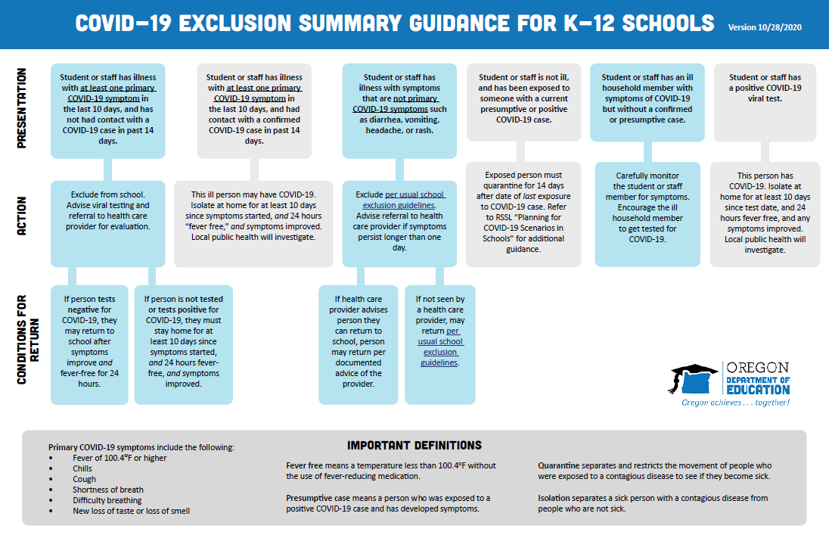
New Quick Exclusion Guide

Slide 32

RSSL Update to Scenario Planning
Updated to match most recent science and learning from the last 10 weeks.
Small fixes, including a broken internal link.

Slide 33

Questions...
Notes:
https://www.nytimes.com/2020/10/19/nyregion/schools-coronavirus.html?name=undefined&region=inline&label=school-reopenings&module=hub_Band&block=&action=click&pgtype=LegacyCollection&impression_id=f0b2a8a0-12f5-11eb-86b1-b973b4ee2810

