Slide 1

Oregon Department of Education
Webinar

Slide 2
Today’s Agenda
Discipline Incidents Annual Collection, 2018
Restraint & Seclusion Annual Collection, 2018

Slide 3
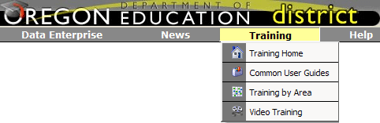
WebEx Training
Web location:
https://district.ode.state.or.us/search/page/?id=257

Slide 4
Data Collection Owner:
Lisa Bateman
Lisa.bateman@ode.state.or.us
(503) 947-5655
Research Analyst:
James Foutch
James.foutch@state.or.us
(503) 947-5776
https://district.ode.state.or.us/apps/usid/CllctnDetails.aspx?DataCllctnID=228&CllctnTyp=Discipline&CllctnNm=Discipline15-16&DBNm=SecureStudent

Slide 5
Discipline Collection Opens:
5/24/18—7/2/18
  Validation Period: 8/23/18 thru 9/17/18

Slide 6
Data Elements
General Consolidated Collection data fields - data fields located in SSID record in SSID System
Data fields pertaining to Discipline Incidents
  Refer to the Discipline Incidents Manual for field-by-field instruction
  http://www.oregon.gov/ode/students-and-family/healthsafety/Pages/School-Discipline,-Bullying,-Restraint-and-Seclusion.aspx

Slide 7
Student Level Collection
  Student collection, not an institution level collection.
  All Suspensions (In-School and Out-of-School), Expulsions, Truancy events and Removals (to alternative settings) must be reported.
  Suspensions, Expulsions, and Removals are entered for ALL students (general and special education) in the Discipline Incidents collection.

Slide 8
Collection reflects student records for the 2017-2018 school year. (July 1, 2017 through June 30, 2018).
  NOTE: If expulsion/suspension/removal extends past June 30, 2018 (i.e., into the 18-19 school year), enter the event in the 17-18 Discipline Incidents collection only, and enter the total number of days (including days extending into next school year).

Slide 9
File layout format, code information and instructions, and Discipline Incidents Collection Manual are located on the Schedule of Due Dates page at the ODE District web site.
Click on the Discipline Incidents 17-18 link or go to:
https://district.ode.state.or.us/apps/info/DataCllctnDetail.aspx?id=228&Collection_ID=1736

Slide 10
Collection closes July 2, 2018
Prior to July 2, review and fix any errors that are displayed in the Error Management / Review Errors – or Housekeeping; delete submitted files associated with errors in ‘Review Errors.’
The discipline incidents collection will re-open from August 23 to September 17, 2018 for validation and error correction.
NOTE: Only records that are error free can be posted and accepted. Be sure to verify your data when submitting by clicking the ‘Verify’ Check Mark.*
*Go to Status Tracking in Consolidated Collections to verify your Discipline Incidents collection when completed.

Slide 11
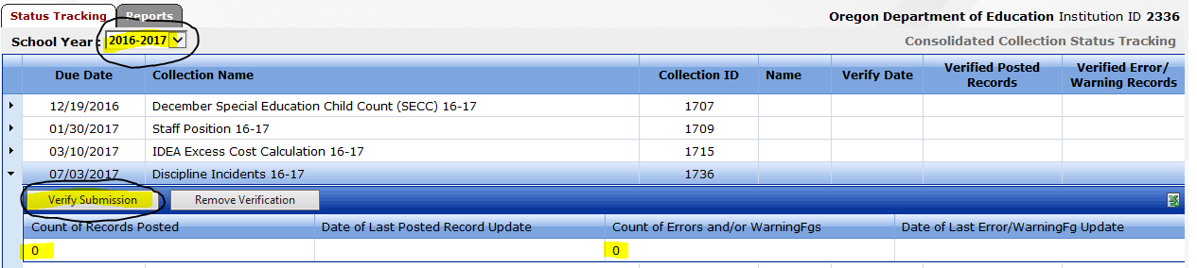
Collection closes July 2, 2018
The Reports section has a number of tools for district use to verify that submitted records have been received and posted by ODE.
Review reports BEFORE July 2 to verify that all files have been submitted and are correct.
Please verify data in collection summary report.
Final Verification: Consolidated Collections Status Tracking screen. District level staff is required to verify that all data submitted (by district / schools) is complete and accurate.
To Finalize Submission after all errors are corrected:
Ensure the School Year shows 2017-2018.
Click on arrow to left of collection name to reveal Verify Submission button.
Click on Verify Submission button and your name, date, time, and statistics will be entered. Then your submission is Final.

Slide 12
Timelines
August 23—September 17 – Report Validation window for Report Card opens to display safe/unsafe status based on Discipline Incidents data submitted – Verification is optional during this window of time.
August 2018 – Unsafe School Choice/ Persistently Dangerous Schools Notification: Districts are notified by ODE based on Discipline Incidents data submitted. (Dates will be determined from close of Report Validation window.)

Slide 13
August - Persistently Dangerous Schools & Parent Notification - Districts must notify parents of Persistently Dangerous status 14 days prior to the start of school and offer parents a chance to relocate to another school.
The following link provides detailed information regarding Persistently Dangerous School status:
http://www.ode.state.or.us/opportunities/grants/nclb/title_iv/a_drugfree/unsafeschchoiceoption.doc

Slide 14
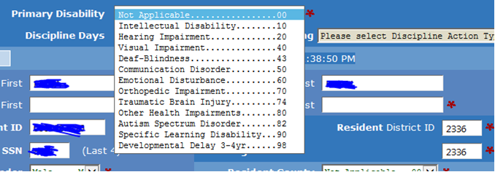
Student’s Primary
Disability:
50 =
Discipline Action Date: mmddyyyy
51 =
Discipline Action Type Code:
1 – Expulsion
2 – In-School Suspension
3 – Out-of-School Suspension
4 – Truancy
5 – Removal to an Alternative Setting
Discipline Action Date: mmddyyyy
Discipline Action Type Code:
1 – Expulsion
2 – In-School Suspension
3 – Out-of-School Suspension
4 – Truancy
5 – Removal to an Alternative Setting

Slide 15

District Incident Code
The district incident ID code can be up to ten characters and must be unique to each incident. If there are multiple students involved in one discipline incident use the same incident ID code for each student. ODE highly recommends the following template when creating incident ID codes;
Ex: A student from school 1294 is disciplined for fighting/mutual altercation (offense type 1700). It is the first mutual altercation at that school during the school year.
Incident ID Code = 1294 1700 1A
The second mutual alteration offense at school 1294 should use the incident ID code of 1294 1700 1B, and so forth.

Slide 16
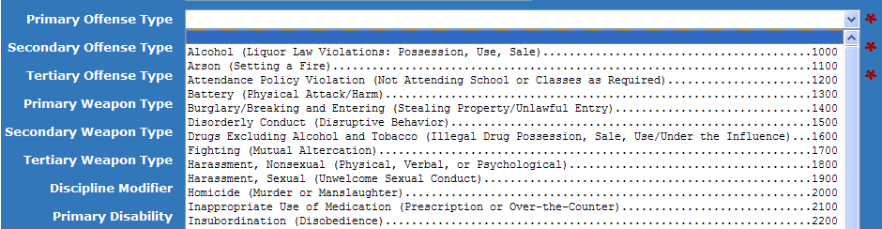
Offense Type Codes
Primary Offense Type Code
Secondary Offense Type Code
Tertiary Offense Type Code

Slide 17
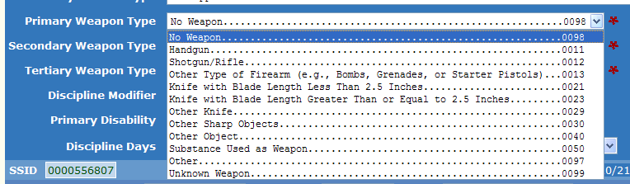
Weapon Type Codes
Primary Weapon Type Code
Secondary Weapon Type Code
Tertiary Weapon Type Code

Slide 18
Discipline Modifier, Days, and Interim Services
Discipline Modifier Code
0 - Not Applicable
1 – Less than 1 year
2 – Removal by ALJ
Discipline Days: Records school days
Interim Services Flag:
If the Discipline Action Code is: | Then the Interim Services Flag options are:
1- Expulsion | Y or N
2- In-School Suspension | Y*
3- Out of School Suspension | Y or N
4- Truancy | Blank (Not Applicable)
5- Removed to an Alternate educational Setting | Y

Slide 19
Violent Criminal Offense Arrest Flag:
Indicates that the incident resulted in the student’s arrest for a violent criminal offense.
Can only be marked Yes (Y) for:
Action Type Code 1 (expulsions) and;
Designated Offense Type Codes

Slide 20
Questions & Answers
Will I need to enter suspension, expulsion, and removal incident days for a student who is not on an IEP?
Yes. The collection and incident days are required for all students.
Q.
A.

Slide 21
Questions & Answers
When is it appropriate to use the “removal to an Interim Alternative Educational Setting (IAES) code?
An IAES is a situation where the student continues to receive instruction, albeit in a different location. There is nothing that prohibits the use of IAES for a general education student as an alternative to out of school suspension. For students who receive special education services, there are three scenarios where IAES may be employed:
Placement by school personnel for violation of a code of conduct (not more than 10 days) 34 CFR 300.530(b);
Placement by school personnel for “special circumstances” (up to 45 school days):
      Weapons
      Drugs
      Infliction of serious bodily injury upon another person (34 CFR 300.530(g);
Placement by a hearing officer [administrative law judge] because of substantial likelihood of injury to child or others 34 CFR 300.532(b)(2)(ii).
* “Hearing officer” means administrative law judge, not the person authorized to hear expulsion cases for a district.
Q.
A.

Slide 22
Q.
What if the student refuses to attend alternative interim services that are offered?
The district is required to Offer interim services starting day 11 of exclusion from school in a given year for a student with special needs, which should be documented from your meeting with the parent/student. If services are Offered, a ‘Y’ (Yes) is marked for Interim services whether or not the student actually attends the services to be provided.
A.

Slide 23
Q.
Do I need to enter data reflecting the type of disability or the eligibility of the student?
Yes. If item # 39, “special education flag”, is marked “Yes”, then item #57 must contain a valid disability code.
A.

Slide 24
Q.
Is my submission to the collection complete once I’ve entered the data?
Your submission is complete after you enter and submit the data, and than only after you click the “Verify Submission” button.
Many districts forget this step after submitting their data. The submission is incomplete until this step is taken.
A.

Slide 25
Physical Restraint & Seclusion Collection

Slide 26
Collection Time Frame
The Physical Restraint and Seclusion Collection is an Institution Consolidated Collection for the 2017-18 School Year.
Opens May 24, 2018
Closes July 2, 2018

Slide 27
Required Data Elements: OAR 581-021-0559
(1) Each entity that has jurisdiction over a public education program must prepare and submit to
the Superintendent of Public Instruction an annual report detailing the use of physical restraint
and seclusion for the preceding school year, including, at a minimum:
(a) The total number of incidents involving physical restraint;
(b) The total number of incidents involving seclusion;
(c) The total number of seclusions in a locked room;
(d) The total number of students placed in physical restraint;
(e) The total number of students placed in seclusion;
(f) The total number of seclusion rooms available; and a description, including the location of those rooms, designated solely for seclusion;
(g) The total number of incidents that resulted in injuries or death to students or personnel as a result of the use of physical restraint or seclusion;
(h) The number of students who were placed in physical restraint or seclusion more than 10 times in the course of a school year and an explanation of what steps have been taken by the
public education program to decrease the use of physical restraint and seclusion for each student;
(i) The number of incidents in which the personnel of the public education program administering physical restraint or seclusion were not trained; and
(j) The demographic characteristics of all students upon whom physical restraint or seclusion was imposed, including race, ethnicity, gender, disability status, migrant status, English proficiency, and status as economically disadvantaged, unless the demographic information would reveal personally identifiable information about an individual student.

Slide 28
Local Level Reporting Requirements
(2) Each entity that has jurisdiction over a public education program shall make its annual report about physical restraint and seclusion available to:
  (a) The public at the entity's main office and the website of the entity;
  (b) The school board or governing body overseeing the entity;
  (c) If the entity is an education service district, the component school districts of the education service district;
  (d) If the entity is a public charter school, the sponsor of the public charter school;
  (e) Parents and guardians of students in a public education program, who shall be advised at least once each school year about how to access the report. (OAR § 581-021-0563).

Slide 29
File Format – complete online
Link To Consolidated Collection: (You need to log in via Central Login and select Consolidated Collections.) https://district.ode.state.or.us/apps/usid/default.aspx
  Hover over Institution Collections to find collection.
Input Numerical and Narrative information
After entering data, be sure to Verify your data by clicking the Verify Submission button
  Click on Status Tracking tab and click on arrow left of Physical Restraint & Seclusion 17-18.
  Verify there are no errors or warnings.
  Verify the counts of records, then click on Verify Submission button to submit.

Slide 30
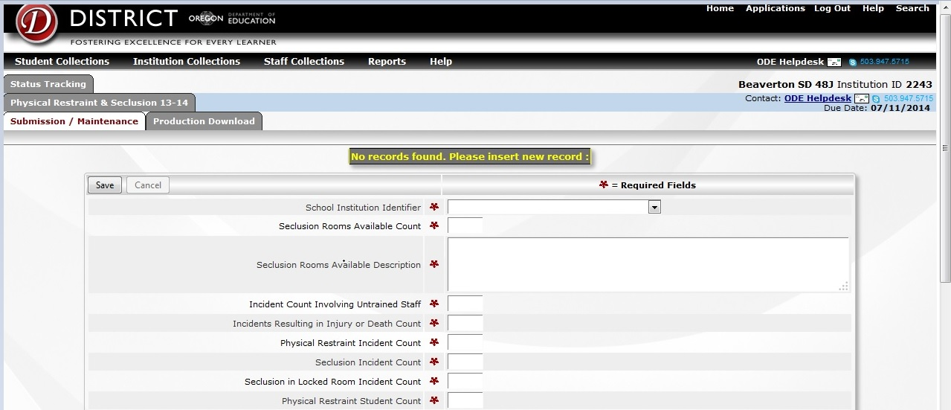
Format – Line by Line

Slide 31
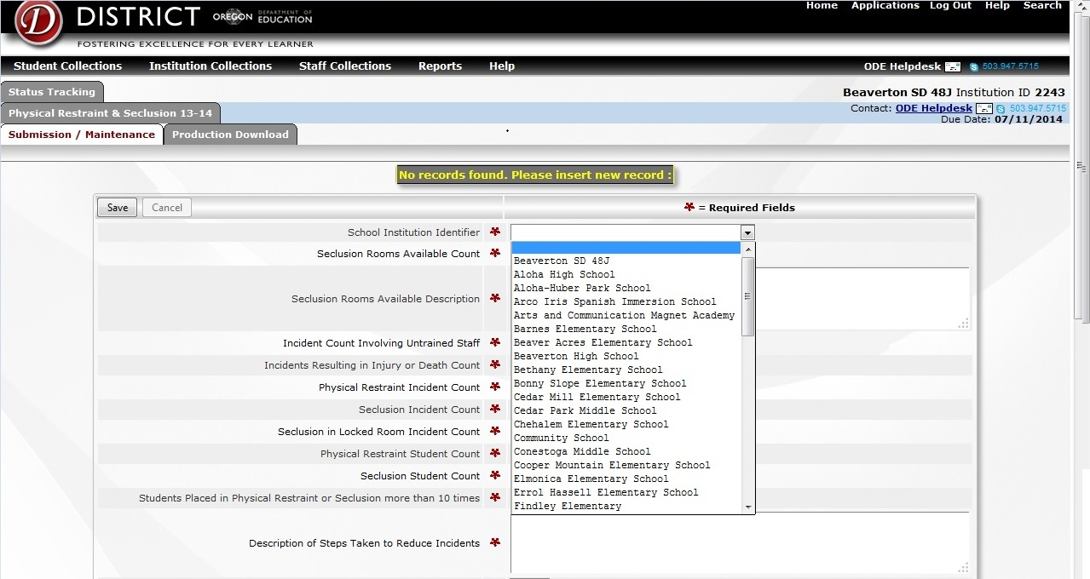
Format – another view

Slide 32
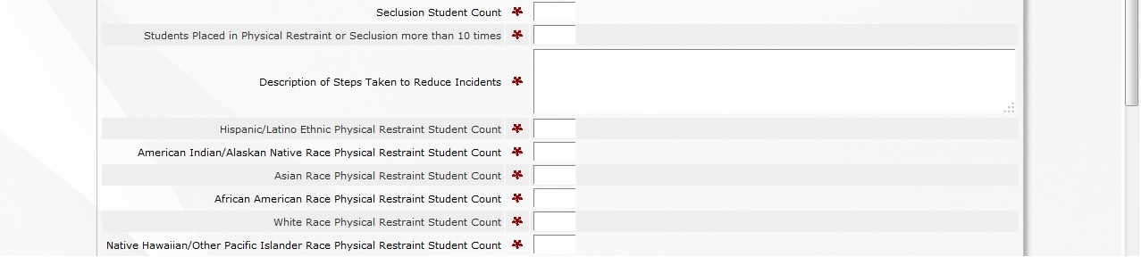
Format (continued)

Slide 33
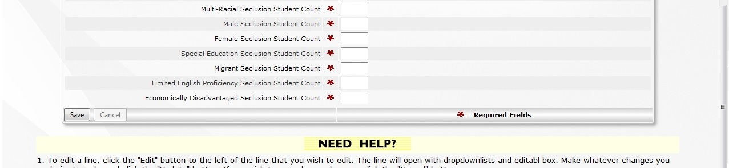
Format - continued

Slide 34
Questions & Answers
Q: Is a student who is physically restrained and put in seclusion during the same time period only counted as one incident?
A: No, the student would be counted and documented as two separate incidents –
physical restraint and seclusion.

Slide 35
Questions & Answers
If a student is physically restrained multiple times within a close time period, is this documented and counted as one incident?
A. Incidents close in time separated by periods of de- escalation must be counted individually.

Slide 36
Questions & Answers
Q: If a student is enrolled in several different race or ethnicity categories, are all reported?
A. This would properly be recorded as multi- racial designation.

Slide 37
Questions & Answers
Q: When making the annual restraint & seclusion report available to the public, what are the responsibilities of the entities that have jurisdiction over a public education program?
A: The report must be made available in the following ways:
  At the entity's main office and on its website;
  The school board or governing body overseeing the entity;
  If the entity is an education service district, the component school districts of the education service district;
  If the entity is a public charter school, the sponsor of the public charter school;
  The parents and guardians of students in a public education program shall be advised, at least once each school year, about how to access the annual report.

Slide 38
Questions & Answers
Q: What if you are a small district and you cannot ensure the confidentiality of a student on the report?
A: Family Educational Rights & Privacy Act (FERPA) requires a district to protect the confidentiality of students. Districts must report all data to ODE where it will be held confidential and subject to suppression rules, and will not be reported at the local level. Districts must amend the collection for publication at the local level to safeguard student confidentiality.

Slide 39
Questions & Answers
Q: When must a report to the state collection specify the corrective action/s a district will take to address the physical restraint or seclusion of a student?
A: The number of students who were placed in physical restraint or seclusion more than ten (10) times in the course of a school year must include an explanation of what steps have been taken by the public education program to decrease the use of physical restraint and seclusion for each student.
OAR 581- 021-0559(1)(h)

Slide 40
Questions & Answers
Does a description and the location of every room and place used for seclusion need to be reported?
Only rooms used solely for seclusion need to be reported, providing a description and the location of those rooms specifically designated and only used for seclusion, per OAR 581-021-0559(f).
  -This does not include counting classrooms, offices, etc. that have multiple uses.

Slide 41
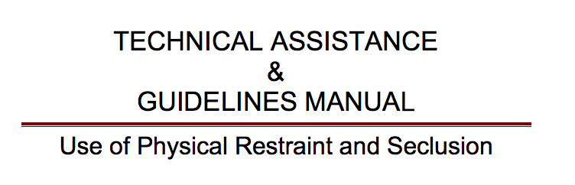
http://www.oregon.gov/ode/students-and-family/healthsafety/Pages/School-Discipline,-Bullying,-Restraint-and-Seclusion.aspx

Slide 42
Thank you for Attending
Program Assistance Questions:
Lisa Bateman, Education Specialist
503-947-5655
Lisa.bateman@ode.state.or.us
Data questions:
James Foutch, Research Analyst
503-947-5776
James.foutch@state.or.us
  Technical Questions:
  ODE External Help Desk 503-947-5715
Link for completing the Collection: https://district.ode.state.or.us/apps/usid/default.aspx

Slide 43

THANK YOU!
We appreciate you!
We cannot produce accurate reports without your excellent work.

