Slide 1
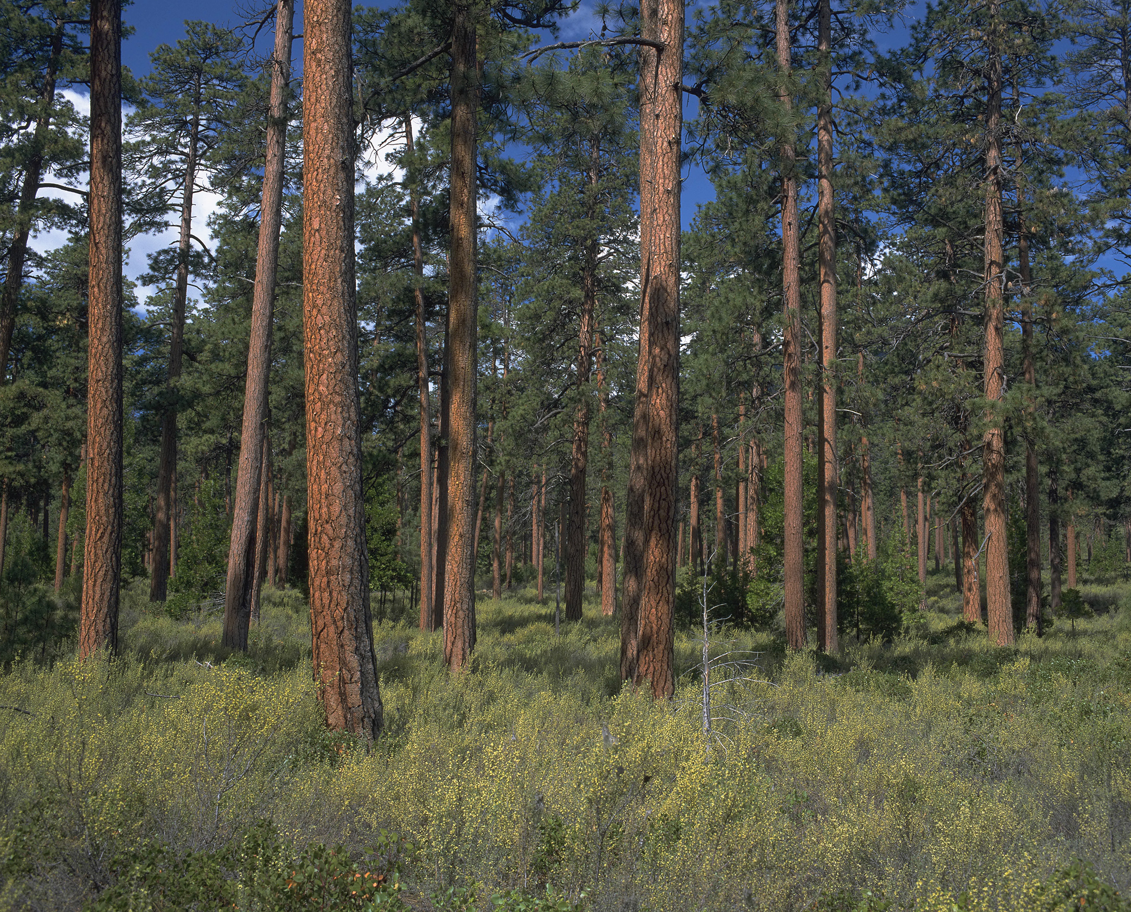


Oregon Forest Ecosystems Carbon Report
Presentation of Draft Results
March 21, 2019
Forest Carbon Accounting Stakeholder Meeting

Slide 2
Oregon Forest Ecosystems Carbon Report
Work plan
Effort accomplished to date
Results!
  Tables – briefly
  Figures – detailed review
Discussion and next steps

Slide 3
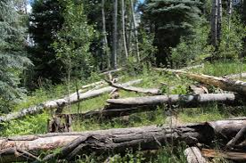
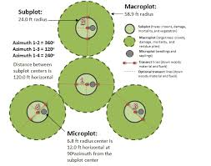
Oregon Forest Ecosystems Carbon Report
The report will provide summaries of total forest carbon stocks and flux by ecoregion, ownership, forest type, and forest pool.
Report data comes from measurements collected by the USFS Forest Inventory and Analysis Program on forest inventory plots in Oregon
  Stocks based on 2001 to 2016 measurements
  Flux based on forest land remaining forest land, comparing 2001-2006 to 2011-2016

Slide 4
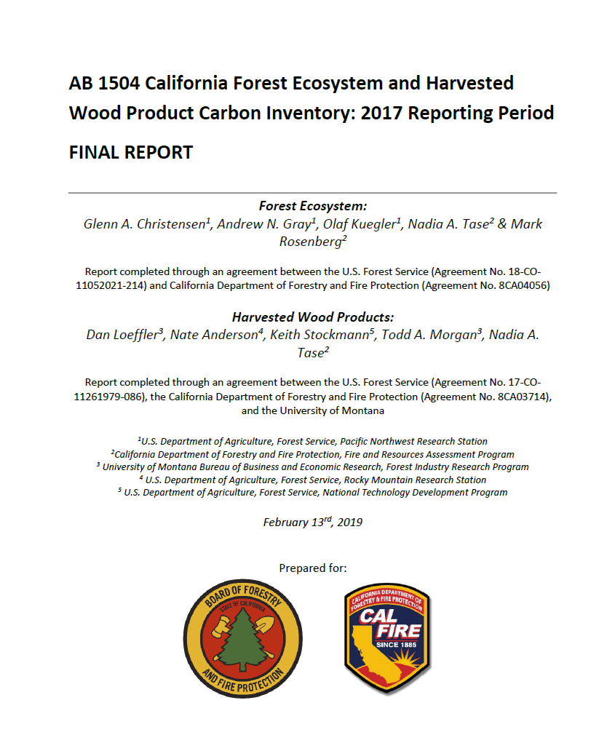
Oregon Forest Ecosystems Carbon Report
Report format based on California Forest ecosystem and Harvested Wood Product Carbon Report
  Layout
  Tables
  Figures

Slide 5
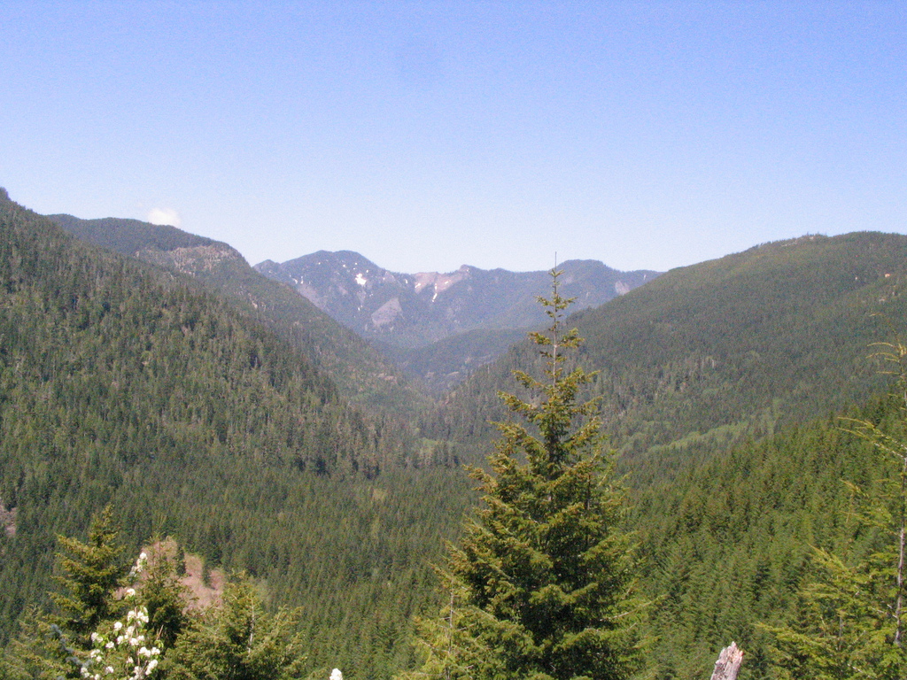
Work plan and timeline
Deliver draft tables – Completed Dec. 2018
Federal government shutdown – Completed Jan. 2019
Analysis and prepare draft report – In progress
Final report – June 2019

Slide 6
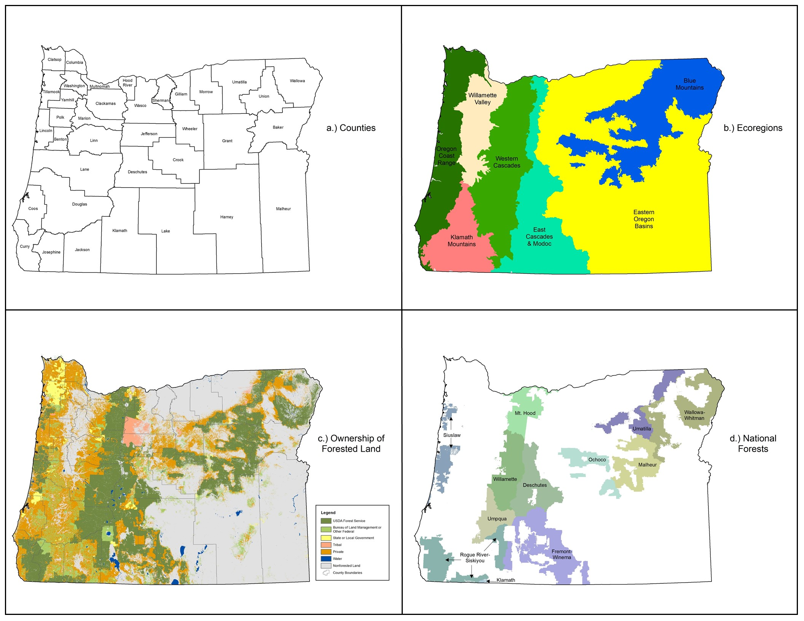

Slide 7
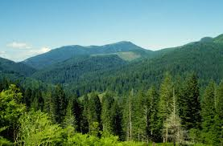
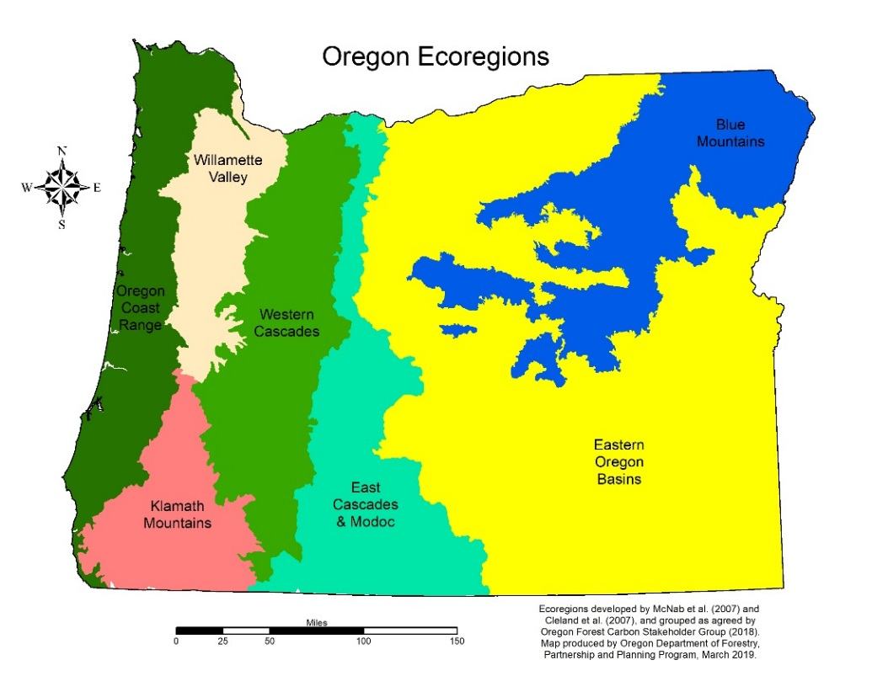
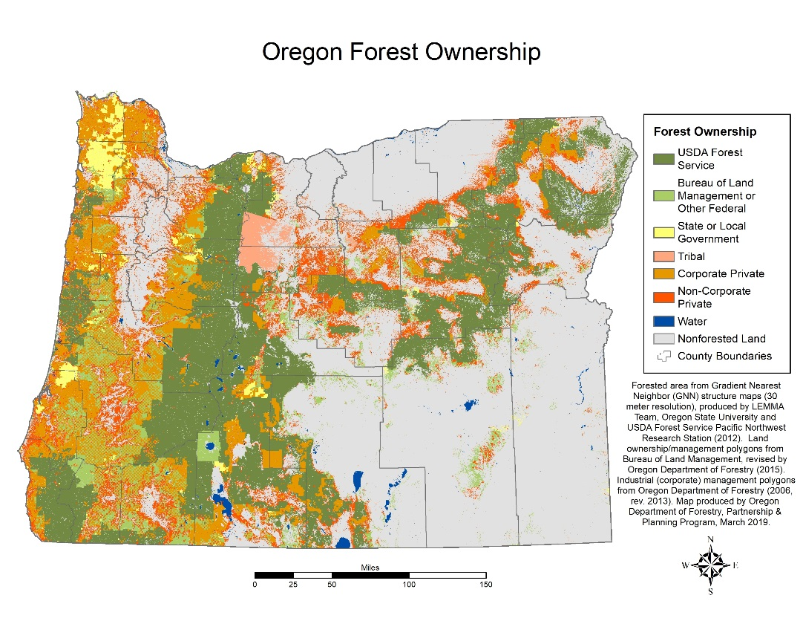

Slide 8
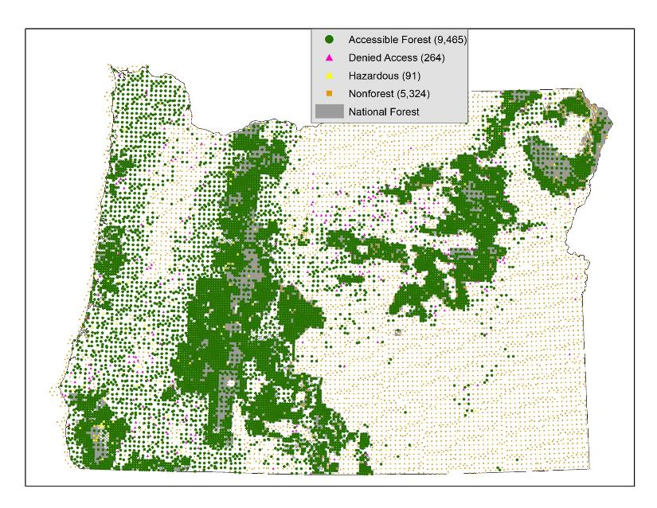
FIA Field Measured Plots in Oregon: Base grid plus R6 Intensified grid
Adds:
4,350 National Forest plots
Plot density of 1 per 1,850 ac. outside of wilderness

Slide 9
Report tables - overview
Index -
  A – Forest land area
  B – Carbon flux
  C – Carbon stocks
  D – Carbon stocks by forest type
  Other – Land use/land change, non-CO2 GHG emissions
  Tables 4.1 – 4.33, tables within text of report

Slide 10
Tables overview - A
Forest land area: 24 tables
  A1 – A8: Area of sampled land by land status, owner group, by ecoregion
  A9 – A16: Area of forest land by land status, owner group, by ecoregion
  A17 – A24: Area of forest land by forest type, owner group, by ecoregion

Slide 11
Tables overview - B
Carbon flux: 12 tables
  B1 – B8: Annual net change in carbon stocks on forest land for all pools by owner group, ecoregion
  B9.1 – B9.3: Annual average net change in aboveground pools by disturbance type, forest land status, owner group, by ecoregion, county, National Forest
  B10: Annual net change per acre by pool, disturbance, forest land status, owner group, average flux in live trees from growth, harvest, mortality, by county,
  B11: Annual net change on timberland, by disturbance, owner group
  B12: Annual net change per acre Area on timberland, by disturbance, owner group

Slide 12
Tables overview - C
Carbon stocks: 79 tables
  Forest land status
  Owner group
  Ecoregion
  By pool –
    Live and dead trees
    Understory
    Below ground
    Soil organic carbon
    Down wood
    Forest floor

Slide 13
Tables overview - D
Carbon stocks by forest type: 72 tables
  Forest land status
  Owner group
  Ecoregion
  By pool –
    Live and dead trees
    Understory
    Below ground
    Soil organic carbon
    Down wood
    Forest floor

Slide 14
Forest Carbon Stocks
  Live trees: Based on FIA regional biomass equations, adds foliage
  Standing dead trees: Same as live trees, including reductions for decay
  Understory vegetation: As modeled and populated in FIA DataBase
  Down wood debris: Use collected measurements and National FIA estimation protocol, piles not included
  Forest floor: Use collected measurements and national estimation protocol
  Roots on live and standing dead trees: Uses National FIA protocol
  Organic soils: As modeled and populated in FIA DataBase using Domke et al. (2017)
Domke, G.M.; Perry, C.H.; Walters, B.F.; Nave, L.E.; Woodall, C.W.; Swanston, C.W. 2017. Towards inventory-based estimates of soil organic carbon in forests of the United States. Ecological Restoration 27(4): 1223-1235. DOI: 10.1002/eap.1516. (accessed: November 2, 2017).

Slide 15
Forest Carbon Stocks
Oregon Statewide Forest Carbon Stocks by Forest Pools, 2007-2016
Forest Carbon Pools | Total Carbon | SE
 | million metric tons
Live Trees | 1,039.0 | 9.6
Standing Dead | 79.0 | 1.6
Understory Veg | 34.0 | 2.1
Down Woody Debris | 156.8 | 1.9
Forest Floor | 117.19 | 0.55
Roots | 238.0 | 2.2
Soil Organic C | 1,575.27 | 7.55
All Pools | 3,239.7 | 16.7

Slide 17
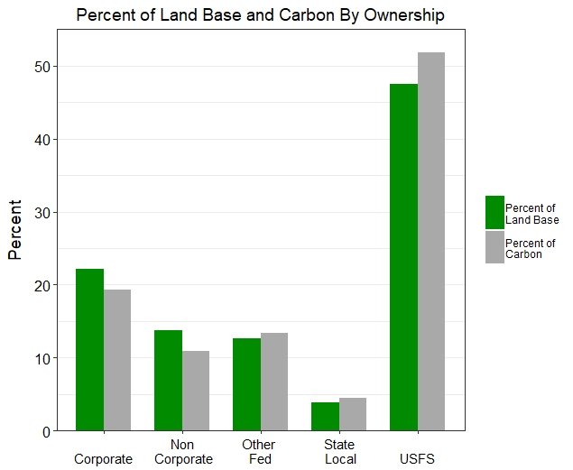

Slide 18
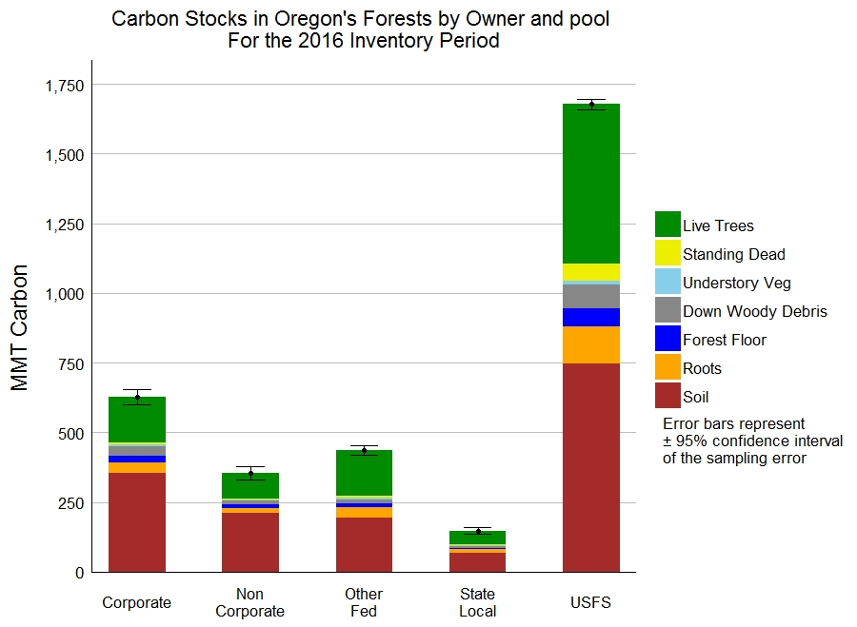

Slide 19
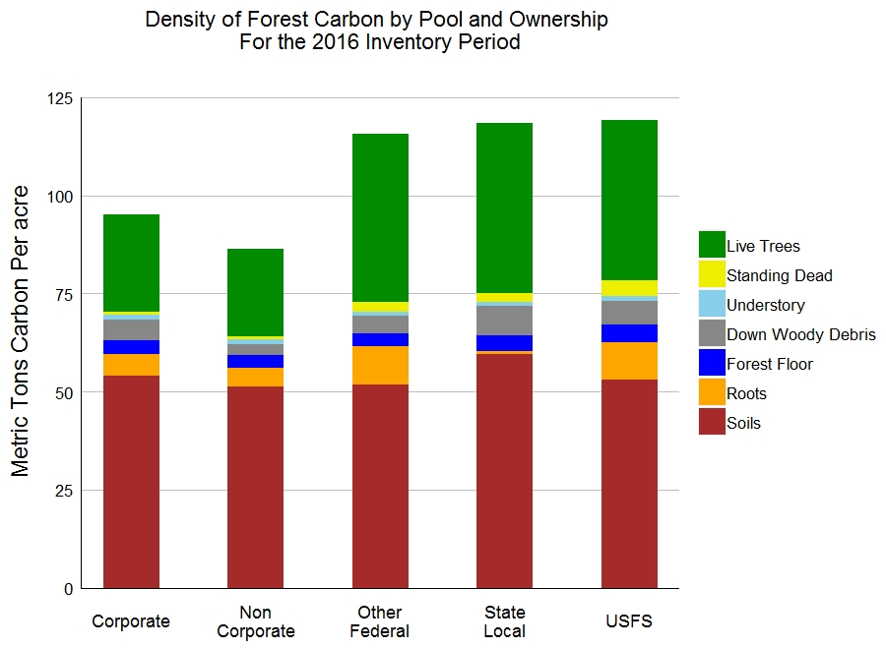

Slide 20
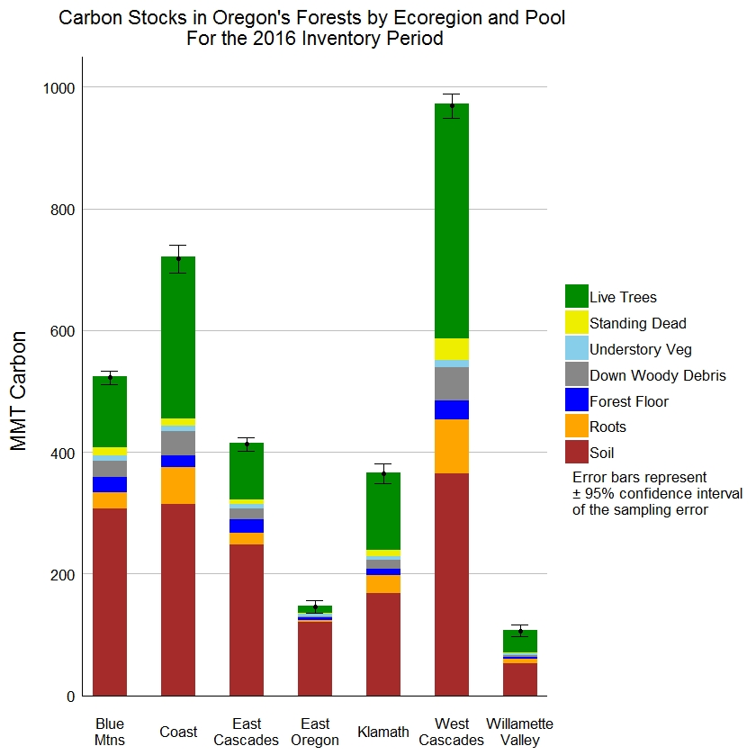

Slide 21
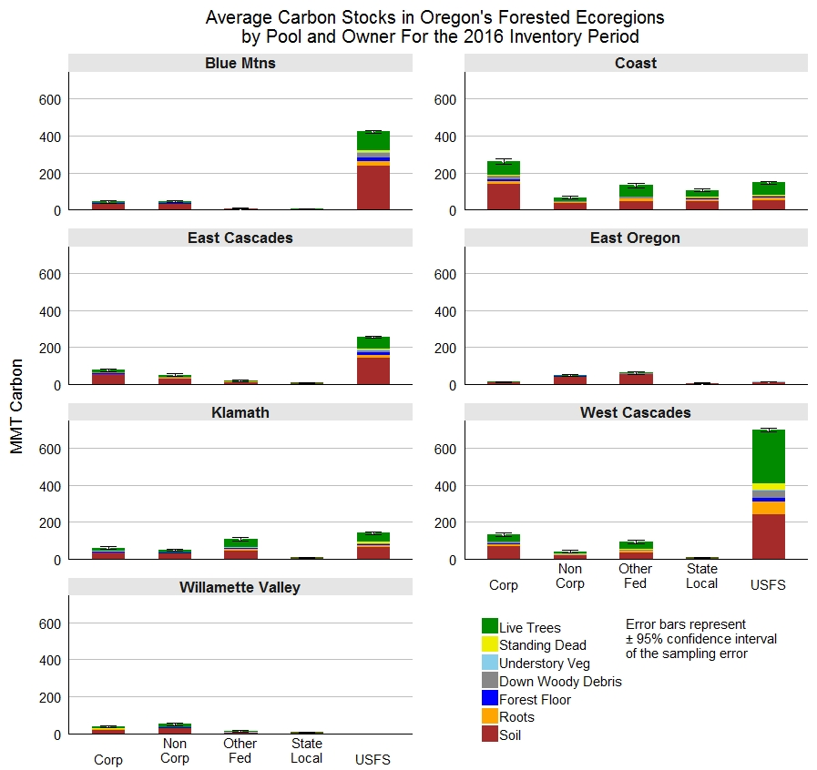

Slide 22
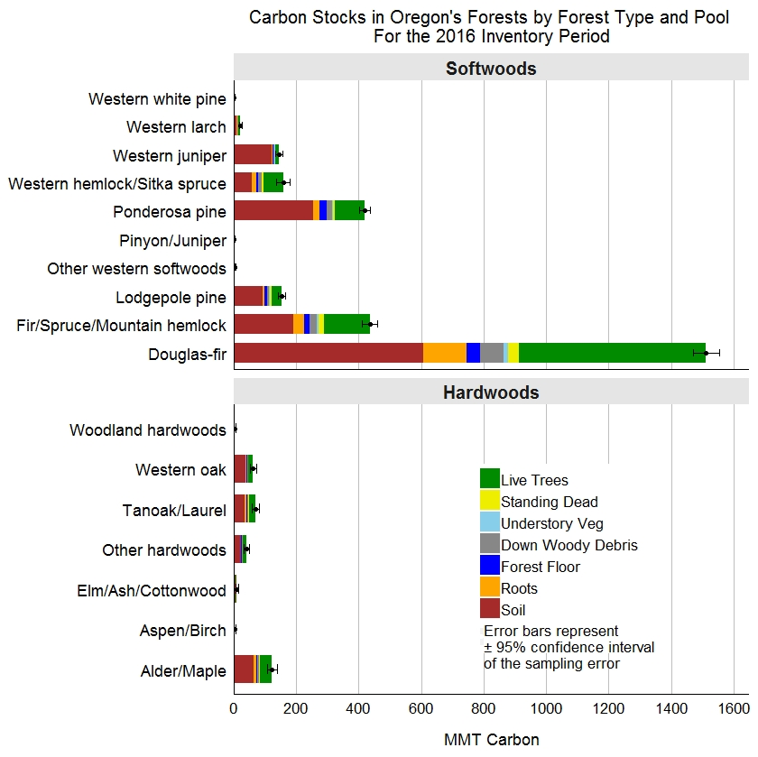

Slide 23
Forest Carbon Flux
Every pool of forest carbon has a rate of carbon input and rate of carbon output.
Flux represents the amount of carbon going into a pool minus the amount going out
Flux is reported in units of CO₂ equivalents
Current estimates of forest carbon flux were based on one repeat measurement on 60% of all plots in Oregon.
100% of all forest inventory plots will be remeasured by 2020
Annual forest carbon flux is estimated from actual measurements of growth, removals, and mortality

Slide 24
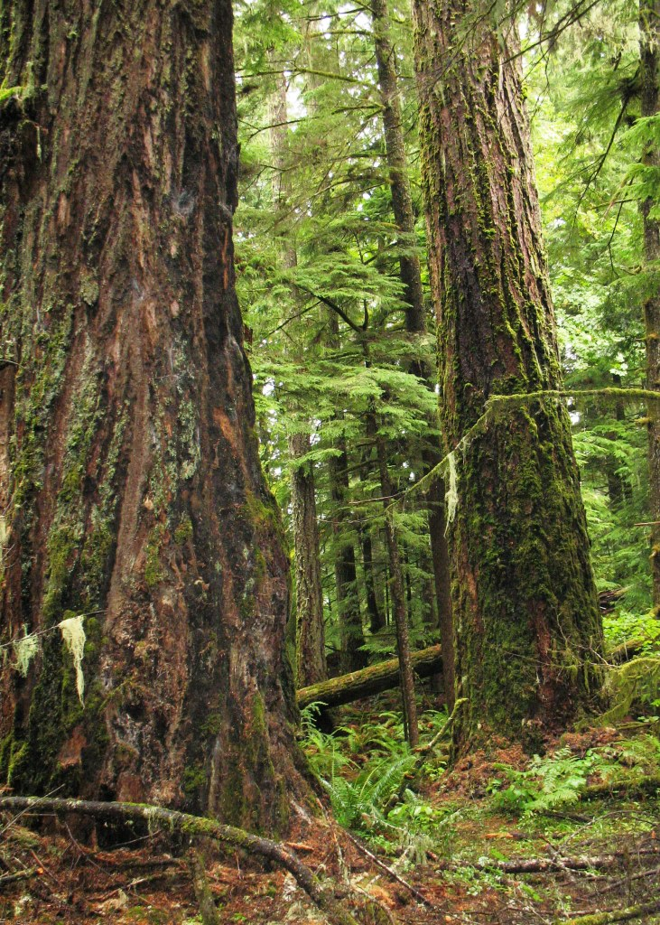
Forest Carbon Flux
Annual Net CO2e Flux From Forest Pools in Forest Land Remaining Forest Land, 2001-2006 to 2011-2016
Forest Carbon Pools | Net flux
 | Total | SE
 | Million Metric Tons CO2 equivalent/yr
Live Trees | 31.73 | 2.90
Standing Dead | -.018 | 0.68
Understory Veg | -0.21 | 0.04
Down Woody Debris | -6.82 | 0.82
Forest Floor | 0.56 | 0.13
Roots | 5.98 | 0.69
Soil | -0.17 | 0.29
Net flux All Pools | 30.91 | 3.77

Slide 25
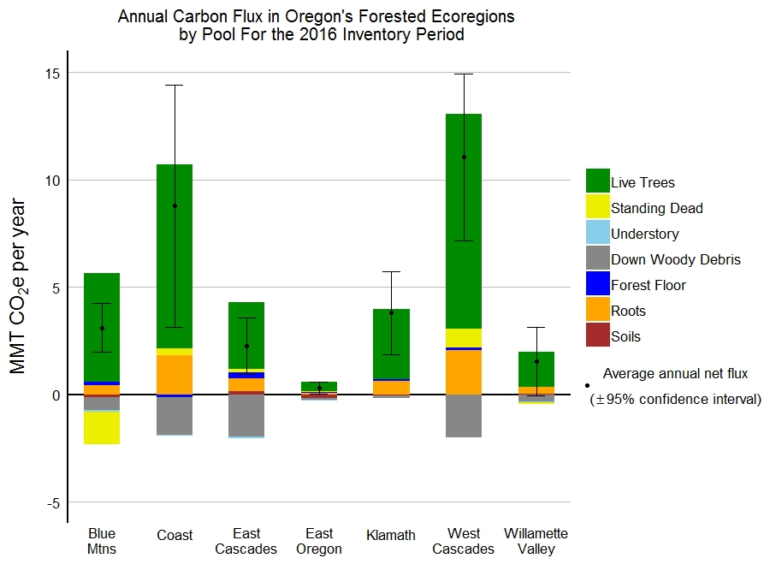

Slide 27
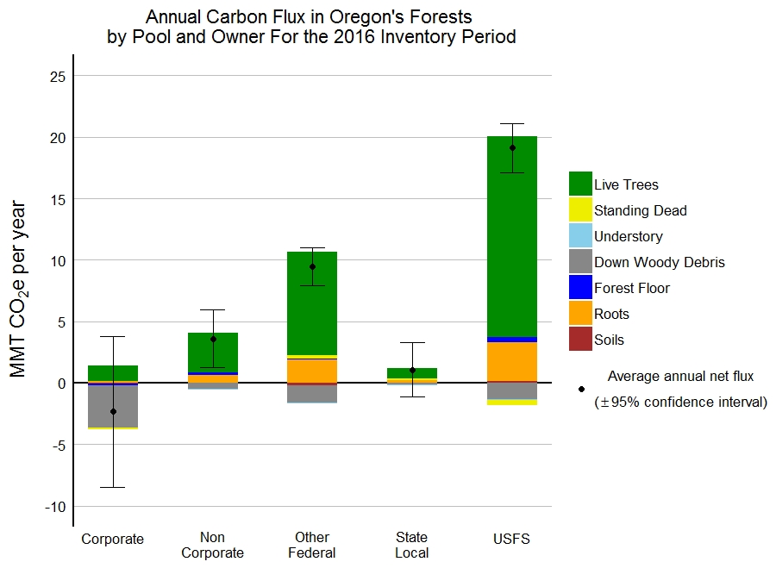

Slide 29
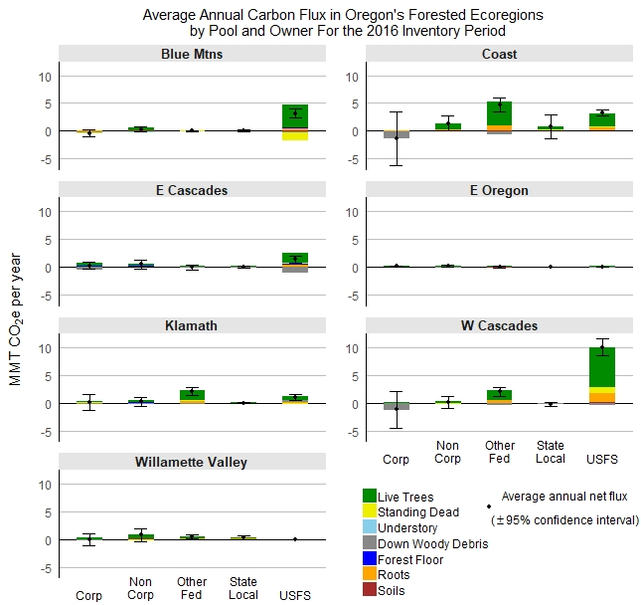

Slide 30
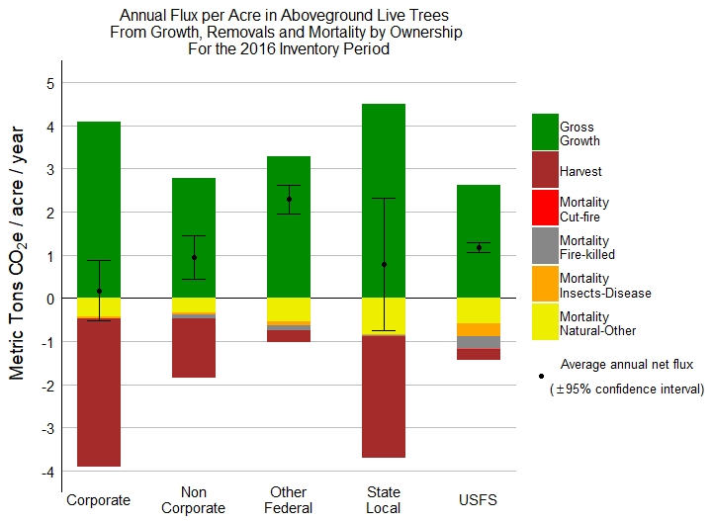

Slide 31
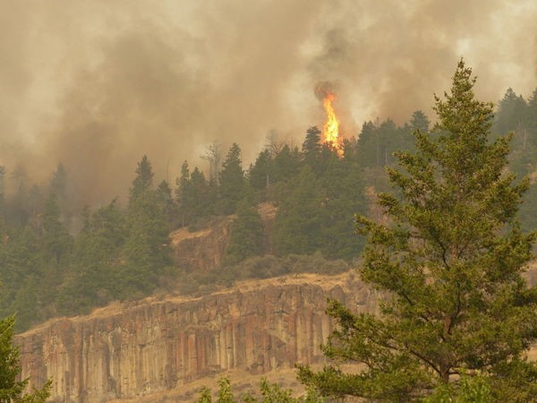

Slide 33
Summary
Carbon storage in Oregon’s forests is about 3.2 billion metric tons.
Each year, Oregon’s forests sequester about 30.9 million metric tons of CO₂ equivalents.
Flux of carbon released from wildfire was smaller than the standard error of 3.8 on the total net flux of 30.9 million metric tons.
Carbon stored in harvested wood products will be completed later this year

Slide 34
Questions?

