Slide 1

ONA reassessments impact on ISPs
Full transition to Service Group framework for in-home hours
March 2025

Slide 2

Main points

Slide 3
Assessments
The ONA is the only assessment for setting in-home hours starting with plans beginning 4/1/2025
The CNA is no longer a valid assessment for children
The ANA can only be used for adults in Supported Living.

Slide 4

School / Summer Hours
All plans for school aged children that start on or after 4/1 must include school and summer hours

Slide 5
Aging into new Service Groupings
When a person ages into a new service group, the hours within the new ONA service level are not automatically available. The person must have an age-appropriate ONA and a revised ISP. If the age-appropriate ONA that moves the person into a new service group is submitted before the birthday, access to the new ONA service level is available as soon as the hours are included in an ISP

Slide 6
Reductions – ONA reassessments
Starting 4/1/2025
If an ONA reassessment lowers a person's service group and their current ISP includes an hour allocation based on an ONA, their hours will be reduced by the end of the month following the ONA submission—unless an exception request is approved.
Notes:
(k) When an ONA assigns an individual to a service group with a lower service level than the hour allocation authorized in an ISP at the time of the ONA, the individual may have access to the amount authorized in the ISP for no longer than the end of the month that follows the month in which the ONA was conducted. (The example used in this subsection of this rule is illustrative only and limited to the facts it contains.) Example: An ONA completed on April 10th assigned an adult to service group 2. The previous ONA had assigned the adult to service group 3. The hour allocation within the service level for service group 3 is available to the adult through May 31st.

Slide 7

Today’s focus
Oregon Needs Assessment reassessments that lead to a change in the Service Group for individuals currently using the ONA to set the hours in their ISP.
Notes:
There are questions about ONA reassessments for folks currently using the ONA service group to set their hours. I will have additional training materials for those scenarios soon.

Slide 8

Pre-Assessment

Slide 9
Notice of Functional Needs Assessment
Notice of Functional Needs Assessment (DHS 0378A or DHS 0378B) must be sent to an individual at least 14 days prior to a planned reassessment by an ONA Assessor.
At the person’s request, the ONA can be scheduled within the 14-day notice period.
Notes:
ORS 411.099 requires that a notice must be mailed to the individual being assessed no fewer than 14 days prior to conducting a reassessment for service eligibility. In ORS 411.099 assessment for service eligibility means a process of evaluating the functional impairment levels of an individual and an individual’s requirements for assistance in performing activities of daily living.
For ODDS, ORS 411.099 applies to the Oregon Needs Assessment (ONA). DHS 0079 (01.19) Only ONAs conducted by an assessor can change a person’s service eligibility.
Case management entities must notify an individual at least 14 days prior to an ONA Assessor conducting a reassessment for service eligibility using ONA.

Slide 10
Notice of FNA not needed for:
Initial ONAs,
A change in need ONA reassessment requested by the individual,
ONA reassessments completed by a Services Coordinator or Personal Agent,
ONA reassessments due to a sudden, urgent increase in needs when the 14- day notification period could unnecessarily delay needed services
Notes:
https://www.oregon.gov/odhs/transmittals/oddstransmittals/23041.pdf

Slide 11

ONA meeting

Slide 12
What to expect next
Let the person know what they can expect next
When the ONA is planned to be completed, and they will get additional information about the results
If the ONA service group changes:
The individual will receive a Service Group letter within 14 days of the ONA being submitted; and
The case manager will review the ISP with the person by the end of the month following the month the ONA is completed

Slide 13

ONA submission

Slide 14
Service Group Change letter
After an ONA is submitted and the ONA results in a change to the person’s service group, the Service Group Change letter must be sent within 14 days of the submission of the ONA.
This applies to both when the change to the service group is the result of:
Changes to the person’s needs (increase or decrease)
Aging into a new age group
Include both:
Exceptions flyer
ONA comparative service group report and cover letter

Slide 15
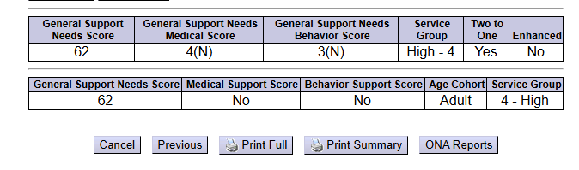

ONA Comparative service group report
Enter PRIME to search for all completed ONAs
Select two ONAs to compare (usually two most recently completed)
Notes:
ONA comparison report shows the individual the differences in the scoring between two ONAs that contributes to the calculation of the person’s service group

Slide 16

ISP review

Slide 17
Reviewing the ISP
Hours Allocation
Desired outcomes
Risk factors from ONA
Community and social activities
Assessed needs from ONA
Technology resources
Support network
Employment and/or school life
Home life
Other supportive services
By the end of the month following a completed ONA regardless of the service group change, the ISP must be reviewed to incorporate changes to needs and preferences.
During this review, determine if the resources available, paid and unpaid, can meet the person’s needs.
This review can take place as a formal meeting, or through other communication methods preferred by the person and their team.
Most reviews will result in a Change Form documenting the changes to the ISP, most times these will not require a signature

Slide 18
Service Group increases
When an ONA results in a higher service group, the hours from the service group are available as soon as the changes to the support needs and hour allocation are incorporated into the person’s ISP.
Most often this can be completed using a change form and does not require signatures to implement.

Slide 19
Service Group decreases
When an ONA results in a lower service group, the reduction takes effect on the last day of the month following the month of the ONA completion date unless an exception request has been submitted to ODDS.
What to expect next
Agree to a reduction
Plan will include reduced hours
Person will receive a NOPA
Does not agree to a reduction
Plan hours will not change now
SC/PA will submit an exception request
ODDS will send a decision

Slide 20

Dates examples

Slide 21
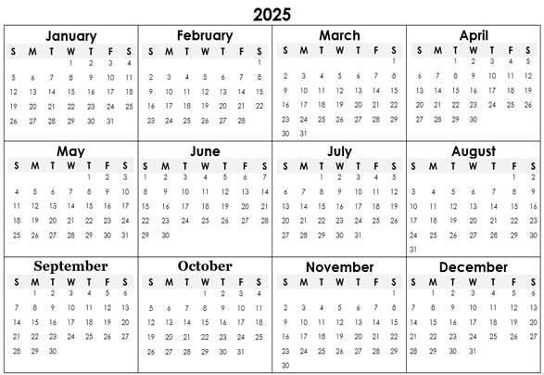
Person agrees with an ONA reassessment reduction during the plan year
ISP start date
ONA reduction
Service Group letter include:
Comparative SG report
and cover letter
Exceptions flyer
ISP review
NOPA sent
Change form to
ISP with reduction

Slide 22
Person disagrees with an ONA reassessment reduction during the plan year
ISP start date
ONA reduction
Service Group letter include:
Comparative SG report
and cover letter
Exceptions flyer
ISP review
Exception request sent
NOPA sent
Change form to
ISP with reduction

Slide 23
Youth turning 18 agrees with an ONA reassessment reduction with Adult SG during the plan year
ISP start date using
Adolescent SG
Adult ONA reduction
18th Birthday!
Service Group letter include:
Comparative SG report
and cover letter
Exceptions flyer
ISP review
NOPA sent
Change form to
ISP with reduction

Slide 24
Youth turning 18 disagrees with an ONA reassessment reduction with Adult SG during the plan year
ISP start date using
Adolescent SG
Adult ONA reduction
18th Birthday!
Service Group letter include:
Comparative SG report
and cover letter
Exceptions flyer
ISP review
Exception request sent
NOPA sent
Change form to
ISP with reduction

Slide 25
Youth turning 18 with an ONA reassessment increase with Adult SG during the plan year
ISP start date using
Adolescent SG
Adult ONA increase
18th Birthday!
Service Group letter include:
Comparative SG report
and cover letter
Exceptions flyer
ISP review
Change form to
ISP with increase

Slide 26
Youth turning 18 agrees with an ONA reassessment reduction with Adult SG before the plan year
Adult ONA reduction
Service Group letter include:
Comparative SG report and cover letter
Exceptions flyer
ISP start date using
Higher Adolescent SG
with reduction in 1 month
18th Birthday!
NOPA sent
Reduction to Adult SG

Slide 27
Youth turning 18 with an ONA reassessment increase with Adult SG before the plan year
Adult ONA increase
Change form to higher
Adult SG hours
Service Group letter include:
Comparative SG report and cover letter
Exceptions flyer
ISP start date using
Adult SG hours
18th Birthday!

Slide 28
Exception request
Youth turning 18 disagrees with an ONA reassessment reduction with Adult SG before the plan year
Adult ONA reduction
Service Group letter include:
Comparative SG report and cover letter
Exceptions flyer
ISP start date using
Higher Adolescent SG
Exception request
18th Birthday!
NOPA sent
Change form to
ISP with reduction

