Slide 1
Making Data Accessible throughout the Data Lifecycle
Data Equity Summit 2024

Slide 2

Why is this important?
Accessibility is required for equity work
To be good communicators
Data is just information
To be thorough
Consideration at every level
Better results
Authenticity and agency

Slide 3
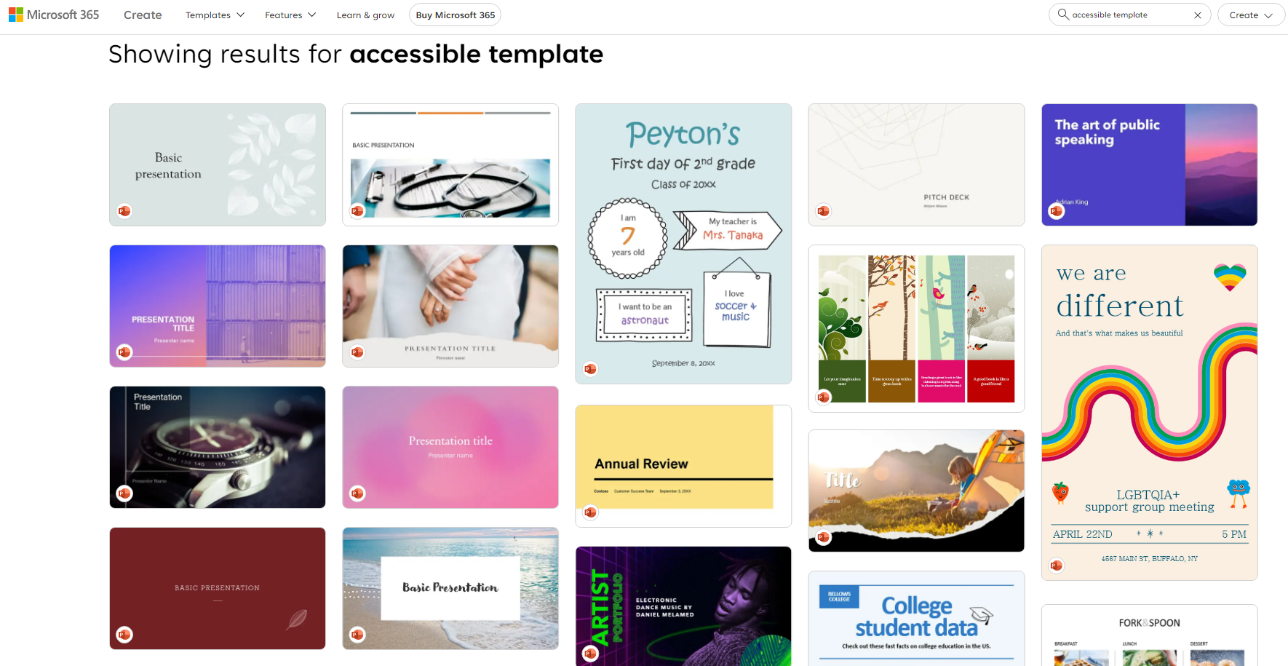
Accessibility Difficulty
Searching for accessibility can be misleading

Slide 4
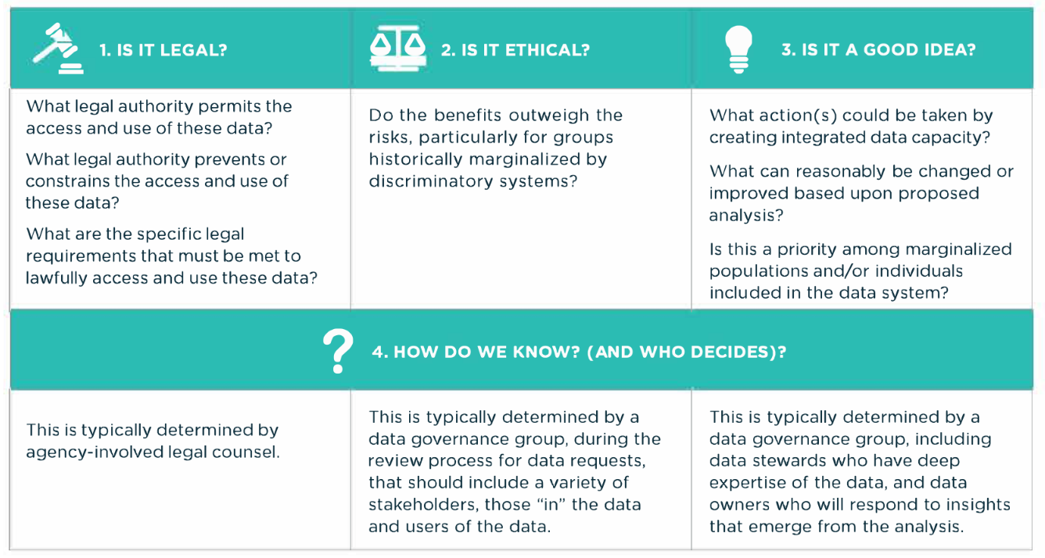
4 Questions by Actionable Intelligence for Social Policy (AISP)

Slide 5
Accessibility at Every Level
Understanding the Reason
Data Collection
Data Cleaning
Data Analysis
Reporting & Review

Slide 6
Understanding the Reason
Data Collection
Data Cleaning
Data Analysis
Reporting & Review
Understanding the Reason
What is being asked?
Will what you’re measuring be directly addressed by your question?
Consider alternative perspectives and understandings of the problem
Have community input to provide deeper understanding
Center racial equity and resist expert bias
Prepare materials for most common types of accessibility requests
See: We All Count for more info

Slide 7
Data Collection
Understanding the Reason
Data Collection
Data Cleaning
Data Analysis
Reporting & Review
Use plain language wording
Highlight accessibility accommodations at the start
Consider environmental impacts of where data is being collected and imported
Have “clarity” questions, and check for understanding and meaning

Slide 8
Data Cleaning
Understanding the Reason
Data Collection
Data Cleaning
Data Analysis
Reporting & Review
Be transparent about the process
Have community feedback inform grouping
Know how to handle small numbers and outliers

Slide 9
Data Analysis
Be transparent about your process
If possible, have community informed analysis
Know how to represent small numbers and outliers
Reflect
Did the data capture all perspectives?
Why might there be missing perspectives?
How do the limitations impact analysis and reporting?
Have you written alt-text for all your graphs?
Understanding the Reason
Data Collection
Data Cleaning
Data Analysis
Reporting & Review

Slide 10
Reporting
Have accessibility resources at the beginning
Have community feedback on how to present the data
Provide framing, context, limitations, and sources
Visualize without disparity comparisons
Understanding the Reason
Data Collection
Data Cleaning
Data Analysis
Reporting & Review

Slide 11
Review
Reflect
How would someone without any previous knowledge interpret your report?
How would someone who disagrees with your conclusions use your results and process against you?
How would someone without sight be able to understand your visualization through titles and alt-text?
What would you change to better address accessibility needs in the future?
Understanding the Reason
Data Collection
Data Cleaning
Data Analysis
Reporting & Review

Slide 12

Reflection
All equity work must be accessible
Accessibility requires multiple approaches and understandings
As with equity, accessibility must be integrated at every level
Be transparent about limitations and plan for future revisions

Slide 13

Thank you!

