Slide 1
Accessibility Tools for Everyone
November 19, 2024
Eaen Goss (they/them)
Oregon Health Authority, Public Health Division
Environmental Health Education & Equity Specialist

Slide 2
Overview
The Basics
Microsoft Built-In Accessibility Features
PowerPoint
Word & Excel
Color Contrast Checkers
Wrap-Up

Slide 3
The Basics

Slide 4
You Already Have the Tools!
All of the tools shared in this presentation are either already built-in to the Microsoft products on your computer or available for free online
Using these tools as a regular part of your work will help ensure that what you are sharing is accessible to the widest amount of people possible

Slide 5

What to Consider
Organization and flow of content
Colors and color contrast
Font size and style
Descriptions of images, charts, and tables

Slide 6
Microsoft Built-In Accessibility Features

Slide 7
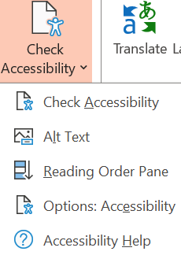
PowerPoint Accessibility Checker
Common accessibility flags include:
Check reading order
Missing descriptive text
Color contrast issues
Missing headings
Missing captions (if a video is included)

Slide 8
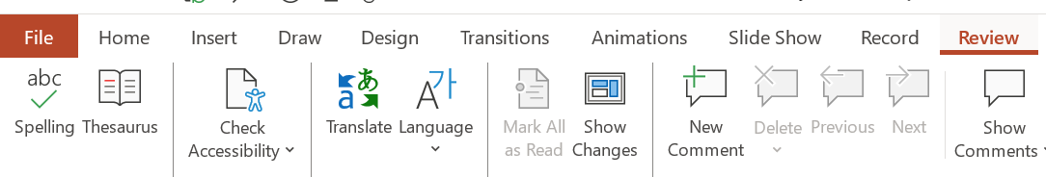
How To Use It
Start the Accessibility Checker
The Checker will open a side panel – expand each section to view all
Click on an issue to see recommended actions

Slide 9
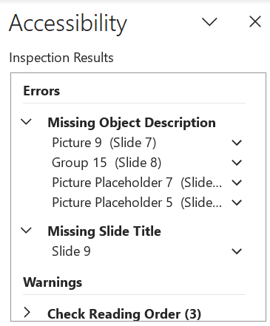
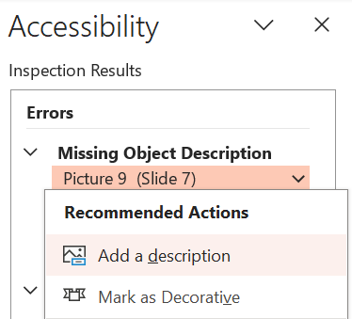
Accessibility Checker In Action

Slide 10

Quick Tips: Alternate (Alt) Text
3 questions to ask yourself when writing alt-text:
Is this meaningful?
Is this descriptive?
Does this provide all the information that someone who could see the image would get?
Practice writing alt-text for this image:

Slide 11
Accessibility Checker Demonstration

Slide 12
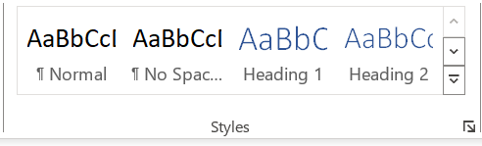
Word & Excel Accessibility Checkers
Use the same process with Word & Excel
You will notice similar warnings and errors, as well as some new types of accessibility issues to address
Microsoft Word tip: Use “Styles” to structure your documents – having headings and subheadings will make them easier to navigate (especially for screenreader users)

Slide 13
Color Contrast Checkers

Slide 14
What to Keep in Mind
If text colors do not have a high enough contrast, the information may not be accessible to people who are low vision or colorblind
Busy backgrounds or pictures behind text can also cause barriers
In general, avoid using color to convey meaning (example: using red to signify a warning)

Slide 15
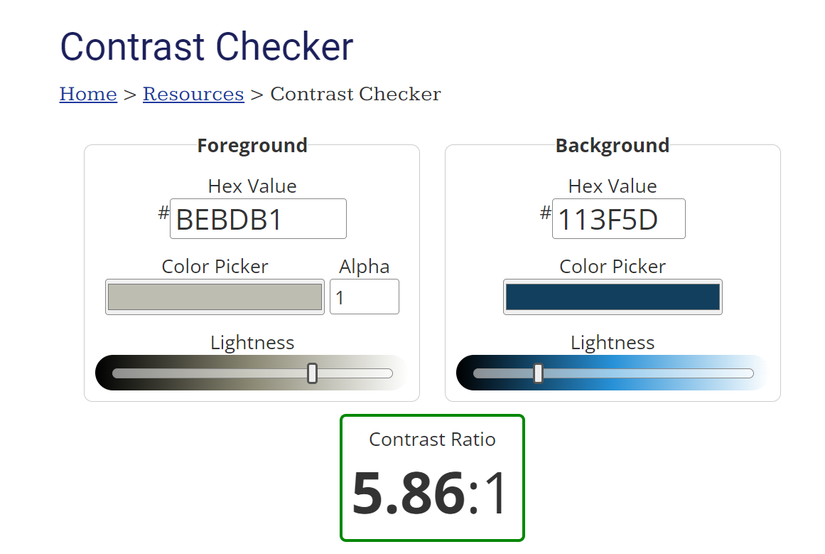
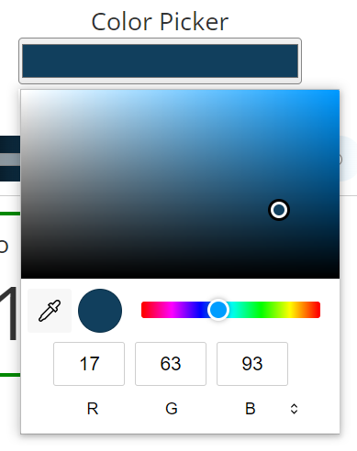
Example: WebAIM Contrast Checker

Slide 16
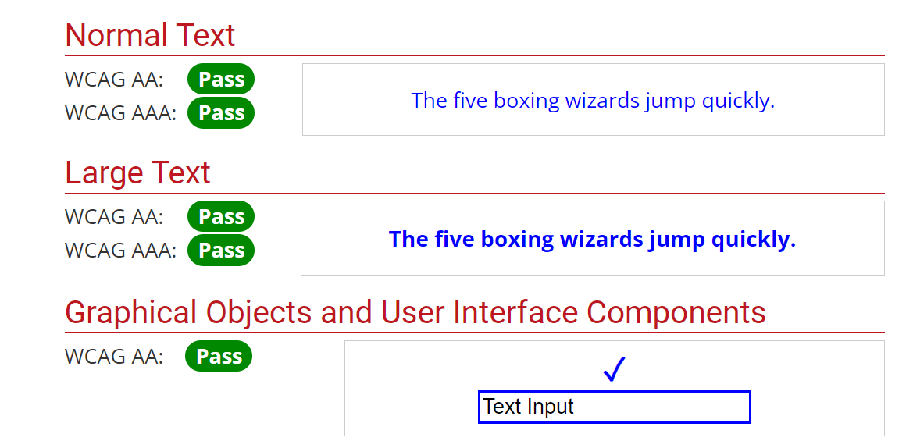
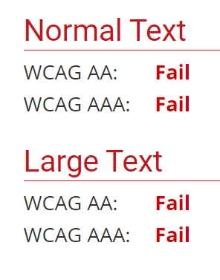
WebAIM Continued
This tool will also let you know if the contrast ratio meets Web Content Accessibility Guidelines (WCAG)

Slide 17
Wrap-Up

Slide 18

What Questions Do You Have?
Contact me: Eaen.Goss@oha.oregon.gov

