Slide 1
Office of Equity and Multicultural Services
Making Data Accessible:
Language Accessibility
Bonnie Windham (they/them)
Language Access Manager
Notes:
Bonnie Windham, she/her pronouns.
Language Access Manager with OEMS
This is just a very brief overview of Language Access Services, we will send out a copies of the slides, so you will have access to all links. I know we only have a very short time today, so I’m happy to answer questions here, or you’re welcome to reach out later via IM or e-mail.

Slide 2
Covered in this presentation
General best practices and determining language needs
Spoken and sign language interpretation
Written translation
Considerations for AI, machine translation, and auto-generated captioning

Slide 3
General Best Practices
Determining language needs

Slide 4
What languages should I be considering?
Bias in population-level language data: Where DON’T we have data where we should?
Ex: Refugee language data changes every couple of years, does not keep up with census data
People’s reported spoken/written languages don’t represent people who are not able to request their language BECAUSE of a language barrier

Slide 5
Language is Political
Mutually intelligible does not mean good enough
Consider how current events might be impacting certain communities
Consider confidentiality in small communities
Refugee and immigrant communities
Deaf, DeafBlind, and Hard of Hearing communities

Slide 6
General best practices
Involve language community as early as possible in development of data collection and planning
Whenever possible, have someone who speaks the language do the data collection work directly
Consider confidentiality and privacy in small communities
Consider politics and power differentials

Slide 7
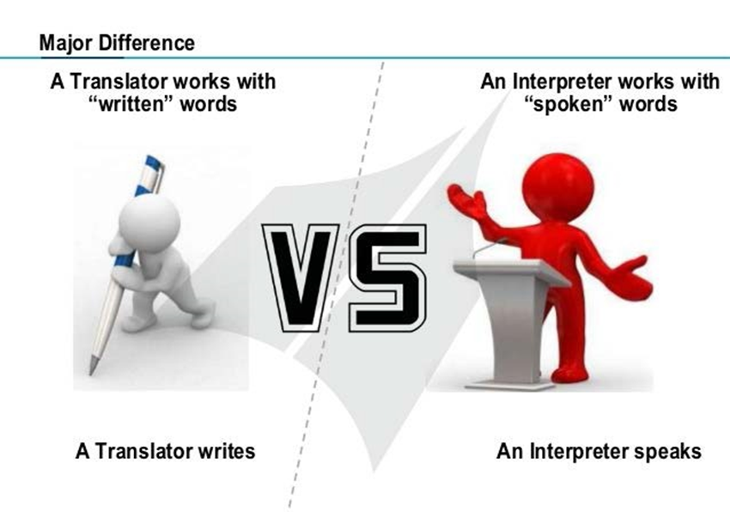
What is the difference?
Notes:
Melissa

Slide 8
Spoken Language Interpretation

Slide 9

Quality of Interpretation (descending order)
Bilingual person or community member doing the work directly
In-person interpreter
Video interpretation
Telephone interpretation

Slide 10
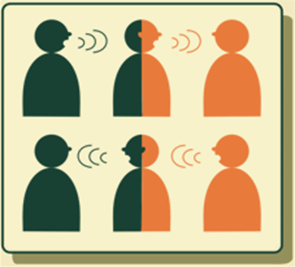
How to Work with an Interpreter
Give interpreter a heads up about what the conversation will be
Speak directly to the person, not to the interpreter
Slow, complete sentences
Pause often
Watch out for jargon and acronyms
Watch body language, check for understanding
All information should be shared with all participants

Slide 11
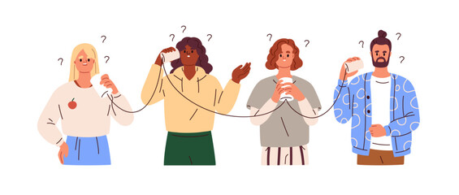
Speaking Through an Interpreter
Speak SLOWLY – Slower than you think
Remember the Telephone game?

Slide 12
Sign Language/Certified Deaf Interpreters
Use the right type of sign language (there’s more than one!)
ASL interpreter vs. Certified Deaf Interpreter
Interpreters typically work in pairs, more for long sessions
Use Zoom instead of Teams
Schedule early: Oregon has a shortage of ASL interpreters

Slide 13
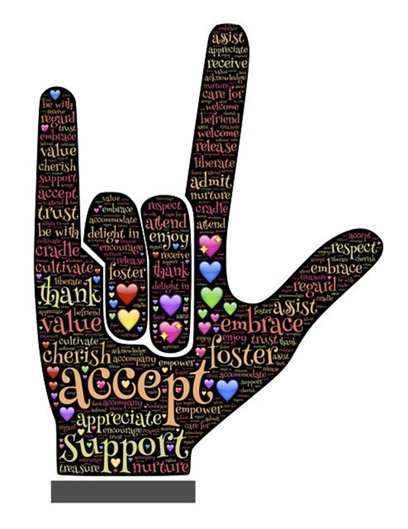
Deaf Community Insights
English is often not the first language of Deaf individuals.
Many Deaf individuals consider themselves a linguistic minority, not necessarily someone with a disability.
People with some useable hearing sometimes still identify as Deaf and use sign language.
Zoom is the preferred platform over Teams

Slide 14

Communication barriers, ineffective solutions
Passing written notes: Slow, limits amount of communication, ineffective where written English skills are limited
Relying on lip-reading: Only about 30% of speech is visible
Speaking loudly: Can distort what’s being said

Slide 15
Written Translation

Slide 16
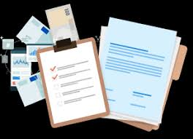
Written Translations
Not all languages have a standard written form
Many Indigenous and Refugee languages are not written
Best practice is to create the document in the target language
Plain language is critical
Reading level WILL go up when material is translated

Slide 17
Machine vs. Human Tanslation
Machine translation is common
Ask your translator whether they use machine translation
Verbatim translation vs. interpretation
Machine translations should always be reviewed by a human translator

Slide 18

CART Captioning Services
CART: Communication Access Realtime Transcription
Live, human-generated captioning for people who are Deaf or Hard of Hearing
Also helpful for people whose first language is not English
Auto-generated captioning not accurate, too fast

Slide 19
What about AI?

Slide 20
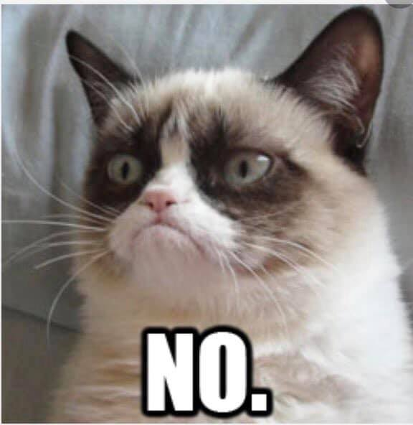
Can’t I just use Google Translate?

Slide 21


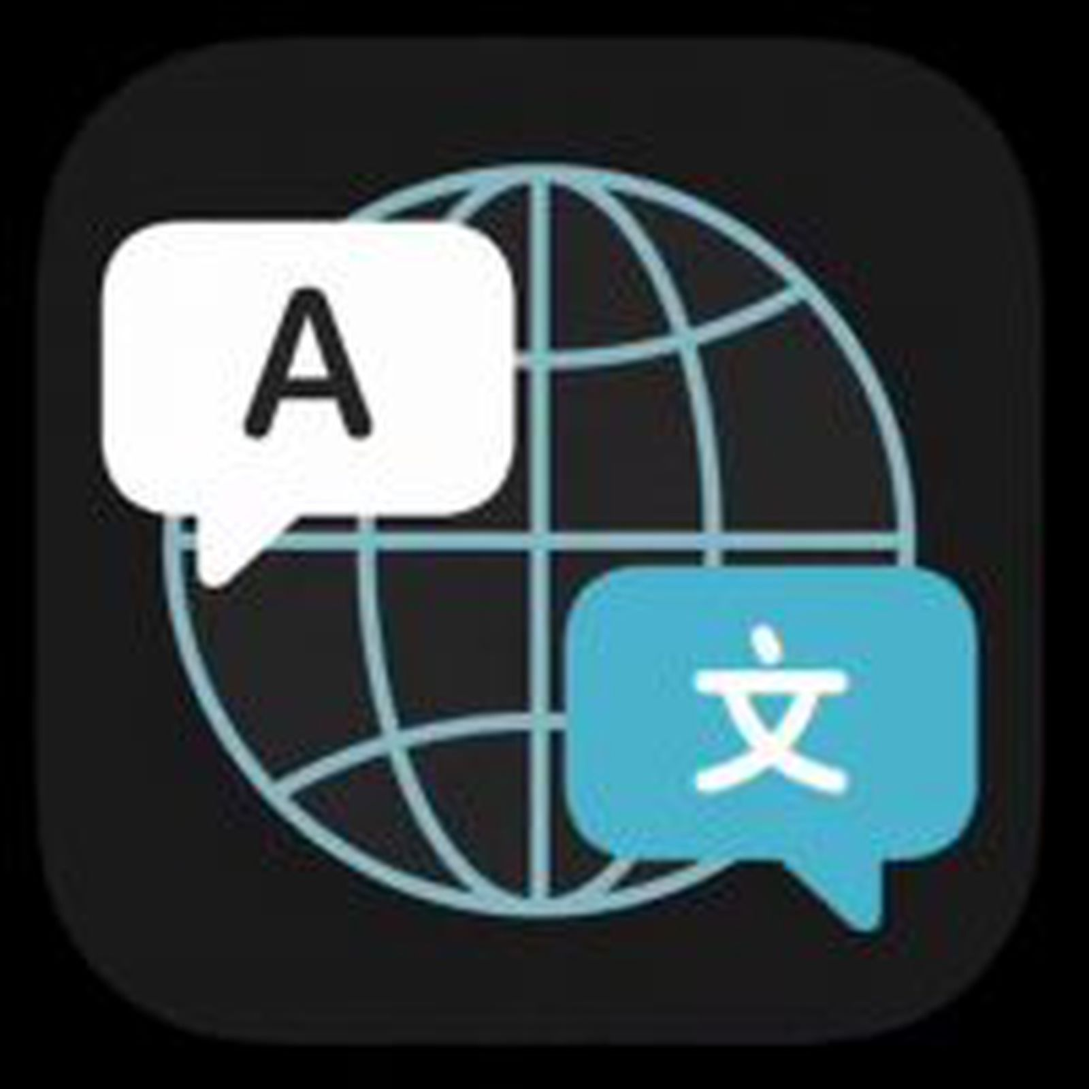
AI Translation is fashionable, not equitable

Slide 22
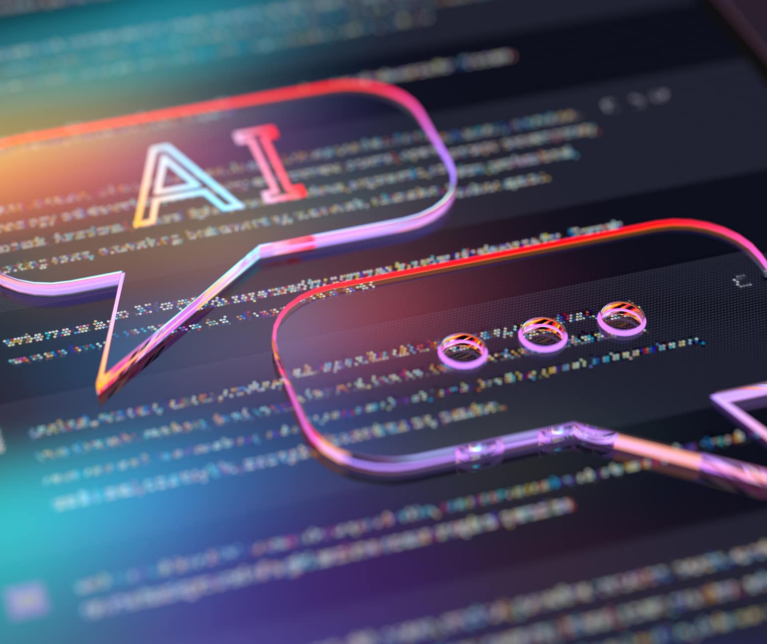
Harm caused by relying on AI
AI translation is biased in favor of certain languages
AI responses rely on input from users
AI often says offensive things
Many concepts do not translate directly
Real and horrifying impacts on communities

Slide 23
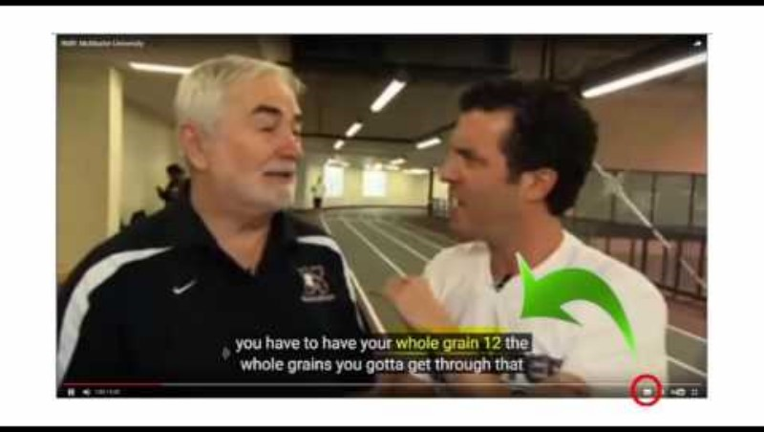
Auto-Generated Captioning

