Slide 1
Equity Metrics: History, Where We Are Now & Future Developments
By Matt T. Bagwell, PhD, MPA (he/him) | Nov. 19, 2024
Disclaimer: The views and opinions expressed in this presentation are solely those of the presenter and do not necessarily reflect the views or positions of any affiliated entity, including the State.

Slide 2
Outline of Talk
PART 1: A Brief History of Equity Metrics
PART 2: Current State of Equity Metrics, Best Practices & Future Directions

Slide 3
Part I: A Brief History of Equity Metrics
Public Health Origins
Moving from Inequity to Equity

Slide 4
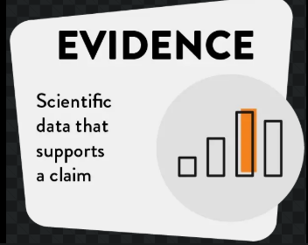
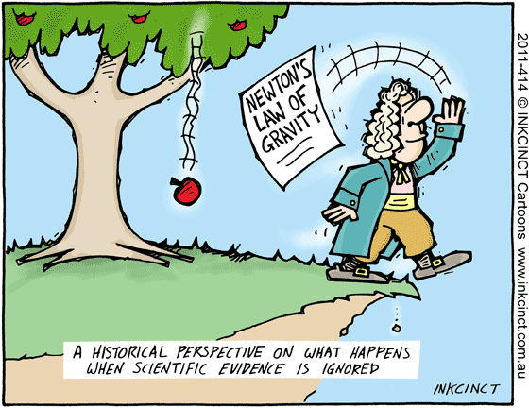
Scientific Evidence

Slide 5

Social Epidemiology

Slide 6
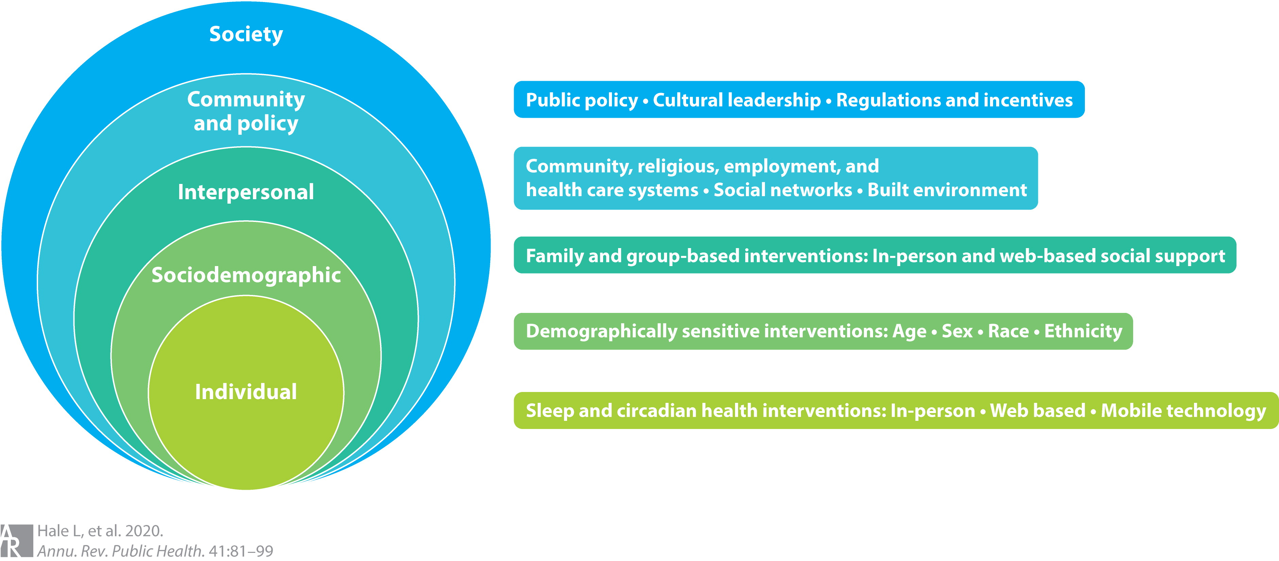
Socioenvironmental Factors

Slide 7

Disparities: Differences in Population Health
Environmental Exposure
Healthcare Access, Utilization, or Quality
Health Status
Health Outcomes
Contextualities: Race, Ethnicity, Gender, Geography, Socioeconomic Status & Age

Slide 8
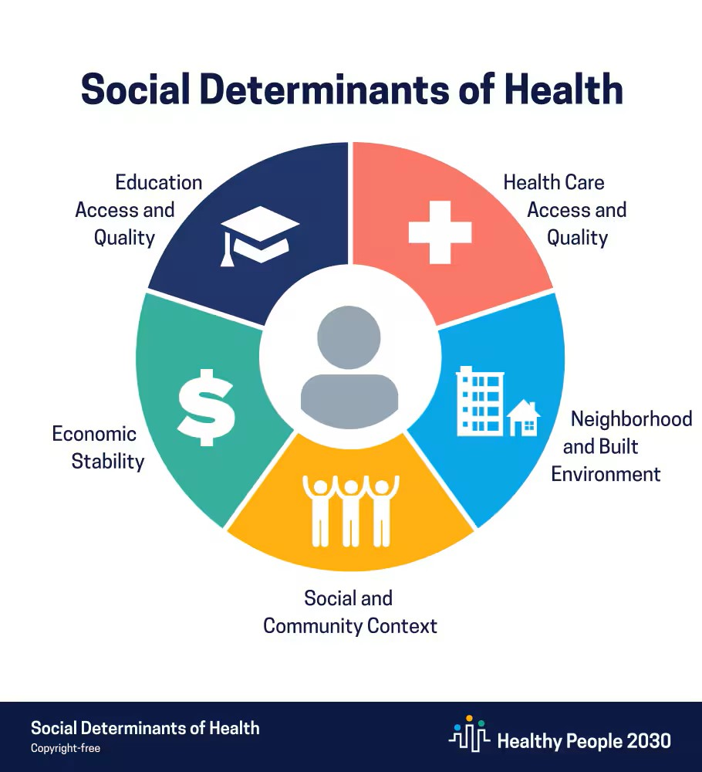
Social Class & Public Health

Slide 9

Complex problems call for complex solutions.

Slide 10
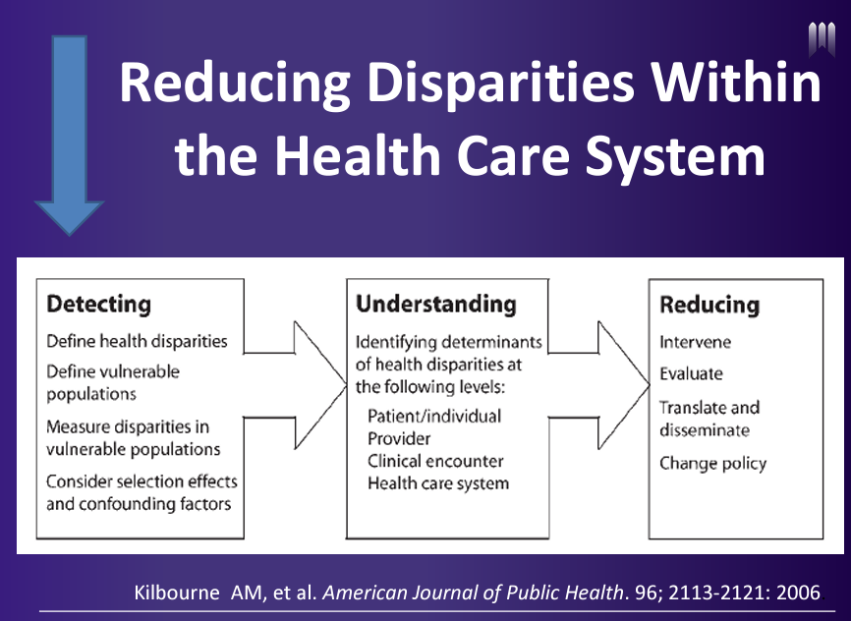

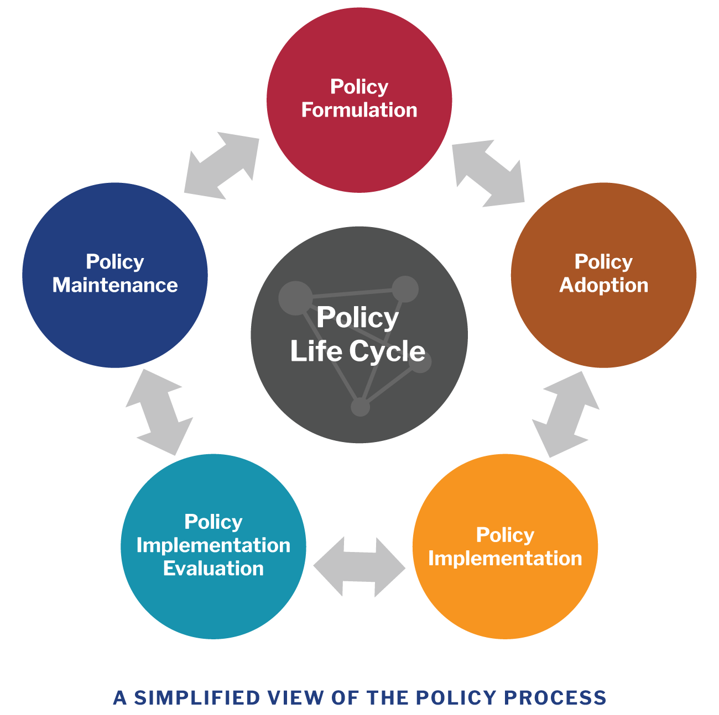
Part II: Current State of Equity Metrics, Best Practices & Future Directions
Conceptual Frameworks
Data Equity
Policy

Slide 11
Best Practices for Health Equity
Shift from only individual-level factors to multifactorial social determinants of health
01
Shift from disparity-centric to an equity-centric model
02
Consider the role of population health in research discovery & programmatic intervention
03

Slide 12

Environmental Justice article excerpt

Slide 13
Best Practices for Health Equity
4. Understand complex, multidisciplinary, multilevel, and multi-factorial interactions
5. Improve research methodologies and statistical analytical techniques
6. Build on community resiliency and partnerships

Slide 14


Best Practices for Improving Health Equity
7. Develop both the Research and Professional Workforce

Slide 15
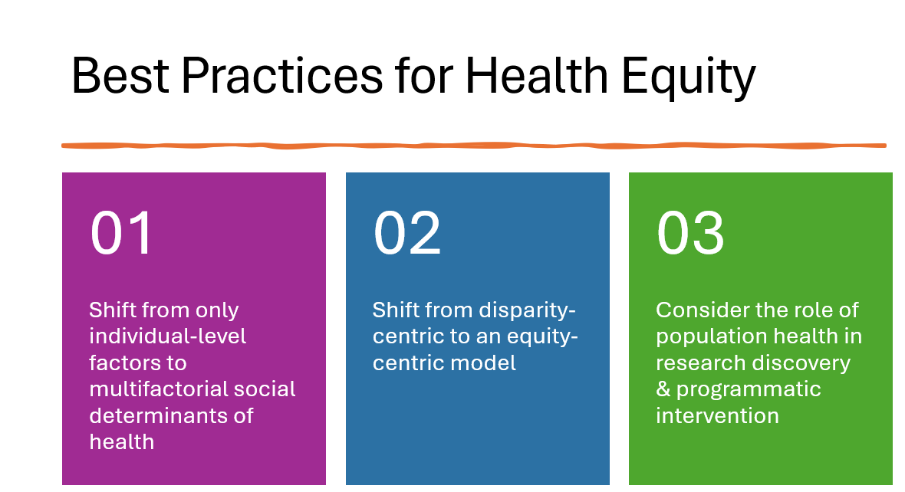
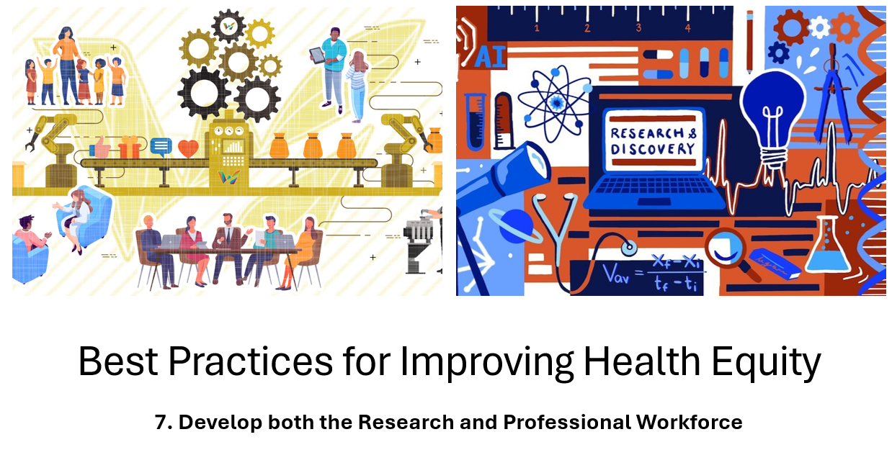
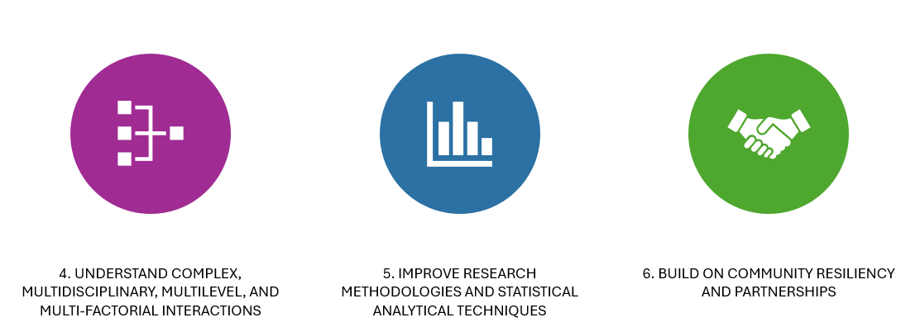
In Summary…
Closing Summary Slide

Slide 16

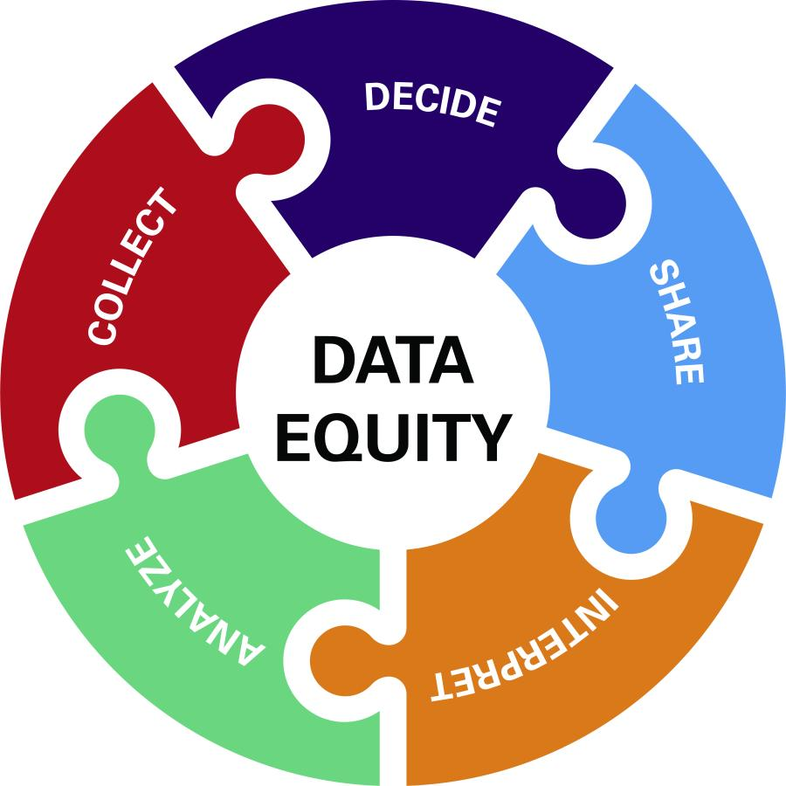
Thank you for Listening! ☺ Questions & Answers Time!
Questions?

Slide 17
Health Equity & Chronic Conditions: Consider:
Asthma
Cancer
Cardiovascular Disease
COPD
Diabetes
Blood Pressure
Among Other Health Conditions
…The need to track these chronic conditions that affect health in both the mind & body.

