Slide 1
Health Equity in Injury Data: Approaches for Injury Data Communication and Dissemination With a Health Equity Lens Resource Guide
Danielle Boyd, MPH, MCHES
dboyd@cste.org
Dagan Wright, PhD, MSPH
dagan.a.wright@oha.oregon.gov
Notes:
WG Form!: https://app.smartsheet.com/b/form/7600fcbdd9114261909f6942414e6c57

Slide 2

Health equity in injury data
Using Data to Drive Public Health Action
Equity Principles for Public Health Practice
Policy and Legislation Impacts
Systemic Factors Affecting Injury Risk
Notes:
Danielle
Health Equity in Injury Data: Approaches for Injury Data Communication and Dissemination with a Health Equity Lens
Available now: https://www.cste.org/members/group.aspx?id=100174
Health Equity in Injury Data: Approaches for Injury Data Communication and Dissemination With a Health Equity Lens
Developed by the CSTE Injury Surveillance Workgroup with Arundel Metrics & CSTE staff
Sought to develop more guidance to help inform how injury data are analyzed and presented to various audiences

Slide 3
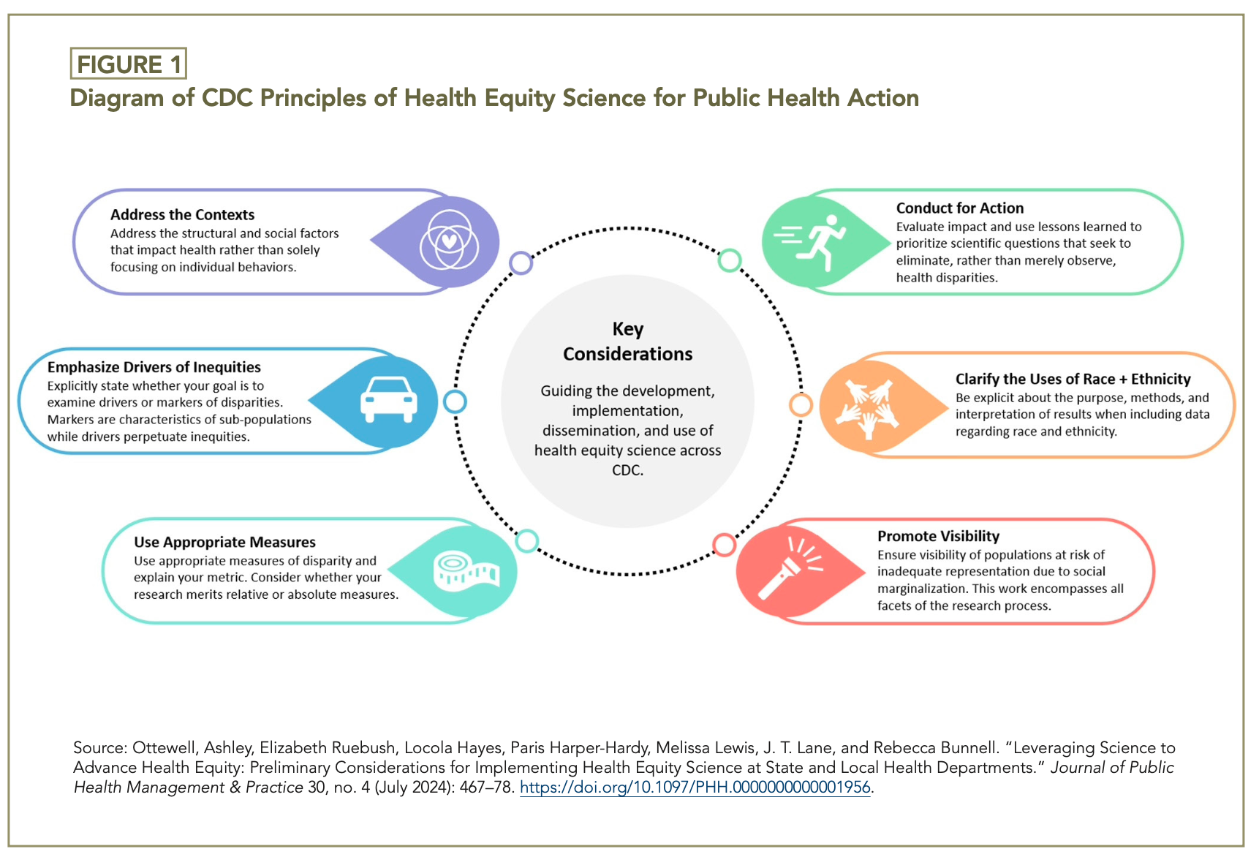
Equity Concepts
Impacting Public Health
Notes:
Danielle

Slide 4
Apply Equity Concepts
Concepts |  | Public Health Application
Conduct health equity for science action |  | Refrain from using data to simply document the demographic makeup of public health issues. Ask questions regarding underlying factors
Clarify uses of race and ethnicity |  | Noting why certain race/ethnicity groups are highlighted in data help ensure readers do not improperly interpret data to reinforce stereotypes
Address the contexts that contribute to health inequities |  | Historical practices such as redlining contribute to structural racism and racialized violence that drive public health issues such as firearm violence
Notes:
Danielle

Slide 5
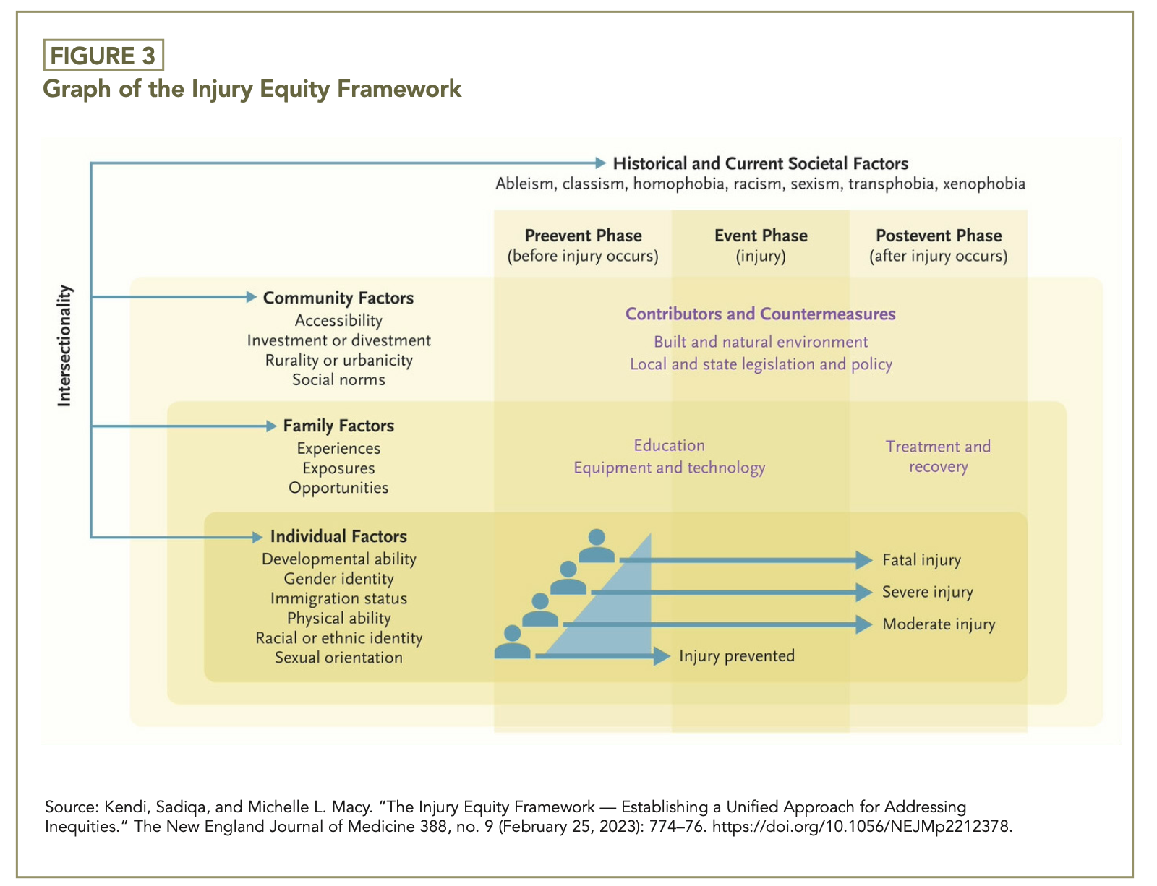
Example Systemic Factors
Affecting Injury Risk
Notes:
Danielle/Dagan feel free to add context as I provide the overview of this framework

Slide 6
Examples of Health Equity in Injury
Notes:
Dagan

Slide 7
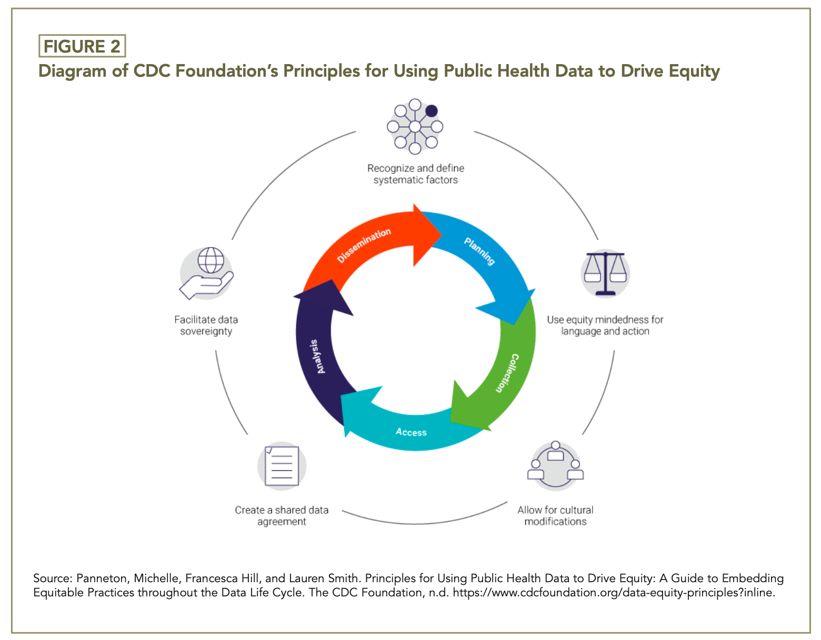
Using Data to Drive
Public Health Action
Notes:
Danielle

Slide 8
Reframing the Narrative
Data must be shared without unintentionally placing
blame or burden on specific groups and places.
Ensure that key communities are represented in data shared about them
Be mindful of the images and narratives used to share data
Be careful of wording used such as instead 'surveillance' use community health indicators
  Instead of "Data suppressed due to low numbers" use "Range is 1-9" as each person and event is significant
Notes:
Dagan

Slide 9
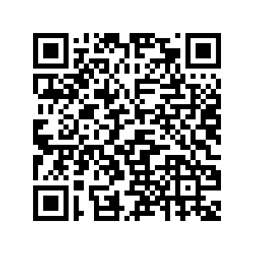
Question and Answer
See Link for the Resource PDF (nearly 80 pages with helpful resource links and images):
Health Equity in Injury Data
Notes:
https://cdn.ymaws.com/www.cste.org/resource/resmgr/2015weston/CSTE_Health_Equity_Injury_Da.pdf

Slide 10
Closing slide
CSTE National Office
2635 Century Parkway NE, Suite 700
Atlanta, Georgia 30345
770.458.3811
770.458.8516
dboyd@cste.org

